Slide 1

Welcome
Ubuntu 101
An Introduction to Ubuntu
Jeremy Bicha

Slide 2
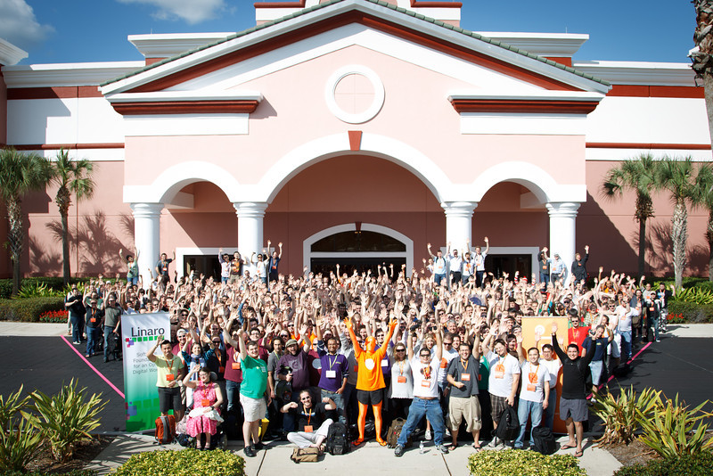
Ubuntu Developer Summit
Notes:
Talk about yourself...

Slide 3
Overview
Where did Ubuntu come from?
What makes Ubuntu different?
How do I install Ubuntu?
How do I use Ubuntu?
How can I get more help?
Notes:
How many here already use Ubuntu?
Today, we're going to discuss the history of Ubuntu and talk about what Ubuntu is. We're going to walkthough an Ubuntu installation and then give the grand tour of Ubuntu, showing off the apps that come with Ubuntu and how to add more. Finally, we'll show you how to get more help when you come across problems.
To discuss where Ubuntu came from, we have to go back in time a few decades.

Slide 4
GNU Project
Unix was created in 1969 as an alternative to the complex mainframe Multics operating system
Unix originally was freely licensed, but became increasingly proprietary
Richard Stallman founded the GNU Project to create a completely free ecosystem similar to Unix
Notes:
In the 1960s, MIT, AT&T's Bell Labs and GE developed an operating system named Mulics. But the OS was complex and heavy for its time. Two Bell Labs researchers, Ken Thompson and Dennis Ritchie led a team to create a better OS in 1969. That OS was named Unix. Dennis Ritchie designed the C programming language which Unix was soon rewritten to use. Because of an anti-trust ruling, AT&T could not enter the computer business and so freely licensed Unix. That restriction ended in 1983 and AT&T soon moved to try to capitalize on Unix's success. Unix became increasingly proprietary as different vendors developed their own versions.

Slide 5
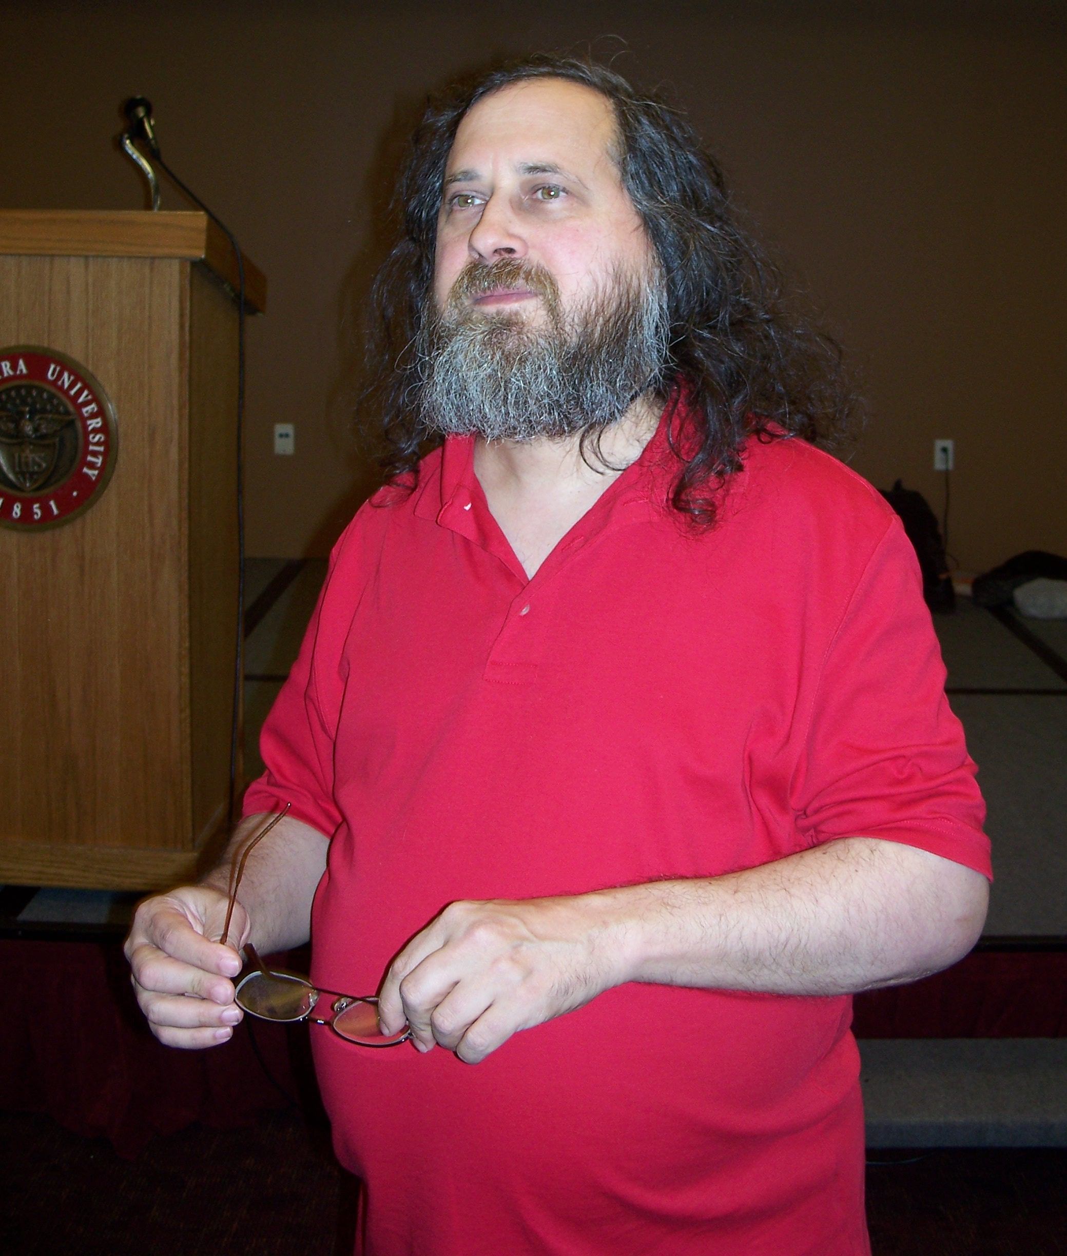
Richard Stallman
Notes:
In 1984, Richard Stallman, a hacker at MIT, launched the GNU Project which had the goal of creating enough free software so that he wouldn't need to use any software that wasn't free. Free software is basically the same as open source software. It refers not just to the price (it's possible to charge for free software), but to the ability for anyone to share, modify and redistribute the software. It-ology offers another workshop that focuses more on what open source software is.

Slide 6
A Kernel
By the end of the 1980s, GNU had all of the basic components necessary except the kernel
Notes:
By the end of the 1980s, GNU had all of the basic components necessary except the kernel. The kernel is the fundamental piece of an operating system that runs your apps, allows you to run multiple apps simultaneously and use hardware.
In 1991, a student in Finland was studying operating systems and decided to branch beyond the sample educational Minix kernel offered at the university and write his own kernel. He had a new 386 computer so he wrote it specifically for that. Because he thought it might be useful to someone else, he posted his work on the Internet. Here's the original announcement for what later became known as Linux.

Slide 7
The Linux Kernel
From: torvalds@klaava.Helsinki.FI (Linus Benedict Torvalds)
Newsgroups: comp.os.minix
Subject: What would you like to see most in minix?
Summary: small poll for my new operating system
Date: 25 Aug 91 20:57:08 GMT
Organization: University of Helsinki
Hello everybody out there using minix -
I’m doing a (free) operating system (just a hobby, won’t be big and professional like gnu) for 386(486) AT clones. This has been brewing since april, and is starting to get ready. I’d like any feedback on things people like/dislike in minix, as my OS resembles it somewhat (same physical layout of the file-system (due to practical reasons) among other things).
I’ve currently ported bash(1.08) and gcc(1.40), and things seem to work.
This implies that I’ll get something practical within a few months, and I’d like to know what features most people would want. Any suggestions are welcome, but I won’t promise I’ll implement them :-)
Linus (torvalds@kruuna.helsinki.fi)
PS. Yes – it’s free of any minix code, and it has a multi-threaded fs. It is NOT protable (uses 386 task switching etc), and it probably never will support anything other than AT-harddisks, as that’s all I have :-(.

Slide 8
The Linux Kernel
From: torvalds@klaava.Helsinki.FI (Linus Benedict Torvalds)
Newsgroups: comp.os.minix
Subject: What would you like to see most in minix?
Summary: small poll for my new operating system
Date: 25 Aug 91 20:57:08 GMT
Organization: University of Helsinki
Hello everybody out there using minix -
I’m doing a (free) operating system (just a hobby, won’t be big and professional like gnu) for 386(486) AT clones. This has been brewing since april, and is starting to get ready. I’d like any feedback on things people like/dislike in minix, as my OS resembles it somewhat (same physical layout of the file-system (due to practical reasons) among other things).
I’ve currently ported bash(1.08) and gcc(1.40), and things seem to work.
This implies that I’ll get something practical within a few months, and I’d like to know what features most people would want. Any suggestions are welcome, but I won’t promise I’ll implement them :-)
Linus (torvalds@kruuna.helsinki.fi)
PS. Yes – it’s free of any minix code, and it has a multi-threaded fs. It is NOT protable (uses 386 task switching etc), and it probably never will support anything other than AT-harddisks, as that’s all I have :-(.
Notes:
A few things I'd like to point out is that it started out as a simple hobby but became much more than that. From the beginning, he wanted to make his work available and was willing to implement suggestions. I don't think he expected that others would be submitting code, not just ideas. And finally, Linux today supports more hardware than any other operating system in history.

Slide 9
Linux
91% of the fastest 500 supercomputers run Linux (TOP500, Nov 2011)
43% of US smartphone users use Android (Nielsen, Nov 2011)
Nearly all ebook readers run Linux
Used by a majority of webservers (65% use Apache Netcraft, Nov 2011)
Notes:
From the world's largest supercomputers to the smallest embedded devices, Linux is everywhere. Every ebook reader I've seen runs Linux; that includes the Kindle, the Nook, Sony Reader and more. Most webservers run either Linux or BSD which is similar to Linux. So if you use Google or Amazon, you're using Linux in a way.

Slide 10
Linux Distributions
An operating system using the Linux kernel and including a collection of apps
There are hundreds available
Some of the most popular are Red Hat, Fedora, SUSE, Debian, and Ubuntu
Notes:
As useful as the kernel is, it's only a part of what you need. Developers bundle the kernel and useful apps into what are called distributions. Some of the more popular include Red Hat and its community Fedora version, SUSE, Debian, and Ubuntu.

Slide 11
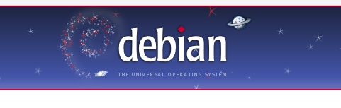
Debian
“Without Debian, Ubuntu would not be possible.”
– https://wiki.ubuntu.com/MarkShuttleworth
Notes:
As Ubuntu's founder, Mark Shuttleworth says, Debian is the foundation for Ubuntu. Debian is one of the oldest distributions. It was founded in 1993 by a developer named Ian Murdock. Picking names for software is quite challenging. Ian decided to name his project based on a combination of his name and his then-girlfriend's name, Debra.

Slide 12
Debian Social Contract
Debian will remain 100% free.
We will give back to the free software community.
We will not hide problems.
Our priorities are our users and free software.
– http://www.debian.org/social_contract
Notes:
Debian gives back to the free software community by keeping all of their code and bugtrackers open. Also, Debian developers submit improvements and bug reports to the original developers, which we call the “upstream” developers.
Also part of the Social Contract, and in fact the oldest part are the Free Software Guidelines...

Slide 13
Debian Free Software Guidelines
Free Redistribution
Source Code
Derived Works
No Discrimination Against Persons, Groups, or Fields of Endeavor
License Must Not Be Specific to Debian
License Must Not Contaminate Other Software
Notes:
Debian's Free Software Guidelines were and continue to be very influential. They were used as the basis of the Open Source Definition. Here's some of the high points from Debian's list.
1. No royalties, no restrictions on selling or giving away the software
2. Source code must be available and modifications must be allowed to be made and distributed the same way as the original.
3. For instance, an app can't restrict its use in a business or by the US military.
4. Developers can't make special arrangements for Debian to distribute their software; those privileges must be available to everyone.
5. A software license shouldn't be allowed to restrict what you can do with other software you may want to use.

Slide 14
Other Debian Distinctives
Independently Governed Organization
Focus on Stability (i.e. “release when ready”)
Supports a wide variety of architectures and desktops
Abundance of choice
Package management system
Notes:
Here are some other things Debian is known for. Debian is the largest Linux distribution that completely runs itself without an outside controlling company. Debian takes 2 or 3 years between releases, trying to make the releases as bug free as possible. Debian sees itself as the “Universal Operating System” supporting every architecture and app equally.The most common architectures include the Intel/AMD 32-bit and 64-bit systems, the PowerPC architecture used by Apple before they switched to Intel 64-bit, and the ARM architecture that runs on cellphones and an increasing number of gizmos around your house. Additionally, Debian supports half a dozen other systems.
The last point about Debian is that they were one of the first to create a package management system which allows for easy install & upgrades of all of your software. This is in contrast to Windows or Mac where you have to upgrade seemingly every app separately which opens the possibility that either you forget to update or you get tired of messing with it.

Slide 15
Mark Shuttleworth's Idea
To build a world class operating system for ordinary desktop computer users, that is genuinely free and freely available, that is immediately useful, and that represents the very best that the free software world can achieve today.
– The Official Ubuntu Book
Notes:
So we've seen how GNU laid the foundation for a free operating system, Linux provided the heart of the system, and distributions like Debian wrapped up all this work into a nice package. Mark Shuttleworth, who became a millionaire with his security certificate company, was a Debian developer and saw the potential to make this software available to a lot more people.

Slide 16
Ubuntu Distinctives
Shared governance between Canonical and community developers
Scheduled releases every six months. Every two years, a long term support release.
There will never be a separate “commercial” version
Best of class default choices
Supports the Intel/AMD 32-bit and 64-bit platforms as well as ARM
Pragmatic use of proprietary hardware drivers where no usable open source alternative exists
Notes:
I spent some time talking about Debian's distinctives so that I could show how Ubuntu changed some of them. Shuttleworth founded a company named Canonical which employs a few hundred developers, designers, and more. A lot of decision-making power for Ubuntu itself though is held by community members who are not employed by Canonical. A big contrast with Red Hat's business model is that Ubuntu has a promise to never release a separate version just for paying companies. A big contrast with Debian and still somewhat unique among other operating systems is that Ubuntu always releases every six months in April and October. And since that's more frequently than many large IT departments like to upgrade, there's a long term support release every two years that gets security updates for up to 5 years. Ubuntu focuses their efforts by only supporting the normal architectures home & office users have. Also because too many choices are confusing especially for people new to something, Ubuntu picks the best web browser, word processor, and so on and supports those. The other choices are available for install later on for those that want them. Finally, Ubuntu will include proprietary drivers for things like graphics cards or wireless networking when necessary.

Slide 17
Ubuntu Releases
Official Releases are numbered in Year.Month format. The current release is 11.10.
The “Adjective Animal” format is used during the development cycle. The current release is Oneiric Ocelot. Next is Precise Pangolin.
Notes:
The current Ubuntu release is 11.10. This isn't just a random number, but it represents the year and the month. This one was released in October (the 10th month) 2011. Code names are used during the development cycle. I guess they're not used as much after release since they may be seen as too much fun or too confusing or something.

Slide 18
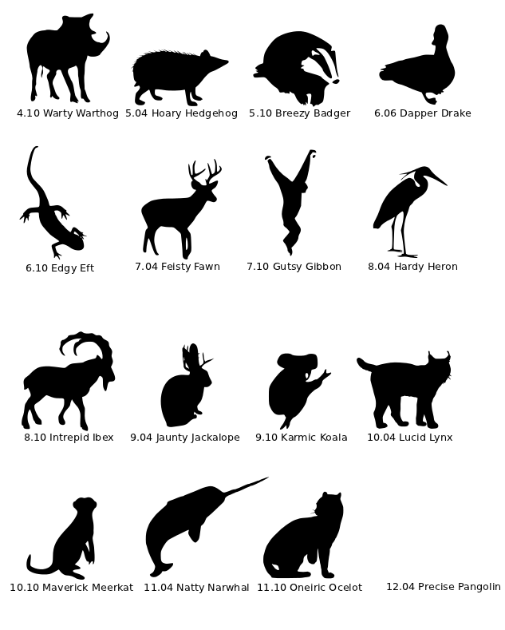
Notes:
These are all of the Ubuntu releases starting with the Warty Warthog, which got its name because the small group of developers expected it to have some ugly spots. The releases in the right column are the Long Term Support (LTS) releases. The first LTS was Dapper Drake was the only release not in April or October. It was released in June to get an extra 6 weeks of attention especially since the decision to make it LTS happened later in the cycle. As you can see, the next release, Precise Pangolin will also be an LTS in April.

Slide 19
Install
Notes:
Now we're going to show you how the install works.

Slide 20
Installation Choices
32-bit or 64 bit?
Normal install, WUBI, or Virtual machine?
At least 10 GB of hard drive space
Notes:
List possible ways to install Ubuntu (from Windows, after reboot, etc.) along with other high-level choices (64 vs. 32 bit).

Slide 21
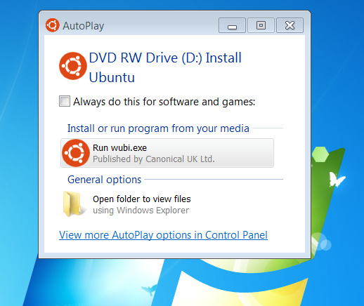
WUBI

Slide 22
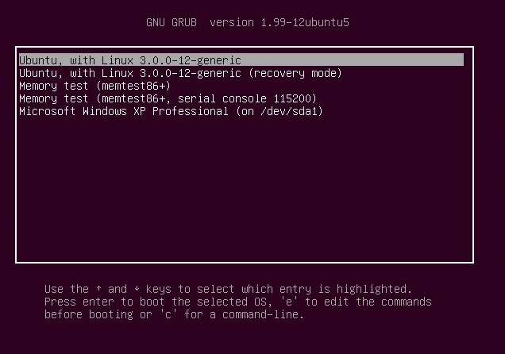
Dual Boot

Slide 23
Installation Choices
32-bit or 64 bit?
Normal install, WUBI, or Virtual machine?
At least 10 GB of hard drive space
Notes:
List possible ways to install Ubuntu (from Windows, after reboot, etc.) along with other high-level choices (64 vs. 32 bit).

Slide 24
Ubuntu Tour

Slide 25
Intro to Unity
Launcher (At the Left)
Menu Bar (At the Top)
Dash
Notes:
Unity is Ubuntu's new, unique way to use your computer. It was designed to optimize

Slide 26
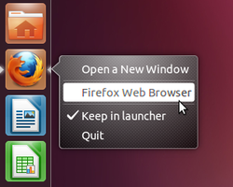
The Launcher
Notes:
The Windows taskbar can be set to always show or always hide. The Ubuntu launcher uses “Intellihide”. It hides when you have an app full screen or covering the space the Launcher normally is. To get the Launcher back, slide your mouse to the left of the screen.

Slide 27
Menu Bar
Stretches across the top of the screen
Always visible
Window management buttons
App Menu
Status Menus (Indicators)
Notes:
The menu bar includes your app's File menus and your system status. The file menus and window management buttons hide out of the way until you move your mouse to the top of the screen.
There are two different kinds of status menus, system-wide ones and application ones. The system ones in order are messaging, power, bluetooth, network, volume, clock, me, and system.

Slide 28
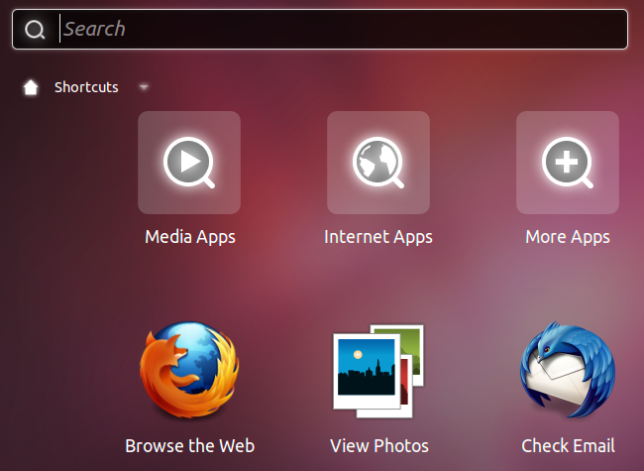
The Dash

Slide 29
Keyboard Shortcuts
Windows key – Opens the dash
Hold down the Windows key to open launcher items
Alt+F1 – Opens the launcher and makes it keyboard accessible
Alt+F2 - “Run a command” mode
F10 – Navigate the menu bar

Slide 30
Dash Keyboard Shortcuts
Win + A – Open the Applications lens
Win + F – Open the Files lens
Win + M – Open the Music lens
Tab – Switch between lenses
More Unity shortcuts can be found in the keyboard shortcuts page in help.

Slide 31
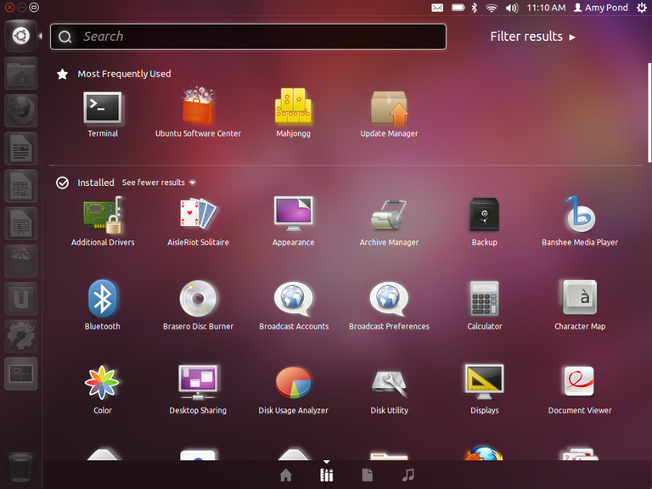

Slide 32
Logon Screen
Notes:
The logon screen uses simpler versions of the status menus we already saw. The gear next to your name allows you to log in to the 2D version which is nearly the same as the 3D version but with out as many visual effects. If your graphics drivers aren't adequate, you'll get the 2D version anyway.

Slide 33
Customizing Ubuntu
Notes:
In System Settings, we can change the background.
Accessibility
* Change the text size
* Turn on high contrast
* Turn on the screen reader
* Turn on the on screen keyboard
Add a new user
- Ubuntu also supports a guest user by default. The guest user won't have access to your files and any changes they make will be deleted once they log out unless they save files to a separate USB stick for instance.

Slide 34
Getting Work Done
Notes:
LibreOffice is a good alternative to Microsoft Office. It can open Microsoft documents although it may have some trouble with especially complex ones. By default, it saves to the Open Document Format, but you can choose to save as Microsoft Office 2003 or 2007 if you want to share with Microsoft users. LibreOffice also is available for Windows or Mac OS X.
Ubuntu One gives you 5 gigabytes of online storage for free. It automatically sync files from certain folders and you can choose which folders you want backed up to the Internet. You can access your files via the Internet, your mobile phone, or from an app available for Windows or Mac. Additional storage and a music app are available for purchase.

Slide 35
Getting Fun Done
Notes:
Ubuntu includes Mahjongg, Minesweeper, Sudoku, and Solitaire. Go to Game>Select Game to choose from the 50-something different solitaire variations.
Cheese is a handy webcam app available for install that's fun to play with.

Slide 36
Creativity
Notes:
Many apps are available for install for you to be creative and artistic.
Gimp is a powerful alternative to Photoshop. Inkscape is a vector graphics program. Vector graphics are lines and curves instead of pixels which means it can be scaled up or down and you shouldn't have the boxy look you get when you zoom in too far on a photograph.
Speaking of photographs, Shotwell is a nice photo management program included by default. There are several video editors (PiTiVi, OpenShot) available if you want too.

Slide 37
Install More Apps
Notes:
Software Center

Slide 38
Keeping Ubuntu Up to Date
Notes:
Update Manager

Slide 39
How Can I Get More Help?

Slide 40
Help!
Pre-installed help
help.ubuntu.com
Askubuntu.com
Ubuntuforums.com
IRC chat
Columbia Linux Users Group (COLALUG)
Notes:
#ubuntu on Freenode. You can use Empathy for IRC. Also see https://help.ubuntu.com/community/InternetRelayChat for other choices.

Slide 41
