Slide 1

Welcome
Ubuntu 102
Ubuntu: Next Steps
Jeremy Bicha

Slide 2
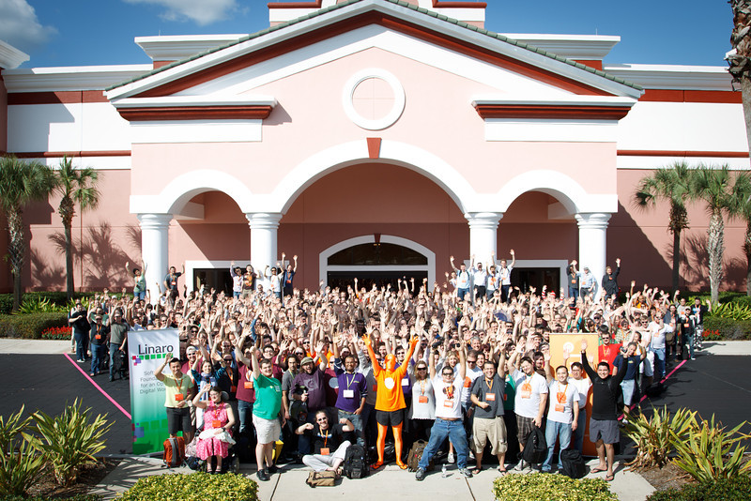
Ubuntu Developer Summit
Notes:
Talk about yourself...

Slide 3
Overview
How can I customize Unity?
What are other popular Linux desktops and how can I try them?
Where are my files?
How do I use a terminal?
How do I install software that isn't in Software Center?
Notes:
How many here already use Ubuntu?
Today, we're going to discuss the history of Ubuntu and talk about what Ubuntu is. We're going to walkthough an Ubuntu installation and then give the grand tour of Ubuntu, showing off the apps that come with Ubuntu and how to add more. Finally, we'll show you how to get more help when you come across problems.
To discuss where Ubuntu came from, we have to go back in time a few decades.

Slide 4
Customize the Dash
Lenses
Notes:
In the 1960s, MIT, AT&T's Bell Labs and GE developed an operating system named Mulics. But the OS was complex and heavy for its time. Two Bell Labs researchers, Ken Thompson and Dennis Ritchie led a team to create a better OS in 1969. That OS was named Unix. Dennis Ritchie designed the C programming language which Unix was soon rewritten to use. Because of an anti-trust ruling, AT&T could not enter the computer business and so freely licensed Unix. That restriction ended in 1983 and AT&T soon moved to try to capitalize on Unix's success. Unix became increasingly proprietary as different vendors developed their own versions.

Slide 5
Linux File System
Directory = Folder
Everything in Unix comes under /
/home/yourname is where your files live
/media is where your removable devices go
/etc contains editable system configuration files
Notes:
In the 1960s, MIT, AT&T's Bell Labs and GE developed an operating system named Mulics. But the OS was complex and heavy for its time. Two Bell Labs researchers, Ken Thompson and Dennis Ritchie led a team to create a better OS in 1969. That OS was named Unix. Dennis Ritchie designed the C programming language which Unix was soon rewritten to use. Because of an anti-trust ruling, AT&T could not enter the computer business and so freely licensed Unix. That restriction ended in 1983 and AT&T soon moved to try to capitalize on Unix's success. Unix became increasingly proprietary as different vendors developed their own versions.

Slide 6
Punctuation
/ the top level
~ your home directory
. the current directory
.. one directory up
Files and directories that start with a . are hidden by default in your file browser, like .mozilla/
$ shows you're logged in
# shows root is logged in
Use quotation marks to include spaces
Notes:
In the 1960s, MIT, AT&T's Bell Labs and GE developed an operating system named Mulics. But the OS was complex and heavy for its time. Two Bell Labs researchers, Ken Thompson and Dennis Ritchie led a team to create a better OS in 1969. That OS was named Unix. Dennis Ritchie designed the C programming language which Unix was soon rewritten to use. Because of an anti-trust ruling, AT&T could not enter the computer business and so freely licensed Unix. That restriction ended in 1983 and AT&T soon moved to try to capitalize on Unix's success. Unix became increasingly proprietary as different vendors developed their own versions.

Slide 7
What is sudo or How do I get root?
Sudo allows running commands as root
Use
Notes:
In the 1960s, MIT, AT&T's Bell Labs and GE developed an operating system named Mulics. But the OS was complex and heavy for its time. Two Bell Labs researchers, Ken Thompson and Dennis Ritchie led a team to create a better OS in 1969. That OS was named Unix. Dennis Ritchie designed the C programming language which Unix was soon rewritten to use. Because of an anti-trust ruling, AT&T could not enter the computer business and so freely licensed Unix. That restriction ended in 1983 and AT&T soon moved to try to capitalize on Unix's success. Unix became increasingly proprietary as different vendors developed their own versions.

Slide 8
How do I use the command line?
cd
ls
ls -lh
rm
-r or -R
--help
man
Notes:
In the 1960s, MIT, AT&T's Bell Labs and GE developed an operating system named Mulics. But the OS was complex and heavy for its time. Two Bell Labs researchers, Ken Thompson and Dennis Ritchie led a team to create a better OS in 1969. That OS was named Unix. Dennis Ritchie designed the C programming language which Unix was soon rewritten to use. Because of an anti-trust ruling, AT&T could not enter the computer business and so freely licensed Unix. That restriction ended in 1983 and AT&T soon moved to try to capitalize on Unix's success. Unix became increasingly proprietary as different vendors developed their own versions.

Slide 9
How do I use the command line?
nano
apt-get update
apt-get upgrade
Notes:
In the 1960s, MIT, AT&T's Bell Labs and GE developed an operating system named Mulics. But the OS was complex and heavy for its time. Two Bell Labs researchers, Ken Thompson and Dennis Ritchie led a team to create a better OS in 1969. That OS was named Unix. Dennis Ritchie designed the C programming language which Unix was soon rewritten to use. Because of an anti-trust ruling, AT&T could not enter the computer business and so freely licensed Unix. That restriction ended in 1983 and AT&T soon moved to try to capitalize on Unix's success. Unix became increasingly proprietary as different vendors developed their own versions.

Slide 10
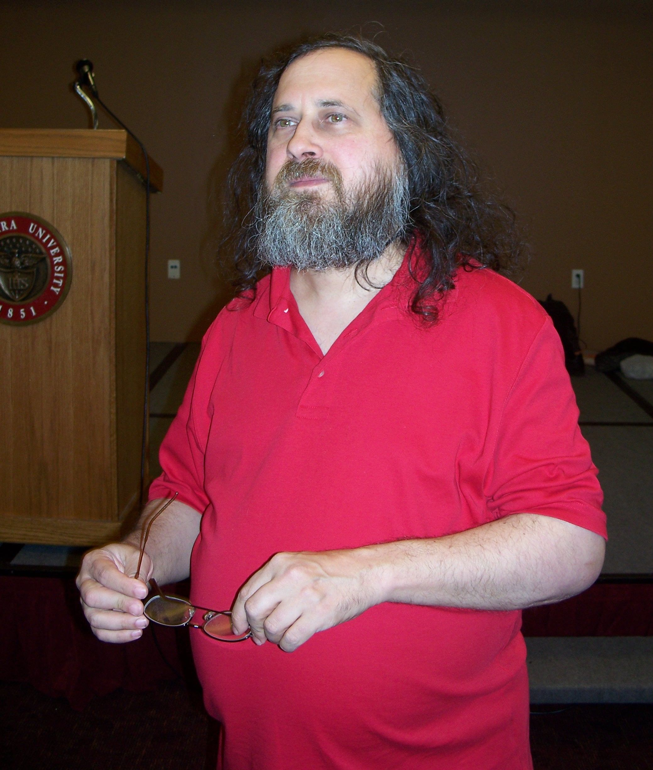
Richard Stallman
Notes:
In 1984, Richard Stallman, a hacker at MIT, launched the GNU Project which had the goal of creating enough free software so that he wouldn't need to use any software that wasn't free. Free software is basically the same as open source software. It refers not just to the price (it's possible to charge for free software), but to the ability for anyone to share, modify and redistribute the software. It-ology offers another workshop that focuses more on what open source software is.

Slide 11
How Do Apps Get into Ubuntu?
Upstream developers write code.
Developers add an open source license (GPL, BSD, Apache, etc.)
Developers release their source code as a tarball (.tar.gz, .tar.bz2, .tar.xz or .zip)
The tarball can be extracted, compiled, installed, and then run
Linux distributions take care of finding the latest tarball releases, packaging them, and making them available for install in software repositories
Notes:
Update Manager

Slide 12
Installing an App from Source

Slide 13
Installing an App from Source
Extract the tarball (unzip it!)
./configure
make
make install

Slide 14
Personal Package Archives
PPAs are extra repositories that may include apps or updates not available in the official repositories

Slide 15
How Can I Get More Help?

Slide 16
Help!
Pre-installed help
help.ubuntu.com
Askubuntu.com
Ubuntuforums.com
IRC chat
Columbia Linux Users Group (COLALUG)
Notes:
#ubuntu on Freenode. You can use Empathy for IRC. Also see https://help.ubuntu.com/community/InternetRelayChat for other choices.

Slide 17
