Slide 1

Open Source Software
Opportunities for you
  POSSCON
  Open Source Lab
  Call for Papers
  Projects
Notes:
Topics covered today will include open source software – what it is and the difference between it and proprietary or closed software – and opportunities related to open source software for you, the student.

Slide 2

Proprietary
Example – Microsoft
  R&D costs incurred and recouped
Open Source
Example – Linux
  Access to source code, customization, support
Notes:
Keep this to two models only – closed versus open. It is far easier for students to understand if explained in these terms. We normally mention software-as-a-service, but don’t when speaking to students. It tends to muddy the water somewhat. I take them through the proprietary process beginning with the BA gathering requirements and turning those into technical specs. I then discuss the programmers turning specs into code, QA people testing that code, then the marketing process that must take place to sell the software. This is done in private and dollars must be recouped to cover costs inherent in the process. Open Source is quite different.

Slide 3

Programs whose licenses give users the following four freedoms:
  Run program for any or multiple purposes
  Study how program works and adopt it to your needs
  Redistribute copies so can help neighbor
  Improve program and release improvements to the public

Slide 4
Most common license is the GNU General Public License; Top 6 comprise 85%
Also known as Free Software (FS), FLOSS and FOSS
Clarification:
  “Free” doesn’t mean the cost is free
  It means “Freedom”
  “Freeware” is proprietary and given away without right to modify, redistribute or examine source code
Notes:
First bullet point is not so important here as it can be confusing if students don’t know a license dictates how open source software can be distributed, and most don’t. The FS/FLOSS/FOSS and Freedom vs. ‘Free’ is important. Open Source does not mean ‘free’ as in ‘no money’. Many companies make money from it and multiple revenue models do exist.

Slide 5

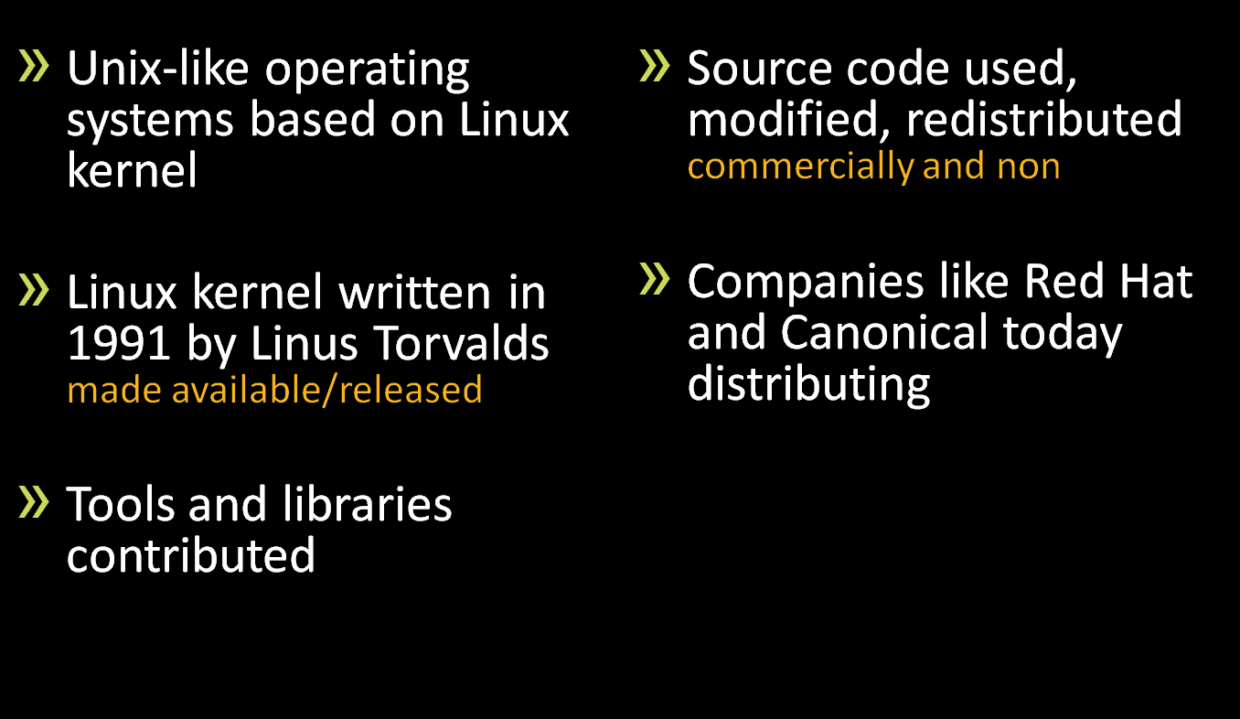
Notes:
Give Linux as the example since most people have heard of it..

Slide 6

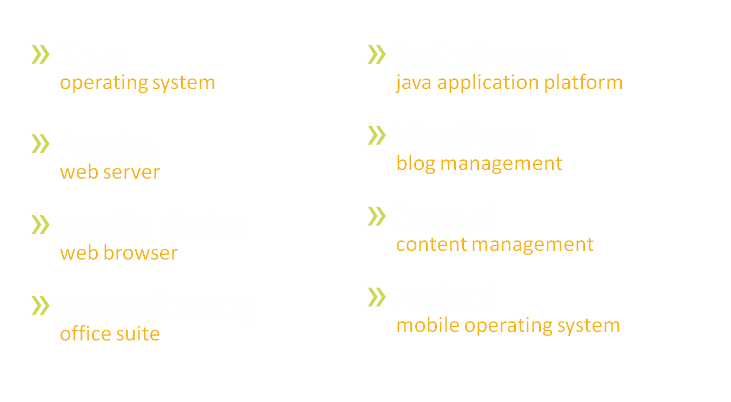
Notes:
Provide other examples. Most people, even students have heard of and used at least one of these examples, especially the Firefox browser.

Slide 7

Distributes cost of development – “commons-based peer production”
Better reliability and security
Control/flexibility – modify/maintain own
Freedom from control – one vendor
Value/innovation created when free to tinker
Support/Maintenance questions
Potential licensing issues
Notes:
Students may not fully grasp these points but they are important..

Slide 8


continued…
Notes:
Although students may not have heard of these particular technologies, they MUST know open source is being used now and will be used more in the future. Therefore, it is imperative students familiarize themselves with it if they are going to get IT jobs. Students must be skilled with the technologies companies and government organizations, etc. are using.

Slide 9


continued…
Notes:
Continued…

Slide 10


Slide 11






















SPONSOR & PARTNERS
MEDIA
PARTNERS
Notes:
POSSCON covered..

Slide 12

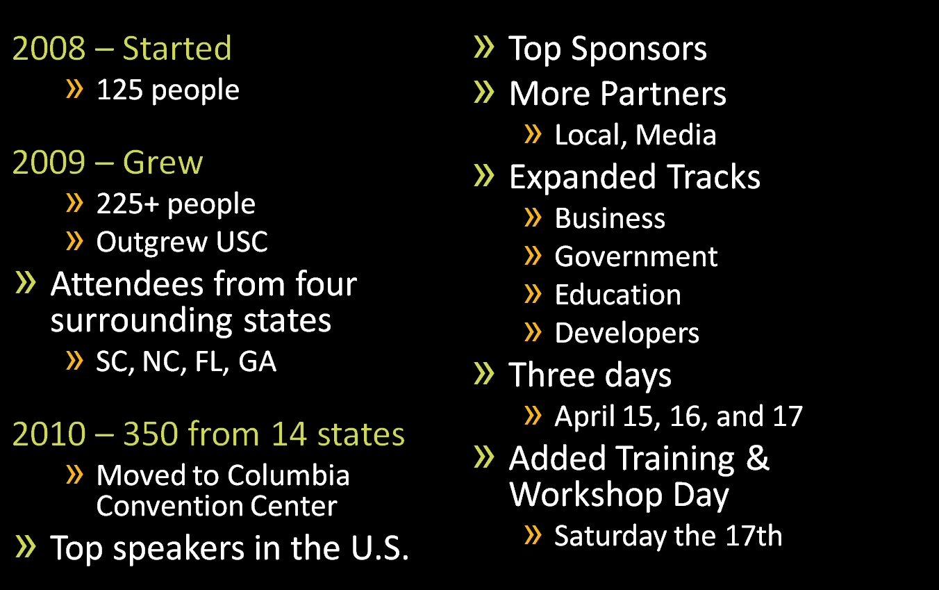
Notes:
Brief history of POSSON..

Slide 13

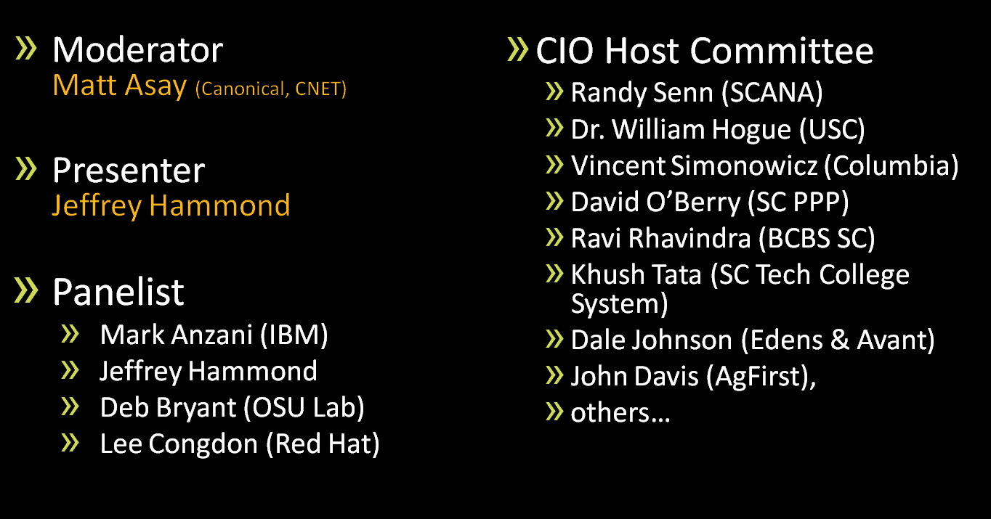
Executive CIO/CTO Forum – April 15
Notes:
Not so important to students per se.. Won’t mean much to them..

Slide 14
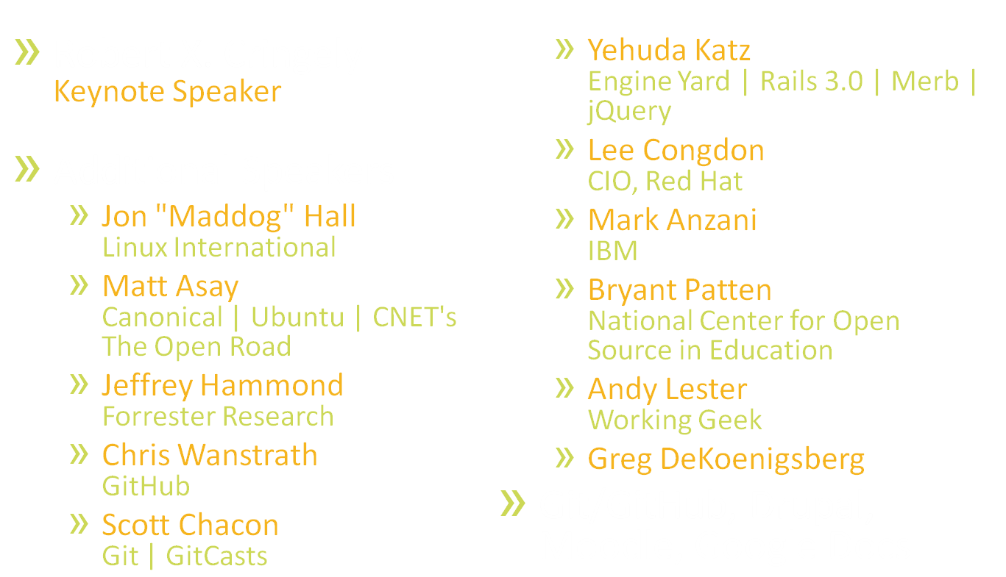
Notes:
Again, won’t mean so much to them…

Slide 15

  Schools/teachers need to know what technologies are being used by companies/government, etc.
  Schools/Teachers need to know what to teach
  Students need to be prepared
  Teachers need better ways of doing things
  Admin/schools/teachers need to save money
  Students need to experience conferences and meet IT leaders
Notes:
VERY IMPORTANT. Why POSSCON and open source education is important to students, teachers, and education in general..

Slide 16

Location
New CESM building on Gervais St, Downtown Columbia
Multiple workstations/platforms
Mac, pc, OLPC, tablet (Samsung Galaxy), Linux desktop, netbook
Open Source Books and resources
White board to collaborate
Media monitor
Training/workshops
Notes:
Tell them about the open source lab. We want students to visit the lab and participate in training/workshops, etc.

Slide 17

Asking for ways you’ve used/implemented open source software
Three (3) page description
January 21 deadline
Student category (grades 9-12)
$500, award and industry recognition to winner
Use this process to identify Lab Fellowes
Fellowes will be invited to participate in projects, work on-site, etc.
Notes:
Students need to submit an entry to the Call for Papers. Details provided here..

Slide 18

Example is Columbia Museum of Art
Micro site promoting Who Shot Rock Exhibit
Collaboration between students at Lexington and professional team
Scheduled for January 24 launch on web
Exhibit launches one month later in February
Notes:
Students can also participate in projects we do through the lab and with open source in general. The Columbia Museum of Art project is a perfect example.

