Slide 1

Open Source – A Key To Your Future

Slide 2
Welcome
Open Source
A Key To Your Future
Bryant Patten
Todd Lewis
Jarrell Waggoner

Slide 3
Overview
What is Open Source?
Why Should You Care?
How Do You Get Involved?

Slide 4
Open Source is....

Slide 5
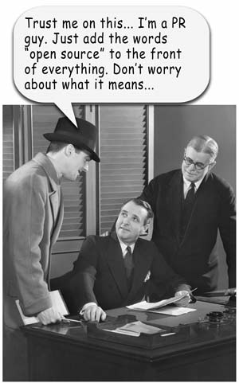

Slide 6
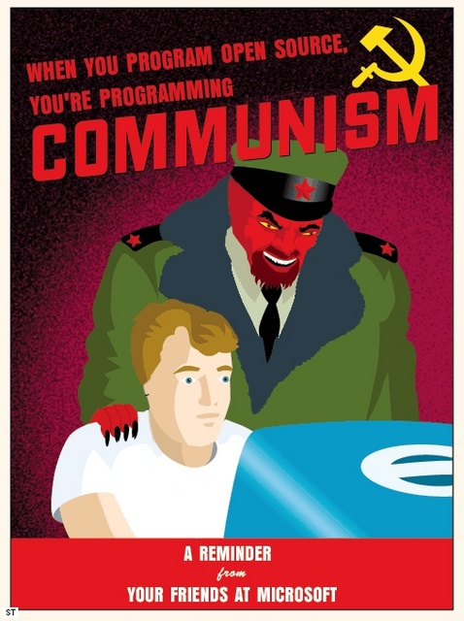

Slide 7
Free Software
Open Source Software (OSS)
Free Open Source Software (FOSS)
Free/Libre Open Source Software (FLOSS)

Slide 8



Slide 9
What? Where? How? Who?
Why?!

Slide 10
Why?!
For fun (Civil War Buffs)
For creative expression (music)
For freedom (custom situations)
For money (It’s a job)
For status (The ‘Photo’)

Slide 11
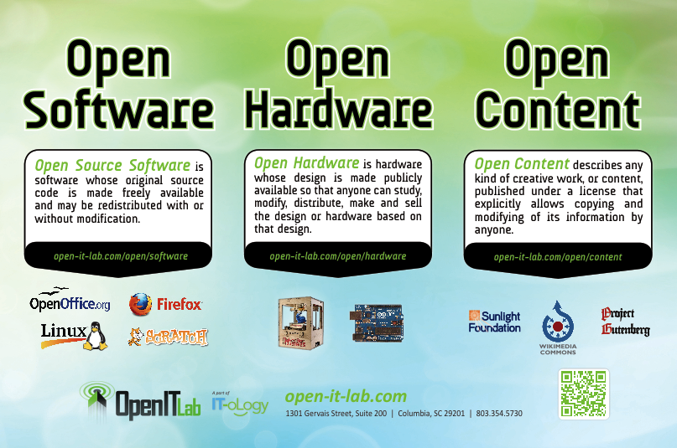

Slide 12
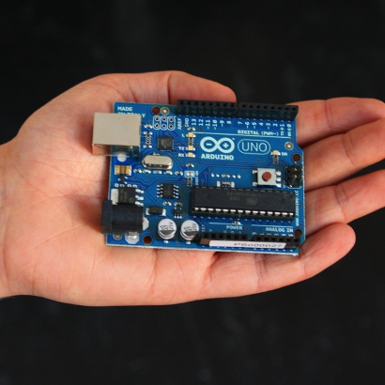

Slide 13
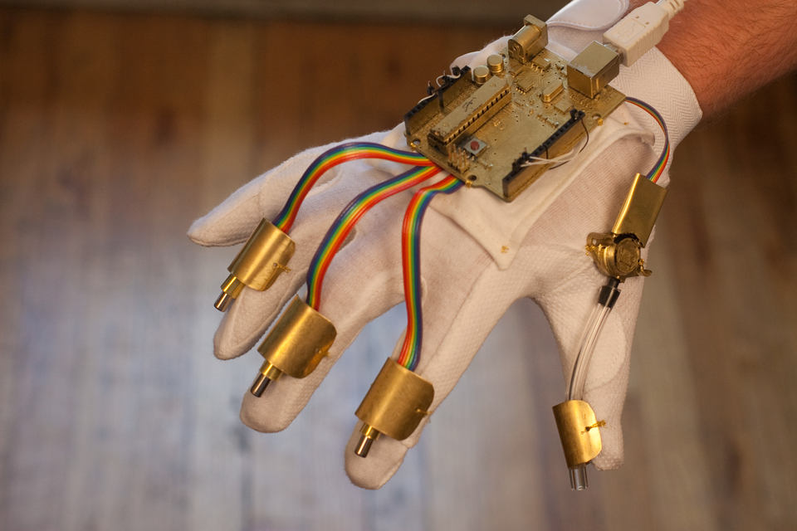
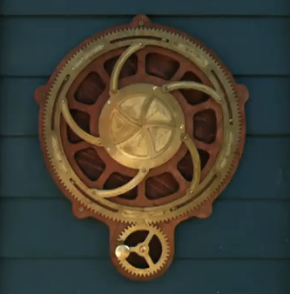


Slide 14

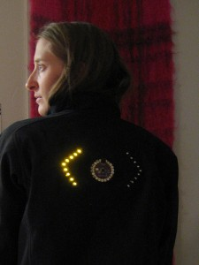


Slide 16
Hardware & Content
Open Hardware Summit recently held in NYC. 500 attend
Makerbot, creator of home 3D printers, takes $10 million in investment – August 23, 2011
Open data movement taking place across US. Washington DC and NYC now open data to outside developers.
Apps.dc.gov and data.dc.gov
Blackduck, supports large scale adoption of open source – received $12 million in VC funding – October 13, 2011

Slide 17


Slide 18



Slide 19

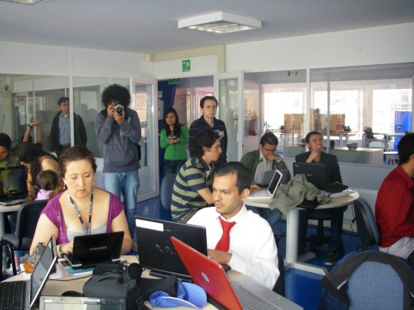
http://crisiscommons.org/

Slide 20

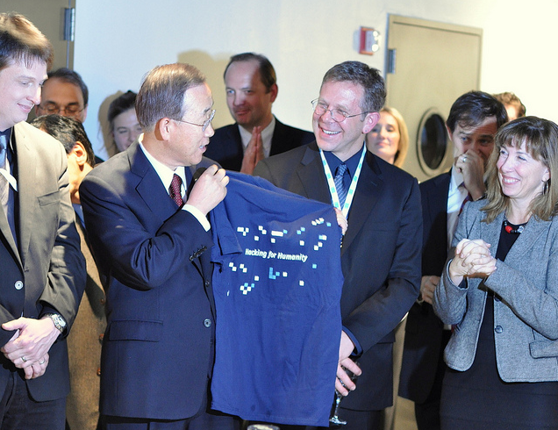
http://www.rhok.org/

Slide 21

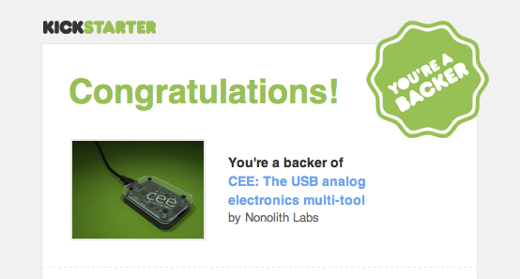

Slide 22
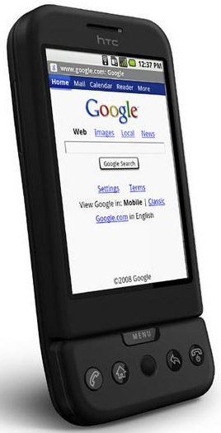
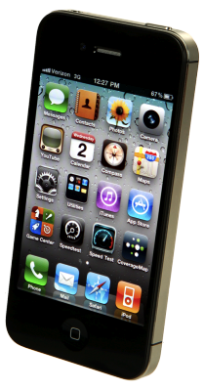
Open vs. Closed

Slide 23

FOSS ≠ Web 2.0
“If you are using a free (no-cost) service on the Internet, you aren't the customer – you are the product being sold.”

