Slide 1
Why should You care?

Slide 2
Some Statistics
More than 50% of leading IT organizations are using open source
30% of software at these companies is open source, up from 10% five years ago
4 out of 5 developers use open source for development, application deployment, or both
1 out of 4 developers target Linux as their primary platform
1 out of 5 developers contribute to at least one open source project

Slide 3
Some Statistics
80% of front line IT people say they use open source in some way
US adoption is closing the gap with Europe

Slide 4
Regional adoption in the Southeast
“Which of the OSS infrastructure tools have you included as part of your development activities or deployed an application or software project to? “(Select all that apply.)
US
Southeast
Base: 1,900 software decision-makers at North American and European enterprises and SMBs
Source: Enterprise And SMB Software Survey, North America And Europe, Q4 2009

Slide 5
Who Uses - Software
Zappos
Department of Defense
Proctor & Gamble
Google
Twitter
BMW
Southwest Airlines
BlueCross BlueShield SC, Medical University of South Carolina, Research & Statistics

Slide 6
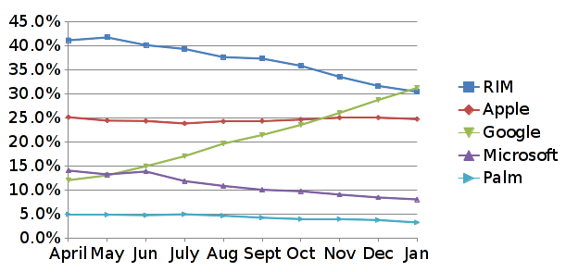
And Then There’s Mobile:
Top Smartphone Platforms: 3 Mo. Avg. Total U.S. Smartphone Subscribes Ages 13+
Source: Comscore MobiLens
Notes:
http://metrics.admob.com/

Slide 7
Local & National Jobs
Lead Developer – PHP, Javascript, Ruby on Rails, Hadoop (distributed storage), breathes technology, leads change & innovation
Programmer – Clojure, Ruby on Rails, Apache SOLR, jRuby
PHP/Java Developer, Apache
LAMP stack (Linux, Apache, MySQL, PHP)
HotLinuxJobs.com, OpenPros.net

Slide 8
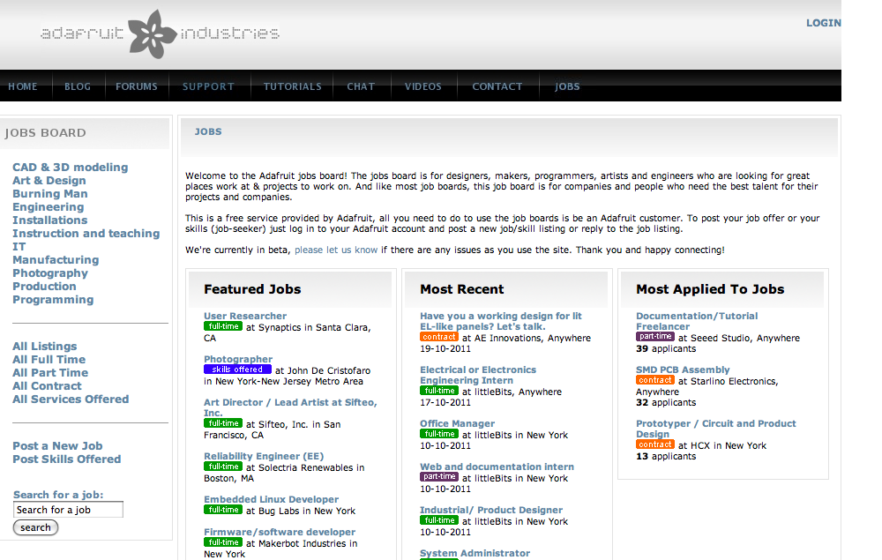
Adafruit

Slide 9
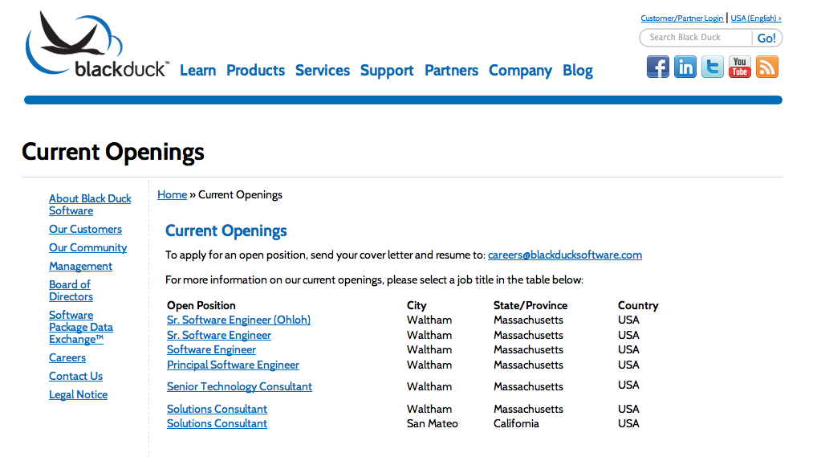
Blackduck

Slide 10
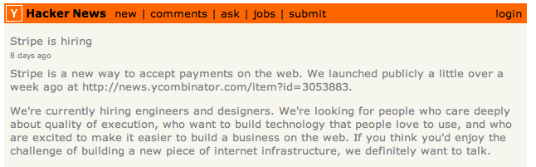
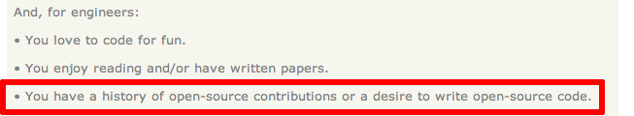
Stripe
Never asked for a resume!

Slide 11

When it comes to hiring, I'll take a Github commit log over a resume any day
--John Resig

Slide 12
Case Study:
SC Dept. of Corrections
IT budget drives the effort
Technology
  Java
  Eclipse IDE
  Apache web server
  ANT
  CVS
Use Linux: OpenSUSE and Ubuntu
LibreOffice used for document creation

Slide 13
Careers in IT
Application Development, Business System Analysis, Client Account Management, Computer Operations,Database Management, Design Architecture, Desktop Support, I/S Risk and Compliance, I/S Security, IT Business Support, IT Procurement, Network Management, Network Operations, Process Management, Program Management, Proposal Management, Quality Assurance, Server Management, System Performance, System Programming, System Support, System Testing, Technical Training, Technology Support, Telecommunications, Web Application Development, Web System Support

