Slide 1

Todd Lewis, Jim Salter,
Jarrell Waggoner

Slide 2
Open Source
{
}
What? | Top 10 | Why?
Notes:
Double-Negative: UK's largest film-only VFX company

Slide 3



Who We Are
Open Source training and consulting services since 2008
www.palmettocomputerlabs.com
Started the Palmetto Open Source Software Conference (POSSCON) in 2008
www.posscon.org
Started the Open IT Lab at IT-oLogy in 2011
www.open-it-lab.com

Slide 4
600 people from 20+ states in 2012
The world’s top technology companies:
Google, Red Hat, IBM, Oracle, Microsoft, HP
World’s top open source experts:
Scott McNealy keynoted in 2012

Slide 5

Center for open source awareness, education and research & development
Multiple platforms and OS technologies
Regular workshops and training opportunities
Project-based work

Slide 6
"Knowledge is the only resource that multiplies when you share it."
Notes:
Double-Negative: UK's largest film-only VFX company

Slide 7
Definition
Open:
The freedom to share, explore, reproduce, and contribute ideas and projects based on these ideas.

Slide 8


Open
Software: source code available to share and modify
Hardware: documentation available to reproduce components
Content: license to share and remix

Slide 9
"Free software is a matter of liberty, not price. To understand the concept, you should think of free as in free speech, not as in free beer."
–Richard Stallman, MIT
Notes:
Double-Negative: UK's largest film-only VFX company

Slide 10
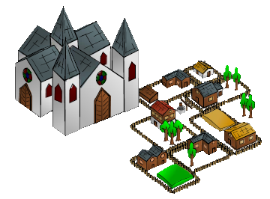
Development Methodology

Slide 11

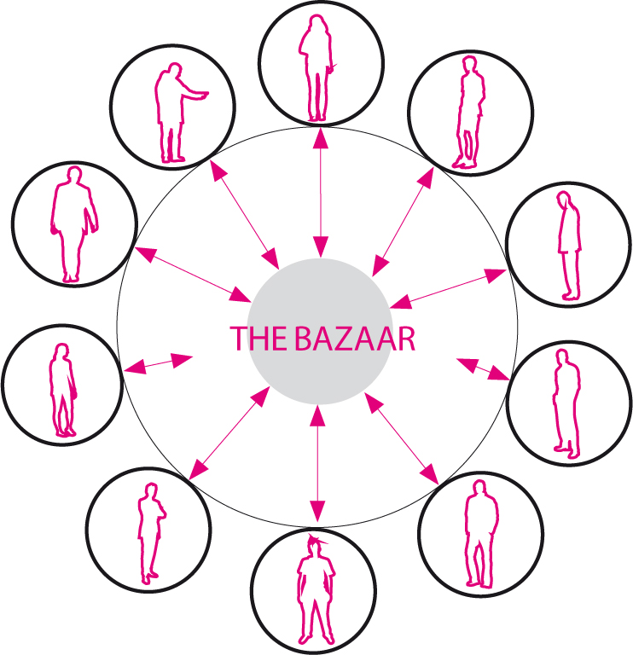
Development Methodology

Slide 12
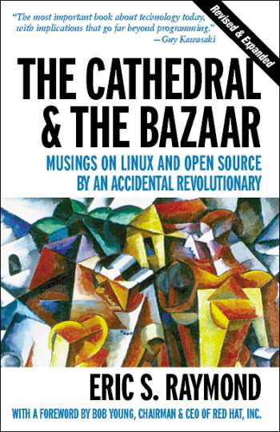

Slide 13
{
}
Top 10
OSS Projects
Notes:
Double-Negative: UK's largest film-only VFX company

Slide 14

The Linux Kernel
Android smartphones
24 of the top 38 web hosting providers
Network appliances
Household appliances
Etc, etc, etc...

Slide 15

The BSD OS(es)
TCP/IP networking
7 more of the top 38 web hosting providers
Network appliances
Household appliances
Etc, etc, etc...
When you can't handle the GPL, there's always BSD...

Slide 16

Apache Webserver
60%-70% of the web
(most of the rest is nginx or Google!)
(IIS is about 12% - mostly parked domains)
Incredibly configurable
PHP, Perl, Python, JBOSS, rewrites, proxies...
Cross-platform

Slide 17

MySQL
Extremely high-performance DB suite
Transaction support
Multiple storage engines
Multiple replication schemas
Sharding, smart proxying, clusters...
Free as in beer, free as in speech
The next big fork? (Maria, Drizzle)

Slide 18
Google Chrome
Fast, lightweight, modern, secure
Only browser to survive pwn2own comp
Next generation feature support
Native Flash support
Cross-platform

Slide 19
Mozilla Firefox
Most extensible browser around
Hugely popular
Cross-platform

Slide 20

Capable, reliable, full-featured office suite
Compatible with all major competitors
Easy to pick up and use (no ribbon!)
Cross-platform
Great example: codeforks protect rights

Slide 21
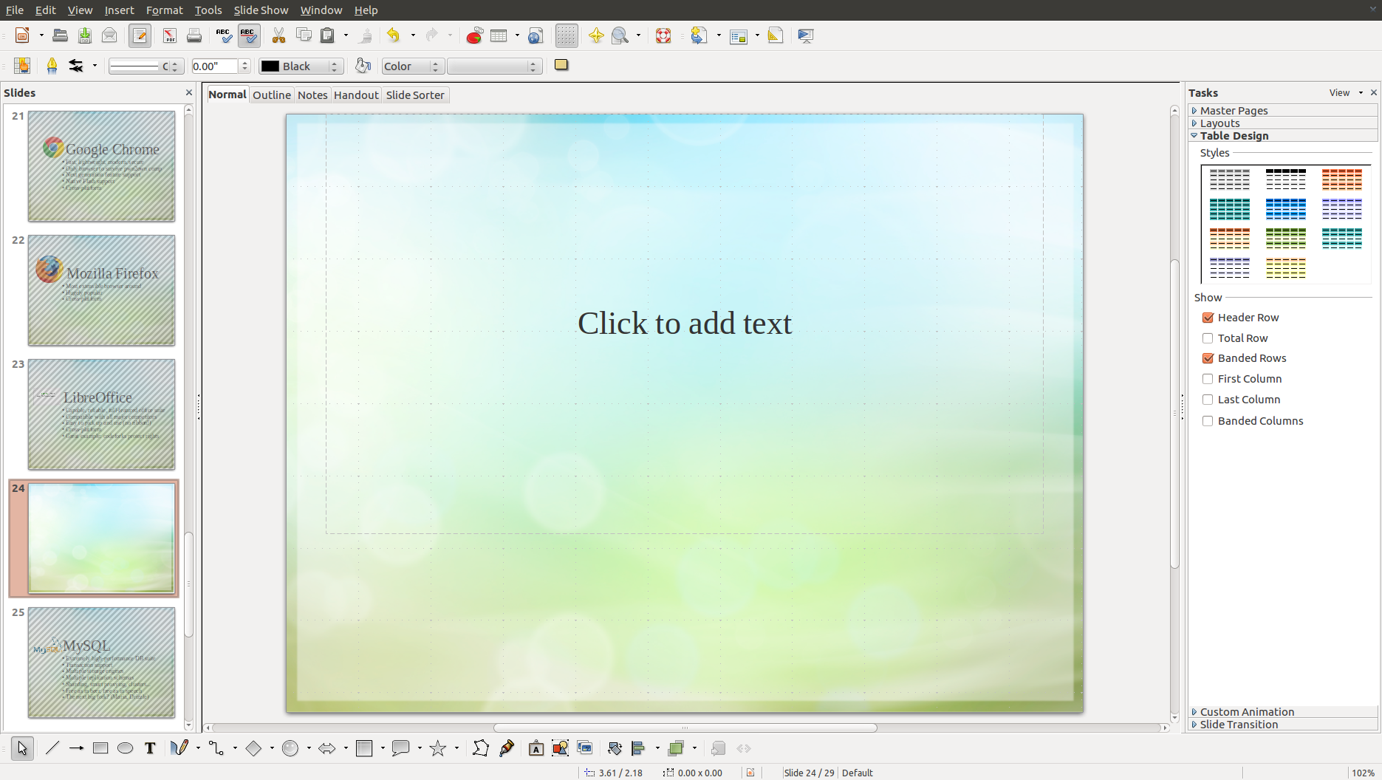

Slide 22

The GIMP
Full-featured pro quality image editor
Layers, filters, effects, paths... oh my!
Hugely popular
Enable users stuck behind a paywall
Cross-platform

Slide 23
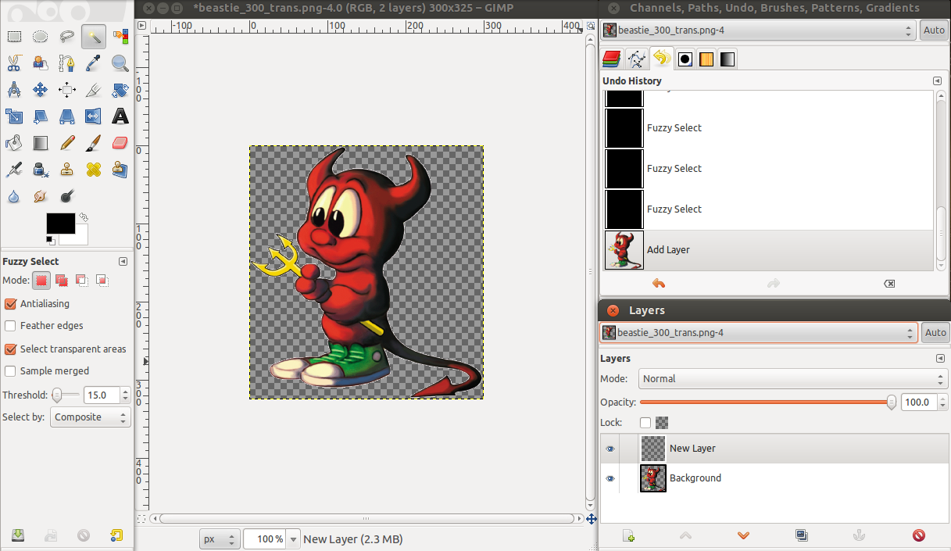

Slide 24
Blender
The open-source “3D Everything” suite
Modeling, raytracing, skinning, texturing, UV unwrapping, camera tracking, animation...
TV commercials, Spider-Man 2, award-nominated films...

Slide 25
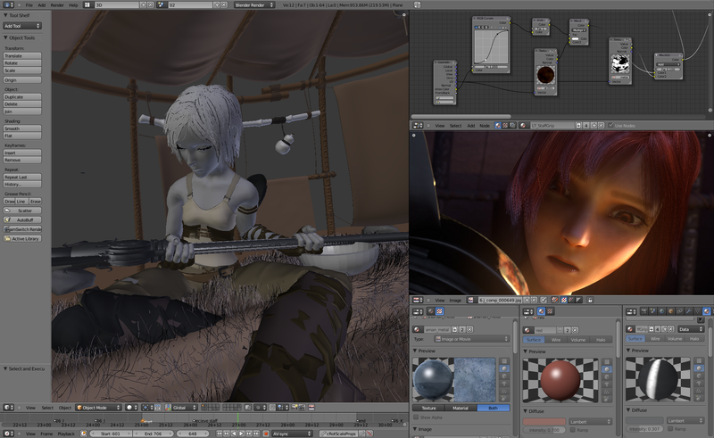

Slide 26
Linux KVM
the Kernel Virtual Machine
Extremely high performance
Extremely accessible
Exposes Linux infrastructure features (RAID, Logical Volumes, etc) to the Windows admin
No licensing hassles
No vendor lock-in

Slide 27
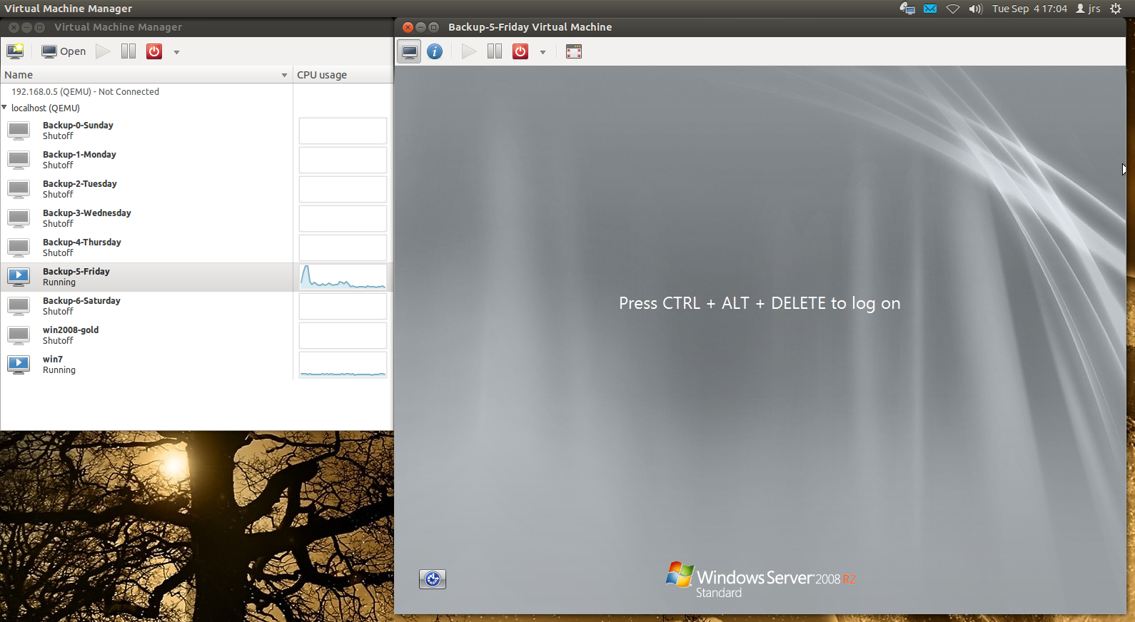

Slide 29
{
}
Why?
Open Source
Notes:
Double-Negative: UK's largest film-only VFX company

Slide 30







Using open source...
80% of companies use Open Source in some way.

Slide 31
Some Statistics
More than 50% of leading IT organizations are using open source
30% of software at these companies is open source, up from 10% five years ago
4 out of 5 developers use open source for development, application deployment, or both
1 out of 4 developers target Linux as their primary platform
1 out of 5 developers contribute to at least one open source project

Slide 32
Some Statistics
80% of front line IT people say they use open source in some way
US adoption is closing the gap with Europe

Slide 33
Regional adoption in the Southeast
“Which of the OSS infrastructure tools have you included as part of your development activities or deployed an application or software project to? “(Select all that apply.)
US
Southeast
Base: 1,900 software decision-makers at North American and European enterprises and SMBs
Source: Enterprise And SMB Software Survey, North America And Europe, Q4 2009

Slide 34


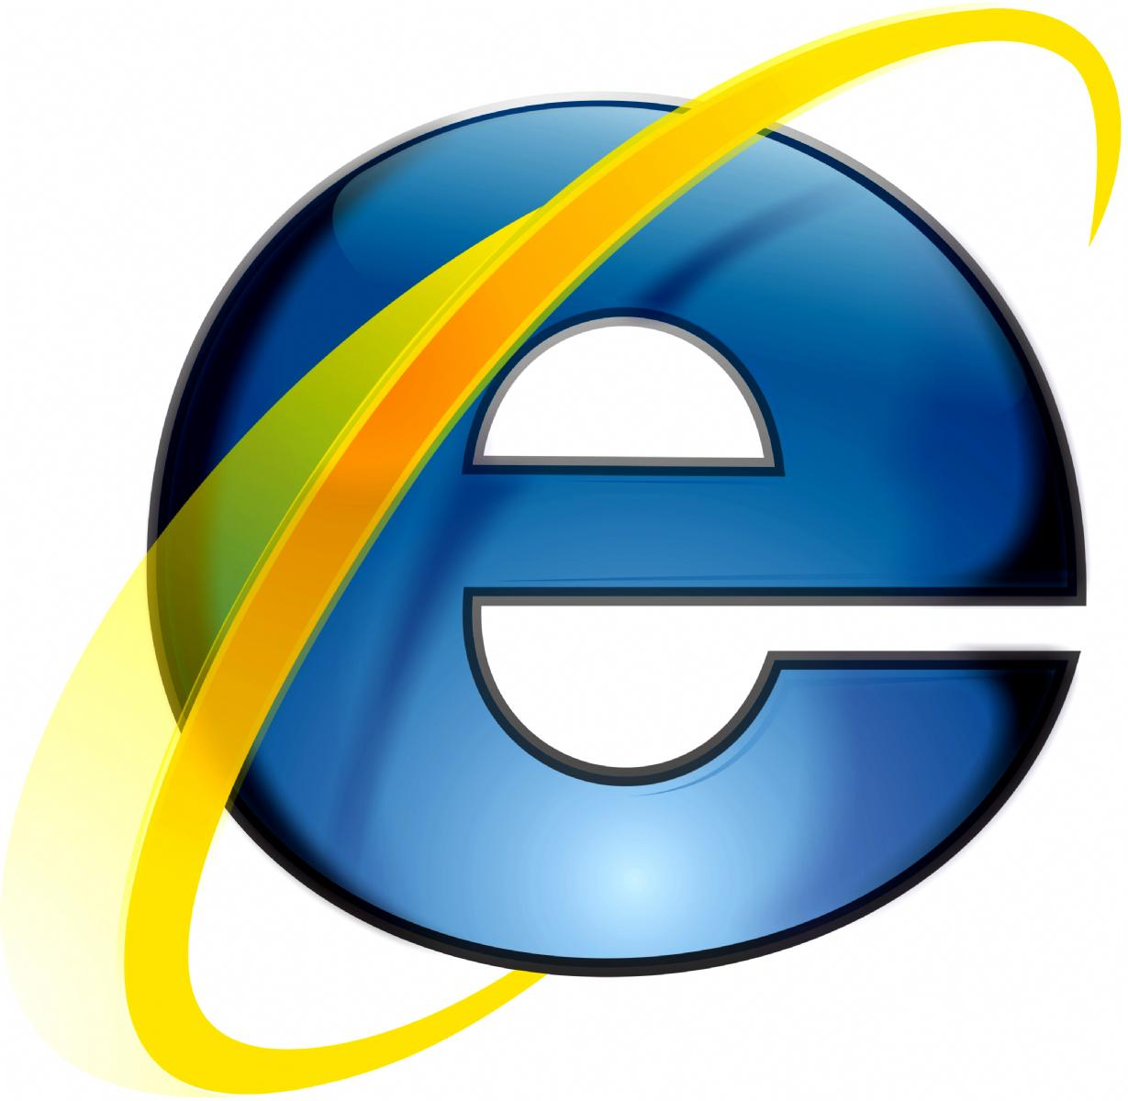

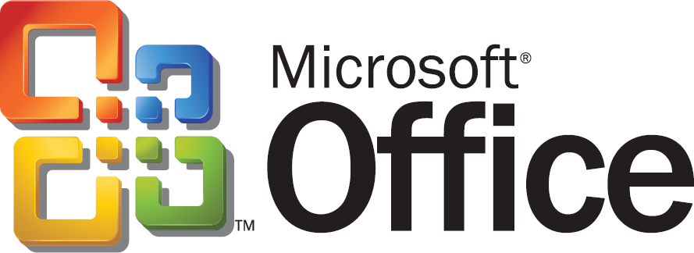


Open vs. Proprietary
Firefox
Android
Blender ($0)
Security
Standards
Freedom
Price
Internet Explorer
3ds max ($3,500)

Slide 35
Why Open Source?
Price (no license costs)
No “lock-in” with single vendor
Data interoperability
Try as much as you like before committing
Better reliability and security – seen by more eyes
Easier to customize
More resources available for help
No upgrading “gotchas”

Slide 36
Why Not Open Source?
Licencse may not always fit what you want to do (GPL)
Formal support may not be as readily available
May take effort to integrate in an environment with other proprietary or custom products
Documentation or user interface design might not always be as high-quality as the code

