Slide 1

Welcome
Ubuntu 102
Getting More
Out of Ubuntu
Jeremy Bicha

Slide 2
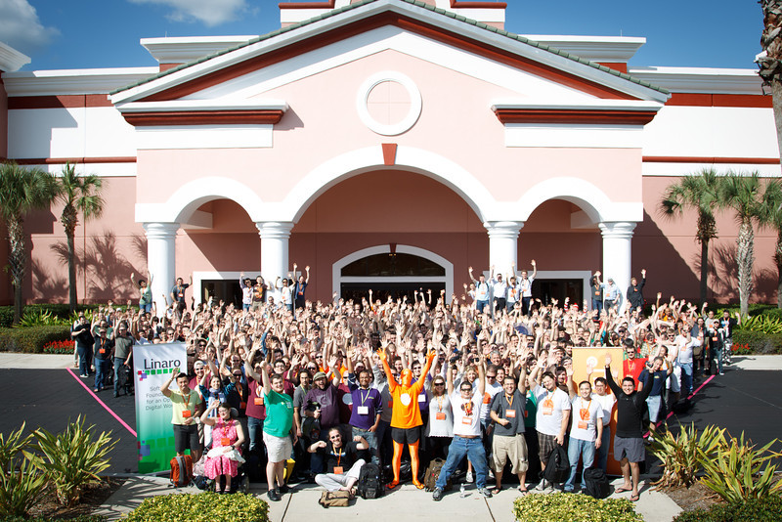
Ubuntu Developer Summit
Notes:
Talk about yourself...

Slide 3
Overview
How do updates work?
How do I install additional stuff?
How do I play music & videos?
How can I use Unity more efficiently?
Where are my files?
Notes:
How many here already use Ubuntu?
Today, we're going to discuss the history of Ubuntu and talk about what Ubuntu is. We're going to walkthough an Ubuntu installation and then give the grand tour of Ubuntu, showing off the apps that come with Ubuntu and how to add more. Finally, we'll show you how to get more help when you come across problems.
To discuss where Ubuntu came from, we have to go back in time a few decades.

Slide 4
Intro to Unity
Launcher (At the Left)
Menu Bar (At the Top)
Dash
Notes:
Unity is Ubuntu's new, unique way to use your computer. It was designed to optimize

Slide 5
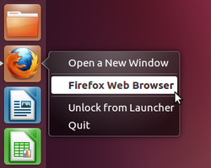
The Launcher
Notes:
The Windows taskbar can be set to always show or always hide. The Ubuntu launcher uses “Intellihide”. It hides when you have an app full screen or covering the space the Launcher normally is. To get the Launcher back, slide your mouse to the left of the screen.

Slide 6
Menu Bar
Stretches across the top of the screen
Always visible
Window management buttons
App Menu
Status Menus (Indicators)
Notes:
The menu bar includes your app's File menus and your system status. The file menus and window management buttons hide out of the way until you move your mouse to the top of the screen.
There are two different kinds of status menus, system-wide ones and application ones. The system ones in order are messaging, power, bluetooth, network, volume, clock, me, and system.

Slide 7
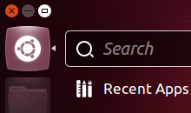
The Dash

Slide 8
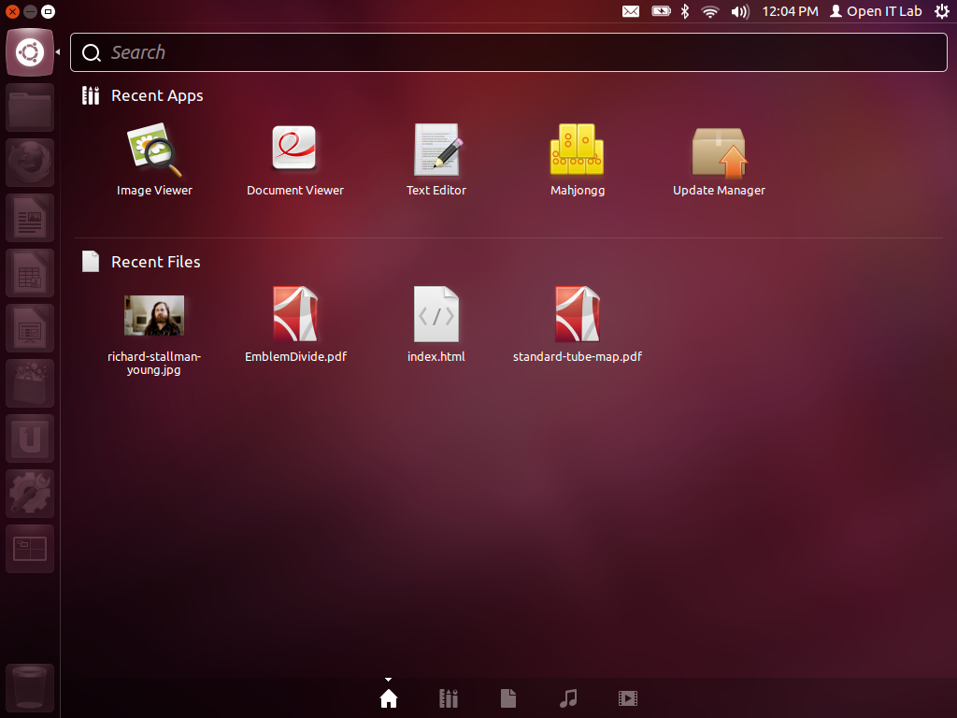
The Dash

Slide 9
Updates
Notes:
How many here already use Ubuntu?
Today, we're going to discuss the history of Ubuntu and talk about what Ubuntu is. We're going to walkthough an Ubuntu installation and then give the grand tour of Ubuntu, showing off the apps that come with Ubuntu and how to add more. Finally, we'll show you how to get more help when you come across problems.
To discuss where Ubuntu came from, we have to go back in time a few decades.

Slide 10
Upgrading to New Ubuntu
You can use the built-in update manager
Or you can download the next release, create a bootable CD or USB stick, and use that to upgrade
  Allows you to test the new release first
  Won't keep changes you've made to system directories
Notes:
In the 1960s, MIT, AT&T's Bell Labs and GE developed an operating system named Mulics. But the OS was complex and heavy for its time. Two Bell Labs researchers, Ken Thompson and Dennis Ritchie led a team to create a better OS in 1969. That OS was named Unix. Dennis Ritchie designed the C programming language which Unix was soon rewritten to use. Because of an anti-trust ruling, AT&T could not enter the computer business and so freely licensed Unix. That restriction ended in 1983 and AT&T soon moved to try to capitalize on Unix's success. Unix became increasingly proprietary as different vendors developed their own versions.

Slide 11
Additional Drivers
Notes:
How many here already use Ubuntu?
Today, we're going to discuss the history of Ubuntu and talk about what Ubuntu is. We're going to walkthough an Ubuntu installation and then give the grand tour of Ubuntu, showing off the apps that come with Ubuntu and how to add more. Finally, we'll show you how to get more help when you come across problems.
To discuss where Ubuntu came from, we have to go back in time a few decades.

Slide 12
Playing Music & Videos
Notes:
How many here already use Ubuntu?
Today, we're going to discuss the history of Ubuntu and talk about what Ubuntu is. We're going to walkthough an Ubuntu installation and then give the grand tour of Ubuntu, showing off the apps that come with Ubuntu and how to add more. Finally, we'll show you how to get more help when you come across problems.
To discuss where Ubuntu came from, we have to go back in time a few decades.

Slide 13
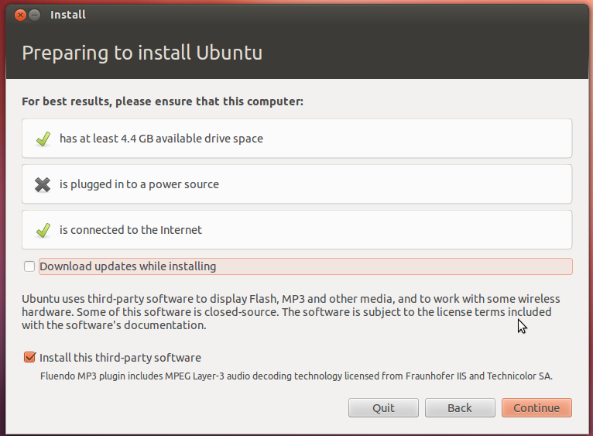
Ubuntu Restricted Extras
Notes:
In the 1960s, MIT, AT&T's Bell Labs and GE developed an operating system named Mulics. But the OS was complex and heavy for its time. Two Bell Labs researchers, Ken Thompson and Dennis Ritchie led a team to create a better OS in 1969. That OS was named Unix. Dennis Ritchie designed the C programming language which Unix was soon rewritten to use. Because of an anti-trust ruling, AT&T could not enter the computer business and so freely licensed Unix. That restriction ended in 1983 and AT&T soon moved to try to capitalize on Unix's success. Unix became increasingly proprietary as different vendors developed their own versions.

Slide 14
Why Don't My DVDs Play?
The Digital Millennium Copyright Act (1996)
“No person shall circumvent a technological measure that effectively controls access to a work.”
Notes:
In the 1960s, MIT, AT&T's Bell Labs and GE developed an operating system named Mulics. But the OS was complex and heavy for its time. Two Bell Labs researchers, Ken Thompson and Dennis Ritchie led a team to create a better OS in 1969. That OS was named Unix. Dennis Ritchie designed the C programming language which Unix was soon rewritten to use. Because of an anti-trust ruling, AT&T could not enter the computer business and so freely licensed Unix. That restriction ended in 1983 and AT&T soon moved to try to capitalize on Unix's success. Unix became increasingly proprietary as different vendors developed their own versions.

Slide 15
How Do I Play DVDs Anyway?
Purchase the Fluendo DVD Player
Alternatively, install decryption software described at “How do I enable restricted codecs to play DVDs?” in the Ubuntu help
Be aware that using the alternate decryption software may be illegal
Notes:
In the 1960s, MIT, AT&T's Bell Labs and GE developed an operating system named Mulics. But the OS was complex and heavy for its time. Two Bell Labs researchers, Ken Thompson and Dennis Ritchie led a team to create a better OS in 1969. That OS was named Unix. Dennis Ritchie designed the C programming language which Unix was soon rewritten to use. Because of an anti-trust ruling, AT&T could not enter the computer business and so freely licensed Unix. That restriction ended in 1983 and AT&T soon moved to try to capitalize on Unix's success. Unix became increasingly proprietary as different vendors developed their own versions.

Slide 16
Using the Web
Notes:
How many here already use Ubuntu?
Today, we're going to discuss the history of Ubuntu and talk about what Ubuntu is. We're going to walkthough an Ubuntu installation and then give the grand tour of Ubuntu, showing off the apps that come with Ubuntu and how to add more. Finally, we'll show you how to get more help when you come across problems.
To discuss where Ubuntu came from, we have to go back in time a few decades.

Slide 17
Using Unity More Efficiently
Notes:
How many here already use Ubuntu?
Today, we're going to discuss the history of Ubuntu and talk about what Ubuntu is. We're going to walkthough an Ubuntu installation and then give the grand tour of Ubuntu, showing off the apps that come with Ubuntu and how to add more. Finally, we'll show you how to get more help when you come across problems.
To discuss where Ubuntu came from, we have to go back in time a few decades.

Slide 18
Customize the Dash
Lenses allow you to search for specific things. Switch between lenses by clicking the white icons at the bottom of the Dash or Ctrl+Tab.
Filters allow you to limit the search results
Scopes are providers for lenses
You can install additional lenses and scopes
Notes:
In the 1960s, MIT, AT&T's Bell Labs and GE developed an operating system named Mulics. But the OS was complex and heavy for its time. Two Bell Labs researchers, Ken Thompson and Dennis Ritchie led a team to create a better OS in 1969. That OS was named Unix. Dennis Ritchie designed the C programming language which Unix was soon rewritten to use. Because of an anti-trust ruling, AT&T could not enter the computer business and so freely licensed Unix. That restriction ended in 1983 and AT&T soon moved to try to capitalize on Unix's success. Unix became increasingly proprietary as different vendors developed their own versions.

Slide 19
Keyboard Shortcuts
Super key – Opens the dash
Hold down the Super key to see a chart of shortcuts
Alt+F1 – Makes the launcher keyboard accessible
Alt+F2 - “Run a command” mode
F10 – Navigate the menu bar

Slide 20
Dash Keyboard Shortcuts
Super + A – Open the Applications lens
Super + F – Open the Files lens
Super + M – Open the Music lens
Ctrl+Tab – Switch between lenses

Slide 21
Other Keyboard Shortcuts
Alt + Tab = Switch between apps
Alt + (key above tab) = Switch between windows of the same app
Generally, Windows keyboard shortcuts work in Ubuntu

Slide 22
HUD
Press Alt to easily search menus

Slide 23
Where Are My Files?
Notes:
How many here already use Ubuntu?
Today, we're going to discuss the history of Ubuntu and talk about what Ubuntu is. We're going to walkthough an Ubuntu installation and then give the grand tour of Ubuntu, showing off the apps that come with Ubuntu and how to add more. Finally, we'll show you how to get more help when you come across problems.
To discuss where Ubuntu came from, we have to go back in time a few decades.

Slide 24
Linux File System
Directory = Folder
Everything in Unix comes under /
/home/yourname/ is where your files live
/media is where your removable devices go
/etc contains editable system configuration files
Notes:
In the 1960s, MIT, AT&T's Bell Labs and GE developed an operating system named Mulics. But the OS was complex and heavy for its time. Two Bell Labs researchers, Ken Thompson and Dennis Ritchie led a team to create a better OS in 1969. That OS was named Unix. Dennis Ritchie designed the C programming language which Unix was soon rewritten to use. Because of an anti-trust ruling, AT&T could not enter the computer business and so freely licensed Unix. That restriction ended in 1983 and AT&T soon moved to try to capitalize on Unix's success. Unix became increasingly proprietary as different vendors developed their own versions.

Slide 25
Partitioning
Windows uses NTFS
For Linux you should use ext4
A swap partition is useful. Make it at least a bit bigger than your available RAM
Notes:
In the 1960s, MIT, AT&T's Bell Labs and GE developed an operating system named Mulics. But the OS was complex and heavy for its time. Two Bell Labs researchers, Ken Thompson and Dennis Ritchie led a team to create a better OS in 1969. That OS was named Unix. Dennis Ritchie designed the C programming language which Unix was soon rewritten to use. Because of an anti-trust ruling, AT&T could not enter the computer business and so freely licensed Unix. That restriction ended in 1983 and AT&T soon moved to try to capitalize on Unix's success. Unix became increasingly proprietary as different vendors developed their own versions.

Slide 26
Ubuntu One
Online storage built in to Ubuntu
Free Android, iOS & Windows apps
5GB of storage for free or buy extra storage
Music streaming service with offline abilities
New referral program

Slide 27
Punctuation
/ the top level
~ your home directory
. the current directory
.. one directory up
Files and directories that start with a . are hidden by default in your file browser, like .mozilla/
$ shows you're logged in
# shows root is logged in
Use quotation marks to include spaces
Notes:
In the 1960s, MIT, AT&T's Bell Labs and GE developed an operating system named Mulics. But the OS was complex and heavy for its time. Two Bell Labs researchers, Ken Thompson and Dennis Ritchie led a team to create a better OS in 1969. That OS was named Unix. Dennis Ritchie designed the C programming language which Unix was soon rewritten to use. Because of an anti-trust ruling, AT&T could not enter the computer business and so freely licensed Unix. That restriction ended in 1983 and AT&T soon moved to try to capitalize on Unix's success. Unix became increasingly proprietary as different vendors developed their own versions.

Slide 28
What is sudo or How do I get root?
Sudo allows running commands as root
Use your own password
Only 'admin' users can use sudo by default
Notes:
In the 1960s, MIT, AT&T's Bell Labs and GE developed an operating system named Mulics. But the OS was complex and heavy for its time. Two Bell Labs researchers, Ken Thompson and Dennis Ritchie led a team to create a better OS in 1969. That OS was named Unix. Dennis Ritchie designed the C programming language which Unix was soon rewritten to use. Because of an anti-trust ruling, AT&T could not enter the computer business and so freely licensed Unix. That restriction ended in 1983 and AT&T soon moved to try to capitalize on Unix's success. Unix became increasingly proprietary as different vendors developed their own versions.

Slide 29
How do I use the command line?
cd
ls
ls -lh
rm
-r or -R
--help
man
Notes:
In the 1960s, MIT, AT&T's Bell Labs and GE developed an operating system named Mulics. But the OS was complex and heavy for its time. Two Bell Labs researchers, Ken Thompson and Dennis Ritchie led a team to create a better OS in 1969. That OS was named Unix. Dennis Ritchie designed the C programming language which Unix was soon rewritten to use. Because of an anti-trust ruling, AT&T could not enter the computer business and so freely licensed Unix. That restriction ended in 1983 and AT&T soon moved to try to capitalize on Unix's success. Unix became increasingly proprietary as different vendors developed their own versions.

Slide 30
How do I use the command line?
nano
apt-get update
apt-get upgrade
Notes:
In the 1960s, MIT, AT&T's Bell Labs and GE developed an operating system named Mulics. But the OS was complex and heavy for its time. Two Bell Labs researchers, Ken Thompson and Dennis Ritchie led a team to create a better OS in 1969. That OS was named Unix. Dennis Ritchie designed the C programming language which Unix was soon rewritten to use. Because of an anti-trust ruling, AT&T could not enter the computer business and so freely licensed Unix. That restriction ended in 1983 and AT&T soon moved to try to capitalize on Unix's success. Unix became increasingly proprietary as different vendors developed their own versions.

Slide 31
How Do Apps Get into Ubuntu?
Upstream developers write code.
Developers add an open source license (GPL, BSD, Apache, etc.)
Developers release their source code as a tarball (.tar.gz, .tar.bz2, .tar.xz or .zip)
The tarball can be extracted, compiled, installed, and then run
Linux distributions take care of finding the latest tarball releases, packaging them, and making them available for install in software repositories
Notes:
Update Manager

Slide 32
Installing an App from Source

Slide 33
Installing an App from Source
Extract the tarball (unzip it!)
./configure
make
make install

Slide 34
Questions?
Notes:
How many here already use Ubuntu?
Today, we're going to discuss the history of Ubuntu and talk about what Ubuntu is. We're going to walkthough an Ubuntu installation and then give the grand tour of Ubuntu, showing off the apps that come with Ubuntu and how to add more. Finally, we'll show you how to get more help when you come across problems.
To discuss where Ubuntu came from, we have to go back in time a few decades.

Slide 35
Personal Package Archives
PPAs are extra repositories that may include apps or updates not available in the official repositories
However, there are no guarantees that the packages in the PPA do what they say they do.

Slide 36
"A PPA is just a third-party software repository that happens to be hosted on Launchpad. Just like any other third-party repository, it has total control over your system. It can delete half your system by accident, replace Unity with an MP3 of “Never gonna give you up”, or include a maintainer script that e-mails the contents of your home folder to Mark Zuckerberg.
It’s equivalent to making an administrator account, on your computer, for the person who maintains the PPA. So, use a PPA only if you know and trust the person well enough that you’d do that."
- Matthew Paul Thomas

Slide 37
What If I Don't Want to Automatically Run Ubuntu on Boot?
Open a terminal and run
sudo nano /etc/default/grub
Set GRUB_TIMEOUT="-1"
sudo update-grub

Slide 38
How Can I Get More Help?

Slide 39
Help!
Pre-installed help
help.ubuntu.com
Askubuntu.com
Ubuntuforums.com
IRC chat
Columbia Linux Users Group (COLALUG)
Notes:
#ubuntu on Freenode. You can use Empathy for IRC. Also see https://help.ubuntu.com/community/InternetRelayChat for other choices.

Slide 40
Further Workshops
Open 101, September 15
Command Line 101
And many more...
Web Admin 101 on Saturday at 9:30 am
http://open-it-lab.com/register
Notes:
#ubuntu on Freenode. You can use Empathy for IRC. Also see https://help.ubuntu.com/community/InternetRelayChat for other choices.

Slide 41
