Slide 1
Towards Linked Language Data for Digital Humanities
Thierry Declerck, Piroska Lendvai, Karlheinz Moerth, Gerhard Budin & Tamás Váradi
DFKI & ICLTT, HASRIL, ICLTT, ICLTT, HASRIL
LDL Workshop, Frankfurt, 07.03.2012

Slide 2
Table of Content
Motivation
Thompson's Motif Index (TMI), Aarne Thomson Uther (ATU) Type Classification of international folktales
Linguistic annotation of labels of TMI/ATU
  Mapping linguistic objects of TMI/ATU with linguistic objects in folktale texts -> semi-automatic motif annotation and classification of folktale texts
  Combining both catalogues
Multilingual extensions of the catalogues
  Use of Wiktionary and Wikipedia
Ontologies for folktales annotations

Slide 3
Motivation
Providing a taxonomical or ontological "upgrade" of the Thomson Motif Index (TMI), for supporting the corresponding automatized semantic annotation/indexation of folk literature. The same for the Aarne-Thompson-Uther classification system (ATU) of international folktales
Prior to this we need to precisely analyze and encode the terminology (within labels associated with classes) used in TMI/ATU, enriching them with linguistic information, for facilitating the mapping with linguistic analysis of folktale text
  As a side effect, we expect to be able to support translation of the English labels, and so to enable a multilingual extension of TMI/ATU
Our work builds on two related initiatives
  CTL (Conceptual, Terminological and Linguistic modeling of labels; Declerck & Lendvai, LREC 2010)
  The “lemon” model for the representation of lexicon information in ontologies, developed in the European R&D project “Monnet” (see John Mccrae, Elena Montiel Ponsoda and Philipp Cimiano “Integrating WordNet and Wiktionary with lemon”, in this Workshop

Slide 4
Index of Motifs in Folktales
http://www.folklore.bc.ca/Motifindex.htm: "In order to compare folk tales, and understand their distribution, they are classified by an indexed system called the Types of the Folk Tale. Generally tales are made up of a number of specific elements in order to make them work as tellable tales. These elements are known as motifs.
To be accepted as a motif the element needs to be an identifiable unit of the tale's makeup or character and, by giving it a number within an alphabetical system, one can quickly access and compare similar motifs, in other tales, seeing where they occur and how common they are.....“

Slide 5
ATU
What is ATU? Quoting from: http://en.wikipedia.org/wiki/Aarne-Thompson#Hans-J.C3.B6rg_Uther:
"The Aarne-Thompson classification system is a system for classifying folktales. First developed by Antti Aarne and published in 1910, it was translated and enlarged by Stith Thompson, whon 1961 created the AT-number system (also referred to as AaTh system) often used today. As a treatment of morphology, it uses motifs rather than actions to group the tales."
"Over all, the tales are grouped by Animal Tales, Fairy Tales, Religious Tales, Realistic Tales, Tales of the Stupid Ogre, Jokes and Anecdotes, and Formula Tales. Within each group, they are further subdivided by motifs until the individual type."
"The AaTh system was updated and expanded in 2004 with the publication of The Types of International Folktales: A Classification and Bibliography by Hans-Jörg Uther. Uther noted that many of the earlier descriptions were cursory, and that the existing system did not allow for expansion. To remedy these shortcomings Uther developed the Aarne-Thompson-Uther classification (ATU number) system, and includes international folktales in the expanded listing."

Slide 6
Types and Index (http://storydynamics.com/Articles/Finding_and_Creating/types.html)
What's a type?
  Type numbers were assigned to the major Indo-European tales by Finnish scholar Antii Aarne in his 1910 book (revised in 1928), The Types of the Folktale.For Aarne, a type was a collection of similar stories that bear a historical relationship to each other. (See The Folktale, page 416.)Therefore, to say that a story is an example of type 510A means, strictly speaking, that the story is historically derived from some of the others in the type. In other words, the type index was not begun as a purely descriptive tool, but as an instrument of the theory of folk-tale dispersion within the Indo-European culture areas.
  The great U.S. folklorist Stith Thompson added a second, more detailed type of numerical index, the motif index, which catalogs smaller elements of a story and implies no historical connection between stories listed together. Thompson then revised Aarne's Types of the Folktale to include the motifs most commonly associated with each type.
  After Thompson's work, a type has become less a statement of historical connection and more a simple description of narrative content. For our purposes, a type may be seen as a "bundle of motifs" that commonly appear together as an independent story. Some scholars have created type indexes for African and Asian oral tales. Most type indexes, however, continue to emphasize the story plots that are widely distributed in Indo-European cultures.
What do type indexes actually index?
  Type indexes catalog folk stories by their overall plots. They do not index motifs, which are smaller elements of plot. For example, "Apple causes magic sleep" and "Compassionate executioner: substituted heart" are motifs, while "Snow White" is a type containing those motifs. Therefore, a type index is only useful when we seek variants of an entire plot.
  Further, type indexes refer only to the actual narrative events, not to ideas or themes.
  For example, although "stories with animal actors" are grouped together (Types 1-299), there is no way to use a type index to find all the stories about kindness to animals, or - even more broadly - to find stories about the roles of animals in our lives.
  Conversely, a type index will refer us to other stories whose events are similar to Snow White, but that may, in fact, emphasize entirely different ideas or emotional themes.
  With rare exceptions, type indexes refer only to tales collected from oral tradition. Thus, you will not find references in a type index to literary "fairy tales" from known authors, such as Hans Christian Anderson, Oscar Wilde, or Jane Yolen - even when these authors have rewritten traditional tales.

Slide 7
Types and Motifs (Uther)
Quoting from: http://oaks.nvg.org/uther.html
"The new type descriptions have been written with the following principles in mind:
  The main characters, both active and passive, and their opponents, must be named, and the tale's actions and objects and especially its situation must be recognizable."
"Uther explains that now a motif can be a combination of statements about an actor, an object, or an incident - all three of these elements. He says,
  "Motif" thus has a broad definition that enables it to be used as a basis for literary and ethnological research. It is a narrative unit, and as such is subject to a dynamic that determines with which other motifs it can be combined. Thus motifs constitute the basic building blocks of narratives. On pragmatic grounds, a clear distinction between motif and type is not possible because the boundaries are not distinct. "

Slide 8
Thompson's Motif-Index of Folk Literature (TMI)
Ca 45.000 Motifs (labels of classes) organized by alphabet letters, so for example: P. SOCIETY, and then by numbers
P0--P99. Royalty and nobility
  P0. Royalty and nobility
    P10. Kings
    P20. Queens
    P30. Princes
    P40. Princesses
    P50. Noblemen (knights)
    P60. Noble (gentle) ladies
    P90. Royalty and nobility--miscellaneous

Slide 9
TMI (2)
P12. Character of kings.
  P12.1. Hunting a madness of kings. (Penzer II 127; Irish myth: *Cross; Icelandic: Boberg; India: Thompson-Balys.)
  P12.2. Injustice deadliest of monarch’s sins. (Penzer I 124 n. 1.)
    P12.2.1. Tyrannical king. (Jewish: *Neuman; India: Thompson-Balys.)
  P12.3. Usurper imposes burdensome taxes. (Dickson 175 n. 39.)
  P12.4. King who intends rape killed. Attackers flee into exile. (Irish myth: Cross.)
  P12.5. Good king never retreats in battle. (Irish myth: *Cross.)
    P12.5.0.1. Dead king carried into battle in his war-chariot. (Irish myth: Cross.)

Slide 10
Thompson Motif Index (3)
Our source: " S. Thompson. Motif-index of folk-literature : a classification of narrative elements in folktales, ballads, myths, fables, medieval romances, exempla, fabliaux, jest-books, and local legends. Revised and enlarged. edition. Bloomington : Indiana University Press, 1955-1958. Grant support: INTAS project 05-1000008-7922, as to be found in http://www.ruthenia.ru/folklore/thompson/index.htm (this page contains a zip file with the whole list of motifs)
  But some “cleaning work” is necessary before getting the complete content as machine-readable data.

Slide 11
TMI in CTL: Concepts
We keep in the conceptual part only the indexes of TMI.
  One can also add specific relations between the indexes and so transform the taxonomic relations into an ontology
  ...
  O
  P
  P0
    P10.
    P12.
      P12.5.
        P12.5.0.1.
      P12.9.
      P12.10.
      …
  ...

Slide 12
TMI in CTL: Concepts and Relations
We propose a twofold ontological representation
A sub-class hierarchy
  P10 (Kings) is a sub-class of P0 (Royalty and Nobility)
Relation (properties) associated to classes
  Class P10 has property “hasCharacter“, introducing here a new class Character, which subsumes terms associated to the word "king(s)" like "good", "luxurious", "tyrannical" etc.
  The relation would be then hasCharacter with domain P10 (and very probably the higher class P0) and range "Character"
Actual work on how to derive those ontological components from the actual TMI classification and the linguistically enriched labels.

Slide 13
TMI in CTL: Term-Level
Terms are represented in an independent module, with
  An ID
  Information about the language of the term,
  A link to the related concept(s) – a (sub-)term might refer to different concepts (for example „king“ is used in 1111 labels)
  Links to available related textual resources (to add)
Terms are also tokenized, so that relevant subterms can be precisely encoded.
  Each WordForm in a token will include a pointer to its lemma in a lexicon and to (possibly) disambiguated morpho-syntactic information
  The tokenized terms are enriched with syntactic information (constituency and dependency)

Slide 14
Example of TMI terms in CTL (1)
Kings
  ID: T34 (the figure "34" is arbitrary here)
  Concept RefID => P10
  Lang: EN
  Tokens: [t0 Kings]
  lex:pointer for t0 to an external lexicon (lemma: king)
  Morpho-syntax pointer for t0 to ISO datcat: [Noun, Masc, Plural] (all the categories used here should be in fact just pointers to ISOcat)
  Syntax pointer for T34 to ISO datcat: [NP, indef, count noun, head = t0] (all the categories used here should be in fact just pointers to ISOcat)

Slide 15
Example of TMI terms in CTL (2)
Good king never retreats in battle
  ID: T345 (the figure "345" is arbitrary here)
  Concept RefID: => P12.5
  Lang: EN
  Tokens: [t0 Good ][t1 king][t2 never][t3 retreats][t4 in][t5 battle]
  lex:pointer for t0 to an external lexicon (lemma: good) (similar for the other tokens)
  Morpho-syntax pointer to ISO DatCats: t0 => [Adj], t1 => [Noun, Masc, Sing], t2 => [Adv, neg, temp], t3 => [Verb, Pres, 3rd Person], t4 => [Prep,loc-temp-thematic-..], t5 => [Noun, Sing]
  Syntax pointer to ISO DatCats for T345 => [Sent(t0-t5), head=t3, adv-mod=t2, Subj= [t0-t1, cat:NP, head=t1, mod=t0, PP-mod= [t4-t5, head=t4, compl=[t5, cat=NP,head=t5]]

Slide 16
Or simpler
• <CLASS ID=”0” SPAN=”0-99” LABEL=”Creator”>
• <CLASS ID=”20” LABEL=”Origin of the creator” SubClassOf=”0”>
• <CLASS ID=”21” MOTIF=”Creator from above” TYPE=”Abstract” SubClassOff =“0”>
• <CLASS ID=”21.1” MOTIF=”Woman who fell from the sky” TYPE=”Ref” part of=”21”>

Slide 17
Linguistic Annotation of labels of TMI
woman,N+Nb=s+Distribution=Hum
who,PRO+Distribution=RelQ
fell,fall,V+Tense=PT+Pers=3+Nb=s
from,PREP
the,DET
sky,N+Nb=s
Lexical analysis
A1. Identity of creator.
A1.1. Sun-god as creator.
A1.2. Grandfather as creator..
A1.3. Stone-woman as creator.
A2. Multiple creators.
A2.1. Three creators
A2.2. First human pair as creators.
.....
A21. Creator from above.
A21.1. Woman who fell from the sky.
....
Syntactic analysis
<NP>
<NP><HEAD><REFOF XREF="396.2">Woman</HEAD>
</NP>
<SENT><RELCLAUSE>
<SUBJ><XREF>who</XREF></SUBJ>
<PRED>fell</PRED>
<PP><PPOBJ>from
<NP><SPEC>the</SPEC><HEAD>sky</HEAD></NP>
</PPOBJ></PP>
</RELCLAUSE></SENT></NP>
Lexical semantics + syntax =>
Apply to linguistically annotated tales
for automatic index annotation
Extract from Thompson Motif Index for Folktales

Slide 18
Motifs in CTL: Overview
Concepts
Terminology
Linguistic
P0
Has_Subclass
P10
P20
P30
P40
P50
P60
…
P10
Has_Property
WasChoosenBy
HasCharacter
HasCustoms
HasCoronation
HasPerquisites
...
Royalty and nobility
T34 [Kings]
T35 [Queens]
T36 [Princes]
T37 [Princesses]
T38 [[_{t0}Noblemen] [_{t1}(knights)]]
T39 [[_{t0}Noble] [_{t1}(gentle)] _{t2}[ladies]]
T345 [[_{t0}Good] [_{t1}king] [_{t2}never] [_{t3}retreats] [_{t4}in] [_{t5}battle]]
Lemma
/good/
/king/
/retreat/
...
Morpho-Syntax
/Noun-Singular/
/Noun-Plural/
/Verb-3rdPers-Singular/
/Adjective/
....
Syntax
NP
Sentence

Slide 19
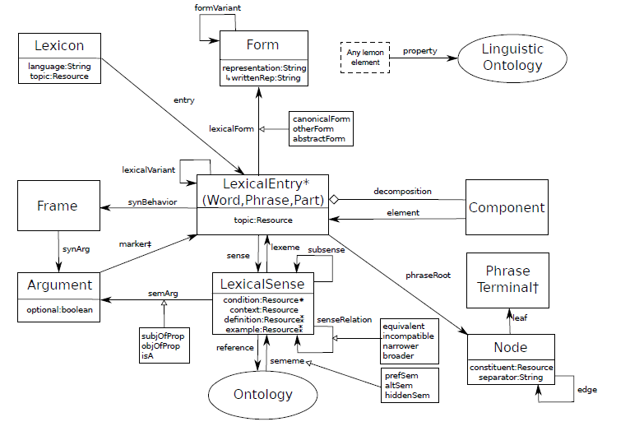
Use of the RDF based lemon model for encoding the CTL approach
Graphic:s courtesy of John McCrae

Slide 21
Advantages
The organization of TMI in CTL (using lemon as the representational means for linguistic information in ontologies) will allow to
  Make the conceptual hierarchy more compact
  Establish explicit relations between terms and sub-terms
    Also marking the different roles a term can take
  Disambiguate certain terms/words
    A10 Nature of the creator / F960 .Extraordinary nature phenomena
  Establishing cross-lingual linkings or building a multilingual TMI
  Ease the mark up of more precise fragments of text with motifs, since both sides (Ontology/Taxonomy) and text are linguistically annotated.
  All texts mentioning something about a king, can serve as a basis for extending semi-automatically the P10 class (this being valid for all the classes and for the whole taxonomy)

Slide 22
Lexical Semantics for Motifs?
Generic Lexical Semantics resources (like WordNet, FrameNet, etc.) can be used.
But actually investigating the generation of domain specific lexical semantic resources from the TMI labels
  Origin of the creator. :: A20.
    Creator from above. :: A21.
      Woman who fell from the sky. :: A21.1.
      Old man from sky as creator. :: A21.2.
"sky" as a hyponym (or meronym?) of "above"

Slide 23
Text Examples: Creator from Above
the Creator, the Great Chief Above, made the world. Then he made the animals and the birds and gave them their names -- Coyote, Grizzly Bear, Deer, Fox, Eagle, the four Wolf Brothers, Magpie, Bluejay, Hummingbird, and all the others. When he had finished his work, the Creator called the animal people to him. "I am going to leave you," he said. "But I will come back. When I come again, I will make human beings. They will be in charge of you." The Great Chief returned to his home in the sky, and the animal people scattered to all parts of the world.
relevant parts of TMI Mentioning the word chief
Rebellion of lesser gods against chief. :: A162.8.
Veils of fire and ice before chief door of heaven. :: A661.0.1.1.2.

Slide 24
Text Examples: Woman fell from the sky
in the beginning there was no earth to live on, only a watery abyss, but up above, in the Great Blue, there was a community called the Sky World including a woman who dreamed dreams.
One night she dreamed about the tree that was the source of light. The dream frightened her, so she went and asked the men in the Sky World to pull up the tree. They dug around the trees roots to make space for more light, and the tree fell through the hole and disappeared. After that there was only darkness. Distraught, they pushed the woman through the hole as well. The woman would have been lost in the abyss had not a fish hawk come to her aid using his feathers to pillow her.
The fish hawk could not keep her up all on his own, so he asked for help to create some firm ground for the woman to rest upon. A helldiver went down to the bottom of the sea and brought back mud in his beak. He found a turtle, smeared the mud onto its back, and dove down again for more. Ducks also brought beaksful of the ocean floor and to spread over the turtle's shell.
The beavers helped build terrain, making the shell bigger. The birds and the animals built the continents until they had made the whole round earth, while the woman was safely sitting on the turtle's back. The turtle continues to hold the earth on its back.
ISSUE of co-occurences: often the topic of the woman falling from the sky, there is a turlte. TMI has the motif: Earth from turtle's back. :: A815 (but not marking the relation to the motif: Woman who fell from the sky. :: A21.1)

Slide 25
Availability of ATU
The whole catalogue is not available (yet) in an electronic form, but some details are available on Wikipedia, but with some discrepancies across the language specific pages:
  (EN) Rapunzel 310 (Italian, Italian, Greek, Italian)
  (DE) AaTh 310 Jungfrau im Turm KHM 12 Rapunzel
  (FR) AT 310 : « La Fille dans la tour » (The Maiden in the Tower) : version allemande
The English version further links Rapunzel to four tale versions, in different languages. The
original German tale is reached if the reader clicks on “Rapunzel”). The German version links
additionally to a German classification system (KHM = Kinder- und Hausmärchen --
Children's and Household Tales--, used for the classification of Grimm’s Fairy Tales).

Slide 26
Proposal for normalizing ATU data from Wikipedia
<ATU ID=”310”>
< LABEL lang=”EN”>Rapunzel</LABEL>
< LABEL lang=”DE”>Jungfrau im Turm</LABEL>
< LABEL lang=”FR”>La Fille dans la tour</LABEL>
< ALT lang=”DE”>Rapunzel</ALT>
< ALT lang=”EN”> The Maiden in the Tower </ALT>
</ATU>

Slide 27
Multilingual Extension
Relatively clear for the ATU entries (see previous slides)
For the TMI case, we started to look at Wiktionary for getting a freely available multilingual source. But:
  Wiktionary is not (really) machine readable
  Witjonary is not (really) standardized – using wiki style
  Wiktionary is not (really) consistent in its lexical mark-up
  But still a very valuable source, worth to transform in ISO-LMF, TEI or W3C-RDF (the lemon model, next talk)

Slide 28
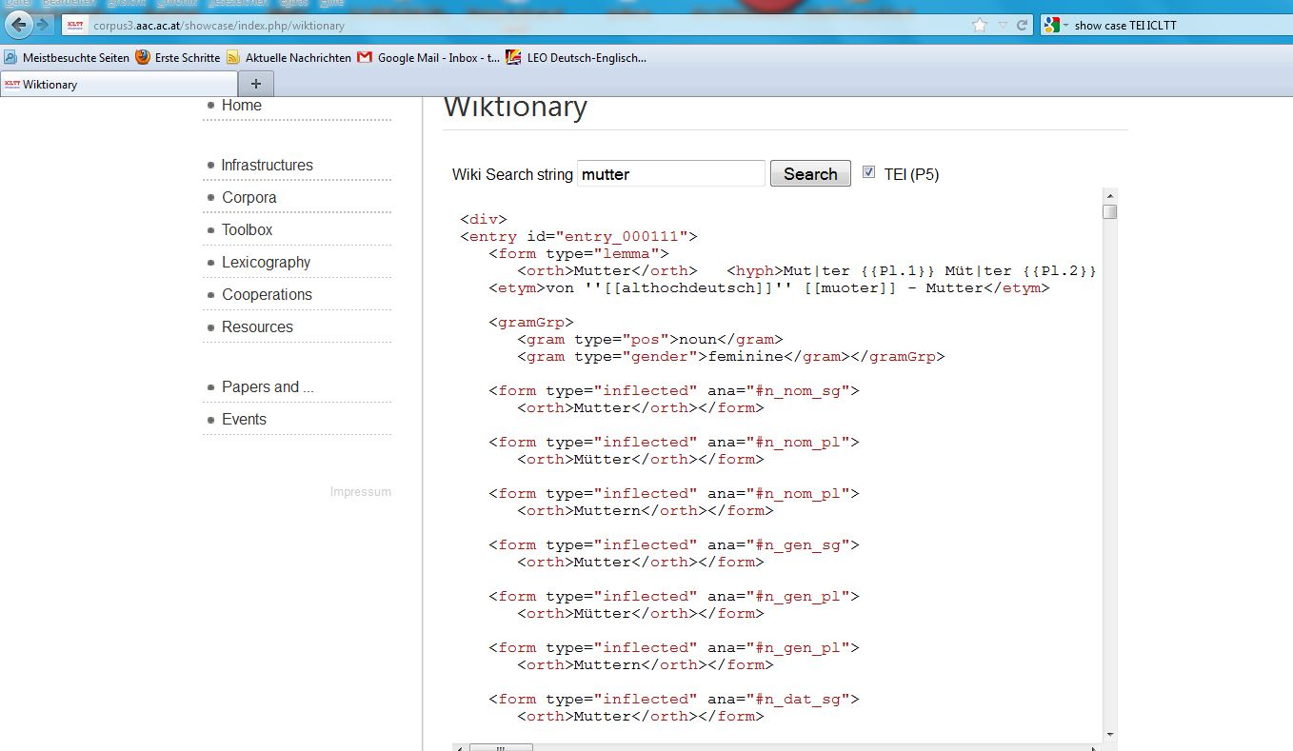
Transformation of German Wiktonary in TEI (at ICLTT)

Slide 29
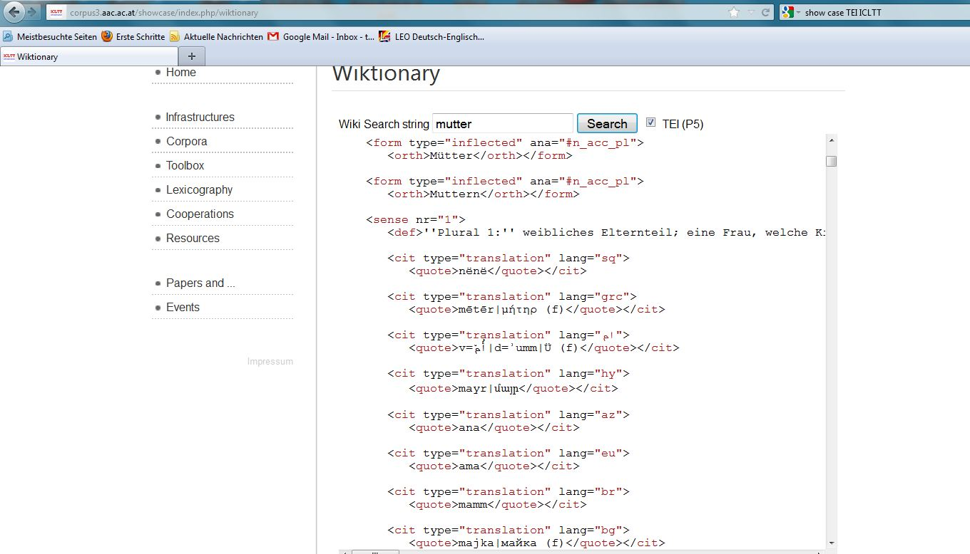
Transformation of German Wiktonary in TEI (at ICLTT) - 2

Slide 30
Extracting „Senses“ from Wiktionary Categories, a multilingual coverage
"Family" =>
  „EN“
    100174 :: great uncle :: class = Family
    106389 :: next of kin :: class = Family
    107577 :: great-aunt :: class = Family
    1079640 :: great- :: class = Family
    111522 :: birthright :: class = Family
    1121476 :: great-niece :: class = Family378617
    ... :
  „DE“
    1866896 :: Nachwuchs :: class = Family
    34191 :: Neffe :: class = Family
    387412 :: GroÃŸmutter vÃ¤terlicherseits :: class = Family
    509514 :: Enkelin :: class = Family
    509516 :: Enkelkind :: class = Family
    ...
Still to visualize the direct links between the entries

Slide 31
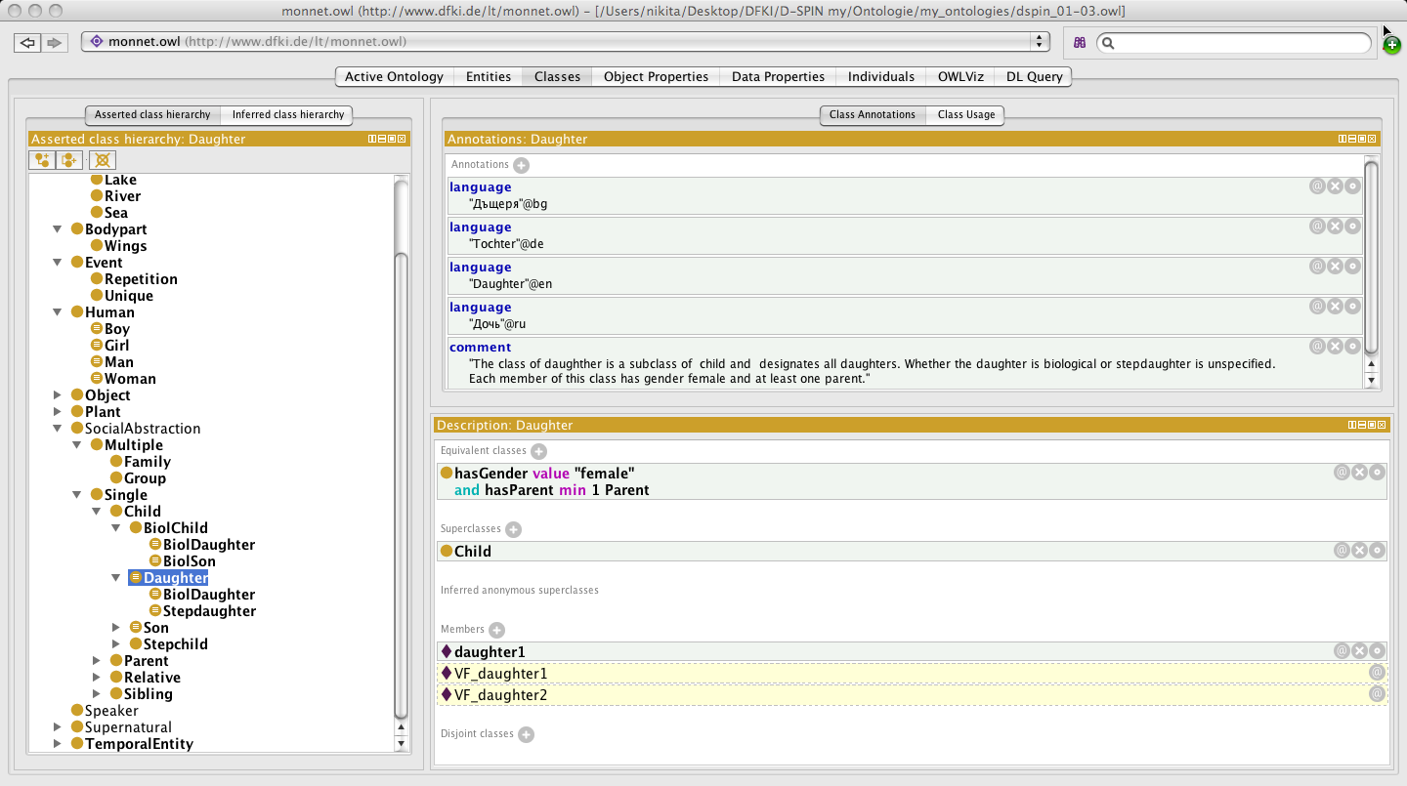
Ontology-based character detection: Bachelor Work by Nikolina Koleva

Slide 32
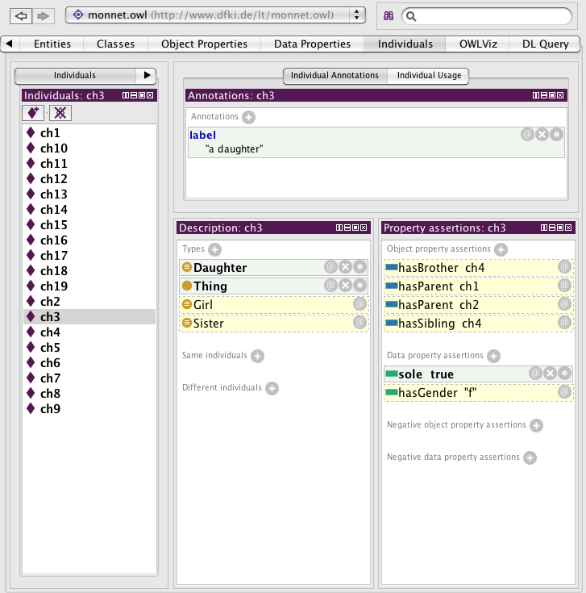
Allows Inferences

Slide 33
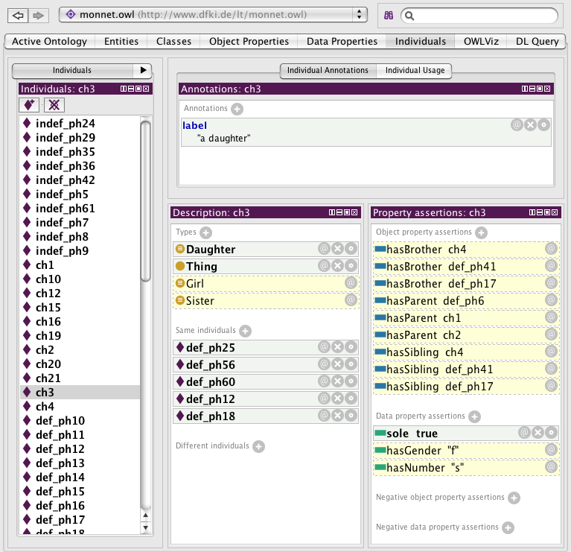
Performing some co-reference resolution

Slide 34
A need for an interface between linguistic annotation and ontology objects
LOD compliant lemon model (developed within the Monnet project, see next talk)

Slide 35
Further Work
Ontology-based motif detection and knowledge base population
  Building on Bachelor Thesis by Nikolina Koleva on Ontology-based character detection in folktales
Multilingual TMI (EN → DE & HU)
  Joint work by ICLTT and HASRIL, using web resources like Wiktionary

Slide 36
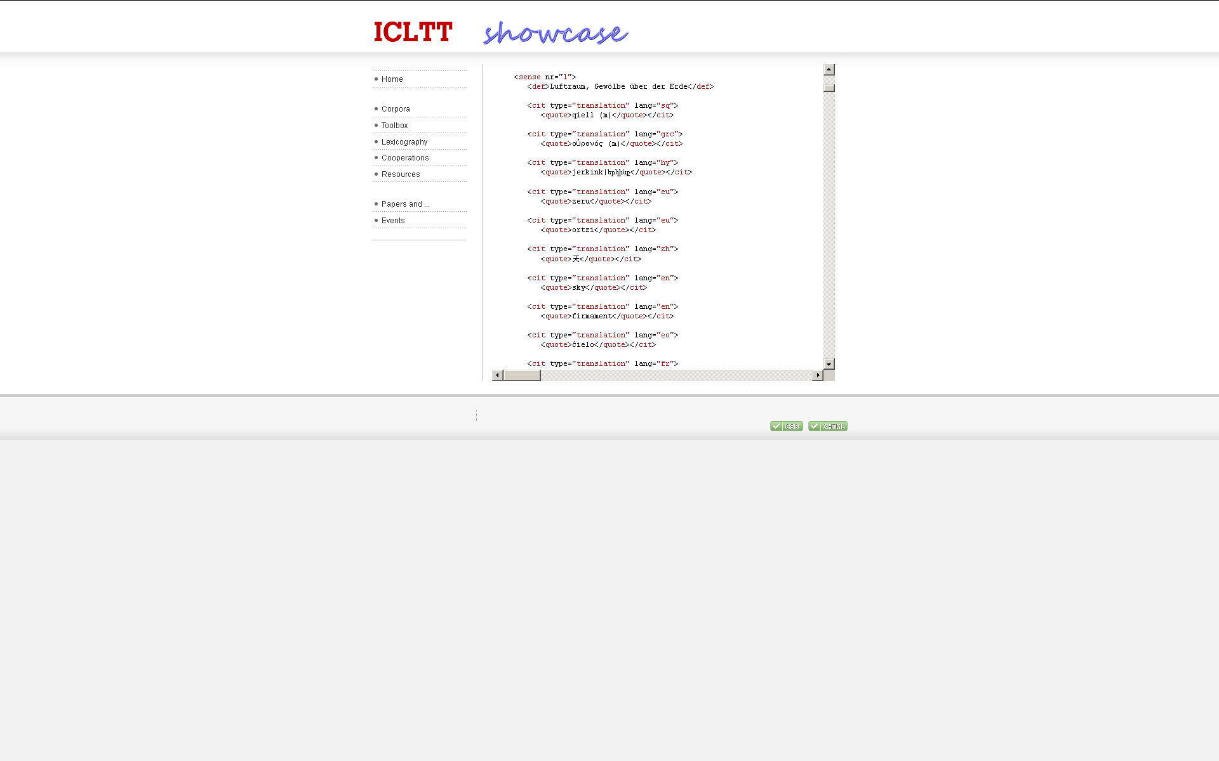
TEI Version of Wiktionary for supporting label translation
http://corpus3.aac.ac.at/showcase/index.php/wiktionary001

Slide 37
Thanks!

