Slide 1
SDN and OpenFlow
Advantages and features of SDN & OpenFlow
Contains material from Software-Defined Networking: The New Norm for Networks ONF White Paper April 13, 2012;
OpenFlow Switch Specification Version 1.3.3 (Protocol version 0x04) September 27, 2013;
OpenFlow Switch Specification Version 1.3.0 (Wire Protocol 0x04) June 25, 2012 and http://flowgrammable.org/

Slide 2
Software Defined Networking
Software-defined networking (SDN) is an approach to computer networking that allows network administrators to manage network services through abstraction of lower level functionality.
SDN requires some method for the control plane to communicate with the data plane. One such mechanism, OpenFlow, is often misunderstood to be equivalent to SDN, but other mechanisms could also fit into the concept.
Notes:
1. This is done by decoupling the system that makes decisions about where traffic is sent (the control plane) from the underlying systems that forward traffic to the selected destination (the data plane). This simplifies networking
2. To get a clearer picture, let’s look at the OpenFlow implementation of SDN….

Slide 3
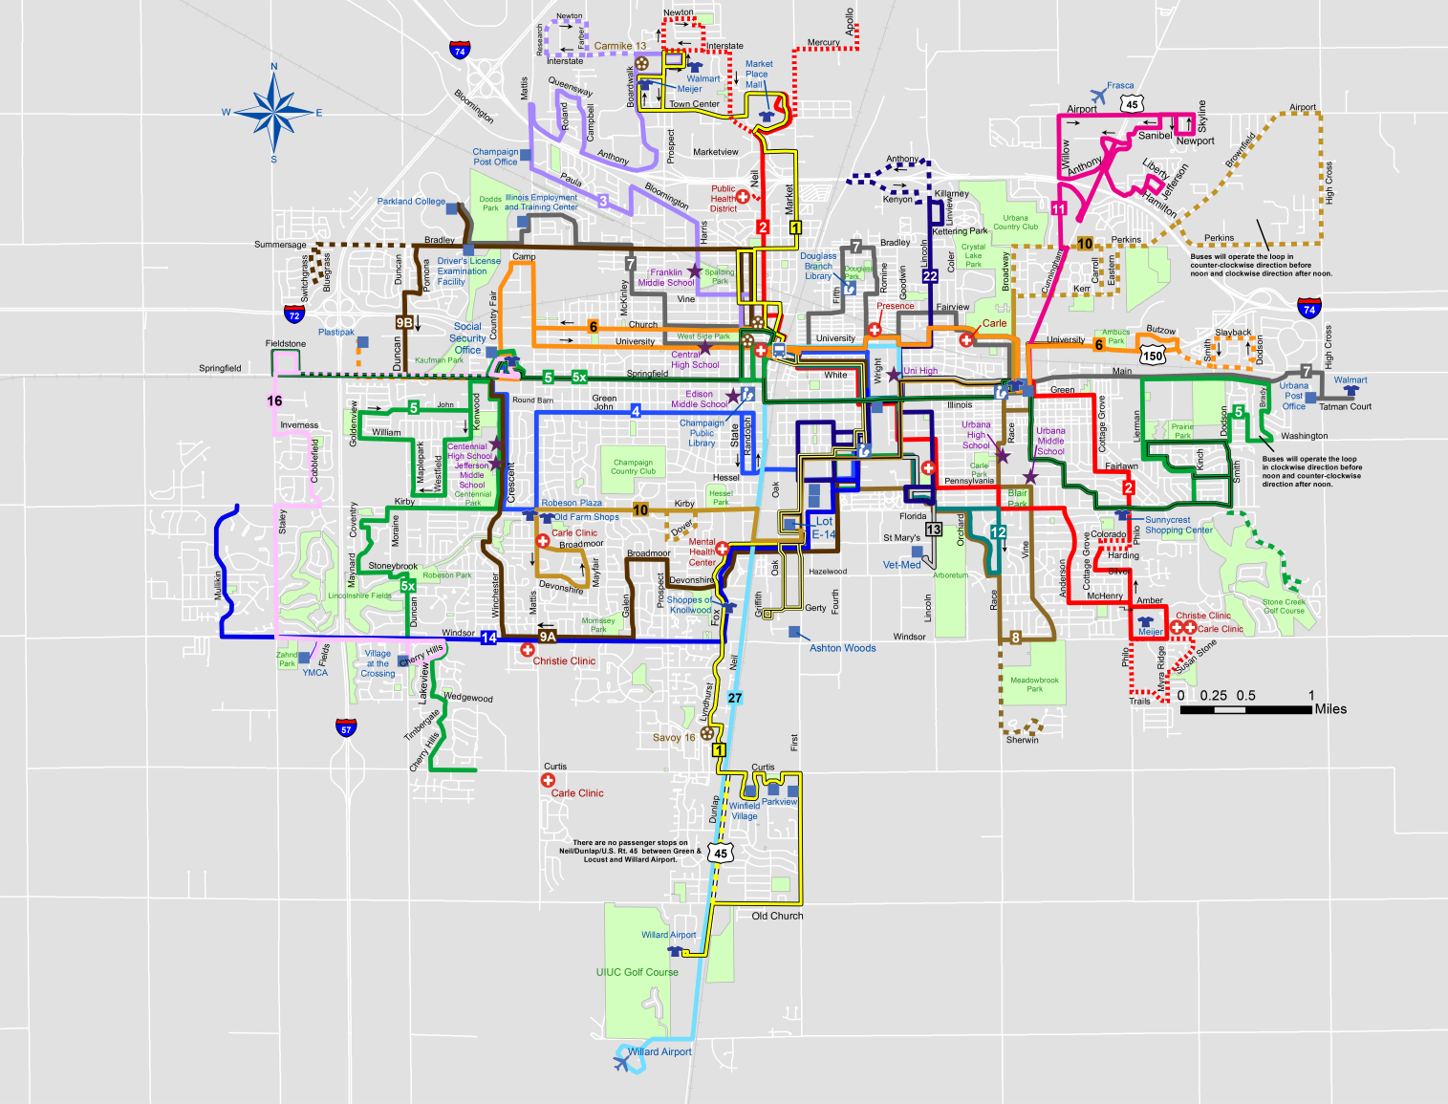
Control Plane vs Data Plane
Notes:
Above we see a bus map for Champaign Urbana. In a lot of ways it’s like a computer network.
There is a flow between endpoints that obey certain rules and so forth.
When this system was set up initially, certain decisions had to be made.

Slide 4
Control Plane
Deciding which routes the busses will take, how many busses we will have and what sort of connections will exist between them is a lot like the control plane of a computer network.
There aren’t any busses running yet, there are no people on the busses, but we know where they will go, where the will stop and where they will connect.
Traditional networks can do this through static routes. There are also some dynamic routing protocols that allow routers to teach one another which paths to take.
Notes:
2. (end) The control plane is mostly about learning which routes exist.
3. (end) All of the above is the Control Plane.

Slide 5
Data Plane
Once the rules are in place, the data plane takes over.
The data plane consists of the movement of the actual data through the network.
By separating the control and data planes, software defined networking seeks to reduce some of the load from the data plane hardware.
This allows network admins to control the flow of traffic through the use of a layer software abstraction.
Notes:
Routers and switches still hold the flow tables, but no longer have to do the heavy lifting.
If they encounter a packet that doesn’t match, the toss it up to a software controller who determines how to
Handle it and then writes a new rule to the flow tables of any switches or routers involved.
More about controllers later.

Slide 6
Inside OpenFlow
OpenFlow is the first standard communications interface defined between the control and forwarding layers of an SDN architecture.
OpenFlow allows direct access to and manipulation of the forwarding plane of network devices such as switches and routers, both physical and virtual (hypervisor-based).

Slide 7
Inside OpenFlow contd.
It is the absence of an open interface to the forwarding plane that has led to the characterization of today’s networking devices as monolithic, closed, and mainframe-like.
No other standard protocol does what OpenFlow does, and a protocol like OpenFlow is needed to move network control out of the networking switches to logically centralized control software.

Slide 8
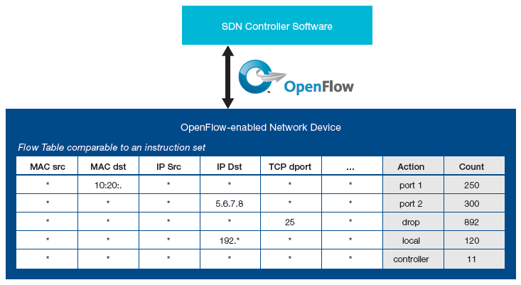
Example of OpenFlow Instruction Set
Notes:
OpenFlow can be compared to the instruction set of a CPU. As shown in
Figure 2, the protocol specifies basic primitives that can be used by an external
software application to program the forwarding plane of network devices,
just like the instruction set of a CPU would program a computer system.

Slide 9
OpenFlow protocol
The OpenFlow protocol is implemented on both sides of the interface between network infrastructure devices and the SDN control software.
OpenFlow uses the concept of flows to identify network traffic based on pre-defined match rules that can be statically or dynamically programmed by the SDN control software.
It also allows IT to define how traffic should flow through network devices based on parameters such as usage patterns, applications, and cloud resources.

Slide 10
Granularity
Since OpenFlow allows the network to be programmed on a per-flow basis, an OpenFlow-based SDN architecture provides extremely granular control, enabling the network to respond to real-time changes at the application, user, and session levels.
Current IP-based routing does not provide this level of control, as all flows between two endpoints must follow the same path through the network, regardless of their different requirements.

Slide 11
Standardization
The OpenFlow protocol is a key enabler for software-defined networks and currently is the only standardized SDN protocol that allows direct manipulation of the forwarding plane of network devices.
While initially applied to Ethernet-based networks, OpenFlow switching can extend to a much broader set of use cases.
OpenFlow-based SDNs can be deployed on existing networks, both physical and virtual.

Slide 12
Implementation
Network devices can support OpenFlow-based forwarding as well as traditional forwarding.
The Open Networking Foundation is chartered to standardize OpenFlow and does so through technical working groups.
OpenFlow is being widely adopted by infrastructure vendors, who typically have implemented it via a simple firmware or software upgrade.
Notes:
which makes it very easy for enterprises and carriers to progressively introduce OpenFlow-based SDN technologies, even in multi-vendor network environments.
responsible for the protocol, configuration, interoperability testing, and other activities, helping to ensure interoperability between network devices and control software from different vendors.
One implementation is the OVS software switch used in mininet and on Pica8 switches

Slide 13
Benefits of OpenFlow-Based Software-Defined Networks
Centralized control of multi-vendor environments
Reduced complexity through automation
Higher rate of innovation
Increased network reliability and security
More granular network control
Better user experience

Slide 14
Centralized control of multi-vendor environments
SDN control software can control any OpenFlow-enabled network device from any vendor.
Rather than having to manage groups of devices from individual vendors, IT can use SDN-based orchestration.
Notes:
1. This includes switches, routers, and virtual switches.
2. This enables them to use management tools to quickly deploy, configure, and update devices across the entire network.

Slide 15
Reduced complexity through automation
OpenFlow-based SDN offers a flexible network automation and management framework.
These automation tools will reduce operational overhead, decrease network instability introduced by operator error, and support emerging IT-as-a-Service and self-service provisioning models.
In addition, with SDN, cloud-based applications can be managed through intelligent orchestration and provisioning systems, further reducing operational overhead while increasing business agility.
Notes:
1. which makes it possible to develop tools that automate many management tasks that are done manually today.

Slide 16
Higher rate of innovation
SDN adoption accelerates business innovation by allowing IT network operators to literally program—and reprogram—the network in real time.
By virtualizing the network infrastructure and abstracting it from individual network services, give IT—and potentially even users—the ability to tailor the behavior of the network.
Notes:
This allows them to to meet specific business needs and user requirements as they arise.
for example, SDN and OpenFlow
and introduce new services and network capabilities in a matter of hours.

Slide 17
Increased network reliability and security
SDN makes it possible for IT to define high-level configuration and policy statements, which are then translated down to the infrastructure via OpenFlow. An OpenFlow-based SDN architecture eliminates the need to individually configure network devices each time an end point, service, or application is added or moved, or a policy changes, which reduces the likelihood of network failures due to configuration or policy inconsistencies.
Because SDN controllers provide complete visibility and control over the network, they can ensure that access control, traffic engineering, quality of service, security, and other policies are enforced consistently across the wired and wireless network infrastructures, including branch offices, campuses, and data centers. Enterprises and carriers benefit from reduced operational expenses, more dynamic configuration capabilities, fewer errors, and consistent configuration and policy enforcement.

Slide 18
More granular network control
OpenFlow‘s flow-based control model allows IT to apply policies at a very granular level, including the session, user, device, and application levels, in a highly abstracted, automated fashion. This control enables cloud operators to support multitenancy while maintaining traffic isolation, security, and elastic resource management when customers share the same infrastructure.

Slide 19
Better user experience
By centralizing network control and making state information available to higher-level applications, an SDN infrastructure can better adapt to dynamic user needs. For instance, a carrier could introduce a video service that offers premium subscribers the highest possible resolution in an automated and transparent manner. Today, users must explicitly select a resolution setting, which the network may or may not be able to support, resulting in delays and interruptions that degrade the user experience. With OpenFlow-based SDN, the video application would be able to detect the bandwidth available in the network in real time and automatically adjust the video resolution accordingly.
All material taken directly from Software-Defined Networking: The New Norm for Networks ONF White Paper April 13, 2012

Slide 20
Comparison/Contrast of Version 1.3.0 and 1.3.3
Following slides contain information taken from the following presentation:
Open Flow 1.3.1 Support: Controller View
Anilkumar Vishnoi, Abhijit Kumbhare
IBM

Slide 21
Links and more info
Tutorials
http://archive.openflow.org/wk/index.php/OpenFlow_Tutorial
https://www.clear.rice.edu/comp529/www/papers/tutorial_4.pdf Mininet
http://mininet.org/download/
VMs https://github.com/mininet/mininet/wiki/Mininet-VM-Images
https://github.com/mininet/openflow-tutorial/wiki/Installing-Required-Software
OpenDayLight – Java based and powerful controller
https://wiki.opendaylight.org/view/OpenDaylight_Controller:Installation
Pox – Python based, easy to configure controller
https://openflow.stanford.edu/display/ONL/POX+Wiki

