Slide 1
O
OpenOKR
Your OKR coach, built in.
Open source, AI-native, self-hosted or in our cloud. The OKR method as executable rules, and two AI teammates that run the practice with you.
Product overview · August 2026

Slide 2
Most organisations do not fail at OKRs because their software was bad.
They fail because the practice never happened.
Somebody wrote objectives in a spreadsheet in January, nobody checked in by March, and the quarterly review was a meeting where everyone agreed things had gone reasonably well.
THE PROBLEM
2

Slide 3
THE PROBLEM
How OKRs are run today, and why the practice still dies
WHAT MOST START WITH
WHAT MOST BUY
WHAT MOST FALL BACK ON
Spreadsheets
Conventional OKR trackers
Consulting and training
No cadence, no accountability, no quality bar. Nobody is ever told anything. The file is opened twice a quarter.
A database with a progress bar. They store objectives faithfully and are entirely passive. They will happily hold a badly written key result for a whole quarter without comment.
The method is real, but it walks out of the door with the consultant. There is nothing to enforce it on a wet Tuesday in week six.
The practice that makes OKRs work has been well understood for twenty years. It just does not live in the software.
THE PROBLEM
3

Slide 4
THE PROBLEM
The failure pattern is always the same
Objectives are written as project plans.
Key results measure activity instead of impact.
Nothing has a baseline, so nothing can be scored.
Teams commit to more than they can deliver, and never record what they cut.
Check-ins stop by week five.
Blockers sit unowned.
The quarterly review becomes a presentation rather than a diagnosis.
The next quarter starts from a blank page, as if nothing had been learned.
Every one of those is a rule that could have been enforced, a question that could have been asked at the right moment, and a person who could have been told. That is the product.
THE PROBLEM
4

Slide 5
01
What OpenOKR is
Two things make it different, and every design decision serves one of them.
5

Slide 6
WHAT OPENOKR IS
The method is in the product, and the product is active
DIFFERENCE ONE
DIFFERENCE TWO
The method is in the product
The product is active
The OKR practice canon is written as one authoritative specification and compiled into a pure library with no database, no network and no AI. It holds the eight-phase cycle, the scoring and confidence bands, twenty quality rules with their word lists and coaching prompts, six publish gates, the alignment arithmetic, the KPI corridors, the blocker and root-cause taxonomies, both session agendas, and the closing diagnostic.
Two agent members ship with every workspace. They are members, not features: they have names, they appear in feeds, they can be mentioned, and they are accountable. They initiate, escalate and propose, in the browser, in Slack, Microsoft Teams, WhatsApp and Telegram, by email, and through whatever AI agent the user already runs.
WHAT OPENOKR IS
6

Slide 7
THE METHOD IS IN THE PRODUCT
One specification, compiled, running in four places at once
Because the rule engine is pure, the same code checks a draft in the browser, refuses a bad write on the server, drives the agents, and validates imported data.
In the browser
On the server
Inside the agents
In the importer
As the user types, on every keystroke
Before any write is accepted
So a nudge cites the same rule a user sees
So migrated data is judged by the same bar
A conformance suite fails the build when the specification and the code disagree, so the product cannot drift away from the method. Every coaching message carries a rule key that resolves back to the specification, so a user can open the rule and argue with it.
WHAT OPENOKR IS
7

Slide 8
THE PRODUCT IS ACTIVE
Two AI teammates, with names, scopes and accountability
C
OKR Coach
Ch
OKR Champion
Quality and practice
Rhythm and momentum
Reviews every draft against the twenty rules. Runs a nightly semantic sweep for duplicated metrics, better parents and hidden dependencies. Speaks up when the not-doing list is empty, when nothing was cut at the capacity check, when a goal is reported on track but its key results have not moved in a month, and when the scores cluster suspiciously near perfect at the close.
Reminds the champion before a check-in is due, on the day, and daily after. Escalates to the reviewer, the coordinator and then the sponsor, always visibly to the person being escalated past. Runs the blocker clock, opens and closes the weekly session, assembles the digest, keeps the streak, watches every KPI corridor, and drafts the recovery objective when one drops out of range.
WHAT OPENOKR IS
8

Slide 9
THE PRODUCT IS ACTIVE
It all still works with AI switched off
The rules, nudges, escalations, gates, scores and the diagnostic are deterministic code, not prompts. AI adds drafting, rewriting, semantic judgement and natural language. It never makes the decision.
Sellable where AI is not
Propose by default
Capped and least-privilege
Regulated, air-gapped and AI-sceptical buyers get the whole practice. Continuous integration proves the product is whole with the provider off.
Every write an agent wants becomes a proposal in a human review queue. Direct writes need a narrow, explicit opt-in. Sandbox mode commits nothing.
Bindings on named spaces and goals only, never a workspace-wide grant. Every step metered, with a hard cost cap that halts a run mid-flight.
WHAT OPENOKR IS
9

Slide 10
NINE READERS, ONE PRODUCT
Who it is for
Reader | What OpenOKR gives them
Team member | One place, or one chat message, that says what they owe this week
Champion | A composer that says why a key result is weak while it is being written
Reviewer or manager | Every check-in from their people in one queue, one click to acknowledge
Coordinator | A weekly session the product runs: confidence, blockers, commitments, digest
Facilitator | A cycle that knows its phase, and a sixty-minute review with a timer
Executive or sponsor | The organisation on one map, and escalations before things are unrecoverable
OKR lead or PMO | Cycles across the organisation, KPI trees, alignment health, all exportable
Administrator | Access, single sign-on, backups, a tamper-evident audit log, AI cost caps
An external AI agent | A consented sign-in, acting as its user, within their permissions, audited
Organisations it fits: companies of any size that want the practice and not just a database; universities, government and regulated sectors that must self-host; consultancies running the method for clients.
WHAT OPENOKR IS
10

Slide 11
02
The product
What it actually looks like, screen by screen.
11

Slide 12
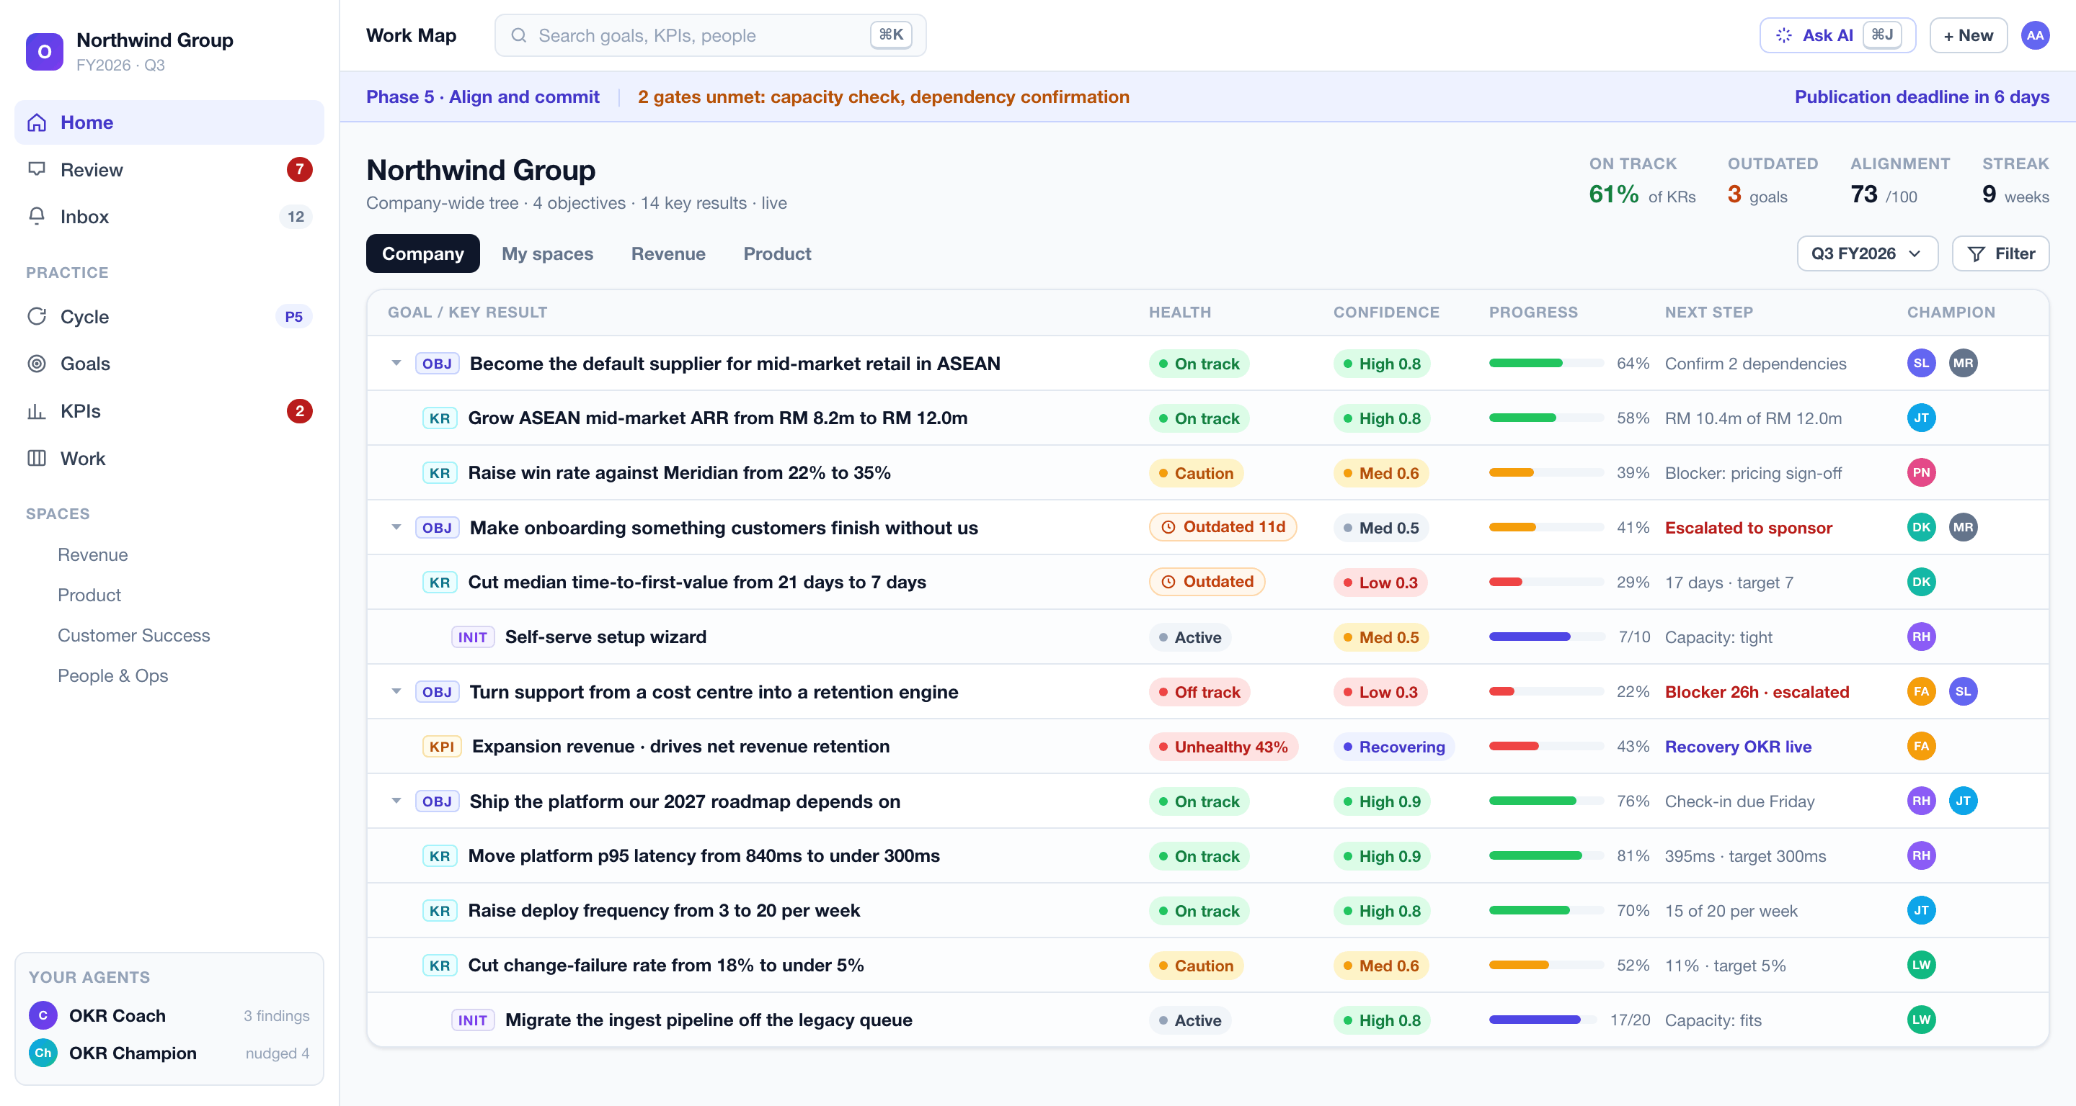
The Work Map is the front door
S-01
One company-wide tree. Every row carries the same contract: health, staleness, confidence, progress, champion and next step. An outdated badge overrides the last reported health, so nobody can hand-paint a goal green.
THE PRODUCT
12

Slide 13
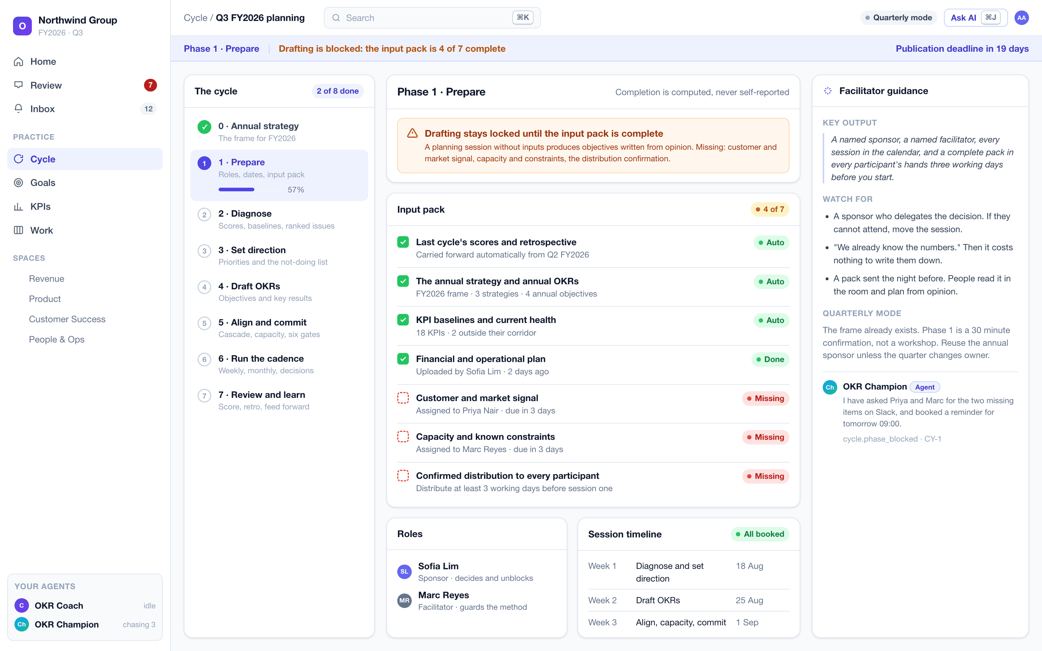
A guided cycle that knows what is missing
S-04 / S-06
Eight phases with computed completion, never self-reported ticks. Here drafting is locked because three of the seven input pack items are missing, and the block names them. A planning session without inputs produces objectives written from opinion.
THE PRODUCT
13

Slide 14
THE GUIDED CYCLE
The eight phases, and the gate on each one
Phase | What happens | The gate
0. Annual strategy | Mission, vision, annual strategies and objectives, the not-doing list | The frame is agreed
1. Prepare | Sponsor, facilitator, every session booked, the seven-item input pack | Drafting refused until the pack is complete
2. Diagnose | Score the last cycle, read KPI baselines, rank five to ten issues | Prior cycle scored, or a first cycle declared
3. Set direction | Three to five priorities with twelve-month success statements | The not-doing list is written
4. Draft OKRs | Write objectives and key results, twenty rules checking live | Every key result passes its checks
5. Align and commit | Map contribution, register dependencies, check capacity | All six publish gates green
6. Run the cadence | Weekly check-ins, monthly reviews, the decision log | Sessions booked for the whole cycle
7. Review and learn | Score, retro, diagnose, feed forward automatically | Every objective closed deliberately
THE PRODUCT
14

Slide 15
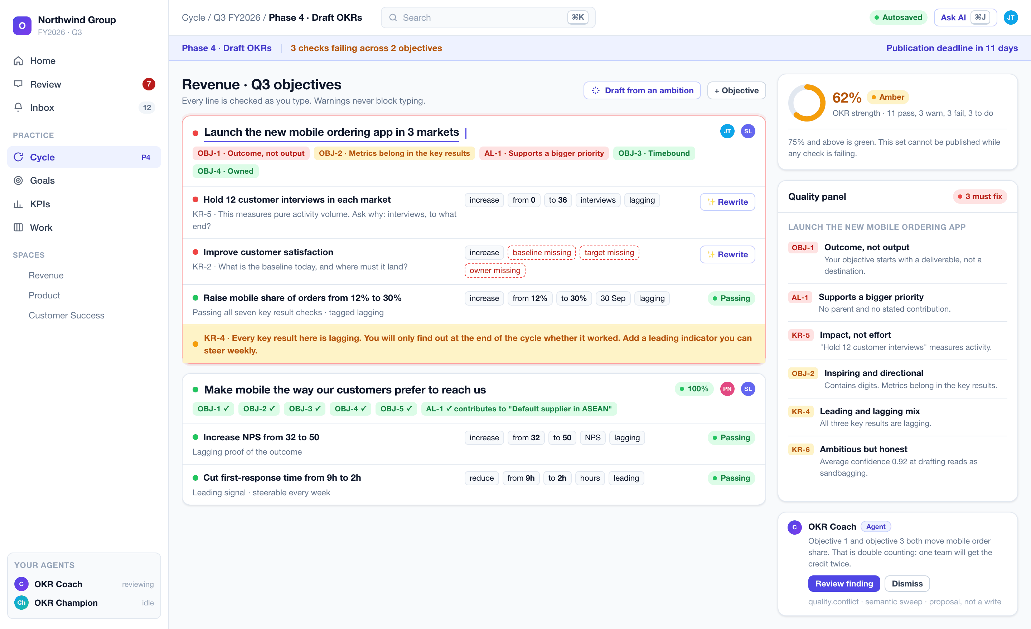
Twenty rules, running on every keystroke
S-09
The failing objective shows its verdicts inline. One key result measures activity, another has no baseline, and the whole set has no leading indicator. The strength meter and quality panel update live. Warnings never block typing.
THE PRODUCT
15

Slide 16
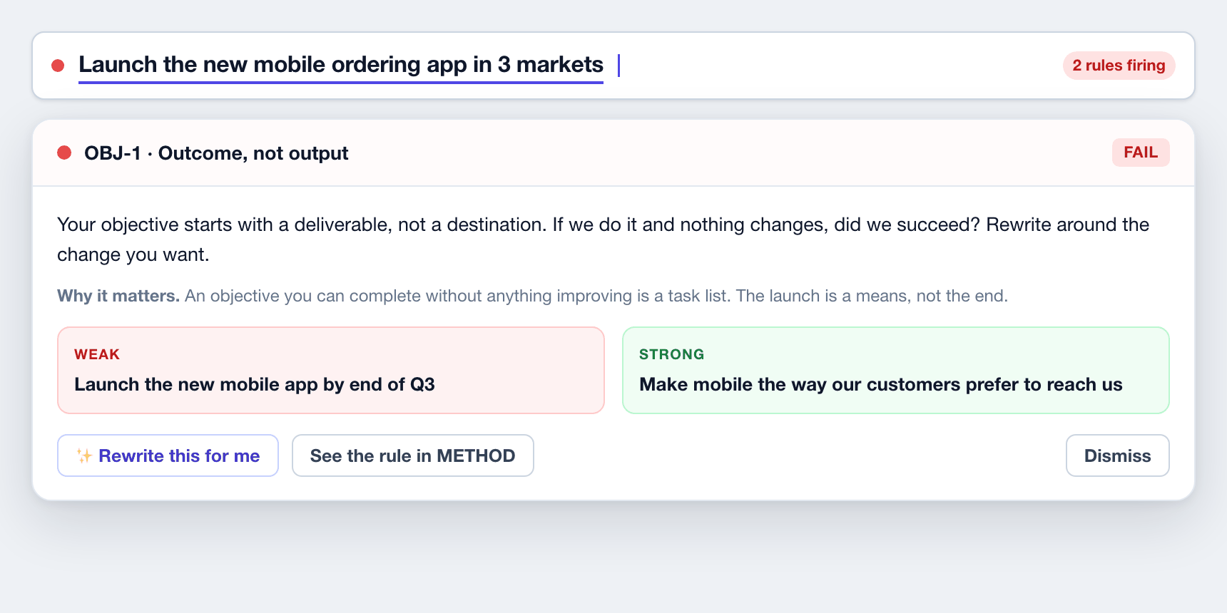
QUALITY AT THE POINT OF WRITING
Coaching that is specific, and arguable
EVERY VERDICT OPENS INTO THE RULE
The coaching prompt, why it matters, a weak-versus-strong pair, and a rewrite the user applies or dismisses. Never a bare error string, and never a mysterious red dot.
SOME OF WHAT IT CATCHES
An objective starting with "launch". If we launch it and nothing changes, did we succeed?
A key result with a target but no baseline. Without the "from", movement cannot be proved.
"Hold twelve customer interviews." That is activity. What are they for? Measure that.
Every key result lagging. You only find out at the end. Add a leading indicator.
Average confidence above ninety percent at drafting. That is sandbagging, not a stretch.
THE PRODUCT
16

Slide 17
ALIGN AND COMMIT
Six publish gates, enforced server-side
1
Every objective has a title, a named champion and a named reviewer.
Gate five is the one nobody has had
2
Every key result passes its checks.
Capacity is read from the initiatives actually planned against each key result, not self-declared. If one exceeds and no cut is recorded, the cycle cannot be published. A plan where nothing was cut is a plan that has not been made.
3
Alignment is mapped. Each objective states what it contributes to.
4
Every dependency is confirmed, or logged with a named risk owner.
5
Capacity is checked, nothing is left exceeding, and the cuts are recorded.
6
A publication date is set before day one of the cycle.
THE PRODUCT
17

Slide 18
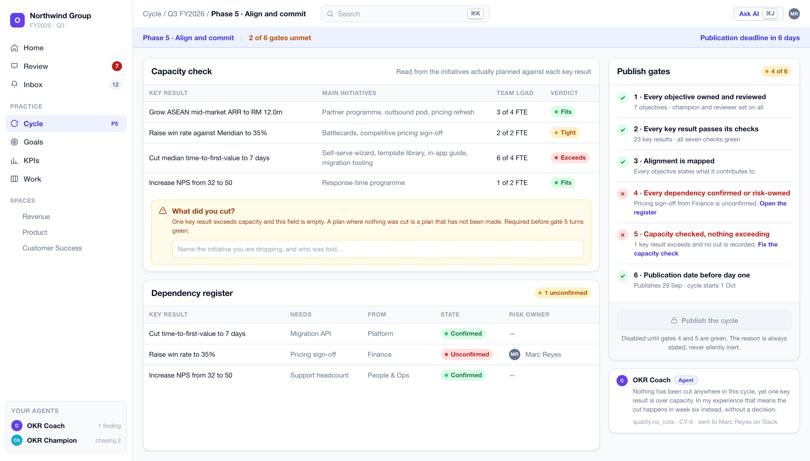
The publish control states its reason, never sits silently inert
S-10
Two gates are red. Capacity exceeds on one key result with nothing recorded as cut, and a dependency on Finance is unconfirmed. The Coach names the consequence rather than just the rule.
THE PRODUCT
18

Slide 19
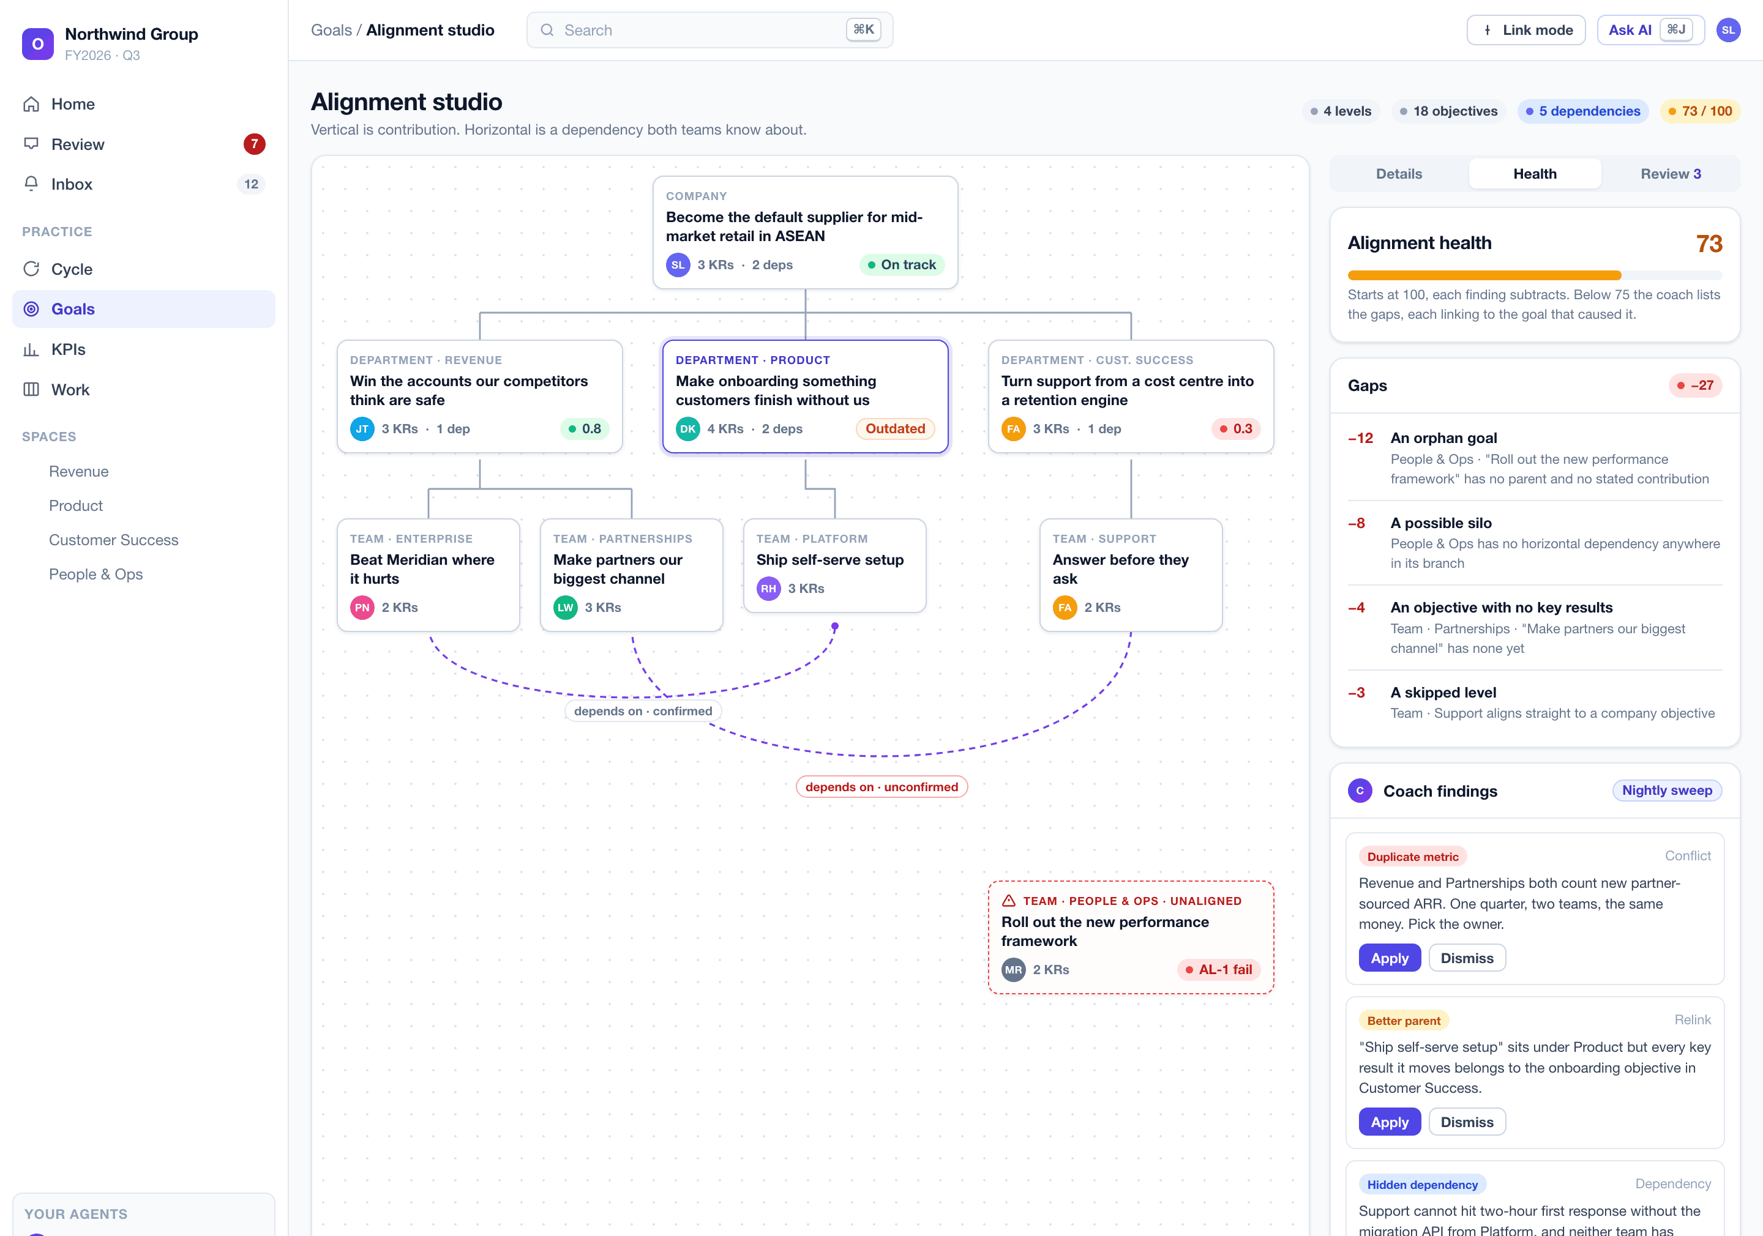
Alignment is contribution, not copying
S-16
Solid connectors are contribution, dashed are dependencies both teams know about. The orphan goal is flagged, the health score names every gap with its penalty, and the Coach adds what structure alone cannot see.
THE PRODUCT
19

Slide 20
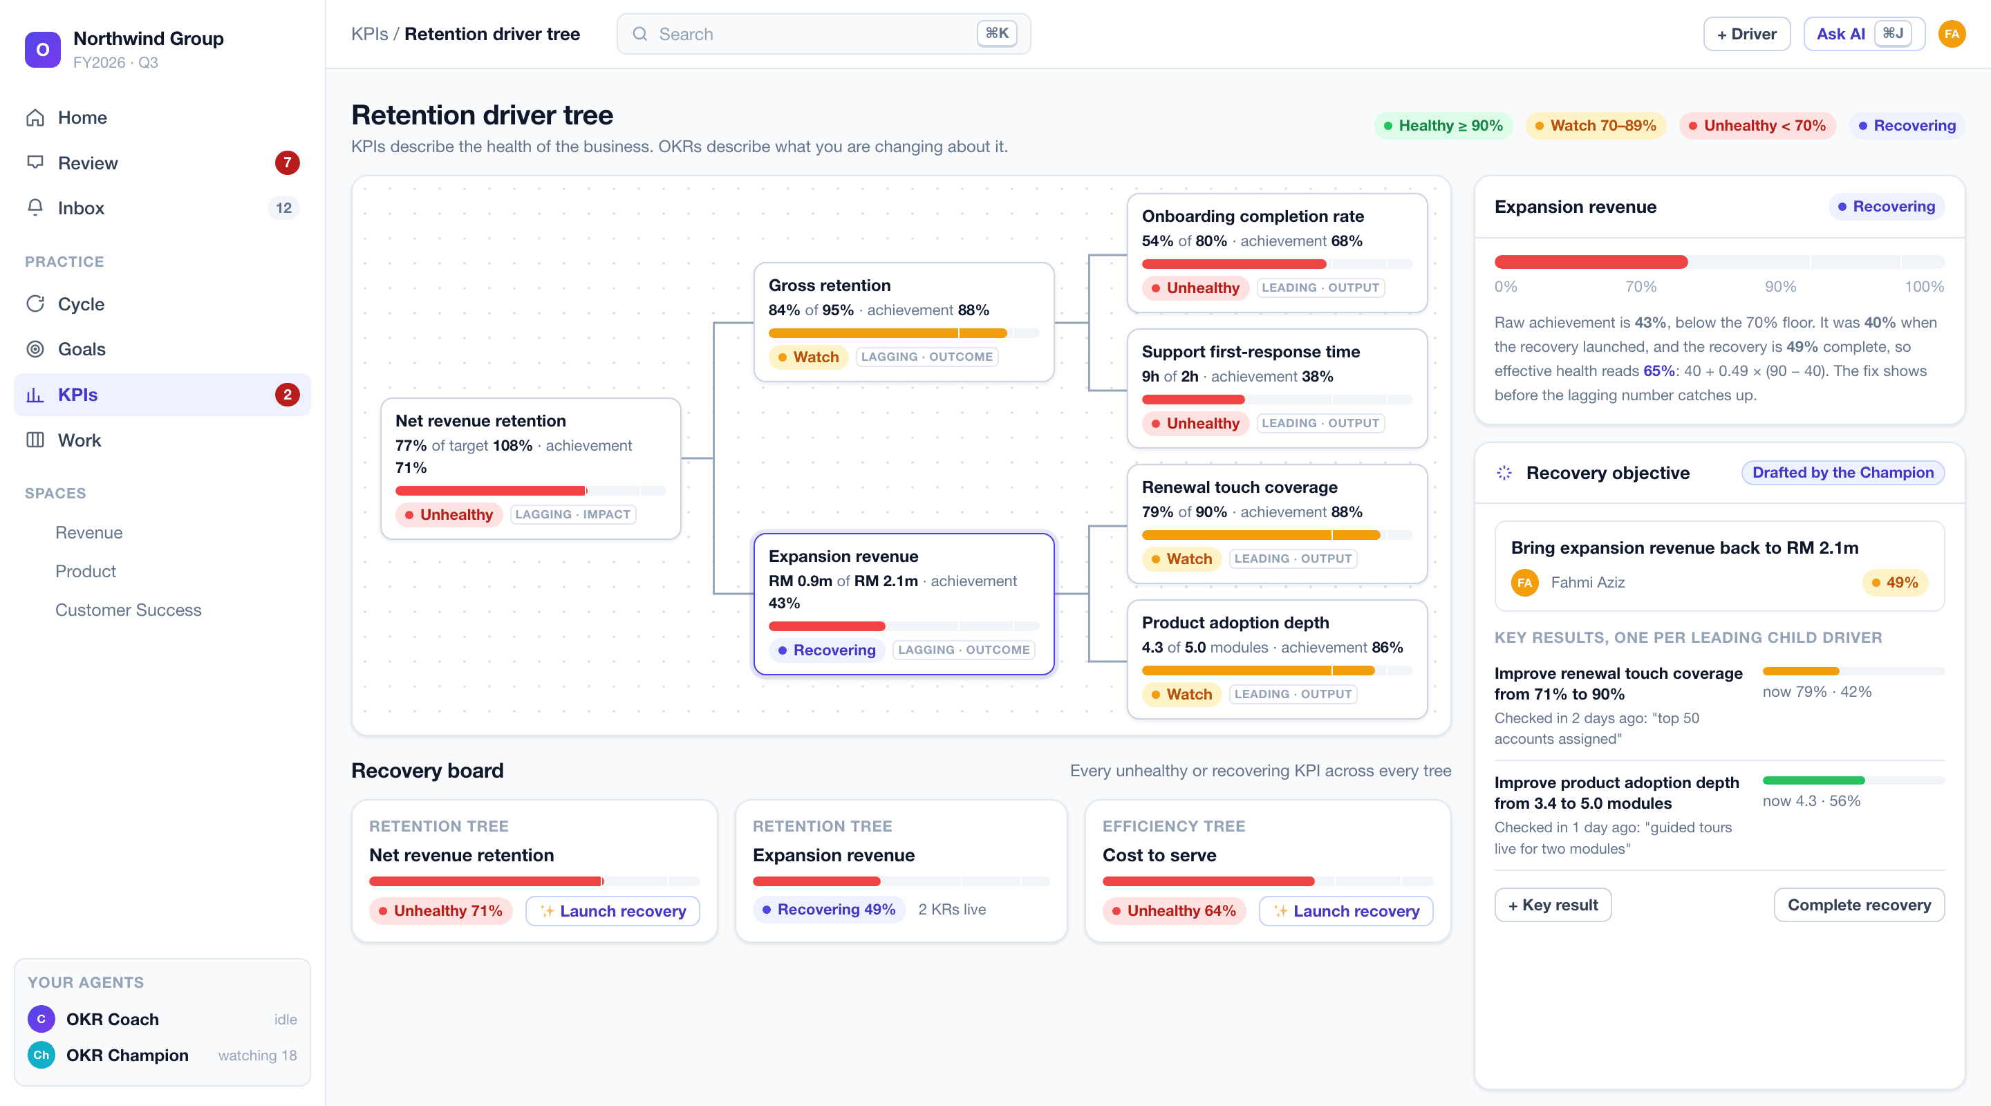
When a KPI leaves its corridor, the product drafts the fix
S-18 / S-19
Expansion revenue sits at forty-three percent of target. It was forty percent when the recovery launched and the recovery is forty-nine percent complete, so effective health reads sixty-five: the fix shows before the lagging number catches up. One key result per leading child driver.
THE PRODUCT
20

Slide 21
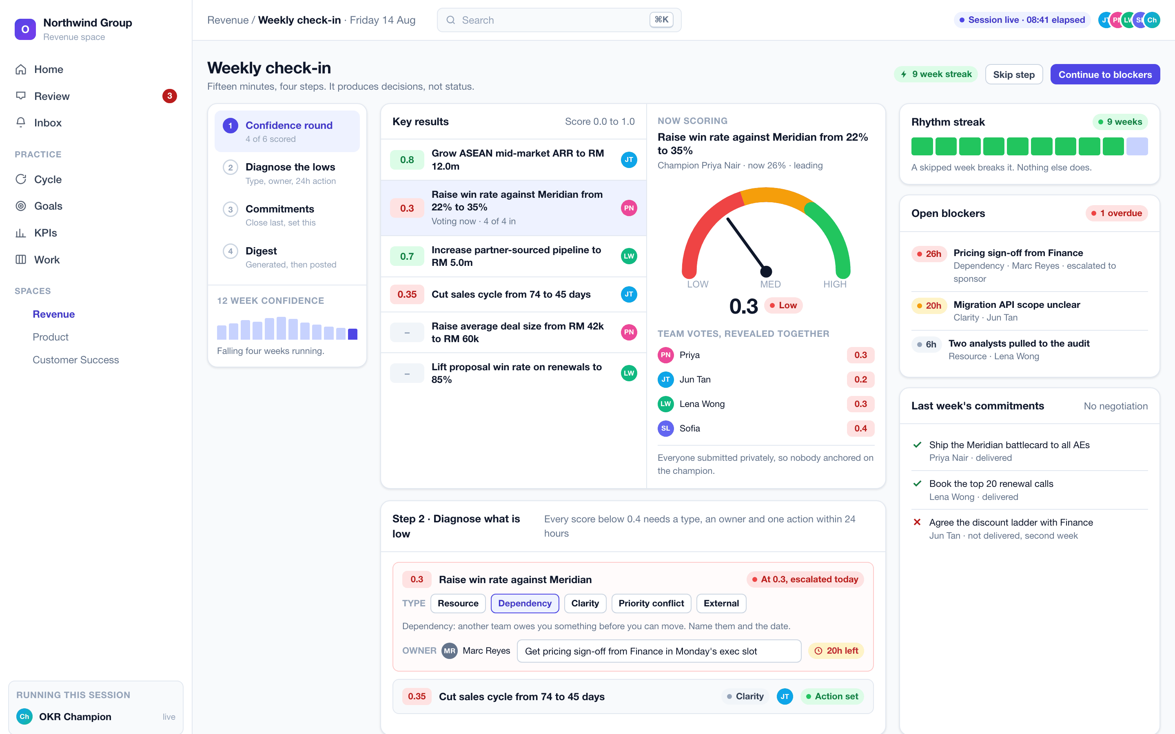
Fifteen minutes, four steps, run by the product
S-22
Team votes reveal together so nobody anchors on the champion. Every low score becomes a typed blocker with a named owner and one action inside twenty-four hours. Last week's commitments close honestly, including the one that did not land.
THE PRODUCT
21

Slide 22
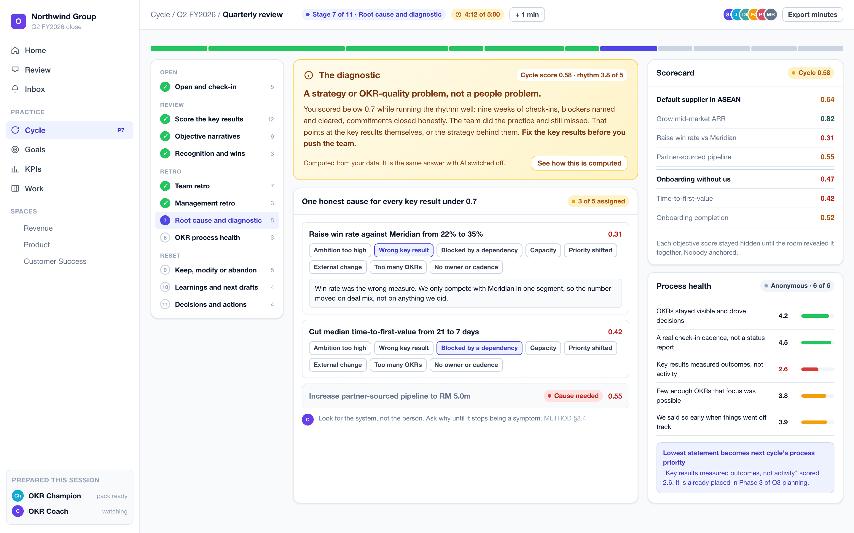
Sixty minutes, eleven timed stages, one honest diagnosis
S-24
Scores stay hidden until the room reveals them together. Every key result below 0.7 gets exactly one cause. Five process-health statements are scored anonymously, and the lowest becomes next quarter's process priority.
THE PRODUCT
22

Slide 23
REVIEW AND LEARN
The diagnostic is the most valuable output of the quarter
It reads the cycle score against the rhythm score and returns a verdict with a prescription. Computed from the workspace's own data, and the same answer with AI off.
The situation | What it means | What to do about it
Cycle score 0.7 or above | Results delivered | The question is not effort. It is whether the ambition was set high enough to be worth the quarter
Below 0.7, rhythm strong | A strategy or OKR-quality problem | The team ran the practice and still missed. Fix the key results, not the people
Below 0.7, rhythm weak | A cadence problem | Restore the weekly check-in before rewriting a single objective
That is the single question every executive asks at the close, and the one no tracker answers.
THE PRODUCT
23

Slide 24
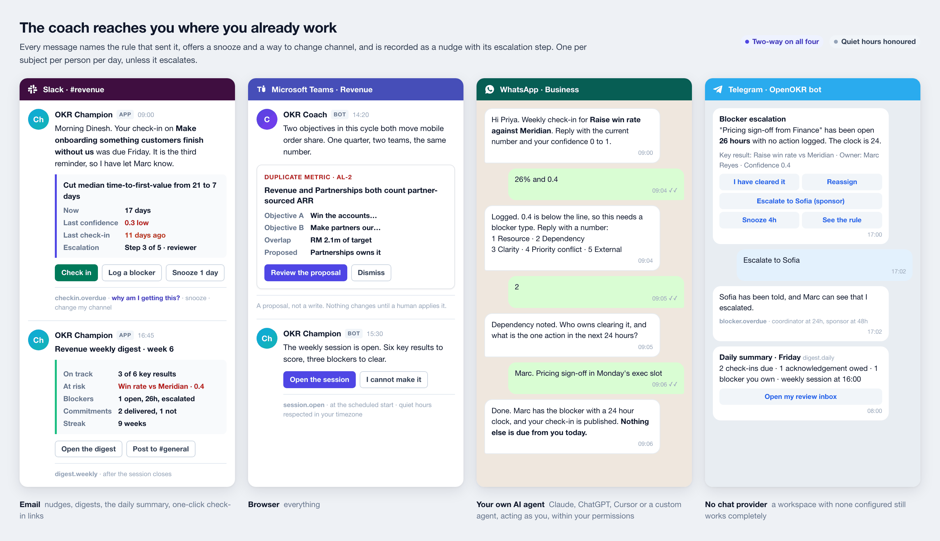
A coach that only lives in a browser tab is not active
CHANNELS
Every channel is two-way: nudges out, and real work in. A fully conversational WhatsApp check-in captures a typed blocker and its owner. Every message names the rule that sent it and where it sits on the escalation ladder.
THE PRODUCT
24

Slide 25
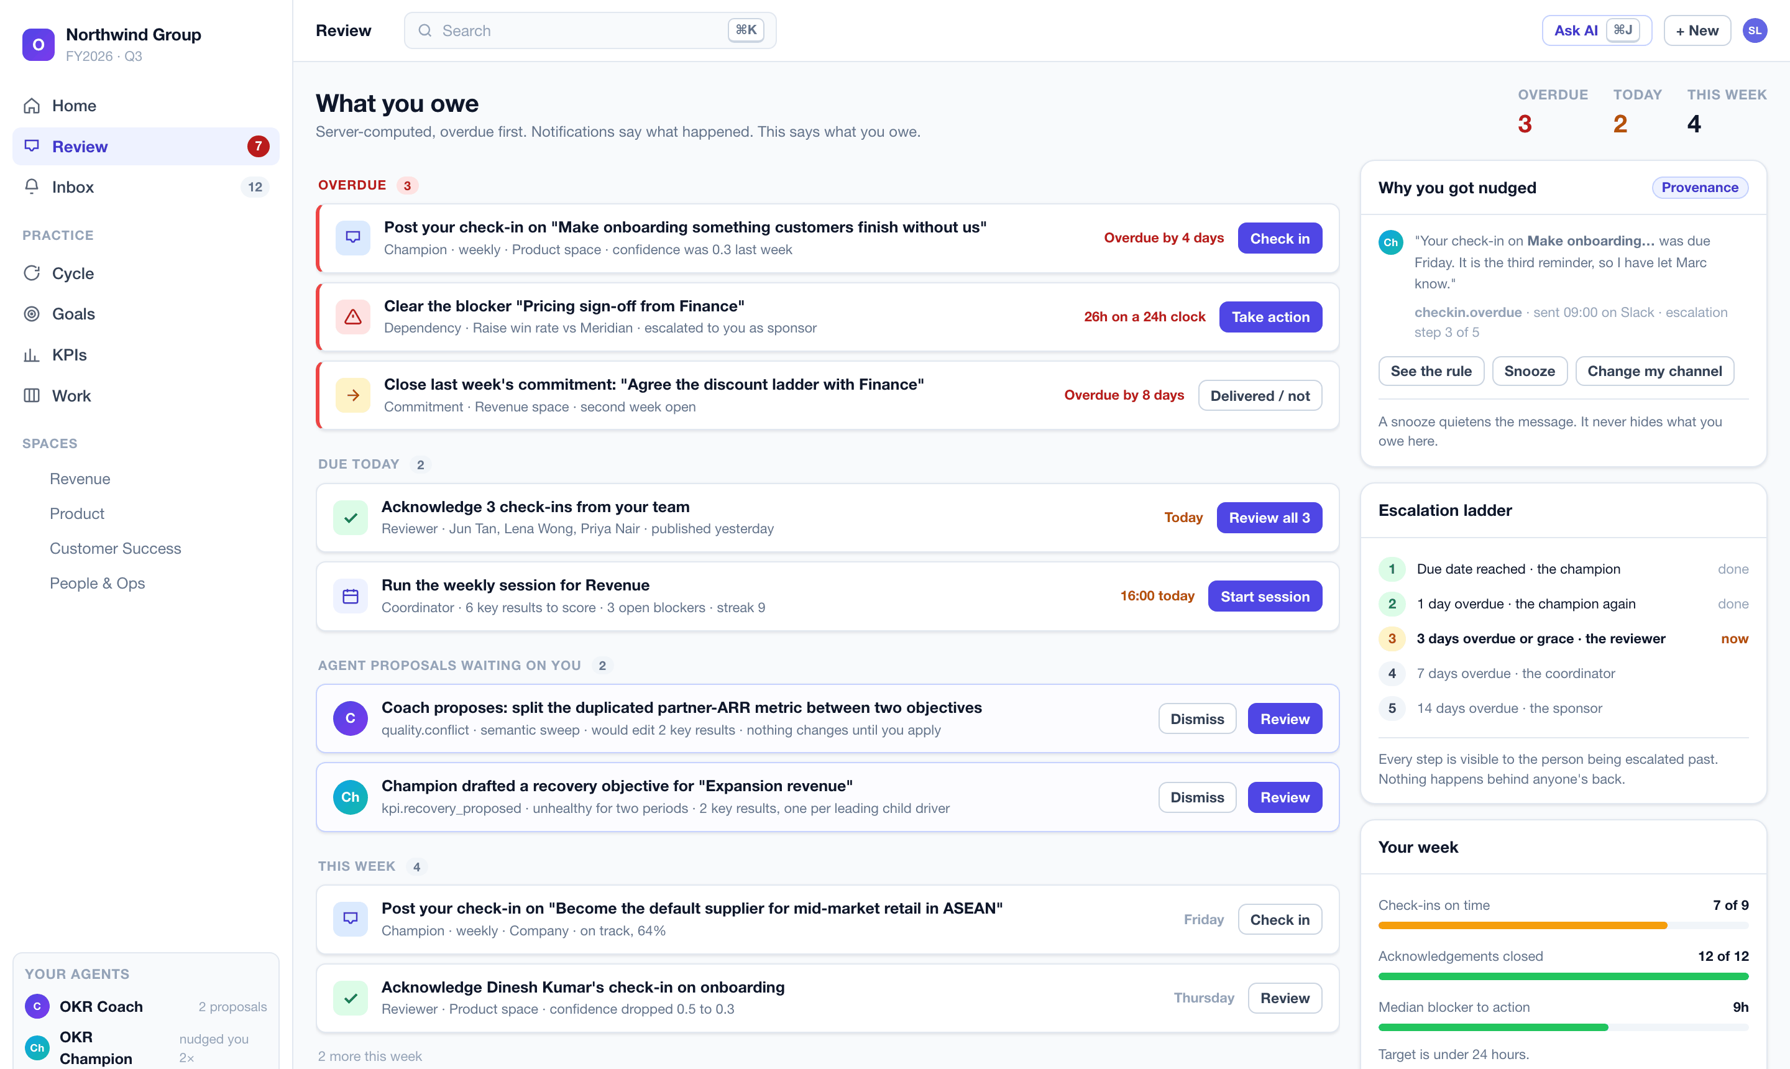
Notifications say what happened. This says what you owe.
S-02
Server-computed, overdue first, driving a live badge. Agent proposals queue here too. A snooze quietens the message and never hides the obligation.
THE PRODUCT
25

Slide 26
03
Why it wins
What no other OKR tool does, and what each of you gets.
26

Slide 27
WHY IT WINS
Five things no other OKR tool does
1
The method is executable, not documentation
Competitors ship templates and help articles. We ship rules that run on every keystroke and refuse a bad publish. A customer cannot quietly stop doing the practice.
2
The software initiates
Every other tool waits to be visited. Ours arrives in Slack on Friday morning, escalates the blocker that aged past its clock, and tells the sponsor early.
3
It works with AI switched off
The deterministic core makes it sellable into regulated, air-gapped and AI-sceptical buyers who would reject an LLM-dependent product outright.
4
It diagnoses, not just reports
At the close it says whether a missed quarter was a cadence problem or a strategy problem. Every executive asks that. No tracker answers it.
5
Agent-native to the core
Everything a human can do, an agent can do, through one permission-checked contract. The customer's own Claude or ChatGPT is a first-class user, not a scraping workaround.
WHY IT WINS
27

Slide 28
WHY IT WINS
What each of you gets
A methodology institute
An investor
An early customer
The practice becomes enforceable after the engagement ends. Every rule, band, corridor, taxonomy and agenda lives in one versioned, auditable specification, separable from the code. Coaching prompts and rule names are translatable strings. You can see exactly what the product teaches, and disagree with it in a specific place rather than in general.
A category with real budget, sold today mostly as passive databases. Open source removes funnel cost and makes the enterprise security review a non-event. AGPL blocks a hyperscaler reselling it. The cloud sells operation, so there is one product, one release and no feature-gate resentment. The agent layer is the moat: accumulated method, not a copyable prompt.
Setup to first check-in in under fifteen minutes. Data on your own servers, in your own country, with no seat limit and no feature gate. Existing goals import from a spreadsheet with an AI-assisted mapper and a dry run. The whole workspace exports whenever you want. Nothing creates lock-in, which is exactly why it is easy to say yes to.
WHY IT WINS
28

Slide 29
WHY IT WINS
The outcomes we are designing for
Leading indicators, instrumented in the product from day one.
< 15 min
70%+
> 75%
< 24 h
6+ weeks
From install to first published check-in
Of due check-ins submitted on time
Median OKR strength score at publication
Median blocker logged to next action taken
Rhythm streak in half or more of active spaces
Lagging: active instances after six months, organisations completing a full cycle end to end, and organisations running an agent unattended every week.
WHY IT WINS
29

Slide 30
04
The business
Scope, licence, status, and what we are asking for.
30

Slide 31
SCOPE
Everything in version one, across six pillars
Nothing is gated behind a paid tier. Self-host gets every capability, with no seat limit.
A
The OKR core
B
The rhythm
C
The work
Cycles and the guided workflow · goals and direction-aware key results · alignment with dependencies and the health score · KPIs, driver trees and formulas · health corridors and recovery OKRs · check-ins with snapshots and team voting · scorecard
Weekly check-in session · the five-type blocker taxonomy on a 24-hour clock · commitments · monthly review and decision log · the eleven-stage quarterly review · mid-cycle calibration · cadence and staleness · the review inbox and digests
Initiatives with a capacity verdict · tasks and the key-result-linked board · rich documents with version history · file attachments. Deliberately OKR-shaped, not a project management suite
D
Coaching and AI
E
Channels and reach
F
Platform
The Draft Coach rule engine · the OKR Coach and OKR Champion · agent governance with least privilege, proposals and hard caps · the nudge engine · assists everywhere · the copilot · bring your own provider, including local models
Browser · email · Slack · Microsoft Teams · WhatsApp Business · Telegram · any external AI agent acting as its user. Every inbound message runs the same permission checks as a click
Spaces · people and org chart · relationship-based access · comments, mentions and notifications · activity feed · search and command palette · admin and audit · encrypted export and import · spreadsheet and FlowyTeam importers · accessibility
THE BUSINESS
31

Slide 32
DEPLOYMENT AND LICENCE
One release, run two ways
How | Who it suits | What it takes
Self-hosted, one server | Anyone who wants data on their own machines | One Docker Compose file and a first-run wizard that generates every secret. Target: under 30 minutes
Self-hosted, Kubernetes | Universities, government, large enterprise | A Helm chart, the customer's own PostgreSQL, single sign-on and backups
Managed cloud | Teams that do not want to run anything | Sign up, name a workspace, start. The same container under our operation
AGPL-3.0, plus a contributor agreement
Air-gap capable, by construction
AGPL stops a third party selling a closed hosted version. An organisation self-hosting for its own staff takes on no obligations at all. The contributor agreement preserves the right to run a paid cloud and to relax the licence later.
No feature hard-depends on an external service. AI points at a local model or is off. Channels are optional, telemetry is opt-in, assets are self-hosted. Tenant isolation is enforced inside the database, not in application code.
Self-host is never seat-limited and never feature-gated. The cloud sells operation, not features.
THE BUSINESS
32

Slide 33
STATUS
Fully specified, and sequenced so the coach is not last
Eight phases, 104 scoped tasks, each with acceptance criteria and a test plan.
1
Foundation
2
Platform and agent spine
Monorepo, database with the tenant floor, adapter ports and the outbox, authentication, the single write pipeline, Compose and Helm
Access model, people, notifications, design system, and the AI foundation: provider port, keys, metering, the agent runtime
3
The OKR core
4
The coaching layer
Cycles and the guided workflow, goals and key results, scoring, cadence, check-ins, alignment, KPIs with recovery, the Work Map
The method library, the Draft Coach, both agents, the trigger catalogue, the weekly and quarterly sessions, the copilot
5
Reach
6
Data
Slack, Teams, WhatsApp, Telegram, the external agent server, initiatives, tasks and the board, documents, search
The spreadsheet importer with the AI mapper, the FlowyTeam importer, workspace export and import, backups with restore drills
7
Hardening
8
Cloud and launch
Performance at scale, load and soak testing, the security review, the accessibility audit, observability
Tenant provisioning, the operator console, single sign-on and directory sync, the air-gap guide, documentation, launch
The AI and agent foundation lands in phase two so the coaching layer ships in phase four, beside the OKR core. An OKR tool where the coach arrives last is just another tracker.
THE BUSINESS
33

Slide 34
STATUS
The risk we are managing, openly
A coaching engine that produces false positives is worse than no coaching at all, because people learn to dismiss it.
What we are doing about it
Where a partner adds the most value
The warn-versus-fail line on all twenty rules will be tuned against a corpus of real, anonymised OKRs before launch. Assembling that corpus is a named deliverable of the coaching phase design gate, not an afterthought.
This is the single place where methodology expertise changes the product most. A partner who can challenge a threshold, or contribute real OKRs to tune against, moves the quality of every coaching message in the product.
THE BUSINESS
34

Slide 35
WORKING WITH US
Three different conversations
A methodology institute
An investor
An early customer
WHAT WE ASK
WHAT WE ASK
WHAT WE ASK
Review the method specification, and challenge any rule, threshold, band or agenda you think is wrong. Help us assemble the tuning corpus.
A conversation about the category, the open source route to market, and the plan to first revenue.
Run a real quarter on it, with us, and tell us where the coaching is wrong.
WHAT YOU GET
WHAT YOU GET
WHAT YOU GET
Your practice becomes enforceable software that keeps working after the engagement ends, with every rule attributable, versioned and arguable.
A fully specified product with an unusually defensible core, in a market currently served by passive databases.
Free use for the pilot, direct influence on the rules and the roadmap, and no lock-in of any kind because the whole workspace exports at any time.
THE BUSINESS
35

Slide 36
The practice is the product.
Every rule, threshold, band, corridor, taxonomy and agenda in one specification, compiled into code, enforced at the point of writing, and worked by two teammates who initiate.
The full planning set behind this deck is available on request: requirements, architecture, the method canon, the schema, forty screen specifications and 104 tasks.

