Slide 1
Information Blocking
Regulatory and Policy Affairs Division
Office of Policy
Office of the National Coordinator for Health Information Technology (ONC)
Dan Healy, Policy Coordinator, Compliance and Administration Branch

Slide 2
Disclaimer
Please Note
The materials contained in this presentation are based on the provisions contained in 45 C.F.R. Parts 170 and 171.
While every effort has been made to ensure the accuracy of this restatement of those provisions, this presentation is not a legal document.
The official program requirements are contained in the relevant laws and regulations. Please note that other Federal, state and local laws may also apply.
This communication is produced and disseminated at U.S. taxpayer expense.

Slide 3
Information Blocking Definition
45 CFR 171.103
(a) Information blocking means a practice that—
(1) Except as required by law or covered by an exception, is likely to interfere with access, exchange, or use of electronic health information (EHI); and
(2) If conducted by a health information technology developer of certified health IT, health information network or health information exchange, such developer, network or exchange knows, or should know, that such practice is likely to interfere with access, exchange, or use of EHI; or
(3) If conducted by a health care provider, such provider knows that such practice is unreasonable and is likely to interfere with the access, exchange, or use of EHI.
(b) For the period before October 6, 2022, electronic health information for the purposes of paragraph (a) of this section is limited to the electronic health information identified by the data elements represented in the USCDI standard adopted in § 170.213.
Elements of Information Blocking
Not “required by law”
Not covered by an exception
Likely to “interfere with” access, exchange, or use
Electronic health information (EHI)
By a health IT developer of certified health IT, HIE/HIN, or health care provider (an information blocking “actor”)
Actor has requisite knowledge
Interfere with or interference means to prevent, materially discourage, or otherwise inhibit.
VERSION 1

Slide 4

Required by Law
What does it mean?
Refers specifically to interferences with access, exchange, or use of EHI that are explicitly required by state or federal law.
Distinguishes between interferences that are “required by law” and those engaged in pursuant to a privacy law, but which are not “required by law.”
Clarification from the Final Rule
Federal and state law includes:
Statutes, regulations, court orders, and binding administrative decisions or settlements, such as (at the Federal level) those from the FTC or the Equal Employment Opportunity Commission (EEOC)
Tribal laws, as applicable

Slide 5


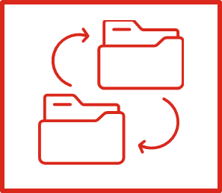
Information Blocking – Am I an “Actor”?
Information blocking prohibition applies to three types of “actors”
Health Care Providers
Each actor is uniquely and individually accountable for their own information blocking conduct
Health IT Developers of
Certified Health IT
Health Information Networks (HINs)
& Health Information Exchanges (HIEs)

Slide 6
Knowledge Standard
Health Care Providers
Health IT Developers of Certified Health IT and HINs/HIEs
“…knows that such practice is unreasonable and is likely to interfere with the access, exchange or use of electronic health information….”
“…knows, or should know, that such practice is likely to interfere with the access, exchange or use of electronic health information….”

Slide 7

Electronic Health Information Definition
Electronic Health Information (EHI) means electronic protected health information (ePHI) to the extent that the ePHI would be included in a designated record set as these terms are defined for HIPAA.
Except for psychotherapy notes (45 CFR 164.501) and information compiled in reasonable anticipation of, or for use in, a civil, criminal, or administrative action or proceeding.
This is applicable whether or not the information is held by or for a HIPAA covered entity.
Does not limit EHI to what is recorded or exchanged consistent with any specific interoperability standard.

Slide 8
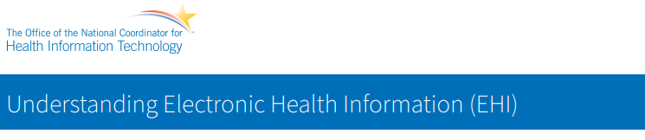
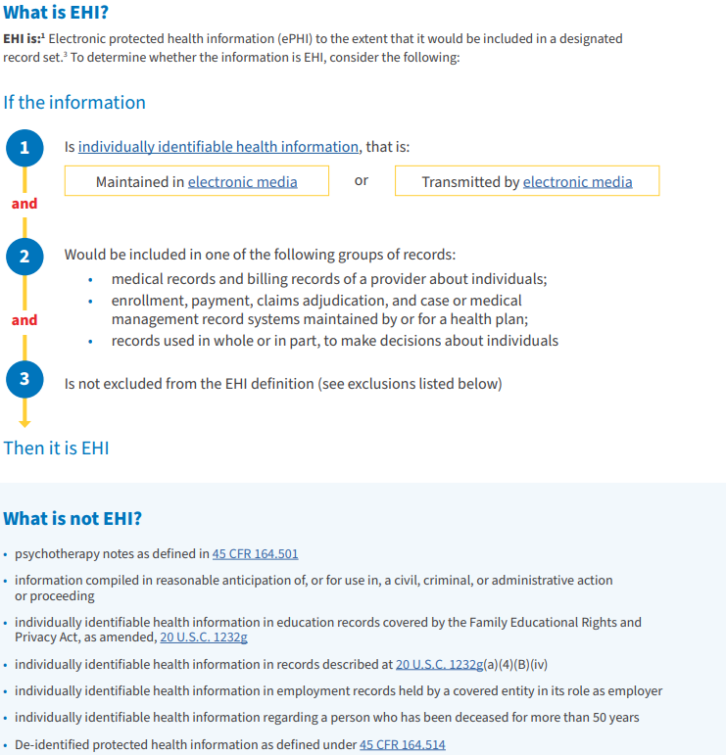
Understanding EHI
Additional EHI Resources
Health IT Buzz Blogs:
Say Hi to EHI
Eight Regulatory Reminders for October 6th
Understanding EHI Fact Sheet
Understanding EHI Infographic
EHI FAQs
Recorded Webinars

Slide 9

What Are the Consequences for Information Blocking?
“Actor” | Consequence
Health care providers | Appropriate disincentives
Health information networks and Health information exchanges | Civil monetary penalties (CMPs) up to $1 million per violation
Health IT developers of certified health IT | Civil monetary penalties (CMPs) up to $1 million per violation Certification action which could include a termination or ban
Notes on Enforcement:
Civil monetary penalties (CMPs): enforcement dates will be established by current OIG rulemaking.
Appropriate disincentives: to be established by future HHS rulemaking.

Slide 10
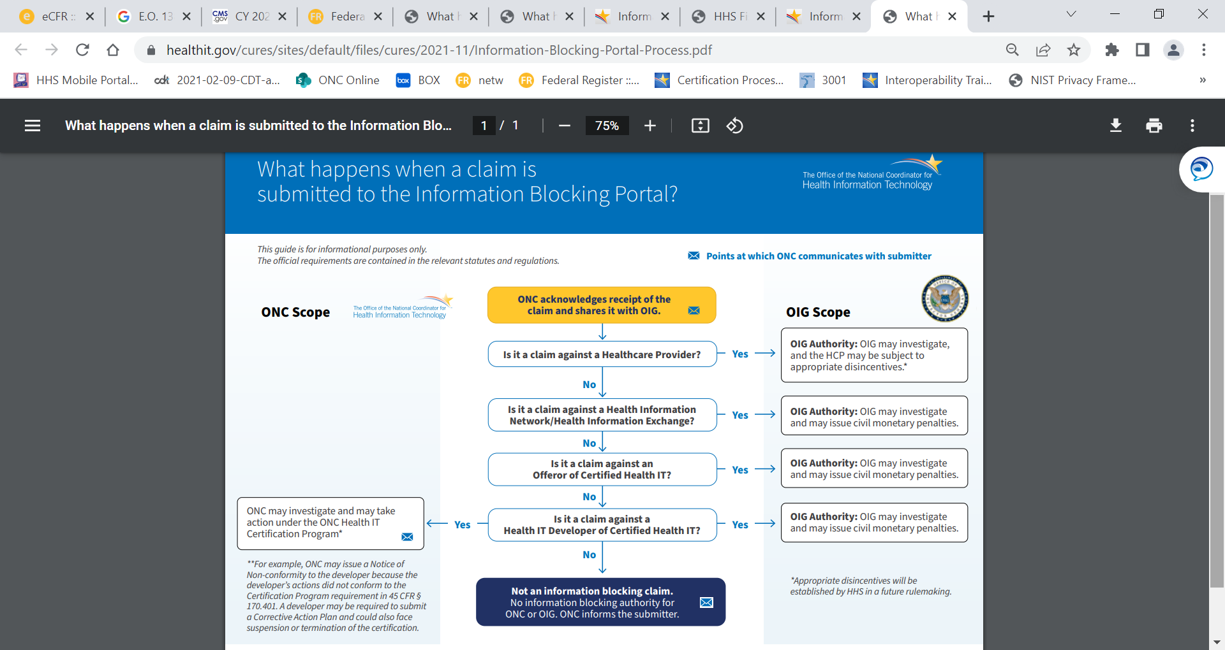
Information Blocking Claims
https://www.healthit.gov/sites/default/files/page2/2021-11/Information-Blocking-Portal-Process.pdf

Slide 11

What Makes an Individual or Entity an Information Blocker?
Elements of information blocking
Actor regulated by the information blocking provision
Involves electronic health information (EHI)
Practice is likely to interfere with access, exchange, or use of EHI
Requisite knowledge by the actor
Not required by law
Not covered by an exception

Slide 12
Information Blocking Exceptions
Information Sharing: the norm is to avoid actions or omissions (“practices”) that are likely to interfere with information sharing.
Exceptions: the exceptions offer assurance that reasonable and necessary “practices” covered by an exception will not be considered information blocking.
Applicable to delaying, restricting, or denying access, exchange, or use
Applicable to processes or procedures for fulfilling access, exchange, or use of EHI
Infeasibility Exception
Preventing Harm Exception
Privacy Exception
Security Exception
Health IT Performance Exception
Content and Manner Exception
Fees Exception
Licensing Exception

Slide 13

Content and Manner Exception
Overview
It will not be information blocking for an actor to limit the content of its response to a request to access, exchange, or use EHI or the manner in which it fulfills a request, provided certain conditions are met.
To satisfy this exception, an actor’s practice must meet both of these conditions:
Content Condition
+
Manner Condition

Slide 14
Content and Manner Exception
Content Condition
From April 5, 2021 to October 6, 2022, an actor must respond to a request to access, exchange, or use EHI with, at a minimum, the requested EHI that is identified by the data elements represented in the USCDI standard.
On and after October 6, 2022, an actor must respond to a request to access, exchange, or use EHI with EHI as defined in § 171.102.
Points of Interest:
Can be met if the actor does not have all the requested EHI.
Does not require EHI be held in or shared using specific technology or particular technical standards.
Can be met where some EHI is withheld due to laws or is permissible to be withheld, such as under the Preventing Harm or Privacy exceptions.

Slide 15
Content and Manner Exception
Manner Condition – Any Manner Requested
An actor must fulfill a request in any manner requested unless the actor is:
Technically unable to fulfill the request in a manner requested; or
Cannot reach agreeable terms with the requestor to fulfill the request.
If an actor fulfills a request in any manner requested, the actor’s practice is not subject to the Fees or Licensing Exceptions.

Slide 16
Content and Manner Exception
Manner Condition – Alternative Manner
If an actor responds in an alternative manner, the actor must fulfill the request without unnecessary delay in the following order of priority, only proceeding to the next consecutive paragraph if technically unable to fulfill the request in that manner:
Using technology certified to standard(s) adopted in Part 170 that is specified by the requestor.
Using content and transport standards specified by the requestor and published by:
Federal Government; or
Standards developing organization accredited by the American National Standards Institute.
Using an alternative machine-readable format, including the means to interpret the EHI, agreed upon with the requestor.

Slide 17

Fees Exception
Overview
It will not be information blocking for an actor to charge fees, including fees that result in a reasonable profit margin, for accessing, exchanging, or using EHI, provided certain conditions are met.
To satisfy this exception, the practice must:
Meet basis for fees condition
+
Not be specifically excluded
+
Comply with Assurances and/or API Conditions of Certification, as applicable

Slide 18

Infeasibility Exception
Overview
It will not be information blocking if an actor does not fulfill a request to access, exchange, or use EHI due to the infeasibility of the request, provided certain conditions are met.
To satisfy this exception, an actor must:
Demonstrate that the practice meets one of the conditions for uncontrollable events, segmentation, or infeasibility under the circumstances
+
Provide written response, within 10 business days of receipt of the request, with the reason(s) why the request is infeasible

Slide 19


Privacy Exception
Overview
It will not be information blocking if an actor does not fulfill a request to access, exchange, or use EHI in order to protect an individual’s privacy, provided certain conditions are met.
To satisfy this exception, an actor’s privacy-protective practice must:
Satisfy at least one of the following 4 sub-exceptions
Pre-condition not satisfied
Health IT developer of certified health IT not covered by HIPAA
Denial of an individual’s request for their EHI consistent with 45 CFR 164.524(a)(1) and (2)
Respecting an individual’s request not to share information
+
Meet all conditions applicable to a sub-exception being relied upon

Slide 20
Privacy Exception: The Four Sub-exceptions
An actor’s practice of not fulfilling a request to access, exchange, or use EHI in order to protect an individual’s privacy will not be considered information blocking when the practice meets all of the requirements of at least one of the sub-exceptions in this section.
(b) precondition not satisfied
(c) health IT developer of certified health IT not covered by HIPAA
(d) denial of an individual’s request for their EHI consistent with 45 CFR 164.524(a)(1) and (2)
(e) respecting an individual’s request not to share information

Slide 21

Security Exception
Overview
It will not be information blocking for an actor to interfere with the access, exchange, or use of EHI in order to protect the security of EHI, provided certain conditions are met.
To satisfy this exception, an actor’s security-related practice must:
Be directly related to safeguarding the confidentiality, integrity, and availability of EHI
Implement a Qualifying Organizational Policy
+
Implement a Qualifying Individualized Finding
Be tailored to specific security risks; and
+
Be implemented in a consistent and non-discriminatory manner; and
Implement a qualifying organizational security policy
Implement a qualifying ​ security determination
OR

Slide 22

Where To Find More Information
ONC Website Resources: https://www.healthit.gov/
Information Blocking Resources (including fact sheets, FAQs, blogs, and webinars): https://www.healthit.gov/topic/information-blocking
FAQs: https://www.healthit.gov/faqs
Blogs: https://www.healthit.gov/buzz-blog/category/information-blocking
Webinars: https://www.healthit.gov/topic/information-blocking
A report of potential information blocking can be submitted through the Report Information Blocking Portal: https://healthit.gov/report-info-blocking
Contact ONC:
ONC Health IT Feedback and Inquiry Portal: https://www.healthit.gov/feedback
Twitter: @onc_healthIT
LinkedIn: https://www.linkedin.com/company/office-of-the-national-coordinator-for-health-information-technology
ONC Events: https://www.healthit.gov/newsroom/events

Slide 23
Contact ONC

