Slide 1
Seções transversais das Vigas OpenPulse

Slide 2


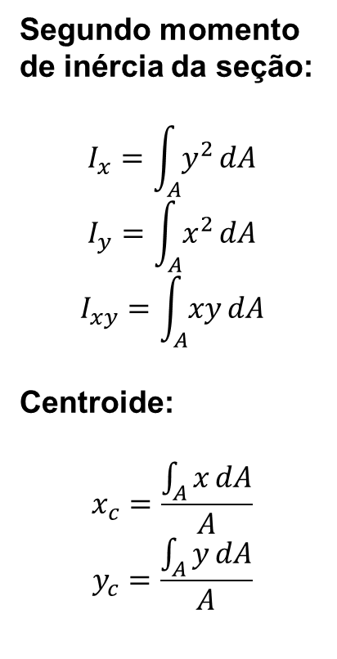



Propriedades da seção transversal
Segundo momento de inércia da seção:
$$I_{x}=\int_{A}{y^{2}}dA$$
$$I_{y}=\int_{A}{x^{2}}dA$$
$$I_{xy}=\int_{A}{xy}dA$$
Centroide:
$$x_{c}=\frac{\int_{A}{x}dA}{A}$$
$$y_{c}=\frac{\int_{A}{y}dA}{A}$$
$$I_{x}=\frac{bh^{3}}{3}; I_{y}=\frac{hb^{3}}{3}$$
$$I_{xy}={\left(\frac{hb}{2}\right)}^{2}$$
$$I_{x_{c}}=\frac{bh^{3}}{12}; I_{y_{c}}=\frac{hb^{3}}{3}$$
$$x_{c}=\frac{b}{2}; y_{c}=\frac{h}{2}$$
$$y$$
$$h$$
$$x$$
$$b$$

Slide 3

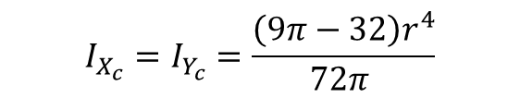



Propriedades da seção transversal
Segundo momento de inércia da seção:
$$I_{x}=\int_{A}{y^{2}}dA$$
$$I_{y}=\int_{A}{x^{2}}dA$$
$$I_{xy}=\int_{A}{xy}dA$$
Centroide:
$$x_{c}=\frac{\int_{A}{x}dA}{A}$$
$$y_{c}=\frac{\int_{A}{y}dA}{A}$$
$$I_{x}=I_{y}=\frac{πr^{4}}{16}$$
$$I_{xy}=\frac{r^{4}}{8}$$
$$I_{x_{c}}=I_{x}−\frac{4r^{4}}{9π}$$
$$I_{y_{c}}=I_{x}−\frac{4r^{4}}{9π}$$
$$x_{c}=y_{c}=\frac{4r}{3π}$$
$$y$$
$$r$$
$$x$$
$$I_{X_{c}}=I_{Y_{c}}=\frac{\left(9π−32\right)r^{4}}{72π }$$

Slide 4






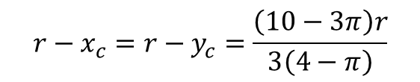
Propriedades da seção transversal
Segundo momento de inércia da seção:
$$I_{x}=\int_{A}{y^{2}}dA$$
$$I_{y}=\int_{A}{x^{2}}dA$$
$$I_{xy}=\int_{A}{xy}dA$$
Centroide:
$$x_{c}=\frac{\int_{A}{x}dA}{A}$$
$$y_{c}=\frac{\int_{A}{y}dA}{A}$$
$$I_{x}=I_{y}=\frac{\left(16−3π\right)r^{4}}{48}$$
$$I_{xy}=\frac{r^{4}}{8}$$
$$I_{x_{c}}=I_{x}−\frac{r^{4}}{9\left(4−π\right)}$$
$$I_{y_{c}}=I_{x}−\frac{r^{4}}{9\left(4−π\right)}$$
$$I_{x_{c}y_{c}}=I_{xy}−x_{c}y_{c}A$$
$$I_{x_{c}y_{c}}=\frac{\left(28−9π\right)r^{4}}{72(4−π)}$$
$$x_{c}=y_{c}=\frac{2r}{3\left(4−π\right)}$$
$$y$$
$$y_{c}$$
$$r$$
$$x_{c}$$
$$x$$
$$r−x_{c}=r−y_{c}=\frac{\left(10−3π\right)r}{3\left(4−π\right)}$$

Slide 5
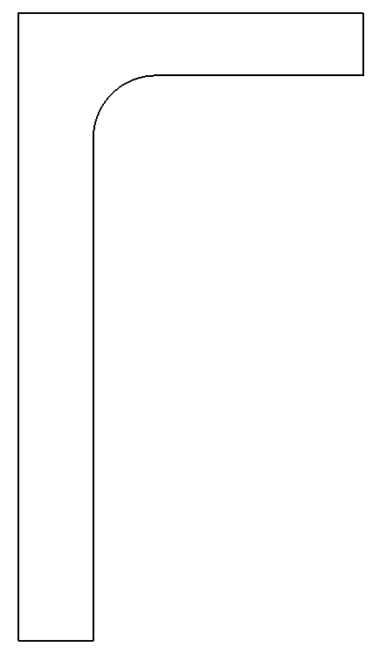




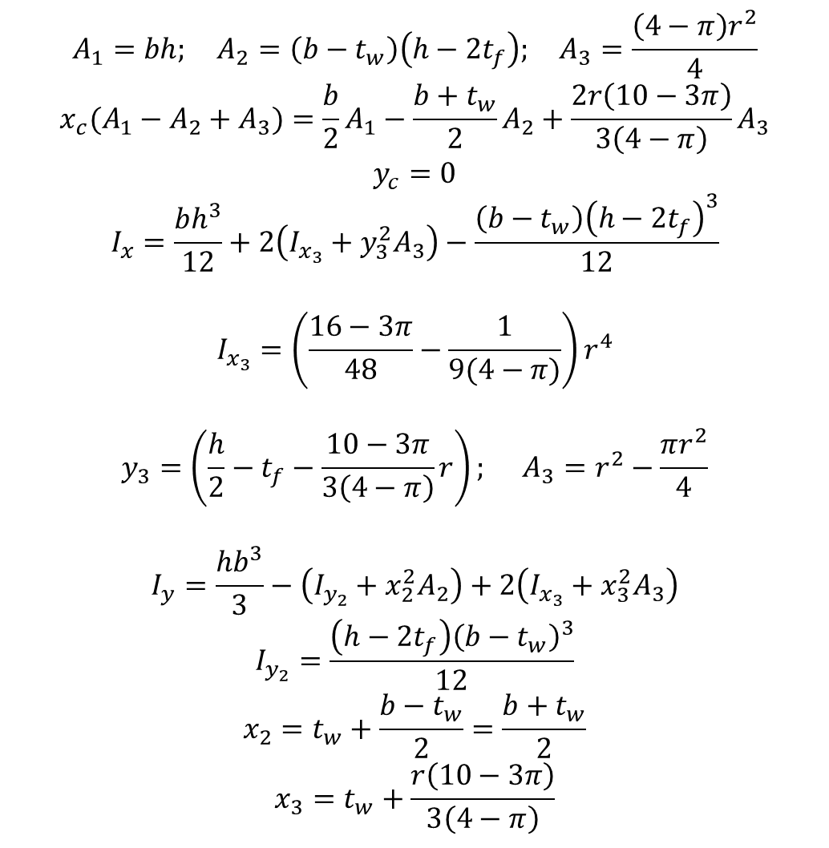




$$A_{1}=bh; A_{2}=\left(b−t_{w}\right)\left(h−2t_{f}\right); A_{3}=\frac{\left(4−π\right)r^{2}}{4}$$
$$x_{c}(A_{1}−A_{2}+A_{3})=\frac{b}{2}A_{1}−\frac{b+t_{w}}{2}A_{2}+\frac{2r\left(10−3π\right)}{3\left(4−π\right)}A_{3}$$
$$y_{c}=0$$
$$I_{x}=\frac{bh^{3}}{12}+2\left(I_{x_{3}}+y_{3}^{2}A_{3}\right)−\frac{\left(b−t_{w}\right){\left(h−2t_{f}\right)}^{3}}{12}$$
$$I_{x_{3}}=\left(\frac{16−3π}{48}−\frac{1}{9(4−π)}\right)r^{4}$$
$$y_{3}=\left(\frac{h}{2}−t_{f}−\frac{10−3π}{3\left(4−π\right)}r\right); A_{3}=r^{2}−\frac{πr^{2}}{4}$$
$$I_{y}=\frac{hb^{3}}{3}−\left(I_{y_{2}}+x_{2}^{2}A_{2}\right)+2\left(I_{x_{3}}+x_{3}^{2}A_{3}\right)$$
$$I_{y_{2}}=\frac{\left(h−2t_{f}\right){\left(b−t_{w}\right)}^{3}}{12}$$
$$x_{2}=t_{w}+\frac{b−t_{w}}{2}=\frac{b+t_{w}}{2}$$
$$x_{3}=t_{w}+\frac{r\left(10−3π\right)}{3\left(4−π\right)}$$
$$y$$
$$b$$
$$t_{f}$$
$$r$$
$$\frac{h}{2}$$
$$t_{w}$$
$$x$$
$$x_{c}$$

Slide 6
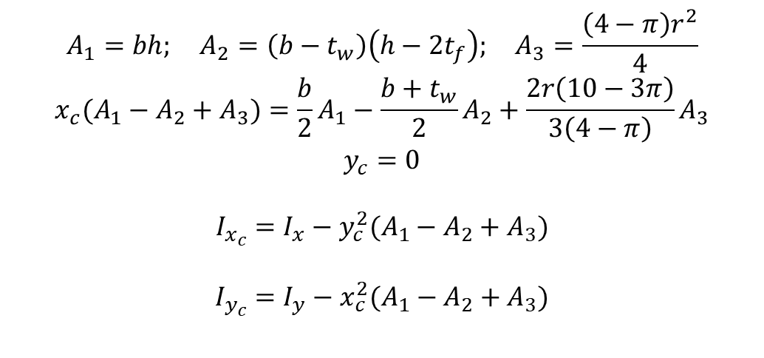
$$A_{1}=bh; A_{2}=\left(b−t_{w}\right)\left(h−2t_{f}\right); A_{3}=\frac{\left(4−π\right)r^{2}}{4}$$
$$x_{c}(A_{1}−A_{2}+A_{3})=\frac{b}{2}A_{1}−\frac{b+t_{w}}{2}A_{2}+\frac{2r\left(10−3π\right)}{3\left(4−π\right)}A_{3}$$
$$y_{c}=0$$
$$I_{x_{c}}=I_{x}−y_{c}^{2}(A_{1}−A_{2}+A_{3})$$
$$I_{y_{c}}=I_{y}−x_{c}^{2}(A_{1}−A_{2}+A_{3})$$
$$y$$
$$b$$
$$t_{f}$$
$$r$$
$$\frac{h}{2}$$
$$t_{w}$$
$$x$$
$$x_{c}$$

Slide 7
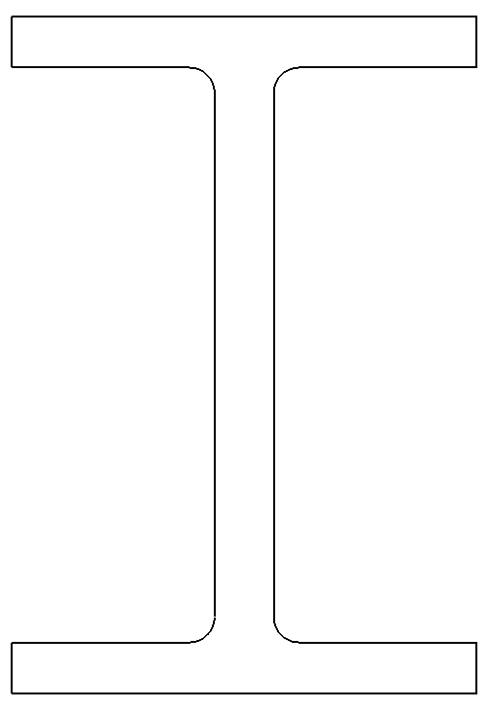
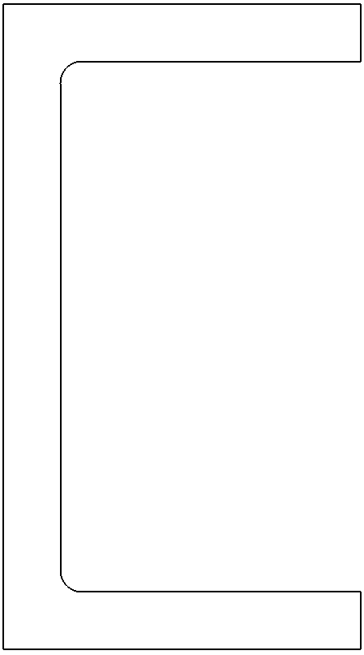

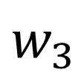




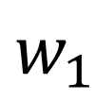


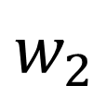



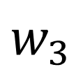
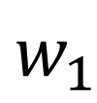



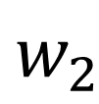
$$w_{1}$$
$$w_{1}$$
$$t_{1}$$
$$y$$
$$r$$
$$t_{1}$$
$$y$$
$$h$$
$$t_{2}$$
$$h$$
$$t_{2}$$
$$x$$
$$x$$
$$w_{2}$$
$$w_{2}$$
$$t_{3}$$
$$w_{3}$$
$$w_{3}$$
$$t_{3}$$

Slide 8
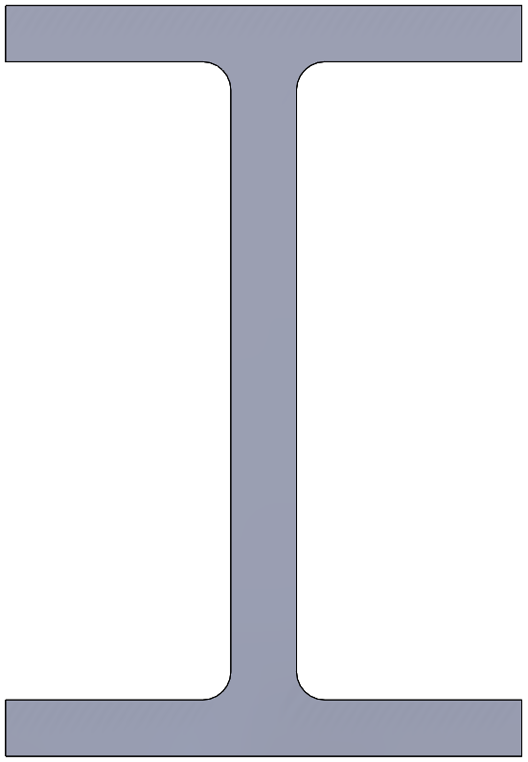
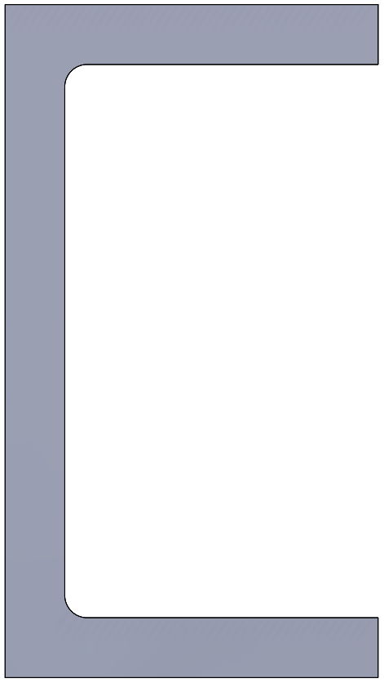


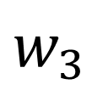








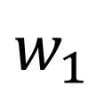


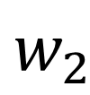
$$w_{1}$$
$$w_{1}$$
$$t_{1}$$
$$z$$
$$r$$
$$t_{1}$$
$$z$$
$$h$$
$$t_{2}$$
$$h$$
$$t_{2}$$
$$y$$
$$y$$
$$w_{2}$$
$$w_{2}$$
$$t_{3}$$
$$w_{3}$$
$$w_{3}$$
$$t_{3}$$

Slide 9
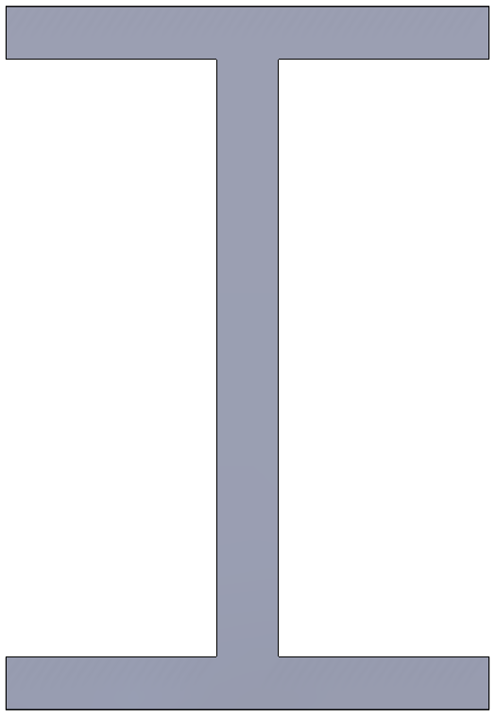

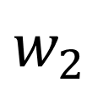




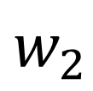



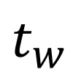




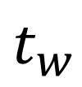
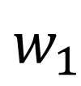



$$w_{1}$$
$$w_{1}$$
$$t_{1}$$
$$t_{1}$$
$$z$$
$$z$$
$$e_{y}$$
$$e_{y}$$
$$e_{z}$$
$$y$$
$$y$$
$$e_{z}$$
$$h$$
$$h$$
$$t_{w}$$
$$t_{w}$$
$$t_{2}$$
$$t_{2}$$
$$w_{2}$$
$$w_{2}$$

Slide 10








$$w_{1}$$
$$w_{1}$$
$$t_{1}$$
$$t_{1}$$
$$y$$
$$e_{z}$$
$$y$$
$$e_{z}$$
$$h$$
$$h$$
$$e_{y}$$
$$e_{y}$$
$$z$$
$$z$$
$$t_{w}$$
$$t_{w}$$
$$t_{2}$$
$$t_{2}$$
$$w_{2}$$
$$w_{2}$$

Slide 11
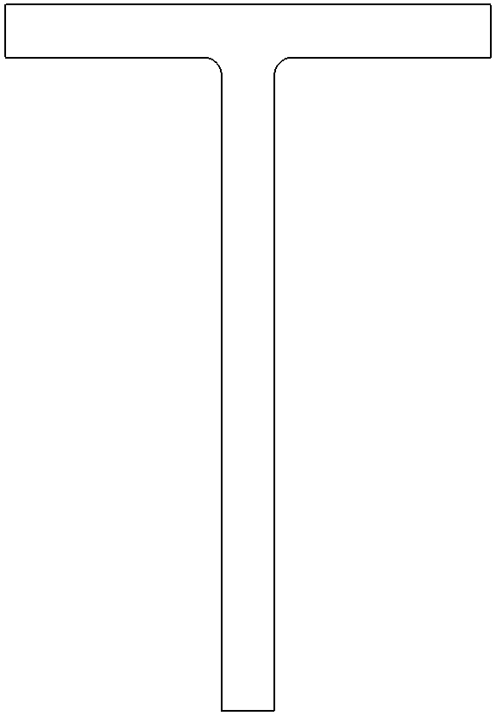

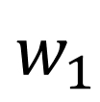





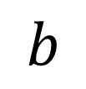


$$w_{1}$$
$$b$$
$$y$$
$$t_{1}$$
$$h$$
$$t_{2}$$
$$x$$
$$h$$
$$t$$
$$w_{2}$$

Slide 12
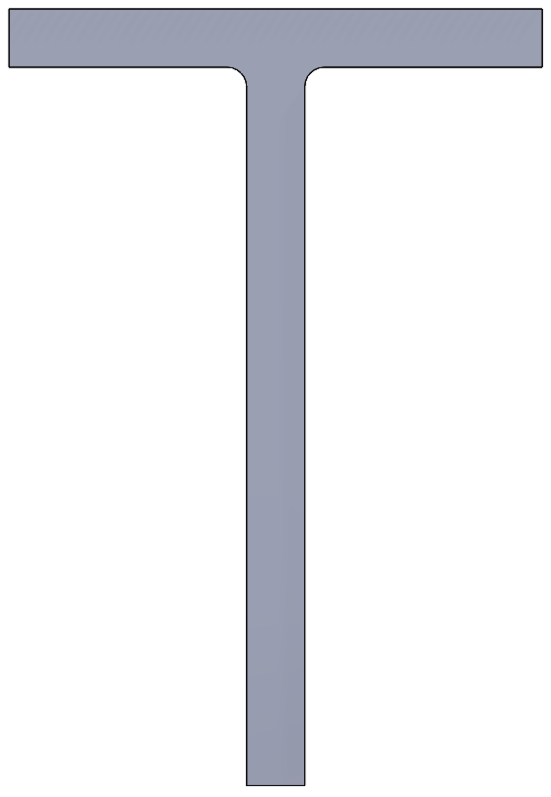




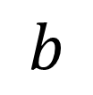



$$w_{1}$$
$$z$$
$$b$$
$$r$$
$$t_{1}$$
$$z$$
$$h$$
$$t_{2}$$
$$h$$
$$y$$
$$y$$
$$t$$
$$w_{2}$$

Slide 13
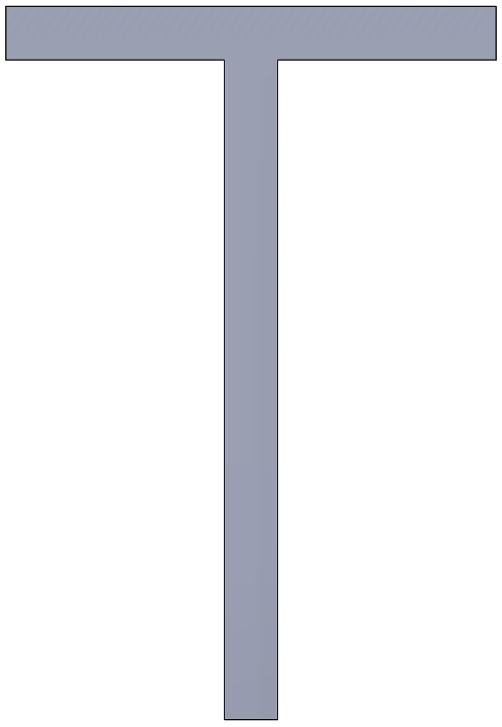



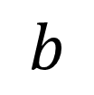







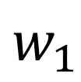



$$w_{1}$$
$$b$$
$$t_{1}$$
$$y$$
$$e_{z}$$
$$e_{z}$$
$$e_{y}$$
$$y$$
$$h$$
$$h$$
$$z$$
$$e_{y}$$
$$t$$
$$z$$
$$t_{w}$$

Slide 14




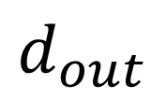







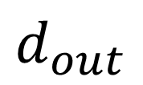


$$t$$
$$e_{z}$$
$$t$$
$$y$$
$$e_{z}$$
$$y$$
$$t_{i}$$
$$e_{y}$$
$$e_{y}$$
$$z$$
$$z$$
$$d_{out}$$
$$d_{out}$$

