Slide 1

LF Energy Open Renewable Energy Systems (ORES) WG
Annual Review, April 2025

Slide 2

Introduction
About ORES:
Open-source initiative under LF Energy
Focus on modular, interoperable renewable energy systems
Enables collaboration between software developers, hardware vendors, and utilities
Mission & Vision:
Democratizing renewable energy integration
Standardizing architectures and APIs for scalable adoption
Bridging the gap between open-source software and utility-scale deployments

Slide 3

Key Updates (Year in Review): Specification
API Standardization
Architecture Standardization
Defined a unified API
Leveraged IEEE 2030
Improved documentation and compliance guidelines
Enhanced interoperability across platforms
Established modular reference designs
Introduced best practices for scalability
Engaged with industry stakeholders for alignment

Slide 4

Key Updates (Year in Review): Reference Implementation
DIY Systems & Implementations: reduce deployment cost
Developed multiple reference designs
Provided step-by-step guides
Expanded community contributions
System Diagrams & Prototypes: reduce equipment cost
Created detailed hardware-software interaction diagrams
Open-sourced blueprints for microgrid integrations
Enabled simulation and testing

Slide 5
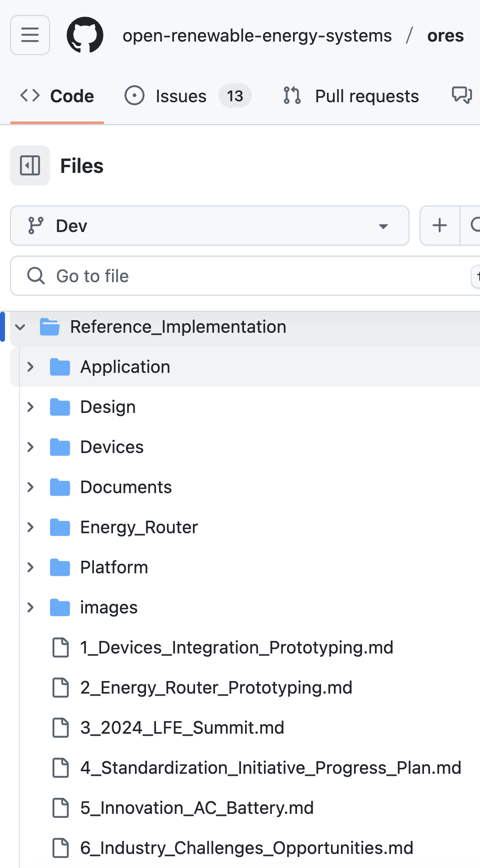
Reference System Architecture Design
Application: typical Software Defined EMS applications.
Design: outdoor cabinet standard proposals.
Devices: third party ESS devices integration.
Documents: solution kits evaluation.
Energy Router: schematic, layout, 3d design for DEGCent's innovation SMB / AC Battery / Cascaded PCS development.
Platform: IoT platform for Software Defined EMS.
Evaluation: Battery on-line, off-line performance.

Slide 6
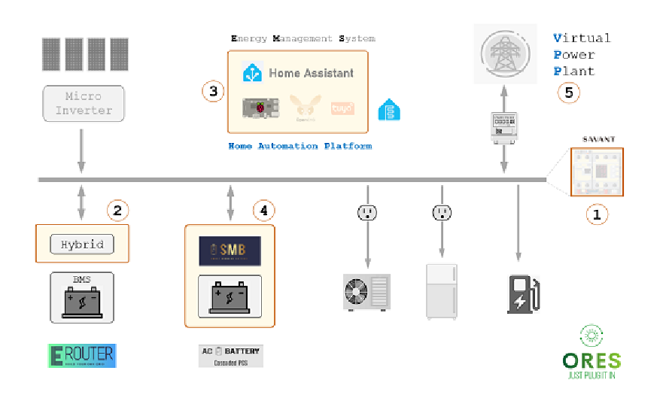
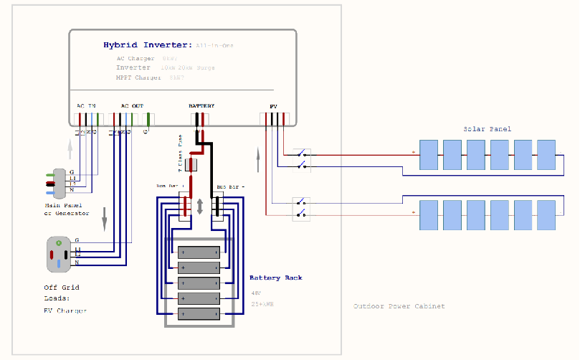
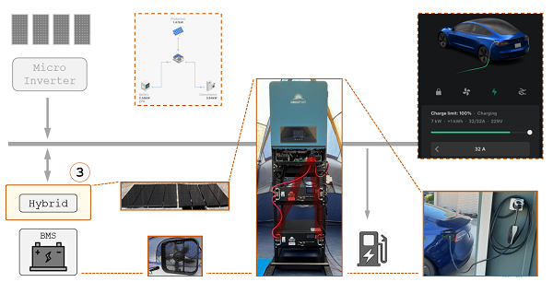
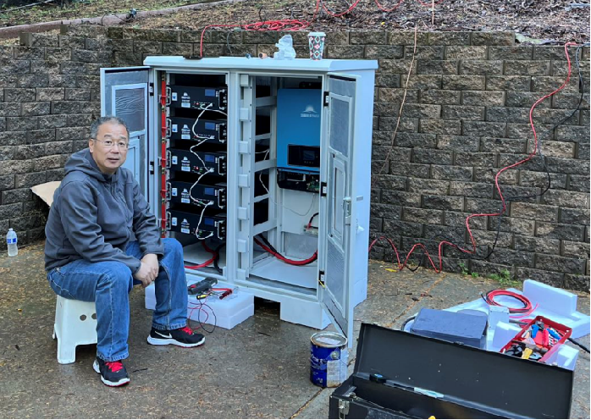
Reference System Trial Deployments
Kit: solar panels, all-in-one Inverter, Batteries
System Diagram
Deployment & Production

Slide 7
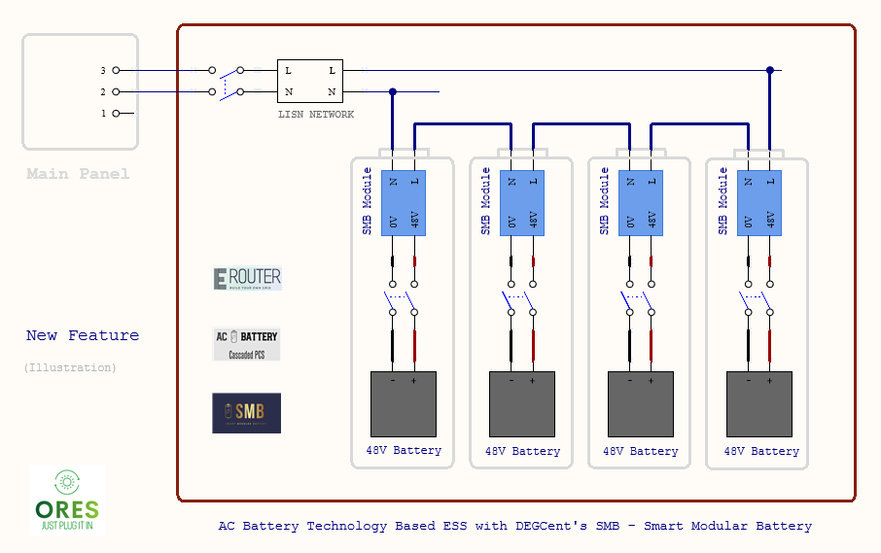
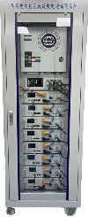

Energy Router: DEGCent’s Disruptive ESS Innovation
“AC Battery” - Smart Modular Battery low-voltage Cascaded PCS Technology
Differentiated Competitive Advantages: Safety, Cost, Efficiency.

Slide 8
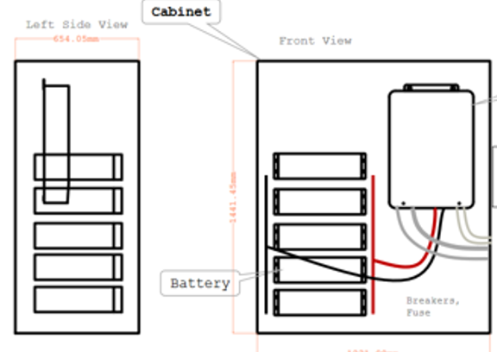
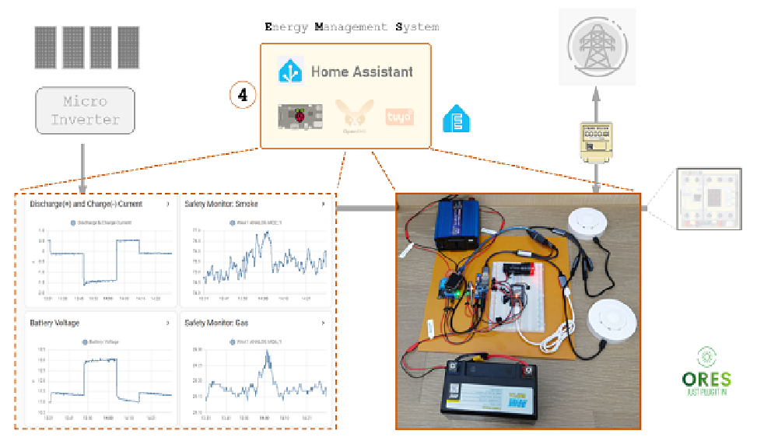
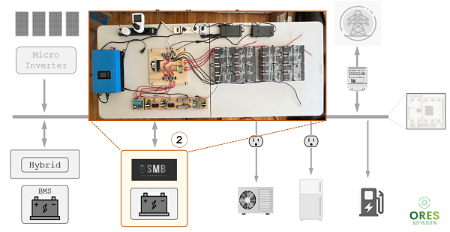
Standardized Cabinet & Software Defined EMS
Smart Home & IoT compatible
Fine-grained Energy Management
DIY support, Drop & Play
Cost efficiency with third party

Slide 9



Growth & Opportunities
Expanding Vendor Collaboration:
Great opportunity for hardware vendors to integrate and certify their devices
Open standards reduce vendor lock-in
Ongoing discussions with manufacturers
Utility Engagement & Adoption:
Help needed in interfacing with utilities
Potential for pilot projects
Advocating for policy alignment
Community & Ecosystem Growth:
Increased contributors
Growing interest from researchers and startups
Enhanced documentation

Slide 10
Call to Action
How You Can Contribute:
Hardware Vendors: Integrate and test devices
Developers: Enhance implementations and APIs
Utilities: Collaborate on pilot projects
Researchers: Explore new use cases
Next Steps:
Become ISO standard
Expand industry partnerships
Develop more deployment guides
Engage with policymakers

Slide 11




Conclusion
ORES is driving the future of open renewable energy systems.
Collaboration is key—developers, vendors, utilities can all contribute.
Join us at:
GitHub: https://github.com/open-renewable-energy-systems/ores
LF Energy Community
Upcoming Events: KubeCon + CloudNativeCon, Hong Kong, China

Slide 12
Thank You!

