Slide 1

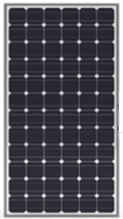





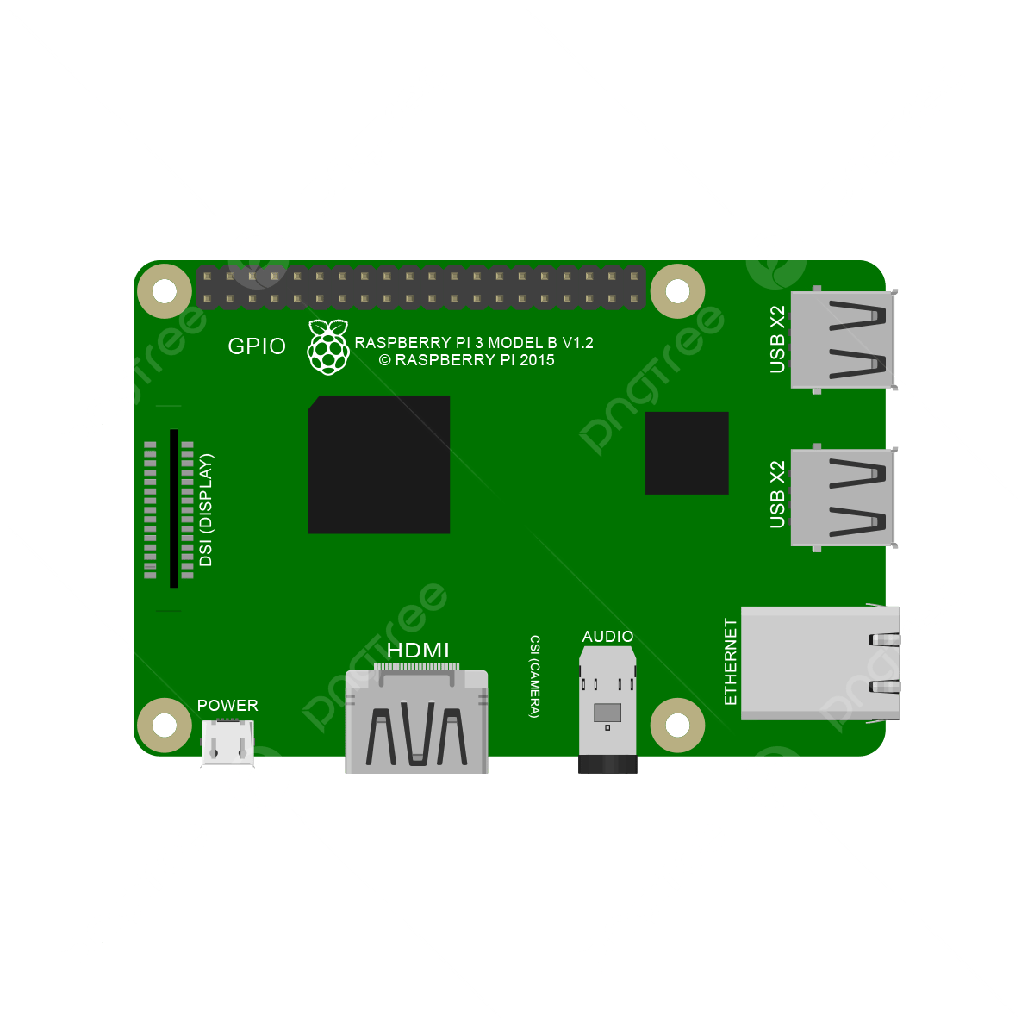



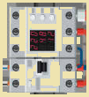


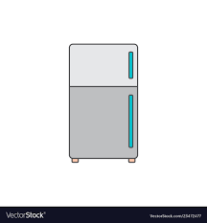
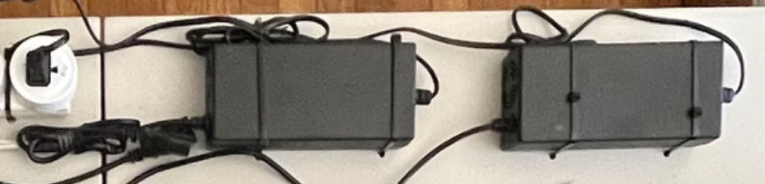
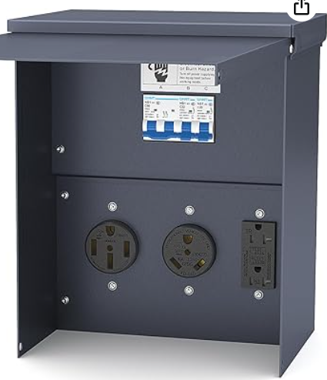



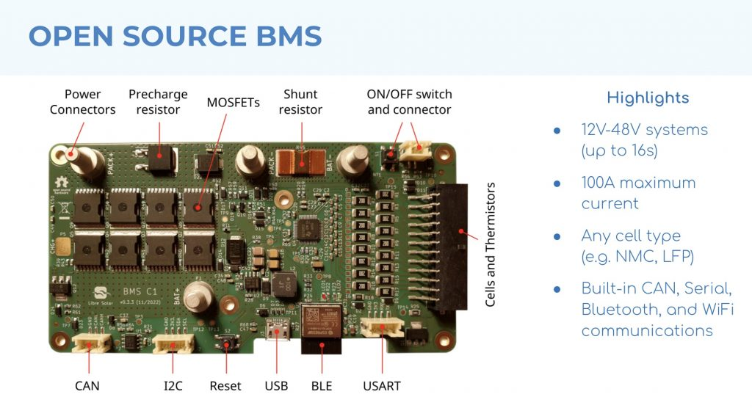
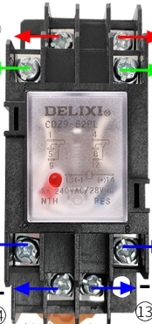
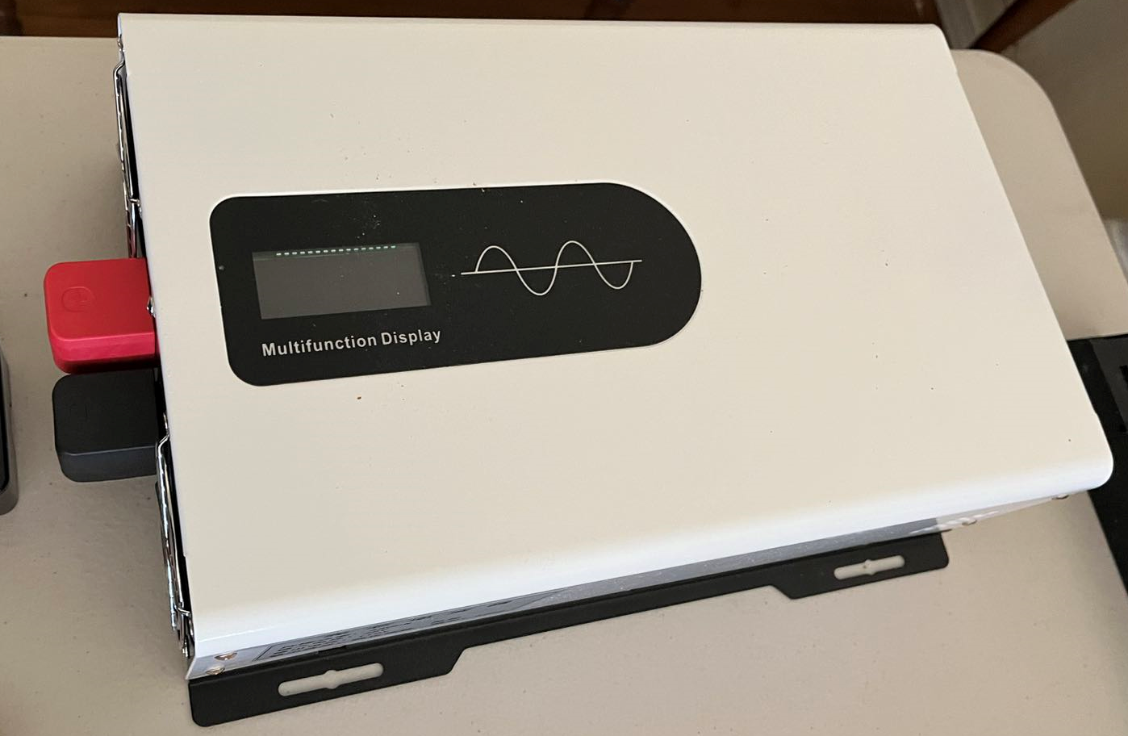

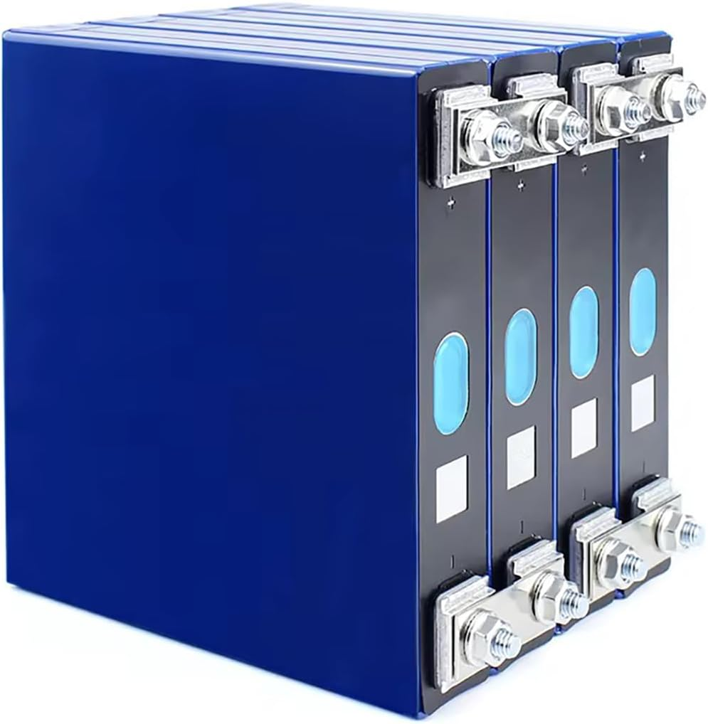
Software Defined EMS
Solar
Inverter
Home Assistant
Smoke detector
Carbon Monoxide detector
4
Cooling fan
5
Smart Plug
Outlet
Smart Plug
2
Charger
Smart Plug
BMS
1
Lebre Solar / enAccess
Relay
3
6
LiFePO4 Cell 3.2V 32Ah, 16S
Inverter
Off-Grid, In/DC 48V, Out/AC 110V, 3.3kW, 60Hz
Battery Module
Open Source Lab
Notes:
Open BMS Initiative, DEGCent， 9/26/2025

Slide 2
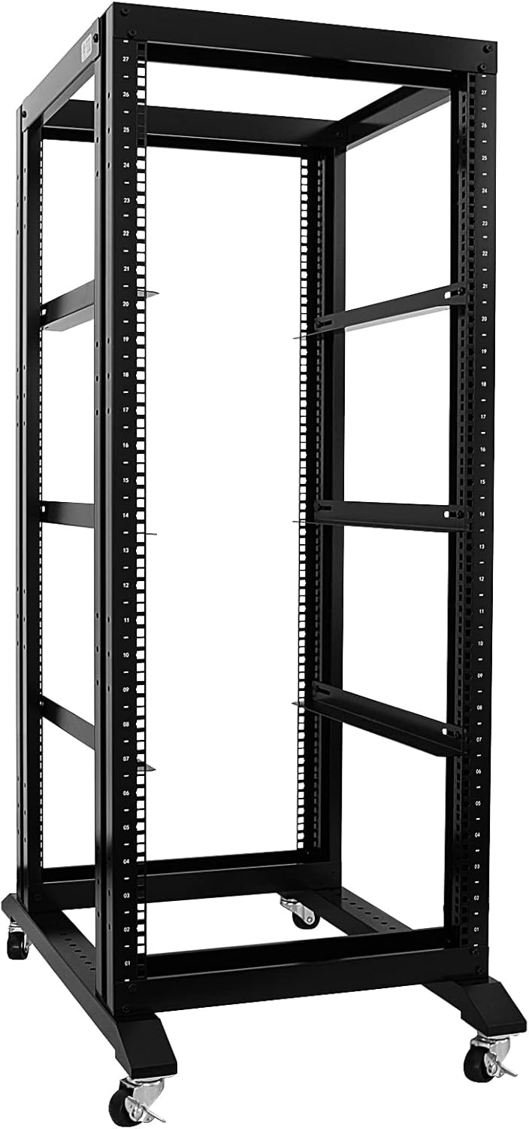
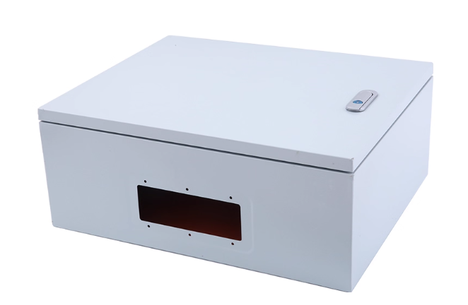
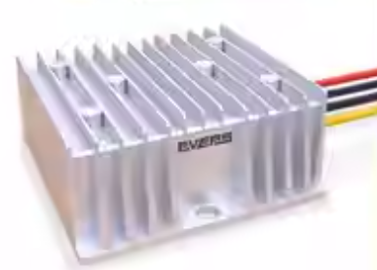

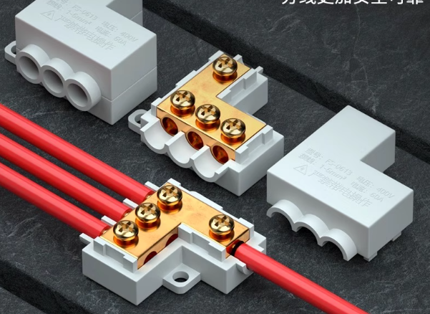
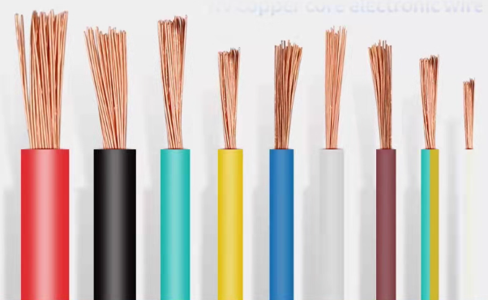
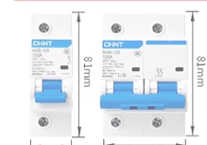
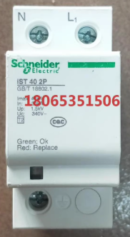
Open Source Lab
Electrical Box
DC/DC Converter
Emergency Swtich
Relay
Terminal/Connectors
Various Cables
AC/DC Breaker
Surge/Lightning Protect Device
Rack
Notes:
Open BMS Initiative, DEGCent, 9/26/2025

