Slide 1
ORES (Open Renewable Energy Systems)

Slide 2
What is ORES?
ORES: Open Renewable Energy Systems
A working group under Linux Foundation Energy
Builds open architecture and standards for decentralized renewable energy systems
Focused on cloud-native software + hardware abstraction + interoperability
Use cases: microgrids, home grid energy networks, community DER coordination, started currently pilot deployments for houses in California

Slide 3
Why ORES?
Problem: Traditional home energy systems are siloed, inflexible, and hardware-bound: device & deployment cost .
Need: open source, standardized, Innovation, interoperable, and intelligent systems to integrate DERs, storage, and smart appliances.
Vision: Empower households with plug-and-play, software-defined energy autonomy, and a total solution with cloud native & AI.

Slide 4
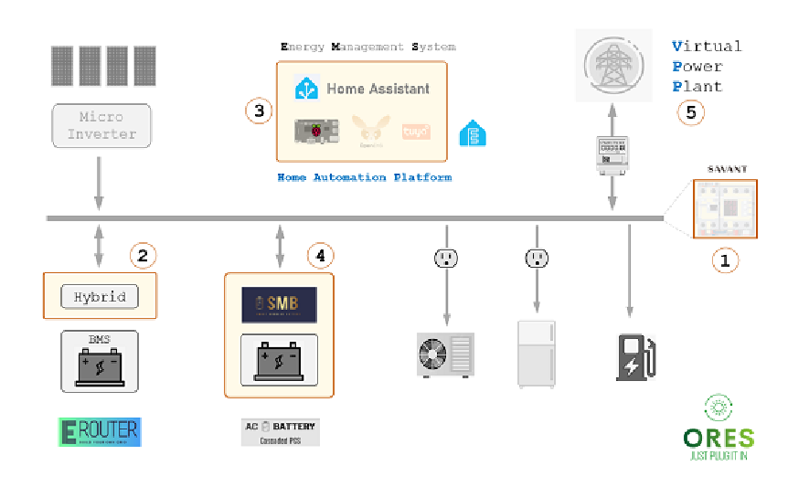
Open Source & Standardized System
Dimensions to address:
1) Hardware device level
2) Compatible communication and interconnection
3) Software Defined EMS
4) Deployment, safety monitoring and operation maintenance.
5) Cloud Native & AI: Battery on-line, off-line safety and performance evaluation and analysis, etc.
Solar Panel + Battery/BMS + PCS + Software Defined EMS

Slide 5
Introducing standardization proposal
Open Renewable Energy Systems (ORES) working group. “Functional Specification, Architecture, and APIs.” GitHub. https://github.com/open-renewable-energy-systems/ores/blob/Dev/Specification/ORES_Spec.md.
/microinverter/status, /microinverter/energy, /microinverter/control
/energystorage/status, /energystorage/storage, /energystorage/control
/device/discovery, /device/register. /device/firmware/update, /device/security/authenticate, /device/safety/fault-detection, /device/data/logging, /device/diagnostics/remote
/hub/communicate, /hub/configure
/app/monitor, /app/notify, /app/settings
Reference implementation (related): https://github.com/open-renewable-energy-systems/ores/tree/Dev/Reference_Implementation

Slide 6
Positioning related work on standardization
Home Assistant Integrations https://www.home-assistant.io/; Matter protocol (Google): stronger focus on end-user smart home, however not on status data used for energy management
KNX: medium-sized installations, control and less (?) accounting data, available open-source stack https://github.com/OpenKNX
EEBus: similar scope to KNX, vendor independent, but needs consortium membership
IEEE 2030.5: larger-scale systems, focus more on accounting than control, open source implementation of clients by interstore-project.eu

Slide 7
Introducing GAIFARE
Generative AI for Autonomous Renewable Energy -> https://github.com/open-renewable-energy-systems/gaifare
A new initiative incubated under ORES proposed,
Uses generative AI to power intelligent agents across home devices
Enables autonomous coordination of energy production, storage, and consumption, and safety
Context-aware learning: weather, pricing, usage patterns, peer negotiation
Builds on the software-defined foundation of ORES to enable the next-gen autonomous grid
Demo (mockup) https://open-renewable-energy-systems.github.io/gaifare_demo/ and (source code) https://github.com/open-renewable-energy-systems/gaifare_demo

Slide 8



Call to Action
Join us in building the open source future of energy
Contribute to ORES projects (software, architecture, AI models, hardware protocols)
Collaborate on GAIFARE and other AI-powered workstreams
Be part of a community shaping cloud-native, intelligent, and sustainable energy systems
Connect!
ORES Github
ORES Website

