Slide 1

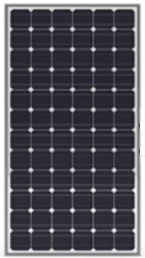
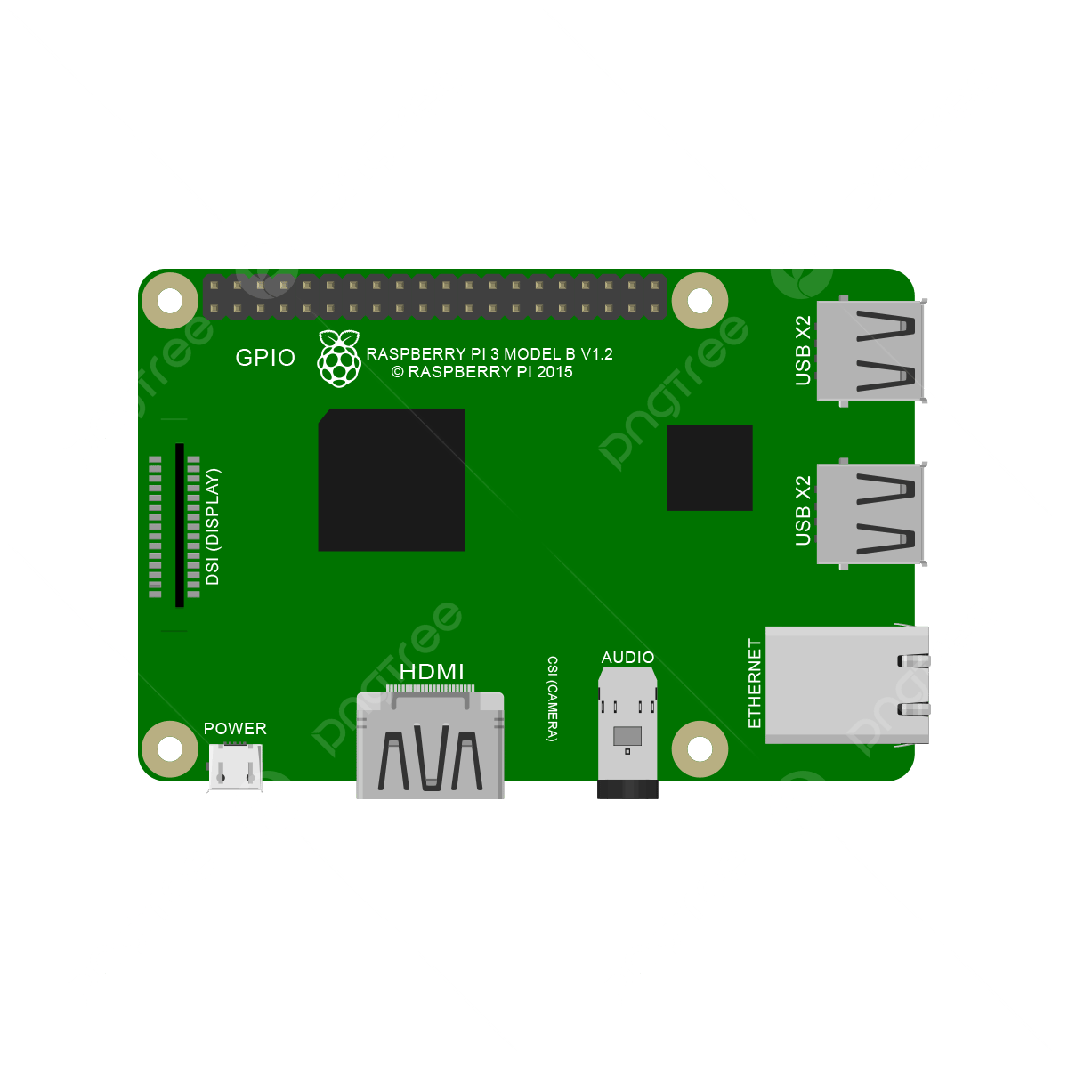


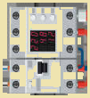

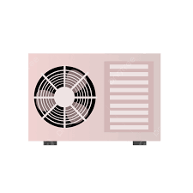
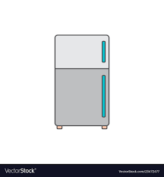


Generation
Grid
Energy Management System
Micro
Inverter
Smart
Meter
240V split phase AC Bus
Smart
Plug
Smart
Electric
Panel
PCS
^{Charger}
^{Inverter}
BMS
BMS
...
Consumption
Air
Conditioner
EV
Charger
Primery
Storage
Secondary
Storage
Refrigerator
Notes:
2024-04-18

