Slide 1
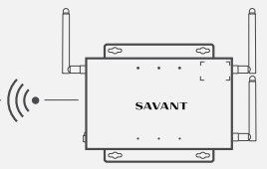
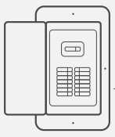



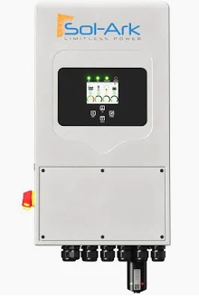
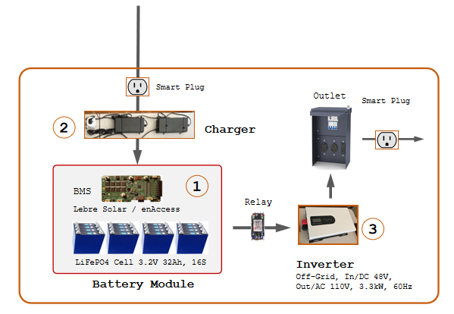
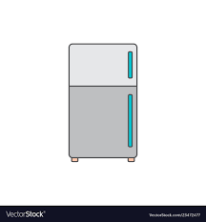

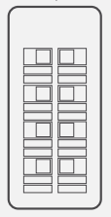
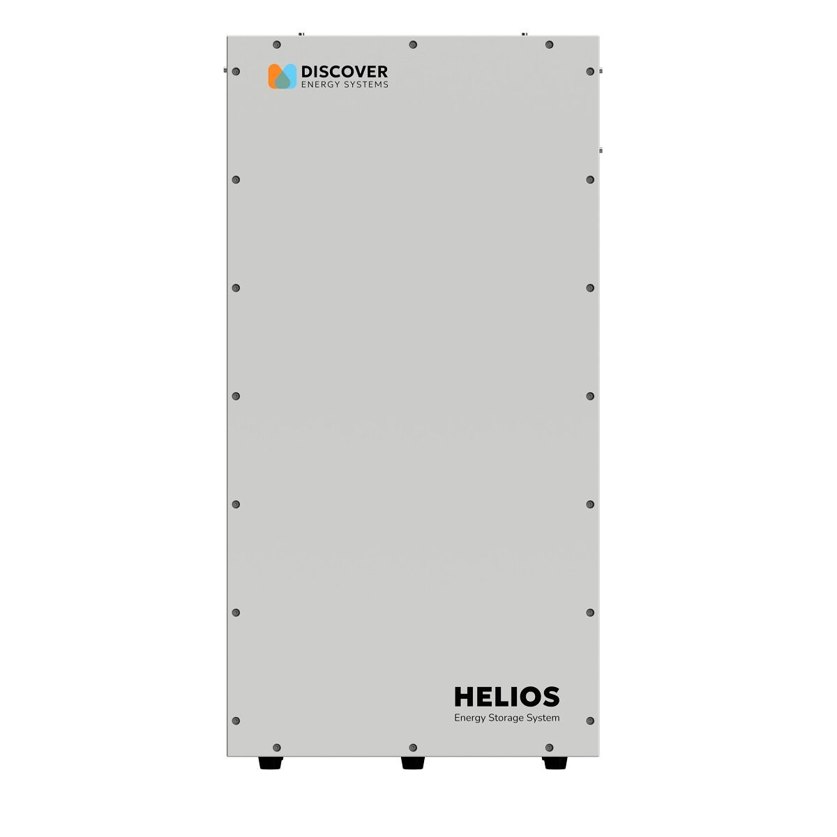

House Renawable Energy System Development & Testing Envrionment
Software Defined
EMS
SolArk
5K 120/230V 48V Hybrid All-In-One Inverter
Main Service Panel
Non-backed up
Utility Service
Smart Meter
DC Solar
0
Sub Panel
Backed up
Smart Modules
Discovery Battery 20kWH
Open Source BMS
Development & Testing Envrionment
Open Source Lab
Notes:
Open BMS Initiative, DEGCent， 9/27/2025

Slide 2


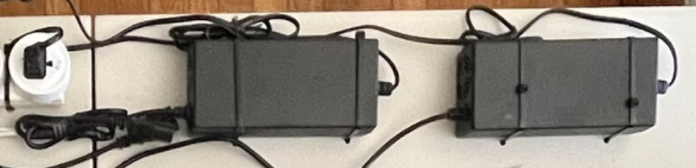
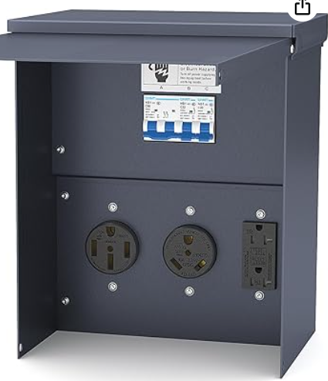

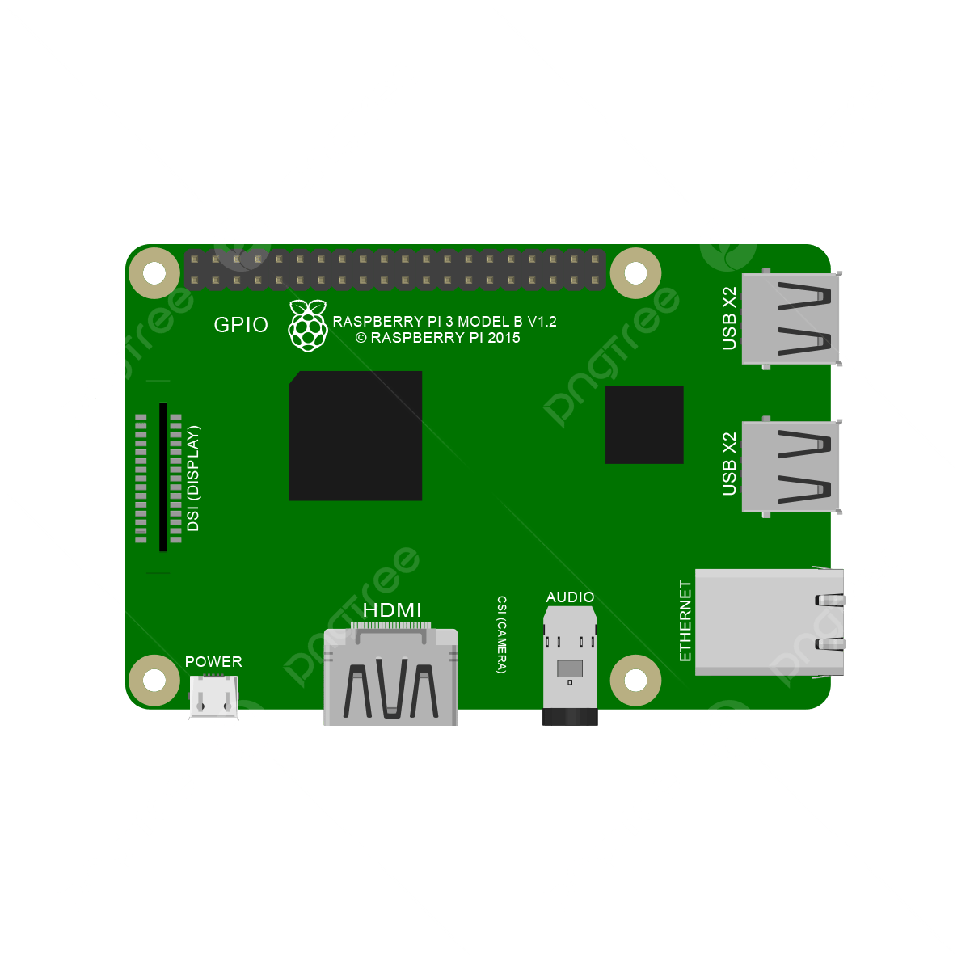



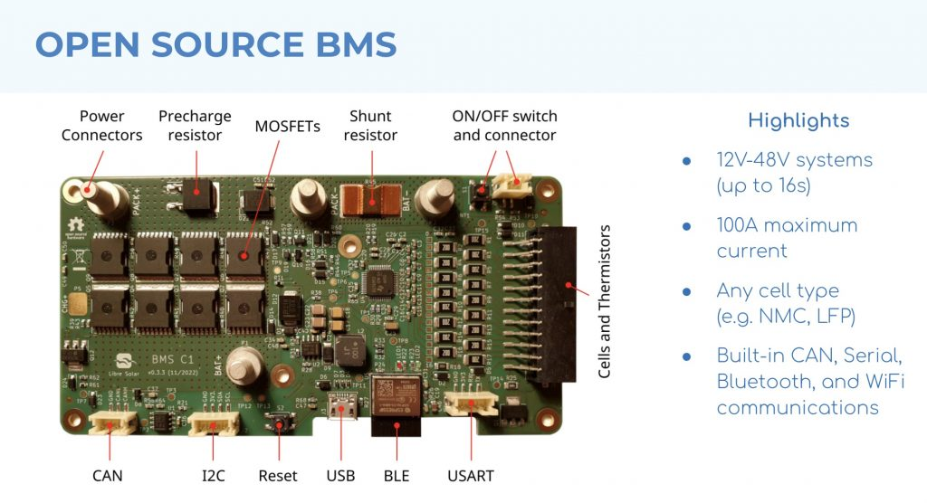

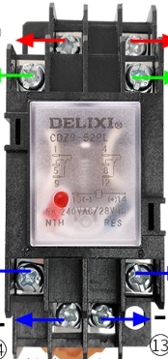
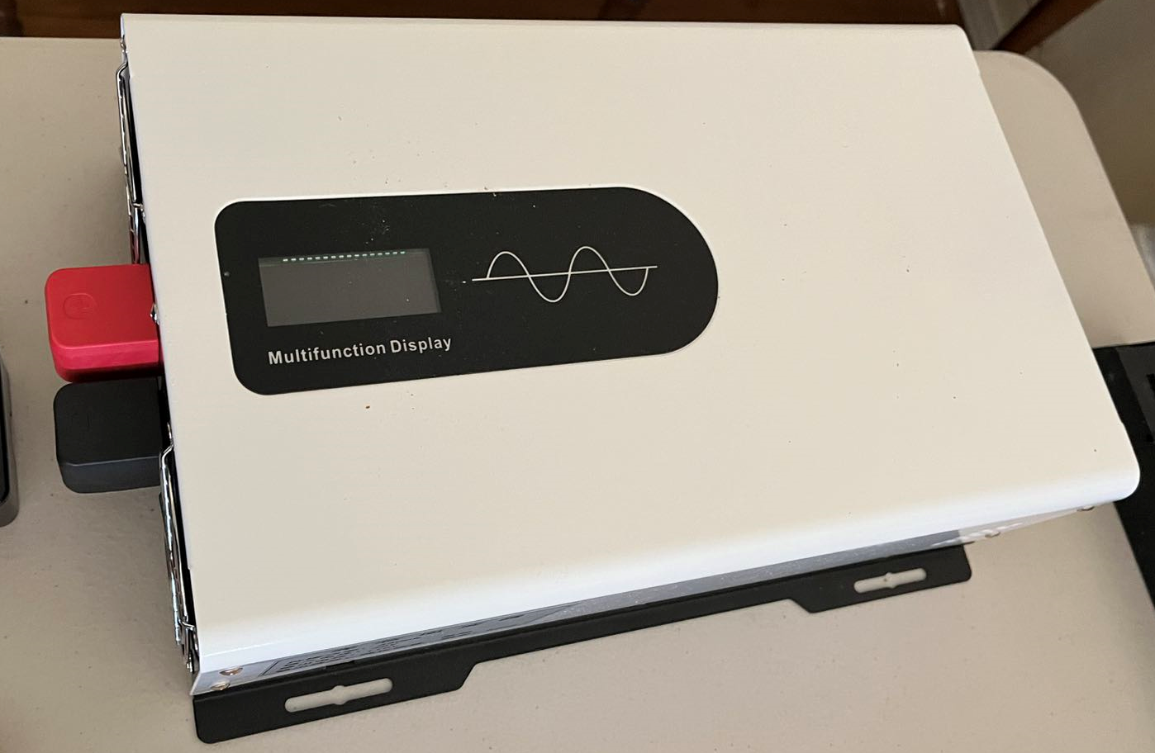
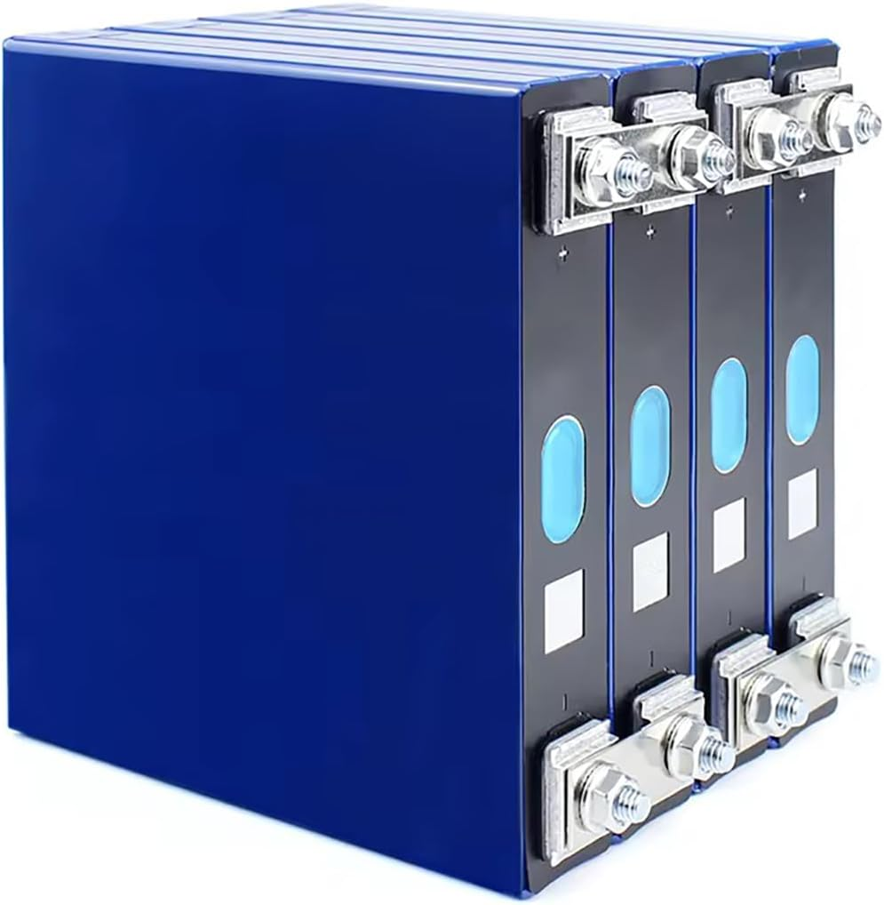





Open Source BMS Development & Testing Envrionment
Software Defined EMS
Smart Plug
Outlet
Home Assistant
4
2
Charger
Smart Plug
BMS
1
Lebre Solar / enAccess
Relay
Smoke detector
Carbon Monoxide detector
3
LiFePO4 Cell 3.2V 32Ah, 16S
Inverter
Off-Grid, In/DC 48V, Out/AC 110V, 3.3kW, 60Hz
Cooling fan
Battery Module
Open Source Lab
5
6
Notes:
Open BMS Initiative, DEGCent， 9/26/2025

Slide 3
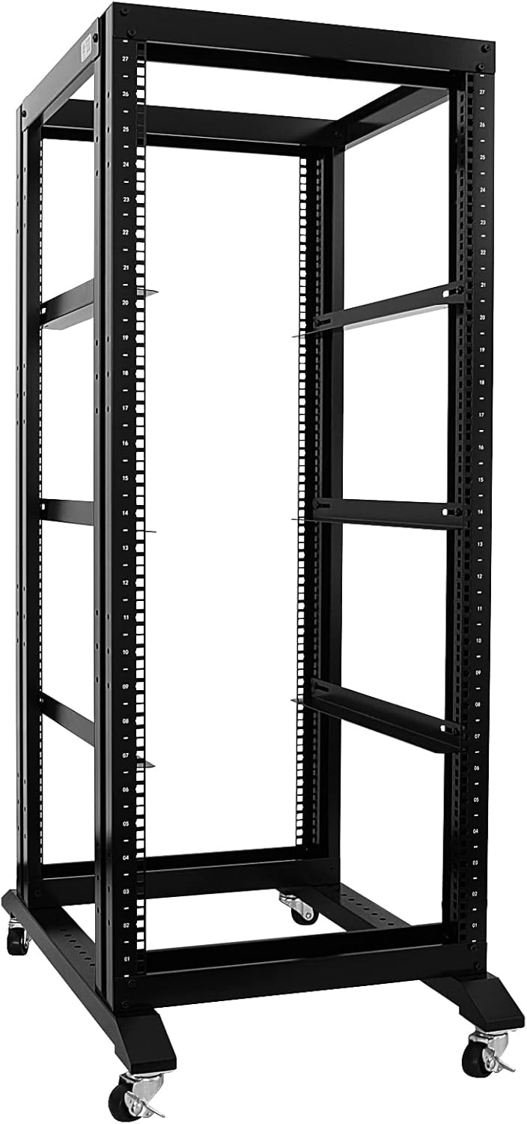
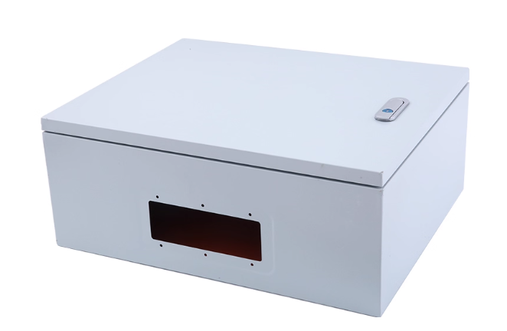
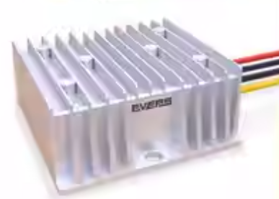

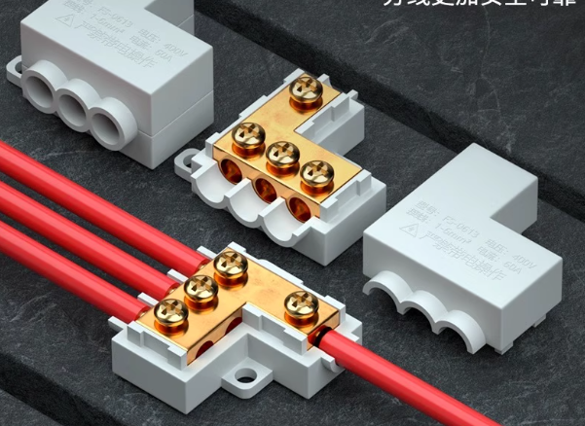
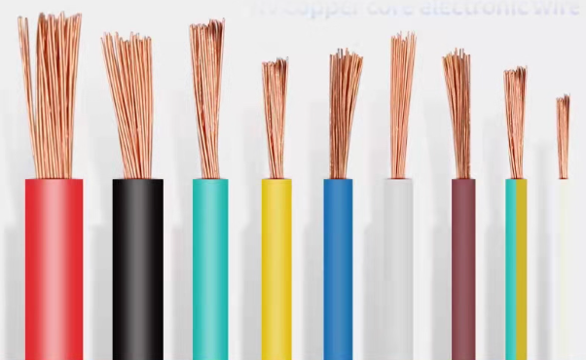
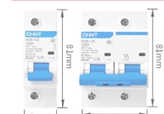
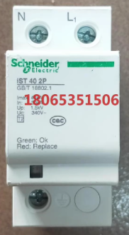
Rack, Cabinet，Accessories
Open Source Lab
Electrical Box
DC/DC Converter
Emergency Swtich
Relay
Terminal/Connectors
Various Cables
AC/DC Breaker
Surge/Lightning Protect Device
Rack
Notes:
Open BMS Initiative, DEGCent, 9/26/2025

