Slide 1
Empowering Sustainable Living with ORES
A Cloud-Native Approach to Software-Defined Home Energy Network
Chris Xie, Head of Open Source Strategy, Futurewei
Karl Xiaofeng Yang, CEO, DEGCent (缔森特能源科技)
LF Energy ORES Working Group
KubeCon & CloudNativeCon China 2025 – Lightning Talk

Slide 2
What is ORES?
ORES: Open Renewable Energy Systems
A working group under LF Energy
Builds open architecture and standards for decentralized renewable energy systems
Focused on cloud-native software + hardware abstraction + interoperability
Use cases: microgrids, home grid energy networks, community DER coordination, started currently pilot deployments for houses in California
KubeCon & CloudNativeCon China 2025 – Lightning Talk

Slide 3
Why ORES?
Problem: Traditional home energy systems are siloed, inflexible, and hardware-bound: device & deployment cost .
Need: open source, standardized, Innovation, interoperable, and intelligent systems to integrate DERs, storage, and smart appliances.
Vision: Empower households with plug-and-play, software-defined energy autonomy, and a total solution with cloud native & AI.
KubeCon & CloudNativeCon China 2025 – Lightning Talk

Slide 4
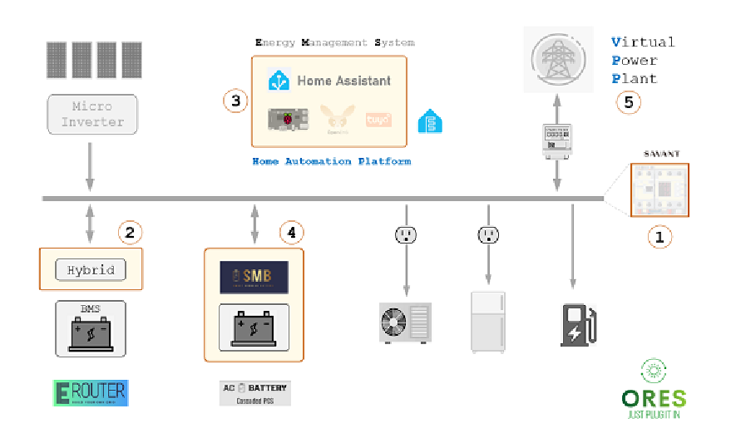
Open Source & Standardized System
Solar Panel + Battery/BMS + PCS + Software Defined EMS
Dimensions to address:
1) Hardware device level
2) Compatible communication and interconnection
3) Software Defined EMS
4) Deployment, safety monitoring and operation maintenance.
5) Cloud Native & AI: Battery on-line, off-line safety and performance evaluation and analysis, etc.
KubeCon & CloudNativeCon China 2025 – Lightning Talk

Slide 5
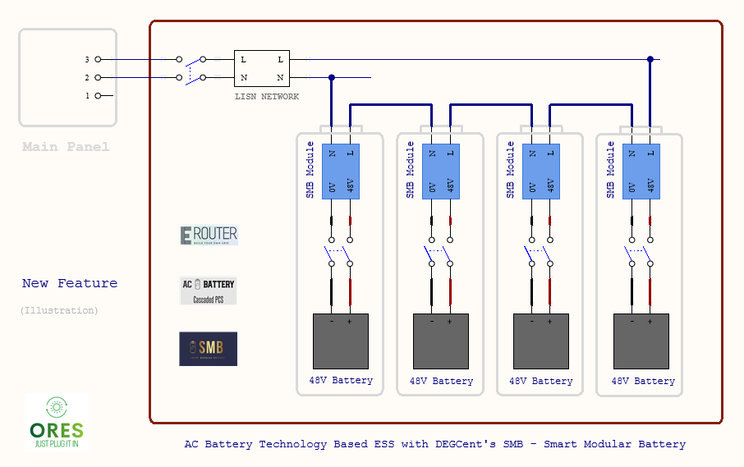
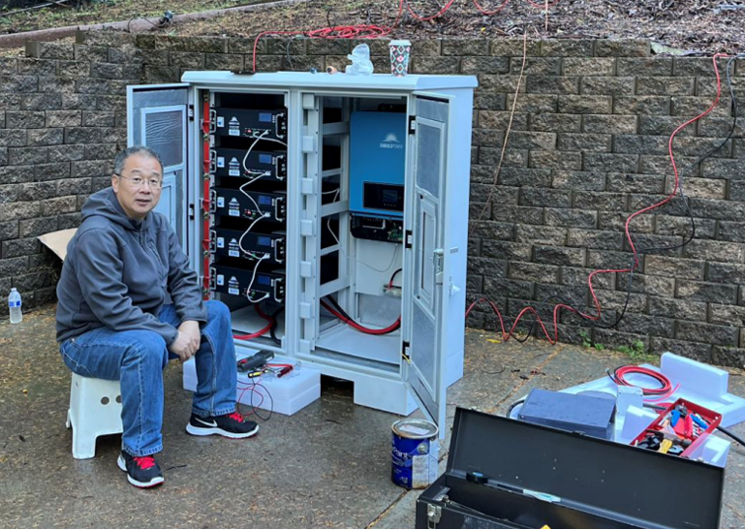
Pilot Implementation & Innovation
“AC Battery” - Smart Modular Battery low-voltage Cascaded PCS Technology
DIY support, LV, Drop & Play
Reduce deployment cost
Increase Safety
Reduce equipment cost
KubeCon & CloudNativeCon China 2025 – Lightning Talk
Differentiated Competitive Advantages: Safety, Cost, Efficiency.

Slide 6
Cloud-Native Home Energy Architecture
Software-Defined EMS (Energy Management System)
Built on Kubernetes-native architecture
RESTful APIs, declarative energy states
Flexible plug-in model for energy devices (inverters, batteries, EVs, HVAC, etc.)
To the Edge (Hardware): Modular smart devices with firmware agents, "Energy IoT"
To the Cloud: Real-time telemetry, distributed orchestration, resilience at scale
Requirements & Expectation
Deployment, monitoring,
maintenance, safety

Slide 7
Introducing GAIFARE
Generative AI for Autonomous Renewable Energy
A new initiative incubated under ORES proposed
Uses generative AI to power intelligent agents across home devices
Enables autonomous coordination of energy production, storage, and consumption, and safety
Context-aware learning: weather, pricing, usage patterns, peer negotiation
Builds on the software-defined foundation of ORES to enable the next-gen autonomous grid
KubeCon & CloudNativeCon China 2025 – Lightning Talk

Slide 8



Call to Action
Join us in building the open source future of energy
Contribute to ORES projects (software, architecture, AI models, hardware protocols)
Collaborate on GAIFARE and other AI-powered workstreams
Be part of a community shaping cloud-native, intelligent, and sustainable energy systems
Connect!
ORES Github
ORES Website
KubeCon & CloudNativeCon China 2025 – Lightning Talk

Slide 9
Thank you!

