Slide 1

Breaking the Impact Factor
How CoARA is changing research assessment
2025-April-11
Joanna Sendecka, PhD

Slide 2
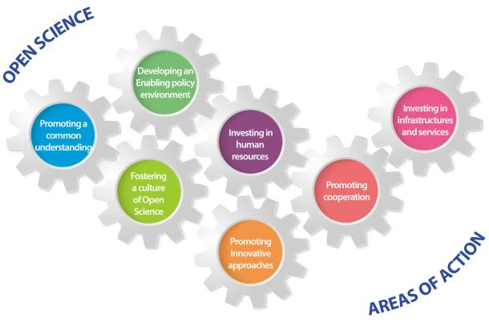
Open Science - more than publications
UNESCO Recommendations on Open Science

Slide 3
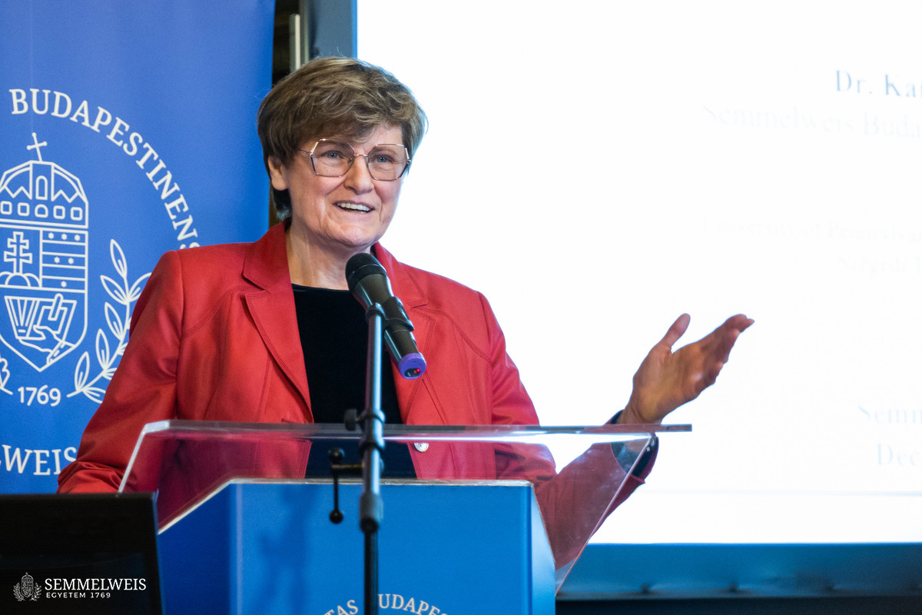
“A person isn't a better scientist because she publishes more or first perhaps, she's holding back from publication because she wants to be absolutely certain of her data. Similarly, the number of citations might have little to do with the value of the paper and more to do with external events.”
Interview with Katalin Karikó, Nobel Prize winner 2023

Slide 4
Open Science implementation issues
“For open science practices to be worthwhile for scholarly reputation, there would need to be new methods of evaluating achievement that reward Open Science practices.” Open Economics Guide, The Role of Open Science in the Evaluation of Research Work, CC BY 4.0
“The transition to an open science system affects the entire research process. The reward systems also need to be adjusted in order to support and mirror the open research landscape.”
Umeå University, Towards a new reward system for open science, Sanna Isabel Ulfsparre, CC BY 4.0
“Open Science will never be achieved unless accompanied by a change in the way researchers are evaluated. Without this, no researcher, will take the proven risk of departing from the old principles that continue to paralyse scientific communications.”
European University Association, 2019 EUA Open Science and Access Survey results, CC BY-NC 4.0
Notes:
Implementation of Open Science practices is slow, and there is little incentive for researchers to follow OS practices.
Right now, researchers are mainly rewarded for publications, not for including Open Science into their projects. Departing from this paradigm is a risk to individual researchers’ careers. Changes thus need to be made in the way researchers are evaluated.
This tracks closely with the findings previously discussed in this report, indicating that Open Science and Access policies have not yet been transposed into university incentive and reward structures. European University association 2019

Slide 5
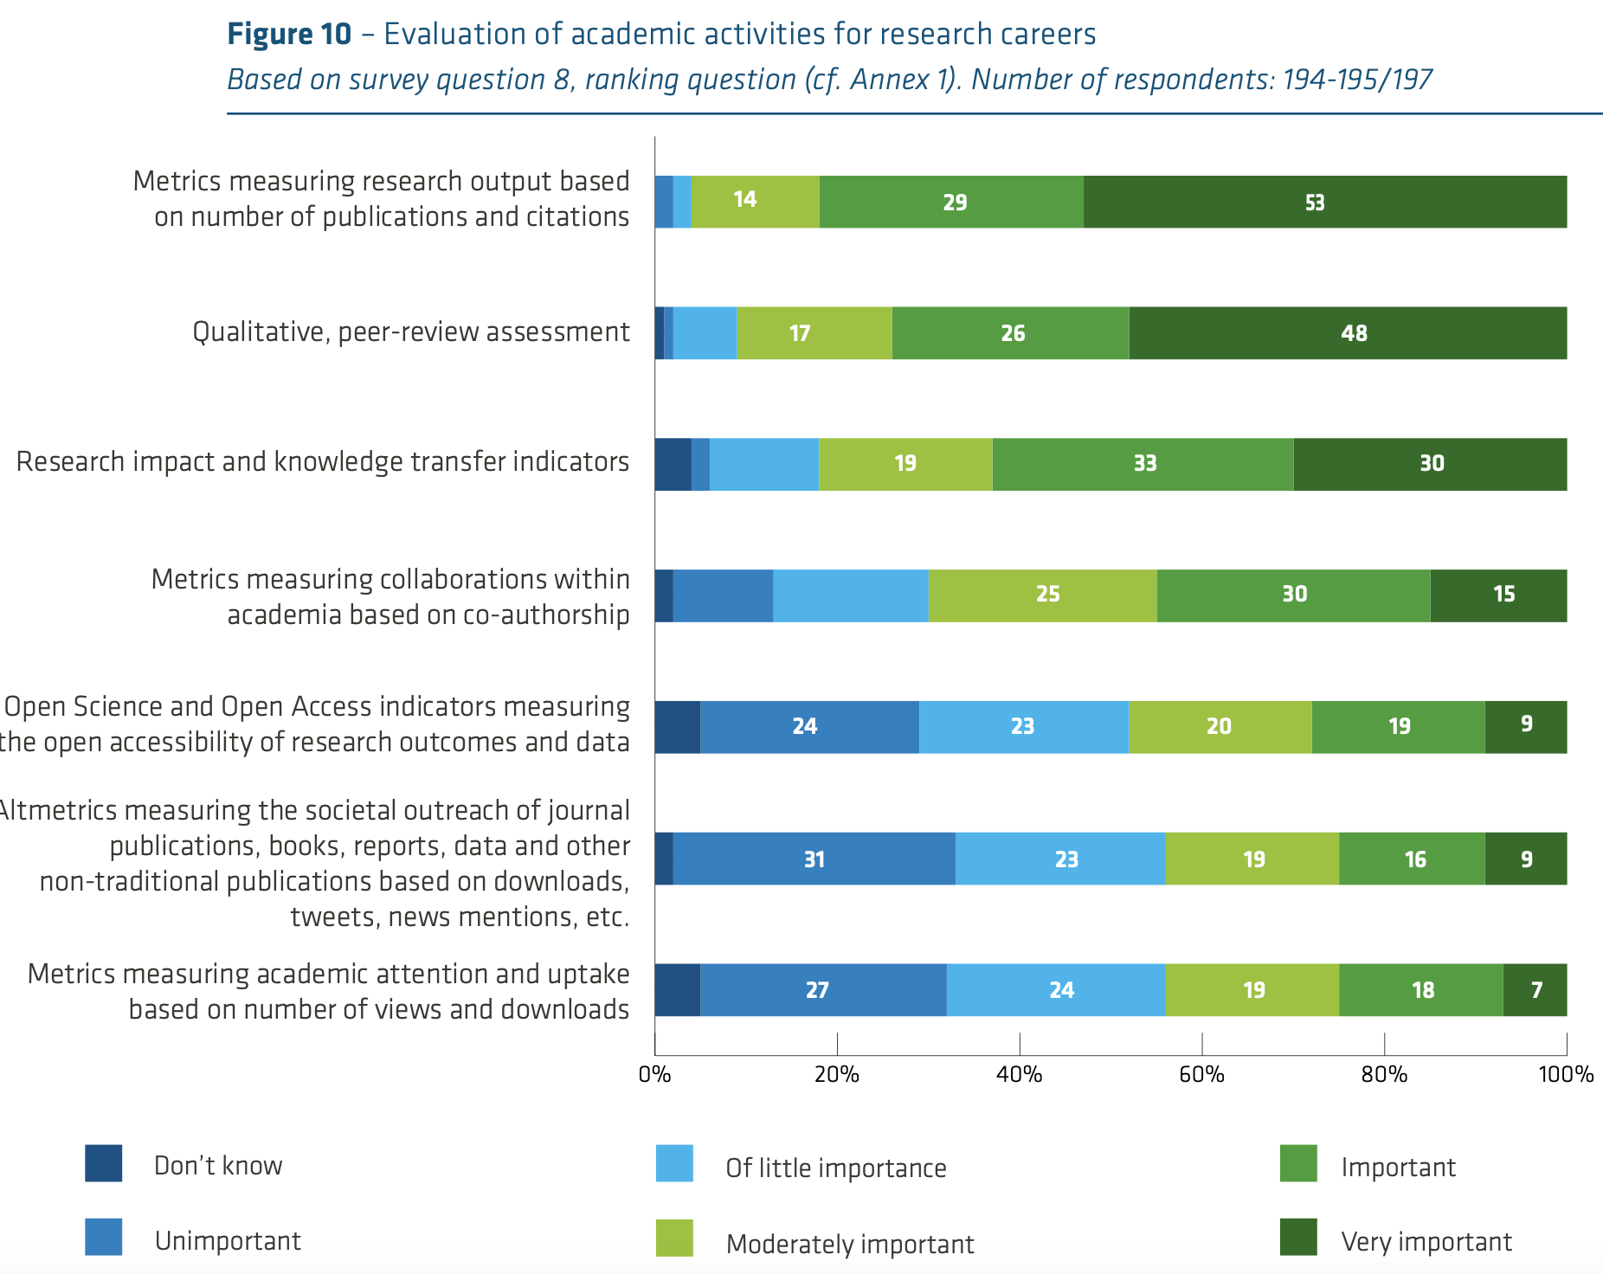
Research evaluation survey 2019
European University Association, 2019 EUA Open Science and Access Survey results CC BY-NC4.0
Notes:
This report’s findings are based on 260 valid responses from universities in 32 European countries.
Methods used to evaluate researchers:
‘Very important’: metrics citations or publication number 53%, qualitative peer-review assessment 48%, research impact & patents 30%. A large majority of responding institutions use a combination of qualitative peer-review and quantitative metrics to assess research for career purposes.
research impact and knowledge transfer: e.g. intellectual properties such as patents and licenses
metrics measuring collaborations within academia based on co-authorship: e.g. SCOPUS Author position metric
Open science indicators: e.g. PLOS Open Science indicators (sharing of research data in repositories, sharing of code, posting of preprints, protocol sharing, study registration).
Altmetrics: e.g altmetric.com Altmetric’s interface tracks online engagement to reveal how and where your research is making a difference.
Main metric used is JIF, h-index, not so much other metrics
Universities approaches to research assessment are mainly determined by government influence, and guidelines developed by other universities. Not so much DORA (15-23%) and Leiden manifesto (15-22%)

Slide 6




Research evaluation - current practices
Funders
A list of all works published in peer-reviewed journals and with the ten most significant publications highlighted. For scientific areas where it is applicable, using Web of Science, Scopus or Google Scholar, an h-index and the number of publications and citations the h-index is based on must be specified.
Bibliometrics shall be used with caution in the review, and only as part of an overall assessment of the merits carried out by reviewers with expertise in the area in question. Bibliometrical data gathered in conjunction with the application shall be relevant to the research area and the grant form the call relates to.
No publicly available information about procedures for evaluation
Knut & Alice Wallenberg Foundation, 2024. Funding guide
VR, 2024. Peer-review handbooks

Slide 7
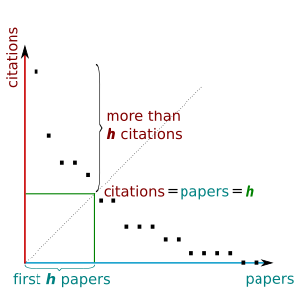
Indexes - convenient …?
The h-index is an author-level metric that measures both the productivity and citation impact of the publications, initially used for an individual scientist or scholar. (...) The index is based on the set of the scientist's most cited papers and the number of citations that they have received in other publications.
E.g. h-index = 6 means 6 papers were cited at least 6 times
Image: https://en.wikipedia.org/wiki/H-index

Slide 8

Indexes - convenient but problematic
2 papers cited 1000+ times plus 4 cited 6 times h-i6
100 papers, most cited no more than 6 times h-i6
reviews vs. original work
granularity of publications
Image by brgfx on Freepik

Slide 9
Indexes - convenient but problematic
difficult to compare different fields
2 papers cited 1000+ times plus 4 cited 6 times h-i6
100 papers, most cited no more than 6 times h-i6
reviews vs. original work
many publications with many authors vs. single person work
young researchers’ penalty
granularity of publications
Image by brgfx on Freepik

Slide 10
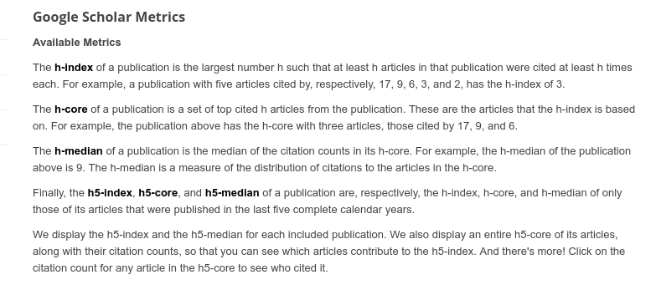
Indexes - convenient but problematic
Google Scholar’s h-core, h-median and more - also based only on most cited papers
From: https://scholar.google.com/intl/en/scholar/metrics.html#metrics

Slide 11
Indexes - convenient but problematic
Google Scholar’s h-core, h-median
preprints and other versions of papers count as new papers
self-citations count the same as others
difficult to compare different fields
100 papers, most cited no more than 5 times h-i6
2 papers cited 1000+ times plus 4 cited 6 times h-i6
reviews vs. original work
many publications with many authors vs. single person work
re-citing by individual GS authors’ pages (citation count inflation)
not all citations are verified (manual edits)
young researchers’ penalty
granularity of publications
Image by brgfx on Freepik

Slide 12
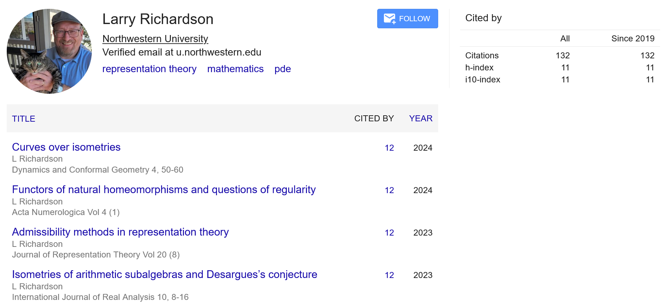
Is h-index even true?

Slide 13
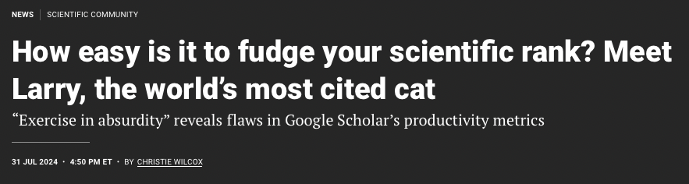
Research evaluation - Change needed
Christie Wilcox (2024) How easy is it to fudge your scientific rank? Science 10.1126/science.zl99qni

Slide 14
Research evaluation - change requested
How does research evaluation based on bibliometrics hinder Open Science?
encourages publishing in paywalled journals because of their high impact factors, despite the availability of open access alternatives
generates excessive attention to rankings that hinders collaboration
waste efforts, time and resources through the duplication of work as ‘negative’ findings go largely unreported
promotes quantity and speed at the expense of quality and rigour
lead to risk-adversity because taking risks may reduce the chances of publication
lead to the emergence of predatory journals and conferences
CoARA, 2022. Agreement on reforming research assessment, CC BY 4.0
Notes:
Evaluation of individual researchers based on bibliometrics is not only deeply flawed, but also hinders the progression towards Open Science in the following ways:

Slide 15
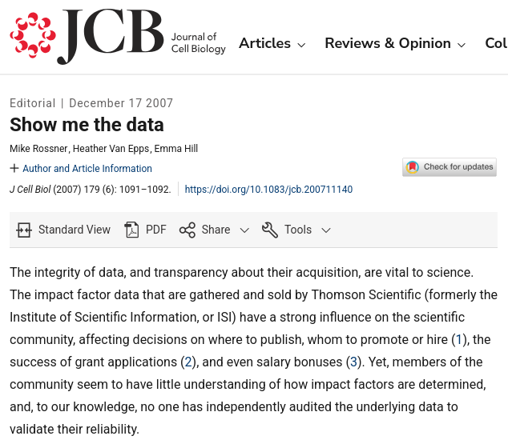
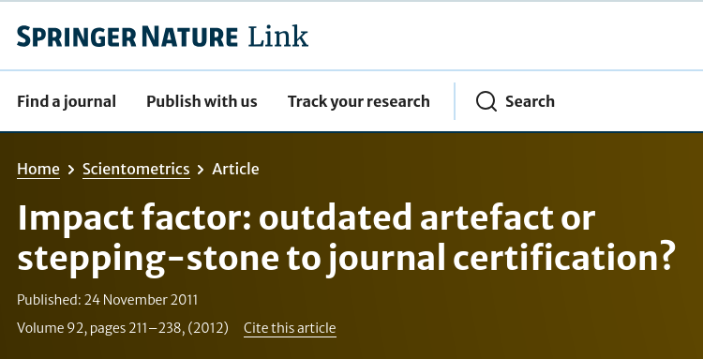
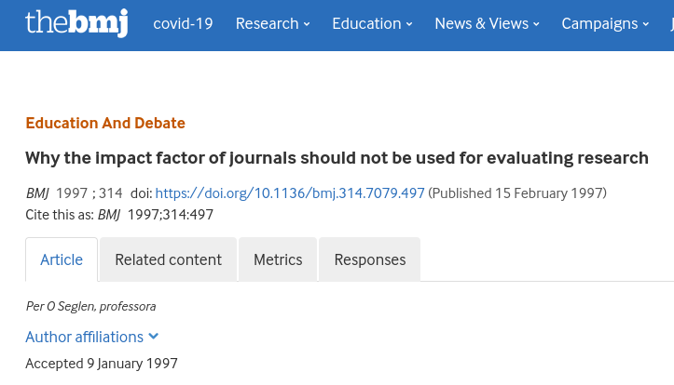
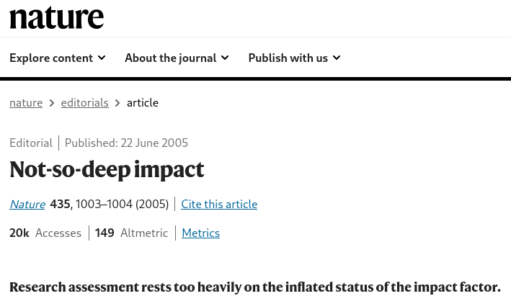
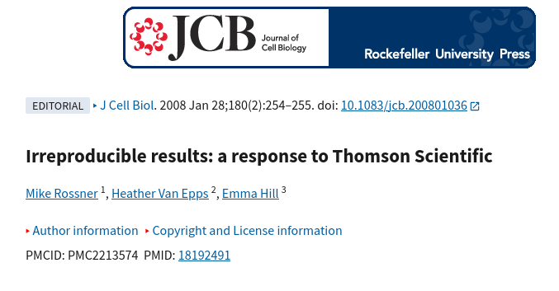
Research evaluation - change requested
https://doi.org/10.1007/s11192-011-0561-0
https://doi.org/10.1136/bmj.314.7079.497
https://doi.org/10.1083/jcb.200711140
https://doi.org/10.1038/4351003b
https://doi.org/10.1083/jcb.200801036
Notes:
https://doi.org/10.1007/s11192-011-0561-0
https://doi.org/10.1038/4351003b
https://doi.org/10.1136/bmj.314.7079.497
https://doi.org/10.1083/jcb.200711140
https://doi.org/10.1083/jcb.200801036

Slide 16

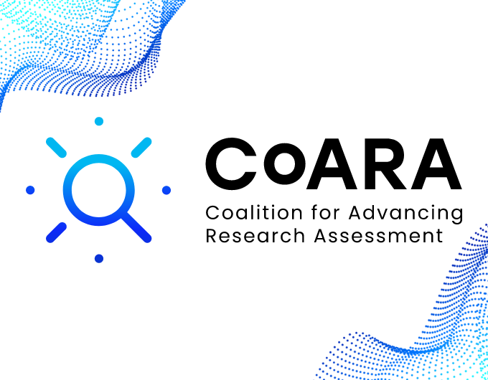

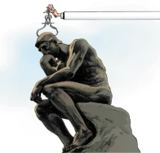

Research evaluation - Change coming
ERA initiatives
Leiden Manifesto
Towards a reform of the research assessment system
2000
2013
2014
2015
2016
2017
2018
2019
2020
2021
2022
2023
2024
value and impact of all research outputs
necessity for comprehensive changes in research evaluation to enhance the quality, performance, and impact of research
openness, collaboration, and fairness in research. limitations of traditional assessment methods
responsible, context-aware, and qualitative approach to evaluation
practical, coordinated, institution-driven movement. structured implementation, institutional commitment, policy integration
DORA, 2013. San Francisco declaration on research assessment, CC BY-SA 4.0
Leiden Manifesto, 2015: https://www.nature.com/articles/520429a
CoARA, 2022. Agreement on reforming research assessment, CC BY 4.0
Notes:
The first European Research Area (ERA) plans, introduced in the early 2000s, laid the foundation for harmonizing research policies across Europe but did not explicitly focus on research assessment reform. However, they indirectly influenced the evolution of research assessment by promoting principles that later became central to reform efforts.
Key Links Between ERA and Research Assessment Reform:
Encouraging Open Science and Research Integrity
The ERA’s initial plans emphasized open access to publications and data, which challenged traditional research evaluation methods based solely on journal impact factors.
As Open Science gained traction, assessment practices had to adapt to recognize diverse research outputs, such as datasets and collaborative projects.
Funding Allocation and Evaluation Criteria
The ERA’s push for greater investment in research and innovation (e.g., through Horizon 2020 and Horizon Europe) led to increased scrutiny of how research quality is assessed.
Traditional bibliometric indicators were found insufficient for evaluating interdisciplinary and applied research, necessitating new assessment frameworks.
Cross-Border Research Collaboration
One of the ERA’s primary goals was to remove barriers to cross-border research collaboration.
Standardized assessment criteria across countries became essential, prompting discussions about more transparent and fair research evaluation methods.
Responsible Use of Metrics
Early ERA policies were aligned with growing concerns about the misuse of quantitative metrics in assessing research performance.
This concern was later formalized in initiatives such as DORA (2012), the Leiden Manifesto (2015), and the 2021 ERA reforms.
The 2020+ ERA and Research Assessment Reform
The revised ERA Policy Agenda (2021–2024) explicitly addressed the need for reforming research assessment to recognize a broader range of contributions, including societal impact, Open Science practices, and interdisciplinary work.
This directly led to the establishment of CoARA (Coalition for Advancing Research Assessment) in 2022, which pushes for qualitative peer review alongside responsible metrics.
Horizon 2020, the European Union’s research and innovation funding program (2014–2020), played a crucial role in shaping research assessment reform by encouraging a more open, responsible, and impact-driven approach to evaluating research. Here’s how it contributed to changing research assessment practices:
1. Promoting Open Science and Open Access
Requirement for Open Access: Horizon 2020 mandated that all publicly funded research outputs (publications and data) be openly accessible.
Impact on Research Assessment: This challenged the traditional reliance on journal impact factors, as research visibility and influence could no longer be judged solely by paywalled high-impact journals.
2. Expanding the Definition of Research Excellence
Societal Impact Focus: Horizon 2020 placed a strong emphasis on how research benefits society, the economy, and policy-making.
Impact on Research Assessment: This required assessment criteria to go beyond publication metrics, incorporating indicators of real-world impact, such as patents, collaborations, and policy influence.
3. Encouraging Interdisciplinary and Mission-Oriented Research
Funding for Grand Challenges: Horizon 2020 prioritized research addressing major societal challenges (e.g., climate change, health, digital transformation).
Impact on Research Assessment: Traditional discipline-based assessment methods were inadequate for evaluating interdisciplinary research, leading to new qualitative and mission-driven evaluation criteria.
4. Fostering Responsible Research and Innovation (RRI)
RRI Framework: Horizon 2020 integrated principles of ethics, inclusivity, and public engagement into research projects.
Impact on Research Assessment: This expanded the scope of evaluation to include how research was conducted, rather than just its outcomes, encouraging responsible and ethical research practices.
5. Paving the Way for Research Assessment Reform in ERA
Link to ERA and CoARA: Horizon 2020’s push for Open Science, broader impact criteria, and interdisciplinary work directly influenced the 2020+ European Research Area (ERA) policy, which called for a fundamental reform of research assessment.
Formation of CoARA: These discussions ultimately led to the Coalition for Advancing Research Assessment (CoARA) in 2022, which formalized commitments to move beyond journal impact factors and support qualitative peer review.

Slide 17
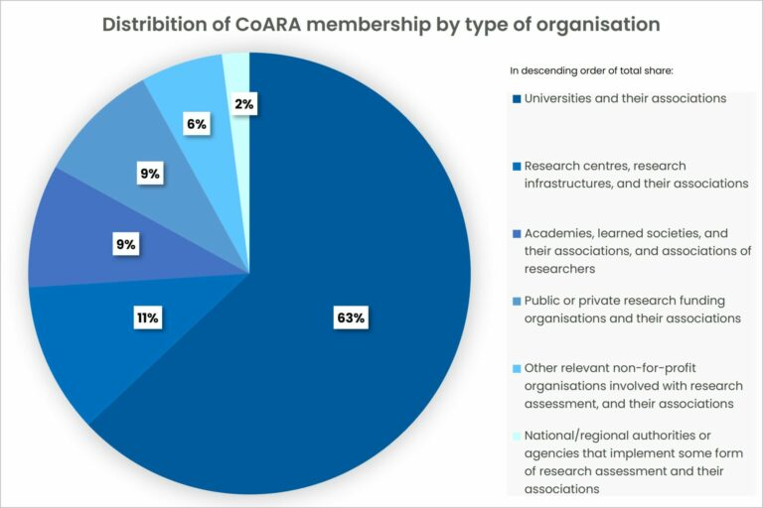
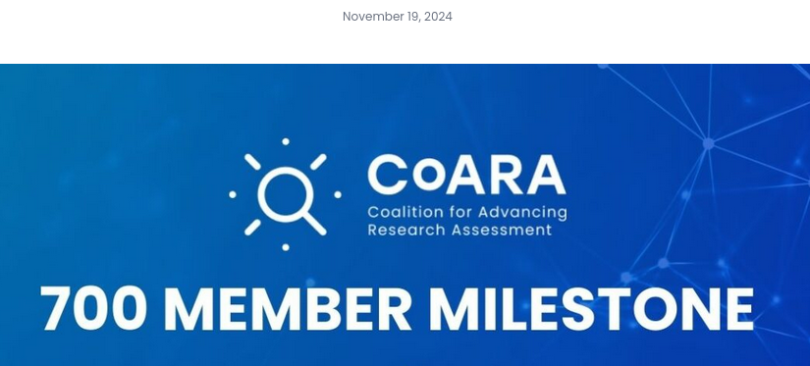
CoARA today
13 active Working Groups
16 active National Chapters

Slide 18
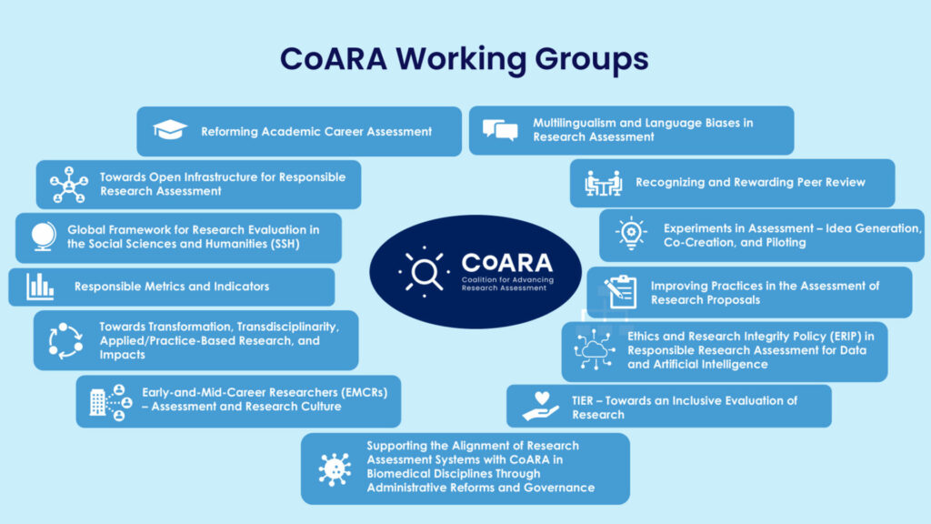
CoARA - Change coming
Open Infrastructures Multilingualism
Innovative Assessments
Career Assessment
Diverse academic roles
Diverse initiatives Responsible Metrics
Proposal Evaluation
Ethics in AI
Transdisciplinarity
Peer Review Recognition
https://coara.eu/working-groups/working-groups/

Slide 19
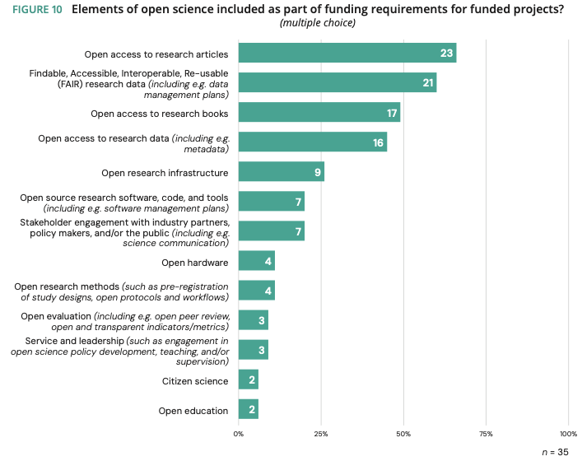
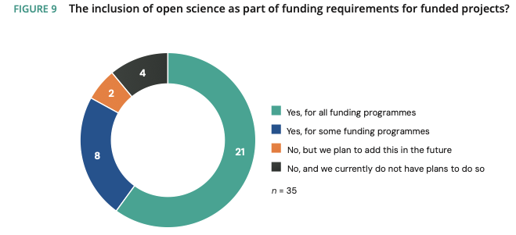
Research evaluation - Change is here
Science Europe, 2024. Survey Report: Strategic Approaches to and Research Assessment of Open Science, CC BY 4.0
Notes:
More recent study among funders, 36 members in 28 countries,, including 32 funding bodies, 1 research performing organisation, and 3 organisations with both funding and research performing roles. As such, the survey results predominantly reflect the perspective of public research funding organisations in Europe.
Results indicate that the inclusion of open science as part of funding requirements is increasing.
Responding institutions indicated that these influences are predominantly from governments and research funding organisations who set the regulatory and funding frameworks, and also from the competitive research and innovation environment (cf. section 3.1.). Conversely, the influence of research community principles and guidelines (e.g. DORA, the Leiden Manifesto, the Metric Tide) was much less recognised (cf. section 4.1.).

Slide 20
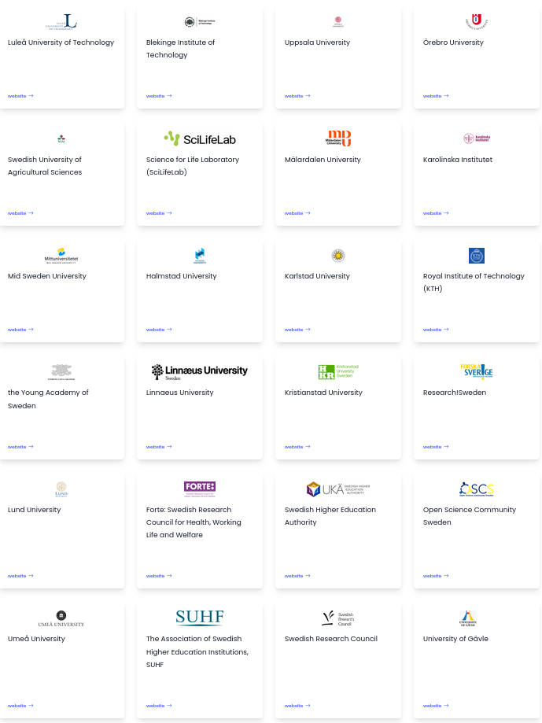
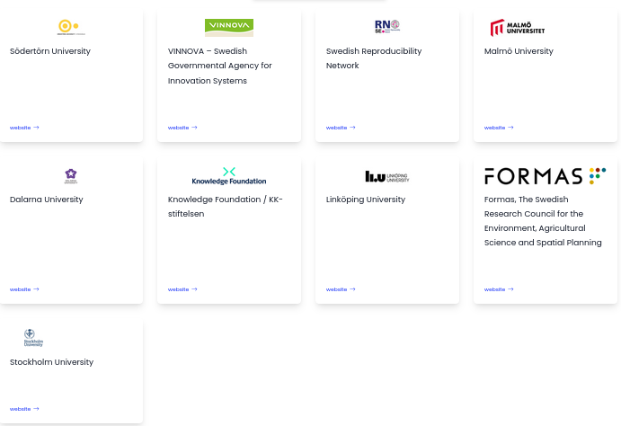
CoARA in Sweden
33 signatories
universities
funders
organisations
https://coara.eu/working-groups/national-chapters/coara-national-chapter-sweden/

Slide 21

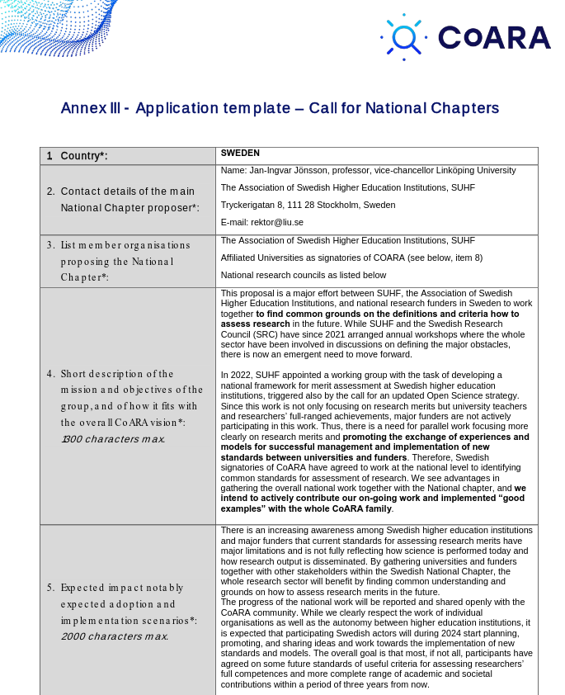
CoARA in Sweden
Key objectives:
Develop Common Standards: Collaborate at the national level to identify and implement unified standards for assessing research, moving beyond traditional metrics like publication counts and citation numbers
Promote Experience Sharing: Encourage the exchange of experiences and best practices among Swedish universities and research institutions to facilitate the adoption of new assessment models
Engage Major Funders: Work towards involving major funding bodies in the reform process to ensure comprehensive changes in research assessment that encompass both academic and societal contributions
Contribute to the CoARA Community: Actively share successful examples and insights from the Swedish context with the broader CoARA community to support global efforts in research assessment reform
https://coara.eu/working-groups/national-chapters/coara-national-chapter-sweden/

Slide 22
CoARA in Sweden and SciLifeLab
Working groups
1. Research applications at national level, individual and environmental support
Coco Norén, Uppsala University
2. Good practice in the evaluation of researchers, research training and career paths
Adina L. Feldman, KI
3. Responsible bibliometrics
Katrine Riklund, Umeå University
4. Incentives for open science
Gustav Nilsonne, SweRN/KI
5. Merit values in collaboration and utilization
Margareta Friman, Karlstad university
SciLifeLab participates in National-level working groups
Notes:
mention universities

Slide 23
CoARA in Sweden and SciLifeLab
Working groups
1. Research applications at national level, individual and environmental support
Coco Norén, Uppsala University
2. Good practice in the evaluation of researchers, research training and career paths
Adina L. Feldman, KI
3. Responsible bibliometrics
Katrine Riklund, Umeå University
4. Incentives for open science
Gustav Nilsonne, SweRN/KI
5. Merit values in collaboration and utilization
Margareta Friman, Karlstad university
Main objectives:
investigate existing projects in collaboration merit assessment in Sweden and internationally
learn from previous projects
facilitate information exchange and collaboration between relevant actors
contribute to common framework for merit assessment
Notes:
mention universities

Slide 24
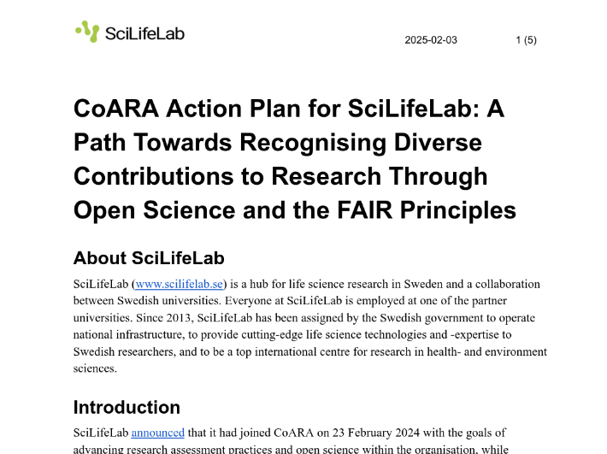
CoARA in Sweden and SciLifeLab
Main objectives:
recognise diverse research contributions beyond traditional metrics
promote OS practices and adoption of FAIR principles
support career development - value broader range of research outputs
align SciLifeLab practices with CoARA
https://zenodo.org/records/14796936
Notes:
mention universities

Slide 25
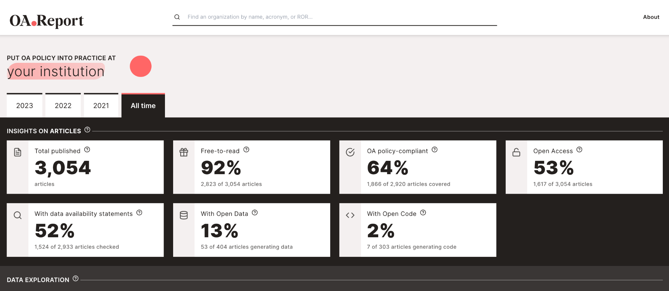
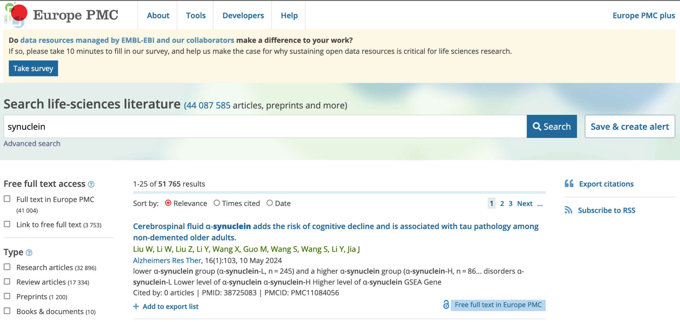

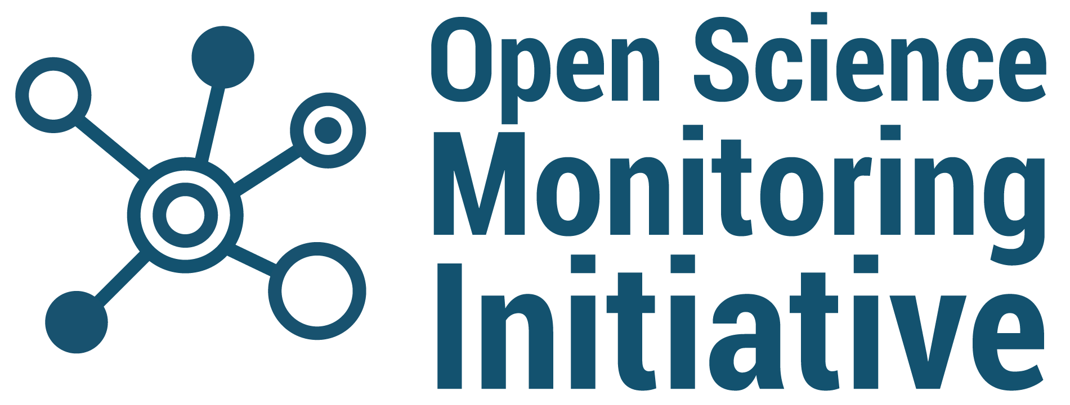
Monitoring Open Science and FAIR
Dashboard that tracks SciLifeLab open and FAIR research outputs (publications, data, software, protocols, etc.)
Mining and indexing service to improve discovery of these outputs (e.g., Europe PMC)
Notes:
Images from: Dataseer, OA.Report, Europe PMC

Slide 26

Research evaluation - future practices
A new contextualising part has been introduced in the application (...). In this part, the applicant must describe how the merits that have been indicated in the CV and under “Publications and other research output” show the competence to carry out the proposed research.
The list of publications in the application is now called “Publications and other research outputs.” It consists of two parts where the applicant must separate between publications and research outputs that are peer-reviewed and not peer-reviewed.
When assessing the research achievements of the applicants, focus on the scientific content and refrain from using surrogate measures of the quality of research outputs, such as Journal Impact Factors
Applicants may include relevant additional information on their research careers to provide context to the evaluation panels when assessing their research achievements and peer recognition
VR, 2024. Peer-review handbooks
ERC, 2025. Guide for peer reviewers: starting and consolidator grants
ERC, 2024. Work program

Slide 27

What change, in your opinion, would have the greatest value for future development of research assessment to make it more ethical, inclusive and relevant?
Reproducibility
Proper credit for all the authors, not only the first authors and corresponding authors
Right now, if I am being honest, it is not as attractive to submit an open access paper compared to the top tiered journals. So promoting the idea of open access more and doing that might attract high quality researchers which in turn increase the reputation
Science outreach to the public
Transparency
Take into account preprints also
Quality over quantity
It is more important to concentrate on research work than on publications
Collaboration
Inclusion
Assess quality over quantity
Drop requirements for "high impact" journals. Omit hard requirements for a specific number of publications for graduation. Place higher emphasis on "negative results" journals, open access journals
Access contribution to scientific community, not just publishing
Fair credit for work
Relevance in current times
New metric that is more fair and relevant for the research impact
Reproducibility
Include mentorship of junior researchers
Look more granularly at contributions of different authors (not just first and corresponding authors)
Higher quality by not only publishing success but also failure
Alternatives to papers for scientific contribution
Assess researcher's skills in other areas i.e. teaching, communication, policy
Focus on high-impact science, not high-impact journals
Social impact, open science, collaboration and diverse contributions
Make sure that there are infrastructure and knowledge to be able to make good decisions
Multi-metric assessment
How much emphasis on science communication there is
Indicators of research assessment should not be included in research job markets
Research work impact (methods and use of results by the community at large)
Quality over quantity
Publish for the sake of furthering science, not for a number on your CV
Have a better way of measuring research "success"
More qualitative assessment
More focus on quality rather than quantity
Reward actual contributions instead of placement in author list
How committed to open science a researcher is
Stop the publish-or-perish culture
SURVEY RESULTS

Slide 28



Slide 29


Why employ OS researcher?
Funder/Employer perspective
Advantages
Disadvantages

Slide 30
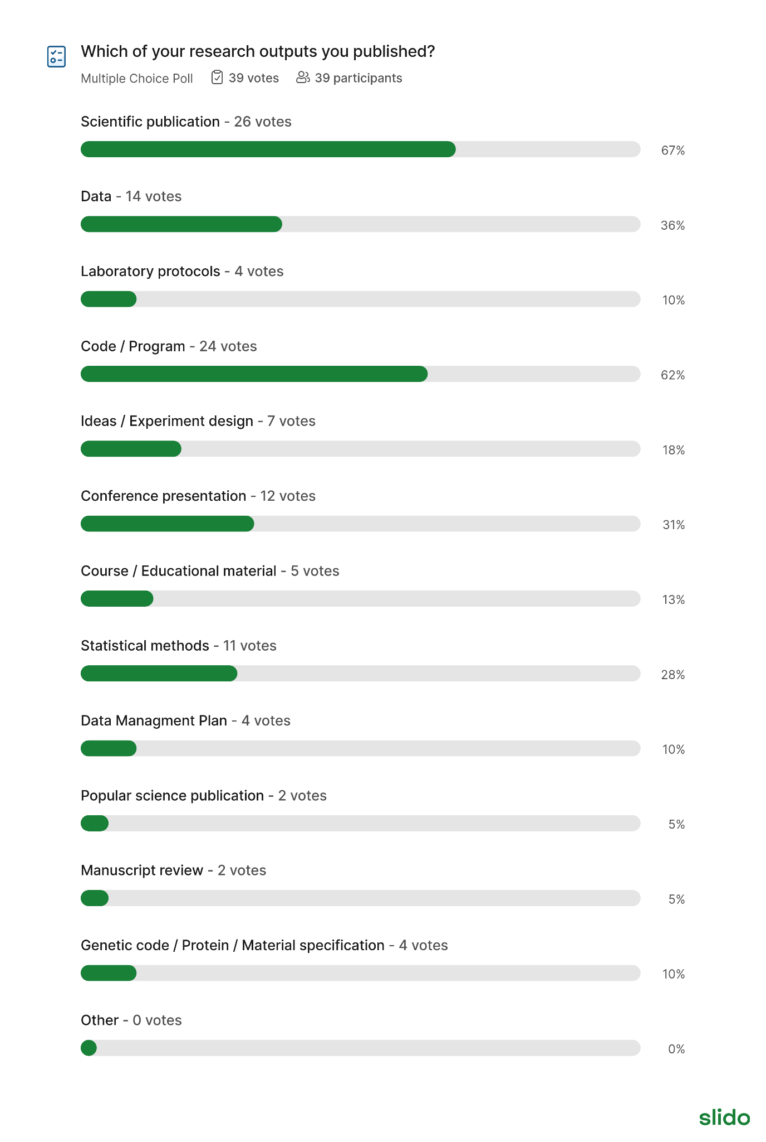

Are you ready for the change?
SURVEY RESULTS

Slide 31


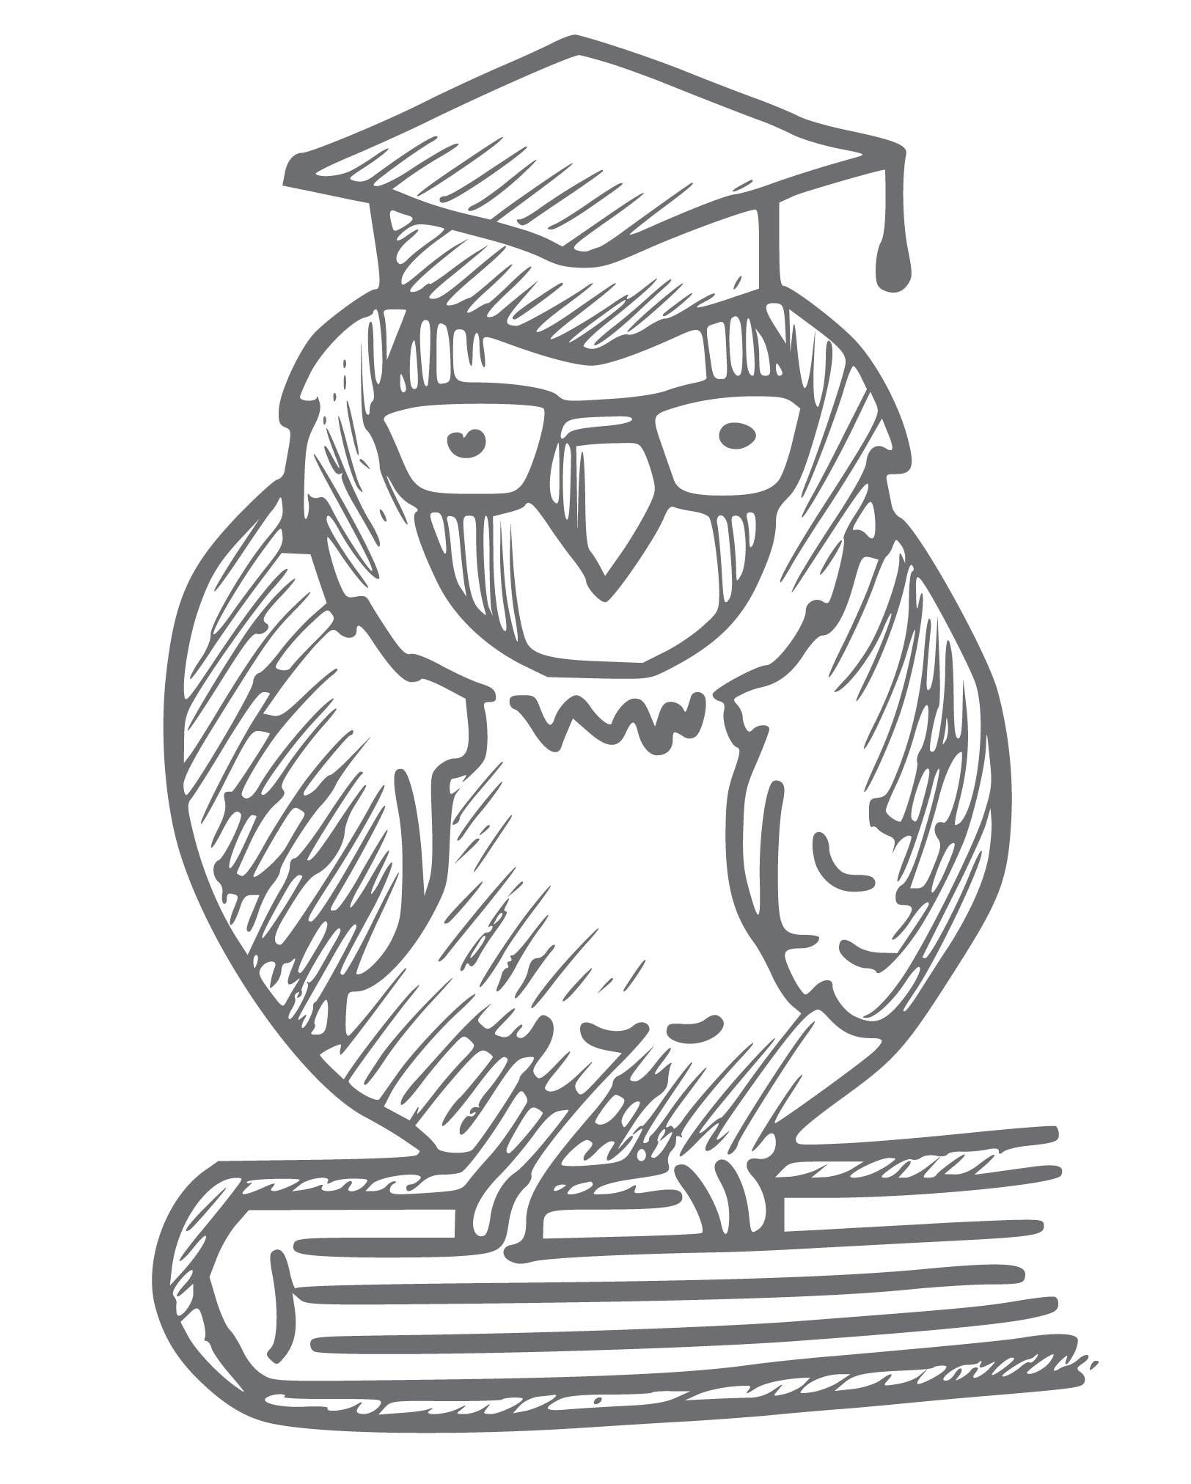
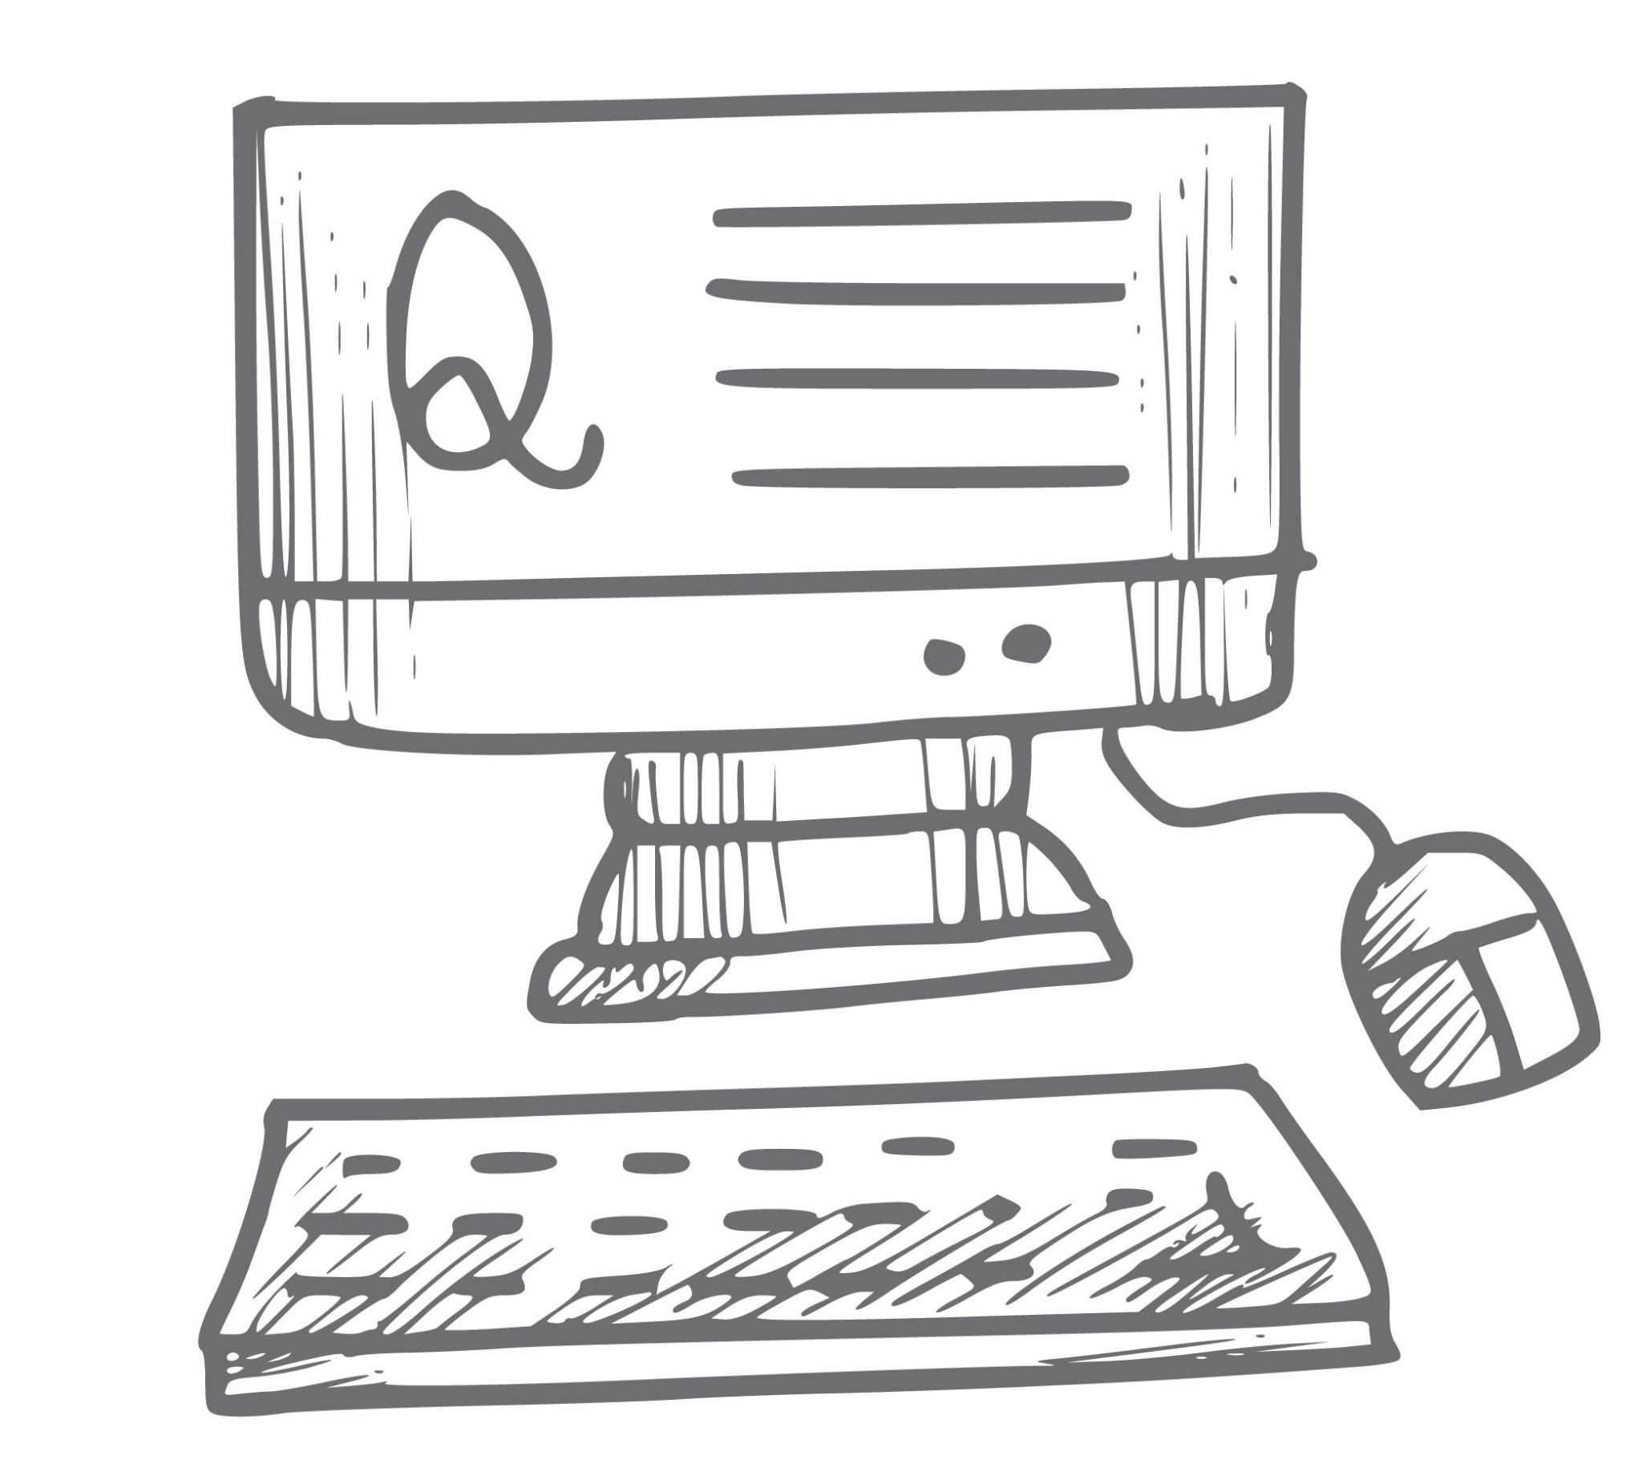

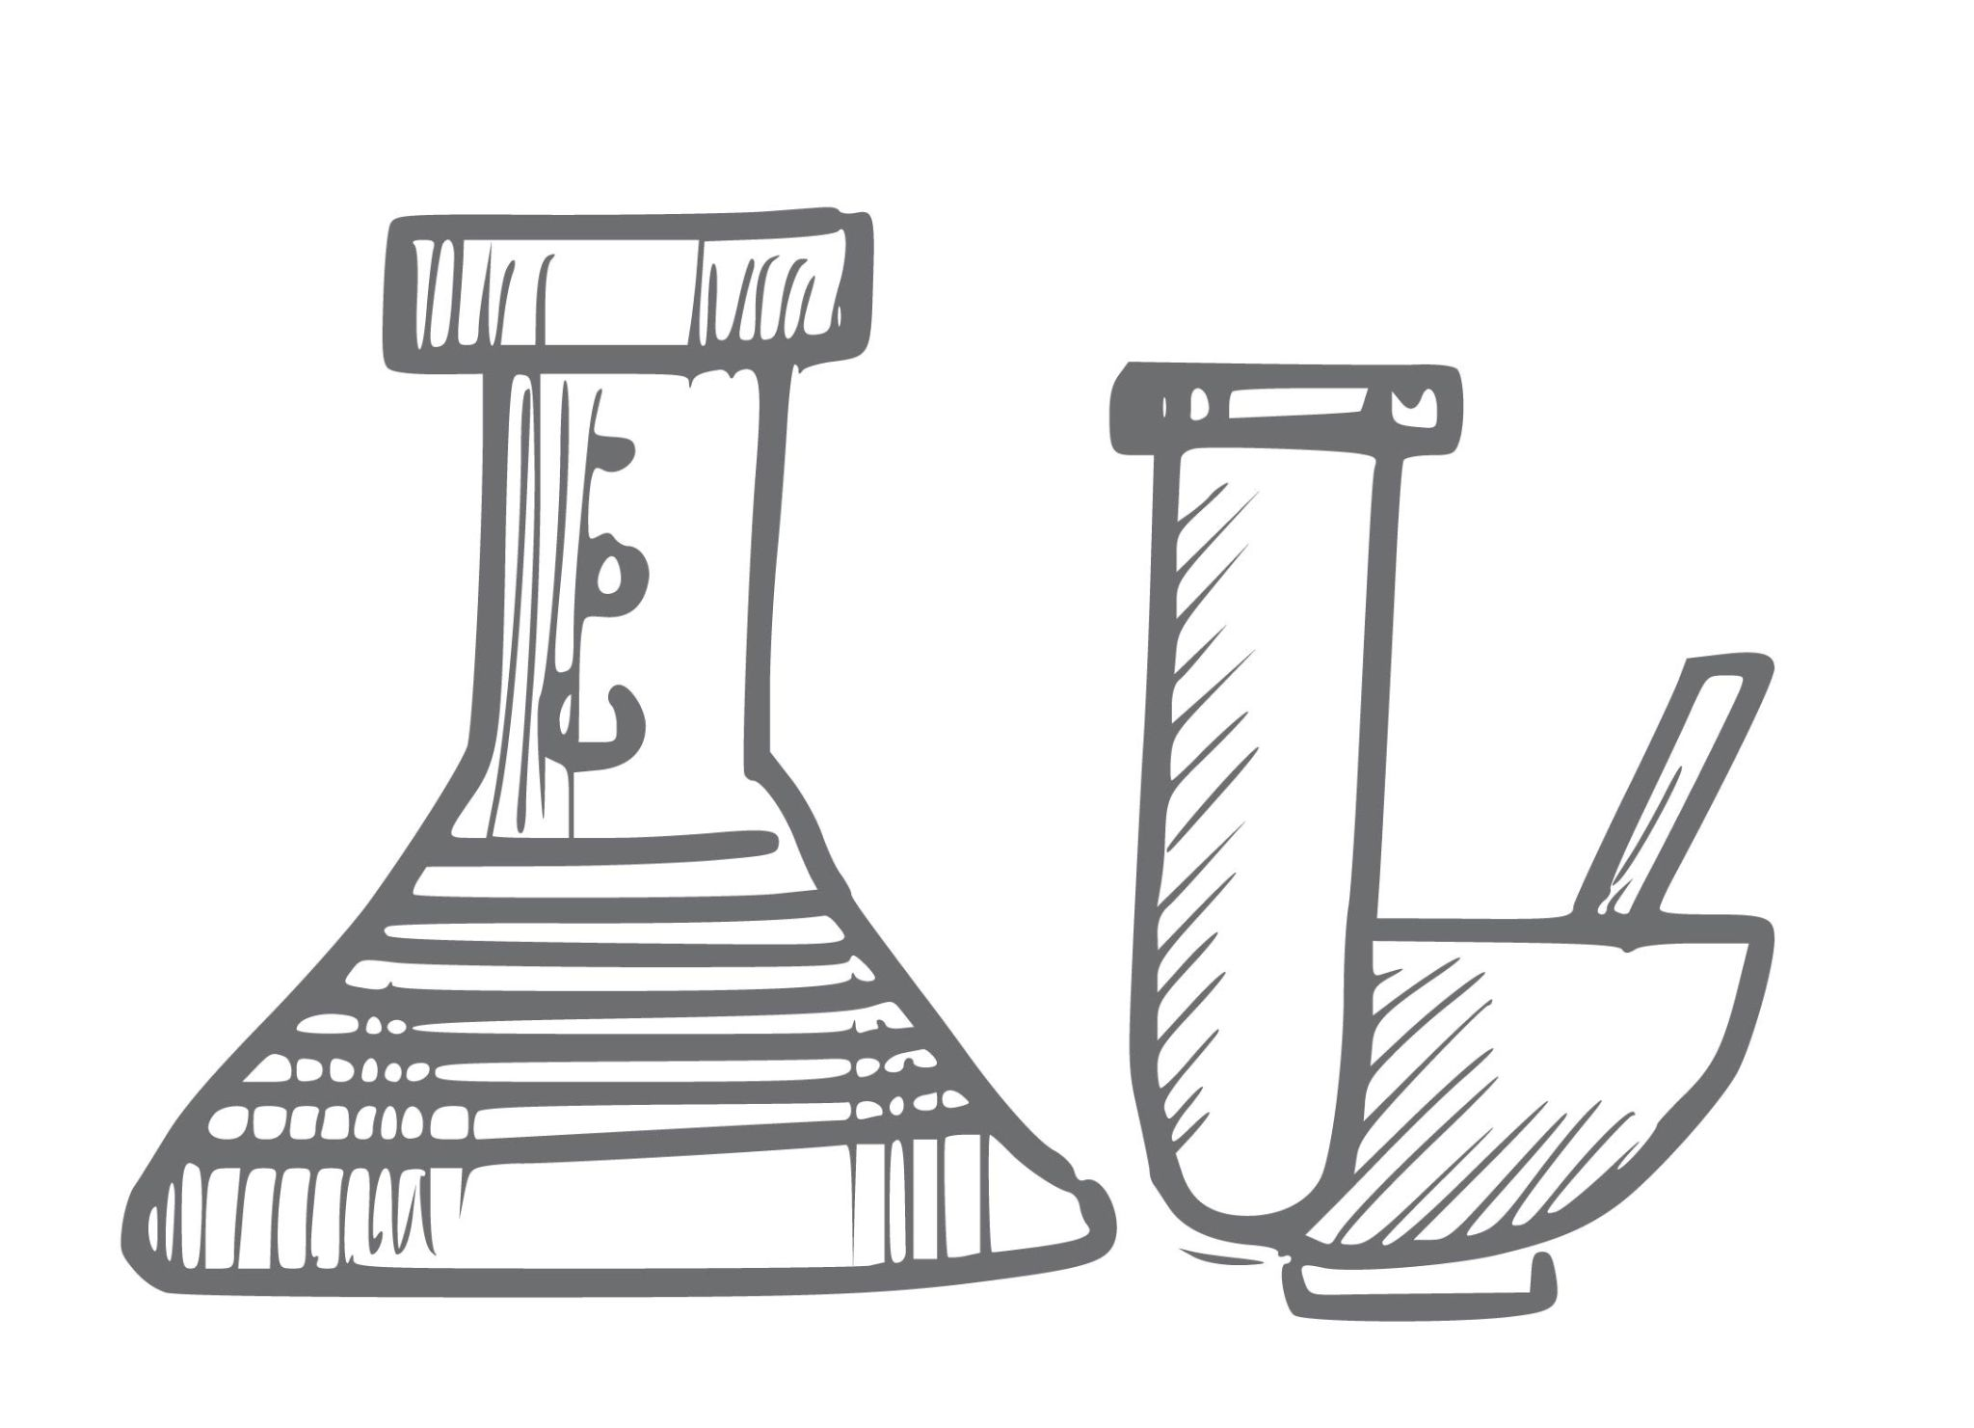
Show your work to the world
What can be published, shared, cited
PAPERS
DISCOVERIES
EDUCATIONAL MATERIAL
DATA/ CODE
STATISTICAL MODELS
(LAB) METHODS
Icons by Harryarts on Freepik CC BY
Notes:
<a href="https://www.freepik.com/free-vector/hand-draw-doodle-sketch-icon-set-design_35473778.htm#fromView=author&page=21&position=3&uuid=a295196d-3eca-43e0-9da1-3cfd4b834f61">Image by Harryarts on Freepik</a>

Slide 32





Show your work to the world
What can be published, shared, cited
PAPERS
DISCOVERIES
EDUCATIONAL MATERIAL
DATA/ CODE
STATISTICAL MODELS
(LAB) METHODS
DMPs
REVIEWS
PREPRINTS
IDEAS
. . .
Icons by Harryarts on Freepik CC BY
Notes:
<a href="https://www.freepik.com/free-vector/hand-draw-doodle-sketch-icon-set-design_35473778.htm#fromView=author&page=21&position=3&uuid=a295196d-3eca-43e0-9da1-3cfd4b834f61">Image by Harryarts on Freepik</a>
<a href="https://www.freepik.com/free-vector/hand-draw-doodle-sketch-icon-set-design_35473815.htm#fromView=author&page=18&position=45&uuid=055e2556-8685-4249-89f4-1cc21a625a6f">Image by Harryarts on Freepik</a>

Slide 33
Share smart = share FAIR
Data, Educational material, Notebooks, (results) Repositories Discipline-specific, Institutional, General
Figshare, Zenodo, EU OS Node
Right place
DOI
Formats
Metadata
“Think alien”
Code
GitHub (no DOI!), Serve, Figshare, Zenodo
Lab procedures, Bioinformatics procedures, SOPs
protocols.io

Slide 34
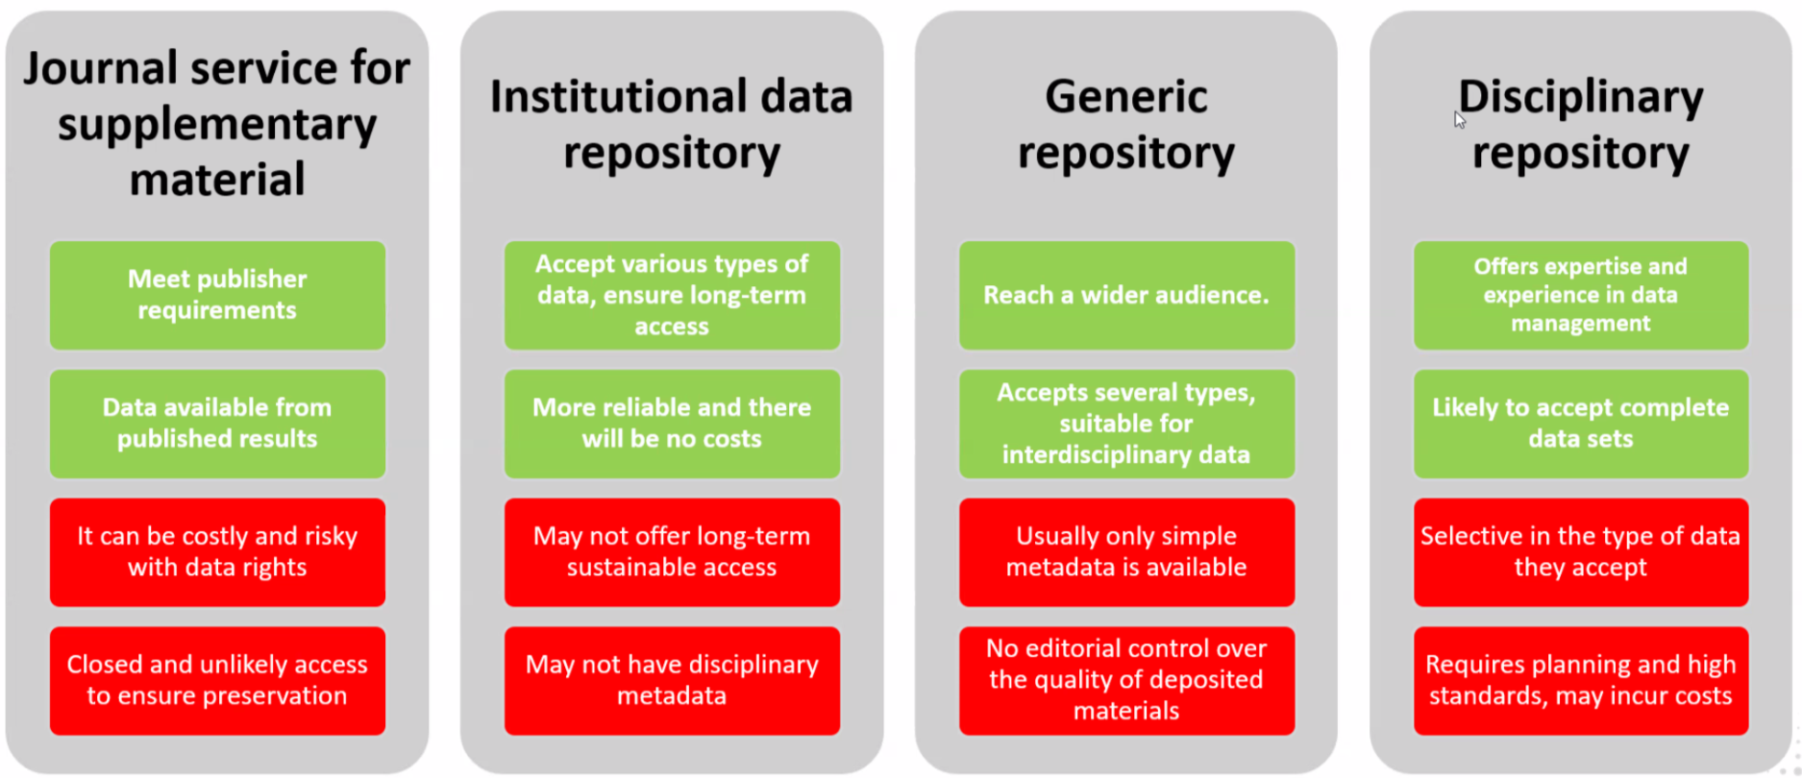
Repositories
Notes:
will not talk about it - just give it to them as help-sheet

Slide 35

Metadata - think alien
Would anyone understand your data/code/presentation without your help?
Make item understandable, usable and citable:
data provenance
data content and structure
code usage/ documentation
quality checks
use conditions (license)
authorship/ “cite as”
…
Icons by Harryarts on Freepik CC BY
and SBTS2018

Slide 36
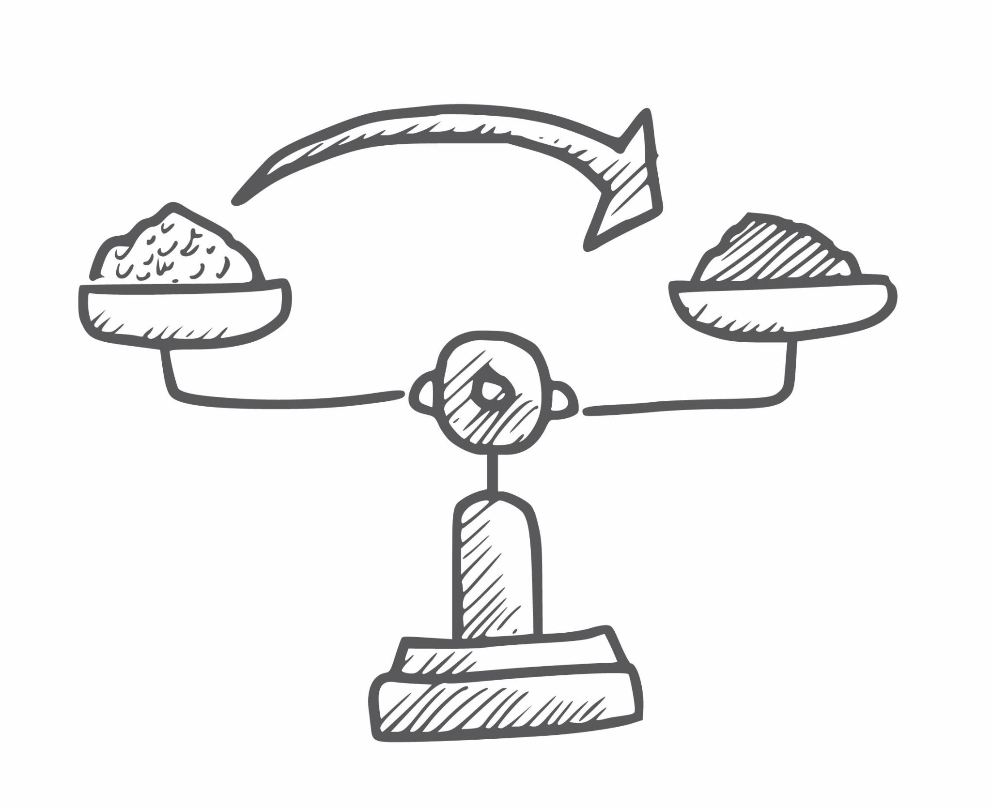
Metadata - standards
 | Ready Standards | Own Standards
Interoperability | ✓ | ✗
Flexibility | ✗ | ✓
Quality and completeness | ✓ | ☡
Regulatory Compliance | ✓ | ☡
Time-demands | ✓ | ✗
Complexity vs Tailored to needs | Compl. > Needs | Compl. < Needs
Check out the standards:
https://www.openaire.eu/what-is-metadata
https://fairsharing.org/search?fairsharingRegistry=Standard
https://pitt.libguides.com/metadatadiscovery/metadata-standards
Icons by Harryarts on Freepik CC BY

Slide 37

Acknowledge the others
Acknowledge when?
Whenever you use someone’s work or input!
Icons by Harryarts on Freepik CC BY

Slide 38
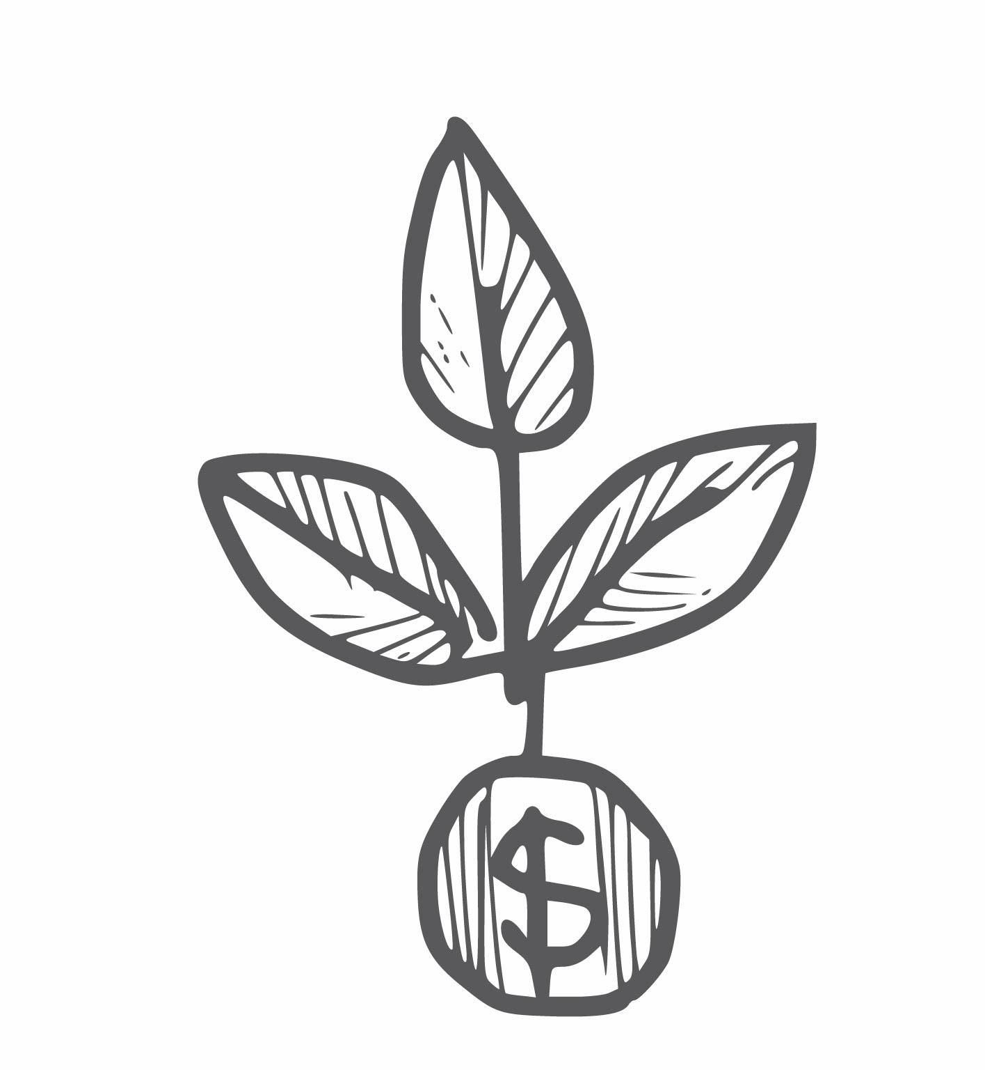
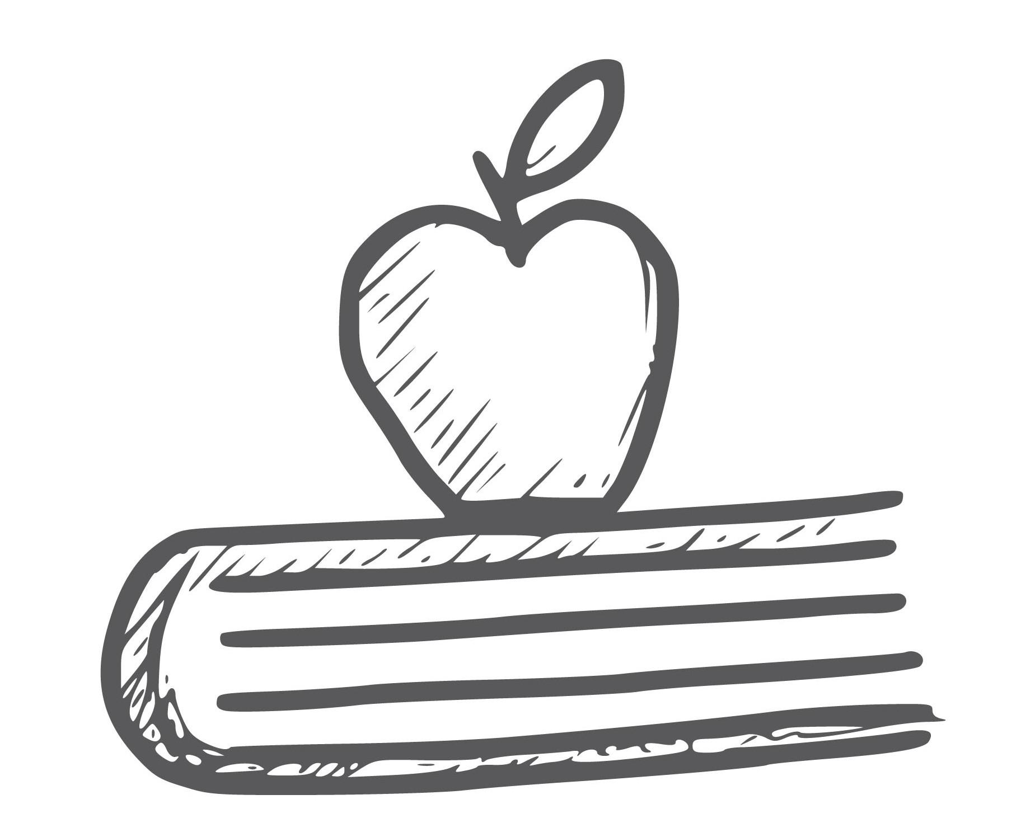
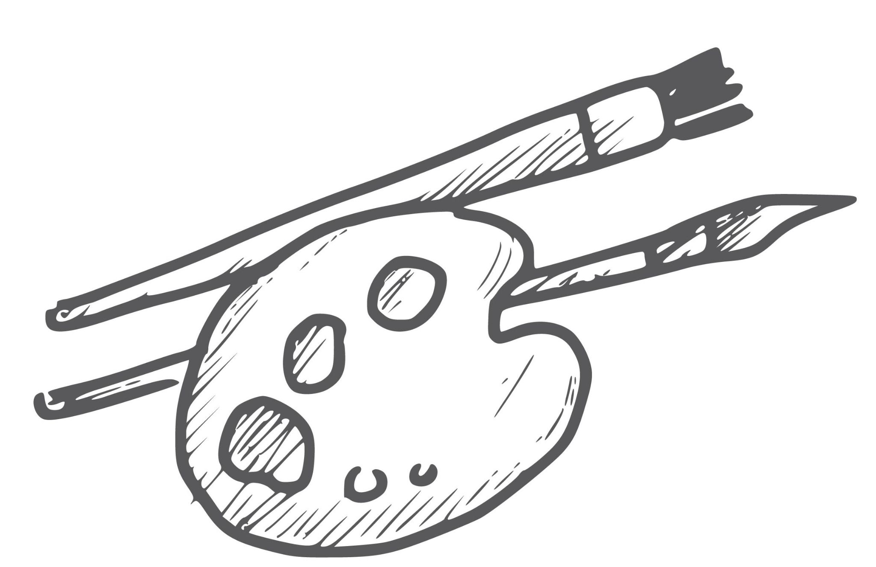

Acknowledge the others
Acknowledge who?
AUTHORS
CONTRIBUTORS
ARTISTS
DATA/CODE PROVIDERS
INSTITUTION/ MENTOR
FUNDERSS
Icons by Harryarts on Freepik CC BY
Notes:
<a href="https://www.freepik.com/free-vector/hand-drawn-business-icons-doddle-set-sketch-design_35473795.htm#fromView=search&page=1&position=49&uuid=8fe4dbbe-5710-4174-9816-059433f11907&query=collection+of+icons+for+author">Image by Harryarts on Freepik</a>

Slide 39


Acknowledge the others
Acknowledge who?
AUTHORS
CONTRIBUTORS
ARTISTS
DATA/CODE PROVIDERS
INSTITUTION/ MENTOR
FUNDERSS
?
?
REVIEWERS
AI
Icons by Harryarts on Freepik CC BY
Notes:
<a href="https://www.freepik.com/free-vector/hand-drawn-business-icons-doddle-set-sketch-design_35473795.htm#fromView=search&page=1&position=49&uuid=8fe4dbbe-5710-4174-9816-059433f11907&query=collection+of+icons+for+author">Image by Harryarts on Freepik</a>

Slide 40
Acknowledge the others
Acknowledge how?
Authorship
Acknowledgement
Citation

Slide 41
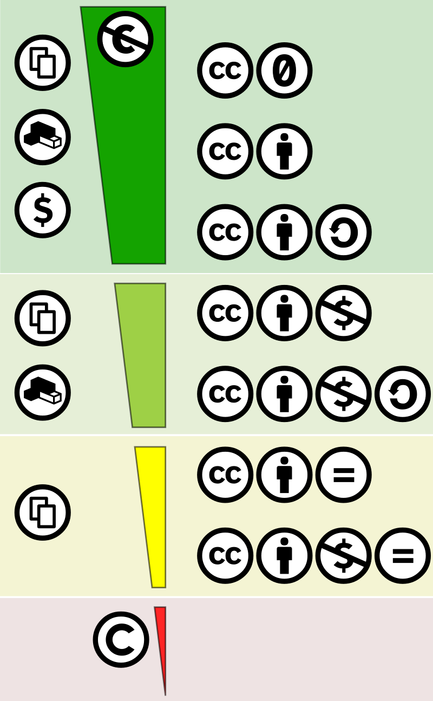
Acknowledge the others
Acknowledge how?
Title Author Source License URL
Contribution level

Slide 42
Acknowledge the others
Acknowledge how?
Metadata
README
In-text/ verbal
Dedicated slide Cover page Page Footer
“Cite as”/ License file

Slide 43
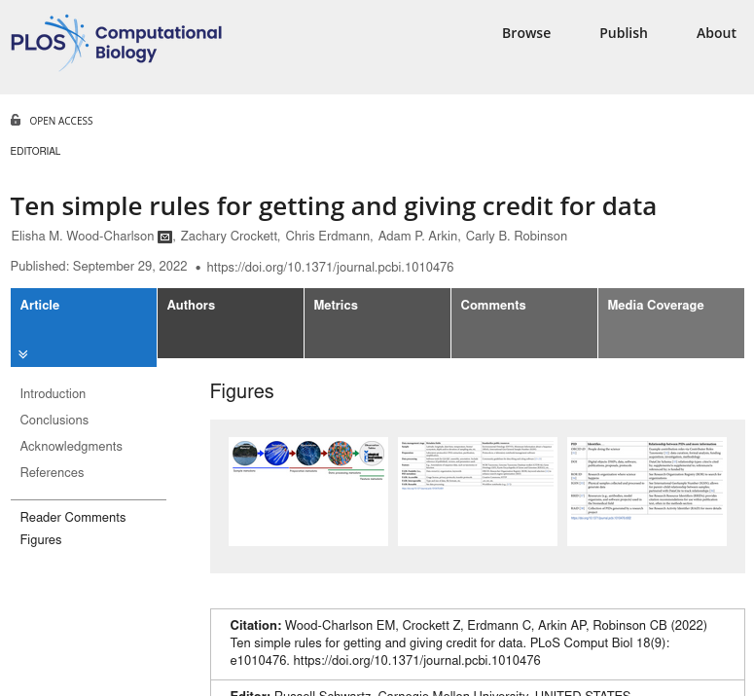
Read more:
https://doi.org/10.1371/journal.pcbi.1010476

Slide 44

Make it easy for others
PLACE THE LICENSE IN THE MOST EVIDENT PLACE
PROVIDE “CITE AS” INFORMATION
METADATA!
PROMOTE BEST PRACTICES
Icons by Harryarts on Freepik CC BY

Slide 45

Open Science practices already make the difference
Notes:
The aim for this workshop is to highlight the importance of the upcoming changes in research evaluation and to provide you with tools to share all your research output.

Slide 46
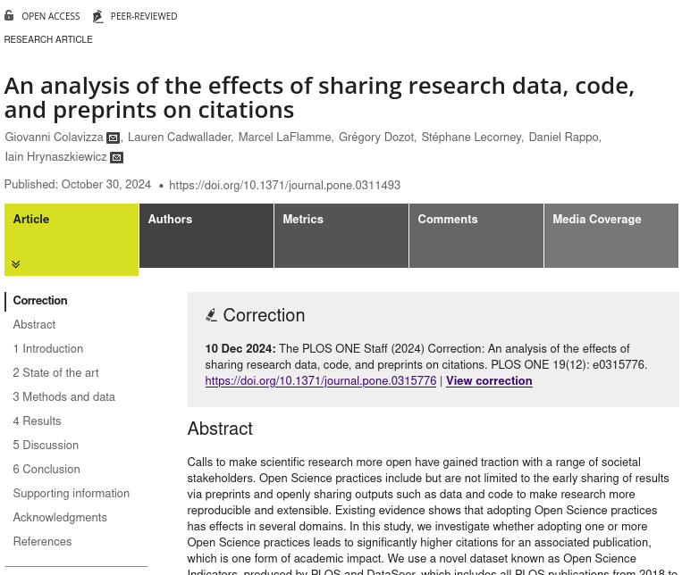
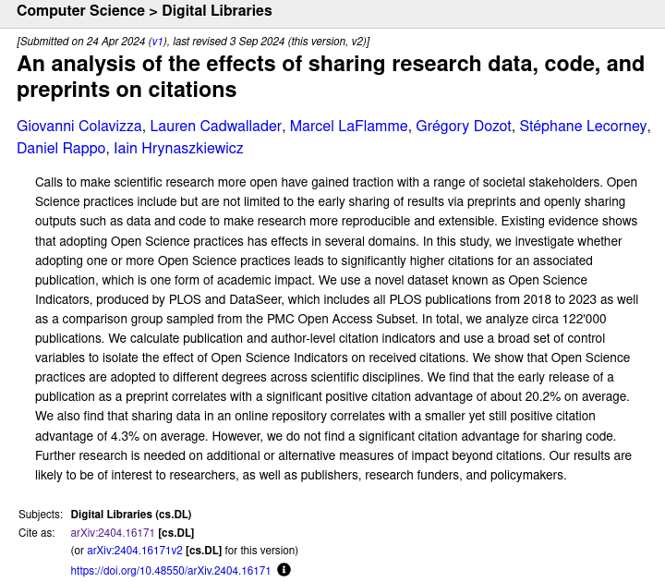
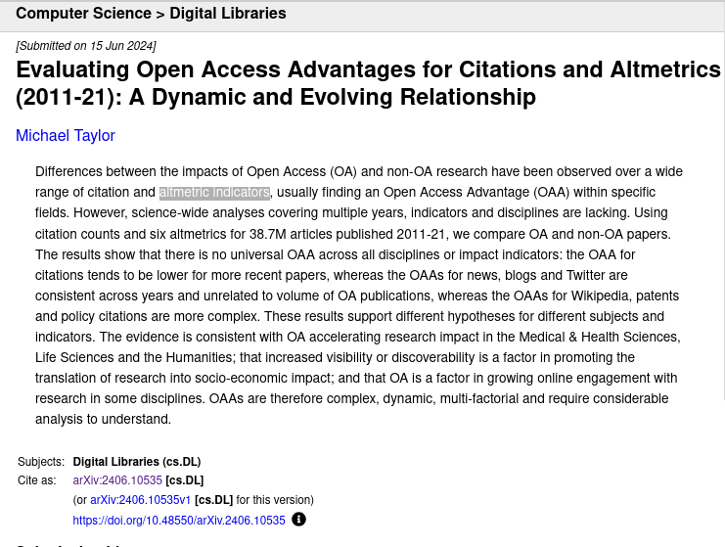
OS is working to researchers’ advantage
open access-published research gets more attention
https://doi.org/10.48550/arXiv.2406.10535
open data, code and pre-prints result in more citations
https://doi.org/10.1371/journal.pone.0311493
open data and pre-prints result in more citations
https://doi.org/10.48550/arXiv.2404.16171

Slide 47
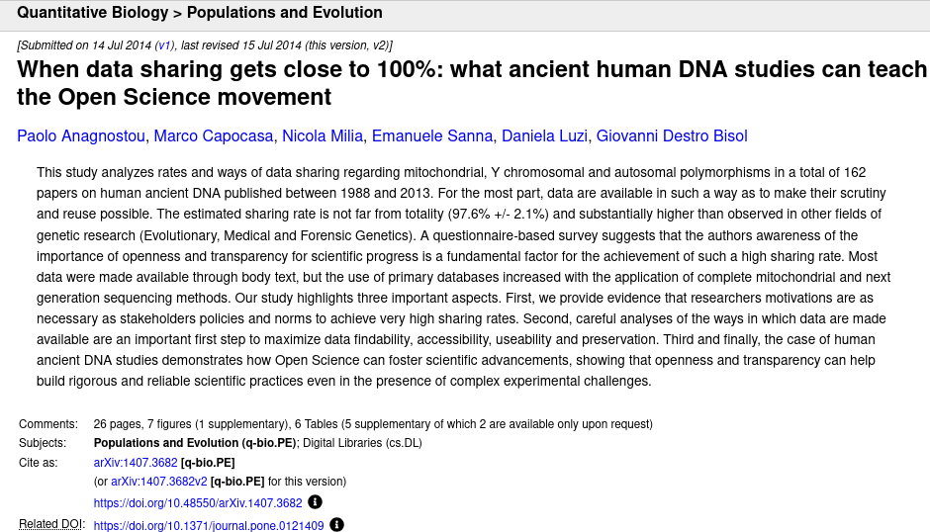
OS is working to researchers’ advantage
Sharing ancient human DNA
accelerated progress
wide collaboration
high reproducibility
increased credibility
high number of studies/publications
community-driven development of bioinformatics tools
https://doi.org/10.1371/journal.pone.0121409

Slide 48
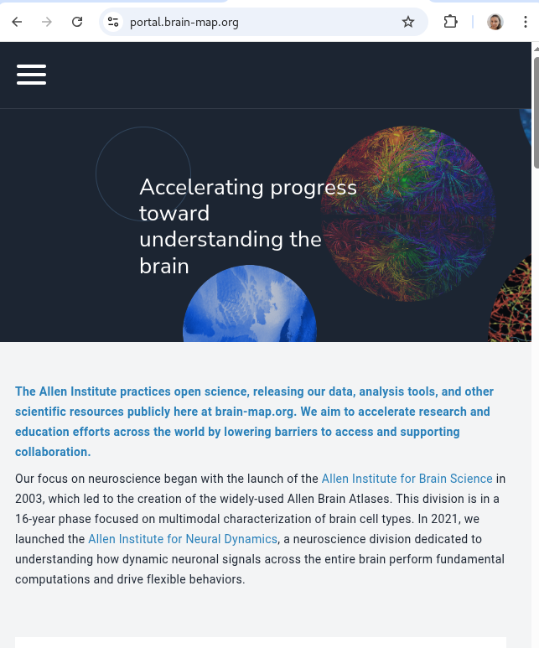
OS is working to researchers’ advantage
Allen Brain Observatory
Public resource providing in vivo recordings of neuronal activity in the mouse brain
accelerated research and discovery
saving of public funds
development of brain-inspired artificial intelligence and other tools
increased citation and recognition
high international collaboration
education and training

Slide 49
Take-home messages
current researchers’ evaluation practices were criticised already for a long time
h-index and similar are not objective measures, often resulting in unethical practices, skewed results and loss of trust in science
organisations around the world decided on making a change to researchers’ assessment practices
CoARA is currently the largest movement and Sweden is a part of it
Open Science practices already benefit researchers and these benefits with grow
you already can work towards the future!
Notes:
what about repositories and other sites for sharing

