Slide 1
What does Open Science mean for qualitative research?
Anna Hallberg, PhD student
Health Services Research, Department of Public Health and Caring Sciences
Notes:
My name is Anna and I’m a PhD student at the Department of Public Health and Caring Sciences where I study the processes of macro-level governance of the Swedish healthcare system, with a specific interest in the relation between the central and local levels in this regard.
For this, I mainly use qualitative methods and case study methodology. Today I will give an introduction (overview!) of open science in relation to qualitative research… While I have tried to account for some of the variations within the qualitative realm, the examples I give will quite clearly be biased by the fact that I am a political scientist with a certain interest in healthcare.

Slide 2
“solutions such as open science practices are more easily and appropriately executed for deductive research in base disciplines that share common methods, epistemologies, and ontological assumptions. There is danger in inappropriately importing the logics developed largely in experimental social psychology to the field-based, qualitative, and theory-generating side of our field.”
Source: Pratt et al. 2019
Notes:
The problem – solutions for open science developed for some research approaches may not be appropriate for others.

Slide 3
What is qualitative research good for?
Some important things are unattainable, or cannot at least be fully understood, quantitatively. Some concrete examples:
Why are people hesitant to vaccines?
How do doctors choose their specialty?
Why do politicians make certain decisions?
What is democracy?
How do actors solve complicated issues together?
How did historic people think?
How is power exercised in different cultures?
What is the meaning of pain for different people?
Notes:
First, what is qualitative research? Why should we care about it, both in general and in relation to open science? My experience is that qualitative research is not always easy to grasp for those how are more keen to du quantitative work. So, I want to start to this presentation by stating what I believe is great and valuable about it…
Very generally, some important things are unattainable, or cannot at least be fully understood, quantitatively. Sometimes it is about exploring new phenomena that can be further tested quantitatively, and sometimes qualitative data is simply the only way to get to something. It can be about how we interact, how society works and has developed over time, and how people relate to society and what consequences that has.
More concretely:
Why are people hesitant to vaccines? - important for how to organize public health intervention
How do doctors choose their specialty? – important with reasoning behind this choice, discussed in my research group right now as a result of the lack of general practicioners
Why do politicians make certain decisions?
What is democracy? - will get back to this
How do actors solve complicated issues together?
How did historic people think?
How is power used in different cultures?
What is the meaning of pain for different people?
As you see, it is often why, how and what-questions that gives us a deeper understanding of different phenomena.

Slide 4
What about open science then?
First, a distinction between positivist and interpretivist approaches to qualitative research
Qualitative research generally
aims to answer the “how,” “why,” and “what” questions of a phenomenon
often uses language as its data, be it written or oral, collected via interviews, focus groups, observation and so forth (Haven & Van Grootel 2019)
Positivism and interpretivism
Different epistemologies (that give different implications for open science)
Example: what is democracy?
Notes:
Having made a case then for the relevance of qualitative research, the actual question of today’s presentation is what open science mean for qualitative research.
In order to answer this properly however, a distinction needs to be made between different kinds of qualitative research – more specifically, between positivist approaches and interpretivist approaches. This is not an exhaustive account of the different variants of qualitative research, but it is a common one that shows clearly some different implications of qualitative research.
These two have things in common – interest in how and why questions, and using similar type of data. But also differ in ways that gives different implications of open science.
Very generally, postivist epistemology has a view on the world as something distant from ourselves, while interpretivists believe the world at least partly is created by ourselves, through our language. This means, that when handling for example an interview material, postivists and interpretivists approach such data differently. A positivist seeks objective information about something, interpretivists interpret what someone is saying in order to understand how the interviewed person experience a certain situation.
An example – what is democracy? A classic example. Interpretivists make puzzle of different meanings, perhaps in different cultures, rather than attempting to conden it into one specific meaning.
These similarities and differences means that there are sometimes different implications of open science, also within the qualitative realm of methodology and methods. I will get back to this.

Slide 5
What is the problem?
QTD - the Qualitative Transparency Deliberations
Not necessarily crisis in replication
“In quantitative research, the sharing of data and code is often meant to enable replicability as an evaluative standard. For the research communities at the core of the QTD, by contrast, transparency contributes to research assessment primarily in ways unrelated to replication. By far the most commonly expressed view was that the provision of more information about the research process helps research audiences better identify potential biases or other threats to the validity of findings.” (Jacobs et al. 2021)
Rather than replicable…
Humphreys et al (2021) talks of trustworthiness
Jacobs et al (2021) discusses transparency in order to achieve “richer communication about knowledge production, research integrity, and professional ethics”
Notes:
The so called replication crisis in social psychology has been an important starting point for the discussion the last decades and clearly pointed to more issues of ”questionable research practices” also more generally (also within other disciplines).
It has raised awareness also among qualitative researcher, and it has in line with this been discussed recently, for example within the frame of QTD, the Qualitative Transparency Deliberations. A three-year deliberative process involving hundreds of political scientists in a broad discussion of these issues. They concluded however that replication is a two narrow idea of open science to be relevant for qualitative work, as this quote expresses.
Instead, notions such as trustworthiness and transparency are discussed – and also broader goals such as to help ”research audiences better identify potential biases or other threats to the validity of findings” or “richer communication about knowledge production, research integrity, and professional ethics”.
So this is just to give you an idea about how the issues of open science are discussed more generally – we will now get into the specifics…

Slide 6
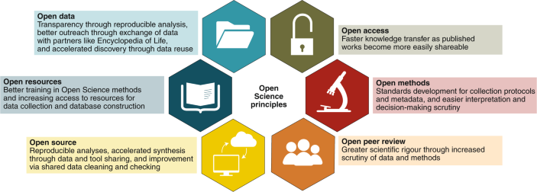
Source: Gallagher et al (2020). Open Science principles for accelerating trait-based science across the Tree of Life. Nature ecology & evolution, 4(3), 294-303.
Notes:
Will use this as my framework… Will not dwell on all of this, because some things, for example open access, are roughly the same. Others are not really applicable. While some software can be used for qualitative research, I will not go into the open source catagory.
I will discuss open methods, open peer review and open resoruces/data.

Slide 7
Open methods
Data collection/generation
Field notes and interview transcripts only gets us thus far
”there are more nuanced understandings between researcher and participant that may not be captured in the field notes” (Chauvette et al 2019).
Specifics for interpretivist approaches
“not all of what the researcher observes, feels, and hears can be written down” (Chauvette 2019)
A specific role for the researcher when data is generated rather than collected
Analysis/presentation
the use of tables (Cloutier & Ravasi 2021)
Can be controversial depending on your standpoint/approach
Notes:
Regarding methods, this is an aspect of open science where there are both similarities and differences between positivist/realist and interpretivist qualitative approaches
First, there are similar issues with regards to openness of methods in terms of data collection/generation… This is because, to some extent, it is the case for all qualitative research that it is an information-heavy endeavor and attempts to pin it down through interviews or field notes only acknowledges part of the process. For example, when I conduct interviews, I usually record and transcribe them in order to analyse them. However, seeing an interview in text is not the same as conducting it – there is information that goes missing in that process that I however have, having conducted the interview. While an interview guide can be made of use for making the data collection transparent, it only gets us thus far.
This is even more so for ethnographic studies when researchers “immerse themselves” in a setting for a prolonged time period. This is for example how researcher go about to answer questions about power dynamics in a specific community or the implementation of a specific intervention in healthcare. In this cases, it is a common approach to take up field notes. But as stated by Chauvette, ”there are more nuanced understandings between researcher and participant that may not be captured in the field notes” (Chauvette et al 2019).
Furthermore, there are also differences here between the postitists and interpretivists – in the latter, the reasercher is involved in the generation of data rather then collection, making transparency with regards to this process even more tricky. For sure, there are concepts that helps researchers refer to these processes, for example reflexivity and iteration, it can be difficult to make those processes of data generation completely transparent. As you see, I have highlighted the word feel here, as this is a specific feature of interpretivist approaches that can be hard to pin down.
For positivists, I would say that the analytical process and presentation of data can be made fairly transparent for example by incorporating your interview guide in your publications. This is also the case for analysis and presentation. For example, interview transcripts can be used for quoting, showing how data has been interpreted. Furthermore, it has been suggested that the transparency of analysis and interpretation for qualitative data can be improved by the use of tables… This goes for both the research process and the data.
While I believe this to be very true for my own positivist qualitative research, and experience a lack sometimes of this kind of transparency achieved for example through tables, it is also a controversial suggestion for interpretivists. This is because the organizing of data in different ways, is not value-free…
Practices for example thick description, persistent observation and member checks (Pratt et al 2019; Lincoln & Guba 1985)
analogs to external validity, construct validity, and reliability – practices for example, use of multiple sources, develop case study data base (Pratt et al 2019; Yin 2003)

Slide 8
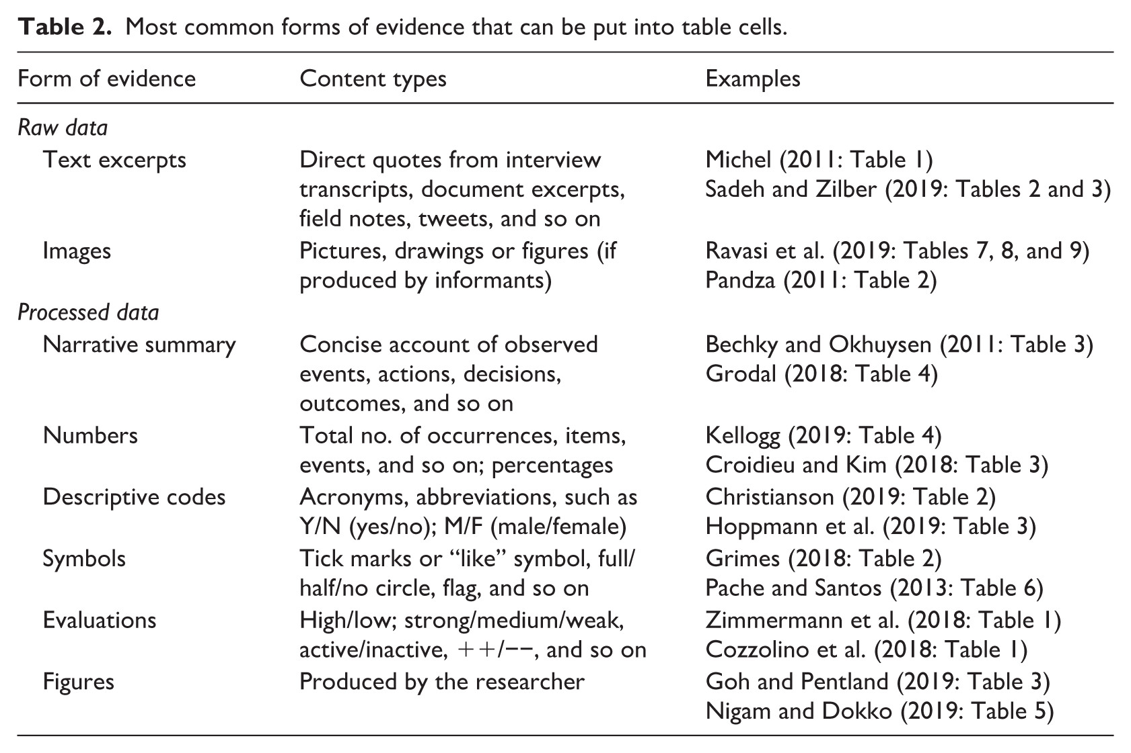
Source: Cloutier & Ravasi 2021
Notes:
Some examples of how the qualitative research process can be made more transparent through tables…

Slide 9
Open peer review
To some extent, the same as for quantitative research
But what about pre-registration?
For some qualitative research, when generating hypothesis is the purpose (postdiction rather than prediction), flexibility is key
Qualitative pre-registration as “a living document” (Haven & Van Grootel 2019)
Notes:
With regards to the peer review process, the basics are the same. A more transparent process could be obtainable and is perhaps desirable. For me, I believe it is necessary to not only demand more openness, but also more focus and resources for peer review in general.
Something that is worth mentioning regarding qualitative research and the peer review process specifically is pre-registration. This is because qualitative research is sometimes explorative, aiming to generate hypothesis by an open approach to the data and discovering new things. In this, flexibility is key – and questions, data collection, analytic procedures etc, that is what your may “freeze” to some extent in traditional pre-registration, need to change after the start of the study.
It has been suggested that pre-registration should be a ”living document”. While this is an interesting thought, it does put demands on reviewers and journals to understand the specific nature of pre-registering qualitative research, and also high demands for the researcher to constantly record all changes made…
”Qualitative preregistration needs to be a living document that is constantly accessible to the public, not its first version only. Hence, “freezing” the preregistration
more than once could foster the transparency. Viewed this way, the demands of a preregistration are tougher for the qualitative researcher, but not unworkable and certainly not undesirable, as it allows the reviewer or interested reader to track the development of the study.” (Haven & Van Grootel)

Slide 10
Open data
Similar kinds of data (language, personal accounts) for positivists and interpretivists that require confidentiality
Highly contextualized
Is sharing relevant and “worth it”?
Case study database
Hard to anonymize
Is sharing ethical?
Notes:
In general, the nature of the data of qualitative research is such that it requires confidentiality, consent and put high demands on privacy. It can be about sensitive subjects, or involve people that have a specific position within their context.
A specific issue regarding openness of qualitative data, that actualizes the question ”is it worth it?”, is its contextuality. Much of the point of qualitative research is to take context into account, and it makes sharing data, at least for reuse, difficult. This is not always the case however, and for case studies aiming for generalization to a more general phenomena, the idea of a data base is interesting.
Another issue often discussed for open science and qualitative research is the need for confidentiality vis-a-vis the research participants. In my own research for example, there is a clear trade-off between keeping people with specific positions anonymous, while still being transparent with who I have interviewed. Data may be sensitive, and it needs to be considered to what extent it can be shared ethically.

Slide 11
References
Chauvette, A., Schick-Makaroff, K., & Molzahn, A. E. (2019). Open data in qualitative research. International Journal of Qualitative Methods, 18, 1609406918823863.
Cloutier, C., & Ravasi, D. (2021). Using tables to enhance trustworthiness in qualitative research. Strategic Organization, 19(1), 113-133.
Humphreys, L., Lewis Jr, N. A., Sender, K., & Won, A. S. (2021). Integrating qualitative methods and open science: Five principles for more trustworthy research. Journal of Communication, 71(5), 855-874.
Jacobs, A. M., Büthe, T., Arjona, A., Arriola, L. R., Bellin, E., Bennett, A., ... & Yashar, D. J. (2021). The qualitative transparency deliberations: Insights and implications. Perspectives on Politics, 19(1), 171-208.
Pratt, Michael G., Sarah Kaplan, and Richard Whittington. "Editorial essay: The tumult over transparency: Decoupling transparency from replication in establishing trustworthy qualitative research." Administrative Science Quarterly 65.1 (2020): 1-19.
Tamarinde L. Haven & Dr. Leonie Van Grootel (2019) Preregistering qualitative research, Accountability in Research, 26:3, 229-244, DOI: 10.1080/08989621.2019.1580147

Slide 12
Thank you!
E-mail: anna.hallberg@pubcare.uu.se

