Slide 1
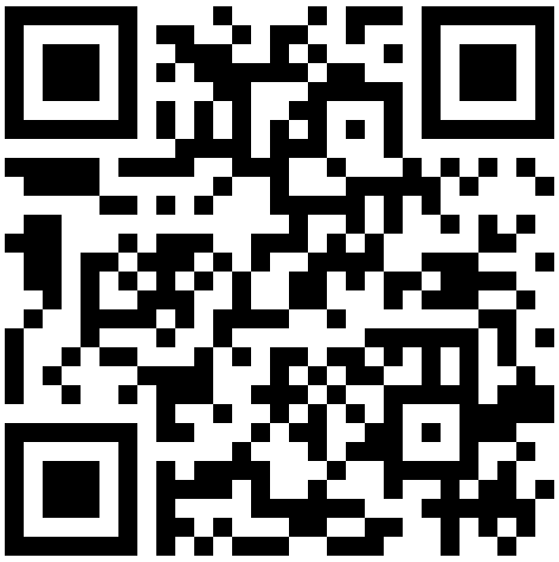
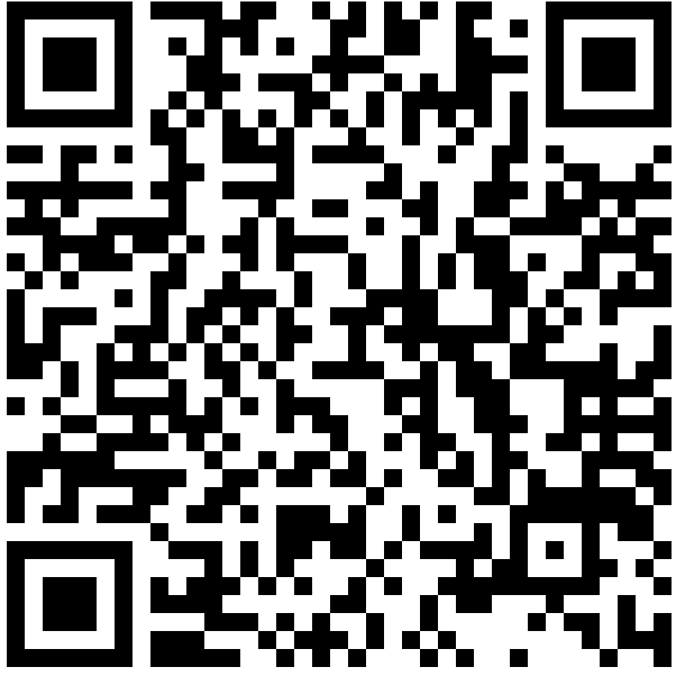
DAC-2026 Birds-of-a-Feather
Open-Source EDA, Data and Collaboration
June 28, 6:30-9:30pm, Room 104C
Interest Form
Agenda

Slide 2
Welcome !
7th in this Birds-of-a-Feather series, 2018-
“Open-source EDA, Data and Collaboration”
Purpose: “updates and invitations”
Agentic AI-EDA, enablement, ecosystem, governance…
What can we build together?
A great agenda !
I. Opening
II. General Updates from the Community
III. Open-Source Ecosystem & Infrastructure
IV. AI-Assisted EDA and Physical Design Workflows
V. Workforce Development and Training
VI. Lightning Round and Closing Remarks
VII. After-Event Networking: “Open Source, Open Tabs”
Notes:
Hello, everyone !!! I’m Andrew Kahng from UCSD, and it’s my privilege to welcome you here. Today is the SEVENTH installment of this DAC birds-of-a-feather series! --- with the theme of open-source EDA, DATA and COLLABORATION.
[CLICK] This evening is about updates and invitations – from agentic EDA to 2nm research PDKs to ecosystem and governance. Above it all: it’s open source. What can we build together?
[CLICK] And a great agenda, including the largest panel ever held at DAC and [CLICK] Session Seven across the street at the Auld Dubliner: Open Source and Open Tabs.

Slide 3
Thanks to You, the OS EDA Community !!!
Speakers
Contributing from around the world, industry and academia
Accomodating the time limits
Extended slides, videos will be posted on the webpage
Organization and Support
CHIPS Alliance
Precision Innovations
UC San Diego
Yiting Liu, UCSD and Oleg Levitsky, Precision Innovations
Let’s stay in touch !
Signup sheets are circulating
Discussions++ afterward
Notes:
Each year the best moment of DAC is to see you and say THANK YOU to you, the community of open-source EDA
[CLICK] The speakers from around the world – sharing the time with others and contributing more material for the webpage.
[CLICK] Thank you to the financial sponsors: CHIPS Alliance, Precision Innovations, and UCSD. Huge thanks to Yiting Liu and Oleg Levitsky who have done an amazing job with this year’s organization.
[CLICK] And let’s stay in touch – sign up so that we can send you email. I truly hope we accomplish a lot tonight and in the coming year. This is an exciting time for open-source EDA, and there is a lot to work on.
Now let me turn things over to Oleg and Yiting. Thank you.

