Slide 1

Updates on 3D OpenROAD Database
Osama Hammad
Cho Moon
precision
Precision Innovations is the primary industrial developer of OpenROAD and provides commercial support and customization for OpenROAD.

Slide 2
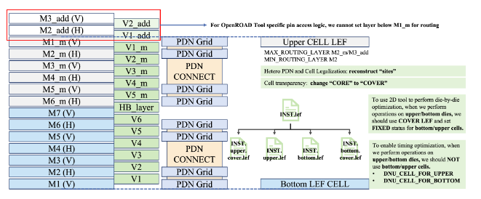
P&R for 3D IC Designs
OpenROAD database (ODB) has been enhanced to read, write, visualize, analyze and optimize 3D designs
We want to invite more adoption of open-source tools and improve collaboration
3Dblox format is used for design I/O
One design = multiple dies, multiple processes, bonded together
Each die/chiplet can have its own PDK and TechLEF
ODB now models this end to end with persistency (write_db & read_db without data loss)
“Unfolded view” is available to enable full chip analysis for linting, visualization, timing analysis
No more layer stack “hacks” for 3D designs

Slide 3
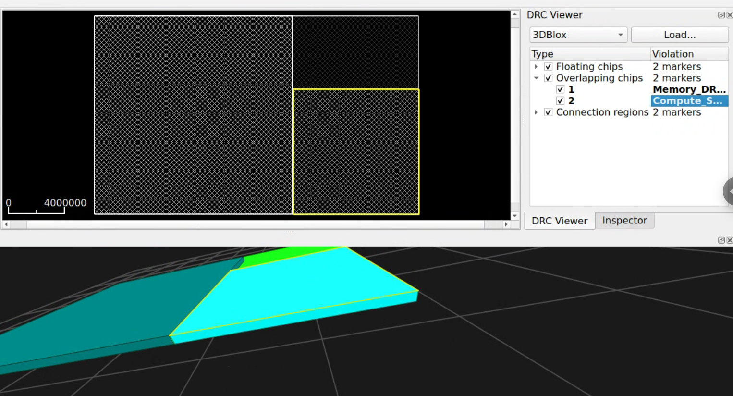
3D Viewer and Linter
Check | Purpose
Logical connectivity | Physically aligned bump pairs that belong to different nets.
Floating chips | Flags chip sets that aren't reachable to "ground". They're floating in the design
Overlapping chips | die chiplets whose 3D bounding boxes overlap.
Internal-ext usage | INTERNAL_EXT regions not referenced by any connection.
Connection regions | Connections whose regions don't xy-overlap or whose mating-surface gap mismatches the connection thickness.
Bump physical alignment | Bumps sitting outside their parent region's footprint.
Alignment markers | Missing, duplicate, or mis-oriented alignment markers between connected chips.

Slide 4
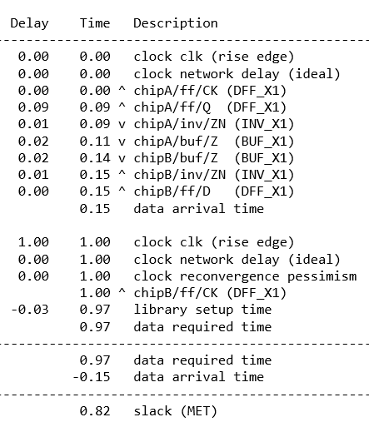
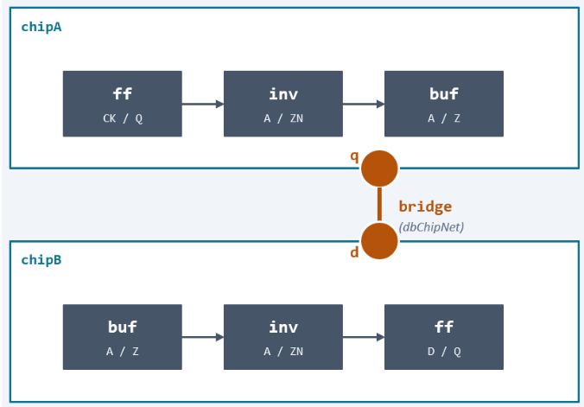
3D STA and RC Extractor

Slide 5
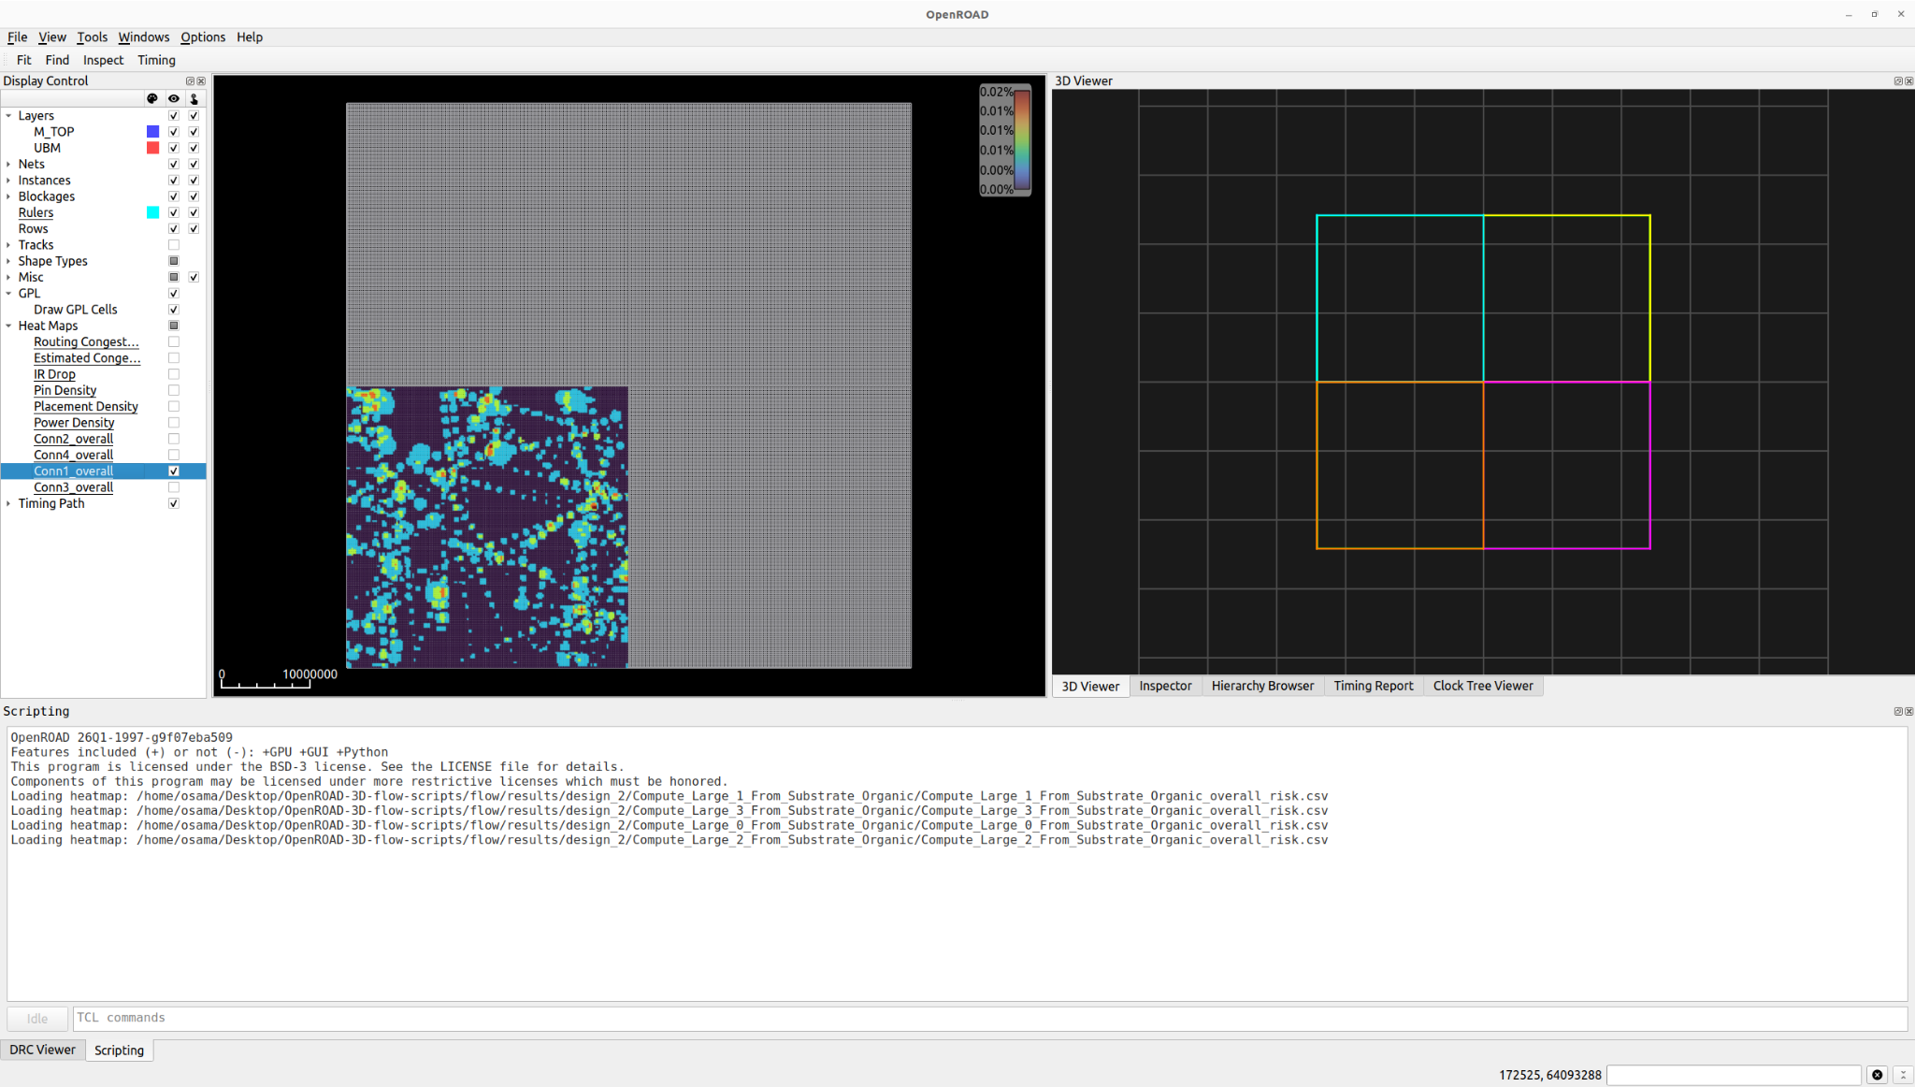
Yield Analysis
YAP from UCLA has been integrated into OpenROAD via a file-based interface
Bond failure can be analysed
Heat map can be displayed

Slide 6
3D Database Overview
Same pattern as dbMaster / dbInst, lifted one level up to the chip itself.
dbChip
Type: DIE | HIER | RDL | IP | SUBSTRATE
instantiates
dbChipInst
placed at (x, y, z) with dbOrientType3D
dbBlock
dbTech
TechLEF per chip
dbChipRegion
front | back | internal | internal_ext
instantiates
dbChipRegionInst
one per parent dbChipInst
dbChipBump
bumpmap
instantiates
dbChipBumpInst
Located on dbChipRegionInst
connects
connects
dbChipNet
logical net spanning bump insts
dbChipConn
region <-> region with thickness

Slide 7
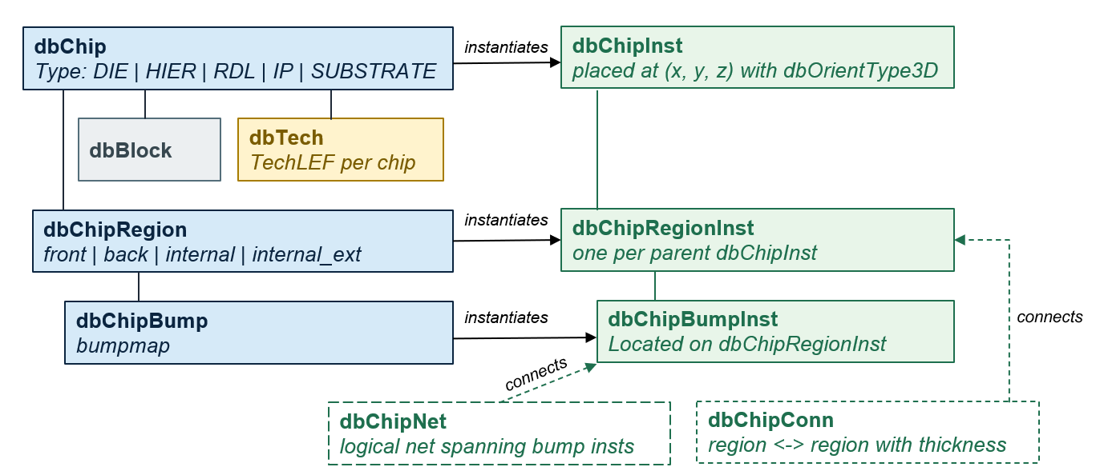
3DBlox Files (3dbx and 3dbv)
read_3dbx top_design.3dbx
Design: name: top_design external:
verilog_file: “top.v” ChipletInst: cpu_inst: reference: cpu_complex ... Stack: interposer_inst: loc: [0,0] z: 0.0 orient: R0 ... Connection: Conn1: top: interposer_inst.regions.to_cpu
bot: cpu_inst/compute_inst.regions.to_interposer
thickness: 10.0
dbChip(HIER)
read_3dbv chiplet_definitions.3dbv
ChipletDef:
compute_tile:
type: die
design_area: [1000, 1000]
thickness: 50
regions:
to_interposer: side: back coords: [[...]...]
bmap: compute_tile.bmap
external: APR_tech_file: [tech_5nm.lef]
cache_die: .........
dbChipInst
dbChip
dbChipRegion
dbChipBump
dbTech
dbChipConn
Notes:
3dbx contains chiplet connections
3dbv contains chiplet details

Slide 8
Additional Documentation
https://github.com/The-OpenROAD-Project/OpenROAD/blob/master/src/odb/doc/3dic.md

