Slide 1
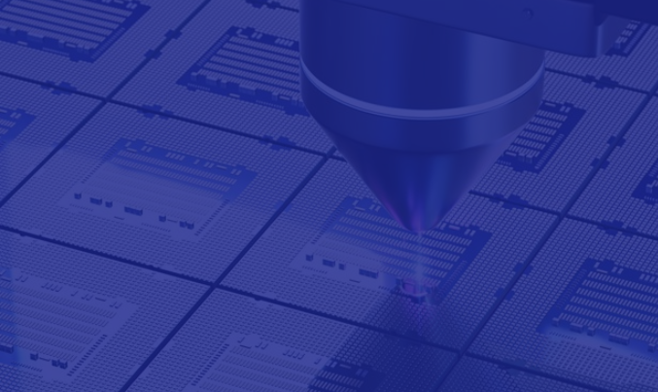

​
Secure Open-Source EDA
building trust into the tools that build silicon
Ishraq Tashdid​​
Security Researcher Intern Intel Corp
PhD Candidate at University of Central Florida, Orlando
DAC 2026
Birds-of-a-Feather Session
28 July 2026​
Notes:
Good afternoon. My name is Ishraq Tashdid. I'm a security researcher at Intel and a PhD candidate at the University of Central Florida. Over the next seven minutes, I'd like to offer a slightly different angle on the conversation we're having here today. My view is that open-source EDA has already won the adoption argument to an extent. And the next question in front of this community now is whether it can win the trust argument as well.

Slide 2
Need for Open-Source EDA
The semiconductor market is growing fast, on track for $2.9T by 2029
Every dollar of that growth runs through EDA tools at some point
As nodes shrink, software licensing has become the largest cost in chip design
Open-source EDA offers the same rigor, without the toll
Free · Community · Flexibility · Innovation · Accessibility
Notes:
Let me start with a number that anchors everything I'll say today. 2.9 trillion dollars is where the semiconductor market is headed by 2029, and essentially every dollar of that passes through an EDA tool at some point. (click) Here's the tension underneath that growth. At 2 nanometers, software licensing alone accounts for over 280 million dollars of a single chip's design cost, and if you look at the chart behind me, you'll see software has consistently been the single largest line item across every node. This is really the underlying reason open-source EDA moved from an academic interest to a practical necessity. When licensing alone accounts for the largest share of a chip's design cost, only a small number of organizations, the largest fabless companies with the volume to absorb that cost, can afford to treat it as simply a line item. Everyone else, university labs, startups, smaller fabless teams, is effectively priced out of the tools they'd need to compete. Open-source EDA, in large part, is a response to that imbalance.

Slide 3





Adoption of Open-Source EDA
Governments are putting real money behind it. The CHIPS R&D program and CHIPS Alliance alone represent $13B
DARPA is backing it too, through the POSH and IDEA programs
Community efforts are keeping pace. The OpenROAD Initiative has grown from a research project into ORFS and OpenLane EDA
And it's already producing results. RISC-V and OpenTitan show open-source silicon can compete, not just participate
Notes:
And the response to that imbalance has been real, not just aspirational. Thirteen billion dollars has been committed jointly through the CHIPS R&D program and the CHIPS Alliance. DARPA is running two parallel programs, POSH and IDEA, specifically aimed at de-risking open silicon. The OpenROAD Initiative has gone from an academic prototype to a production flow, ORFS, that's fabbing real tape-outs today. And RISC-V and OpenTitan are really the proof point here. Open-source silicon isn't just participating in this market anymore. It's competing in it.

Slide 4




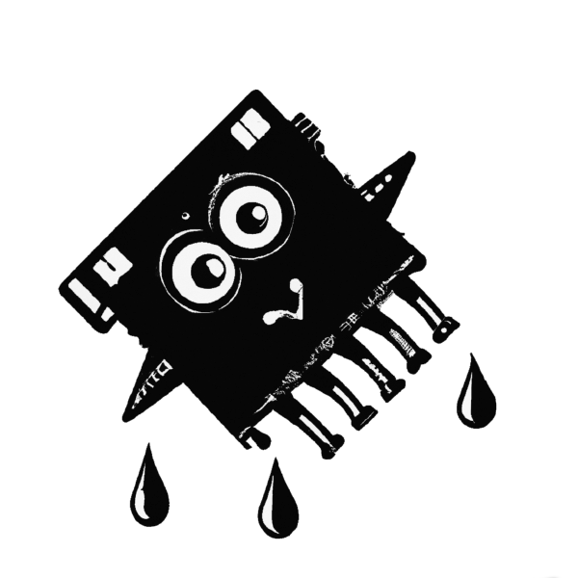
Public Hardware Security Incidents
Speculation & Side-Channel Leakage (Spectre)
Architectural checks may still “pass,” while transient microarchitectural behavior leaks sensitive data.
Cross-Boundary Isolation Failure (Foreshadow)
A single flaw can impact multiple trust domains, from OS and VMs to enclave-style protected contexts.
Stale Internal State Exposure (ZombieLoad)
Hidden microarchitectural buffers can unintentionally reveal leftover data across executions.
Fault-Induced Security Breaks (Plundervolt)
Trusted system controls (like voltage/frequency tuning) can be turned into an attack path.
Variant Recurrence in Related Mechanisms (Downfall)
Downfall
Notes:
But adoption at this scale means adoption of risk, and this isn't theoretical for us. The last decade gave us a recurring class of vulnerability. There were side-channel and speculative-execution flaws that let an attacker extract secrets not by breaking a design's logic, but by observing how that logic behaves in time, power, or shared microarchitectural state. A design can pass every functional and architectural check we currently know how to write, and still leak. And the cost of that gap is not abstract to us. When this exact class of vulnerability became public in 2018, our stock dropped roughly 9 percent in a single week, on the order of high tens of billions of dollars in market value. That is what's at stake when we say a chip is secure and we turn out to be wrong. If we're opening our tools to the world, we are opening this exact attack surface to the world as well.

Slide 5
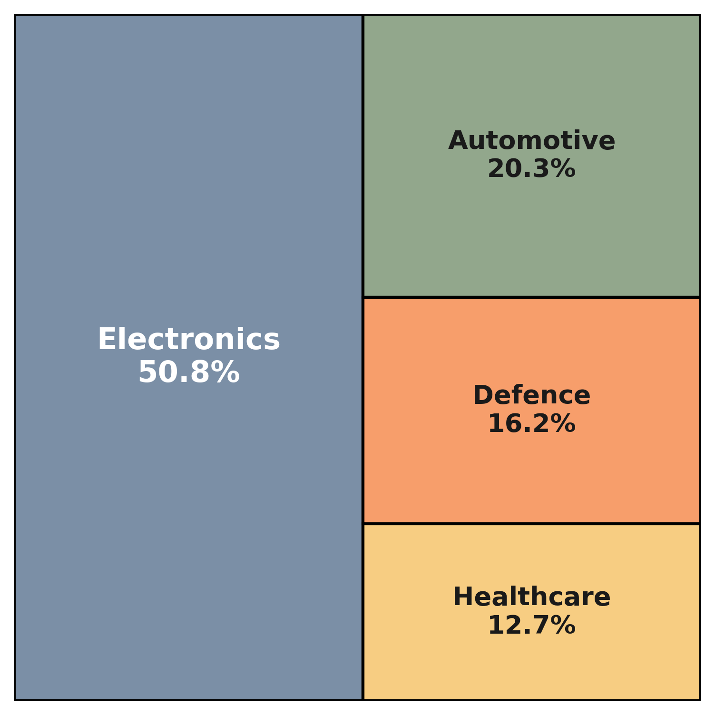
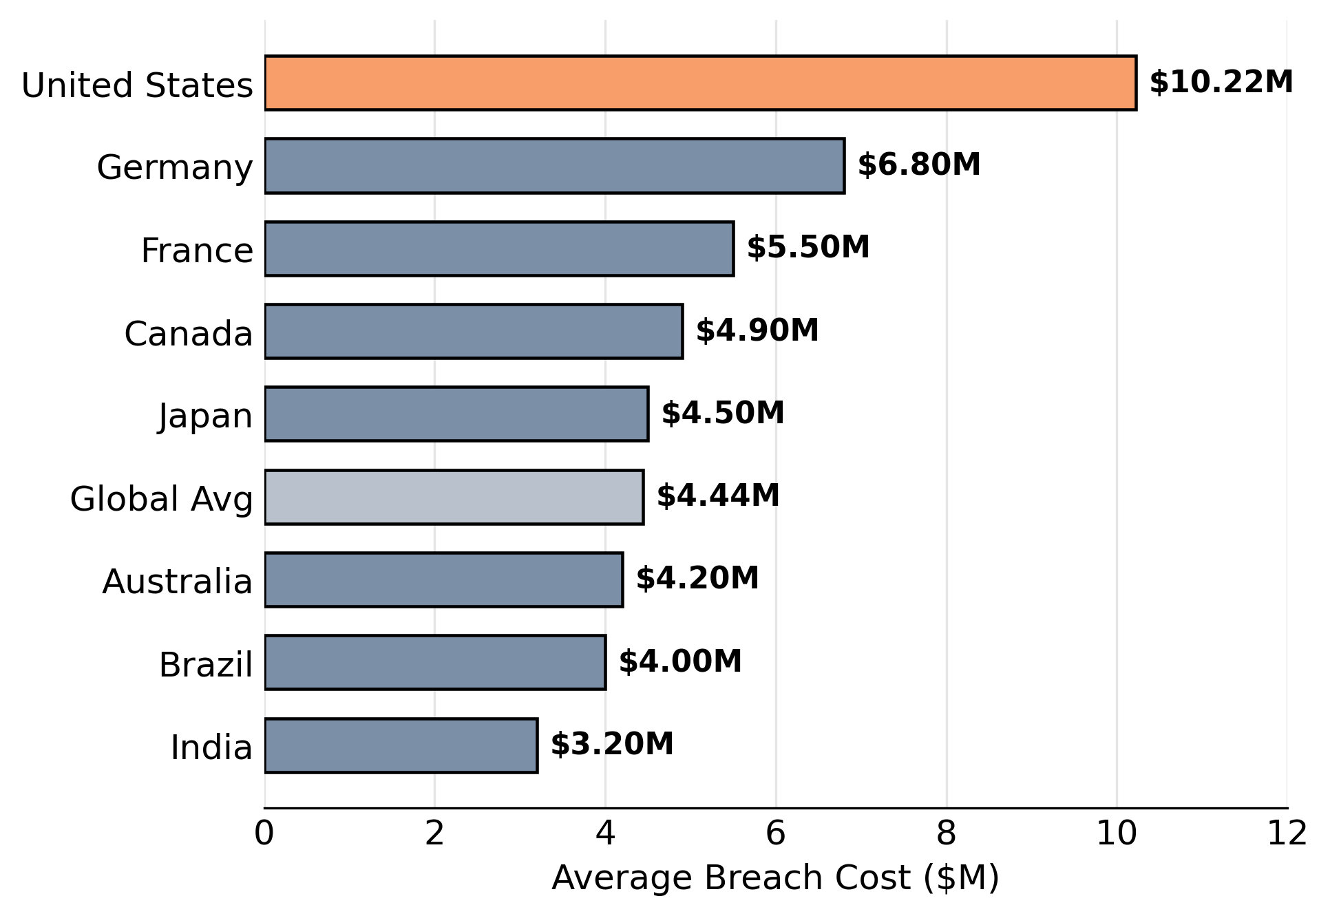
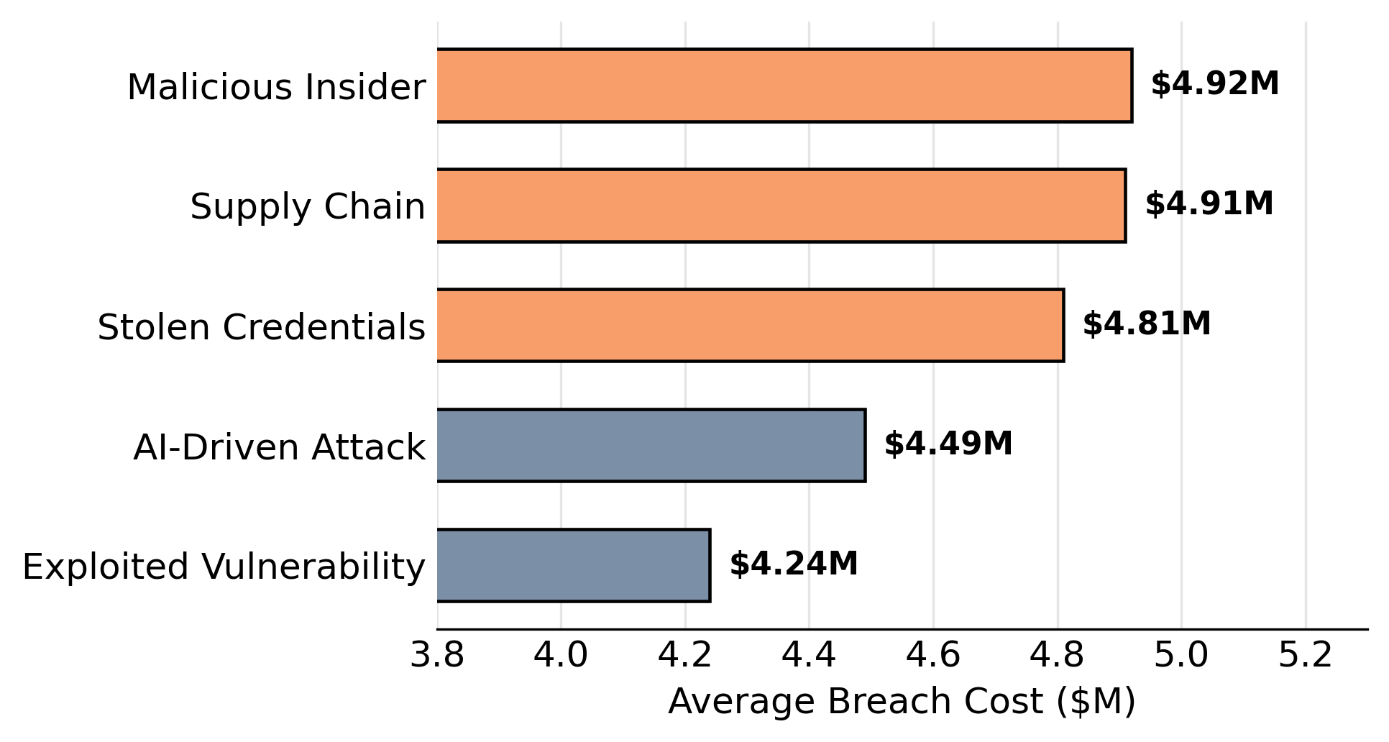
Impact of a Security Breach
The global average breach now costs $4.4M
Breaches take 241 days on average to detect and contain
The US has the highest cost of any country, an all-time high
Third-party breaches have doubled
Healthcare is the most targeted sector
Notes:
And you can see that this is a very risky area as well. On average, it takes about 241 days just to detect and contain a bug. In the US specifically, that cost just hit an all-time high. What's most important is that it is not because of some external hacking or stolen credentials anymore. It's supply chain compromise and malicious insiders, both now averaging north of $4.9 million per incident. And for us, that's worth sitting with for a moment, because an open-source tool flow is, by definition, part of our supply chain.

Slide 6
Quantifying Security Analysis
Hardware security needs the same rigor as functional verification: assurance, not assumption
Security metrics let us verify coverage, discover residual risk, and enable countermeasures across different attack types
Notes:
So how do we actually respond, not just in words but in practice? The way I see it, we treat security the same way we already learned to treat functional correctness, with coverage metrics instead of intuition. Think about it this way. If the concern is hardware Trojans, we reach for obfuscation and camouflaging. If the concern is piracy, we reach for IC metering and split manufacturing. But none of that means much unless we attach a real metric to each countermeasure, something like probability of detection, bits of information leaked, or the distance between chip responses. Without that number, we're not actually verifying anything. We're just hoping. But unfortunately that number do not exist for security like it does for other metrics like PPA.

Slide 7
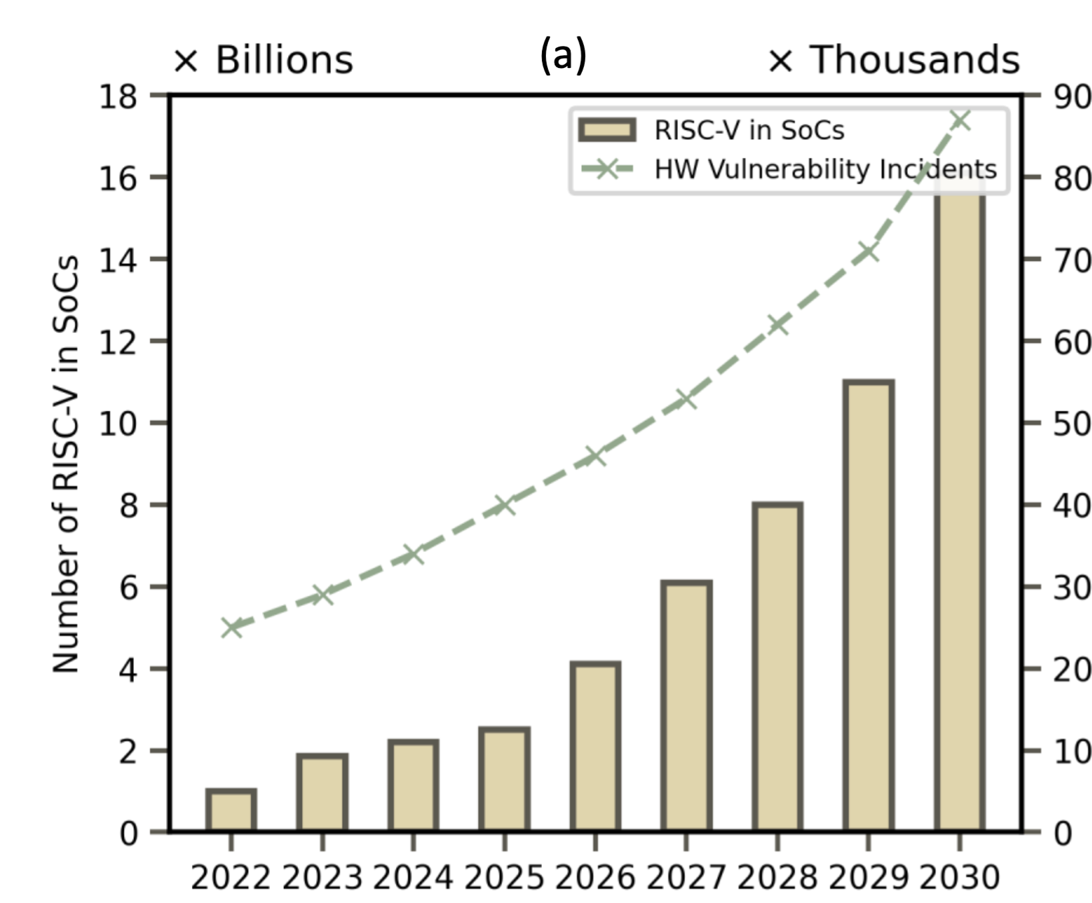
Rising Vulnerabilities vs. Human Bandwidth
Modern SoCs are growing in complexity, heterogeneity, and integration speed.
More IPs, more interfaces, more privilege modes, more corner cases.
Security risk is expanding faster than teams can manually review and verify.
Threat analysis, property writing, and cross-module reasoning do not scale easily.
In a fast-moving market, human expertise is essential but no longer sufficient alone.
We need workflows that amplify expert effort, not replace it.
Based on publicly reported SoC growth and hardware vulnerability incident trends (NIST/MITRE)
Notes:
And this brings me to the trend that worries me most. I picked this chart because it shows that open source RTLs like RISC-V integration across SoCs is growing at a steady, encouraging pace. Hardware vulnerability disclosures are also climbing exponentially. And that is a very important factor for us. And the problem is there aren't enough tools that can help cover the gap. I don't think we close that gap by simply hiring more people, because expertise just doesn't scale that way. So we need to come up ideas and ways to improve our open-source tools to fight this. And, the goal isn't to replace the security engineer. It's to give them more reach.

Slide 8
Countermeasure Feasibility
Security vs. design constraints trade-off
Coherence between countermeasures
Successful threat mitigation
Post-insertion functionality equivalence
No PPA overhead violation
Scalability to emerging threats
Notes:
Now, everything I just described sounds good in principle, but a countermeasure that never makes it into a real design is really just a paper sitting on a shelf. And to actually ship, it has to clear quite a few bars at the same time. It needs to genuinely stop the threat it's aimed at. It has to live within the power, performance, and area budget we're already working inside. It needs to get along with whatever other countermeasures are already present in the design, without quietly undoing each other. It has to preserve the exact same functional behavior after it's inserted, provably, not just probably. And it needs to keep holding up as new kinds of threats show up, not just the ones we knew about when we designed it. That's a demanding list. But if you think about it, it's really just a constrained optimization problem, and that happens to be something this community already does better than almost anyone else.

Slide 9
Conclusion
Open-source EDA is no longer a research curiosity. It's backed by billions in funding, it spans the full RTL-to-GDSII flow, and it's already producing silicon that competes.
That same openness is what makes it a target. Every stage from synthesis to physical design carries real, measurable risk, and the cost of getting it wrong is counted in the hundreds of billions.
Security has to be designed in, not bolted on. The frameworks and metrics exist. What's needed now is for the community to treat security as a first-class requirement, the same way it already treats correctness and performance.
Notes:
So let me bring this together. Adoption, I think, is already a settled question. Thirteen billion dollars in public funding and a complete, open RTL to GDSII flow settled it. What's left isn't really a technical question anymore. It's a choice. We can start treating security as a first class design requirement, with the same seriousness we already give timing closure and area, or we can keep bolting it on afterward and paying for it later, usually at a much higher price.

Slide 10
References
WSTS, Global Semiconductor Market Surges Beyond $1.5T (2026)
TestFlow Inc., 2nm Chip Development Cost Analysis ($725M)
Panchal, Free and Open-Source VLSI Chip Design EDA Tools List, LinkedIn
Integrated Circuit Design, Springer (2025)
MDPI Electronics, Vol. 15, Issue 5, Art. 1048
ACM Digital Library, DOI 10.1145/3505170.3511046
VisionSpace, Remote Code Execution and Critical Vulnerabilities in NASA F Prime v3.4.3
Solt et al., USENIX Security 2025
Astute Group, Counterfeit Electronics Threaten Supply Chain Sustainability
StationX, Cyber Security Breach Statistics
DeepStrike, Supply Chain Attack Statistics 2025
International Journal of Information Security, Springer, DOI 10.1007/s10207-026-01284-4
IEEE Xplore, Document 6860363
OpenROAD Initiative, Google Joins ORI, July 14, 2026
Yahoo Finance, Cadence, Synopsys Slide on Kimi K3, July 16, 2026
EuroCDP, Open EDA Tool Gap Analysis and Recommendations, July 10, 2026
NSF Award #2449356

Slide 11
“The next chapter of open-source EDA won't be defined by whether it's adopted. It'll be defined by whether it's trusted.”
Notes:
And I'll leave you with one thought before we open it up for questions. The next chapter of open-source EDA won't be defined by whether it gets adopted. That part is behind us. It'll be defined by whether it's trusted. Thank you.

