Slide 1
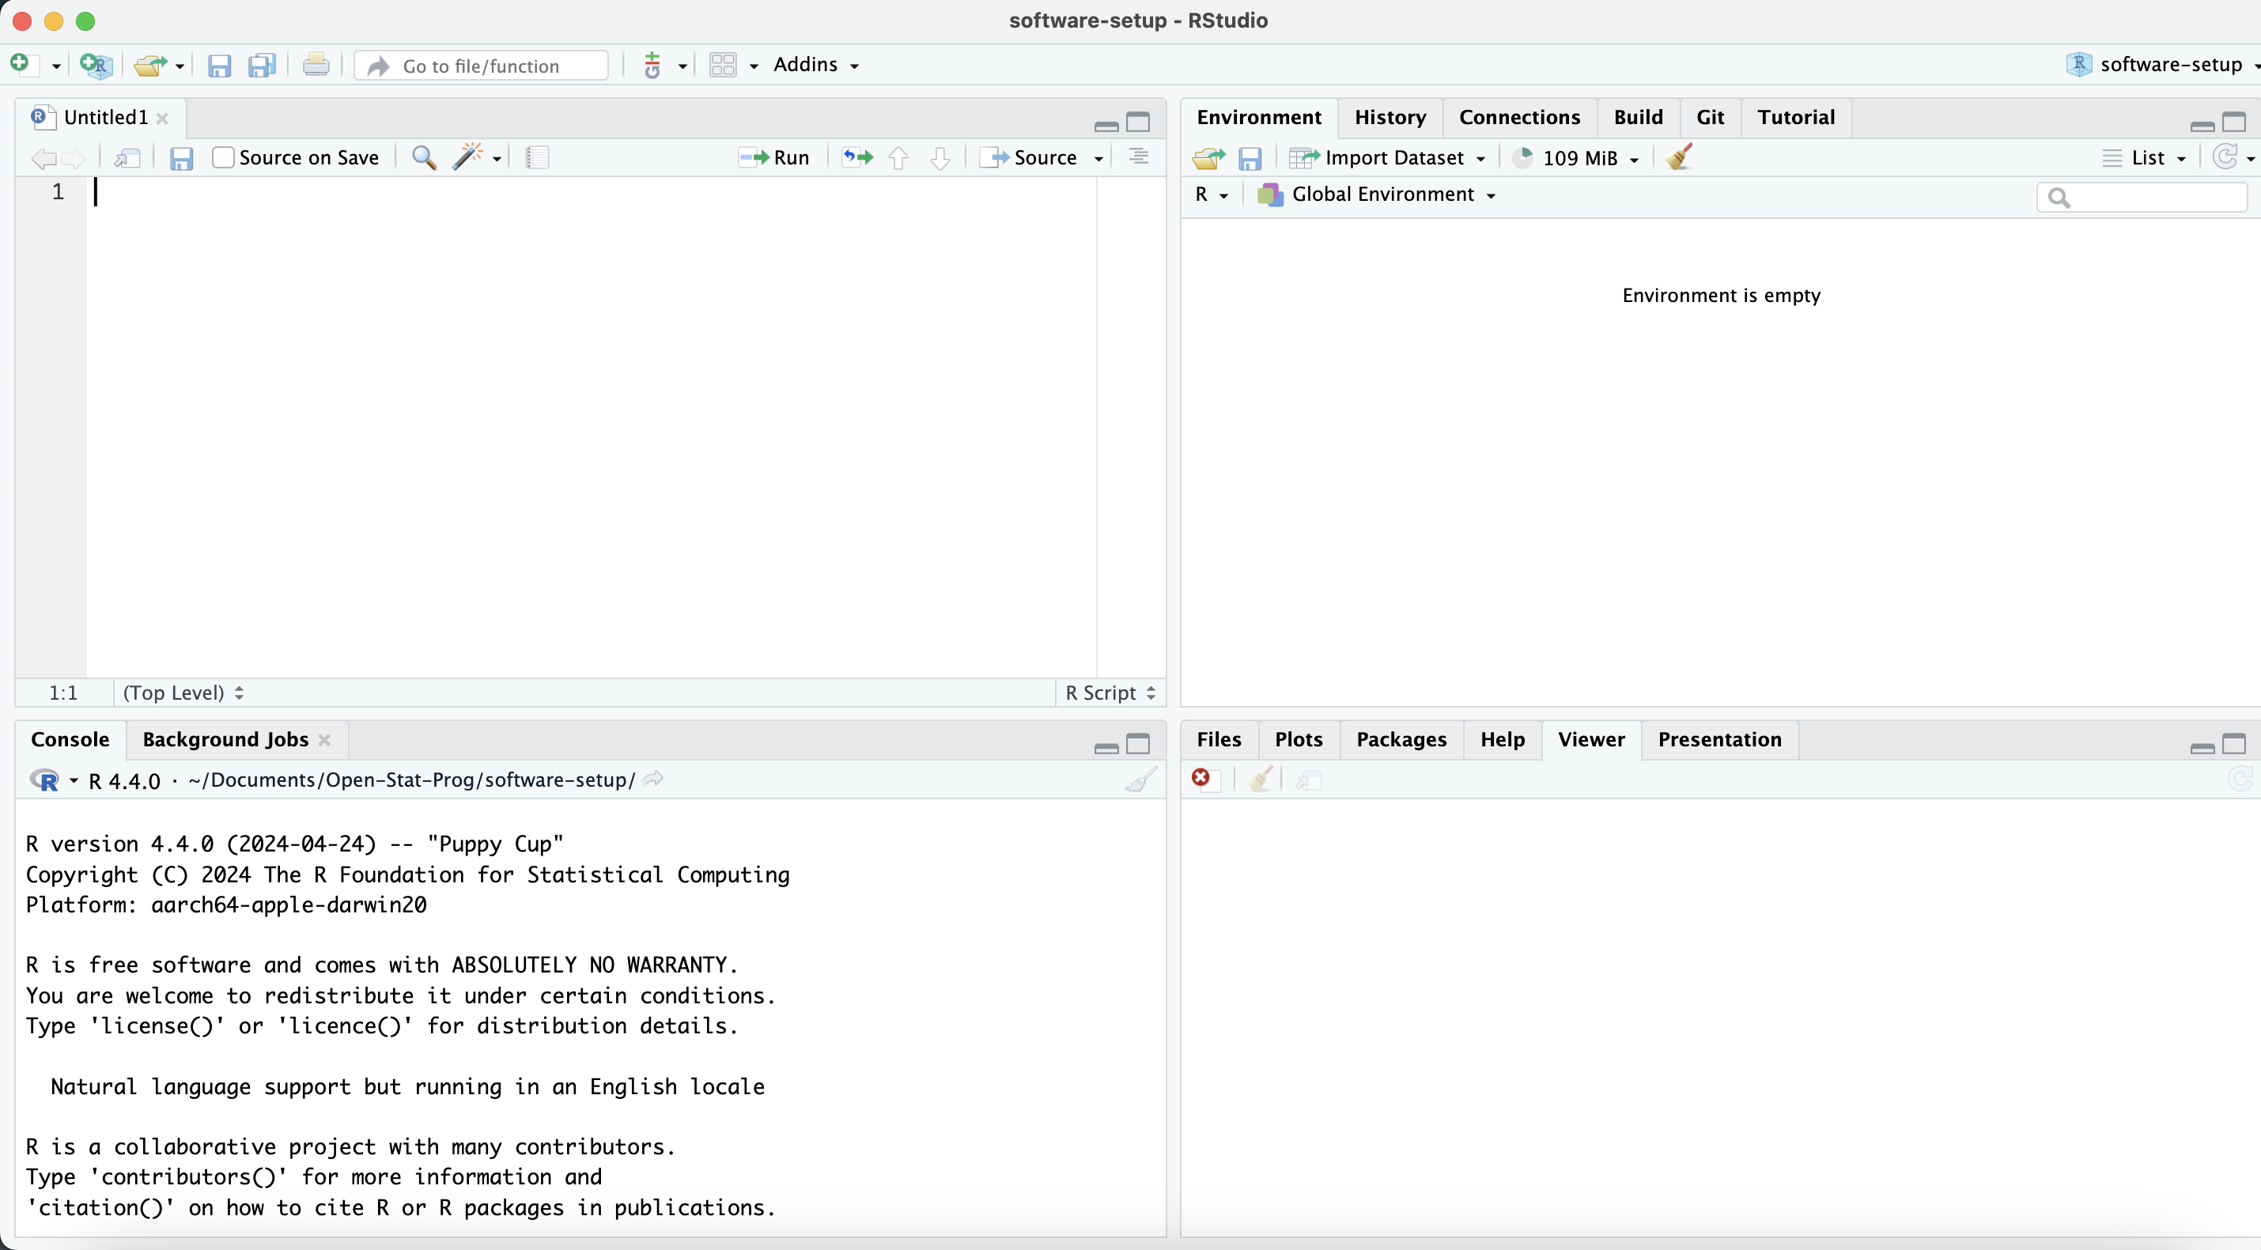
Source
Environments
Console
Output

