Slide 1


Slide 2
💡 NABC – Validated RAG System for MDSAP Regulatory Q&A
🟡 Need
Challenge in validating AI-generated answers in regulatory contexts.
Regulatory documents (e.g., IMDRF, GHTF, RDC 665/2022) are complex and
time-consuming to consult.
🔵 Approach
Built a functional RAG system and evaluation approach in 1.5 days.
Indexed key documents:
- MDSAP Audit Approach (AU P0002), Country specific regulations
- MDSAP AU P0037, Q&A MDSAP, GHTF SG3/N19
Allows natural language questions with document-based answers.
Validation via LLM-as-a-judge and manual inspection.
🟢 Benefits
Reduces time to interpret regulatory content.
Improves consistency and traceability with direct references.
Enables transparent and collaborative validation.
Scalable to other frameworks and jurisdictions.
🔴 Competition / Alternatives
Keyword search: limited and fragmented.
Generative AI: needs robust validation.
Combining automated + manual validation improves answer quality with feasible effort.

Slide 3
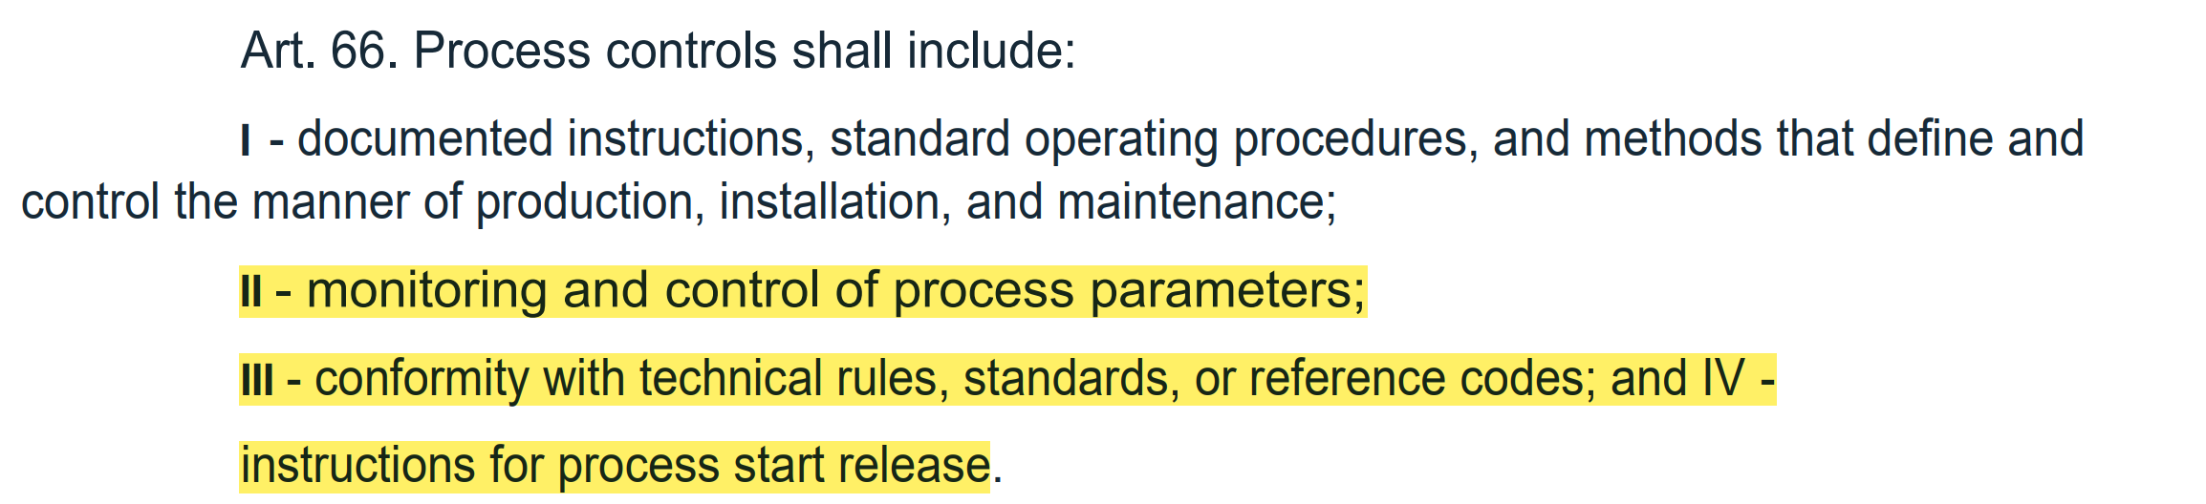
Which article of RDC 665/2022 requires companies to monitor and control process parameters?

Slide 4
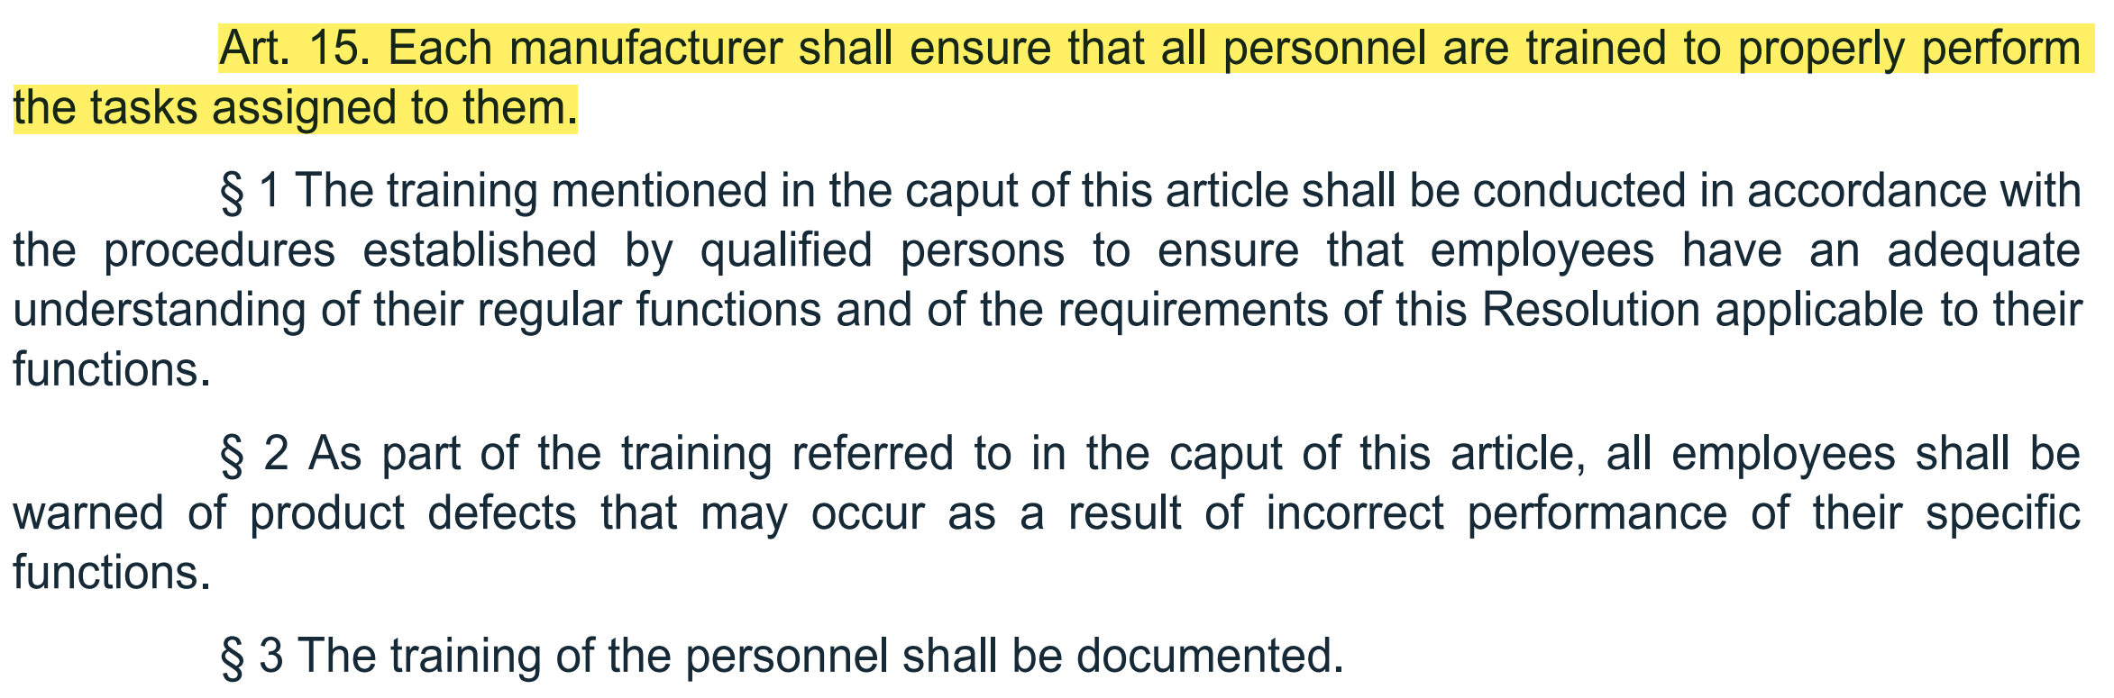
What does RDC 665/2022 establish regarding employee
training requirements for carrying out assigned activities?

Slide 5
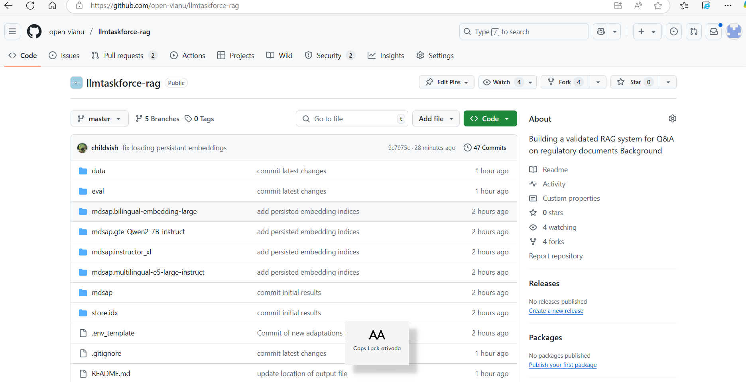

Slide 6
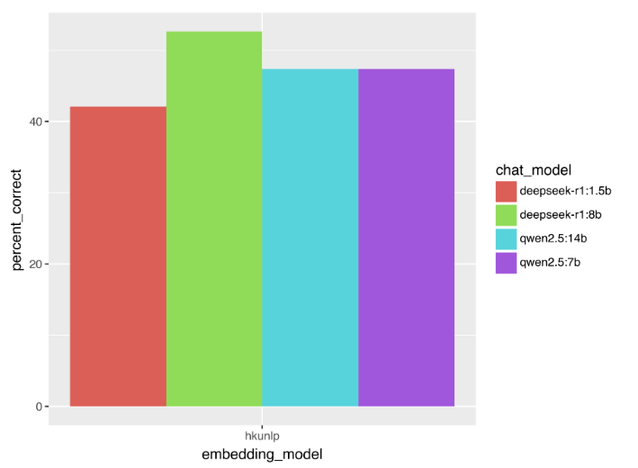

Slide 7
