Slide 1



Conversational GenAI Systems and Interoperable Assistants the Sandbox
Conversational GenAI Workshop August 8, 2024 New York City
Emmett Coin ejTalk
Linux Foundation AI & Data Foundation, Open Voice Interoperability Initiative

Slide 2
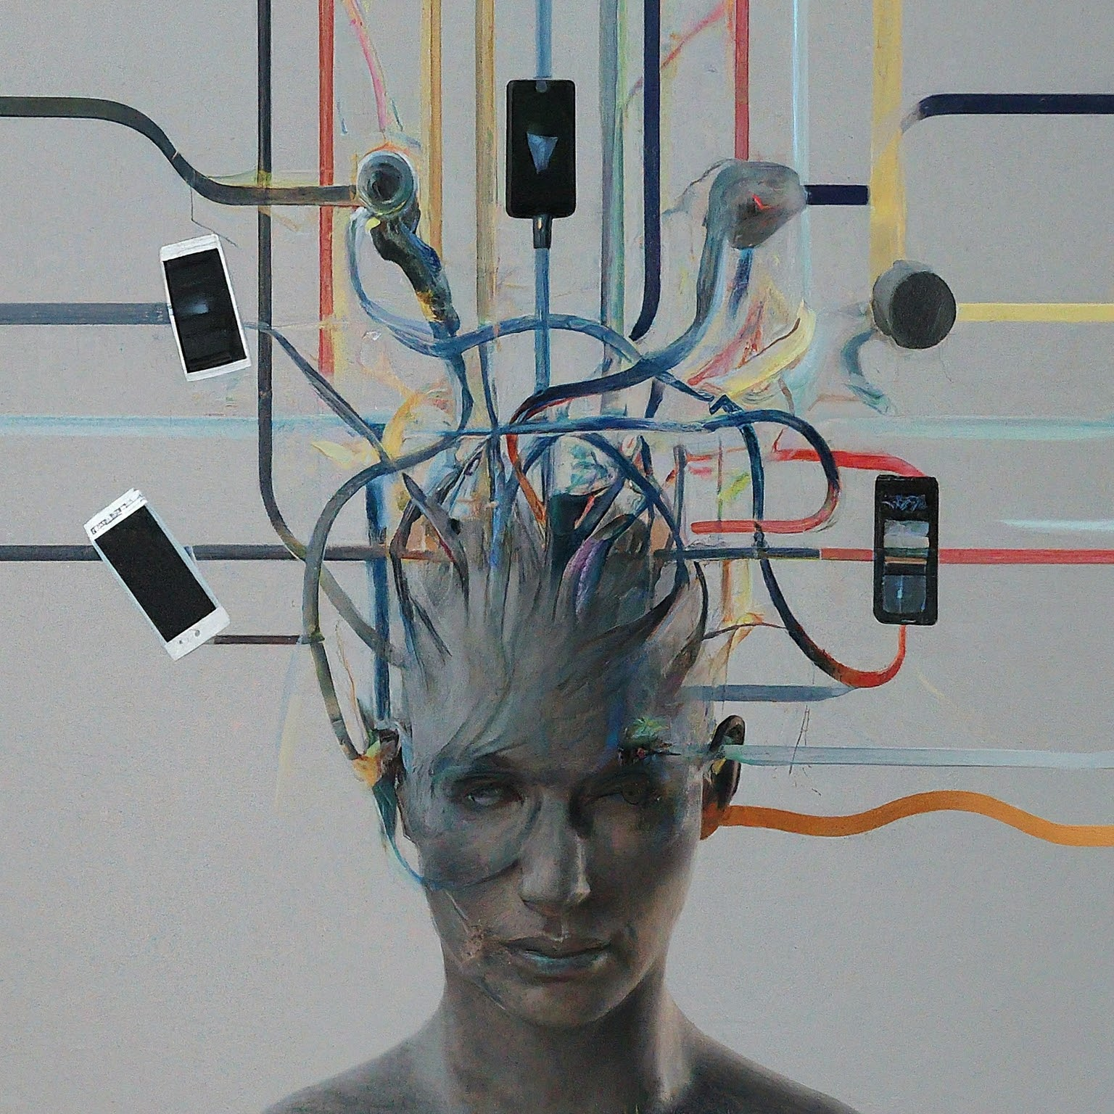
About me
Decades of R&D experience with speech, dialog, and AI technologies starting at MIT
Architected systems across the spectrum
Telephony (proprietary, VoiceXML, etc.)
Wearable (warehouse voice picking, etc.)
Multimodal (text, touch, avatars, etc.)
Project Focused
Enjoy being on the edge

Slide 3

What is the Sandbox?
First, what it is not:
a product
an end user platform
a mandatory implementation

Slide 4
Then what IS the Sandbox?
A functional demonstration of interoperation
An open source project for a browser implementation
A collection of working code that supports the OVON standard
A tool to test and debug OVON compliant interaction

Slide 5
The Sandbox implements OVON Standard What is that?
It is a JSON specification for exchanges between cooperating Assistants
It is similar to the concept of HTML
A server hosts an Assistant (much like a website is hosted)
A JSON Envelope is sent to an Assistant and an Envelope is returned
If a human is in the conversation then the platform provides a UI to capture and render interaction

Slide 6
An OVON JSON exchange:
SENT:: | { "ovon": { "conversation": { "id": "convoID8403984", "startTime": "07-30-2024_10:47:05" }, "schema": { "version": "0.9.0", "url": "not_published_yet" }, "sender": { "from": "Emmett" }, "events": [ {“to": “internal:cassandra“, "eventType": "invite" } ] } }
RECEIVED: | { "ovon": { "conversation": { "id": "convoID8403984", "startTime": "07-30-2024_10:47:06" }, "schema": { "version": "0.9.0", "url": "not_published_yet" }, "sender": { "from": "internal:cassandra" }, "events": [ { "to": “Emmett", "eventType": "utterance", "parameters": { "dialogEvent": { "speakerId": "cassandra", "features": { "text": { "mimeType": "text/plain", "tokens": [ { "value": "Hi Emmett! How can I assist you today?" } ] } } } } } ] } }

Slide 7
OVON Messages are called: Envelopes
They uniquely identify:
The sender
The ongoing conversation
The version of the OVON standard
The payload is one or more events
invite
utterance
(plus more we will discuss later)

Slide 8
OVON Messages are called Envelopes
This is a complete OVON Envelope:
{ "ovon": { "conversation": { "id": "convoID8403984", "startTime": "07-30-2024_10:47:06" }, "schema": { "version": "0.9.0", "url": "not_published_yet" }, "sender": { "from": "internal:cassandra" }, "events": [ { "to": “Emmett", "eventType": "utterance", "parameters": { "dialogEvent": { "speakerId": "cassandra", "features": { "text": { "mimeType": "text/plain", "tokens": [ { "value": "Hi Emmett! How can I assist you today?" } ] } } } } } ] } }

Slide 9
OVON Envelopes have these parts:
This part is about the Envelope
{ "ovon": { "conversation": { "id": "convoID8403984", "startTime": "07-30-2024_10:47:06" }, "schema": { "version": "0.9.0", "url": "not_published_yet" }, "sender": { "from": "internal:cassandra" }, "events": [ { "to": “Emmett", "eventType": "utterance", "parameters": { "dialogEvent": { "speakerId": "cassandra", "features": { "text": { "mimeType": "text/plain", "tokens": [ { "value": "Hi Emmett! How can I assist you today?" } ] } } } } } ] } }
This part is the payload

Slide 10
In the Sandbox you will see the Envelopes as you interact
SENT: | { "ovon": { "conversation": { "id": "convoID8403984", "startTime": "08-01-2024_13:45:50" }, "schema": { "version": "0.9.0", "url": "not_published_yet" }, "sender": { "from": "Emmett" }, "events": [ { "to": "internal:florist", "eventType": "utterance", "parameters": { "dialogEvent": { "speakerId": "Emmett", "features": { "text": { "mimeType": "text/plain", "tokens": [ { "value": "Do you have the light pink ones" } ] } } } } } ] } }
RECEIVED: | { "ovon": { "conversation": { "id": "convoID8403984", "startTime": "08-01-2024_13:45:51" }, "schema": { "version": "0.9.0", "url": "not_published_yet" }, "sender": { "from": "internal:florist" }, "events": [ { "to": "internal:florist", "eventType": "utterance", "parameters": { "dialogEvent": { "speakerId": "cassandra", "features": { "text": { "mimeType": "text/plain", "tokens": [ { "value": "Yes, we do have light pink calla lilies! Would you like to add a card or any other flowers to the arrangement?" } ] } } } } } ] } }

Slide 11
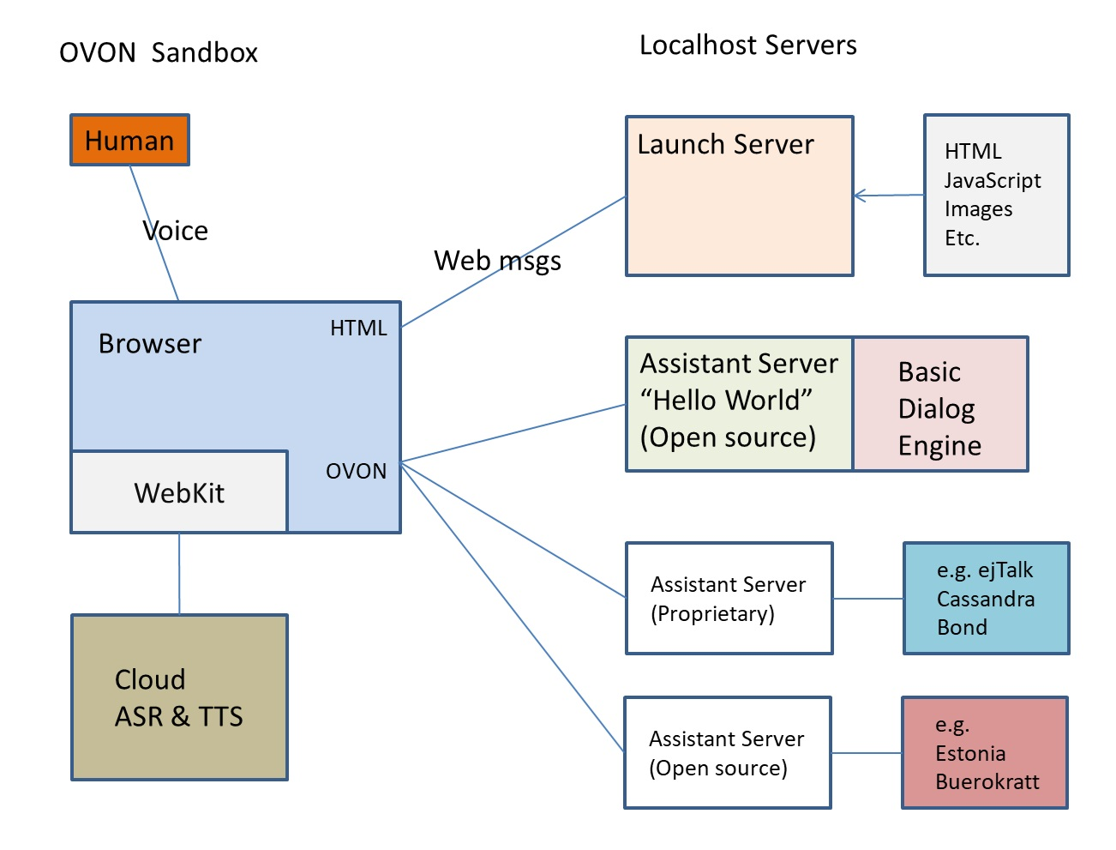
On to the Sandbox: The components

Slide 12

Starting the Sandbox:
Install python 3.12
PIP3 install requests, flask and flask-cors
Install MS Edge browser
Clone (or get ZIP of the Sandbox)
Navigate to the D3 directory.
Start the sandbox server
Python sandboxServer.py
In the browser navigate to http://localhost:6002

Slide 13
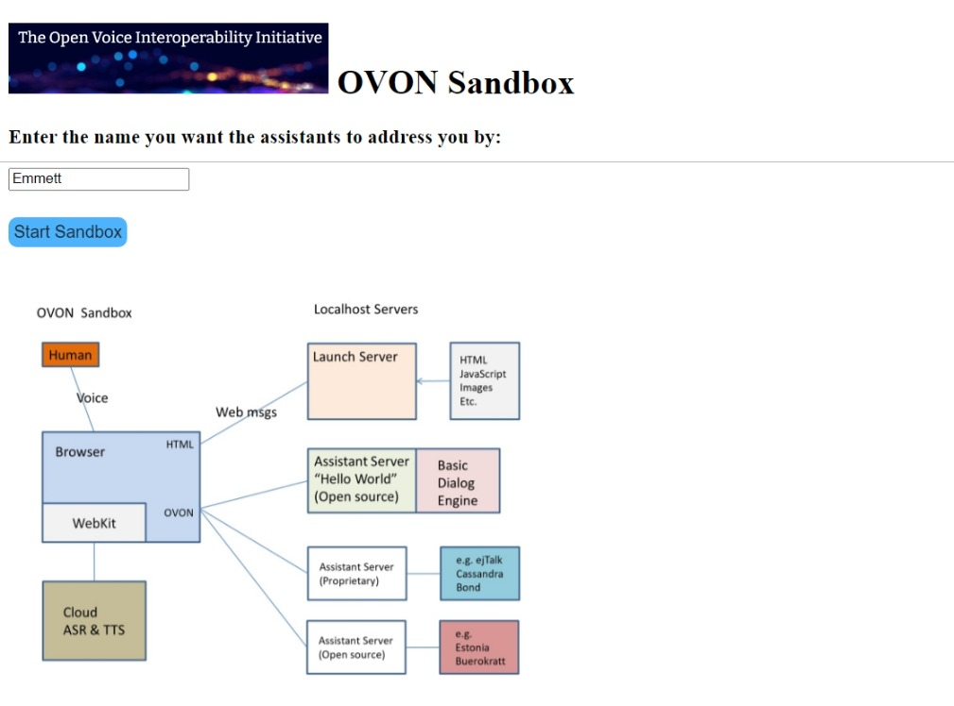
You should see:
Enter your Name
…Then
Click: Start Sandbox

Slide 14
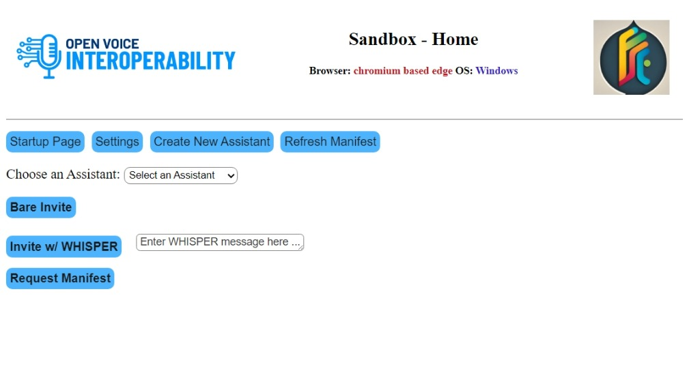
Now you should see:
Click the button
Settings
Find your
… OpenAI Key

Slide 15

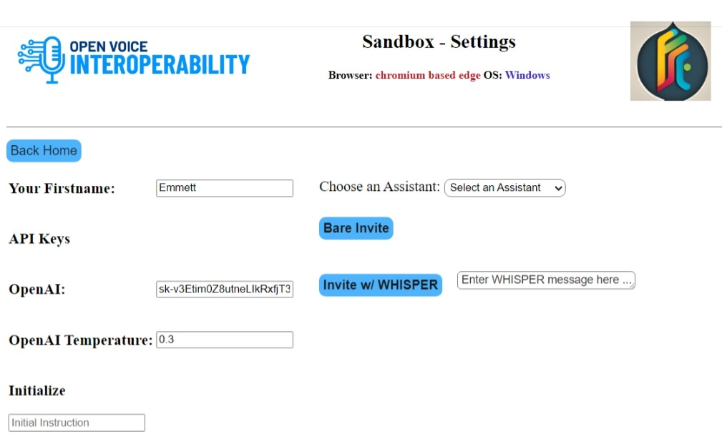
The Settings Page
Paste your key
(in the OpenAI box)
… then
Close this window

Slide 16
Now go to the open Home Page:
Click on the
Select an Assistant
Drop down
Select the Wizard
… then
Click the button
Bare Invite

Slide 17
Begin the free form open lab part of the session

Slide 18
Click:

Slide 19
Click:

