Slide 1





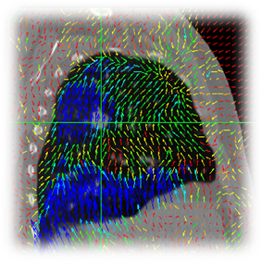

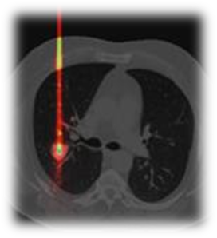
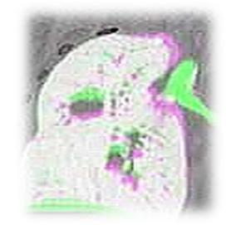

Let’s jump into a new dimension !
Open-source, cross-platform and free
Software for temporal images.
Authors : Pierre Séroul & David Sarrut

