Slide 1



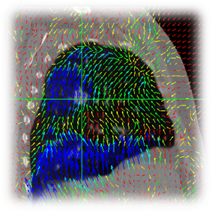

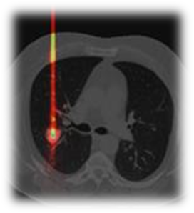
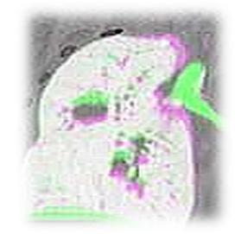

Let’s jump into a new dimension !
Open-source, cross-platform and free
software for temporal images.
Authors : Joël Schaerer, Pierre Séroul & David Sarrut

