Slide 1
Integrating Version Control with VersionOne
Ian Buchanan - Product Manager, Platform & Integrations
Notes:
Tell us how you see the problem, in your words.
What is the priority of integrating VersionOne and your Version Control System compared to other ALM problems?
How does this kind of integration help you advance your agile practices?
What VCS tools are you using now? Do you have a plan to add or change your tooling soon?
How are the tools deployed for you? Cloud vs on-premise?

Slide 2
Agile Practices Depend on Effective Version Control
From the VersionOne State of Agile™ 8th annual report. www.stateofagile.com.
All rights reserved © 2014.
Notes:
If you aren’t doing effective version control, you have bigger problems than Agile can solve.

Slide 3


Sound Familiar?
I just want to see my story but I’m lost in a sea of information about branches and builds.
I am trying to get comfortable with these new engineering practices so I don’t know how everything is related.
Product Owner
Developer
Notes:
Although CI and CD help provide fast feedback, the pace of change can become overwhelming. In early stages of adoption, the frequency can increase much faster than the ability of everyone to understand what is happening. Product Owners want to see progress on their story or defect in the form of working software. While they may get working software more often, it can easily become confusing to know what is “done”. Meanwhile, developers are trying to adjust to new strategies for managing code changes and builds. While they might be responsible for creating all the branches and builds, that doesn’t necessarily mean they know how to relate everything back to stories and defects.

Slide 4
CommitStream
For development teams practicing version control,
who want to improve Continuous Integration and Continuous Deployment CommitStream
is a simple, easy-to-apply web service,
that connects version control systems to VersionOne.
Our solution enables more people to understand what code is changing and why, which leads to better alignment and faster feedback across the organization,
CommitStream eliminates the need for 1-1 version control integrations with pre-built support for the most popular version control tools
Notes:
has no installation footprint for VCSaaS, plugs into existing VCS for on-premise VCS, and is built for extensibility, not copy-paste-modify.
available for all VersionOne Editions
Multiple repositories (both in a tool and across them)

Slide 5
Prebuilt support for most popular version control tools
Each integration has to be installed and managed by the customer
Customer
Multiple repositories require multiple integrations too
Admin/Service
TFS
integration
Admin/Service
Git
integration
Version Control Tools
Commit Stream
VersionOne
Admin/Service
Subversion
integration
Admin/Service
The new CommitStream eliminates the need for 1-1 version control integrations with prebuilt support for your most popular version control tools
Perforce
integration
Today there are unique, 1-1 integrations between version control tools and V1
Coming Soon
Mercurial
ClearCase
Notes:
Scenario:
My company uses multiple version control tools for software development. As the administrator I have to install a service for each point-to-point integration between my version control tools and VersionOne because my teams use different types of tools like Git, TFS, Subversion, and Perforce and they all use VersionOne to project manage the development process.
Any time an update to a version control tool happens I have to update and administrate the point-to-point service that I installed so that the connection to VersionOne is maintained and stories and tasks can get updated as development work is completed.
As my teams grow and they want to use different version control tools I have to install another integration service and manage it to make sure that it connects to VersionOne so developers are happy that they can mark tasks complete in their version control tool and product owners are happy because completed tasks are updated in VersionOne. I really wish that I didn’t need a unique integration for each and every one of my version control tools to connect to VersionOne. It would be great if all version control tools could natively speak to VersionOne without me having to install, manage, and update version control specific services.
Scenario 2:
One scenario that is poorly covered by the old way. If you use Visual Studio Online (hosted TFS), GitHub (hosted Git), or CloudForge (hosted Subversion), then on premise integration isn’t just a burden – it doesn’t even make sense. “I have 2 SaaS products but, to integrate them, you want me to set up an on premise server?” The scenario doesn’t change the picture, but it is still an important part of the story.
Scenario 3:
Admins don’t set this up anymore – its in the hands of the developers now
For a customer we have taken the burden of Admin and config – Easy for dev to turn on definitely promotes the YOUR WAY message
Integrations is a MUST HAVE – You may never WIN business with integrations but you will definitely LOSE business if you don’t integrate to the “food web” of software development.

Slide 6

Demonstration

Slide 7
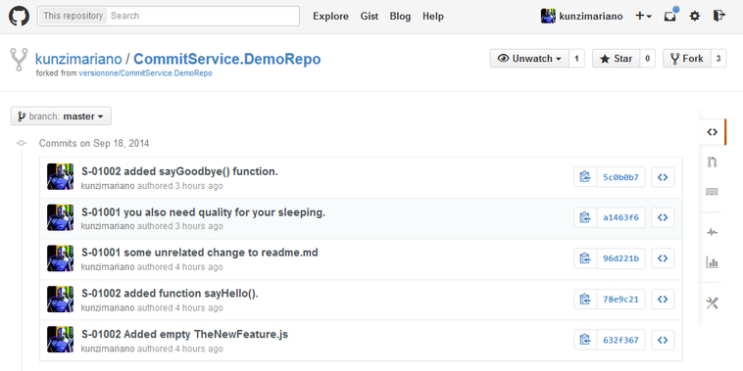
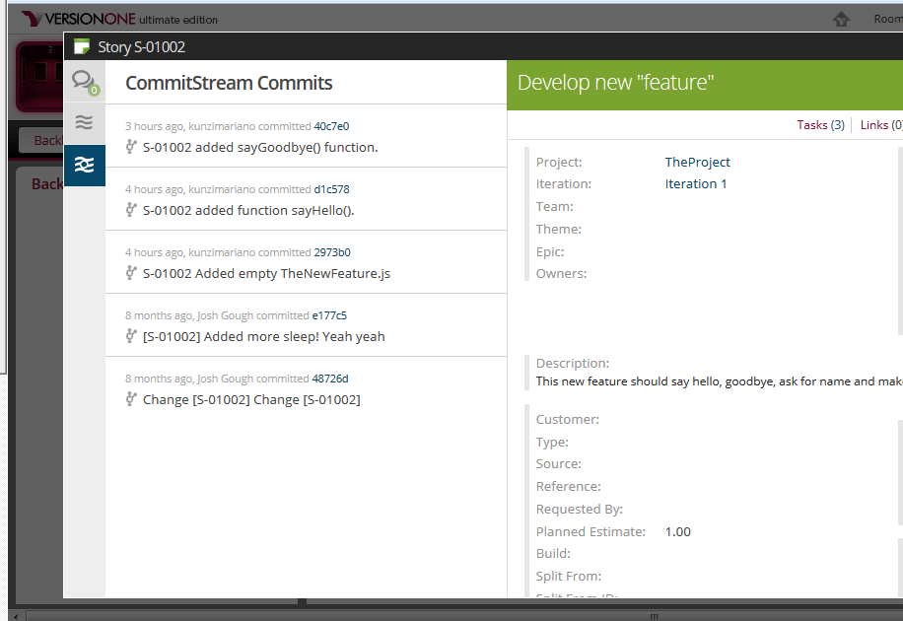

Slide 8
Solution Details
Requirements:
GitHub repository
VersionOne
14.2 or higher with latest service releases
Any edition
No on-premise installation or configuration
Cost:
Freemium, first repository is free, paid after
Support:
VersionOne
Customization:
CommitStream is an open-source micro-platform run as a service
Extension Point: Reporting – add your own “projections” to analyze commits
Extension Point: VCS – if we don’t have it, you can add it

