Slide 1
CSE 575 Class Project Presentation
LEARNING FROM CQA DATA
Name | ASU ID | Email | Contribution | Contribution
Ashish Kumar | 1208657108 | akuma119@asu.edu | Data preprocessing | 16.66%
Kavita Korgaonkar | 1209283721 | kkorgaon@asu.edu | Integration and Evaluation | 16.66%
Saurabh Singh | 1209404713 | ssing139@asu.edu | Auto Tagging | 16.66%
Tejal Sabnis | 1209319614 | tsabnis@asu.edu | LDA | 16.66%
Vatsal Mahajan | 1209373994 | vmahaja1@asu.edu | Opinion/Sentiment mining | 16.66%
Vivek Singh | 1209521349 | vsingh22@asu.edu | Auto Tagging | 16.66%

Slide 2
Problem Description
Predicting Question quality - Good or Bad.
What is a Good question ?
In a community question-answering setting, a good question is not just one
that is found to be useful by other people: a question is good if it is also
presented clearly and shows prior research effort.
Autonomous tagging of Question
Predicting a single tag for a given question

Slide 3
Features
Features arising from the community dynamics :
Questioner reputation (log scale),
# of questions the questioner has asked (log scale)
# of answers on the question
Sum of scores on answers to question,
# of comments on highest-reputation answerer,
2 features of the highest-scoring answer:
Length,
# of comments on it
This set is based on the results in : Discovering Value from Community Activity on Focused. Question Answering Sites: A Case Study of Stack Overflow. Ashton Anderson. Daniel Huttenlocher.
Semantic Features :
Opinion / sentiment score for the comments on the question.
Score based on Auto - Tag prediction for the question.
LDA - Latent Dirichlet Allocation

Slide 4
Labels
As the questions on stack overflow do not have Good or Bad tag; hence we deduce
labels of questions based on the following formula (for questions at least 1 year old):
We consider the quantity p_{i} = s_{i}/v_{i}
where;
v_{i} is the View Count for question q_{i} ,
s_{i} = n⁺_{i} − n⁻_{i} , which is the Score prominently displayed right next to the question.
The average value of pi is about 0.002 (0.003 when conditioned on questions with
positive pi).
Hence we label questions with pi <= 0.001 as bad and those with pi > 0.001 as
good.
Ref : Great Question! Question Quality in Community Q&A. Sujith Ravi, Bo Pang, Vibhor Rastogi, Ravi Kumar.

Slide 5
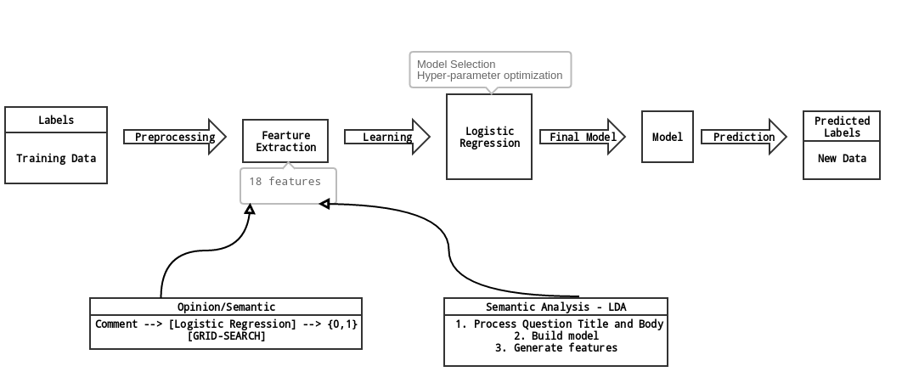
Work-Flow Diagram

Slide 6
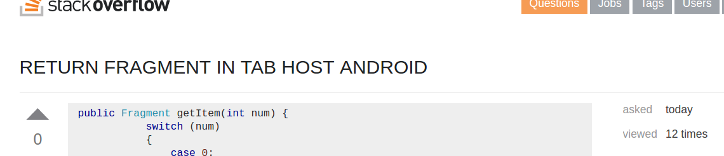
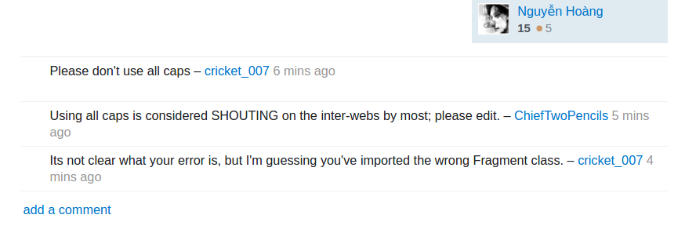
Opinion/Sentiment Mining on Comments
Here we utilize the opinion expressed by comments on the questions as a
parameter to indicate the quality of the question.
Question :
Comments :

Slide 7

Opinion/Sentiment Mining on Comments
We trained our model on the label data set from : http://ai.stanford.edu/~amaas/data/sentiment/
The following table shows the accuracy of the different models trained under different parameters:
 | 1-gram | 2-gram | Stopwords | Stemming | Regularization Parameter | Accuracy
Logistic - Regression |  |  |  |  | 10.0 | 0.896
Logistic - Regression |  |  |  |  | 100.0 | 0.90
SVM |  |  |  |  | 0.13 | 0.83
SVM |  |  |  |  | 0.1 | 0.841

Slide 8
Semantic Analysis - LDA
Notion of question quality goes beyond mere popularity (view count and upvotes)
Voting patterns differ based on question
communities interested in a certain topic might be more (or less) parsimonious about handing out up votes
a question about an arcane topic may not generate too much interest
Relationship between question quality and question content based on latent topic models.

Slide 9
Semantic Analysis - LDA
Training Data: Question Title and Body
Data Preprocessing
Calculate word frequencies
Document Topic Model

Slide 10
Semantic Analysis - LDA
Implementation Details:
Acquire training data
Question title and body
Data Preprocessing
Remove HTML tags
Remove punctuation
Remove stop words

Slide 11
Semantic Analysis - LDA
Implementation Details:
Calculate word frequencies
Two dimensional matrix
No. of questions * No. of unique words
Each element is the number of times that word occurs in that document
Document Topic Model
Two dimensional matrix
No. of questions * No. of topics
Each element is the probability with which that question belongs to the topic

Slide 12
Experiments
Classification with different models:
Linear SVM Accuracy | 0.801
Logistic Regression | 0.812
Gaussian NB | 0.669
Ridge | 0.22
KNeighbors Classifier | 0.778
Decision Tree Classifier | 0.718
Random Forest Classifier | 0.766
Extra Trees Classifier | 0.773
SGD Classifier | 0.754
Ada Boost Classifier | 0.756
Gradient Boosting Classifier | 0.768

Slide 13
Results
Best Results:
Linear SVM Accuracy = 80.1
Logistic Regression = 81.2

Slide 14
Autonomous Tagging
Data is rapidly increasing in various question answer sites like stackoverflow, quora etc.We present an automatic way of grouping and classifying the information in form of tags so that it can be displayed to users in an intuitive way.
There can be various use cases for it such as
Grouping question about a common topic together
Show user posts related to question they input
Question routing to particular group of users

Slide 15
Preprocessing
The original data set contains various fields such owner id, title, body, tag1, tag2 etc.
We found that that terms in the title are more indicative of labels because a user usually attempts to summarize and categorize the question in the title.
We aim to enhance the performance by using top 50 tags among whole dataset to test and train our model
We used title to create feature and tag1 as label for learning

Slide 16
Feature & Classification Flow
.
Text
Title Text
Bag of Words
Tf-idf
Classifier
Label Prediction

Slide 17
Feature Extraction
We have used each Title to construct following two columns which are used
Bag of Words
In this step we are splitting the title and counting the occurrence of each word per document.We removed common English words from it to improve accuracy
Tf-Idf
It is short for term frequency-inverse document frequency
It reflects importance of word for a document in a collection

Slide 18
Classifier
We have used following classifiers for training the given sample and predicting for test data:
Ridge Classifier
Linear Support Vector Classifier
Multinomial Naive Bayes
KNN classifier

Slide 19
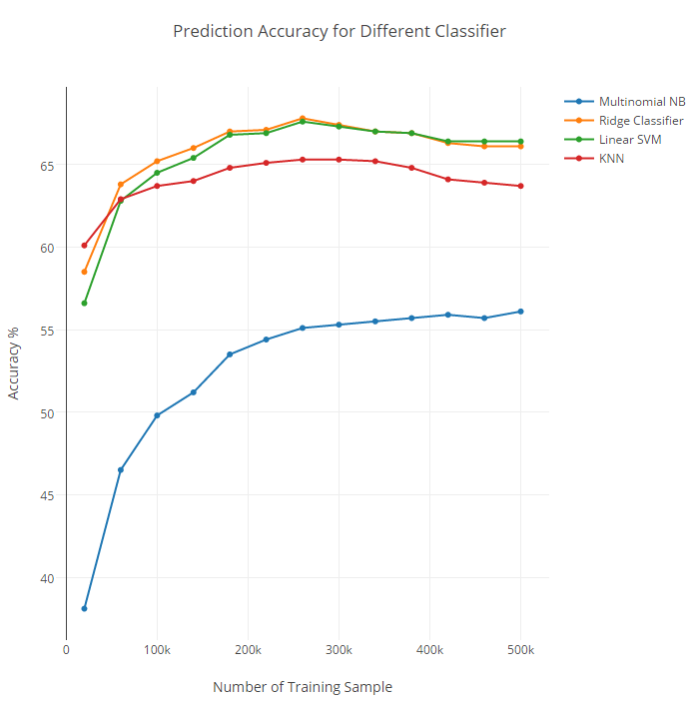
Performance Analysis

Slide 20
Conclusion
The Linear Support Vector Classifier gives the maximum accuracy of 67.60% by using top 50 tags for autonomous tagging.
For improving the accuracy of autonomous tagging additional features need to be explored such body of the question, stripping off the code portion from the body.
We get an accuracy of 81% for predicting the quality of the question using Logistic Regression.

Slide 21
Reference
[1] https://www.cs.cornell.edu/home/kleinber/kdd12-qa.pdf
[2] http://static.googleusercontent.com/media/research.google
.com/en//pubs/archive/42287.pdf
[3] http://tonghanghang.org/pdfs/kdd14_lip.pdf
[4] http://scikit-learn.org/stable/tutorial/index.html

Slide 22
Contributions in project
Name | ASU ID | Email | Contribution | Contribution
Ashish Kumar | 1208657108 | akuma119@asu.edu | Data preprocessing | 16.66%
Kavita Korgaonkar | 1209283721 | kkorgaon@asu.edu | Integration and Evaluation | 16.66%
Saurabh Singh | 1209404713 | ssing139@asu.edu | Auto Tagging | 16.66%
Tejal Sabnis | 1209319614 | tsabnis@asu.edu | LDA | 16.66%
Vatsal Mahajan | 1209373994 | vmahaja1@asu.edu | Opinion/Sentiment mining | 16.66%
Vivek Singh | 1209521349 | vsingh22@asu.edu | Auto Tagging | 16.66%

