Slide 1
Diagrams – associated forwarding constructs in forwardingList
(only if multiple steps forwarding steps), v0.0.5
Diagrams – associated profileInstances

Slide 2
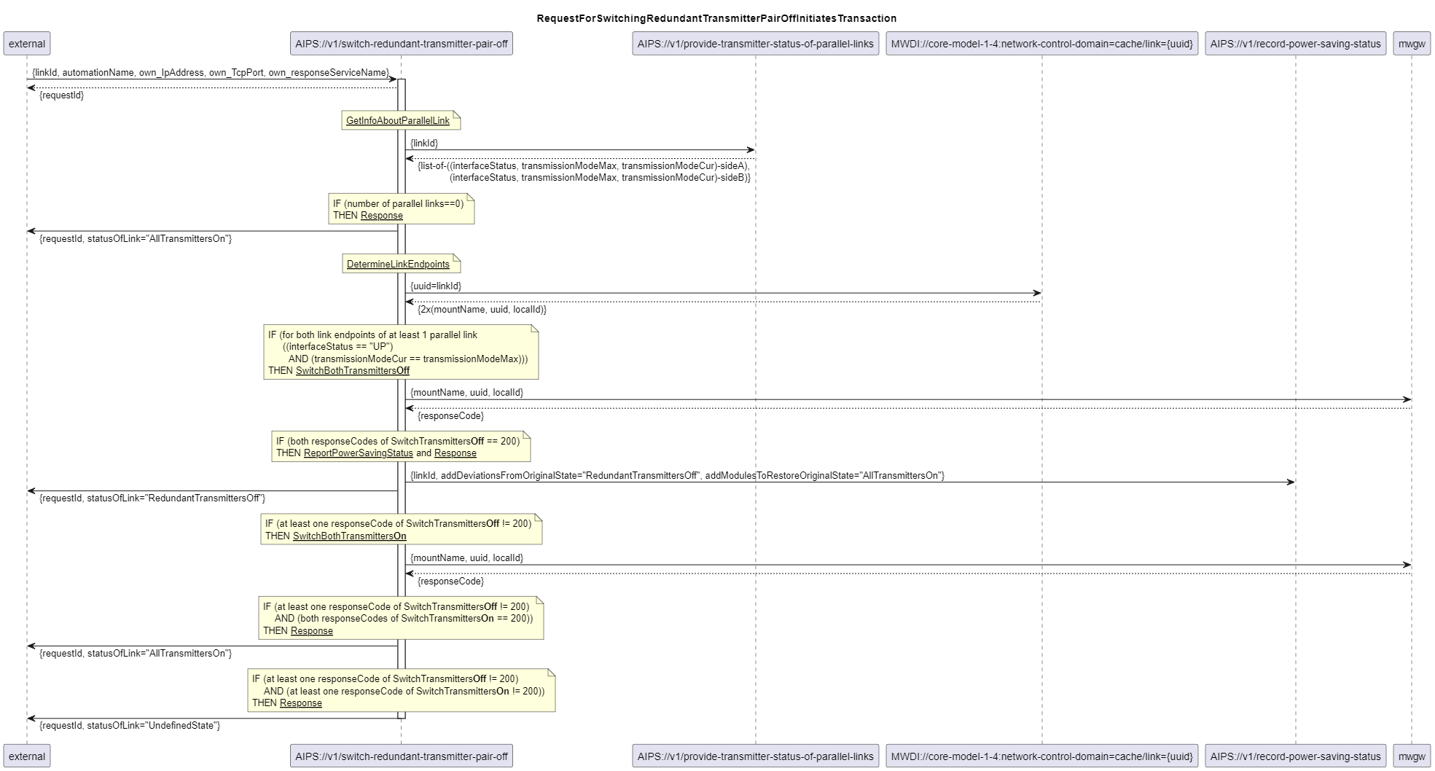
500_switchRedundantTransmitterPairOff
fc-is-500
fc-is-501
fc-is-502
fc-is-503
fc-is-504
fc-is-505
fc-is-501
fc-is-501

Slide 3
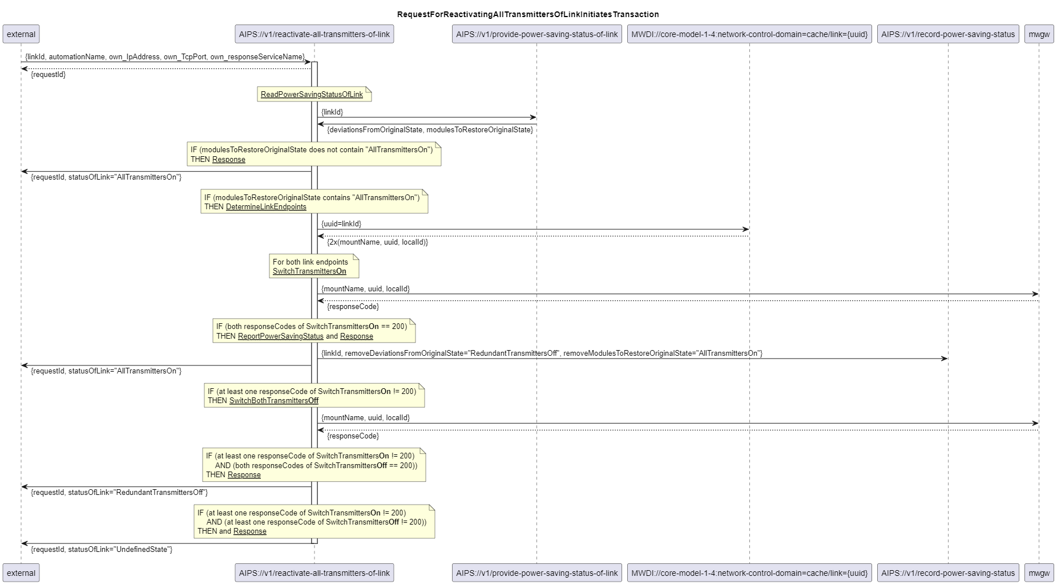
501_reactivateAllTransmittersOfLink
fc-is-510
fc-is-511
fc-is-512
fc-is-513
fc-is-514
fc-is-511
fc-is-515
fc-is-511
fc-is-511

Slide 4
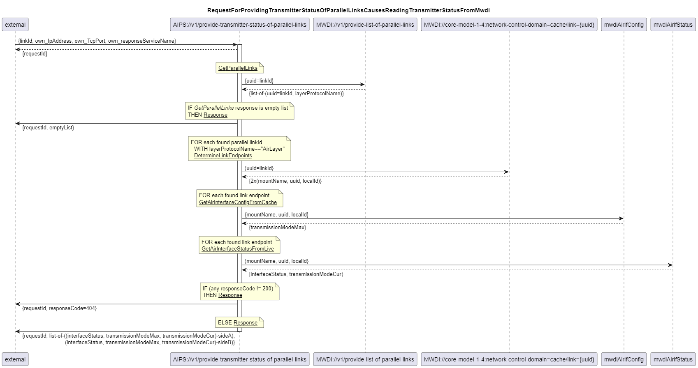
601_provideTransmitterStatusOfParallelLinks
fc-is-600
fc-is-601
fc-is-602
aips-0-0-5-string-p-100
RequestForProvidingTransmitterStatusOfParallelLinkCausesReadingTransmitterStatusFromMwdi.GetAirInterfaceConfigFromCache
fc-is-603
aips-0-0-5-string-p-101
RequestForProvidingTransmitterStatusOfParallelLinkCausesReadingTransmitterStatusFromMwdi.GetAirInterfaceStatusFromLive
fc-is-604
fc-is-601
fc-is-601

Slide 5
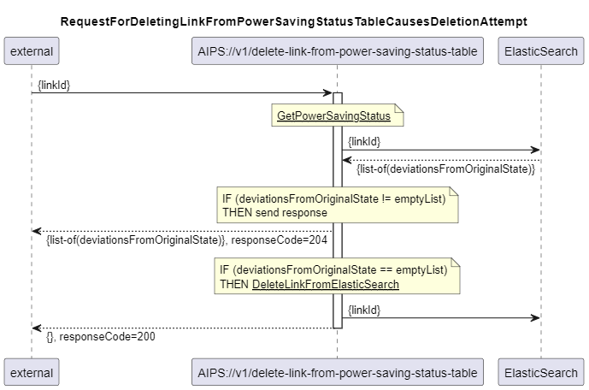
705_deleteLinkFromPowerSavingStatusTable
aips-0-0-5-integer-p-100
powerSavingStatusTableLinkDeletionPeriod
fc-is-705
fc-is-706

