Slide 1
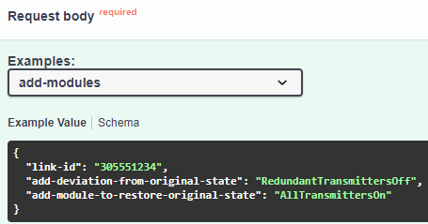
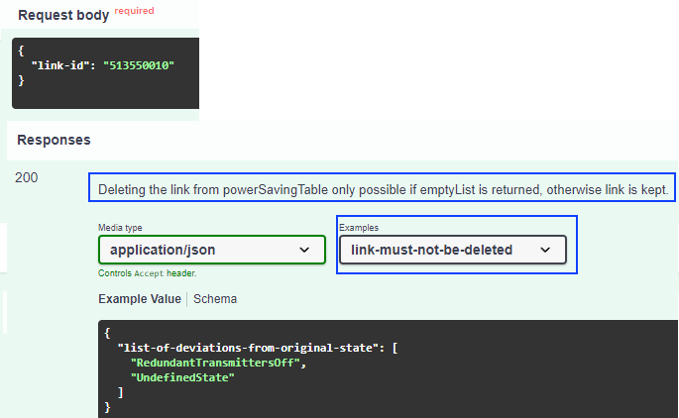
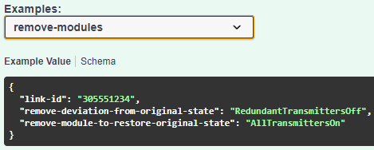
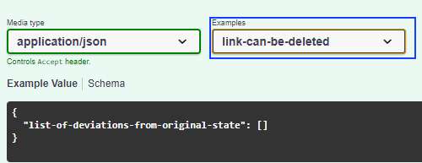

/v1/record-power-saving-status
/v1/delete-link-from-power-saving-status-table
pass oneOf property sets:
add OR remove

Slide 2
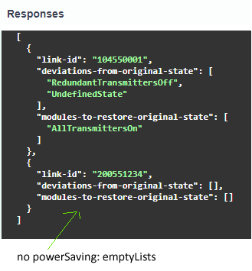
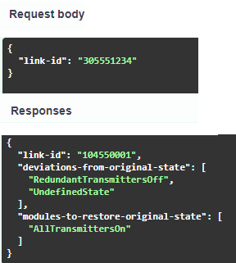
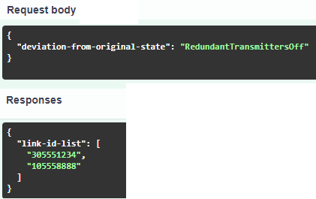
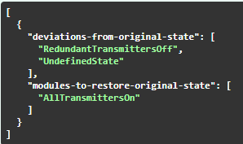
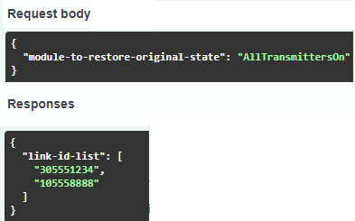
/v1/list-power-saving-status
/v1/provide-power-saving-status-of-link
/v1/list-affected-links
POWER_SAVING_
STATUS_OF_LINK
POWER_SAVING_
STATUS_OF_LINKS
/v1/list-to-be-restored-links
Array of objects
(1 object per link)

Slide 3
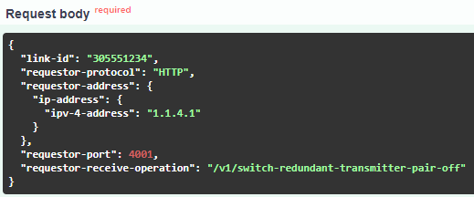
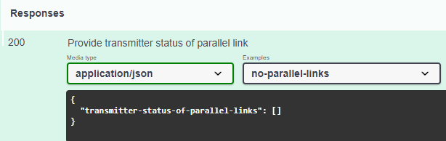
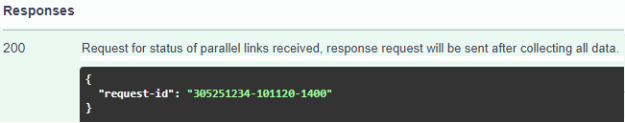
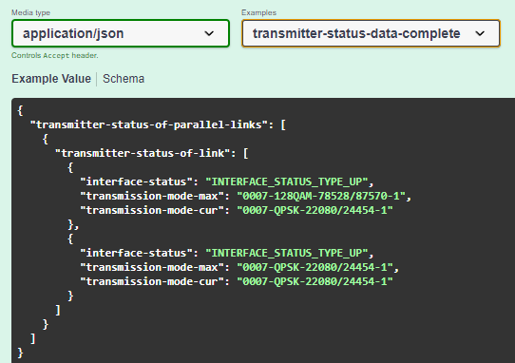
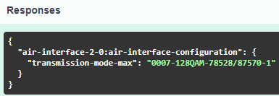

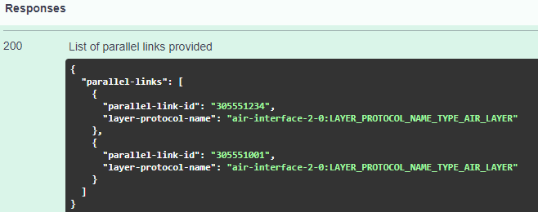
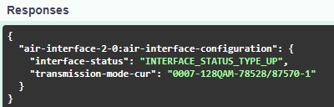
re
/v1/provide-transmitter-status-of-parallel-links
2. DetermineLinkEndpoints
5. Response
MWDI spec dependency -> todo
requestBody:
Wertet aus, ob es parallele Links gibt,
Wertet die Daten aus den Retrievals aus
Returns:
Array:
- (mount-name, uuid, localId)-sideA
- (mount-name, uuid, localId)-sideB
#/components/schemas/LINK_ADDRESS_TRIPLES
3. GetAirInterfaceConfigFromCache
mount-name, uuid, local-id, fields-filter as path parameters
Execute for both link endpoints of each parallel link
-> where to write that down in OAS?
callbacks:
RequestForProvidingTransmitterStatusOfParallelLinkCausesReadingTransmitterStatusFromMwdi:
GetParallelLinks (MWDI)
DetermineLinkEndpoints (MWDI)
GetAirInterfaceConfigFromCache (MWDI)
GetAirInterfaceStatusFromCache (MWDI)
Response
1. GetParallelLinks
MWDI spec dependency -> todo
4. GetAirInterfaceStatusFromLive
mount-name, uuid, local-id, fields-filter as path parameters
Execute for both link endpoints of each parallel link
-> where to write that down in OAS?
Schema geändert -> redundantTransmittersOff/AllTransmittersOn müssen angepasst werden!

