Slide 1
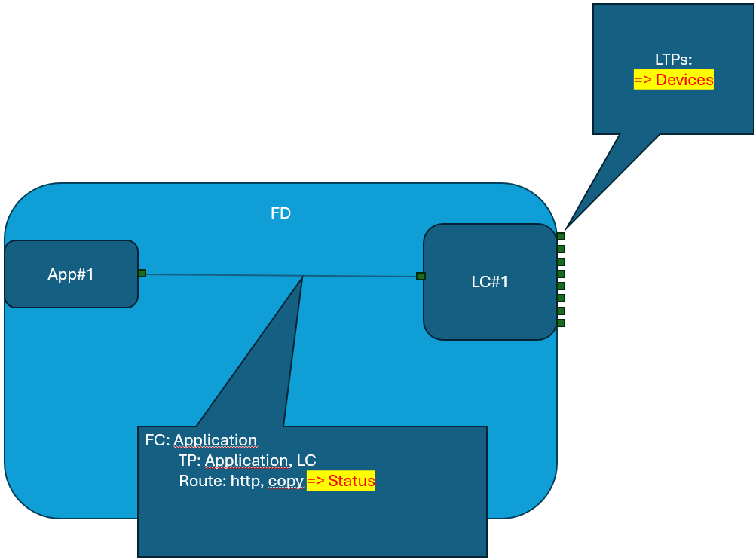
CC
to be deleted, if no longer required for scrolling
ControllerDomain
CDM
functionName
parameter
F
DC
AP
CA
affected-management-domain
affected-management-plane-transport
affected-link
affected-cc/ltp/lp
error-code
error-message
…
_trigger-function
sequence
VS
EC
error-code
description
_implementation-function
_target-function
period-length
…
P
Network
templateName=[managementDomainInterfaceTemplateName]
category=managementDomainInterfaceTemplate
managerIpAddress
managerPort
measureManagementDomainInterfaceService
mediateManagementDomainInterfaceUpdateService
managementDomain Interface [*]
NCD
storage=running,operational, …
templateName=[loadBalancerTemplateName]
category=loadBalancer
loadBalancer [*]
controller [*]
P
Preliminary
templateName=[controllerTemplateName]
category=controller
mountPoint [*]
local-id=[mountPointTemplateName]
category=mountpoint
… and many more
forwardingDomainName=
[managementDomain]
FD
ManagementPlaneTransport
forwardingConstructName=[applicationName]
FC
[*]
R
local-id
Application
LoadBalancer
Controller
LogicalController
CC
elementName=[applicationName]
category=application
_template= managementDomainInterfaceTemplate
elementName=[loadBalancerName]
category=loadBalancer
_template=loadBalancerTemplateName
CC
elementName=[controllerName]
category=controller
_template=controllerTemplateName
_logicalController=[managementDomain]
CC
CC
elementName=[managementDomain]
category=logicalController
_template=controllerTemplateName
_controllers[*]=[controllerName]
_tcpServer=[loadBalancerName/controllerName]
local-id=load-balancer-manager
LTP
local-id=controller-manager
LTP
local-id=controller-manager
LTP
local-id=tcp-server
localIpAddress
localPort
TcpServer [1]
LP
LP
local-id=[applicationName]
httpUserName=[applicationName]
httpPassword
HttpServer [*]
LP
ManagementDomainInterface
Link
MountPoint
Link
LogicalMountPoint
LTP
local-id=[managementDomain]
L
local-id
linktp*[{local-id,_cc,_ltp,_lp}]
LTP
local-id=[deviceName]
_template=mountPointTemplateName
L
local-id=[deviceName]
_template=mountPointTemplateName
LTP
LP
HttpClient [1]
local-id=http-client
httpUserName
=[applicationName]
httpPassword
R
local-id=tcp-link-chain
local-id=http-server / [applicationName]
httpUserName= ~ / [applicationName]
httpPassword
HttpServer [*]
LP
CopyClient [1]
CopyServer[*]
LP
local-id=copy-client
copySource=[managementDomain]
local-id
linktp*[{local-id,_cc,_ltp,_lp}]
local-id=copy-server
copyDestination=[controllerName}
Link
Forwarding
Link
NetconfClient [1]
local-id=netconf-client
netconfUserName
netconfPassword
notificationSubscribe
notificationStreamName
connectionStatus
sessionId
local-id=netconf-client
netconfUserName
netconfPassword
notificationSubscribe
notificationStreamName
availableCapability
unavailableCapability
L
LTP
uuid=[managementDomain]
L
NetconfClient [1]
TcpClient [1]
local-id=tcp-client
remoteIpAddress
remotePort
local-id
linktp*[{local-id,_cc,_ltp,_lp}]
local-id=tcp-server
localIpAddress
localPort
TcpServer [1]
LP
TcpClient [*]
local-id= controllerName remoteIpAddress
remotePort
local-id
linktp*[{local-id,_cc,_ltp,_lp}]
local-id=tcp-server
localIpAddress
localPort
TcpServer [1]
TcpClient [1]
local-id=tcp-client
remoteIpAddress
remotePort
TcpClient [1]
local-id=tcp-client
remoteIpAddress
remotePort
to be deleted, if no longer required for scrolling

Slide 2
CC
to be deleted, if no longer required for scrolling
ControllerDomain
CDM
functionName
parameter
F
DC
AP
CA
affected-management-domain
affected-management-plane-transport
affected-link
affected-cc/ltp/lp
error-code
error-message
…
_trigger-function
sequence
VS
EC
error-code
description
_implementation-function
_target-function
period-length
…
P
Network
templateName=[managementDomainInterfaceTemplateName]
category=managementDomainInterfaceTemplate
managerIpAddress
managerPort
measureManagementDomainInterfaceService
mediateManagementDomainInterfaceUpdateService
managementDomain Interface [*]
NCD
storage=running,operational, …
templateName=[loadBalancerTemplateName]
category=loadBalancer
loadBalancer [*]
controller [*]
P
templateName=[controllerTemplateName]
category=controller
mountPoint [*]
local-id=[mountPointTemplateName]
category=mountpoint
netconfUserName
netconfPassword
… and many more
forwardingDomainName=
[managementDomain]
FD
ManagementPlaneTransport
forwardingConstructName=[deviceName]
FC
[*]
R
local-id
Application
LoadBalancer
Controller
LogicalController
CC
elementName=[applicationName]
category=application
_template= managementDomainInterfaceTemplate
elementName=[loadBalancerName]
category=loadBalancer
_template=loadBalancerTemplateName
CC
elementName=[controllerName]
category=controller
_template=controllerTemplateName
_logicalController=[managementDomain]
CC
CC
elementName=[managementDomain]
category=logicalController
_template=controllerTemplateName
_controllers[*]=[controllerName]
_tcpServer=[loadBalancerName/controllerName]
local-id=load-balancer-manager
LTP
local-id=controller-manager
LTP
local-id=controller-manager
LTP
local-id=tcp-server
localIpAddress
localPort
TcpServer [1]
LP
LP
local-id=[applicationName]
httpUserName=[applicationName]
httpPassword
HttpServer [*]
LP
ManagementDomainInterface
Link
MountPoint
Link
LogicalMountPoint
LTP
local-id=[managementDomain]
L
local-id
linktp*[{local-id,_cc,_ltp,_lp}]
LTP
local-id=[deviceName]
_template=mountPointTemplateName
L
local-id=[deviceName]
_template=mountPointTemplateName
LTP
LP
HttpClient [1]
local-id=http-client
httpUserName
=[applicationName]
httpPassword
R
local-id=tcp-link-chain
local-id=http-server / [applicationName]
httpUserName= ~ / [applicationName]
httpPassword
HttpServer [*]
LP
CopyClient [1]
CopyServer[*]
LP
local-id=copy-client
copySource=[managementDomain]
local-id
linktp*[{local-id,_cc,_ltp,_lp}]
local-id=copy-server
copyDestination=[controllerName}
Link
Forwarding
Link
L
LTP
uuid=[managementDomain]
L
local-id=tcp-client
remoteIpAddress
remotePort
notificationSubscribe
notificationStreamName
connectionStatus
sessionId
local-id=tcp-client
remoteIpAddress
remotePort
notificationSubscribe
notificationStreamName
availableCapability
unavailableCapability
TcpClient [1]
local-id=tcp-client
remoteIpAddress
remotePort
local-id
linktp*[{local-id,_cc,_ltp,_lp}]
local-id=tcp-server
localIpAddress
localPort
TcpServer [1]
LP
TcpClient [*]
local-id= controllerName remoteIpAddress
remotePort
local-id
linktp*[{local-id,_cc,_ltp,_lp}]
local-id=tcp-server
localIpAddress
localPort
TcpServer [1]
TcpClient [1]
TcpClient [1]
to be deleted, if no longer required for scrolling

Slide 3
CC
to be deleted, if no longer required for scrolling
ControllerDomain
CDM
functionName
parameter
F
DC
AP
CA
affected-management-domain
affected-fc affected-management-plane-transport
affected-link
affected-cc/ltp/lp
error-code
error-message
…
_trigger-function
sequence
VS
EC
error-code
description
_implementation-function
_target-function
period-length
…
P
Network
templateName=[managementDomainInterfaceTemplateName]
category=managementDomainInterfaceTemplate
managerIpAddress
managerPort
measureManagementDomainInterfaceService
mediateManagementDomainInterfaceUpdateService
managementDomain Interface [*]
NCD
storage=running,operational, …
templateName=[loadBalancerTemplateName]
category=loadBalancer
loadBalancer [*]
controller [*]
P
out-dated
templateName=[controllerTemplateName]
category=controller
mountPoint [*]
local-id=[mountPointTemplateName]
category=mountpoint
netconfUserName
netconfPassword
… and many more
forwardingDomainName=management-plane-transport
[managementDomain]
FD
ManagementPlaneTransport
forwardingConstructName=[deviceName]
FC
[*]
local-id
R
Application
LoadBalancer
Controller
LogicalController
CC
elementName=[applicationName]
category=application
_template= managementDomainInterfaceTemplate
elementName=[loadBalancerName]
category=loadBalancer
_template=loadBalancerTemplateName
CC
elementName=[controllerName]
category=controller
_template=controllerTemplateName
_logicalController=[managementDomain]
CC
CC
elementName=[managementDomain]
category=logicalController
_template=controllerTemplateName
_controllers[*]=[controllerName]
_tcpServer=[loadBalancerName/controllerName]
local-id=load-balancer-manager
LTP
local-id=controller-manager
LTP
LP
LP
local-id=tcp-server
localIpAddress
localPort
TcpServer [1]
MountPoint
Link
LogicalMountPoint
ManagementDomainInterface
Link
Forwarding
Link
LTP
local-id=[deviceName]
_template=mountPointTemplateName
L
LTP
local-id=[deviceName]
_template=mountPointTemplateName
LTP
local-id=[managementDomain]
Es könnte sein, dass der Controller username/passwort erwartet.
Sollte dies der Fall sein:
Einführung eines Application::RestClients und eines Controller::RestServers
Einführung eines RestLinks von Application bis Controller
complement /v1/establish-management-domain-connection by creation of RestLink(s) ; don‘t route them on TcpLinks ; don‘t integrate them into operationalState calculation
LTP
uuid=[managementDomain]
local-id
linktp*[{local-id,_cc,_ltp,_lp}]
CopyClient [1]
local-id=copy-client
copySource=[managementDomain]
CopyServer[*]
LP
TcpClient [1]
local-id=tcp-client
remoteIpAddress
remotePort
notificationSubscribe
notificationStreamName
availableCapability
unavailableCapability
LP
L
LP
L
LP
TcpClient [1]
local-id=tcp-client
remoteIpAddress
remotePort
notificationSubscribe
notificationStreamName
connectionStatus
sessionId
local-id=copy-server
copyDestination=[controllerName}
TcpClient [1]
local-id=tcp-client
remoteIpAddress
remotePort
local-id
linktp*[{local-id,_cc,_ltp,_lp}]
local-id=tcp-server
localIpAddress
localPort
TcpServer [1]
TcpClient [*]
local-id= controllerName remoteIpAddress
remotePort
local-id
linktp*[{local-id,_cc,_ltp,_lp}]
local-id=tcp-server
localIpAddress
localPort
TcpServer [1]
to be deleted, if no longer required for scrolling

Slide 4
CDM
DDM
MP1a
NETCONF
mP
SNMP
device
Aus der Sicht des DDM:
42.000 Verbindungen zwischen einem MountPoint und einem Device
Aus der Sicht des CDM:
Mehrere Applikationen connecten mit mehreren physischen ODL Instanzen
Repräsentation eines logischen Controllers
LB und ODLs bilden einen logischen Controller
RESTCONF
App
RESTCONF
LB
… x 42,ooo …
MP1b
mP
device
Bis zum MountPoint werden Devices in der URL unterschieden (http layer)
nach dem MountPoint werden Devices im TCP Port unterschieden (tcp layer)
ODL1
LogicalController
App
App
LB
ODLn

Slide 5
ControllerDomain
LoadBalancer
ODL
MWDI
Forwarding
MountP
identical configuration
means: configuration can be
attached to the LogicalController and
bequeathed to the individual ODL
Other geo. region
or prod/pre-prod
LoadBalancing
or 1:1 Protection
MPoint
…
MWDG
ODL
MP
MP
ODL
Forwarding
LoadBalancing
or 1:1 Protection
MP
MP
MedVm
…
MedPro
ODL
MedPro
MP
MP
Wie werden die ManagementPlaneTransportFc (NE-ID) modelliert?
Das MWDI hat einen httpClient LTP
Der ODL hat einen netconfClient LTP (NE-ID)
Das ManagementPlaneTransportFc

Slide 6
ControllerDomain
LoadBalancer
ODL
LogicalController
identical configuration
means: configuration can be
attached to the LogicalController and
bequeathed to the individual ODL
MWDI
Forwarding
MountP
Other geo. region
or prod/pre-prod
LoadBalancing
or 1:1 Protection
MPoint
…
MWDG
ODL
MP
MP
ODL
LogicalController
Forwarding
LoadBalancing
or 1:1 Protection
MP
MP
MedVm
…
MedPro
ODL
MedPro
MP
MP

Slide 7

Automation Application
Interpretation
CandidateDS
Validation
Monitoring
Measurement
RunningDS
OperationalDS
AlarmList
(ToDo-List)
Implementation

Slide 8
Fragestellungen:
Welche Devices sind über welche Domäne an welcher Applikation erreichbar?
Wie ist der operative Status der Anbindung?
3 Keys für eine Aussage
Application - ManagementDomäne - Device
TCP
LoadBalancer
App#1
FW#1
ODL#1
LC#1
ODL#2
App#2
ODL#3
LC#2
ODL#4
App#3
FW#2
ODL#5
LC#3
ODL#6
App#1
MD#1
HTTP
LoadBalancer
App#1
FW#1
ODL#1
LC#1
App#2
MD#2
ODL#2
App#2
ODL#3
LC#2
App#3
MD#3
ODL#4
App#3
FW#2
ODL#5
LC#3
LTPs:
=> Devices
ODL#6
FD: ManagementDomäne
TP: LMP, Applications
FC: ManagementPlaneTransport
TP: LMP, Application
Route
Das Darstellen der Route unter 42.000 Geräten ergibt keinen Sinn.
Das Darstellen der 42.000Geräte unter 6 Routen ergibt ebenso wenig Sinn.
Die 42.000 Geräten müssen gruppiert werden, und die Gruppe durch die Applikationen referenziert werden
Die Verfügbarkeit muss für Routen unter Applikationen berechnet werden.
FD: ManagementDomäne
FC: Device
No TPs
No Route
subFC: _ApplicationGroup
ApplicationGroup:
FC: Application
TPs {LC, App}
Route {LC|ODL, ODL|App}
FD: ManagementDomäne
FC:
TP: {LC, App}
Route
_ltp:
MountPoints
FC: Device
No TPs
No Route
subFC: _ApplicationGroup
ApplicationGroup:
FC: Application
TPs {LC, App}
Route {LC|ODL, ODL|App}
FD
App#1
LC#1
FC: Application
TP: Application, LC
Route: http, copy => Status

