Slide 1









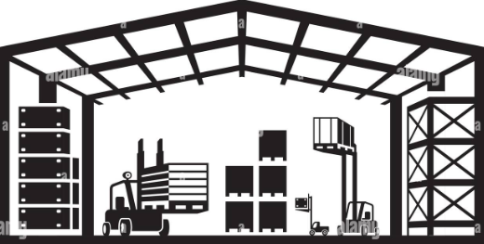









Design #260605
DPMDP
started by /v1/embed-yourself
initiating an instance of p1ProcessDevice for every updated CC
MWDI
p2ProcessDevice
p1UpdateMwdiReplica
MWDI ES
replication
MWDI ES Replica
DataStore
Pre-Processing
- p2LoadRawCc
- p1FieldsFilter
- p2DiscardIrrelevantPmRecords
- p1CalculateInterfacePmDataQuality
Processing
- p2CreateResultCc
- p2PrepareTxModes
- p1CalculateAiCapacity
- p1CalculateIntervalCapacity
- p1RemoveOutOfRangeLevels
- p1RemoveDefaultValues
- p1CalculateEthernetKpis
- p1CalculateUtilization
Transmitting
- p1TransmittingKafka
Storing
- p2Storing
- p1MaintainDs
Serving
- t.b.d.
- p1CalculateBusyHourPerformanceIndicators
- p1RemoveOutOfRangeTemperature
- p1FormattingOutputApt
- p2FormattingOutputOnf

Slide 2
Design #251228
DPMDP
started by /v1/embed-yourself
initiating an instance of p1ProcessDevice for every updated CC
MWDI
p1ProcessDevice
p1UpdateMwdiReplica
MWDI ES
replication
MWDI ES Replica
DataStore
Pre-Processing
- p1LoadRawCc
- p1FieldsFilter
- p1DiscardIrrelevantPmRecords
Processing
- p1CreateResultCc
- p1PrepareTxModes
- p1CalculateAiCapacity
- p1CalculateIntervalCapacity
- p1CalculateEthernetKpis
- p1FormattingOutputApt
Transmitting
- p1TransmittingKafka
Storing
- p1Storing
- p1MaintainDs
Serving
- t.b.d.

Slide 3
Design #251128
DPMDP
started by /v1/embed-yourself
initiating an instance of p1ProcessingPmData for every updated CC
MWDI
p1ProcessingPmData
p1ReplicateMwdiEs
replication
cronjob
MWDI ES
MWDI ES Replica
DPMDP ES
Pre-Processing
- p1LoadRawCc
- p1FieldsFilter
Processing
- p1CreateResultCc
- p1DefaultValueTreatment
- p1OutOfRangeValueTreatment
- p1AirInterfaceCapacityCalculation
- p1EthernetKpiCalculation
- p1FormattingOutputApt
- p1ComputeAirInterfaceNames
- p1ComputeAirInterfacePhysicalLag
- p1ComputeEthContainerNames
Transmitting
- p1TransmittingKafka
Storing
- p1Storing
Serving
-

Slide 4


Design #251127
DPMDP
regardAttributeValueChange
cronjob is notifying a list of ControlConstructs that have been updated in MWDI ES Replica.
regardAttributeValueChange is starting an instance of p1ProcessingOrchestratorForHistoricalPmData for every MountName on the list.
MWDI
p1ProcessingOrchestratorForHistoricalPmData
notifications
cronjob replication
by ES
MWDI ES
MWDI ES Replica
DPMDP ES
Pre-Processing
- p1LoadRawDeviceData
- p1FieldsFilter
Processing
- p1CreateResultCc
- p1DefaultValueTreatment
- p1OutOfRangeValueTreatment
- p1AirInterfaceCapacityCalculation
- p1EthernetKpiCalculation
- p1FormattingOutputApt
- p1ComputeAirInterfaceNames
- p1ComputeAirInterfacePhysicalLag
- p1ComputeEthContainerNames
Transmitting
- p1TransmittingKafka
Storing
- p1Storing
Serving
-

Slide 5
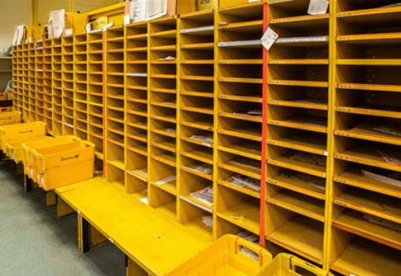
Design #251114
DPMDP
regardAttributeValueChange
As soon as the cronjob is notifying that the DPMDP ES has been updated,
regardAttributeValueChange is initiating p1ProcessingOrchestratorFor15MinHistoricalPmData for every MountName received
AVC notifications
MWDI
AVC notifications
p1ProcessingOrchestratorFor15MinHistoricalPmData
cronjob replication
by ES
MWDI ES
DPMDP ES
reading raw data, capability and config individually and directly from a replication of the MWDI ES
Pre-Processing
-
Processing
-
Transmitting
-
Storing
-
Serving
-

Slide 6
regardAttributeValueChange
Nutzt fields filter auf CC und ermittelt Referenzen auf alle AI/EC
Ruft für jedes AI/EC dazu auf, die neuen PM Daten zu destillieren
IF PmDaten.anzahl == 0 => lösche Referenz von Liste
Für alle Referenzen mit PmDaten.anzahl > 0 ergänze Referenz mit pmDaten
Return Liste mit Referenzen auf alle AI/EC mit PmDaten.anzahl > 0 (incl. pmDaten)
p1ProcessingOrchestratorFor15MinHistoricalPmData
p1ProcessingOrchestratorFor15MinHistoricalPmData
p1ProcessingOrchestratorFor15MinHistoricalPmData
gib mir Liste von zubearbeitenden AI und EC
destilliere neue PM Daten

Slide 7

Design #251112
DPMDP
regardAttributeValueChange
Die Warteperiode beginnt mit dem Erhalt der 1. AVC Notification (d.h. eine Phase, in der keine Notifications eintreffen, führt nicht zur Verlängerung der Periodendauer)
Erwartete Periodenlänge zum Zeitpunkt t=0 : Te₀ = 0s
Zeitpunkt der ersten Abfrage von DPMDP auf Wert in 1. AVC Notification : Ta1 = Te_{(n-1)} – 5s
Zeitpunkt Zwangsstart der Workflows aller betroffenen Geräte : Tz = Te_{(n-1)} + 10s
Periodenlänge zum Zeitpunkt t=n :
Te_{n} = (Te_{(n-1)} – 5s) < Zeitpunkt 1. erfolgreiche Abfrage von DPMDP auf Wert der 1. AVC Notification in Periode n < (Te_{(n-1)} + 10s)
Geräte, die in Periode n bearbeitet wurden, sind für Periode n +1 gesperrt (Grund: Nachzügler Notifications könnten in nächste Periode reichen)
AVC notifications
MWDI
p1ProcessingOrchestratorFor15MinHistoricalPmData
cronjob replication
by ES
MWDI ES
DPMDP ES
reading raw data, capability and config individually and directly from a replication of the MWDI ES
Pre-Processing
-
Processing
-
Transmitting
-
Storing
-
Serving
-

Slide 8

Design #251010
DPMDP
to be clarified: Does the notification make sense as it may arrive before the data has been replicated in ES
notification
just identifies new CC in ElasticSearch
MWDI
no GET for reading entire CC
to be clarified: What is triggering the processing in DPMDP
but replication
of ES
MWDI ES
DPMDP ES
to be clarified: Where to store the output data, as it has a different structure than the MWDI content?
reading raw data, capability and config individually and directly from a replication of the MWDI ES
Pre-Processing
-
Processing
-
Transmitting
-
Storing
-
Serving
-

Slide 9
Considerations after Design #250926 :
To reduce number of requests from DPMDP to MWDI (during processing), not just *HistoricalPerformances shall be retrieved after receiving the notification
To further reduce number of requests the to conform with the data format of the existing APTP interface not just individual interfaces shall be handled but data of the entire device => cart and output shall contain data of the entire device => cc with fields filter on LTP-list incl. LtpAugment and AirInterfacePac and EthernetContainerPac shall be retrieved after receiving the notification
[which notification shall be used as a trigger?]
Retrieving the AirInterfacePax and EthernetContainerPax every 3 hours and storing this raw data for at least 48 hours results in a data volume presumably approximately 10 times bigger than MWDI => too much data to be stored
Storing just the latest raw data creates an exact copy of the content of the MWDI => useless redundancy => idea of storing the raw data is dropped

Slide 10

Design #250926
DevicePerformanceManagementDataProcessor
_PM issue #17 is evaluating a potential change for sending the entire PM data via Kafka instead of just AVC notification
notification
IF new pm-data announced
creates and labels a cart
requests for pm-data
MWDI
GET pm-data
Pre-Processing
-
Processing
-
Transmitting
-
Storing
-
Serving
-

