Slide 1
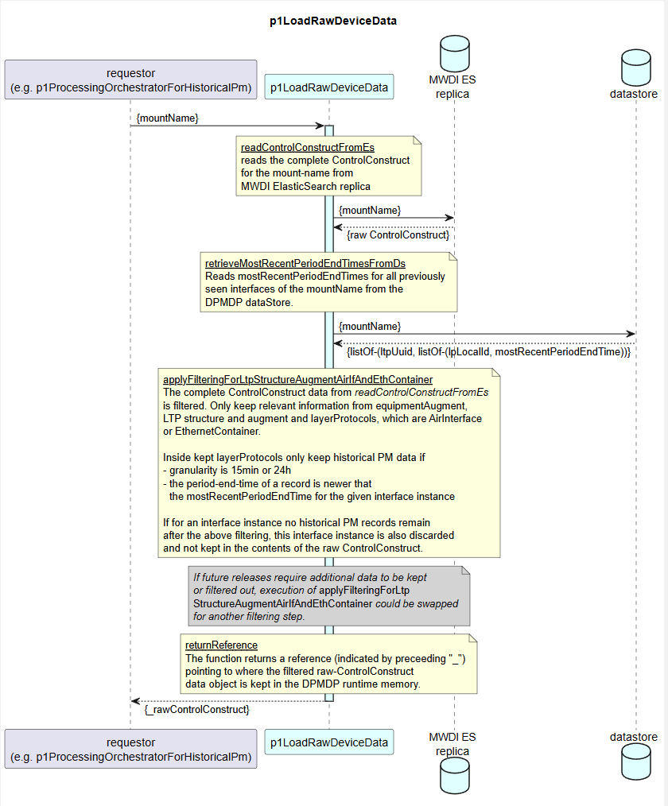
genericFunction:
Removes contents of CC that are not on the whiteList
{ _rawControlConstruct, [whiteListedCcContent] }
{ _rawControlConstruct, [whiteListedLayerProtocolNames] }
genericFunction:
Removes LTPs with LayerProtocols that are not on the whiteList
{ _LTP, ltpUuid, listOf-(lpLocalId, mostRecentPeriodEndTime) }
specificFunction:
Removes out-dated 15min/24h slices of HistPerfData

