Slide 1

Coupled Field Simulation
Manfred Kaltenbacher and Andreas Hüppe
Institute of Mechanics and Mechatronics, Vienna University of Technology
Austria

Slide 2
Outline
Overview about CFS++
History
Capabilities
General Approach
Preprocessing
ANSYS (Classic), Gmsh, ...
Physical definitions
Material definition
Performing simulation
Simulation parameters
Postprocessing
Result files
ParaView

Slide 3

CFS++: History
In the beginning
M. Kaltenbacher and PhD students at Department of Sensor Technology, Friedrich-Alexander University (FAU) Erlangen-Nuremberg, year 2000
Currently involved groups
Kaltenbacher‘s group
Institute of Mechanics and Mechatronics, Vienna University of Technology
R. Lerch‘s group
Department of Sensor Technology, Friedrich-Alexander University Erlangen-Nuremberg
M. Stingl‘s group
Chair of Applied Mathematics 2, Friedrich-Alexander University Erlangen-Nuremberg

Slide 4
History: People
Co-operation partners
S. Reitzinger (support in the design phase)
M. Hofer (bilinear and linear forms)
M. Mohr (algebraic system and XML-structure)
T. Lahmer (inverse schemes)
B. Schmidt (contact handling)
Former Ph.D. students
E. Zhelezina (first implementations)
M. Escobar (aeroacoustics)
G. Link (fluid flow and coupling to mechanics)
Current Ph.D. students
A. Hauck (revisions of class structure, p-FEM, gFEM)
J. Grabinger (non-matching grids, aeroacoustics)
S. Zörner (fluid-structure-acoustic)
A. Volk (magnetostriction)
Post Docs and others
A. Hüppe (aeroacoustics, spectral-FEM, mixed FEM, revisions of class structure)
M. Kaltenbacher (nonlinear PDEs, moving mesh, material modeling, hysteresis )
S. Triebenbacher (non-matching grids, aeroacoustics, CFSDEPS, CMake)
F. Wein (optimization)
Refer to contributors section in developer’s manual

Slide 5



CFS++ Capabilities
Capabilities
Single Field:
Electromagnetics
Mechanics
Acoustics
Flow
FE Topics
Finite Element of higher order (pFEM, spectral FEM)
Non-conforming grids
Moving meshes
Material models with hysteresis
Micro-Macro Modeling (Homogenization)
Fast solvers (AMG, Pardiso)
Optimization (SIMP, topology, shape)
Inverse schemes (material parameter determination)
Multi-Field
Piezoelectricity
Electrostatics-Mechanics-Acoustics
Magnetic-Mechanics-Acoustics
Flow-Mechanics-Acoustics
Commercial version NACS
Highly optimized
Professional support by SiMetris
GmbH Tennenlohe, Germany

Slide 6
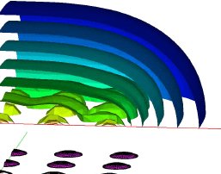
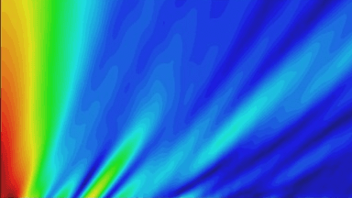
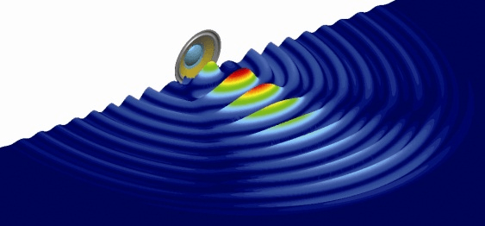
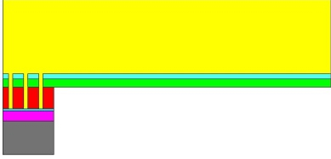
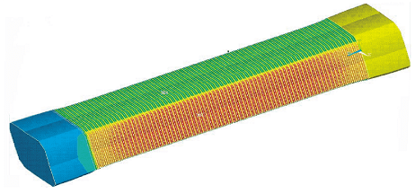
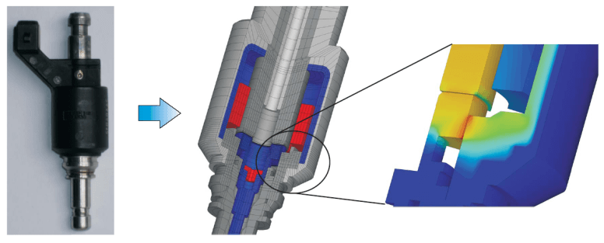
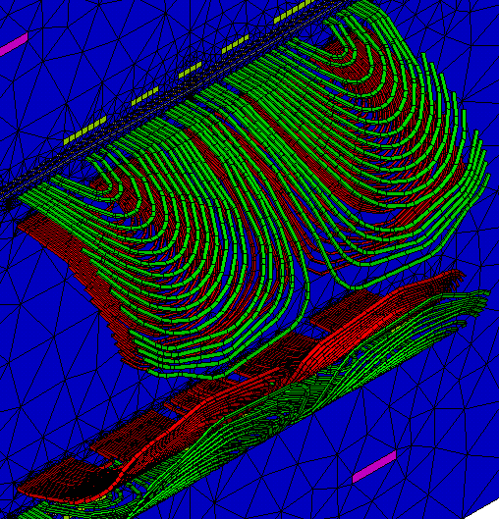
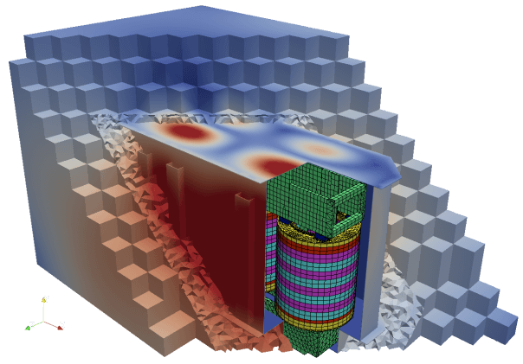
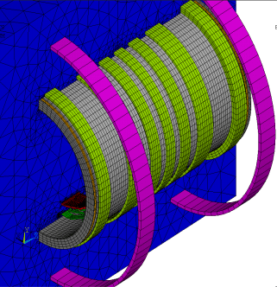
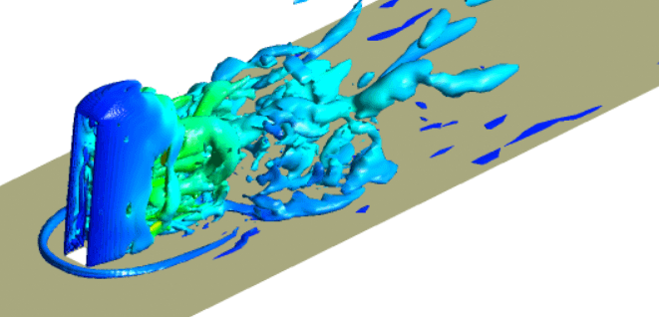
CFS++ Capabilities
CMUTs
Piezoelectric US-array
Electrodynamic loudspeaker
Piezoelectric stack
Electromagnetic valve
MRI-Scanner
Transformer noise
Flow-induced sound

Slide 7

Literature
M. Kaltenbacher: Numerical Simulation of Mechatronic Sensors and Actuators, 2nd Edition, Springer 2007, 2nd edition
M. Kaltenbacher: Advanced Simulation Tool for the Design of Sensors and Actuator. Proceeding of Eurosensors XXIV 2010
Just search for scientific articles
Andreas Hauck
Andreas Hüppe
Jens Grabinger
Tom Lahmer
Gerhard Link
Manfred Kaltenbacher
Simon Triebenbacher
Adiran Volk
Fabian Wein
Stefan Zörner
…………..

Slide 8
Copyright
Overview
No license file exists!
CFS++ is considered open source as it has been developed, and is still developed by projects funded by public research agencies!
Gentleman’s agreement
CFS++ shall not be publicly available
Manfred Kaltenbacher is informed prior to distribution
Development server (SVN, Trac, etc.) in Erlangen
Development approach
Everybody works on own branches
Test cases prevent side effects
Not everything ends on the trunk
time
merge
r. 11
r. 10
task 2
r. 9
r. 8
r. 7
merge
r. 5
r. 6
branch
r. 4
task 1
r. 3
r. 2
branch
revision 1
trunk

Slide 9
CFS++ - Schema
Model: mesh data
Problem: XML file defining problem and physical properties
CFS++: command line based FEM solver/ optimizer
Postprocessing: visualization and calculations
Text: detailed information in ASCII, CSV or XML format
Model
CFS++
Postprocessing
Problem
Text
Preprocessing
(e.g. ANSYS, Gmsh,
GiD, COMSOL, etc.)
Postprocessing
(e.g. ParaView, GiD,
Matlab, Python, etc.)

Slide 10
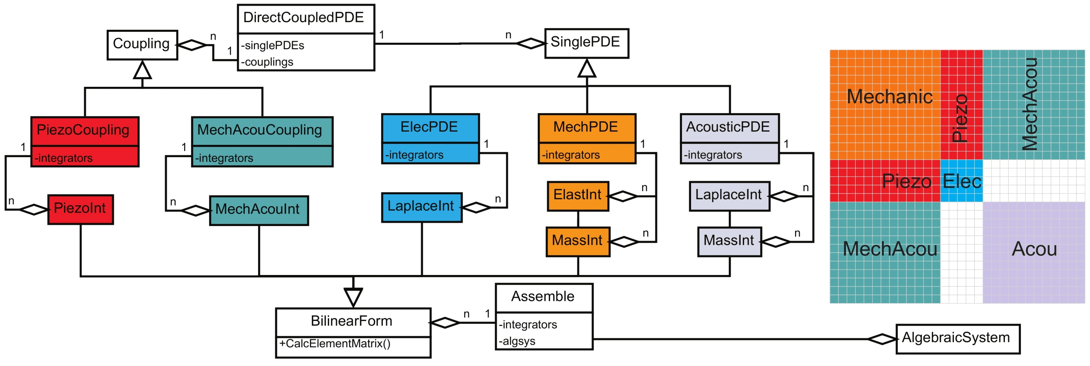
CFS++: General Approach
CFS++ (Coupled Field Simulation):
Models: Based on partial differential equations (PDEs)
Solution of PDEs: Finite-Element-Method
Example: Structure for piezoelectric-acoustic coupled PDEs

Slide 11
CFS++: General Approach
CFS++ (Coupled Field Simulation):
Models: Based on partial differential equations (PDEs)
Solution of PDEs: Finite-Element-Method
Example: Structure for piezoelectric-acoustic coupled PDEs

Slide 12
CFS++: General Approach
CFS++ (Coupled Field Simulation):
Coupling: Electrostatics-Mechanics-Acoustics (MEMS)
Iter
ElecMech
-Linearform
ElecForce
LinearForm
+CalcElementVector()

Slide 13
CFS++: General Approach
CFS++ (Coupled Field Simulation):
Coupling: Electrostatics-Mechanics-Acoustics (MEMS)

Slide 14
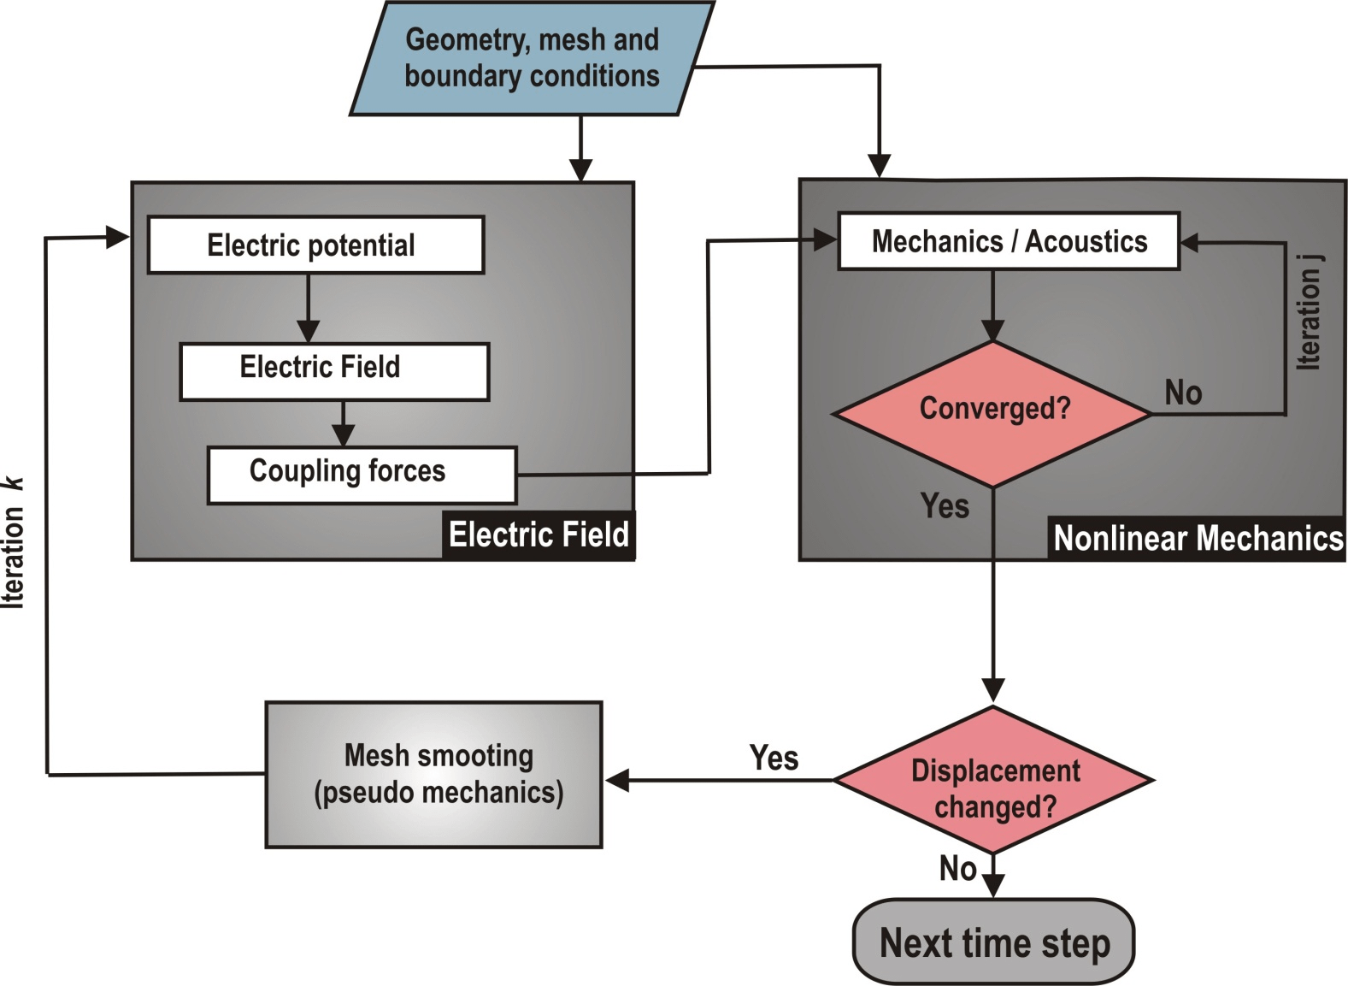
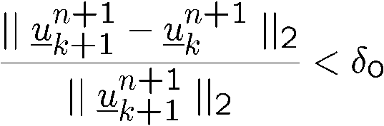

CFS++: General Approach
CFS++ (Coupled Field Simulation):
Coupling: Electrostatics-Mechanics-Acoustics (MEMS)

Slide 15
CFS++: General Approach
Pre-processing
Supported pre-processors: ANSYS (Workbench), GiD, Gmsh, COMSOL, etc…
Physical problem description in XML format:
Post-processing
Supported post-processors: ParaView, GiD, Gmsh, GMV, EnSight, Tecplot, ANSYS ,…
Coordinates and mesh topology of all 3D (volume), 2D (surface) and 1D (interface) elements
<couplingList> <direct> <piezoDirect> <regionList> <region name="solid"/> </regionList> </piezoDirect> … | … <acouMechDirect> <surfRegionList> <surfRegion name="interface"/> </surfRegionList> </acouMechDirect> </direct> </couplingList>

Slide 16
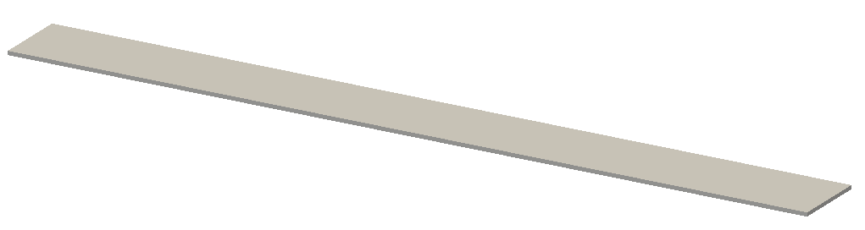
Example 1: Mechanics
Problem setup
Cantilever with pressure load
Goal
Perform
Static analysis
Transient analysis
Harmonic analysis
Eigenfrequency analysis
Pressure load (100N/m²)
Fully supported

Slide 17
Example 1: Mechanics
Preprocessor: ANSYS Classic using prep7 commands
Initialization part
Define constants and generate geometry
fini /uis,msgpop,3 ! disable warning popups /clear /filname,cantilever,1 ! important: define name of the model /prep7 /uis,msgpop,2 ! enable warning popups init ! initialize macros for mesh-interface to CFS++
! define constants eps=1e-7 L=400e-6 b=2e-6 bc=45e-6 ! generate the cantilever block,0,L,0,bc,0,b

Slide 18
Example 1: Mechanics
Preprocessor: ANSYS Classic using prep7 commands
Perform volume meshing
Perform surface mesh for pressure load and mechanical fixing
setelems,'brick' esize,5e-6 vsel,s,,,1 vmesh,all
setelems,'quadr' allsel asel,s,,,2 amesh,all allsel asel,s,loc,x,-eps,eps asel,r,loc,y,-eps,bc+eps asel,r,loc,z,-eps,eps+b amesh,all

Slide 19
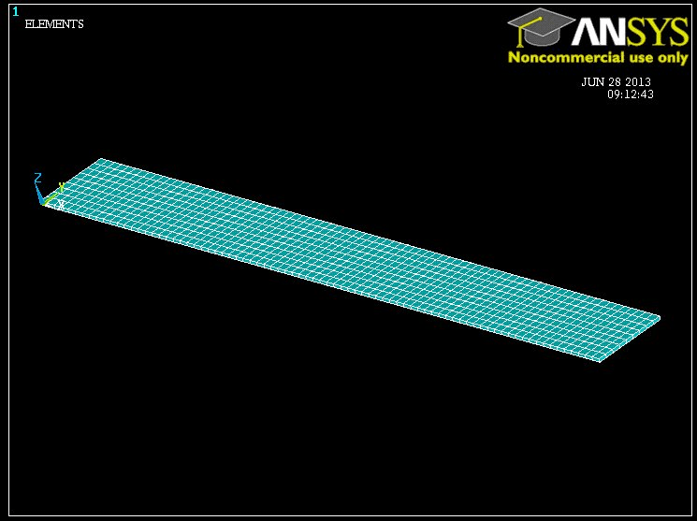
Example 1: Mechanics
Preprocessor: ANSYS Classic using prep7 commands
Display of mesh

Slide 20
Example 1: Mechanics
Preprocessor: ANSYS Classic using prep7 commands
Write mesh file for CFS++: Write volume elements
Write mesh file for CFS++: Write surface elements
allsel,all vsel,s,,,1 eslv welems,'cantilever'
! write surface elements for pressure load allsel asel,s,,,2 esla welems,'excite' ! write surface elements for mechanical fixing allsel asel,s,loc,x,-eps,eps asel,r,loc,y,-eps,bc+eps asel,r,loc,z,-eps,eps+b+b esla welems,'fix-all'

Slide 21
Example 1: Mechanics
Write mesh file for CFS++
Write mesh file for CFS++: Write coordinates of nodes
Write mesh file for CFS++: Write the whole HDF5 file
Result
Within this directory you should now find the file cantilever.h5!
Problems:
If there are inconsistencies, then you will get the error „MKHDF5: Please check the contents of cantilever_cplreader.out”.
! write all nodes allsel wnodes
! write mesh file in HDF5 format mkhdf5

Slide 22
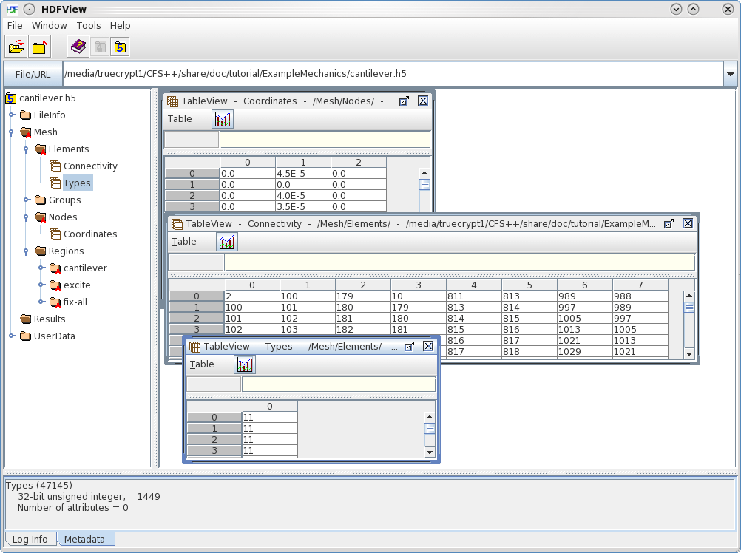
Example 1: Mechanics
Look at contents of mesh file using HDFView (http://www.hdfgroup.org/HDF5)
Hierarchical
structure for
mesh and results
Datasets for element
connectivities
and types
Dataset for node
coordinates
Datasets for
specifying which
elements and nodes
belong to which
region

Slide 23
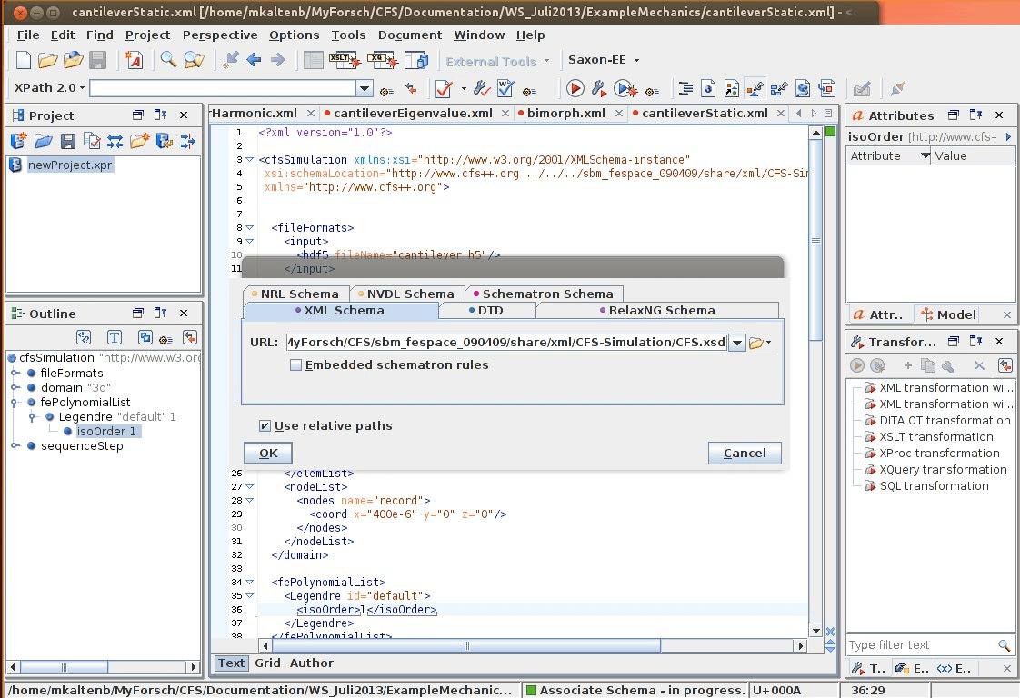
Example 1: Mechanics
Setup the XML file for describing the physics and simulation parameter
Use <oXygen/> XML editor (see http://www.oxygenxml.com/)
Associate W3C XML schema for CFS++ simulations

Slide 24
Example 1: Mechanics
Setup the XML file for describing the physics and simulation parameter
Hint: search for a similar problem in the CFS++ - TESTSUIT
Header
File section
<cfsSimulation xmlns:xsi="http://www.w3.org/2001/XMLSchema-instance" xsi:schemaLocation="http://www.cfs++.org ../CFS/share/xml/CFS-Simulation/Schemas/CFS_FileFormats.xsd xmlns="http://www.cfs++.org">
<fileFormats> <input> <hdf5 fileName="cantilever.h5"/> </input> <output> <text/> <hdf5/> </output> <materialData file="mat.xml"/> </fileFormats>

Slide 25
Example 1: Mechanics
Setup the XML file for describing the physics and simulation parameter
Define computational domain with volume-regions, surface-regions, ..
<domain geometryType="3d"> <regionList> <region material="Steel" name="cantilever"/> </regionList> <surfRegionList> <surfRegion name="excite"/> <surfRegion name="fix-all"/> </surfRegionList> <nodeList> <nodes name="record"> <!– Find the mesh node next to coordinate and assign the name "record" to it --> <coord x="400e-6" y="0" z="0"/> </nodes> </nodeList> </domain>
Define a new node for data recording

Slide 26
Example 1: Mechanics
Setup the XML file for describing the physics and simulation parameter
Start the sequence and define the analysis type
Define the partial differential equation (PDE) and the region it is defined
<sequenceStep> <analysis> <static/> </analysis>
<pdeList> <mechanic subType="3d"> <regionList> <region name="cantilever"/> </regionList>

Slide 27
Example 1: Mechanics
Setup the XML file for describing the physics and simulation parameter
Define boundary conditions
Define store results
<bcsAndLoads> <pressure name="excite" value="100"/> <fix name="fix-all"> <comp dof="x"/> <comp dof="y"/> <comp dof="z"/> </fix> </bcsAndLoads>
<storeResults> <nodeResult type="mechDisplacement"> <allRegions/> <nodeList> <nodes name="record"/> </nodeList> </nodeResult> </storeResults>

Slide 28
Example 1: Mechanics
Setup the XML file for describing the physics and simulation parameter
Close PDE part
Define solver (not necessary)
Close the sequence and the whole xml-definition
</mechanic> </pdeList>
<linearSystems> <system> <solverList> <pardiso/> </solverList> </system> </linearSystems>
</sequenceStep> </cfsSimulation>

Slide 29
Example 1: Mechanics
Setup the XML file for the material parameters
<?xml version="1.0"?> <cfsMaterialDataBase xmlns="http://www.cfs++.org"> <material name="Steel"> <mechanical> <density> 7.8E03 </density> <elasticity> <isotropic> <real> <elasticityModulus> 210E09 </elasticityModulus> <poissonNumber> 0.3 </poissonNumber> </real> </isotropic> </elasticity> </mechanical> </material> </cfsMaterialDataBase>

Slide 30
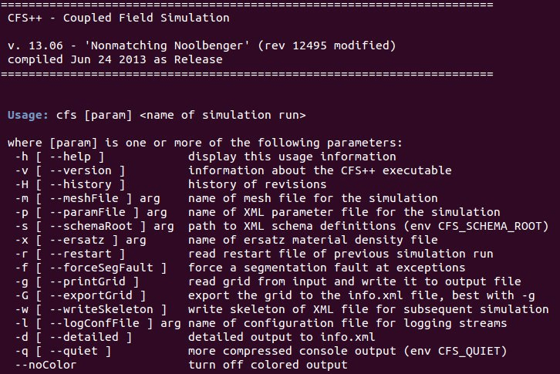
Example 1: Mechanics
Perform the simulation with CFS++
Just „cfs“ you get the follwoing help (provided that the executable is in the path)

Slide 31
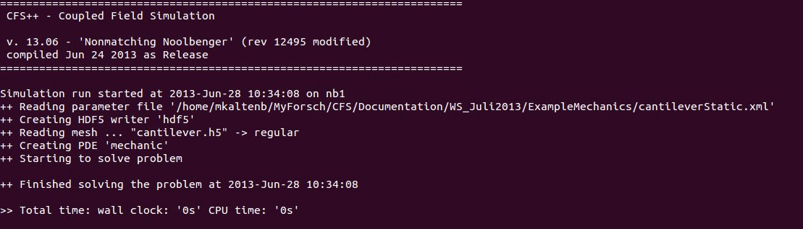
Example 1: Mechanics
Perform the simulation with CFS++
Type in „cfs cantileverStatic“ and you obtain
Generated output files
In results_hdf5: cantileverStatic.h5: contains the simulation result
In history: cantileverStatic-ms1-mechDisplacement-node-91-record.hist
In current directory: cantileverStatic.info.xml

Slide 32
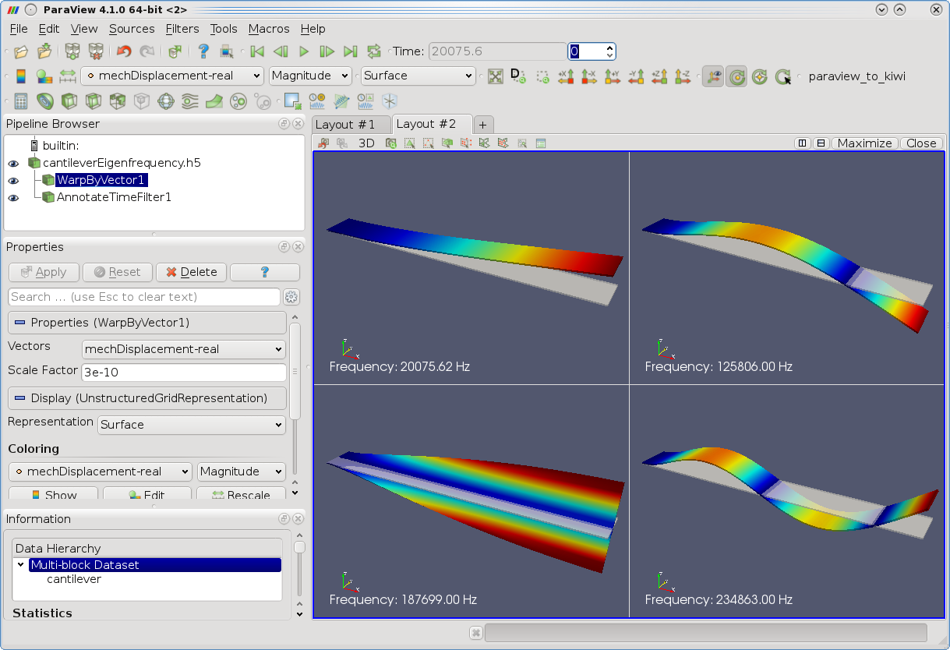
Example 1: Mechanics
Perform postprocessing with ParaView (http://www.paraview.org/)
Start „paraview“ and display the result

Slide 33
Example 1: Mechanics
Perform a transient analysis
Change analysis part
Change in „bcsAndLoads“ for pressure excitation
<sequenceStep> <analysis> <transient> <numSteps> 40 </numSteps> <deltaT> 0.05 </deltaT> </transient> </analysis>
<bcsAndLoads> <pressure name="excite“ value="100*sin(2*pi*1*t)" />
Frequency of 1Hz

Slide 34
Example 1: Mechanics
Perform a harmonic analysis
Change analysis type
Change pressure load towards amplitude and phase
<sequenceStep> <analysis> <harmonic> <numFreq> 10 </numFreq> <startFreq> 10 </startFreq> <stopFreq> 1e4 </stopFreq> <sampling>linear</sampling> </harmonic> </analysis>
<bcsAndLoads> <pressure name="excite“ value="100" phase="0.0" />

Slide 35
Example 1: Mechanics
Perform an eigenfrequency analysis
Change analysis type
No load is needed (not necessarly be changed)
<sequenceStep> <analysis> <eigenFrequency> <isQuadratic> no </isQuadratic> <numModes> 5 </numModes> <freqShift> 0 </freqShift> <writeModes> yes </writeModes> </eigenFrequency> </analysis>
<bcsAndLoads> <fix name="fix-all"> <comp dof="x"/> <comp dof="y"/> <comp dof="z"/> </fix> </bcsAndLoads>

Slide 36
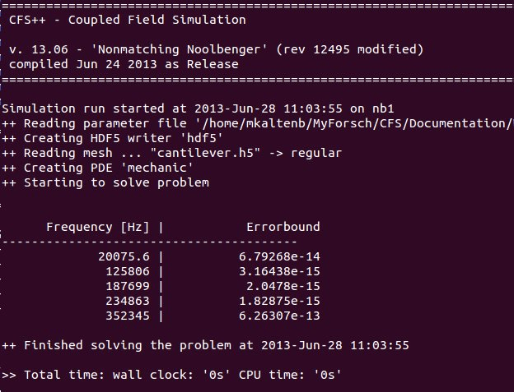
Example 1: Mechanics
Perform the simulation with CFS++
Type in „cfs cantileverEigenfrequency“ and you obtain

Slide 37
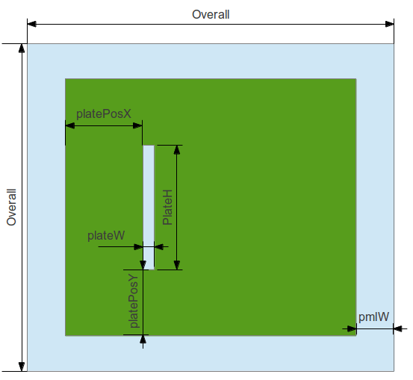
Example 2: Acoustics
Problem setup: wave propagation with sound barrier (point source excitation)

Slide 38
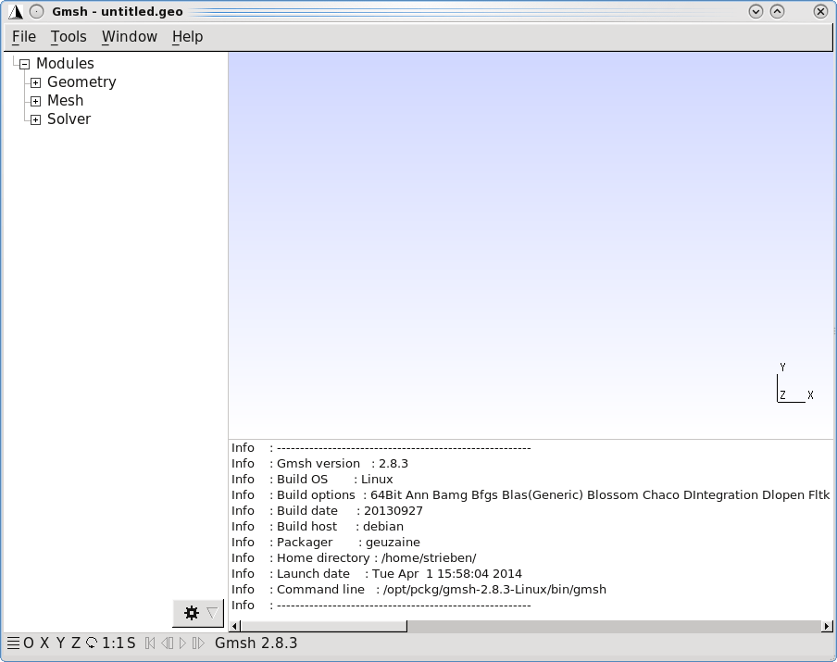
Example 2: Acoustics
Preprocessor: Gmsh (http://geuz.org/gmsh)

Slide 39
Example 2: Acoustics
Define constants
Bottom up modeling approach for structured mesh:
Points → lines → surfaces → volumes → mesh
overall = 10; pmlW = 1; plateW = 0.1; plateH = 3.5; platePosX = 2; platePosY = 2.25; elemSize = 0.1;
//define basepoint for plate basePoint = -overall/2+pmlW+platePosY; Point(1) = {-overall/2, -overall/2 , 0, 1.0}; Point(2) = {-overall/2, -overall/2+pmlW , 0, 1.0}; Point(3) = {-overall/2, basePoint , 0, 1.0}; Point(4) = {-overall/2, basePoint+plateH , 0, 1.0}; Point(5) = {-overall/2, overall/2-pmlW , 0, 1.0}; Point(6) = {-overall/2, overall/2 , 0, 1.0};

Slide 40
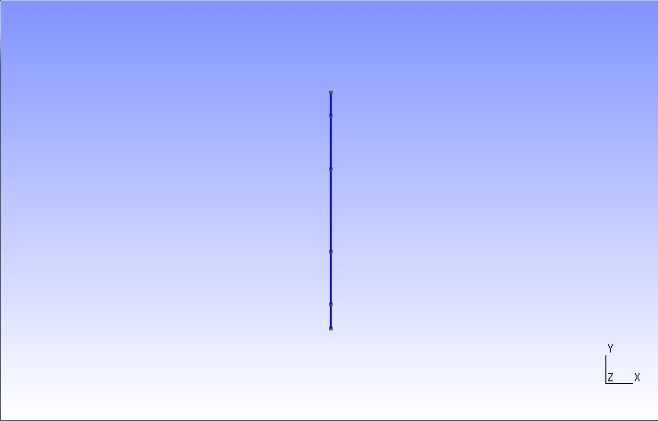
Example 2: Acoustics
Define lines
Current state
Line(1) = {1, 2}; Line(2) = {2, 3}; Line(3) = {3, 4}; Line(4) = {4, 5}; Line(5) = {5, 6};

Slide 41
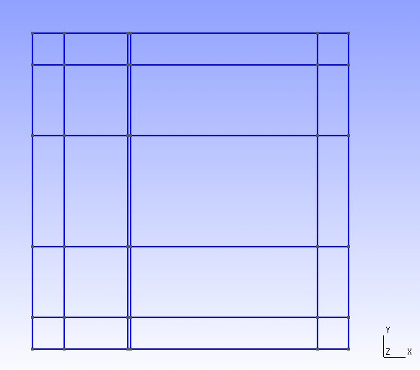
Example 2: Acoustics
Extrusion leads to mis-oriented elements but CFS++ will correct this later on
Get rid of multiple entities
Extrude{ pmlW, 0, 0 }{ Line{1,2,3,4,5}; } Extrude{ platePosX, 0, 0 }{ Line{6,10,14,18,22}; } Extrude{ plateW, 0, 0 }{ Line{26,30,34,38,42}; } Extrude{ overall-2*pmlW-platePosX-plateW, 0, 0 }{ Line{46,50,54,58,62}; } Extrude{ pmlW, 0, 0 }{ Line{66,70,74,78,82}; }
//combine double entities Coherence;

Slide 42
Example 2: Acoustics
Generate regions to address later in CFS++
Structured meshing and recombine triangles to quadrilaterals
Physical Surface("prop") = {33,53,73,38,77,41,61,81,37}; Physical Surface("plate") = {57}; Physical Surface("pml") = { 9,29,49,69,89,93,97,101,105,85,65,45,25,21,17,13 };
Transfinite Surface '*'; Recombine Surface '*'; Transfinite Line {7,8,12,16,20,24,87,88,92,96,100,104} = ((pmlW)/elemSize) Using Progression 1; Transfinite Line {27,28,32,36,40,44} = ((platePosX)/elemSize) Using Progression 1; Transfinite Line {47,48,52,56,60,64} = ((plateW)/elemSize) Using Progression 1; Transfinite Line {67,68,72,76,80,84} = ((overall-2*pmlW-platePosX-plateW)/elemSize) Using Progression 1; …

Slide 43
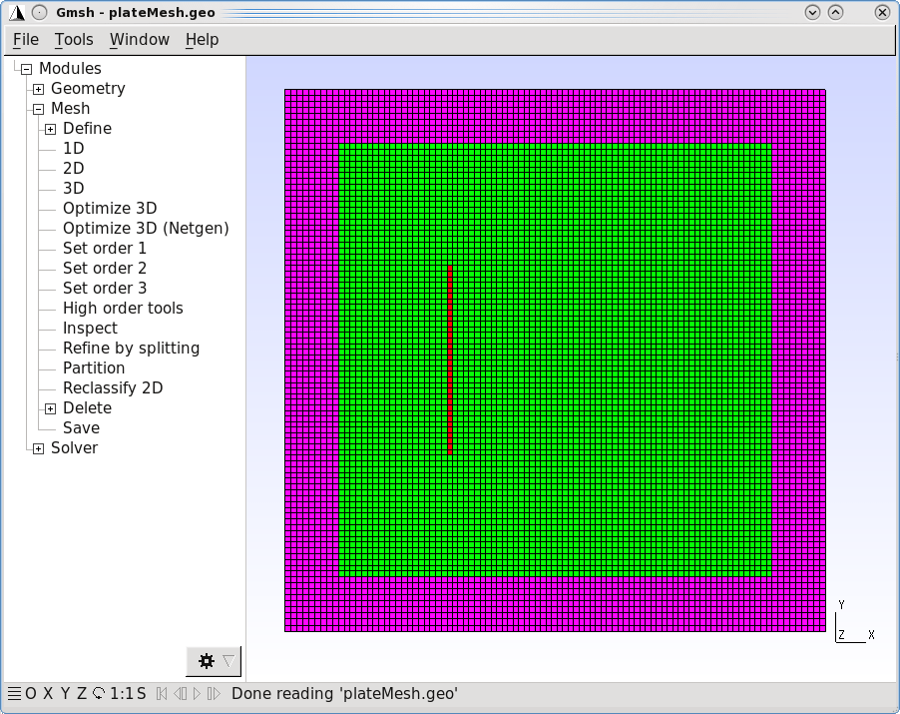
Example 2: Acoustics
Perform meshing with 2nd order elements
Color by physical entities
Tools → Options → Mesh
Visibility → Surface faces
Color → Coloring mode
→ By physical group
Save the mesh file
From GUI:
File → Save Mesh
Modules → Mesh → Save
From command line:
Mesh.ElementOrder = 2; Mesh.SecondOrderIncomplete = 1; Mesh 2;
pml
plate
prop
$ gmsh -2 -bin -n -nopopup plateMesh.geo

Slide 44
Example 2: Acoustics
Setup the XML file for describing the physics and simulation parameter (just will discuss differences to previous example)
Hint: search for a similar problem in the CFS++ - TESTSUIT
Domain with regions
<domain geometryType="plane"> <regionList> <region material="air" name="prop"/> <region material="air" name="plate"/> <region material="air" name="pml"/> </regionList> <nodeList> <nodes name="excite"> <coord x="0.0" y="0.0" z="0.0"/> </nodes> </nodeList> </domain>
Define excitation node.
One could also define
a Physical Point in Gmsh.

Slide 45
Example 2: Acoustics
Setup the xml-File for describing the physics and simulation parameter
Start the sequence and define analysis
Define PDE for acoustics
<sequenceStep> <analysis> <harmonic> <numFreq> 10 </numFreq> <startFreq> 0.1 </startFreq> <stopFreq> 2 </stopFreq> <sampling>linear</sampling> </harmonic> </analysis>
<pdeList> <acoustic> <regionList> <region name="prop"/> <region name="pml" dampingId="myPml"/> </regionList>

Slide 46
Example 2: Acoustics
Setup the xml-File for describing the physics and simulation parameter
Define the PML (Perfectly Matched Layer) used for free field radiation
Define excitation and output results
<dampingList> <pml id="myPml"> <type> inverseDist </type> <dampFactor>1.0</dampFactor> </pml> </dampingList>
<bcsAndLoads> <pressure value="1" name="excite"/> </bcsAndLoads> <storeResults> <nodeResult type="acouPressure"> <allRegions/> </nodeResult> </storeResults>

Slide 47
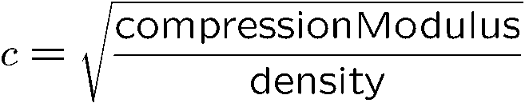
Example 2: Acoustics
Material file
Speed of sound
<cfsMaterialDataBase xmlns="http://www.cfs++.org"> <material name="air"> <acoustic> <density> 1 </density> <compressionModulus> 1 </compressionModulus> </acoustic> </material> </cfsMaterialDataBase>

Slide 48
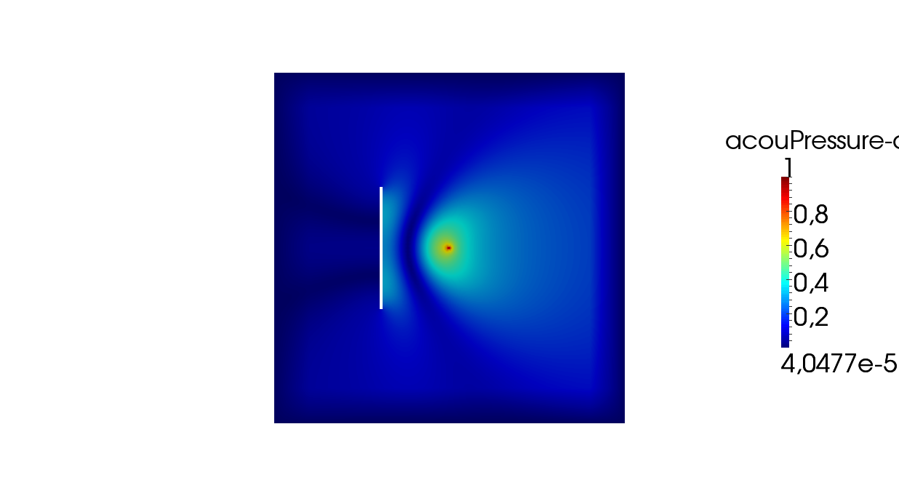
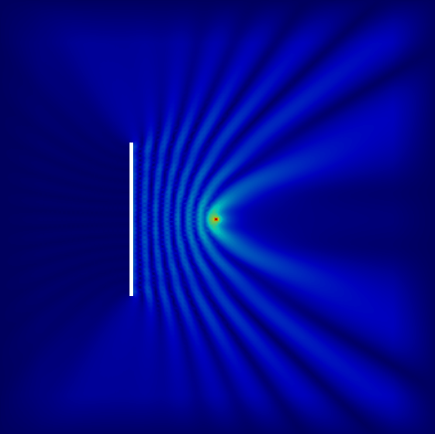
Example 2: Acoustics
Perform simulation „cfs noiseBarrier“ and start ParaView to investigate the solution
2Hz
0.31Hz

Slide 49
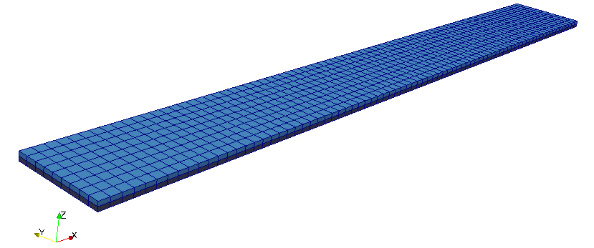
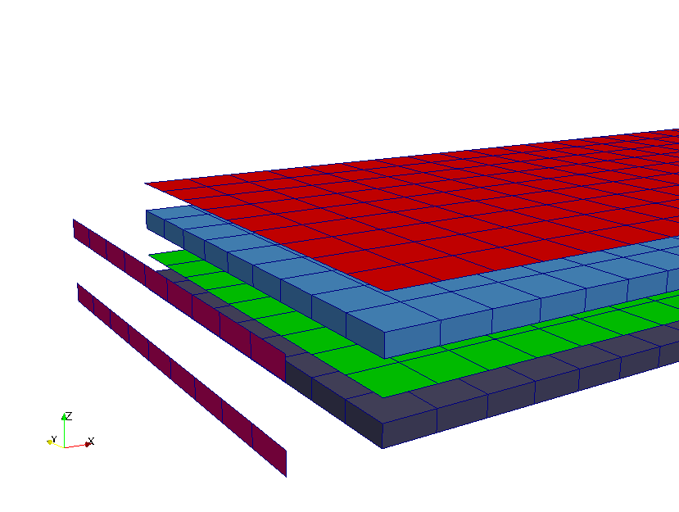
Example 3: Piezoelectricity
Problem setup: Steel cantilever and piezoelectric layer (bimorph)
Goal
Perform a static analysis to obtain deflection, mechanical stresses and electric field intensity
Piezoelectric layer
Hot electrode
Fully supported
Steel cantilever
Ground
electrode

Slide 50
Example 3: Piezoelectricity
Preprocessor: ANSYS Classic using prep7 commands (just addition parts, which are different to example 1)
Generate volume for steel cantilever and piezoelectric layer
Perform surface meshing for both electrodes (ground and loaded electrode) and for the surface, where the structure is mechanically fixed.
block,0,L,0,bc,0,b block,0,L,0,bc,b,2*b nummrg,all,1e-7
Cleans the model from doubled
keypoints, lines, areas, …
setelems,'quadr' allsel, asel,s,,,2 asel,a,,,5 asel,a,,,8 asel,a,,,11 amesh,all

Slide 51
Example 3: Piezoelectricity
Preprocessor: ANSYS Classic using prep7 commands
Write volume elements for both cantilever and piezoelectric layer
Write surface elements for mechanical fixing and electrodes
allsel,all vsel,s,,,1 eslv welems,'cantilever' allsel,all vsel,s,,,2 eslv welems,'piezoLayer'
allsel asel,s,,,2 esla welems,'gnd' | allsel asel,s,,,2 esla welems,'gnd' | allsel asel,s,,,5 asel,a,,,11 esla,,1 welems,'fix-all'

Slide 52
Example 3: Piezoelectricity
Setup the XML file for describing the physics and simulation parameter (just will discuss differences to previous examples)
Domain with regions
<domain geometryType="3d"> <regionList> <region name="cantilever" material="Steel"/> <region name="piezoLayer" material="PZT-5H"/> </regionList> <surfRegionList> <surfRegion name="gnd"/> <surfRegion name="top"/> <surfRegion name="fix-all"/> </surfRegionList>

Slide 53
Example 3: Piezoelectricity
Setup the XML file for describing the physics and simulation parameter
Mechanical PDE
Electrostatic PDE
<pdeList> <mechanic subType="3d"> <regionList> <region name="cantilever"/> <region name="piezoLayer"/> </regionList> …
… <electrostatic> <regionList> <region name="piezoLayer"/> </regionList> <bcsAndLoads> <ground name="gnd"/> <potential value="1.0" name="top"/> </bcsAndLoads> …

Slide 54
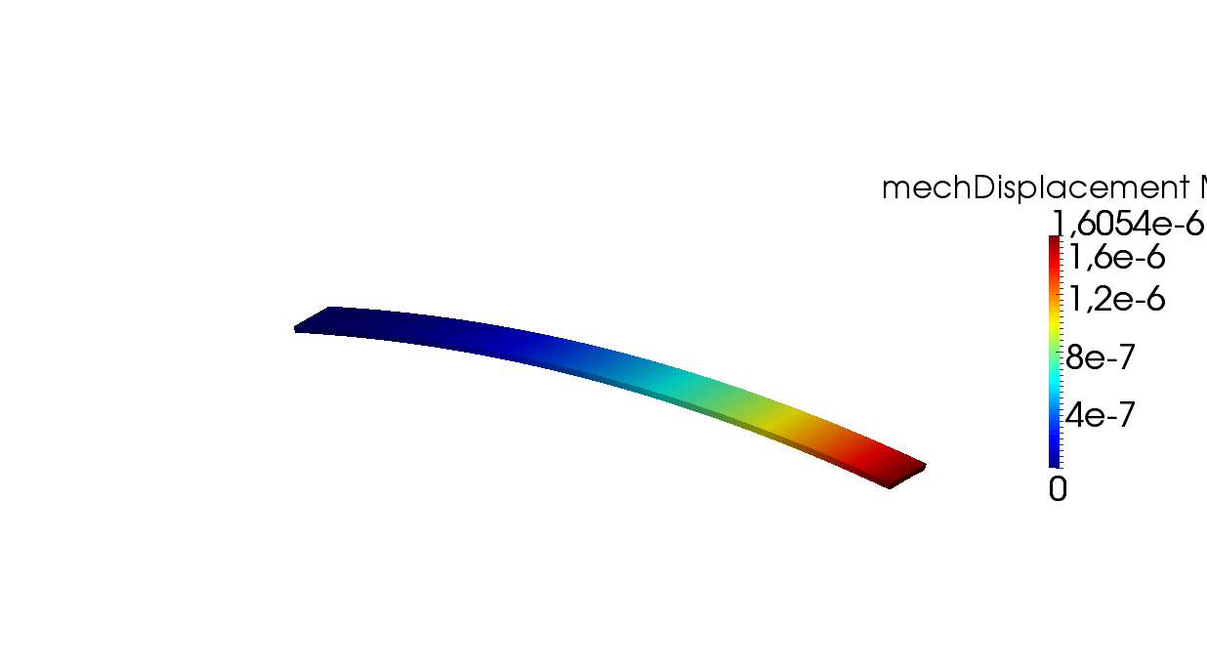
Example 3: Piezoelectricity
Setup the XML file for describing the physics and simulation parameter
Coupling section
Let’s run by typing „cfs bimorph“ and analyze the results by using ParaView
<couplingList> <direct> <piezoDirect> <regionList> <region name="piezoLayer"/> </regionList> </piezoDirect> </direct> </couplingList>

Slide 55
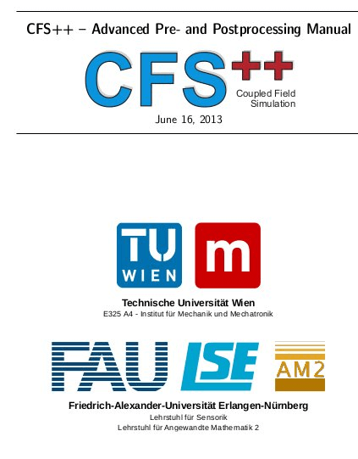
Example 3: Piezoelectricity
For more details
Advanced Pre- and Postprocessing manual
XML-Reference manual
Introduction to Modeling and Simulation with CFS++
Look up the examples in the TESTSUIT

