Slide 1
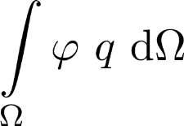
BOperator
shape function itself (IdentityOperator)
CoefFunction
e.g. source density

