Slide 1
Data analysis with ParaView 3.4.0
CSMP Workshop 2009
Gillian Gruen

Slide 2
How to ...
... display a data set (→ Contour, Glyph, Clip, Slice)
… be efficient in displaying similar data sets
(→ work with „Lookmarks“)
... create streamlines
... plot over a line
... plot over time
... interface to other programs (e.g. SigmaPlot)
→ Workflow / Tricks&Pitfalls / Settings

Slide 3
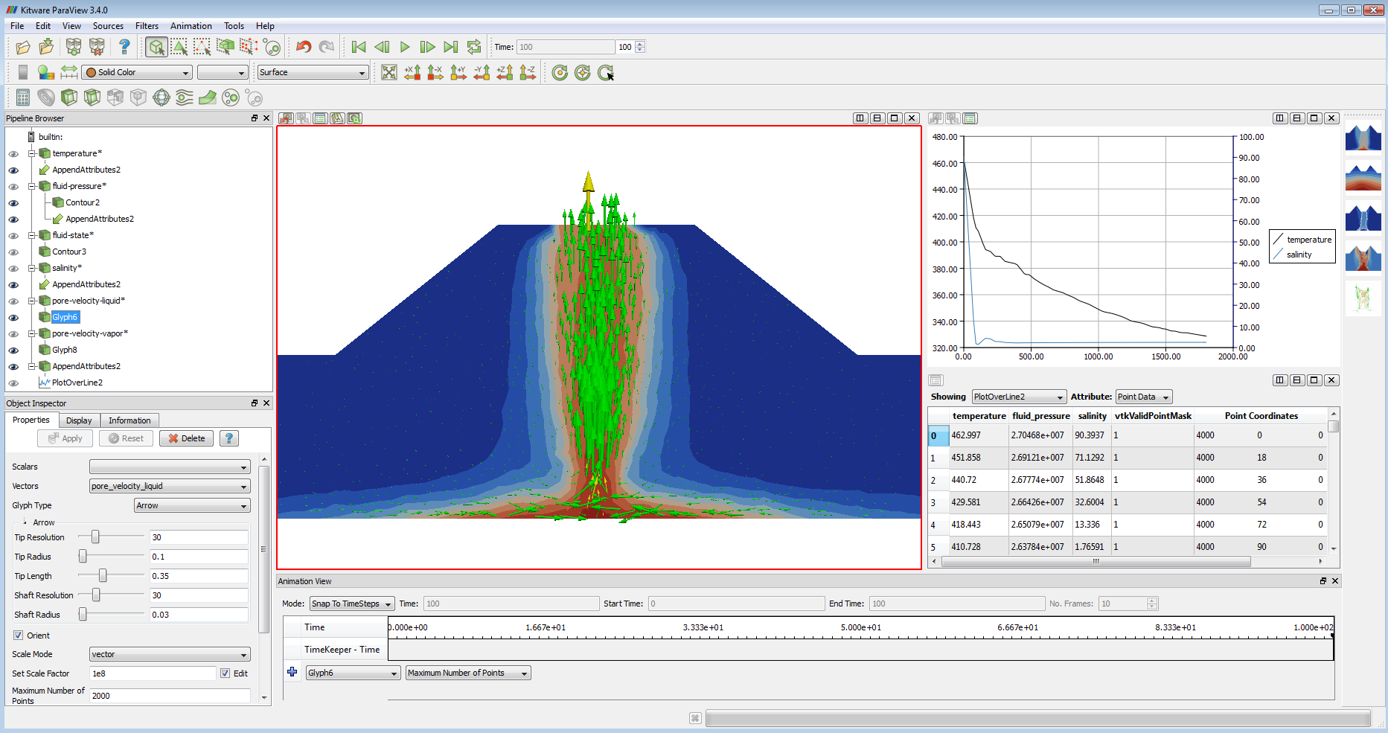
Overview: User Interface
Lookmarks
2D / 3D View
XY Plot View
Pipeline Browser
Spreadsheet View
Object Inspector
Animation Inspector

Slide 4
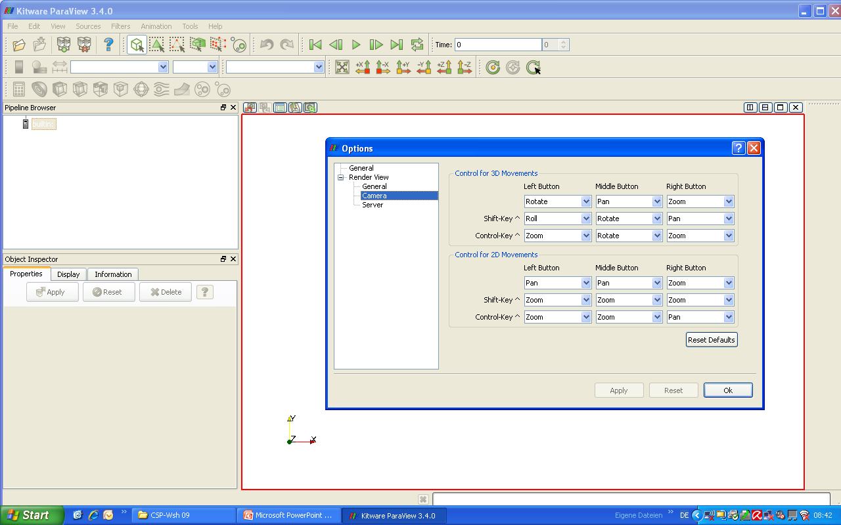
View Control
View directions:
Default movement control settings:
Visibility: select the right view before!

Slide 5
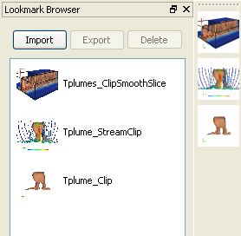
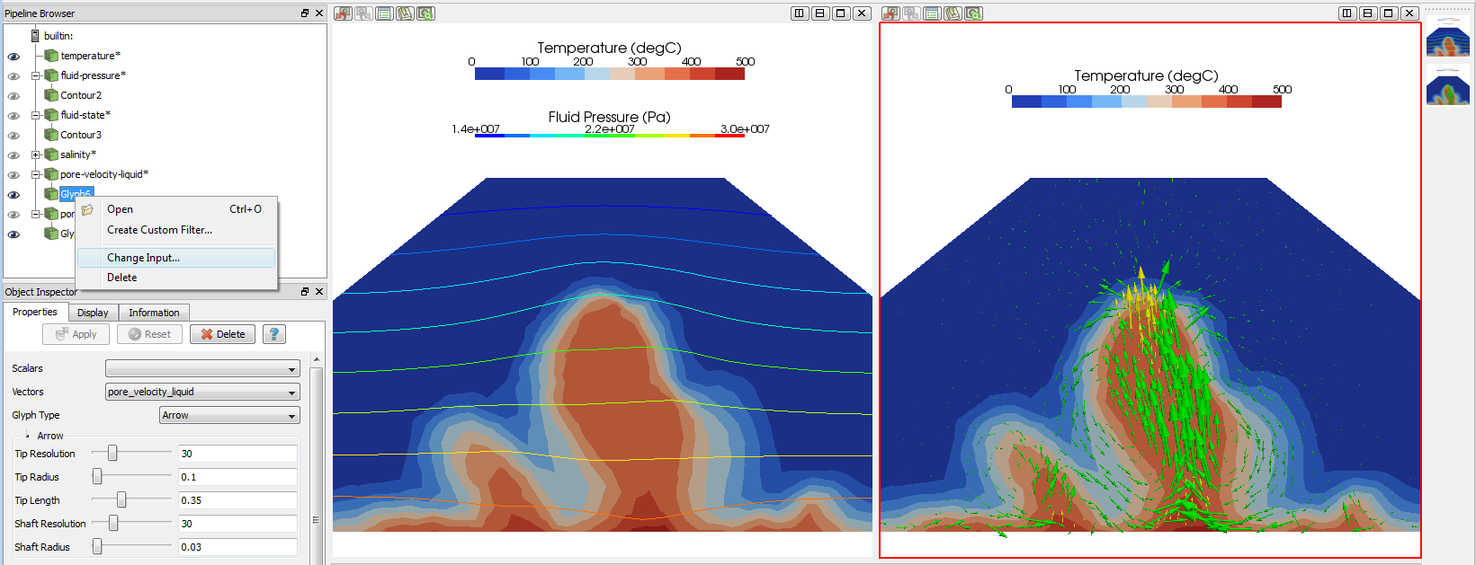
Displaying (similar) data sets
Contour filter: Generate isolines or isosurfaces using point scalars.
Glyph filter: This filter generates an arrow, cone, cube, cylinder, line, sphere, or 2D glyph at each point of the input data set. The glyphs can be oriented and scaled by point attributes of the input dataset.
Smooth filter: Smooths a polygonal surface by iteratively moving points toward their neighbors.
Clip/Slice filters: Clip with an implicit plane. Clipping does not reduce the dimensionality of the data set. The output data type of this filter is always an unstructured grid. Slicing is similar to a contour. It creates surfaces from volumes and lines from surfaces.
Stream Tracer filter: Integrate streamlines in a vector field.
The purpose of Lookmarks is to save and restore particular views of one or more datasets.

Slide 6
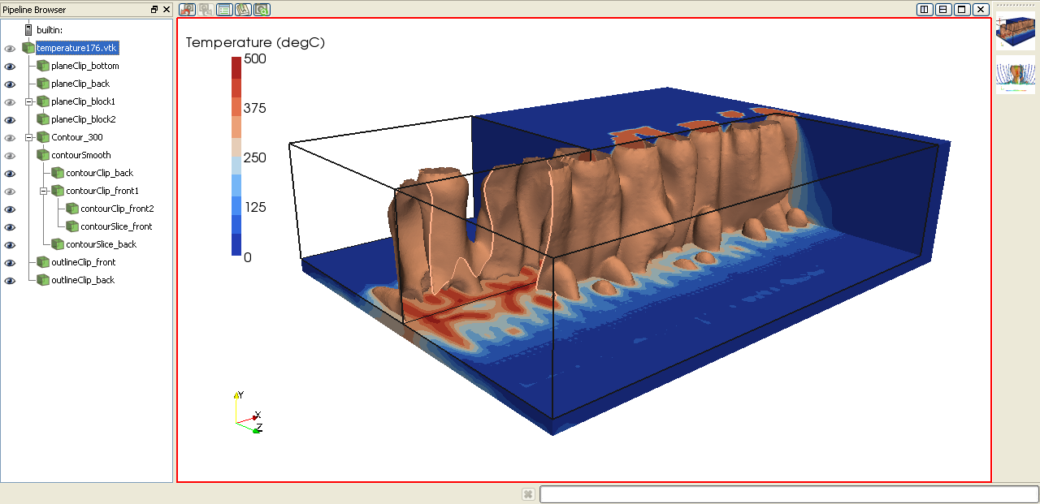
3D-Application 1: Temperature plumes
Plane clipping (shown as „Surface“ = temperature data set)
Contour surface → smoothing → plane clipping & slicing
Box clipping (shown as „Outline“ = black boxes)
Adjust Camera:
Center of Rotation: 2000 / 500 / 700
Position: -2500 / 2500 / 6000
Focal Point: 2000 / -8 / 1000
View Up: 0.2 / 0.2 / -0.23
View Angle: 30

Slide 7
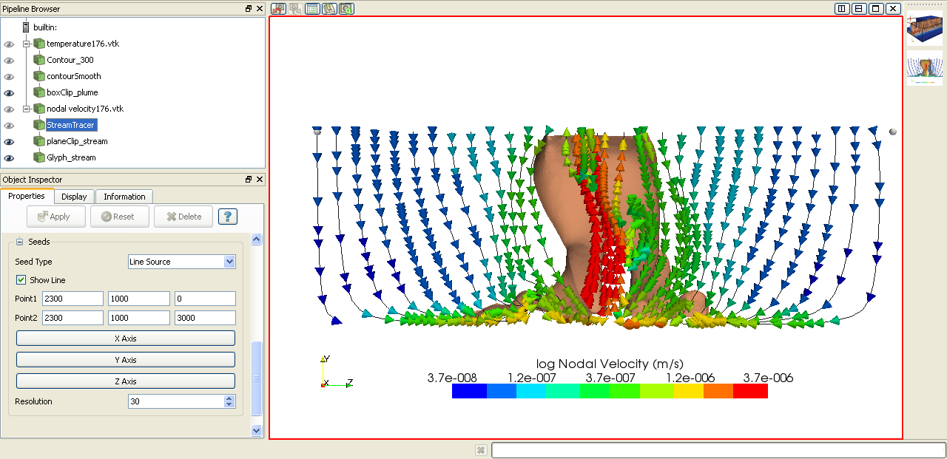
3D-Application 2: Stream lines
Box clipping (shown as „Surface“ = temperature data set)
Stream Tracer → plane clipping
Cone glyphs (colored for nodal velocities)
Adjust Camera:
Center of Rotation: 2000 / 500 / 700
Position: -1800 / 500 / 1400
Focal Point: 2400 / 500 / 1400
View Up: 0 / 1 / 0
View Angle: 30

Slide 8
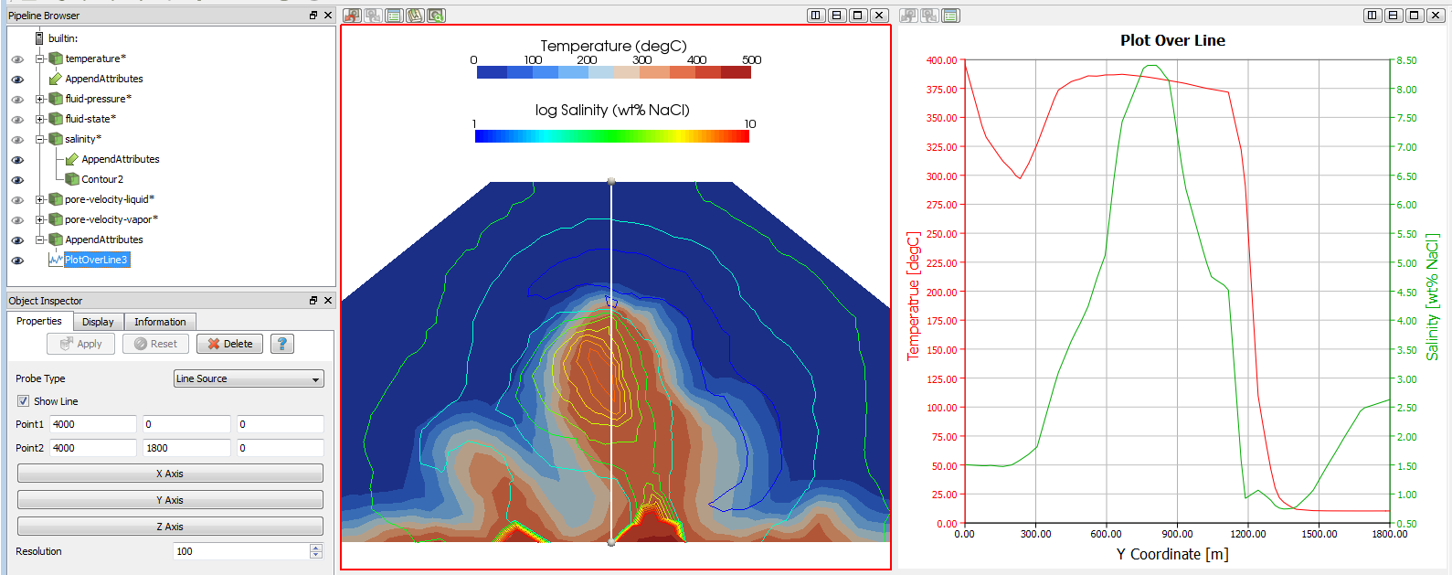
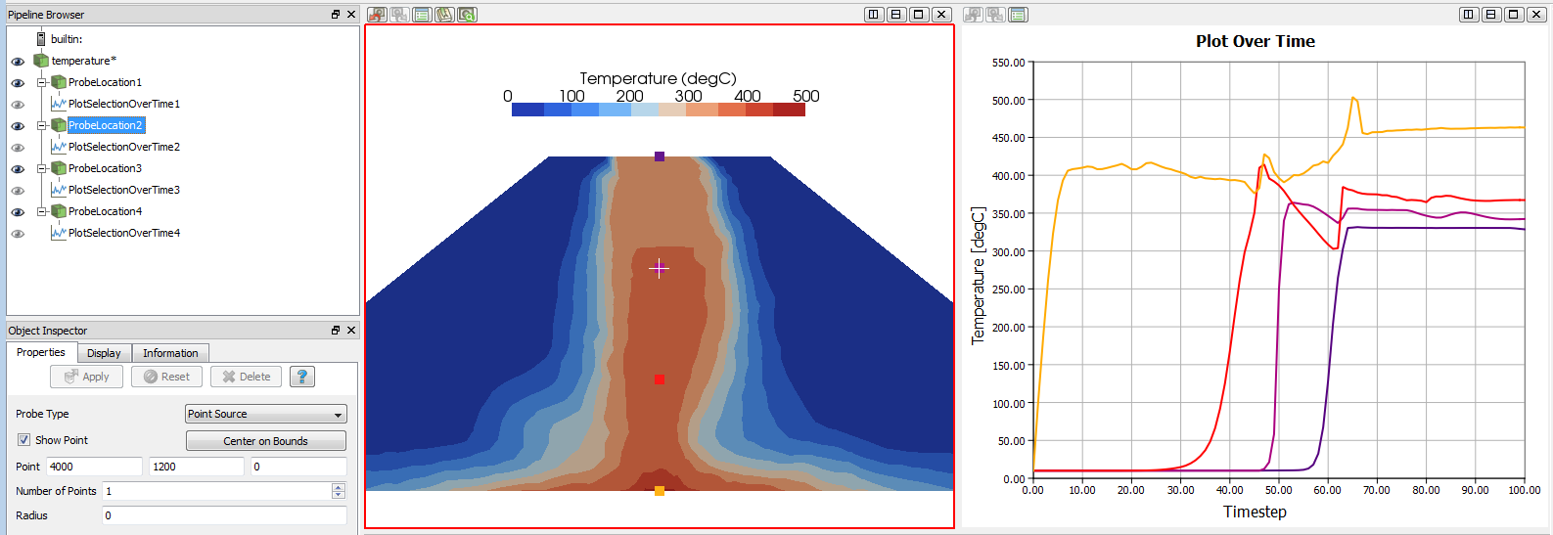
Plotting data over a line / over time
Append Attributes filter: Copies geometry from first input. Puts all of the arrays into the output.
Plot Over Line filter: Sample data attributes at the points along a line. Probed lines will be displayed in a graph of the attributes.
Probe Location filter: Sample data attributes at the points in a point cloud.
Plot (Selection / Global Variables) Over Time filters: Extracts the selection / variables over time.

Slide 9
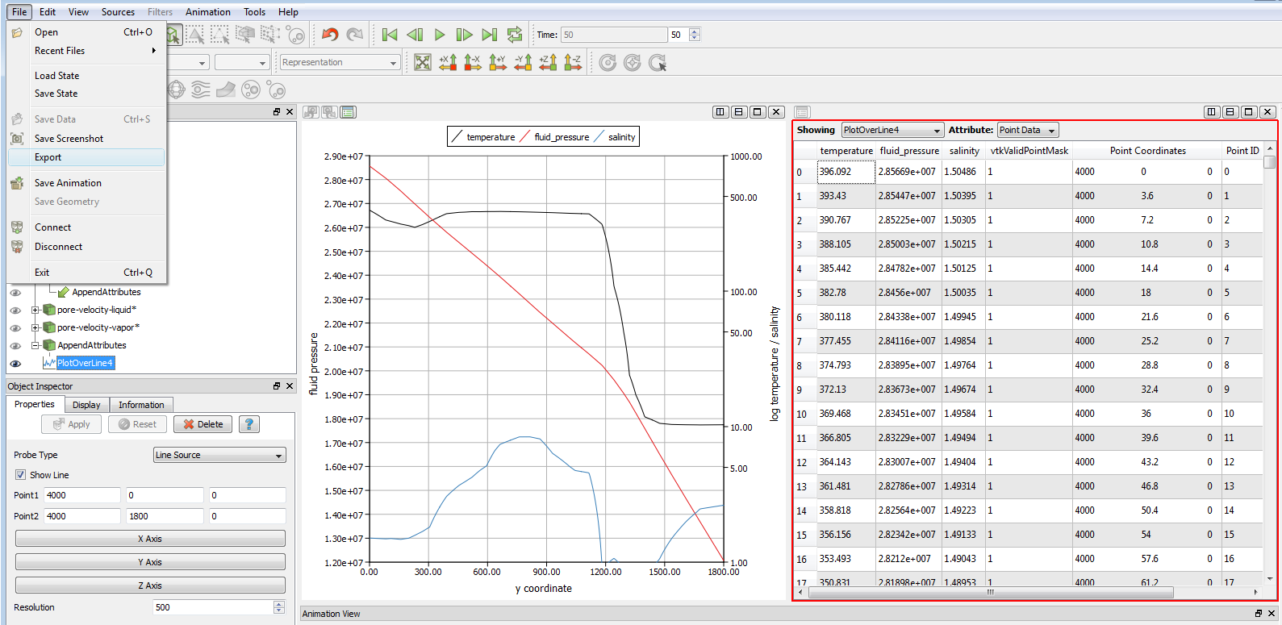
Exporting data to SigmaPlot
The Spreadsheet view displays the underlying data values in a dataset. From the Display tab for the dataset being shown, you can choose whether to display Cell Data, Point Data, or Field Data. The left-most column of numbers in the spreadsheet view lists the index for each entry in the spreadsheet (point ids for Point Data, cell ids for Cell Data), and the rest of the columns show the values at each index of the various arrays the dataset contains. Left-clicking on an entry in the spreadsheet view will select the corresponding point or cell in the dataset; if the dataset is also shown in a 3D view, the points or cells will be highlighted. Pressing the Shift key while clicking rows in the spreadsheet view allows you to select a range of rows; pressing the Ctrl key allows you to select several rows which may not be in sequence.

Slide 10
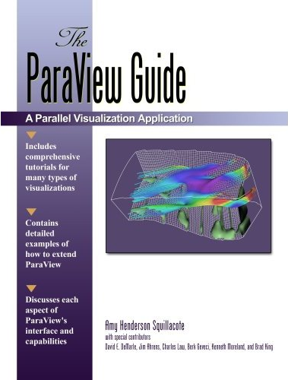
Need help !?
Help F1 – very basic!
Book: „The ParaView Guide“ by Amy Squillacote ($79)
http://www.kitware.com/products/books/paraview.html
(2007: some filters out-of-date for ParaView 3.4)
ParaView wiki: http://www.paraview.org/Wiki/ParaView
Tutorial: http://www.paraview.org/Wiki/The_ParaView_Tutorial
(PDF download for ParaView 3.6)

Slide 11
Filters - Graphical
The Contour filter computes isolines or isosurfaces using a selected point-centered scalar array. The Contour filter operates on any type of data set, but the input is required to have at least one point-centered scalar (single-component) array. The output of this filter is polygonal.
The Glyph filter generates a glyph (i.e., an arrow, cone, cube, cylinder, line, sphere, or 2D glyph) at each point in the input dataset. The glyphs can be oriented and scaled by the input point-centered scalars and vectors. The Glyph filter operates on any type of data set. Its output is polygonal. This filter is available on the Toolbar.
The Smooth filter operates on a polygonal data set by iteratively adjusting the position of the points using Laplacian smoothing. (Because this filter only adjusts point positions, the output data set is also polygonal.) This results in better-shaped cells and more evenly distributed points.
The Clip filter cuts away a portion of the input data set using an implicit plane. This filter operates on all types of data sets, and it returns unstructured grid data on output.
The Slice filter extracts the portion of the input dataset that lies along the specified plane. The Slice filter takes any type of dataset as input. The output of this filter is polygonal data.

Slide 12
Filters – Analytical 1
The Plot Over Line filter samples the data set attributes of the current data set at the points along a line. The values of the point-centered variables along that line will be displayed in an XY Plot. This filter uses interpolation to determine the values at the selected point, whether or not it lies at an input point. The Probe filter operates on any type of data and produces polygonal output (a line).
The Plot Global Variable over Time filter extracts the variables that reside in a dataset's field data and are defined over time. The output is a 1D rectilinear grid where the x coordinates correspond to time (the same array is also copied to a point array named Time or TimeData (if Time exists in the input)).
The Plot Selection Over Time filter extracts the selection over time, i.e. cell and/or point variables at a cells/point selected are extracted over time The output multi-block consists of 1D rectilinear grids where the x coordinate corresponds to time (the same array is also copied to a point array named Time or TimeData (if Time exists in the input)). If selection input is a Location based selection then the point values are interpolated from the nearby cells, ie those of the cell the location lies in.
The Scatter Plot filter creates a scatter plot from a dataset. In point data mode, it uses the X point coordinates as the default X array. All other arrays are passed to the output and can be used in the scatter plot. In cell data mode, the first single component array is used as the default X array.

Slide 13
Filters – Analytical 2
The Calculator filter computes a new data array or new point coordinates as a function of existing scalar or vector arrays. If point-centered arrays are used in the computation of a new data array, the resulting array will also be point-centered. Similarly, computations using cell-centered arrays will produce a new cell-centered array. If the function is computing point coordinates, the result of the function must be a three-component vector. The Calculator interface operates similarly to a scientific calculator. In creating the function to evaluate, the standard order of operations applies.
The Probe Location filter samples the data set attributes of the current data set at the points in a point cloud. The Probe filter uses interpolation to determine the values at the selected point, whether or not it lies at an input point. The Probe filter operates on any type of data and produces polygonal output (a point cloud).
The Stream Tracer filter generates streamlines in a vector field from a collection of seed points. Production of streamlines terminates if a streamline crosses the exterior boundary of the input dataset. Other reasons for termination are listed for the MaximumNumberOfSteps, TerminalSpeed, and MaximumPropagation properties. This filter operates on any type of dataset, provided it has point-centered vectors. The output is polygonal data containing polylines.

Slide 14
Filters – all, short
Append Attributes: Copies geometry from first input. Puts all of the arrays into the output.
Calculator: Compute new attribute arrays as function of existing arrays.
Clip: Clip with an implicit plane. Clipping does not reduce the dimensionality of the data set. The output data type of this filter is always an unstructured grid.
Contour: Generate isolines or isosurfaces using point scalars.
Glyph: This filter generates an arrow, cone, cube, cylinder, line, sphere, or 2D glyph at each point of the input data set. The glyphs can be oriented and scaled by point attributes of the input dataset.
Plot Global Variables over Time
Plot Over Line: Sample data attributes at the points along a line. Probed lines will be displayed in a graph of the attributes.
Plot Selection Over Time
Probe Location: Sample data attributes at the points in a point cloud.
Scatter Plot: Creates a scatter plot from a dataset.
Slice: Slices a data set with a plane. Slicing is similar to a contour. It creates surfaces from volumes and lines from surfaces.
Smooth: Smooths a polygonal surface by iteratively moving points toward their neighbors.
Stream Tracer: Integrate streamlines in a vector field.

Slide 15
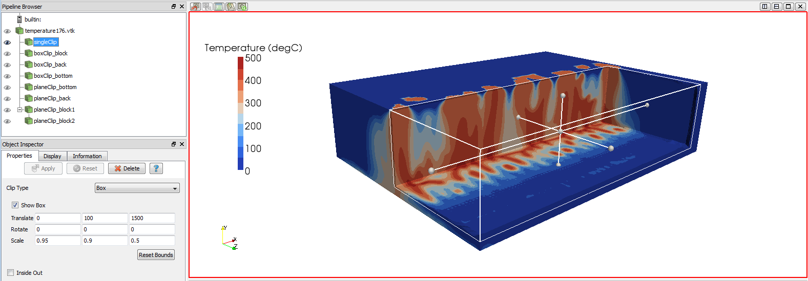
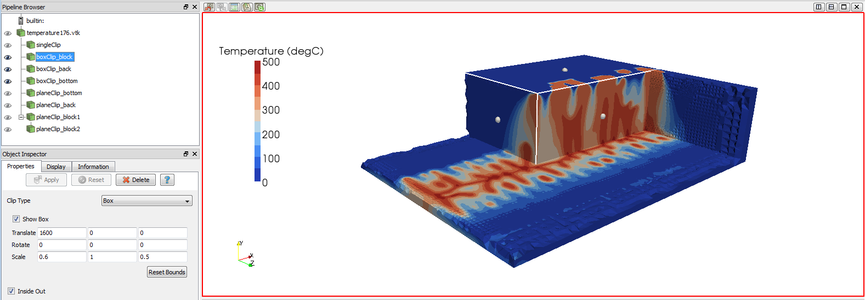

Box clipping
Inside-out
box clipping
Plane clipping

