Slide 1
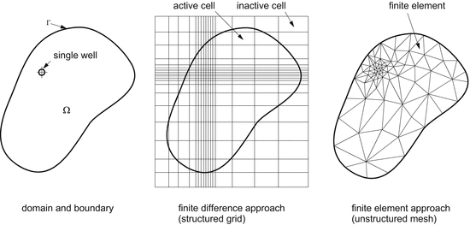
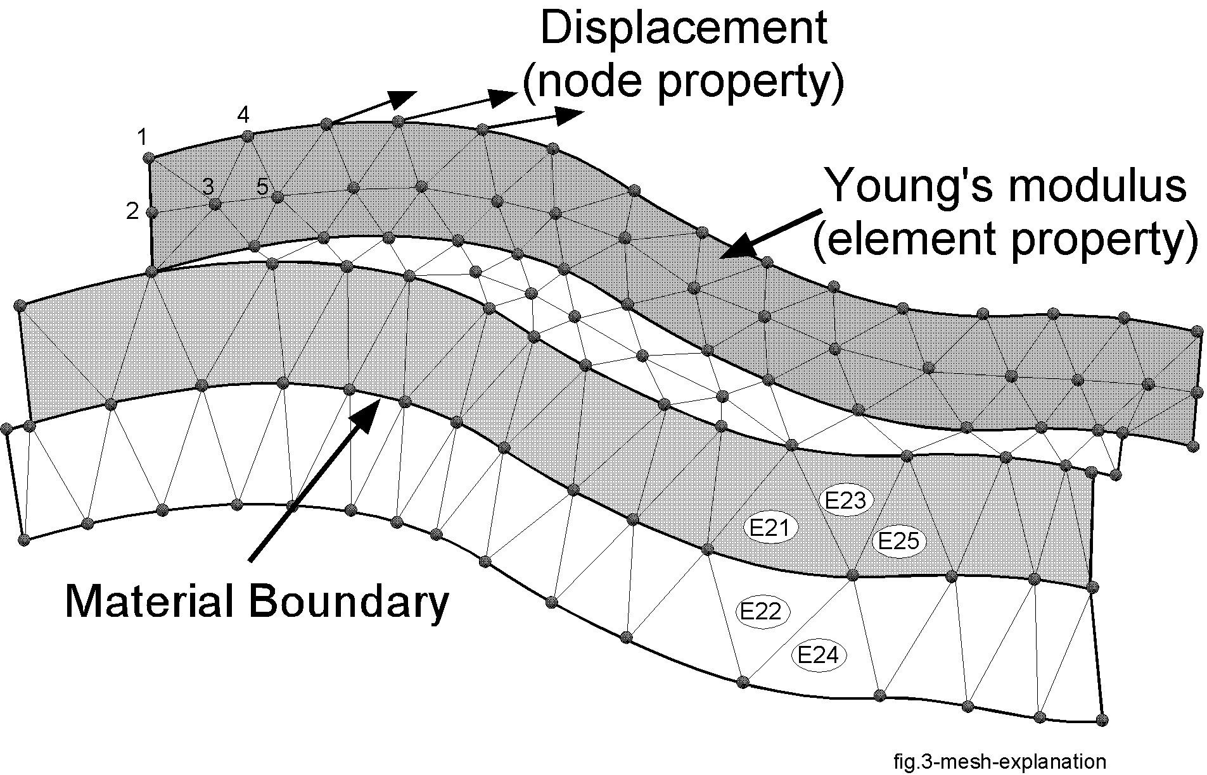
The FE mesh provides access to its nodes and elements via a n,o,p-tree structure, where n is the number of neighbors per element, o=number of nodes connected to each node, and p=number of nodes per element.
The mesh may consist of patches when:
highest-dim mesh is disconnected (stand-alone mesh)
mesh contains lower-dimensional regions (fractures, wells etc.)
manifolds of lower-dimensional elements may connect multiple patches together
Multiple root nodes will exist only if the the highest-dim mesh is disconnected
Array World
Tree World
Region 1
Region 3
Region 4
Region 2
Each ModelSubdomain gives access to its nodes and elements via the arrays:
elmt_vec_
bd_face_vec_
node_vec_
root_node_group_
root_elmt_group_
root_face_group_
root_interface_group_
as many node pointers as required to reach all nodes in the mesh
as many element pointers as required to reach all elements in the mesh
analogous to elements, but always lower-dim, and disconnected
special because
nodes are manifolds
provides cnnectons between patches
Notes:
Required functions
findNodePatches() – all within model, also needed is a version for the VSet
findElementPatches() – starting with highest dimensional to lower dimensional. If multiple higher-dim patches exist, the mesh is fragmented
createModelRegion() – should this be represented by a map or set of elements? – it will change all the time (if so the PDE integrator needs to change to accept computations on maps
nodeTraversal (only)
elementTraversal(only) - stops where elements are disconnected
cellAndNode () – finds any isolated mesh patches
nodeAndParentElementTraversal() – finds any patches, is it slower ?
findCollocatedNode() – as fast as possible by tree traversal
findElementThatContainsPoint() – as fast as possible, use patch scope

Slide 2
