Slide 1
all inside of PolygonGrid
Pillar
begin,end: Point<3U>
attached-cell indices: map:pair:size_t
points: vec
GridNode
xyz: Point<3>
idx: size_t
PolygonCell
stores cell connectivity
GridFace
GridNode* : vec
CSMP_FEM_TYPE
idx: size_t
CornerPointCell
pillar nodes
well intersections
etc
EclipseInterface
region-names: set
parameter/properties: map
reader of .grdecl files
collection of reading functions
GridElement
GridNode* : vec
CSMP_FEM_TYPE
idx: size_t
used by PolygonGrid
+ huge collection of functions in geometricCaclulations and meshingTools
contains CreateModel() method!
returning VSet & ModelTopology
EclipseModelSettings
regions: set:string
parameter/properties: map
CornerPointGrid
cell activity: vec
pillars[][]: vec
cells: map
faults: map
wellfaces: map
welledges: map
axes: vec
well-path functions
PolygonGrid
GridNode*: deque
GridFace*: deque
GridElement*: deque
EclipseModel
settings: EclipseModelSettings
IJKmap: map
regions: set:string
fault names: set:string
well names: set:string
PolygonGridManager
vec: GridNode*
Notes:
Design and other Issues
Code design is not hierarchical:
Cornerpointgrid does not consist of corner-point cells etc.
Difference between Polygon cell and CornerPointCell is not cleare
Questions
- where are the GridNode objects actually stored?
Refactoring
create quality metrics for each cell, right after they are built, isolating those that are problematic or replacing them. Report diagnostics as they arise (before the VSet is build)
compute code coverage to focus effort on critical methods
is there a need to keep property specifications in separate places? – Eclipse will always just be cell properties!
half-constructs so many dysfunctional objects
Unit Testing Strategy
geometricCalculations
classes inside of PolygonGrid (break up?)

Slide 2
Execution Sequence
construct EclipseModel
- EclipseModelSettings::EclipseModelSettings - readDesiredRegions if there, else only construct MATRIX (if not empty)
- MeshSetUp
- PoroPropertySetup
- PermPropertySetup
- RockNumPropertySetup
- EclipseModel::Initialise - EclipseModel::EclipseModelSettings: regions_:std::set<std::string>
- EclipseInterface::ReadFile - grid_:CornerPointGrid
- EclipseInterface::ReadFile
- reader:TextFileInterface<EclipseInterface<dim> > - reads block data into EclipseInterface
- EclipseInterface::ReadDimensions
- EclipseInterface::Read_COORD
- EclipseInterface::Read_ZCORN
- EclipseInterface::ReadFaultsData
- EclipseInterface::ReadActiveCells
- EclipseInterface::ReadScalarProperty (porosity)
- EclipseInterface::ReadTensorProperty (permeability)
- EclipseInterface::ReadWellSpecs
- CornerPointGrid::CreateModel – most of the action is here
- Initialise grid specs and map between pillar and cell nodes
- Initialize polyhedral cells (including cells with wells)
- Assign cell data to VSet
- processing non degenerate cells only meaning that there will be no tetrahedra
- processing degenerate cells
- Assign node coordinates
- Establishing Model Topology
- CornerPointGrid::EstablishActiveDomain
- CornerPointGrid::EstablishFaultRegions
- CornerPointGrid::EstablishWellRegions
- Reporting
- CornerPointGrid::CreateModel: VSet resulting from
- EclipseInterface::WritePropertiesToVSet
branch-point in model building: continue with 1) or without 2) region data
- assigning regions, faults, and wells
- checking that properties exist in CSMP model
- Model<dim>::Initialize: with or without ModelTopology data

Slide 3
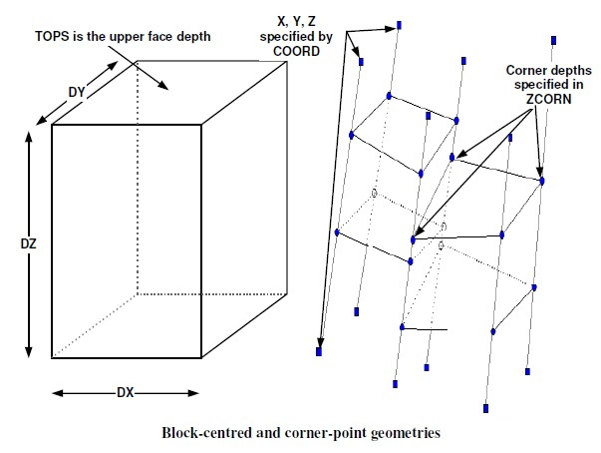
What happens inside CornerPointGrid::CreateModel
Coming from BuildModel()->ReadFile()->ReadFile() – EclipseInterface::ReadBlock() – Read_COORD etc. – stuffing the data into different objects.
InitializeGridSpecs() – just assigns the dimensions
ProcessPillars() – seems to calculate which grid-points will define each FE cell
Initialize polyhedral cells
Notes:
COORD – grid top to bottom lines which become the pillars and are later subdivided by the cell corners specified in ZCORN.
“book order”, line after line until a page has been read, then the next page until all data has been read. I.e. First the top layer (K=1) is read, line by line (begin with J=1, read I=1,...,NX, then J=2, etc.) Then repeat for K=2,...,NZ.
Example
COORD
x(1,1)TOP y(1,1)TOP z(1,1)TOP x(1,1)BTM y(1,1)BTM x(2,1)TOP y(2,1)TOP z(2,1)TOP x(2,1)BTM y(2,1)BTM x(3,1)TOP y(3,1)TOP z(3,1)TOP x(3,1)BTM y31,1)BTM .
.
.x(NX+1,NY+1)TOP y(NX+1,NY+1)TOP z(NX+1,NY+1)TOP x(NX+1,NY+1)BTM y(NX+1,NY+1)BTM z(NX+1,NY+1)BTM
z(1,1)BTM z(2,1)BTM z(3,1)BTM
ZCORN
vertical segmentation of the pillars
0. read the grid, there will be an i,j,k, for each point and a point location corresponding to it. However, some points (in dead cells) coincide, which can be collapsed into single nodes.
data structure: key(I,j,k), value uniquely numbered point (pair(point,idx)). This means that different I,j,k’s point to the same point and id.
Grid construction algorithm (starting with the pillars with beads)
1. find the locations (in CSMP coordinate space) of the corner-points of the Eclipse grid. Number these points. Currently, these are stored in the Pillar 2D array.
2. walk over the corner-point grid (via pillars) mapping out which points make up the cells
3. create a unique numbering for all points
4. create a plist from this unique numbering

