Slide 1
Multiphase Transport Scheme for Hybrid Finite-Element Finite-Volume Meshes:
Replacement of NCFVT framework
Stephan K Matthäi, Philip Weiss, Thomas Driesner, Sebastian Geiger
CSMP Development Consortium
Ideas developed on the basis of a joint meeting at HWU, May 2012

Slide 2
Day – identified issues
PropertyHandle
  Does not yet support operations involving different flavours of integration points
  User has to be able to choose variable interpolation method
SKM to create and send solver test cases from quadratic finite elements and models with gravity with highly permeable subvertical faults to Sebastian Gries

Slide 3
GUI
Needs native QT Creator, QT and VTK libraries; VTK must be compiled for use with QT
Only one property can be visualised at any one time
Multiple variables in Paraview: write scripts for joint visualisation
Development on the basis Philipp’s specs
Is dependent on ANSYS model (stores it)
Only works on Linux
Teaching software (windows), series of plugins, loaded sequentially
Project files *.csmp managed by QT-SQL interface
First display before properties have been loaded: show regions in color, give text with names the same color
Use QML to customize the look of the interface
Properties cannot be read from *-variables.txt file
Configuration from file
GTK library issues?

Slide 4
GUI (2)
include ( ../../uiplugin.prj)
SOURCES, HEADERS
QWidget::MyName::exec() function to run your code
this->VModel()->… (access to its interfaces)
Q_EXPORT_PLUGIN#

Slide 5
GUI (3) – What we need
PropertyDatabase – bring back usage category for variables
categories:
  computed / required
  dependent / independent, material property, fluid property, constitutive variable
Optional adjust ranges of variables
Make pre-compiled binaries of VTK with QT available from our website

Slide 6
Objectives and prerequisites
Refactor- current transport scheme so that it supports more flexible calculations:
Eliminate (Explicit)StencilProcessor and NodeCenteredFiniteVolumeTransport – based subclasses
Make functionality of FiniteVolumeAlgorithm more transparent
Support component transport in up to 3 phases
Phase by phase formulation
Saturation- vs. mass fraction based formulation?
Slightly- vs. fully compressible scheme?

Slide 7

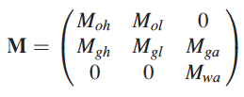



Transport of fluid phases with components
Idea: Geiger et al. 09’ (SPE107485)
Mass per unit volume vector:
Concentrations of components, i (oil, gas,water) in phases, j (h=heavy, l=light, a=aqueous):
Total component concentrations therefore are:
Partitioning of components among phases is described by:
Solution ratios, Rx are used to quantify the partitioning:
Store matrices as new ARRAY variables?
Notes:
Add tricks of Patrick to lag time stepping

Slide 8





Simplified transport equations
Mass balances (excluding sources and sinks)
Component fluxes
Phase velocities
Where the mobilities are (but this is not mass-based?!)
We also need sources and sinks and capillary / gravitational terms!
Isn’t this only a slightly compressible formulation?

Slide 9

Hamdi and Vostok’s approach (2012)
Compositional black-oil model
Thermodynamic constraints

Slide 10
Outline
What should be kept from our old scheme
  and what’s new in CSMP++
Design specifications and considerations
Phase by phase transport
Design prototype: classes and use-case

Slide 11
FE-FVM Discretisation
Different requirements seem to exist here:
(ETHZ wants material properties on the nodes, MUL on the elements)
Exact Solution
Linear FEM Solution
f(x)
Element 1
Element 2
Element 3
Finite Volume
cf., Baliga & Patankar, 1980,
Numerical Heat Transfer,
Paluszny, Matthai and Hohmeyer, 2007, Geofluids
Node 1
Node 2
X
Derivative of Linear FEM Solution, e.g., p_{f} gradient
11
Notes:
Integration of properties is required

Slide 12
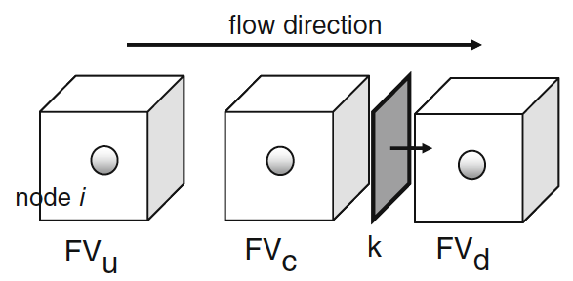
Basic terminology
NEW!
enum PLACEMENT { ELEMENT_INTEGRATION_POINT = 1,
SECTOR_INTEGRATION_POINT = 2,
FACET_INTEGRATION_POINT = 3,
NODE,
EDGE,
FACE,
INTER_FACE,
ELEMENT,
REGION,
BOUNDARY,
SPLIT_BOUNDARY,
MODEL,
UNDEFINED };
FiniteVolume
=FEM node
FiniteVolumeStencil
(as illustrated for linear triangle)
x
FE integration point
sector integration point
facet integration point
subface of element face
x
FV Sector
x
inside node
FV Facet
outside node
NB: Facet normals always point to node with higher local number

Slide 13
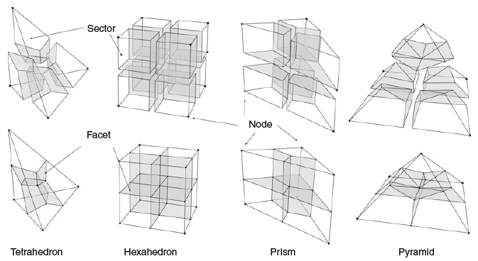
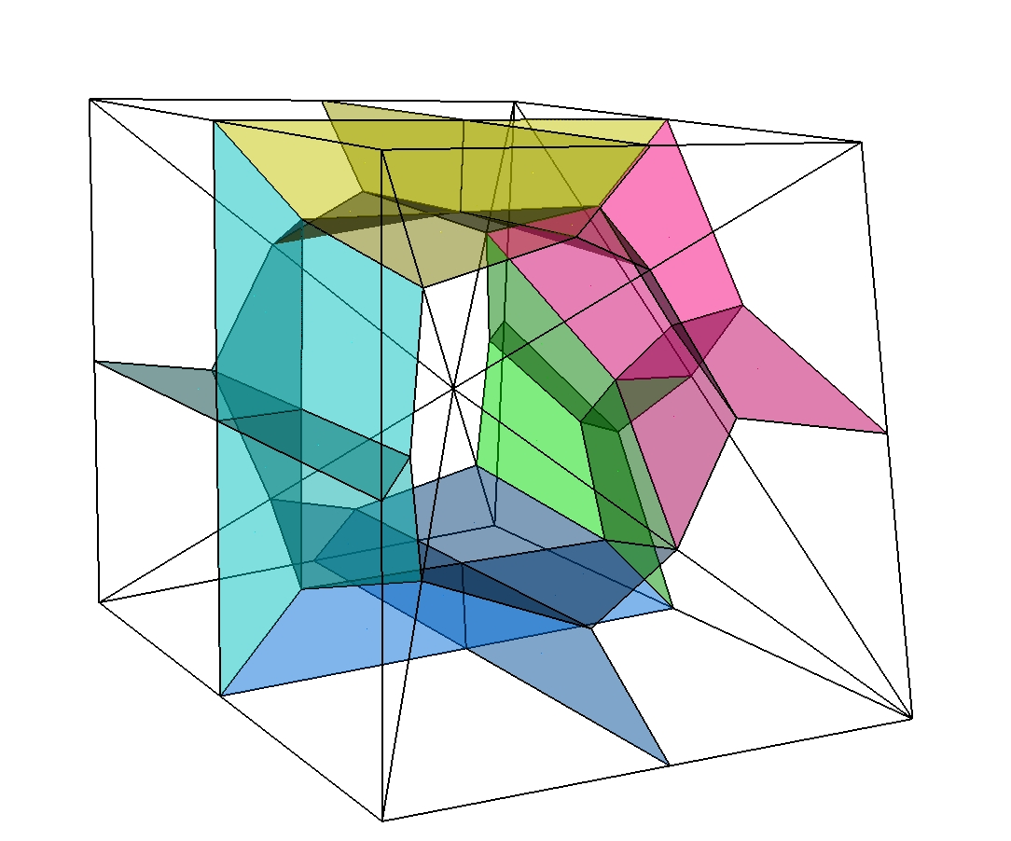
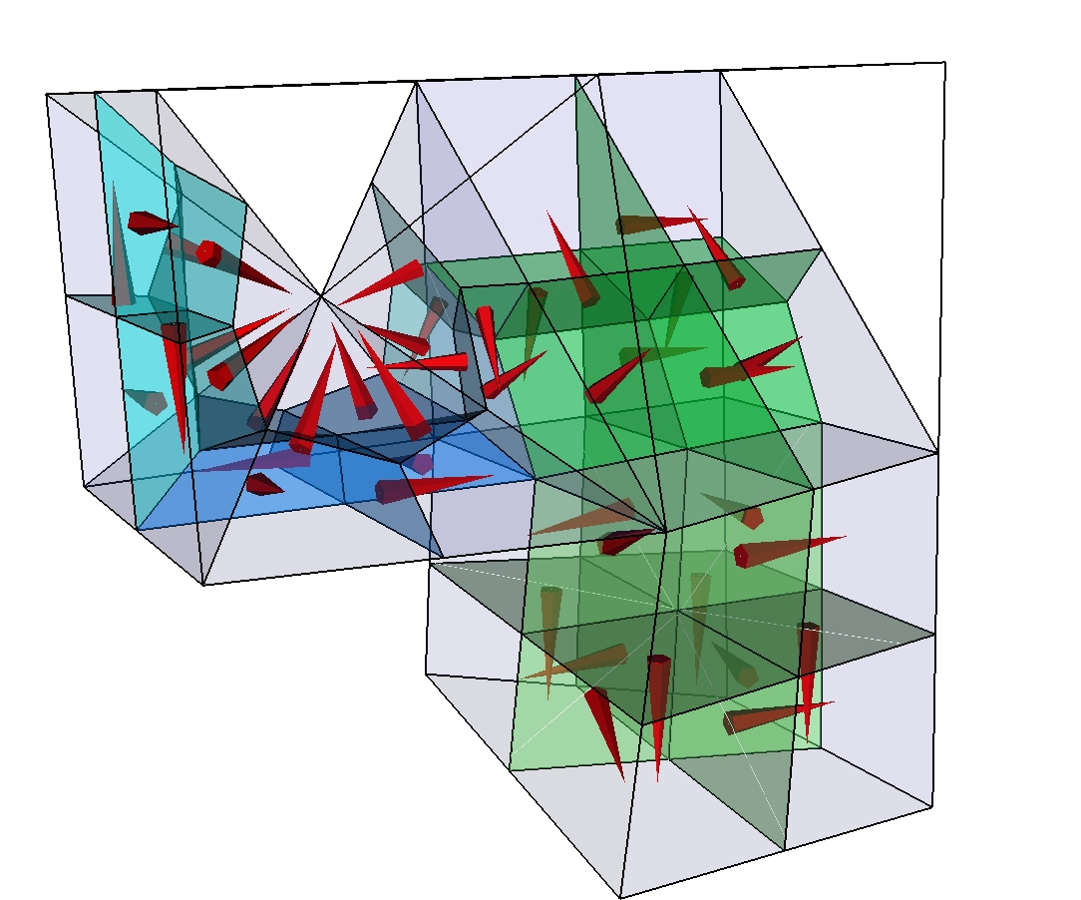
Finite-element finite-volume stencils
For
single element types
Finite volume mesh is not stored
FiniteVolumeStencils for each FE type which has a reference
representation in parametric space
Jacobi transformations applied via FiniteVolumeTraits
to get physical space properties
Paluszny et al. (2007, Geofluids)
FV cells
shared by
different
element
types

Slide 14
Access to FiniteVolume properties / parameters
through FiniteVolumeTraits added to Element / Face / Interface: e.SectorVolume(i);
As fast as possible, but it is better to store values if these are used repeatedly
double64 SectorVolume( size_t iSector ) const;
double64 FacetArea( size_t iFacet ) const;
Point<3U> FacetNormal( size_t iFacet ) const;
double64 FacetIntegral( size_t iFacet, const Index& ) const;
double64 SectorIntegral( size_t iSector, const Index& ) const;
double64 PropertyValueAtFacetIntegrationPoint( size_t iFacet, size_t, const Index& ) const;
double64 PropertyValueAtSectorIntegrationPoint( size_t iSector, size_t, const Index& ) const;
double64 ProjectionOnFacetNormal( size_t iFacet, const VectorVariable<3U>& ) const;
void N_AtFacetIntegrationPoint( size_t iFacet, size_t ip ) const;
void N_AtSectorIntegrationPoint( size_t iSector, size_t ip ) const;
void N_At( const Point<3U>& rst ) const;
Point<3U> RstToXYZ( const Point<3U>& rst ) const;
etc.
To learn how these computations are done, look at Paluszny et al. (2007, Geofluids)
finiteVolumeAuxiliaryFunctions +
FV interface of element, face or interface
FiniteVolumeTraits
additional FV functionality for the Element
Framework provided through Model
FV in parametric space representation
Element
FiniteVolumeStencil
FiniteVolumeStencilManager
Container of available stencils
FV_IntegrationPointsAndWeights
data container for initialisation

Slide 15
Scope for improvement: FiniteVolumeTraits
Speed-up: It may be possible to carry out velocity computations entirely in parametric space, saving several Jacobian operations
To many (confusing) functions in interface of FiniteVolumeTraits:
double64 FacetAreaMapped( size_t iFacet ) const;
Point<3U> FacetNormalMapped( size_t iFacet ) const;
double64 ParametricFacetArea( size_t iFacet ) const;
const Point<3U>& ParametricFacetNormal( size_t iFacet ) const;
Is there an issue with velocity computations on polyhedral (multi-element type) meshes, where there appears to be a divergence in the velocity field?
Option PYRAMID_WITH_TRIANGULAR_FACETS should be used always and flag should be removed

Slide 16
Keeping support functionality from NodeCenteredFiniteVolumeTransport ?
Class needs a rebuild, but SKM suggests that certain features are kept:
Keep functions but dismantle class?
  Internal variables should no longer be stored in NCFVT class, but can now be stored directly on model; still, an initialisation function is needed and state needs to be known
  Single phase transport should also be associated with a phase?
  Complicated procedure to compute nodal volume fluid source terms for FEM scheme should be dropped and managed by FEM pde_operators.
  CFL calculations etc. could be moved to finiteVolumeAuxiliaryFunctions ?
  A transport class is still needed to manage accumulations / integrations etc.
  Implication: mesh variables exist everywhere!

Slide 17
What currently happens when the NCFV transport is instantiated
Finite volume stencil class instances of FiniteVolumeStencil are constructed and initialized with data from FV_IntegrationPointAndWeights “singleton” for the different finite element types
Specific stencils are associated with corresponding elements as managed by the FiniteVolumeStencilManager
FV_Parameter instances are initialized doing computations with the FiniteVolumeStencil objects and are stored in the STENCIL_DATA vector inside of the NodeCenteredFiniteVolumeTransport. Initialized are with facet normals, facet areas, and sector volumes for accelerated lookup and projections during run.
  NB: FV_Parameter data can now be stored on the mesh
FV-pore volumes and flux balance arrays are also computed. If second order is required, a node connectivity graph and SMINMAX array values are initialized for the limiting.

Slide 18
CFL calculation
CFL is currently calculated using the element length in the direction of flow, see NCFVT::AnisotropicCourantIncrement(). This only considers viscous and gravitationally driven flow since capillary spreading is computed with the FE method.
A limiting value is specified by the user for the case when there is no flow.
For explicit calculations, df/ds_{max} is used in the calculation of the 2-phase CFL limit because the resulting step size will be sufficiently small even when df/ds increases from the current to subsequent iterations. For implicit calculations this is not necessary and the virtual CFL method should be overloaded in such schemes to be less restrictive.
To use explit schemes CFL calculation must simultaneously address viscous, gravitational, and capillary terms CFL = max( visc_CFL…) so that even if one of these is zero a meaningful value is established.
For these reasons the CFL methods are virtual so that they can be overriden in the subclasses.

Slide 19
Constitutive relationships
Are currently recovered from subclasses of the TwoPhaseModel (here we need extensions for 3-phase and perhaps for compressible flow)
Idea (for element-based material properties): initialize 2-phase model for element (or specific internal site (=node etc.), then compute terms accessible through interface.
Current interface is a mess! – somebody has tinkered with the base class!
void SaturationWettingPhase( double64 s_wetting );
void Permeability( double64 permeability );
double64 ViscosityNonWettingPhase() const;
double64 ViscosityWettingPhase() const;
double64 DensityNonWettingPhase() const;
double64 DensityWettingPhase() const;
double64 Saturation( size_t phase ) const;
double64 MobilityPhase( size_t phase ) const; // kr_i/mu_i
double64 TotalMobility() const;
double64 TotalMobilityMultiplier() const;
double64 DiffusionMultiplier( size_t phase ) const;
double64 CapillaryDiffusionMultiplier( size_t phase ) const;
double64 GravityMultiplier_G() const;
double64 GravityMultiplier_dGds() const;
double64 AdvectionMultiplier() const;
virtual double64 ShockSpeed() const;
virtual double64 ShockHeight() const;
virtual double64 EffectiveSaturation() const;
virtual double64 krn_Phase() const = 0;
virtual double64 krw_Phase() const = 0;
/// fractional flow
double64 f_Phase( size_t phase ) const;
/// derivative of fractional flow (used in advection multiplier); note that fw+fn=1, dfwdsw=dfndsn
virtual double64 dfds() const = 0;
/// maximum value of previous derivative
virtual double64 MaxFractionalFlowDerivative() const = 0;
/// G multiplier
double64 G() const;
/// derivatives of gravitational flow (advection multipliers)
virtual double64 dGds() const = 0;
virtual double64 pc_Phase( size_t phase ) const = 0;
/// capillary pressure derivatives (treat seff as for previous function)
virtual double64 dpcds_Phase( size_t phase ) const = 0;
/// maximum value of dpcdS
double64 MaxCapillaryPressure( size_t phase ) const;
/// default is the wetting phase
virtual void Out( size_t phase=1U ) const;
What needs to be changed?
Notes:
This interface needs to be cleaned up – I do not know who introduced all this duplicate functions!

Slide 20
Outline
What should be kept from old scheme
  and what’s new in CSMP++
Design specifications and considerations
Phase by phase transport
Design prototype: classes and use-case

Slide 21
Decision needed:
Placement of material properties
Element
FE mesh can be used to represent material boundaries
Saturation at material interfaces makes no physical sense (discontinuities can only be represented with Split Boundaries or FECFVM scheme)
For element-centered saturation, upwind direction does not matter
Node
Material boundaries are blurred and domain volumes cannot be estimated accurately
Saturation is physically meaningful even where sharp property gradients exist
Transmissibility multipliers are non-physical if different flow laws exist in different domains
Fractured reservoir simulation needs element-based material properties

Slide 22
Element-centered variable scheme: needs
To store at different time levels (in one step or by repeated accumulation):
finite volumes:
  Integrated pore volume -> SCALAR
  Divergence of total velocity -> SCALAR
  Sources or sinks -> SCALAR
  Saturation -> ARRAY
  Saturation gradient (for higher order scheme) -> VECTOR
  Inflow versus outflow in the presence of sources and sinks -> SCALAR
facets:
  combined phase and components fluxes
  phase velocities
elements:
  total velocity -> VECTOR
  diffusivities
  sector porosity and pore volumes
  sector source terms (for FEM equations)
  constitutive relationships

Slide 23
New goal: phase-by-phase component transport scheme with support for component exchange among phases
(Transfer among phases is accomplished by EOS classes; diffusion terms are computed by finite element operators accumulated into same solution matrix as terms from implicit version of transport scheme)
Computations needed (first and second-order in space):
  CFL time increment where applicable; else saturation change or inflow vs. outflow
  upwind direction (combined: capillary+diffusion+transport)
  upwind saturation range
  advection terms
  node-centered saturation gradients (or bijective mapping (Matthai et al. 2009, TIPM; check!)
  source terms (upwinded or not)
  storage terms
  limiters

Slide 24
Supported vs. not yet supported functionality
Calculating and updating porosity and pore volume (by Model?)
Calculating and updating facet area and normal (by Model?)
Read / store / range check / projections of variables
Determine upwind nodes
Calculate CFL or any other special requirements on time-step size
Mass balance
Scaling n components and m phases
Calculating components
Determine and store facet fluxes
Accumulation of fluxes
Time-discretization (implicit, explicit, first/second order)
Iterations (e.g. Newton)
Higher-order in space
Limiting
Boundary conditions
Additional physics/chemistry
Access and configuration of the SAMG_Solver from the outside

Slide 25
Efficiency considerations
Whatever we do here has a great impact on speed!
To avoid iffy code, interior domains should be visited first, then their boundaries
Formulation should be suitable for DES implementation
FV visitation mode has a great impact on speed: element-by-element means that facets are only visited once, but may not be possible in higher-order scheme when node-centered saturation gradients are used in the flux approximation
CFL computations based on local shock speed (=element property), only work if the gravitational component of flow is small because shock speed is different in up- or down-dip flow

Slide 26
Outline
What should be kept from old scheme
  and what’s new in CSMP++
Design specifications and considerations
Phase by phase transport
Design prototype: classes and use-case

Slide 27
(New) classes?
EOS
Additional physics/chemistry
InteriorProcessor (base class)
Accumulation (LHS?)
BoundaryProcessor (base class)
Accumulation (RHS?)
FacetFlux
Calculating components
Determine and store facet fluxes
Explicit
Accumulation of fluxes to vector
Accumulation of sources to vector
Add fluxes and sources
Higher-order in space
Limiting
Implicit (RHS vs. LHS accumulations)
Accumulation order
Accumulation of fluxes to matrix
Accumulation of sources to matrix
Iterations (e.g. Newton)
Solver / SAMG
FV_Transport
CompositeVariable (=Phase with Comps)
ArrayVariableHandler?
Reading / storing composite variables
Scaling n and m
Range checking
Storing velocities
TimeIncrement class
Calculate CFL or other criteria
Mass Balance
Volume Based
Time-discretization (implicit, explicit, first/second order)
UpwindDirection class
Projections
Determine upwind nodes
To be carried out and managed by Model
If geometry changes, update porosity, pore volume, facet area and facet normal

Slide 28
A typical calculation?
Compute pressure
Compute total velocity etc.
Update multiphase flow properties, phase densities and viscosities
Determine initial time increment
Accumulate (higher-order) interior stencils
  Compute viscous, gravitational and capillary fluxes
  Determine upwind direction on basis of composite flux
  Establish flux balances and pressure-change dependent source / sink terms
Accumulate first order boundary stencils
Solve transport problem
Transfer results to model

