Slide 1
Multiphase Transport Scheme for Hybrid Finite-Element Finite-Volume Meshes:
Refactoring of NCFVT Framework
Stephan K Matthäi, Philip Weiss, Thomas Driesner, Sebastian Geiger
CSMP Development Consortium
Ideas developed on the basis of joint meeting at HWU, May 2012

Slide 2

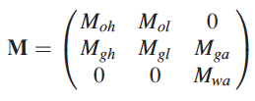



Goal: Transport of fluid phases with components
Composite Variables:
Black Oil Model: Geiger et al. 09’ (SPE107485)
Mass per unit volume vector:
Concentrations of components, i (oil, gas,water) in phases, j (h=heavy, l=light, a=aqueous):
Total component concentrations therefore are:
Partitioning of components among phases is described by:
Solution ratios, Rx are used to quantify the partitioning:
that can be derived from ArrayVariable…
Store matrices as new ARRAY variables?
Notes:
Add tricks of Patrick to lag time stepping

Slide 3





Simplified transport equations
Mass balances (excluding sources and sinks)
Component fluxes
Phase velocities
Where the mobilities are (but this is not mass-based?!)
We also need sources and sinks and capillary / gravitational terms!
Isn’t this only a slightly compressible formulation?

Slide 4

Hamdi and Vostok’s approach (2012)
Compositional black-oil model
Thermodynamic constraints
Different incarnations:
Black-oil based on mass fractions
Slightly-compressible using saturations

Slide 5
Objectives and prerequisites
Refactor- current transport scheme so that it supports more flexible calculations:
Eliminate (Explicit)StencilProcessor and NodeCenteredFiniteVolumeTransport – based subclasses
Make functionality of FiniteVolumeAlgorithm more transparent
Support component transport in up to 3 phases
Store / keep track of the transported components / composite variables (do not change in a transport step)
FV centered saturation gradients using ported Karen’s method
Phase by phase formulation
(Generic) mass-fraction based formulation for fully compressible flow
(Specialisation) speed-optimised slightly- compressible scheme because it is faster as it does not require to computation of the composite variables
For all components compute facet fluxes in one go
Notes:
----- Meeting Notes (10/3/12 18:44) -----
FiniteVolume class helpful? - presently we cannot loop directly over the facets of any one particular finite volume, but we can loop over these facets sector-by-sector, sector facet-by-sector facet

Slide 6
What we can achieve on this workshop
Design generic transport scheme
Implement explicit two-phase formulation for slightly compressible flow with gravity and capillary contributions as a first application
Make a decision on how to calculate timestep size: CFL or other method to calculate timestep size
Support Wish List
LocalVariableStorage: new interfaces AddTo(), MultiplyWith() to modify values without touching the variable flags?
Notes:
----- Meeting Notes (10/3/12 18:44) -----
Test that we can transport 2 components in 2 phases
Decision: we will use a mass-based "CFL" like criterion that guarentees that what goes out is not more than what goes in
(combined this computation with that of the saturation gradients)
- update CFL once any vt is calculated
or more often
- how is this coupled with the pressure time step (is there a cheap way to diagnose what works best?)
- can you calculate a viscous/gravitational/capillary/source balance that is diagnostic for what we can do to the pressure equation

Slide 7
Outline
What should be kept from our old scheme
  and what’s new in CSMP++
Design specifications and considerations
Phase by phase transport
Design prototype: classes and use-case

Slide 8
FE-FVM Discretisation
Different requirements seem to exist here:
(ETHZ wants material properties on the nodes, MUL on the elements)
Exact Solution
Linear FEM Solution
f(x)
Element 1
Element 2
Element 3
Finite Volume
cf., Baliga & Patankar, 1980,
Numerical Heat Transfer,
Paluszny, Matthai and Hohmeyer, 2007, Geofluids
Node 1
Node 2
X
Derivative of Linear FEM Solution, e.g., p_{f} gradient
8
Notes:
Integration of properties is required

Slide 9
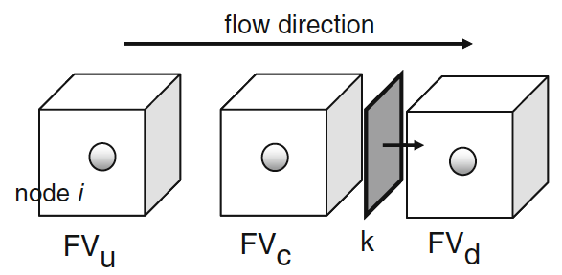
Basic terminology
NEW!
enum PLACEMENT { ELEMENT_INTEGRATION_POINT = 1,
SECTOR_INTEGRATION_POINT = 2,
FACET_INTEGRATION_POINT = 3,
NODE,
EDGE,
FACE,
INTER_FACE,
ELEMENT,
REGION,
BOUNDARY,
SPLIT_BOUNDARY,
MODEL,
UNDEFINED };
FiniteVolume
=FEM node
FiniteVolumeStencil
(as illustrated for linear triangle)
x
FE integration point
sector integration point
facet integration point
subface of element face
x
FV Sector
x
inside node
FV Facet
outside node
NB: Facet normals always point to node with higher local number

Slide 10
Variable placement (Barycentric formulation)
x

Slide 11
Variable placement
(integration-point based formulation)
x
x
x

Slide 12
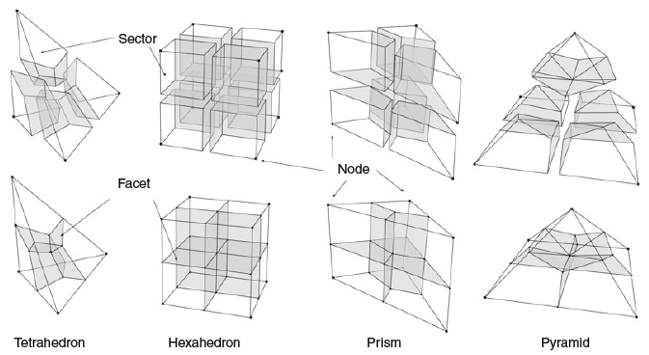
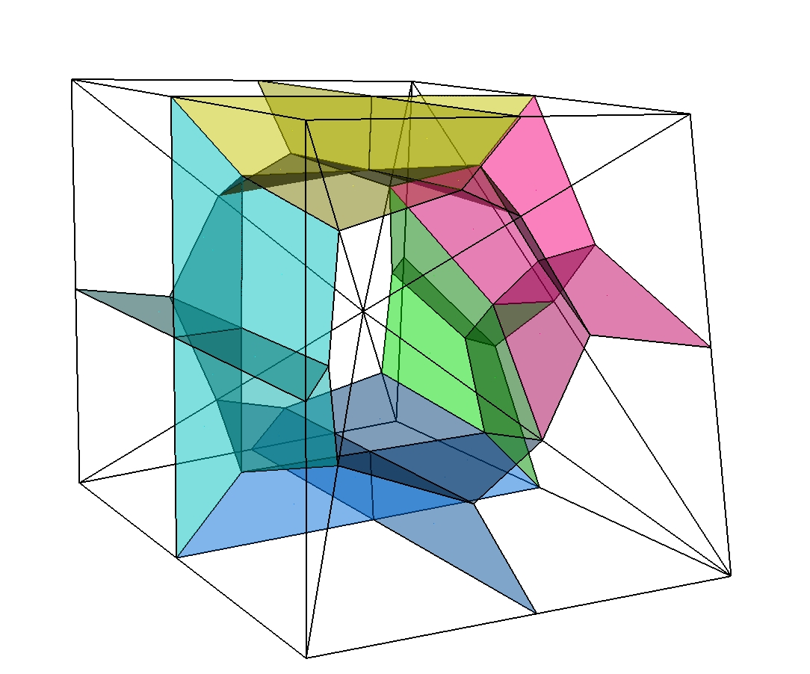
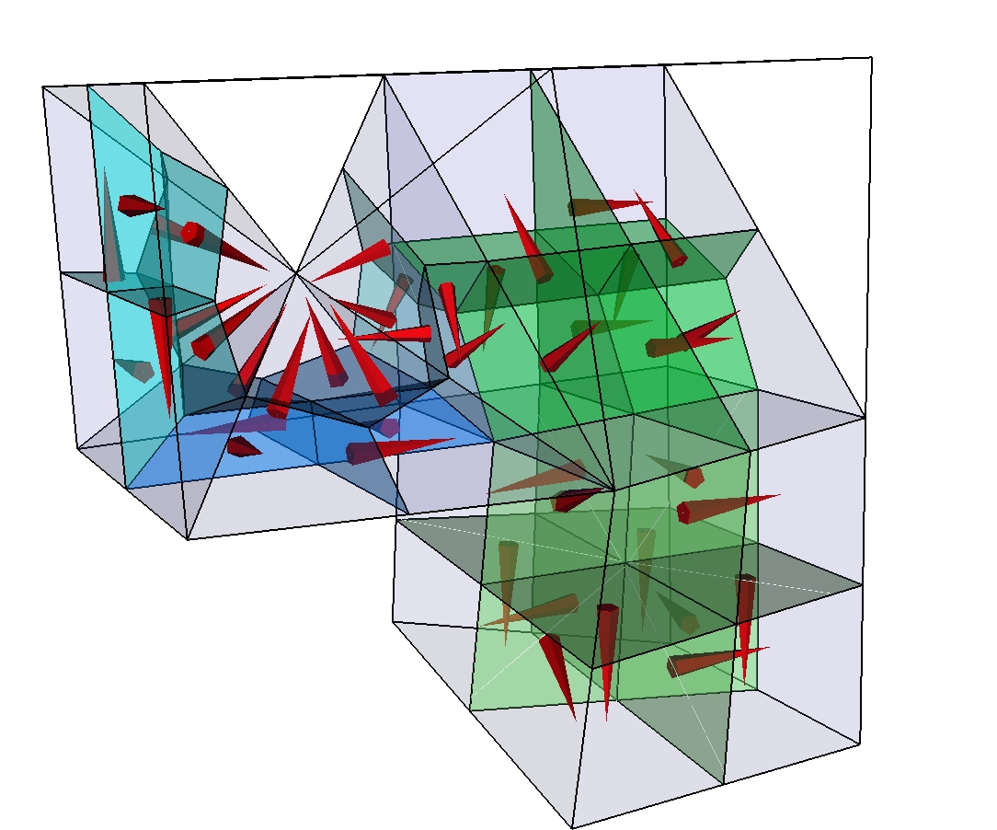
Finite-element finite-volume stencils
For
single element types
Finite volume mesh is not stored
FiniteVolumeStencils for each FE type which has a reference
representation in parametric space
Jacobi transformations applied via FiniteVolumeTraits
to get physical space properties
Paluszny et al. (2007, Geofluids)
FV cells
shared by
different
element
types

Slide 13
Access to FiniteVolume properties / parameters
through FiniteVolumeTraits added to Element / Face / Interface: e.SectorVolume(i);
As fast as possible, but it is better to store values if these are used repeatedly
double64 SectorVolume( size_t iSector ) const;
double64 FacetArea( size_t iFacet ) const;
Point<3U> FacetNormal( size_t iFacet ) const;
double64 FacetIntegral( size_t iFacet, const Index& ) const;
double64 SectorIntegral( size_t iSector, const Index& ) const;
double64 PropertyValueAtFacetIntegrationPoint( size_t iFacet, size_t, const Index& ) const;
double64 PropertyValueAtSectorIntegrationPoint( size_t iSector, size_t, const Index& ) const;
double64 ProjectionOnFacetNormal( size_t iFacet, const VectorVariable<3U>& ) const;
void N_AtFacetIntegrationPoint( size_t iFacet, size_t ip ) const;
void N_AtSectorIntegrationPoint( size_t iSector, size_t ip ) const;
void N_At( const Point<3U>& rst ) const;
Point<3U> RstToXYZ( const Point<3U>& rst ) const;
etc.
To learn how these computations are done, look at Paluszny et al. (2007, Geofluids)
finiteVolumeAuxiliaryFunctions +
FV interface of element, face or interface
FiniteVolumeTraits
additional FV functionality for the Element
Framework provided through Model
FV in parametric space representation
Element
FiniteVolumeStencil
FiniteVolumeStencilManager
Container of available stencils
FV_IntegrationPointsAndWeights
data container for initialisation

Slide 14
Scope for improvement: FiniteVolumeTraits
Speed-up: It may be possible to carry out velocity computations entirely in parametric space, saving several Jacobian operations
Confusing functions in interface of FiniteVolumeTraits:
double64 FacetAreaMapped( size_t iFacet ) const;
Point<3U> FacetNormalMapped( size_t iFacet ) const;
double64 ParametricFacetArea( size_t iFacet ) const;
const Point<3U>& ParametricFacetNormal( size_t iFacet ) const;
Is there an issue with velocity computations on polyhedral (multi-element type) meshes, where there appears to be a divergence in the velocity field?
Option PYRAMID_WITH_TRIANGULAR_FACETS should be used always and flag should be removed
Notes:
----- Meeting Notes (10/3/12 18:44) -----
- agreed to remove PYRAMID_WITH_TRIANGULAR_FACETS
- SPE10 2D case orthogonal quadrilaterals gives you divergence in flow field (3-4 O(M) greater than numerical
zero; always errors does not matter how integration is done - happens only if the viscosities are different)

Slide 15
Keeping support functionality from NodeCenteredFiniteVolumeTransport ?
Class needs a rebuild, but SKM suggests that certain functions are kept:
Alternative: Keep these functions but dismantle class?
  At least the constructor / initialisation function are always needed
  A transport class / visitor is also needed to manage accumulations / integrations etc.
  CFL calculations etc. could be moved to finiteVolumeAuxiliaryFunctions ?
  Complicated procedure to compute nodal volume fluid source terms for PointSourceRHS in FEM scheme should be replaced by pde_operators.
  Transport variables not stored in NCFVT / FV_Parameter array, but on model
    Implication: transport variables exist everywhere!
  Single phase transport should also be associated with a phase?
Notes:
----- Meeting Notes (10/3/12 18:44) -----
- NCFVT refactoring is agreed

Slide 16
What currently happens when the NCFV transport is instantiated
Finite volume stencil class instances of FiniteVolumeStencil are constructed and initialized with data from FV_IntegrationPointAndWeights “singleton” for the different finite element types
Specific stencils are associated with corresponding elements as managed by the FiniteVolumeStencilManager
Storage for SECTOR_INTEGRATION_POINT and FACET_INTEGRATION_POINT variables is created
FV_Parameter instances are initialized doing computations with the FiniteVolumeStencil objects and are stored in the STENCIL_DATA vector inside of the NodeCenteredFiniteVolumeTransport. Initialized are with facet normals, facet areas, and sector volumes for accelerated lookup and projections during run.
  NB: FV_Parameter data can now be stored on the mesh
FV-pore volumes and flux balance arrays are computed. If second order is required, a node connectivity graph and SMINMAX array values are created.
Notes:
----- Meeting Notes (10/3/12 18:44) -----
- pore volume managed by model O.K.
- flux balance stored on Model
SMINMAX is special

Slide 17
What currently happens in an 2nd order explicit transport calculation?
For the transport region, calculate CFL ( / time-stepping criterion)
  Element-by-element: from phase velocity based on combined viscous-gravitational-capillary phase velocity, but not sources
  Decision needed: compute only once using shock speed, vs. recompute for each transport increment
2. Compute FV centered saturations gradients using Karen’s method
3. For (second order in space), find smin / smax upstream of each FV facet
MinMaxAdvectedProperty(); using node-to-node connectivity
3. Loop over all elements of the transport region to accumulate fluxes / sources
  stencil_.AccumulateExplicitAdvectionSolution2( this->SMINMAX, (*fvt), *(*eit), RESULT );
  compute limiter values
4. Accumulate boundary terms, compensating for inflow and outflow
AssignFluxBoundaryConditions();
5. Compose solution S^t+1 = S^t - dt/(phi Vi) * sum_j^faces Aj n . [f vt] + src
6. Save computed saturations to FV
OutputResults( this->pref_, output_result_range );
Notes:
----- Meeting Notes (10/3/12 18:44) -----
Flux boundary conditions for compressible flow?
Dealing with inflow changing to outflow
Should all elements that have a node on a boundary of a region be boundary elements?

Slide 18
CFL calculation
CFL is currently calculated using the element length in the direction of flow, see NCFVT::AnisotropicCourantIncrement(). This only considers viscous and gravitationally driven flow since capillary spreading is computed with the FE method.
A limiting value is specified by the user for the case when there is no flow.
For explicit calculations, df/ds_{max} is used in the calculation of the 2-phase CFL limit because the resulting step size will be sufficiently small even when df/ds increases from the current to subsequent iterations. For implicit calculations this is not necessary and the virtual CFL method can be less restrictive.
For explicit schemes, the CFL calculation must simultaneously address viscous, gravitational, and capillary terms CFL = max( visc_CFL…)
Even if one of these is zero a meaningful value needs to be established.
Should the CFL method be virtual so that they can be overriden?
Notes:
----- Meeting Notes (10/3/12 18:44) -----
Way forward via Thomas suggestion

Slide 19
Constitutive relationships
Are currently recovered from subclasses of the TwoPhaseModel (here we need extensions for 3-phase and perhaps for compressible flow)
Idea (for element-based material properties): initialize 2-phase model for element (or specific internal site (=node etc.), then compute terms accessible through interface.
Current interface is a mess! – somebody has played with the base class!
void SaturationWettingPhase( double64 s_wetting );
void Permeability( double64 permeability );
double64 ViscosityNonWettingPhase() const;
double64 ViscosityWettingPhase() const;
double64 DensityNonWettingPhase() const;
double64 DensityWettingPhase() const;
double64 Saturation( size_t phase ) const;
double64 MobilityPhase( size_t phase ) const; // kr_i/mu_i
double64 TotalMobility() const;
double64 TotalMobilityMultiplier() const;
double64 DiffusionMultiplier( size_t phase ) const;
double64 CapillaryDiffusionMultiplier( size_t phase ) const;
double64 GravityMultiplier_G() const;
double64 GravityMultiplier_dGds() const;
double64 AdvectionMultiplier() const;
virtual double64 ShockSpeed() const;
virtual double64 ShockHeight() const;
virtual double64 EffectiveSaturation() const;
virtual double64 krn_Phase() const = 0;
virtual double64 krw_Phase() const = 0;
/// fractional flow
double64 f_Phase( size_t phase ) const;
/// derivative of fractional flow (used in advection multiplier); note that fw+fn=1, dfwdsw=dfndsn
virtual double64 dfds() const = 0;
/// maximum value of previous derivative
virtual double64 MaxFractionalFlowDerivative() const = 0;
/// G multiplier
double64 G() const;
/// derivatives of gravitational flow (advection multipliers)
virtual double64 dGds() const = 0;
virtual double64 pc_Phase( size_t phase ) const = 0;
/// capillary pressure derivatives (treat seff as for previous function)
virtual double64 dpcds_Phase( size_t phase ) const = 0;
/// maximum value of dpcdS
double64 MaxCapillaryPressure( size_t phase ) const;
/// default is the wetting phase
virtual void Out( size_t phase=1U ) const;
What methods do we really need?
Notes:
This interface needs to be cleaned up – I do not know who introduced all this duplicate functions!
----- Meeting Notes (10/3/12 18:44) -----
Action is needed!
- rename into SaturationFunctions
2-phase model does things it should not do:
- calculate concentrations in phases
It should do:
- relative permeabilities, capillary pressure, fractional flows etc.
- talk to EOS, fluid properties, and other things
- feedback with transport scheme in terms of where variables are sampled

Slide 20
Outline
What should be kept from old scheme
  and what’s new in CSMP++
Design specifications and considerations
Phase by phase transport
Design prototype: classes and use-case

Slide 21
Decision needed:
Placement of material properties
Element
FE mesh can be used to represent material boundaries
Saturation at material interfaces makes no physical sense (discontinuities can only be represented with Split Boundaries or FECFVM scheme)
For element-centered saturation, upwind direction does not matter
Node
Material boundaries are blurred and domain volumes cannot be estimated accurately
Saturation is physically meaningful even where sharp property gradients exist
Transmissibility multipliers are non-physical if different flow laws exist in different domains
Fractured reservoir simulation needs element-based material properties
Notes:
----- Meeting Notes (10/3/12 18:44) -----
We go with Element-based formulation

Slide 22
Element-centered variable scheme: needs
To store at different time levels (in one step or by repeated accumulation):
finite volumes:
  Integrated pore volume -> SCALAR
  Divergence of total velocity -> SCALAR
  Sources or sinks -> SCALAR
  Saturation -> ARRAY
  Saturation gradient (for higher order scheme) -> VECTOR
  Inflow versus outflow in the presence of sources and sinks -> SCALAR
facets:
  combined phase and components fluxes
  phase velocities
elements:
  total velocity -> VECTOR
  diffusivities
  sector porosity and pore volumes
  sector source terms (for FEM equations)
  constitutive relationships
Notes:
----- Meeting Notes (10/3/12 18:44) -----
- no saturation array: mass fractions vs. property gradients
GenericPropertyGradient GenericPropertyLimiter - compare these to the ones CSMP can calculate by extrapolation to nodes
- Divergence of total velocity is only for the slightly compressible flow formulation
- mass flux = flux, no phase velocities

Slide 23
New goal: phase-by-phase component transport scheme with support for component exchange among phases
(Transfer among phases is accomplished by EOS classes; diffusion terms are computed by finite element operators accumulated into same solution matrix as terms from implicit version of transport scheme)
Computations needed (first and second-order in space):
  CFL time increment or else where applicable; else saturation change or inflow vs. outflow (for instance, when source terms dominate)
  upwind direction (combined: capillary+diffusion+transport)
  upwind saturation range
  advection terms
  node-centered saturation gradients (or bijective mapping (Matthai et al. 2009, TIPM; check!)
  source terms (upwinded or not)
  storage terms
  limiter(s)
Notes:
----- Meeting Notes (10/3/12 18:44) -----
- Feedbacks into the pressure equation can change nature of equation
- Computation of compressibilities needs to be more sophisticated than weighted average

Slide 24
Implemented vs. conceptual functionality
Calculating and updating porosity and pore volume (by Model?)
Calculating and updating facet area and normal (by Model?)
Read / store / range check / projections of variables
Determine upwind nodes
Calculate CFL or any other special requirements on time-step size
Mass balance
Scaling n components and m phases
Calculating components
Determine and store facet fluxes
Accumulation of fluxes
Time-discretization (implicit, explicit, first/second order)
Iterations (e.g. Newton)
Higher-order in space
Limiting
Boundary conditions
Additional physics/chemistry
Access and configuration of the SAMG_Solver from the outside

Slide 25
Efficiency considerations
Whatever we do here has a great impact on speed!
To avoid iffy code, interior domains should be visited first, then their boundaries
Formulation should be suitable for DES implementation
FV visitation mode has a great impact on speed: element-by-element means that facets are only visited once, but may not be possible in higher-order scheme when node-centered saturation gradients are used in the flux approximation
CFL computations based on local shock speed (=element property), only work if the gravitational component of flow is small because shock speed is different in up- or down-dip flow

Slide 26
Outline
What should be kept from old scheme
  and what’s new in CSMP++
Design specifications and considerations
Phase by phase transport
Design prototype: classes and use-case

Slide 27
(New) classes?
EOS
Additional physics/chemistry
InteriorProcessor (base class)
Accumulation (LHS?)
BoundaryProcessor (base class)
Accumulation (RHS?)
FacetFlux
Calculating components
Determine and store facet fluxes
Explicit
Accumulation of fluxes to vector
Accumulation of sources to vector
Add fluxes and sources
Higher-order in space
Limiting
Implicit (RHS vs. LHS accumulations)
Accumulation order
Accumulation of fluxes to matrix
Accumulation of sources to matrix
Iterations (e.g. Newton)
Solver / SAMG
FiniteVolumeManager
SaturationFunctions
relperms, etc.
mobilities
Fluid Properties
GenericGradientCalculator
TimeIncrement class
Calculate CFL or other criteria
Mass Balance
Volume Based
Time-discretization (implicit, explicit, first/second order)
To be carried out and managed by Model
If geometry changes, update porosity, pore volume, facet area and facet normal
Notes:
----- Meeting Notes (10/3/12 18:44) -----
FiniteVolumeManager
- Policy-based design for the two-phase model
- Static polymorphism
- no more virtual functions, but all functions are inlined
- identify the common building blocks of the scheme and their dependencies
restrict dependencies to the things that are stored on model
Components are stored as array variables, use Factory method to associate array indices with enumerations for this composite variable

Slide 28
Classes – Colleoli Workshop
SaturationFunction – relative permeability and capillary pressure
Fluid – fluid properties, speciation, phases, components
GenericPropertyGradient – FV centered gradients
FlowFunctions – fractional flows, derivatives etc.
FacetFlux – upwind directions and facet fluxes computed stencil by stencil
FluxEvaluator – flux computations for entire region of computation
Accumulator – assembling LHS and RHS operators
VectorOperator – base class for RHS integrals and BCs
MatrixOperator – base class for LHS integrals
ExplicitTransport – assembly of explicit scheme solution
ImplicitTransport – Newton-Raphson – LineSearch accumulation

Slide 29
FluidProperties
Input are P, T, X
(Maximum) number of phases
Number of components per phase
Mass fractions
Phase densities
Phase viscosities
Saturations (in the case of mass-fraction based scheme)
Component exchange among phases

Slide 30
SaturationFunction
From saturation(s) provided externally computes kri(sw), pc(sw), dpc/ds
Has access to the element interface (and initializes itself there)
relative permeability can be a function of all kinds of parameters (hysteresis, velocity dependence, etc.)
capillary pressure function

Slide 31
FlowFunctions
Computes total mobility, fractional flows, derivatives, pc-derivatives etc. from input variables computed by SaturationFunctions and FluidProperties
Default: all derivatives are evaluated numerically

Slide 32
FacetFluxCalculator
To compute first- and second order facet fluxes
Operations:
  Compute facet normal permeabilities in the case of permeability tensors
  Uses FlowFunctions to compute fractional flow, derivatives etc.
  computes total mobility and velocity if needs
  find phase velocit(ies) (viscous, gravitational and capillary) at the barycenter to determine the upwind directions for all facets
  interpolate saturation using GenericGradientCalculator to find facet saturation
  evaluate relperms (using all kinds of parameters) via SaturationFunctions
  Get fluid properties (densitie(s), viscosity(s), concentrations etc.)
  Evaluate mobilities and fractional flows
  Compute facet fluxes
  Store facet fluxes
  NO LIMITING

Slide 33
The classes that carry out the transport
Combines accumulation process with machinery required to compute solutions / time-integrate transport equations.
ExplicitTransport
- In the simplest case, just writes the solution vector
ImplicitTransport
  Combines accumulation into SparseMatrix with solution with solver, range checks, etc.
  Used to implement iterative solution schemes, for instance, Newton Raphson with line search a la Christine
  Manages csmp::Solver class

Slide 34
LHS_Accumulator and RHS_Accumulator
Provides PDE_Integrator style functionality to assemble flux / source / sink etc. terms into a linear algebra Ax=b or simple vector framework so that a solution can be formed or computed.
Supports the assembly of expressions involving operator
Matrix accumulation by MatrixOperator and VectorOperator with state variables that specify how and when they should be accumulated.
We need telling names for:
  Pore volumes divided by time_increment into diagonal of matrix
  Incoming (higher-order) fluxes coupling diagonal with off-diagonal
  Outgoing(higher-order) fluxes added to diagonal
  Sources / sinks for LHS and RHS
  All these for RHS
  Jacobians for iterative solutions
  Diffusion type FEM integral operators
  Any of these at different time-levels
  Theta-weighting for second-order in time method
Static polymorphism for speed

Slide 35
Operator options
Divide / multiply-with time-increment
Add, Substract, Multiply
LateAccumulate
Lumping
Theta-weighting

Slide 36
FluxEvaluator (for the entire region)
Updates the fluid properties (including the saturations)
If a second-order is requested, computes the finite-volume centered property gradients
Calls the FacetFluxCalculator to compute facet fluxes of phases
Integrates total incoming versus outgoing fluxes for each finite volume
Question: Limiting should be done on the phase flux (total). What does this imply for where the limiter is called (by FacetFluxEvaluator or decoupled)

Slide 37
TimeStepEvaluator
Computes a time increment such that the amount of fluid that leaves any FV is not greater than what was in there
For implicit schemes any relaxation is applied to this

Slide 38
ExplicitTransport and ImplicitTransport
Drives
  FluxEvaluator
  TimeStepEvaluator
  Accumulator
  Solver
Solution process can involve NewtonRaphson and LineSearch algorithms

Slide 39
A typical calculation?
Compute pressure
Compute total velocity etc.
Update multiphase flow properties, phase densities and viscosities
Determine initial time increment
Accumulate (higher-order) interior stencils
  Compute viscous, gravitational and capillary fluxes
  Determine upwind direction on basis of composite flux
  Establish flux balances and pressure-change dependent source / sink terms
Accumulate first order boundary stencils
Solve transport problem
Transfer results to model

