Slide 1
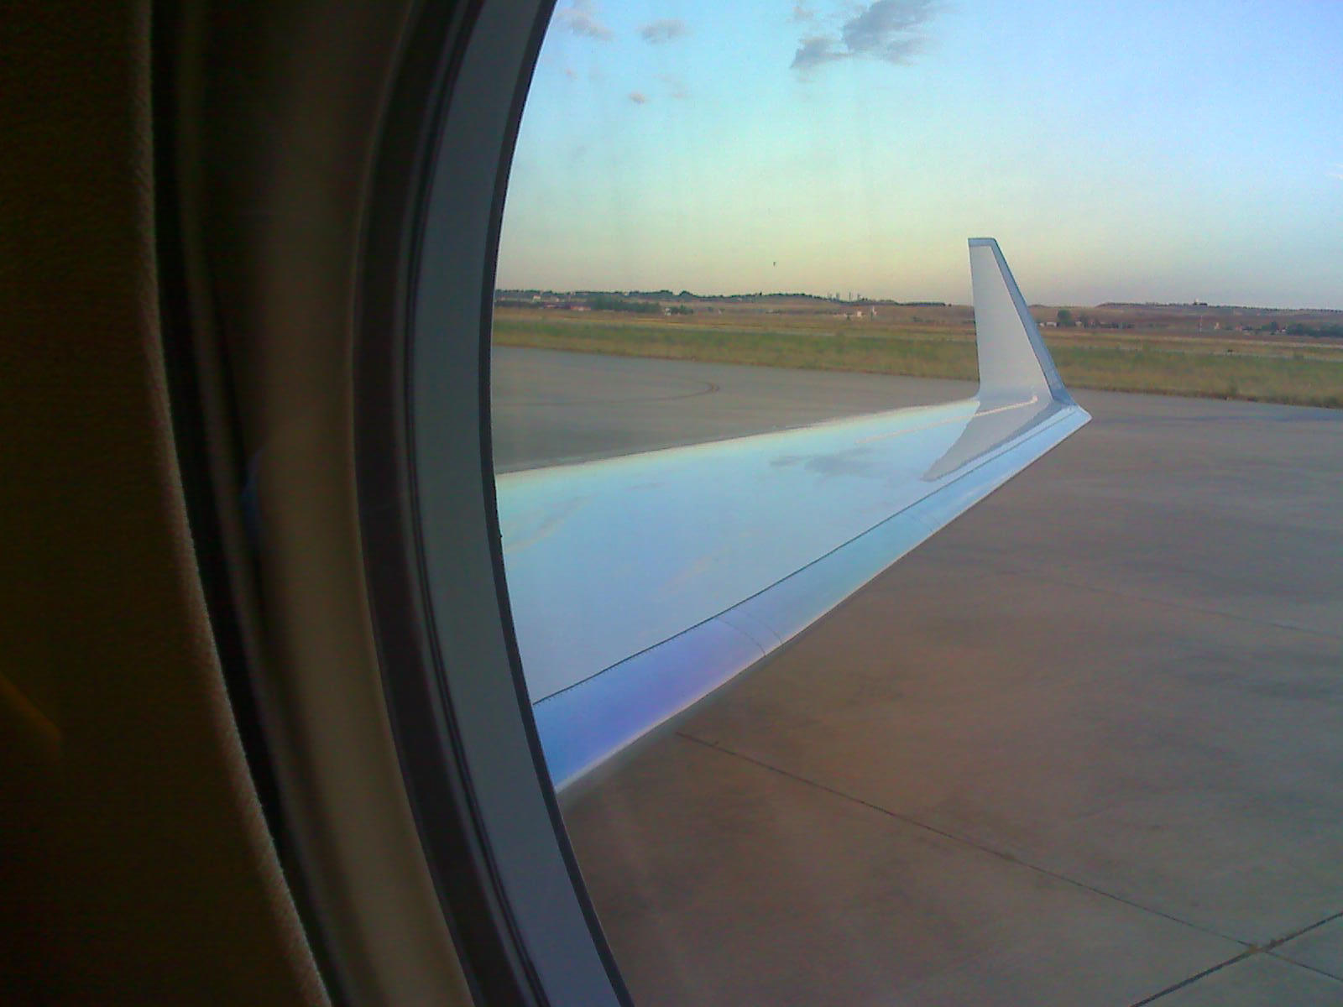
The Complex Systems Modelling Platform
(CSMP++ )
Melbourne Transport Scheme
by Stephan K. Matthai

Slide 2
Outline
Governing Equations
Discretisation
Design specifications and considerations
Phase by phase transport
Design prototype: classes and use-case

Slide 3
Old scheme: 2-phase flow, slightly compressible
Pressure equation including reduced gravity effects but not capillary pressure
Total velocity (including buoyancy-driven flow of the fluid mixture)
Transport equation
soln.vec.
soln.vec.
advection
gravitational segregation (=volume conservative spreading)
Notes:
accompanying derivation is in Maple worksheet Helmig-p107-vs-CSP.mws
rho_n und rho_avg refer to the reduced density
NB: It is a problem that advection etc multpliers depend in their form on the way the equations are being solved -> remove?
Notice also that if the permeability is a tensor, only the vertical component will have to be considered in the calculation of the gravitational spreading

Slide 4
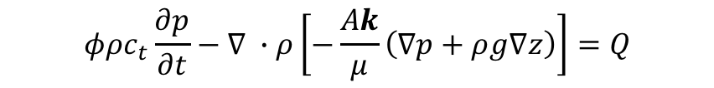


Back to the basics of compressible flow
Conservation of volume becomes conservation of mass:
Substitution of volumetric flow rate u by Darcy’s law gives pressure equation
$$∇ ∙ρ\left[−\frac{Ak}{μ}\left(∇p+ρg∇z\right)\right]=Q$$
Introducing time (continuity equation) / total systems compressibility, c_{t}
$$φρc_{t}\frac{∂p}{∂t}−∇ ∙ρ\left[−\frac{Ak}{μ}\left(∇p+ρg∇z\right)\right]=Q$$
$$c_{t}=φβ_{f}+\left(1−φ\right)β_{r}$$
Backward-Euler FD time discretisation
mass matrix
conductance matrix
mass matrix
body-force matrix
mass matrix
$\left[NN\frac{\left[φρc_{t}\right]}{∆t}+DN\left[\frac{ρAk}{μ}\right]\right]{\left\{p\right\}}_{t+∆t}=$ $NN\frac{\left[φρc_{t}\right]}{∆t} {\left\{p\right\}}_{t}+DNN{\left\{\frac{ρAk}{μ}g∇z\right\}}_{t+∆t}+{NNQ}_{m,t+∆t}$
LHS
RHS

Slide 5
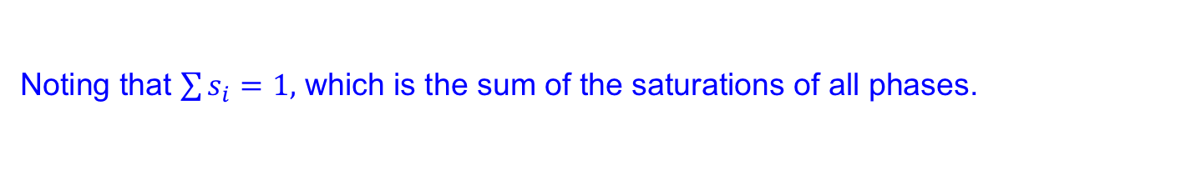
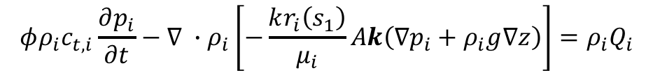
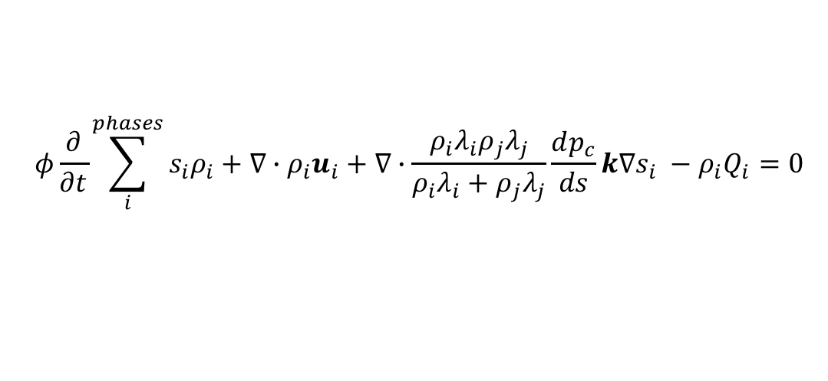

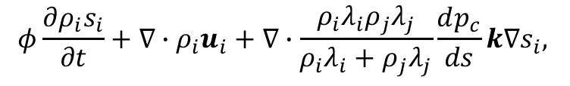
Introducing saturations
Introduction of the extended Darcy’s law in the continuity equation
for a single phase, i
$$φρ_{i}c_{t,i}\frac{∂p_{i}}{∂t}−∇ ∙ρ_{i}\left[−\frac{kr_{i}\left(s_{1}\right)}{μ_{i}}Ak\left(∇p_{i}+ρ_{i}g∇z\right)\right]={ρ_{i}Q}_{i}$$
$$c_{t}=φ(s_{Co2}β_{CO2}+s_{H2O}β_{H2O}+\left(1−φ\right)β_{r}$$
Noting that $\sum{s_{i}}=1,$ which is the sum of the saturations of all phases.
The transport equation now becomes (omitting sources and sinks):
$$φ\frac{∂ρ_{i}s_{i}}{∂t}+{∇∙ρ}_{i}u_{i}+∇∙\frac{ρ_{i}λ_{i}ρ_{j}λ_{j}}{ρ_{i}λ_{i}+ρ_{j}λ_{j}}\frac{dp_{c}}{ds}k∇s_{i},$$
where
$$u_{i}=λ_{i}k∙\left(∇p+ρ_{i}g∇z\right)$$
capillary spreading
Summing over the phases:
$$φ\frac{∂}{∂t}\sum_{i}^{phases}{s_{i}ρ_{i}}+{∇∙ρ}_{i}u_{i}+∇∙\frac{ρ_{i}λ_{i}ρ_{j}λ_{j}}{ρ_{i}λ_{i}+ρ_{j}λ_{j}}\frac{dp_{c}}{ds}k∇s_{i} −ρ_{i}Q_{i}=0$$

Slide 6


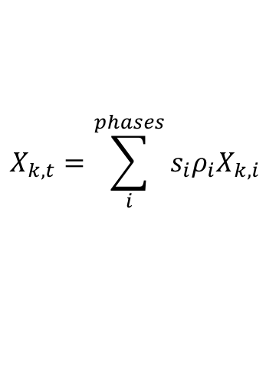
Introducing phase composition
In the mass-based framework, the mass of each phase is the product of its density with its saturation and the porosity.
Now, tracking the composition of each phase in terms of the mass fractions of its components k, x_{k}
The total mass of each component in the system, is the sum of its saturation weighted mass fractions in each phase.
$$X_{k,t}=\sum_{i}^{phases}{s_{i}ρ_{i}X_{k,i}}$$
For the components H₂O, CO₂ and NaCl, (usind the Spycher EOS), we have
$$X_{H_{2}O,total}={s_{1}ρ_{1}X}_{H_{2}O}+s_{2}ρ_{2 }Y_{H_{2}O}$$
$$X_{{CO}_{2},total}={s_{1}ρ_{1}X}_{{CO}_{2}}+s_{2}ρ_{2 }Y_{{CO}_{2}}$$
$$X_{NaCl,total}={s_{1}ρ_{1}X}_{NaCl}−X_{NaCl,precipitated }$$
Combining all this into a multiphase – multicomponent transport scheme:

Slide 7





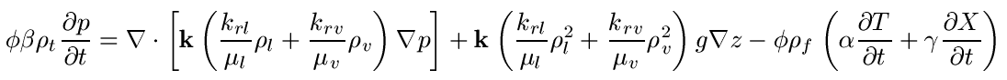
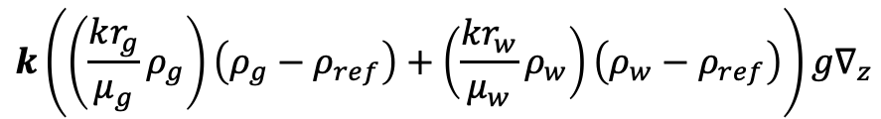
In depth review: pressure equation from conservation of fluid mass
Conservation of mass:
Darcy’s law:
Total density:
compressibility
expansivity
reaction induced volume changes
Thermodynamic relations:
mass source “potentially problematic if timesteps are large”
additional sources and sinks in the pressure equation
Reduced pressure (gravity term):
$$k\left(\left(\frac{kr_{g}}{μ_{g}}ρ_{g}\right)\left(ρ_{g}−ρ_{ref}\right)+\left(\frac{kr_{w}}{μ_{w}}ρ_{w}\right)\left(ρ_{w}−ρ_{ref}\right)\right)g∇_{z}$$
Notes:
Stress that experimental relperm models can be used

Slide 8




Governing equations: Conservation of salt / CO₂
see Geiger et al. 2005, JGR
Advection in fluids:
Dispersion in fluids:
Total salt content:

Slide 9





Governing equations: Conservation of energy
Advection in fluids:
Since the amount of dissolved salt (and CO2) affects fluid density, it influences the total velocity of the fluid mixture.
Energy in salt phases:
Conduction in rock:

Slide 10
Solution strategy
Full problem:
Nested iteration strategy (Hajibeygi & Jenny, 14’):
  Inner saturation loop: predictor – corrector approach for saturation
  Outer iteration loop: pressure with mass source term

Slide 11
Outline
Governing Equations
Discretisation
Design specifications and considerations
Phase by phase transport
Design prototype: classes and use-case

Slide 12
Variable placement (Barycentric formulation)
x

Slide 13
Variable placement
(integration-point based formulation)
x
x
x

Slide 14
Current implementation
0. Thermal equilibration (done only once at beginning), we leave the relatively straight-forward implementation of heat transfer until later.
Initial computation of flow and transport properties
Time-marching loop:
Multiphase / multicomponent transfer, including dispersion of salt and convective overturn of CO₂
EOS computation of saturations and fluid properties (densities of phases etc.)
If salt precipitation, change porosity and apply correlation to find new permeability
Computation of potential source or sink terms
Update of transport properties
Solution of pressure diffusion equation (implicit)
Post-processing of phase velocities

Slide 15
Computation of saturations at new time level
To convert from mass fraction to volume fraction:
vf1 = s_{w} = 1/(1+(rho1/rho2)*(1/wf1-1))
vf2 = s_{CO2} = 1/(1+(rho2/rho1)*(1/wf2-1))
where, vf1=phase 1 (H2O) volume fraction
vf2 = phase 2 (CO2) volume fraction
wf1=phase 1 mass fraction
wf2=phase 2 mass fraction
rho1=phase 1 density
rho2=phase 2 density
PS. Double check that vf1 + vf2 = 1

Slide 16
If necessary: predictor-corrector time-stepping
With Δt = 0.5 * CFL
Diffusion of heat (FE, implicit)
Diffusion of salt and CO2 (FE, implicit)
Advection of heat (FV, explicit)
Advection of salt (FV, explicit)
Update fluid properties (EOS)
Update transport properties (e.g., λ_{t}, D, φ)
Diffusion of fluid pressure (FE, implicit)
Calculate fluid velocities
Repeat with Δt = CFL and v^{t+Δt/2}, λ^{t+Δt/2}, etc.
Error: OΔt²

Slide 17
Outline
Governing Equations
Discretisation
Design specifications and considerations
Phase by phase transport
Design prototype: classes and use-case

Slide 18
Interface supporting FEM-FVM framework
Element / Face / Interface policy: FiniteVolumePolicy excerpts from interface:
double64 SectorVolume( size_t iSector ) const;
double64 FacetArea( size_t iFacet ) const;
Point<3U> FacetNormal( size_t iFacet ) const;
double64 FacetIntegral( size_t iFacet, const Index& ) const;
double64 SectorIntegral( size_t iSector, const Index& ) const;
double64 PropertyValueAtFacetIntegrationPoint( size_t iFacet, size_t, const Index& ) const;
double64 PropertyValueAtSectorIntegrationPoint( size_t iSector, size_t, const Index& ) const;
double64 ProjectionOnFacetNormal( size_t iFacet, const VectorVariable<3U>& ) const;
void N_AtFacetIntegrationPoint( size_t iFacet, size_t ip ) const;
void N_AtSectorIntegrationPoint( size_t iSector, size_t ip ) const;
void N_At( const Point<3U>& rst ) const;
Point<3U> RstToXYZ( const Point<3U>& rst ) const;
etc.
To learn how these computations are done, look at Paluszny et al. (2007, Geofluids)
finiteVolumeAuxiliaryFunctions +
FV interface of element, face or interface
FiniteVolumePolicy
additional FV functionality for the Element
Framework provided through Model class
FV in parametric space representation
Element
FiniteVolumeStencil
FiniteVolumeStencilManager
Container of available stencils
FV_IntegrationPointsAndWeights
data container for initialisation

Slide 19
General design considerations
Transport scheme has two parts:
  manages the transport of a single phase including its components and the physics of advection, diffusion, mechanical dispersion and reaction (sorption, decay and chemical reactions), and
  manages multiple phases
All computations are done in parametric space; tensor permeability is considered
Transfer among phases is accomplished by EOS objects
Rather than having variable storage in the transport schemes classes, all variables are stored as integration point properties inside the LocalVariableStorage class
Multi-species or component transport relies on ArrayVariable objects that encapsulate entire chemical systems; array elements are labeled by enums.
Conditions / limitations
Needs flexibility to define a chemical system during a running simulation
Diffusion may need to consider species, advection may not have to
Saturation functions must be redesigned
Existing visitors are not aligned in terms of their functionality with the design objectives imposed by DES

Slide 20
Required functionality 1
Calculating and updating (if geometry and-or pore volume changes): sector (pore) volume, facet area, and normal
Storage and access of FV-related variables
Determine upwind nodes
Node-to-node connectivity graph for upstream extrema calculations
Projections – finite volume auxiliary functions
Compute and store facet fluxes
Calculate CFL
Range checking of inputs (range of applicability) and outputs
Mass balance calculations / mass based transport
Accumulation of fluxes
Time-discretization (implicit, explicit, first/second order)
Iterations in nonlinear schemes (e.g. Newton)
Higher-order in space
Limiting
Additional physics/chemistry
Boundary conditions and flux balances
Required functionality 2
Calculate min/max for upstream nodes
Scaling of n and m in matrix equation dependent on number of components used
Parametric space computations,
Tests of flux balances for poly-element type meshes
Separation into (new) saturation functions and flow functions that bring in fluid properties from the Fluids objects
Bijective mapping from FV to FEM scheme
Notes:
negative concentrations may be possible in some mathematical models
What should be part of the transport scheme as opposed to some auxiliary functionality.

Slide 21
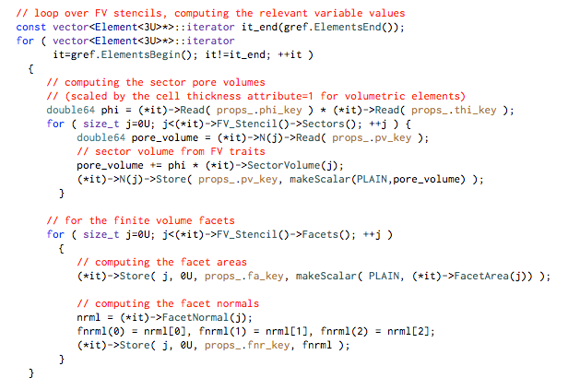
Initialisation and storage of variables
Utilizing storage at SECTOR and FACET_INTEGRATION_POINT reached from the parent elements

Slide 22
What happens in old (2nd-order) explicit 2-phase flow calculation?
For the transport region, calculate CFL ( / time-stepping criterion)
  Element-by-element: from phase velocity based on combined viscous-gravitational-capillary phase velocity, but not sources
  Decision needed: compute only once using shock speed, vs. recompute for each transport increment
2. Compute FV centered saturations gradients using Karen’s method
3. For (second order in space), find s_{min} / s_{max} upstream of each FV facet
MinMaxAdvectedProperty(); using node-to-node connectivity
3. Loop over all elements of the transport region to accumulate fluxes / sources
  stencil_.AccumulateExplicitAdvectionSolution2( this->SMINMAX, (*fvt), *(*eit), RESULT );
  compute limiter values
4. Accumulate boundary terms, compensating for inflow and outflow
AssignFluxBoundaryConditions();
5. Compose solution
6. Save computed saturations to FV
OutputResults( this->pref_, output_result_range );
viscous flow
sources & sinks
capillary spreading
gravitational segregration
Notes:
----- Meeting Notes (10/3/12 18:44) -----
Flux boundary conditions for compressible flow?
Dealing with inflow changing to outflow
Should all elements that have a node on a boundary of a region be boundary elements?

Slide 23
CFL calculation
max distance over which information can be propagated in a single advection step (undefined if strong sources/sinks or elliptic problem)
flow velocity
CFL is currently calculated using element length in the direction of flow (as opposed to FV), see NCFVT::AnisotropicCourantIncrement(). Only viscous and gravitationally driven flow are considered for the FV scheme because capillary spreading is computed with the FE method (has a different time constraint).
An upper limit value must be specified in case there is no flow.
For explicit calculations, df/ds_{max} suffices for the calculation of CFL because the resulting step size is small enough even when df/ds increases during iteration.
For implicit calculations an exact CFL is not necessary.
Experience shows that CFL should not be linked to pressure time-step calculation
When simultaneously addressing viscous, gravitational, and capillary terms CFL should not be based on the addition of these components but their max values; this way, even if one of these is zero a meaningful value is established.
Note: CFL methods should be virtual so that they can be overriden
Notes:
----- Meeting Notes (10/3/12 18:44) -----
Way forward via Thomas suggestion

Slide 24
Constitutive relationships – Refactoring done!
Break up computations involving fluid properties from those that are material parameters, i.e. the saturation functions (careful because of interactions)
Implement scheme using static polymorphism
Saturation functions are currently recovered from subclasses of the TwoPhaseModel (here we will eventually need extensions for 3-phase and perhaps for compressible flow)
Idea (for element-based material properties): initialize 2-phase model for element (or specific internal site (=node etc.), then compute terms accessible through interface.
What methods do we really need?
Notes:
This interface needs to be cleaned up – I do not know who introduced all this duplicate functions!
----- Meeting Notes (10/3/12 18:44) -----
Action is needed!
- rename into SaturationFunctions
2-phase model does things it should not do:
- calculate concentrations in phases
It should do:
- relative permeabilities, capillary pressure, fractional flows etc.
- talk to EOS, fluid properties, and other things
- feedback with transport scheme in terms of where variables are sampled

Slide 25
Outline
What should be kept from old scheme
  and what’s new in CSMP++
Design specifications and considerations
Phase by phase transport
Design prototype: classes and use-case

Slide 26
Placement of material properties on the elements; why?
Element
FE mesh can be used to represent material boundaries
Saturation at material interfaces makes no physical sense (discontinuities can only be represented with Split Boundaries or FECFVM scheme)
For element-centered saturation, upwind direction does not matter
Node
Material boundaries are blurred and domain volumes cannot be estimated accurately
Saturation is physically meaningful even where sharp property gradients exist
Transmissibility multipliers are non-physical if different flow laws exist in different domains
= Fractured reservoir simulation needs element-based material properties
Notes:
----- Meeting Notes (10/3/12 18:44) -----
We go with Element-based formulation

Slide 27
Variable storage needs
For higher order store at different time levels (in one step or by repeated accumulation):
finite volumes (placement NODE):
  Integrated pore volume -> SCALAR
  Divergence of total velocity -> SCALAR
  Sources or sinks -> SCALAR
  Saturations / concentrations -> ARRAY
  Saturation gradient (for higher order scheme) -> VECTOR
  Inflow versus outflow in the presence of sources and sinks -> SCALAR
  CFL ?
facets:
  combined phase and components fluxes
  phase velocities
elements:
  total velocity -> VECTOR
  diffusivities
  sector porosity and pore volumes
  sector source terms (for FEM equations)
  constitutive relationships
Notes:
----- Meeting Notes (10/3/12 18:44) -----
- no saturation array: mass fractions vs. property gradients
GenericPropertyGradient GenericPropertyLimiter - compare these to the ones CSMP can calculate by extrapolation to nodes
- Divergence of total velocity is only for the slightly compressible flow formulation
- mass flux = flux, no phase velocities

Slide 28
Outline
What should be kept from old scheme
  and what’s new in CSMP++
Design specifications and considerations
Phase by phase transport
Design prototyping: classes and use-cases

Slide 29
New goal: phase-by-phase component transport scheme with support for component exchange among phases
(Isochoric transfer among phases is accomplished by EOS classes; diffusion terms are computed by finite element operators accumulated into same solution matrix as terms from implicit version of transport scheme)
Computations needed (first and second-order in space):
  CFL time increment or else whichever applicable; else predictor-corrector saturation change or inflow vs. outflow (for instance, when source terms dominate)
  upwind direction (combined: capillary+diffusion+transport)
  upwind saturation range
  advection terms
  node-centered saturation gradients (or bijective mapping (Matthai et al. 2009, TIPM; check!)
  source terms (upwinded or not)
  storage terms
  limiter(s)
Notes:
----- Meeting Notes (10/3/12 18:44) -----
- Feedbacks into the pressure equation can change nature of equation
- Computation of compressibilities needs to be more sophisticated than weighted average

Slide 30
Implemented vs. conceptual functionality
Calculating and updating porosity, pore volume, facet area and normal
Read / store / range check / projections of variables
Determine upwind nodes
Calculate CFL or any other special requirements on time-step size
Mass balance
Scaling n components and m phases
Calculating components
Determine and store facet fluxes
Sector-based volume source and sink terms, stored on sector integration points
Accumulation of fluxes
SaturationFunction should be made specific to Region instances
Time-discretization (implicit, explicit, first/second order)
Iterations (e.g. Newton)
Higher-order in space
Limiting
Transport calculations in parametric space !!!
Boundary conditions
Additional physics/chemistry
Access and configuration of the SAMG_Solver from the outside

Slide 31
Efficiency considerations
Whatever we do on the facets and FVs has a great impact on speed!
To avoid iffy code, interior domains should be visited first, then their boundaries separately
Formulation should be extensible for DES implementation
FV visitation mode has a great impact on speed: element-by-element means that facets are only visited once, but may not be possible in higher-order scheme when node-centered saturation gradients are used in the flux approximation
Facet flux computations should be dissassembled and recombineable in a flexible way
The framework should be flexible enough to quickly implement all kinds of methods
CFL computations based on local shock speed (=element property), only work if the gravitational component of flow is small because shock speed is different in up- or down-dip flow

Slide 32
Outline
What should be kept from old scheme
  and what’s new in CSMP++
Design specifications and considerations
Phase by phase transport
Design prototype: classes and use-case

Slide 33
Layout 1 (class diagram)

Slide 34
Layout 2

Slide 35
Layout 3: Assembly of FVM equations
LHS
RHS

Slide 36
(New) classes?
EOS
Additional physics/chemistry
InteriorProcessor (base class)
Accumulation (LHS?)
BoundaryProcessor (base class)
Accumulation (RHS?)
FacetFlux
Calculating components
Determine and store facet fluxes
Explicit
Accumulation of fluxes to vector
Accumulation of sources to vector
Add fluxes and sources
Higher-order in space
Limiting
Implicit (RHS vs. LHS accumulations)
Accumulation order
Accumulation of fluxes to matrix
Accumulation of sources to matrix
Iterations (e.g. Newton)
Solver / SAMG
FiniteVolumeManager
SaturationFunctions
relperms, etc.
mobilities
Fluid Properties
GenericGradientCalculator
TimeIncrement class
Calculate CFL or other criteria
Mass Balance
Volume Based
Time-discretization (implicit, explicit, first/second order)
To be carried out and managed by Model
If geometry changes, update porosity, pore volume, facet area and facet normal
Notes:
----- Meeting Notes (10/3/12 18:44) -----
FiniteVolumeManager
- Policy-based design for the two-phase model
- Static polymorphism
- no more virtual functions, but all functions are inlined
- identify the common building blocks of the scheme and their dependencies
restrict dependencies to the things that are stored on model
Components are stored as array variables, use Factory method to associate array indices with enumerations for this composite variable

Slide 37
Classes – envisaged at Colleoli Workshop
SaturationFunction – relative permeability and capillary pressure
FluidProperties – fluid properties, speciation, phases, components
GenericPropertyGradient – FV centered gradients
FlowFunctions – fractional flows, derivatives etc.
FacetFlux – upwind directions and facet fluxes computed stencil by stencil
FluxEvaluator – flux computations for entire region of computation
Accumulator – assembling LHS and RHS operators
VectorOperator – base class for RHS integrals and BCs
MatrixOperator – base class for LHS integrals
ExplicitTransport – assembly of explicit scheme solution
ImplicitTransport – Newton-Raphson – LineSearch accumulation

Slide 38
Read Class
Reading variables
Scaling n and m
Store Class
Range check
Storing results and velocitits
Time Increment Class
Calculate CFL
Mass Balance
Volume Based
Time-discretization (implicit, explicit, first/second order)
UpwindDirection Class
Projections
Determine upwind nodes
Manager Class
Calculating and updating porosity and pore volume
Calculating and updating facet area and normal
Additional physics/chemistry
Boundary Class
Boundary conditions
DetermineStoreFacetFlux
Calculating components
Determine and store facet fluxes
Explicit
Accumulation of fluxes to vector
Accumulation of sources to vector
Add fluxes and sources
Higher-order in space
Limiting
Implicit
Accumulation of fluxes to matrix
Accumulation of sources to matrix
Iterations (e.g. Newton)
Solver / SAMG

Slide 39
FiniteVolumeVariableGradient
PropertyGradient()
PropertyGradientLimiter() – should this be here?
For FV centered estimation of facet saturations as in Geiger et al. (2004)
Separate treatment of model boundary versus interior

Slide 40
SaturationFunction
From saturation(s) provided externally computes kri(sw), pc(sw), dpc/ds
Has access to the element interface (and initializes itself there)
relative permeability can be a function of all kinds of parameters (hysteresis, velocity dependence, etc.)
capillary pressure function

Slide 41
FluidProperties
Input are P, T, X
(Maximum) number of phases
Number of components per phase
Mass fractions
Phase densities
Phase viscosities
Saturations (in the case of mass-fraction based scheme)
Component exchange among phases

Slide 42
FlowFunctions
CapillaryPressureDerivatives() + FractionalFlow()
+ FractionalFlowDerivatives()
+ PhaseMobilities()
+ TotalMobility()
Compute total mobility, fractional flows, derivatives, pc-derivatives etc. from input variables computed by SaturationFunctions and FluidProperties
Default: all derivatives are evaluated numerically

Slide 43
FacetFlux
FacetNormalPermeabilities() – method called in constructor
FaceAndComponentFluxes()
UpwindDirection() – prerequisite to flux calculuation; must be found for each phase
To compute first- and second order facet fluxes
Operations:
  computes total mobility and velocity if needs
  interpolate saturation using FiniteVolumeVariableGradient to find facet saturation
  Uses FlowFunctions to compute fractional flow, derivatives etc.
  find phase velocit(ies) (viscous, gravitational and capillary) at the barycenter to determine the upwind directions for all facets
  evaluate relperms (using all kinds of parameters) via SaturationFunction
  Get fluid properties (densitie(s), viscosity(s), concentrations etc.)
  Evaluate mobilities and fractional flows
  Compute facet fluxes
  Store facet fluxes
  NO LIMITING
Notes:
The up- stream direction for the other phase can be found by substituting the mobility of the known phase that we found by using the flowchart and the average mobility for unknown phase in the following formula, and calculating the pressure gradient for the unknown phase.
Having the pressure gradient of the other phase, we can find the upstream and upstream mobility.

Slide 44
Upstream direction vs. Inside-Outside nodes
Keep the distinction clear
u
u
upstream
2
n
FV_{i}
c
0
v
FV_{j}
1
u
d
Solute Concentration Front
downstream

Slide 45
Finding the upstream direction
Method of Shaho for simultaneous capillary – gravitational - viscous flows.
average o-w mobility
Notes:
After calculating the total facet-normal flux one needs to find the upstream direction for each phase in order to use upstream mobilities to perform saturation transport. If only viscous force is present then finding the upstream is trivial and for both phases is the same as upstream for total velocity. If we have capillary and gravitational forces, flowchart 5 illustrates how to find the upstream direction for one of the phases. Superscripts e and n stands for element and neighbor element, respectively. uz is the vertical unit vector.
The upstream direction for the other phase can be found by substituting the mobility of the known phase that we found by using the flowchart and the average mobility for unknown phase in the following formula, and calculating the pressure gradient for the unknown phase.
Having the pressure gradient of the other phase, we can find the upstream and upstream mobility.

Slide 46
Upstream direction calculation algorithms
for an incoming flux
̂ k_hat is the vertical unit vector pointing upwards
for outgoing fluxes

Slide 47
FluxEvaluator
FacetFluxes() – distributed and stored on facets
FiniteVolumeFluxBalance() – stored on finite volumes
FiniteVolumePropertyGradients()
FluxDivergence()
sources and sink terms computed on the sectors
Comments
uses GenericPropertyGradient
uses FacetFlux
  uses SaturationFunction
  uses FluidProperty
perhaps one could also store sector flux balances
mass balances also stored on finite volumes

Slide 48
FluxEvaluator (for the entire region)
Updates fluid properties (including the saturations)
If a second-order is requested, computes the finite-volume centered property gradients
Calls FacetFlux to compute facet fluxes of phases
Integrates total incoming versus outgoing fluxes for each finite volume
Question: Limiting should be done on the phase flux (total). What does this imply for where the limiter is called (by FacetFluxEvaluator or decoupled)

Slide 49
TransferStepEvaluator
For Explicit- and ImplicitTransport classes and using precomputed facet fluxes
Criteria (keep DES implementation in mind)
OutflowLessThanContentCriterion()
StreamlineCFL()
MaxStep()
MinStep()
Considerations
element-by-element evaluation taking into element length in direction of flow and volume of finite volumes

Slide 50
The classes that carry out the transport
Combine accumulation with application of boundary conditions and machinery required to compute solutions / time-integrate transport equations using data from timestep evaluator
ExplicitTransport
- In the simplest case, just writes the solution vector
ImplicitTransport
  Combines accumulation into SparseMatrix with solution with solver, range checks, etc.
  Used to implement iterative solution schemes, for instance, Newton Raphson with line search a la Christine
  Manages csmp::Solver class
Notes:
Is this class actually needed? - watch out for complementary tasks taking into account Accumulator

Slide 51
Capillary spreading (solved with FEM method)
this divergence is computed as a source or sink for the finite volume for which the surface integration of the second term is computed
O.K. nonlinear diffusive spreading, projection on facet normal
Notes:
The second divergence term is computed by summing dpc/dsn grad sn over the finite volume facets. If the sum is non-zero its value should be multiplied with the averaged k lamda overbar value for that FV to strictly adhere to the form above. However, the material parameters vary from sector to sector within the finite volume. This is taken care of by evaluating the k lamda_overbar at each finite volume facet.

Slide 52
LHS_Accumulator and RHS_Accumulator
PDE_Integrator style functionality to assemble flux / source / sink etc. terms into an Ax=b or simple vector framework so that a solution can be formed or computed: MatrixOperator and VectorOperator
Accumulation by MatrixOperator and VectorOperator with state variables that specify how and when they should be accumulated.
We need telling names for:
  Pore volumes divided by time_increment into diagonal of matrix
  Incoming (higher-order) fluxes coupling diagonal with off-diagonal
  Outgoing(higher-order) fluxes added to diagonal
  Sources / sinks for LHS and RHS
  All of the above for RHS
  Jacobians for iterative solutions
  Diffusion type FEM integral operators
  Any of these at different time-levels
  Theta-weighting for second-order in time method
Static polymorphism for speed
Can this be done at compile time ?
Can we use expression templates ?

Slide 53
Operator options
Divide / multiply-with time-increment
Add, Substract, Multiply
Late Accumulate
Bracket operators ? – for expressions (1 +b) c or defined by sequence in which they are added?
Lumping for LHS only
Theta-weighting

Slide 54
TimeStepEvaluator
Computes advection step such that the amount of fluid that leaves any FV is not greater than what was in there before the step
Writes diagnostics to FV cells, but stores min/max values internally for query at end of loop
For accuracy, criteria must be FV cell based, but facet flux can be precomputed in an element-by-element, facet-by-facet computation
For implicit schemes any relaxation is applied to this

Slide 55
ExplicitTransport and ImplicitTransport
Drives
  FluxEvaluator
  TimeStepEvaluator
  Accumulator
  Solver
Solution process can involve NewtonRaphson and LineSearch algorithms

Slide 56
Simulation steps (big picture)
Step 1: Read mesh from *.asc & *.dat files into appropriate container objects.
Step 2: Read regions selected for incorporation into simulation model from *-regions.txt file.
Step 3: Build simulation model from mesh data and form groups to represent subregions.
Step 4: Assign material properties, initial conditions, and boundary conditions from *-configuration.txt file.
Step 5: User chooses the relative permeability model; default for fractures is Linear model.
Step 6: Setup of monitoring for "saturation oil" and "fluid pressure“.
Step 7: Calculate initial relative permeabilities, phase mobilities and relative fluid densities. Decision is made whether gravitational effects shall be considered or not.
Step 8: Implicit and explicit finite volume advection schemes are setup. Dependent on user's choice of time stepping strategy either of these schemes will be invoked.
Step 9: Setup steady-state and-or transient fluid pressure computation with the SAMG solver. If computation of initial steady-state fluid pressure was requested, it is computed now, else user-specified initial fluid pressure is used.
Step 10: Time-stepping loop is setup and initial time-stepping criteria are established.
Step 11: Timestepping begins. In each time step the following operations are attempted:
  Update time-increment and a check whether results need to be output in the current time interval.
  Advance the saturation front by solving the transport equation.
  Monitor property ranges and integrate saturation over model sub volumes.
  Output variables to file if so required.
  Re-compute two-phase flow properties, capillary pressure etc.
  Re-compute fluid pressure if required.
  Compute “absolute fluid pressure” from the (reduced) “fluid pressure.”
  Re-compute total velocity and capillary pressure gradients.
When the user-specified duration of the run has been reached the program terminates and the memory in use is returned to the operating system. The programme now outputs final saturations, runtime statistics etc.

Slide 57
Two-phase flow equations, slightly compressible
Pressure equation including reduced gravity effects but not capillary pressure
Total velocity (including buoyancy-driven flow of the fluid mixture)
Transport equation
soln.vec.
soln.vec.
advection
gravitational segregation (=volume conservative spreading)
Notes:
accompanying derivation is in Maple worksheet Helmig-p107-vs-CSP.mws
rho_n und rho_avg refer to the reduced density
NB: It is a problem that advection etc multpliers depend in their form on the way the equations are being solved -> remove?
Notice also that if the permeability is a tensor, only the vertical component will have to be considered in the calculation of the gravitational spreading

Slide 58
To do
Rigorous implementation of 2-phase, 2-component transport
  aqueous phase: CO2 – salt – H2O
  capture effects on density and viscosity
Model dry out (CO2 dessication), means that water content of CO2 phase must be tracked (important for geophysical signatures)
Capture porosity and permeability effects of salt precipitation
Remove grid sensitivity from CO2 dissolution rates by including an equilibration time that depends on grid-block size
  Local equilibrium assumption is a can of worms!
implement full tensor permeability transport modelling
test relperm hysteresis formulation
Make sure that the subtle density changes of water due to dissolved CO2 are resolved correctly
Work with reduced pressure and reference density (much more accurate!)
Notes:
accompanying derivation is in Maple worksheet Helmig-p107-vs-CSP.mws
rho_n und rho_avg refer to the reduced density
NB: It is a problem that advection etc multpliers depend in their form on the way the equations are being solved -> remove?
Notice also that if the permeability is a tensor, only the vertical component will have to be considered in the calculation of the gravitational spreading

Slide 59
Improving existing code

Slide 60
Improvements
FV_IntegrationPointAndWeights must become Singleton

Slide 61
Keeping support functionality from NodeCenteredFiniteVolumeTransport ?
Class needs a rebuild, but SKM suggests that certain functions are kept:
Alternative: Keep these functions but dismantle class?
  At least the constructor / initialisation function are always needed
  A transport class / visitor is also needed to manage accumulations / integrations etc.
  CFL calculations etc. could be moved to finiteVolumeAuxiliaryFunctions ?
  Complicated procedure to compute nodal volume fluid source terms for PointSourceRHS in FEM scheme should be replaced by pde_operators.
  Transport variables not stored in NCFVT / FV_Parameter array, but on model
    Implication: transport variables exist everywhere!
  Single phase transport should also be associated with a phase?
Notes:
----- Meeting Notes (10/3/12 18:44) -----
- NCFVT refactoring is agreed

Slide 62
Scope for improvement: FiniteVolumeTraits
Speed-up: It may be possible to carry out velocity computations entirely in parametric space, saving several Jacobian operations
Confusing functions in interface of FiniteVolumeTraits:
double64 FacetAreaMapped( size_t iFacet ) const;
Point<3U> FacetNormalMapped( size_t iFacet ) const;
double64 ParametricFacetArea( size_t iFacet ) const;
const Point<3U>& ParametricFacetNormal( size_t iFacet ) const;
Is there an issue with velocity computations on polyhedral (multi-element type) meshes, where there appears to be a divergence in the velocity field?
Option PYRAMID_WITH_TRIANGULAR_FACETS should be used always and flag should be removed
Notes:
----- Meeting Notes (10/3/12 18:44) -----
- agreed to remove PYRAMID_WITH_TRIANGULAR_FACETS
- SPE10 2D case orthogonal quadrilaterals gives you divergence in flow field (3-4 O(M) greater than numerical
zero; always errors does not matter how integration is done - happens only if the viscosities are different)

Slide 63
Background
Information

Slide 64
Komponenten:
Mobilities and gravity term (n)
  at integration points
  upwinded
  at barycenter
Transport variables (n x m)
  at integration point
  at barycenter
  upwinded
  mixed
Source Term (n x m)
  nodal, element, sector (?)
Storage term (n x m)
  nodal, element (?)
General terms
  porosity / pore volume
  facet area
  facet normal x pressure gradient
Global terms
  time step / CFL

Slide 65
FE-FVM Discretisation
Different requirements seem to exist here:
(ETHZ wants material properties on the nodes, MUL on the elements)
Exact Solution
Linear FEM Solution
f(x)
Element 1
Element 2
Element 3
Finite Volume
cf., Baliga & Patankar, 1980,
Numerical Heat Transfer,
Paluszny, Matthai and Hohmeyer, 2007, Geofluids
Node 1
Node 2
X
Derivative of Linear FEM Solution, e.g., p_{f} gradient
65
Notes:
Integration of properties is required

Slide 66
Volume vs. Surface Integration
(Stokes theorem)
FEM
FV
66
Notes:
p. 257 Stokes, Gauss, Green & divergence theorem

Slide 67
Single-phase transport variables
67

Slide 68
First-Order Implicit FV Solution of Transport Equation
where
As expressed for an incompressible fluid in terms of fluid volume conservation.
Finite Volume / Surface Integrals
Boundary In- & Outflow Conditions
in-flow (+)
out-flow (-)
68

Slide 69
Inclusion of diffusive fluxes in FV framework
NB: we do this with the FEM now
69

Slide 70
Iterative higher-order FV solution with Theta time differencing
LHS stays the same; extra surface integrals are added to RHS:
Matthai et al. TIPM 2009
70
Notes:
Since the lefthandside already contains the first-order solution, it will cancel out upon progressive iteration
And the higher-order solution will be left

Slide 71
Iterative Higher-Order FV Solution with Theta Time Differencing and Diffusion
LHS stays the same; extra surface integrals are added to RHS:
First iteration:
71
Notes:
Since the lefthandside already contains the first-order solution, it will cancel out upon progressive iteration
And the higher-order solution will be left

Slide 72
Iterative Higher-Order FV Solution with Theta Time Differencing and Diffusion
LHS stays the same; extra surface integrals are added to RHS:
All other iterations:
72
Notes:
Since the lefthandside already contains the first-order solution, it will cancel out upon progressive iteration
And the higher-order solution will be left

Slide 73
Spatial Limiting of Advected Quantity
NVD Diagram
1.0
ψ_{min} and ψ_{max} refer to minimum and maximum values of advected property at upstream FV and its immediate neighbor cells.
0.0
0.0
1.0
73

Slide 74
Theta Time Differencing
Idea
θshould be
as close to ½ as
possible
74

Slide 75
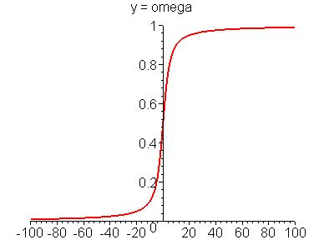
Averting Divergence-Related Negative Contributions to Solution Matrix
Sigma is only used to calculate the omega value !
75
Notes:
This term also needs to be added to the RHS: (1 – omega) psi( surface integral!)
Similar approach for sources and sinks

Slide 76
Bijective-Mapping between FV & FEM Discretisation
Mapped: FV  FEM
FEM
FV (piecewise constant)
76

Slide 77
Computational procedure
Finite Element Computation
Compute
flow properties
Solve pressure equation
with SAMG solver
Solve transport equation
explicitly or
implicitly with SAMG
Compute facet fluxes
Finite Volume Computation

Slide 78
A typical calculation operator-splitting calculation
Compute pressure
Compute total velocity etc.
Update phase densities and viscosities,
Update multiphase flow terms / constitutive relations,
Determine time increment
Accumulate (higher-order) interior stencils
  Compute viscous, gravitational and capillary fluxes
  Determine upwind direction on basis of composite flux
  Establish flux balances and pressure-change dependent source / sink terms
Accumulate lower order boundary stencils
Solve transport problem
Transfer results to model

Slide 79
Two-dimensional FE discretization of pressure equation
fluid pressure, p
viscosity, μ
Variable placement
Element
permeability, k
porosity, ϕ
velocity, v
e.g., Matthai et al. (AAPG Bull. 1996)
Gives linear variation of pressure in element
and piecewise constant velocity via Darcy’s law

Slide 80
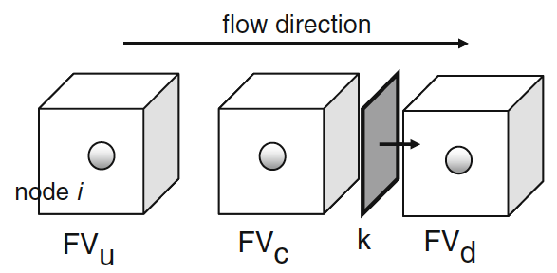
Implementation:
Basic terminology
enum PLACEMENT { ELEMENT_INTEGRATION_POINT,
SECTOR_INTEGRATION_POINT,
FACET_INTEGRATION_POINT,
NODE,
EDGE,
FACE,
INTER_FACE,
ELEMENT,
REGION,
BOUNDARY,
SPLIT_BOUNDARY,
MODEL,
UNDEFINED };
FiniteVolume
=FEM node
FiniteVolumeStencil
(as illustrated for linear triangle)
x
FE integration point
sector integration point
facet integration point
subface of element face
x
FV Sector
x
inside node
FV Facet
outside node
NB: Facet normals always point to node with higher local number

Slide 81
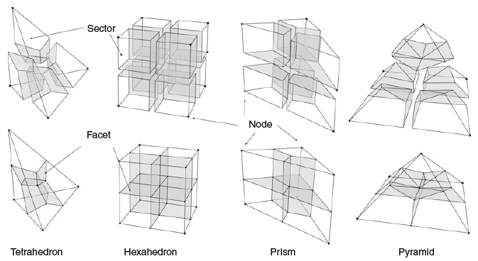
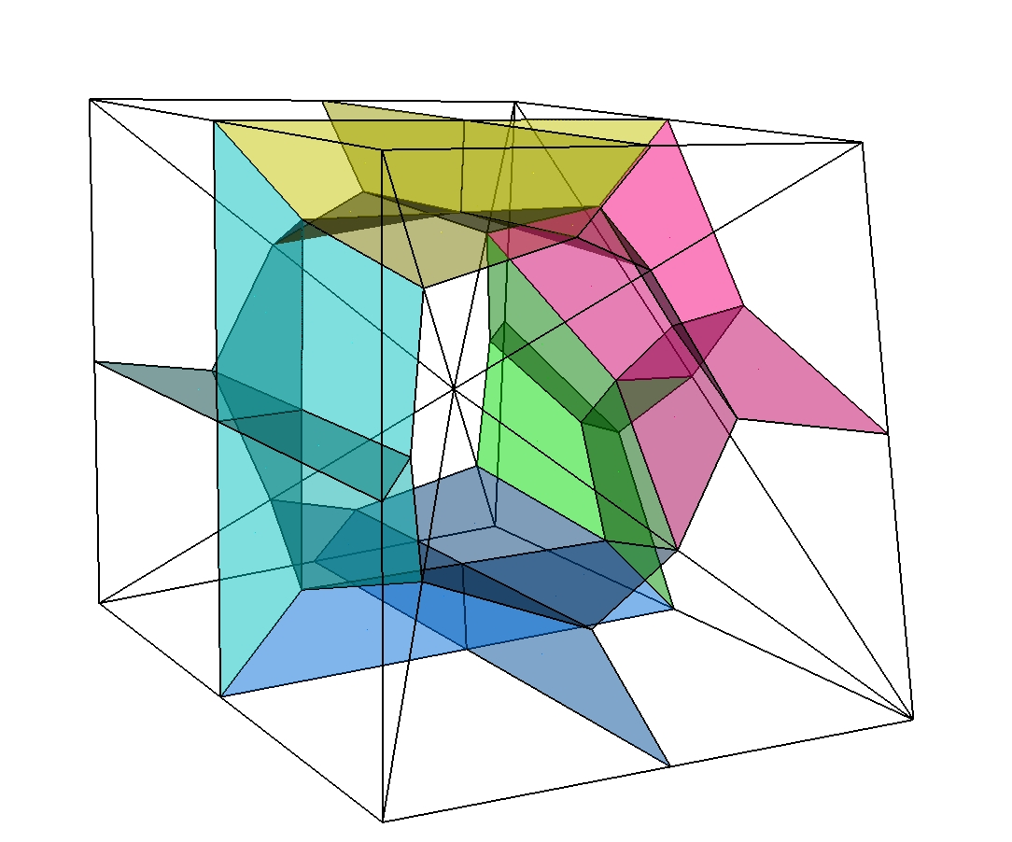
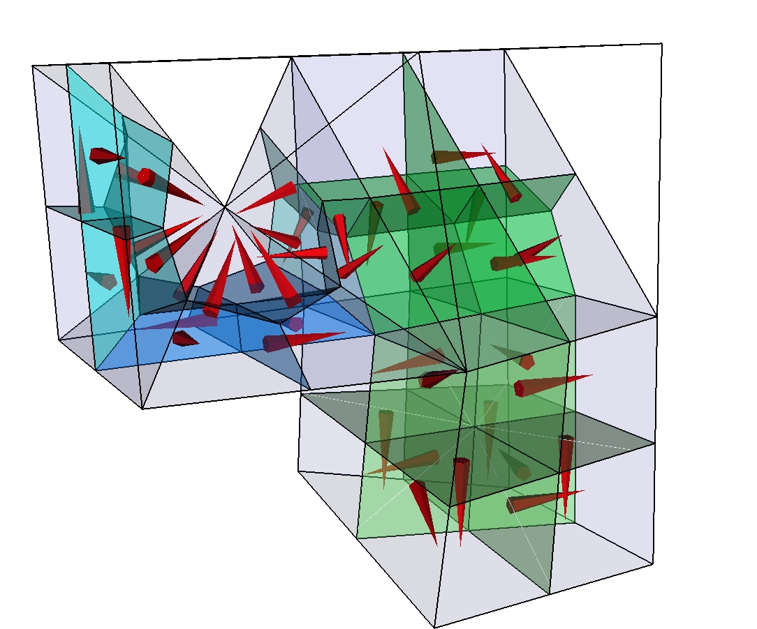
Finite-element finite-volume stencils
For
single element types
Finite volume mesh is not stored
FiniteVolumeStencils for each FE type which has a reference
representation in parametric space
Jacobi transformations applied via FiniteVolumeTraits
to get physical space properties
Paluszny et al. (2007, Geofluids)
FV cells
shared by
different
element
types

Slide 82
Access to FiniteVolume properties / parameters
through FiniteVolumeTraits added to Element / Face / Interface:
Methods are fast, but it is better to store computed values if used repeatedly
double64 SectorVolume( size_t iSector ) const;
double64 FacetArea( size_t iFacet ) const;
Point<3U> FacetNormal( size_t iFacet ) const;
double64 FacetIntegral( size_t iFacet, const Index& ) const;
double64 SectorIntegral( size_t iSector, const Index& ) const;
double64 PropertyValueAtFacetIntegrationPoint( size_t iFacet, size_t, const Index& ) const;
double64 PropertyValueAtSectorIntegrationPoint( size_t iSector, size_t, const Index& ) const;
double64 ProjectionOnFacetNormal( size_t iFacet, const VectorVariable<3U>& ) const;
void N_AtFacetIntegrationPoint( size_t iFacet, size_t ip ) const;
void N_AtSectorIntegrationPoint( size_t iSector, size_t ip ) const;
void N_At( const Point<3U>& rst ) const;
Point<3U> RstToXYZ( const Point<3U>& rst ) const;
etc.
To learn how these computations are done, look at Paluszny et al. (2007, Geofluids)
finiteVolumeAuxiliaryFunctions +
FV interface of element, face or interface
FiniteVolumeTraits
additional FV functionality for the Element
Framework provided through Model
FV in parametric space representation
Element
FiniteVolumeStencil
FiniteVolumeStencilManager
Container of available stencils
FV_IntegrationPointsAndWeights
data container for initialisation

Slide 83
NodeCenteredFiniteVolumeTransport
In collaboration with NodeCenteredFiniteVolumeAlgorithm, StencilProcessor, and finiteVolumeAuxiliaryFunctions (limiters etc.) calculations are done.
Base class NCFVT implements different schemes for single phase transport and CFL calculation.
Subclasses implement implicit and explicit transport schemes for slightly compressible two-phase flow
NodeCenteredFiniteVolumeTransport
NodeCenteredFiniteVolumeAlgorithm
ExplicitNodeCenteredFiniteVolumeTransport
TwoPhaseExplicitNodeCenteredFiniteVolumeTransport
TwoPhaseImplicitNodeCenteredFiniteVolumeTransport

Slide 84
What currently happens when the NCFV transport is instantiated
Finite volume stencil class instances of FiniteVolumeStencil are constructed and initialized with data from FV_IntegrationPointAndWeights for the different finite element types
Specific stencils are associated with corresponding elements as managed by the FiniteVolumeStencilManager
FV_Parameter instances are initialized doing computations with the FiniteVolumeStencil objects and are stored in the STENCIL_DATA vector inside of the NodeCenteredFiniteVolumeTransport. Initialized are with facet normals, facet areas, and sector volumes for accelerated lookup and projections during run.
FV-pore volumes and flux balance arrays are also computed. For higher order accurate transport schemes, a node connectivity graph and SMINMAX array values are initialized for the limiting, see Matthai et al. (2010, TIPM).

Slide 85
CFL calculation
CFL is currently calculated using the element length in the direction of flow, see NCFVT::AnisotropicCourantIncrement(). This only considers viscous and gravitationally driven flow since capillary spreading is computed with the FE method.
A limiting value is specified by the user for the case when there is no flow.
For explicit calculations, df/ds_{max} is used in the calculation of the 2-phase CFL limit because the resulting step size will be sufficiently small even when df/ds increases from the current to subsequent iterations. For implicit calculations this is not necessary and the virtual CFL method should be overloaded in such schemes to be less restrictive.
To use explit schemes CFL calculation must simultaneously address viscous, gravitational, and capillary terms CFL = max( visc_CFL…) so that even if one of these is zero a meaningful value is established.
For these reasons the CFL methods are virtual so that they can be overriden in the subclasses.

Slide 86
Node-centered CVFE scheme: participating classes
NodeCenteredFiniteVolumeTransport
ExplicitNodeCenteredFiniteVolumeTransport
TwoPhaseImplicitNodeCenteredFVTransport
TwoPhaseExplicitNodeCenteredFVTransport
FV_Parameter
NodeCenteredFiniteVolumeAlgorithm
assembly and solution of FV matrix equations, SAMG etc.
FiniteVolumePolicy
additional FV functionality for the Element
StencilProcessor
ExplicitStencilProcessor
e.ConnectedFiniteVolumeStencil()->SurfaceEdge( i, inside_node, outside_node );
Element
FiniteVolumeStencil
TwoPhaseModel
FiniteVolumeStencilManager
two-phase flow properties etc., advection, diffusion and gravity multipliers
FV_IntegrationPointsAndWeights

Slide 87
Node-centered CVFE scheme
TwoPhaseExplicitNodeCenteredFVTransport
ExplicitStencilProcessor
NodeCenteredFiniteVolumeTransport
FV_Parameter
FV_Parameter
ExplicitNodeCenteredFiniteVolumeTransport
TwoPhaseImplicitNodeCenteredFVTransport
NodeCenteredFiniteVolumeAlgorithm
Solver
StencilProcessor
InitializeFirstOrder();
InitializeSecondOrder();
InitializeAdvectedVariableValues();
InitializeLimitedDiffusiveFluxes();
IsotropicallyLimitTransportProperties();
LimitExplicitSourceTerm();
EvaluateThetaValues();
AccumulateImplicitTwoPhaseSolution1();
AccumulateExplicitAdvectionSolution2();
AccumulateExplicitAdvectionDiffusionSolution2();
AccumulateExplicitTwoPhaseSolution1();
AccumulateExplicitTwoPhaseSolution2();
FiniteVolumeTraits
Element
FiniteVolumeStencil
Element
FiniteVolumeStencilManager
TwoPhaseModel
FV_IntegrationPointsAndWeights
ThreePhaseModel

Slide 88
Sequence diagram
Model
TwoPhaseModel
ExplicitNodeCenteredFiniteVolumeTransport
Mesh
Constructor()
decision whether 1st or higher order
NodeCenteredFiniteVolumeTransport
FiniteVolumeStencilManager
FiniteVolumeStencil
FV_IntegrationPointsAndWeights
FV_Parameter
TransportPhase()
Element
SolveNonConservativeTransportEquation1stOrder()
SolveNonConservativeTransportEquation2ndOrder()
StencilProcessor, ExplicitStencilProcessor
FiniteVolumeTraits
AccumulateExplicitTwoPhaseSolution()
NodeCenteredFiniteVolumeAlgorithm
AccumulateLHS()
AccumulateRHS()
AccumulateHigherOrderRHS()
AddToRHS()
SolveMatrixEquation()
OutputResults()
ResetLHS()
ResetRHS()

Slide 89
Variations of the theme: CSMP transport schemes
Discretization approaches supported by CSMP and transport schemes we have implemented for different purposes:
Spatial discretizations: - CVFE, FEMFVM with embedded discontinuities, FECFVM
- Advection - dispersion – decay (passive transport)
- volume-based slightly compressible 2-phase and species transport
- mass-based compressible 3-phase
Black-oil
multiphase multi-component transport (C# in oil phase etc.)
Time-stepping & flux calculation
- IMPES (substepping)
- IMPIMS
- higher-order methods and multi-dimensional flux limiting
- IMPIMS - theta-limited (2nd order in space and time)
- IMPIMS - large-time step linearized method (streamline alternative)
- line-search Newton-Raphson extension of Jenny method
- DES

Slide 90
Classes to implement your own FVM functionality
Elements have pointers to FiniteVolumeStencil instances
Stencils are initialised from data stored in FV_IntegrationPointsAndsWeights
Stencils are stored / managed by FiniteVolumeStencilManager
FiniteVolumeTraits class provides high-level interface to FVM calculations. For efficiency reasons specialisations for 1-3D were implemented.
FiniteVolumeTraits
additional FV functionality for the Element
Element
FiniteVolumeStencil
FiniteVolumeStencilManager
FV_IntegrationPointsAndWeights

Slide 91
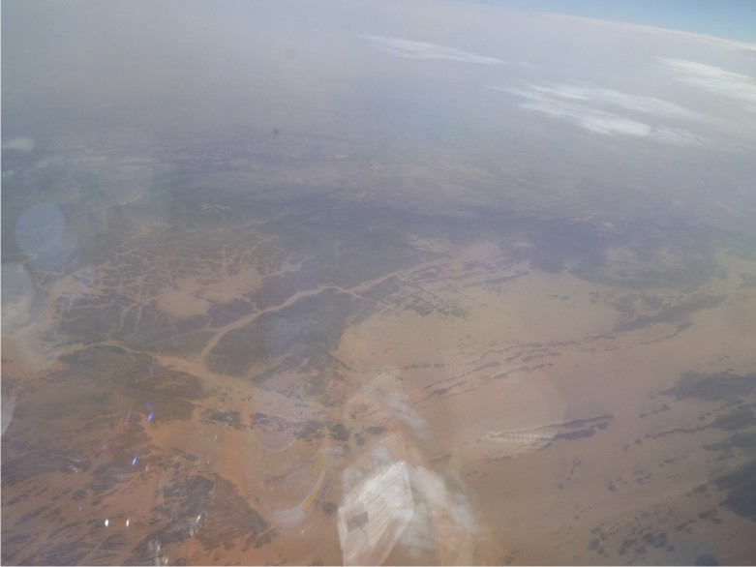
Support FOR EMBEDDED DISCONTINUITIES
Resolution: Keep up the momentum and communications throughout the year
Regular programming exercises are important at each institution
Compile guides for “best ways to do this” code snippets etc. compare and contrast different solutions.
Robert: FAQ for new CSMP
Everybody should use Ali’s configurator
Feedback of what could be improved version 1.0?
Larger user community
Smooth start for new users (Quick-start guide), high-level code out of the box
Freeze of interfaces, focus on crucial functionality
Deadlines for fixing bugs or suggesting alternatives

Slide 92
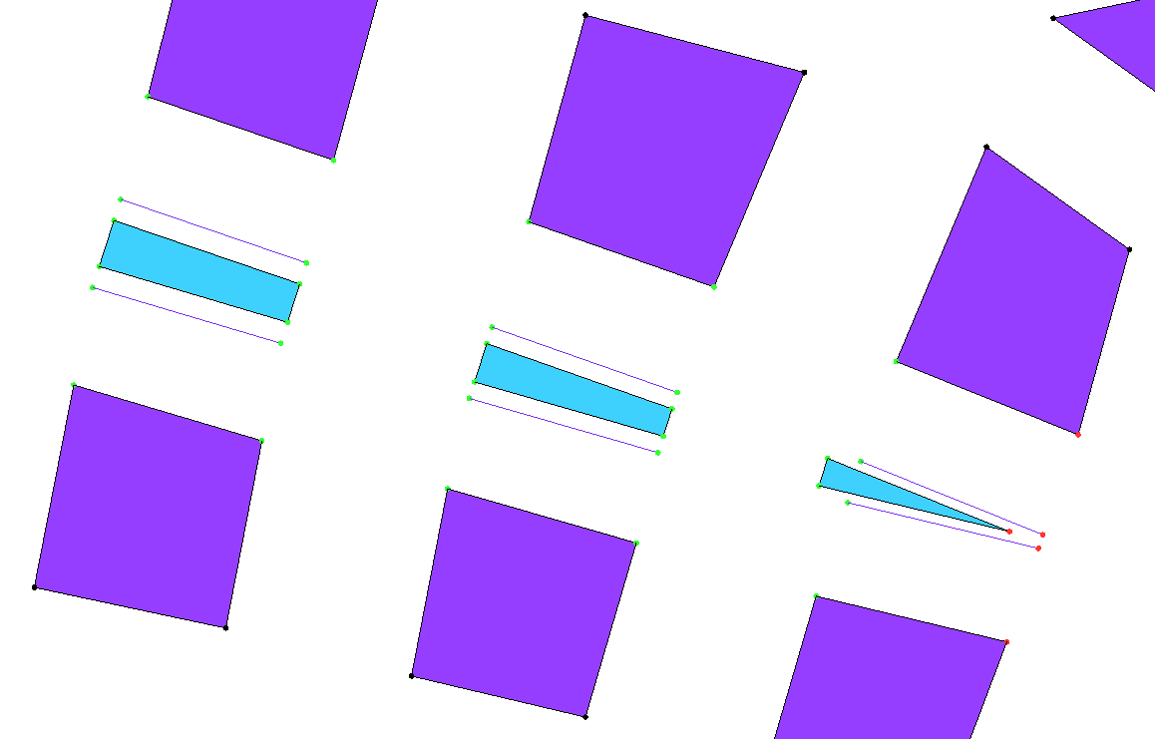
EDS SplitBoundary -based discretisation
Lower dimensional InterFace objects connect multiplicated nodes.
InterFace objects are used to apply transfer terms.
InterFace objects
duplicate Node
matrix
fracture
2D hybrid element model

Slide 93
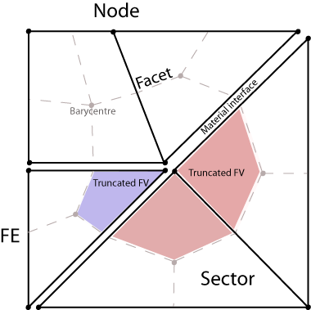

EDF integrals in implicit FEFVM solution
  Pressure equation (FE)
  Advective and diffusive transfer modeled via operator splitting:
  Advection (FV-Implicit)
  Diffusion (FE-Implicit)
see Nick and Matthai (2011, V.Z.J.)

Slide 94
Bridging SplitBoundarys using InterFace elements in implicit fluid pressure computation
To treat multiplicated interface nodes as one, the duplicates receive unity entries in diagonal of solution matrix
Interface nodes are then coupled with minus 1 off-diagonal terms:
p₁
a
b
1D mesh
c
d
interface
e
p₂

