Slide 1
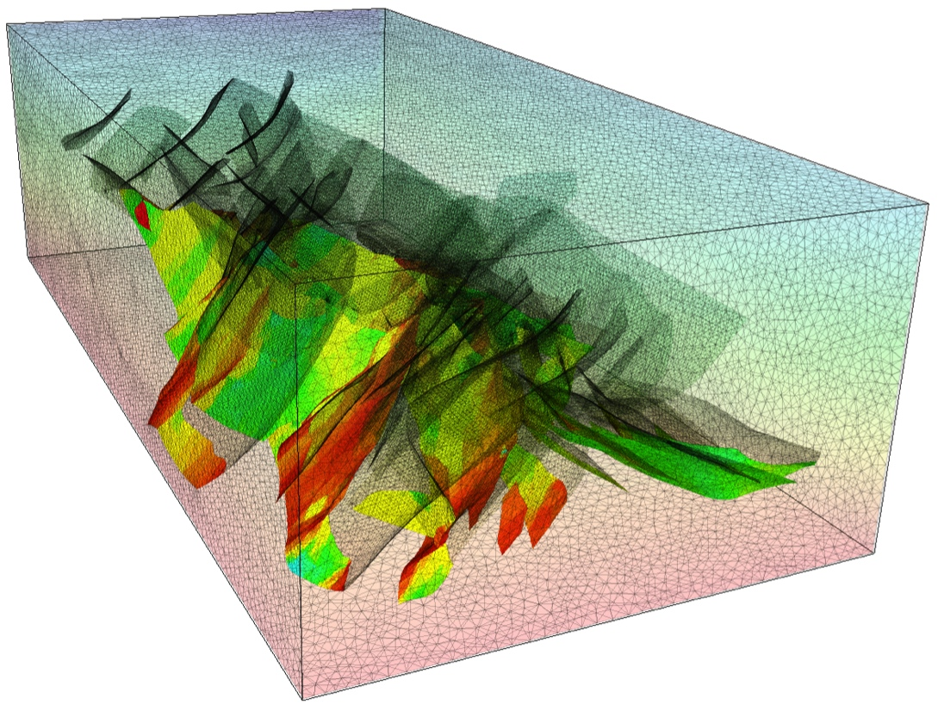
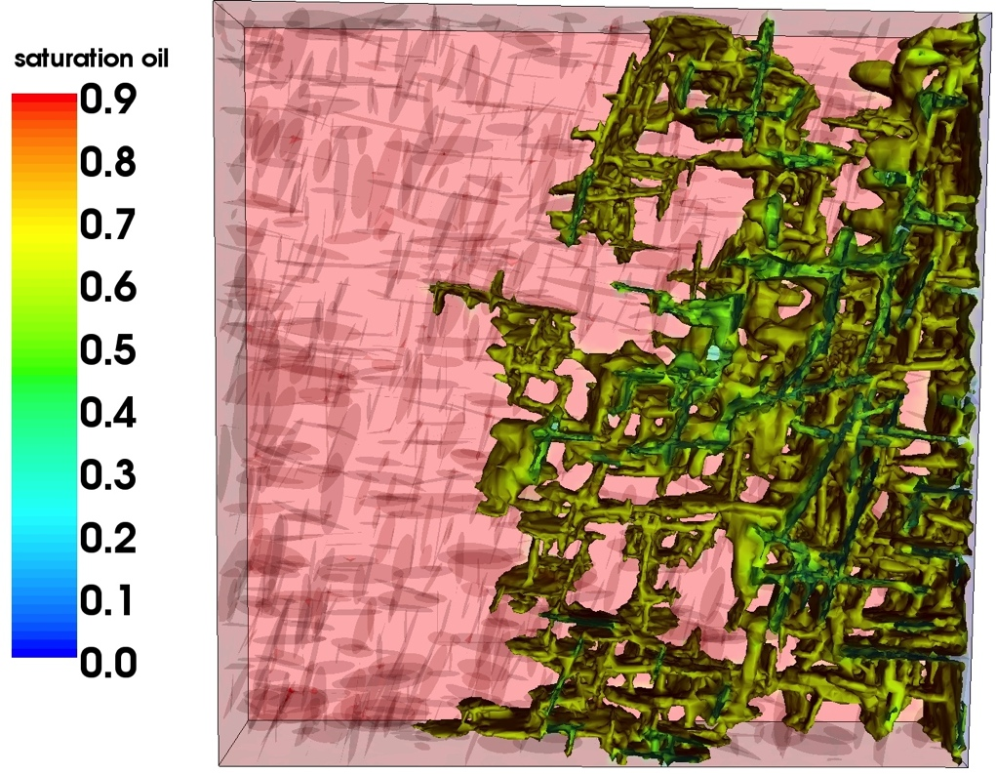
The Complex Systems Modelling Platform (OpenCSMP)
OpenCSMP water-flood model of fractured Monterey Fmt, 0.2 x 1 x 1km
Shear stress on faults in Vietnamese basement oil reservoir
Introduction
Stephan K. Matthai, The University of Melbourne, Australia
Notes:
Singletons : finite elements(specifications)
Working data: for serial and parallel computations
Multiples: Element, Node etc.

Slide 2
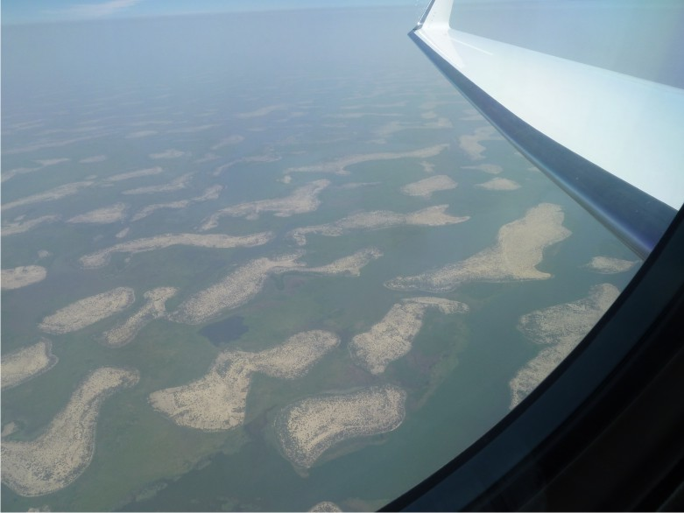
Contents
Introduction
CSMP variable types and their management
The Model, its Regions and Boundaries
Hybrid finite element – finite volume discretization
Solving PDE’s: the PDE_Integrator framework
Constitutive relationships: Visitors etc.
Advanced topics
Notes:
Jens Reindels modifications?

Slide 3
What is CSMP++ ?
C++17 standard compliant Application Programmer Interface (API),
Polygonal distributed data model,
Finite Element (FEM) - Finite Volume (FVM) partial differential equation solver,
Collection of tools for integrated simulation of THMC processes in geometrically complex models resolving multiple length scales,
Implementation of:
  Constitutive relationships for THMC processes
  Range of equations of state
Basis of a variety of forward simulation programs ranging from reservoir simulation to geophysical modelling.
Notes:
illustrate these

Slide 4
What could it do?
Most important features that have been demonstrated on conferences and in publications, but are currently not available in the API library (including CSP code that has not been ported to CSMP yet):
fracture propagation using J-function integral approach (Adriana Paluszny); this involves remeshing and feature tracking using deformable NURBS
asynchronous time stepping with a discrete event simulation method (DES, Roman Manasipov & Julian Mindel)
Multiphase flow on models with full-tensor permeability (SKM)
Black-Oil multi-component multiphase transport model (Sebastian Geiger); correlation-based HC properties etc. (Leoben team)
Reactive transport in combination with GEMS (PSI / ETHZ)
Pore-scale fluid flow and transport (various approaches)

Slide 5
Why is OpenCSMP unique?
CSMP facilitates multi-domain simulations where different physics can be simulated in different model regions
CSMP is a THMC simulator that capitalizes on the geometric flexibility offered by unstructured hybrid element meshing
CSMP implements embedded discontinuities into continuum models
CSMP supports dynamic space-time (mesh) adaptivity:
  Computational domains can evolve over time
  Storage neither relies on arrays nor on global cell numbers
  Material properties and dependent variables are directly associated with the underlying mesh entities (nodes, elements…)
  A tree structure multi-directionally connects mesh entities supporting local time-stepping methods = time adaptivity
CSMP leads in the field of Discrete Fracture and Matrix simulation
CSMP supports goal-based simulation
Notes:
There is OpenFOAM, DiffPack, Comsol Multiphysics, Deal2, FEMLab etc., why is there a need for CSMP?

Slide 6
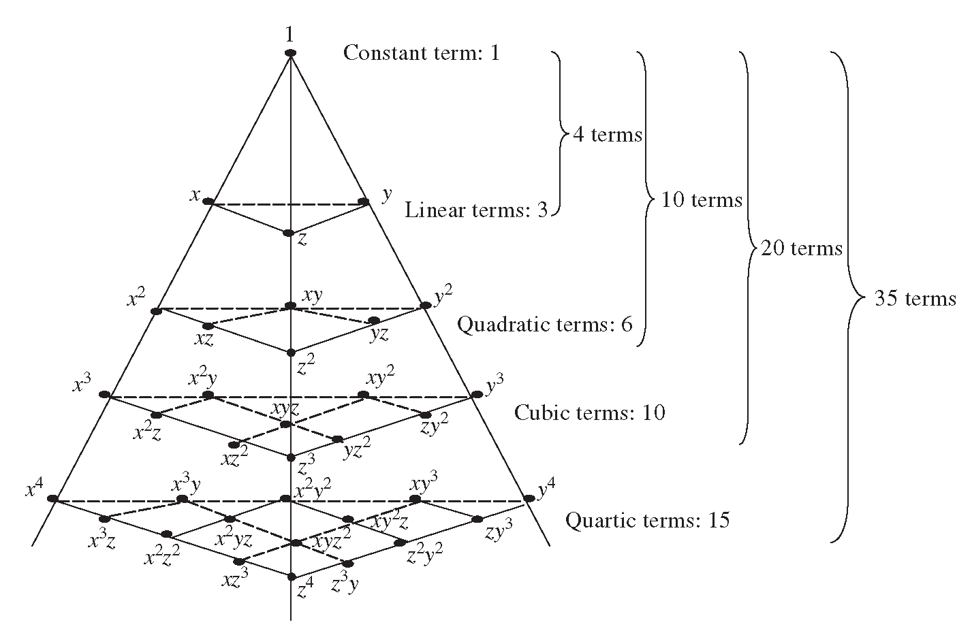
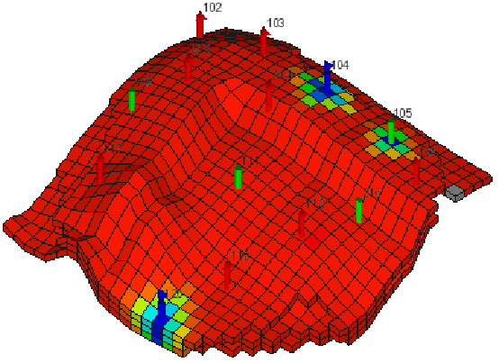
What’s wrong with standard reservoir simulators?
Complete polynomials in 3D
7-point FD stencil
= 2-point (one-dimensional) flux approximation, but is it possible to do any better ?
Implicit-only representation:
wells
faults
Geometric limitations:
Fixed resolution
Smeared interfaces
Aspect ratio fixed
No oblique permeable faults
Conservative only for k-orthogonal grids
ij - Transmissibility averaging
Physics limits:
Gradients
Full-tensor props
Flow focusing
Instabilities
No multiphysics

Slide 7
FE-FVM Discretisation
Different requirements seem to exist here:
(ETHZ wants material properties on the nodes, MUL on the elements)
Unknown actual variation
Linear FEM approximation
Element 1
Element 2
Element 3
Cordes & Kinzelbach, 1992 (WRR),
Paluszny, Matthai and Hohmeyer, 2007 (Geofluids)
f(x)
Finite Volume
Node 1
Node 2
X
Derivative of Linear FEM Solution, e.g., p_{f} gradient
7
Notes:
Integration of properties is required

Slide 8
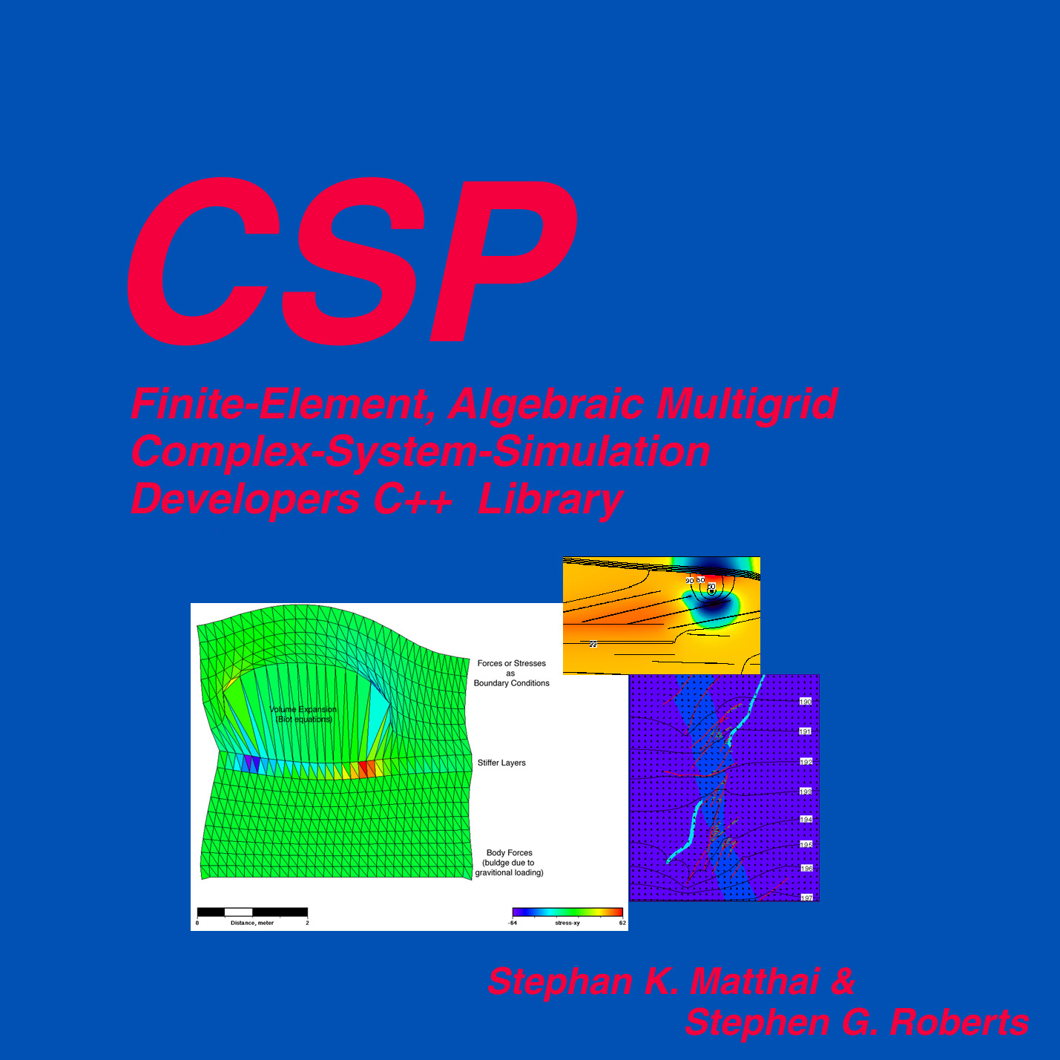
OpenCSMP
Development History
1994: Idea of CSMP at Cornell University, NY
Spring 1995: SKM’s first implementation of CSMP
Autumn 1995: Sabbatical of S.G. Roberts at Stanford University, CA, CSMP with Meschach & AMG solver
1996: Review of CSMP and suggestions by Bruce Eckel
1996-2000: SKM’s main development and implementation of CSMP
2000-2001: S. Geiger develops FV capabilities
2001: CSP3D 4.0 in Std C++ using meta-template programming techniques
2001: ICEM – CSMP interface
2002: Design of IMP-IMPS capabilities in collaboration with C. Pain, integration and interfacing with CFD tools
2003: SAMG-based large-scale mechanical calculations
2003: Interface to anisotropic adaptivity module
2003: SAMG-based large-scale mechanical calculations
2003: Interface to anisotropic adaptivity module
2003: Generalized 3D IMP-IMPS multiphase flow capabilities including gravity drainage and capillary driven flow
2004: Introduction of DFEM methods to deal with discontinua, EOS for H2O-NaCl mixtures
2005: Parallelisation including SAMGp, work on advanced graphical user-interface, Navier-Stokes compressible flows
2006: Black oil model, elastic-plastic deformation, shear-band formation and fracture propagation in 2D
2007: Commercial licensing, embedded discontinuity method
2008: Provisions for parallel adaptivity
2009: Embedded discontinuity model
2010: New reactive transport module, build-bot, PBCD
2011: Policy-based design, element-centered transport scheme, DES prototype
2012: New integration point variables and storage, FECFVM
2013: Fractured basement-reservoir simulator, full-tensor fracture modeling tools
2014: SplitBoundary objects in 3D, fracture aperture modeling workflow, discrete event simulation time-stepping scheme (DES), coupling of CSMP with GEMS (chemical reaction code)
and my more since then…
by Stephan K Matthäi (IC),
Sebastian Geiger (HWU),
Stephen G. Roberts (ANU),
+ contributions from:
Thomas Driesner,
A. Mezentsev, D. Coumou, A. Paluszny, H. M. Nick, P. Weiss, K. Schmid, Y. Zaretsky, Shaho Bazr Afkan, Philipp Lang, Julian Mindel, Georg Seidl, C. Meyer, A. Yappirova, R. Manasipov, R. Annewandter, Qi Shao, Luat Khoa Tran, Edoardo Pezzuli, Anlor Tertois…

Slide 9
Motivation for a Complex Systems Modelling Platform
US NSF Blue Ribbon Panel, WTAC, PITAC on Simulation-Guided Engineering of Complex Systems (SGECS):
“today we cannot tolerate any view of nature that partitions phenomena into neat categories of scale”
but: “…much of our current software in computational engineering science is inadequate for dealing with the multifaceted challenges of SGECS.“
“…will require the creation of interdisciplinary teams that work together on leading-edge simulation problems.“
“We must overhaul our education system to foster the interdisciplinary study that SGECS requires.“
The promise of Simulation-Guided Engineering:
“to elevate decision-making from a practice relying on simple interpolative models to a more rigorous science based on high-fidelity predictive simulation“

Slide 10
A new simulation toolkit
Simulation limitations
Lack of geometrical flexibility (faults, pinch-outs, large aspect ratio features)
Implicit wells
1D 2-point flux approximations
Transmissibility multipliers
Slow global time-stepping
Smeared material interfaces
Slow solvers, especially w.r.t. geomechanics
Inability to do multiphysics
Scale-dependent empirical constitute relationships
No error estimates nor target error specification
Overcoming them
Unstructured poly-element type meshes; BREPS with or without NURBS
Discrete lower-dimensional well representations
Multidimensional fluxes obtained via FEM discretisation
FEM-FVM hybrid simulation scheme
Discrete Event Simulation (DES-PEP)
Embedded discontinuity simulation (2 alternative approaches)
GPU kernel and SAMGp, embedded simulation,
Single THMC framework
Error metric and dynamic adaptivity + data model for goal-based simulation
10

Slide 11
Contents
Introduction
CSMP variable types and their management
The Model, its Regions and Boundaries
Hybrid finite element – finite volume discretization
Solving PDE’s: the PDE_Integrator framework
Constitutive relationships: Visitors etc.
Advanced topics
Notes:
Jens Reindels modifications?

Slide 12
CSMP organisation
Model
PropertyDatabase
MeshManager
FiniteElementManager
FiniteVolumeManager
NodeManifoldManager
variable storage
ModelSubDomain
Node - Element – Face – InterFace
Region – Boundary – SplitBoundary
variable storage
variable storage
finite element – finite volume functionality
Data Model versus Computations
Visitors
PDE Integrator
constitutive relations and more
Integrals
Matrices
Solvers
Post-processes
PropertyHandle
Interrelations
operations on distributed variables
single-result calculations

Slide 13
Base classes for computations
Visitor
  Calculation of multiple variables
  Full access to FEM-FV interfaces
  Mesh traversals as needed
PDE_Integrator
  To solve (integrate) PDEs discretized with FE and FV methods
  Strategy pattern
  Base class of a hierarchy of iterative solution methods
PropertyHandle
  Overloaded operators for distributed variables (like mathematical worksheet programs)
Interrelation
  Calculations interpolating variables with different placements, but with a single result variable
Notes:
Use visitors inside the PropertyHandle to carry out calculations

Slide 14
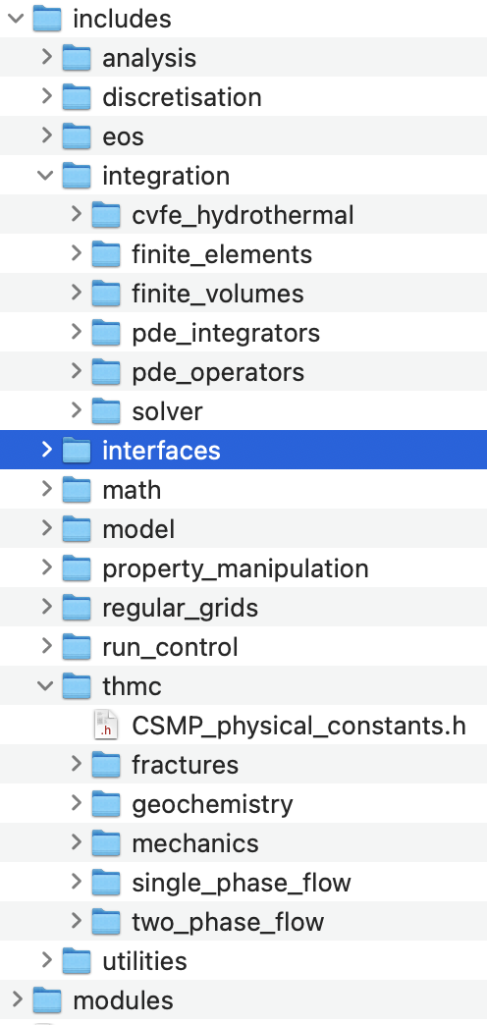
Organisation of OpenCSMP API library
input interfaces
Model
PropertyDatabase
RegionInterface
BoundaryInterface
Application Specific
SplitBoundaryInterface
MeshManager
FiniteElementManager
FiniteVolumeManager
output interfaces

Slide 15
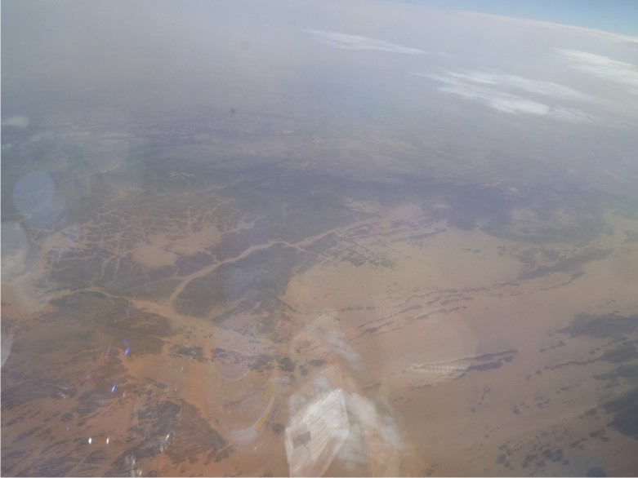
DiSTRIBUTED Variables
Notes:
Resolution: Keep up the momentum and communications throughout the year
Regular programming exercises are important at each institution
Compile guides for “best ways to do this” code snippets etc. compare and contrast different solutions.
Robert: FAQ for new CSMP
Everybody should use Ali’s configurator
Feedback of what could be improved version 1.0?
Larger user community
Smooth start for new users (Quick-start guide), high-level code out of the box
Freeze of interfaces, focus on crucial functionality
Deadlines for fixing bugs or suggesting alternatives

Slide 16
OpenCSMP interoperable physical variables
In-built types (CSMP_definitions.h)
  double
  STL container<>::size_type = size_t
  enum int8_t
Abstract data types
  ScalarVariable (1 flag)
  VectorVariable<uint32_t> (dim flags)
  TensorVariable< uint32_t > (dim flags)
  ArrayVariable< uint32_t > (1 flag)
  FlaggedArrayVariable<uint32_t> (n flags)

Slide 17
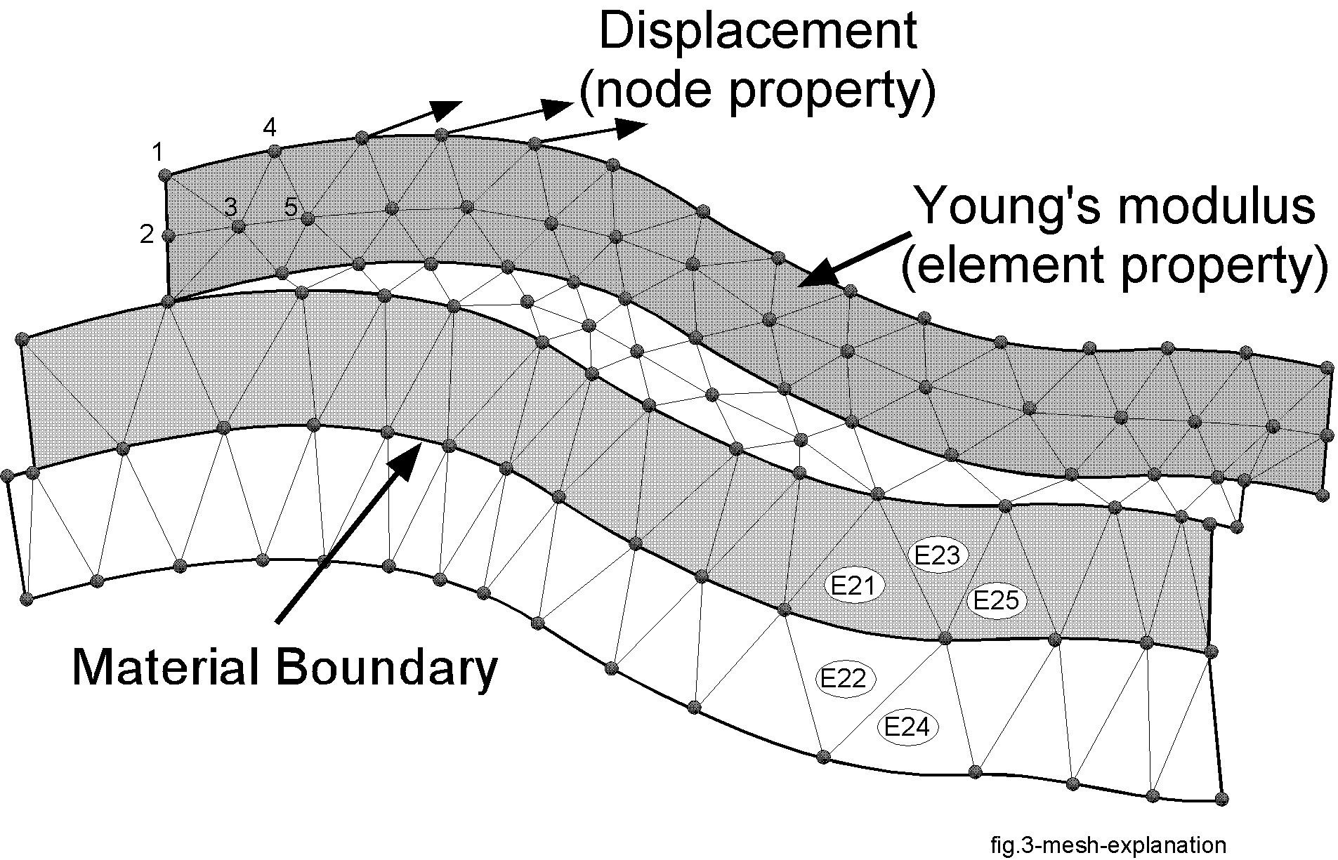
Variable Placement
Options: model, region, boundary, split boundary, element, face, interface, node;
Within element: ELEMENT_INTEGRATION_POINT, FACET_INTEGRATION_POINT, SECTOR_INTEGRATION_POINT

Slide 18
Variable placements on finite elements
fluid pressure, p
viscosity, μ
Variable placement
FiniteVolume
=FEM node
FiniteVolumeStencil
(as illustrated for linear triangle)
Element
permeability, k
porosity, ϕ
velocity, v
x
FE integration point
sector integration point
facet integration point
subface of element face
x
FV Sector
x
inside node
FV Facet
outside node

Slide 19
Index – access to distributed variables
struct Index {
Index();
Index( VARIABLE_TYPE, PLACEMENT, uint32_t );
Index( const csmp::Index& );
Index& operator=( const csmp::Index& );
bool operator==( const csmp::Index& ) const;
bool operator!=( const csmp::Index& ) const;
bool operator<( const csmp::Index& ) const;
bool IsDefined() const; void Out() const;
VARIABLE_TYPE type;
PLACEMENT place;
...
};
Extensions
In the CSMP API, indices cannot be discriminated at compile time! – this necessitates many switch statements, which is far from ideal for variables that are already known at compile time. As a remedy, a templatized version of the Index has been implemented:
/// templatised version with allows for compile-time type selection
template<VARIABLE_TYPE ty,PLACEMENT pl>
struct INDEX : public Index {
explicit INDEX( uint32_t i ) : Index(ty,pl,i) {};
};
To read a variable, get its index, then find the variable in the storage hierarchy. Before reading, query the variable placement it gives the class the variable is discretized on.
Notes:
Can you spot the change?

Slide 20
Variable management: PropertyDatabase
Parameter class objects contain the variable specifications: name, notation, SI unit, type, placement, physically meaningful value range
PropertyDatabase lives inside the model and returns variable Index structs for variable access through Model and Region interfaces; these contain pre-computed offsets for fast lookup
Initialization from text file or within running program
PropertyDatabase can be used to perform range checks on all Store() operations
Variables file can also contain a usage classifier for the GUI-based configurator
example ‘*-variables.txt’ file for pressure diffusion / single-phase flow
physically meaningful range
Note: Neither the PropertyDatabase nor the variable file store actual variable values.

Slide 21
LocalVariableStorage with Read(), Store(), and Status() interfaces
LocalVariableStorage
Model<dim>
Region<dim,Element>
Regions consist of Elements,
Boundaries of Faces, and
SplitBoundaries of InterFaces,
all of these have FE policies.
Boundary<dim,Face>
SplitBoundary<dim,InterFace>
Node<dim>
Implemented as C++ policy subclasses of all
classes that have variables associated with them:
template<uint32_t dim>
class Element : public LocalVariableStorage<dim, Element>, public…
Notes:
are the name still correct

Slide 22
class LocalVariableStorage: Features
Distributed small object component
Supports variable creation and deletion at runtime
Internally, variables are stored in vectors, one std::vector<VARIABLE_FLAG> for variable flags and one std::vector<double> vector for values.
Stores any of OpenCSMP’s variable types
Provides access via Read(Index), Store(Index), and Status(Index) interfaces
Read( Index, i (0..ip-1)) if variable is placed on integration points

Slide 23
Code examples
Reading / writing a variable:
Range check of a variable:
const uint32_t dim{2U}; // spatial dimension of model
// getting a key to an existing variable from the PropertyDatabase
csmp::Index pb_key(model.Database().StorageKey(“pressure”));
// creating a new scalar variable placed on the element integration point
PropertyHandle<dim> lapbc( model, ”parabolic function",
SCALAR, ELEMENT_INTEGRATION_POINT );
Region<dim>&. gref = model.Region(“sandstone”);
ScalarVariable sc;
for ( vector<Element<dim>*>::iterator
eit=gref.CellsBegin(); eit!=gref.CellsEnd(); eit++ ) {
// interpolate and recover variable value and flag value at element barycenter
(*eit)->PropertyValueAtBaryCenter( pb_key, sc );
for ( uint32_t i=0U; i<(*eit).IntegrationPoints(); i++ )
(*eit)->Store( i, lapbc.Key(), (sc /= 1.5) );
}
double min, max;
model.Database().RangeOf( “pressure”, min, max );
csmp::Index pb_key(model.Database().StorageKey(“pressure”));
ScalarVariable sc;
for ( auto eit=gref.CellsBegin(); eit!=gref.CellsEnd(); eit++ ) {
(*eit)->Read( pb_key, sc );
if ( !sc.IsWithinRange( min, max ) )
throw csmp::Exception( WARNING, “main”, “pressure out of range”);
}

Slide 24
Contents
Introduction
CSMP variable types and their management
The Model, its Regions and Boundaries
Hybrid finite element – finite volume discretization
Solving PDE’s: the PDE_Integrator framework
Constitutive relationships: Visitors etc.
Advanced topics
Notes:
Jens Reindels modifications?

Slide 25
The MODEL
template<uint32_t dim>
class Model : public RegionInterface<dim,Model>,
public BoundaryInterface<dim,Model>,
public SplitBoundaryInterface<dim,Model>
{
public:
Model( VSet<dim>&, const char* var_file, bool isoparametric=false );
Model( const ModelTopology&, const VSet<dim>&, const char* vfile );
explicit Model( const char* variables_file );
Model( const Model& );
Model& operator=( const Model& );
virtual ~Model();
Resolution: Keep up the momentum and communications throughout the year
Regular programming exercises are important at each institution
Compile guides for “best ways to do this” code snippets etc. compare and contrast different solutions.
Robert: FAQ for new CSMP
Everybody should use Ali’s configurator
Feedback of what could be improved version 1.0?
Larger user community
Smooth start for new users (Quick-start guide), high-level code out of the box
Freeze of interfaces, focus on crucial functionality
Deadlines for fixing bugs or suggesting alternatives

Slide 26
The workings of the Model
Model<> object represents computational domain with associated properties
Manages its unique (non-overlapping) and non-unique (potentially overlapping) subdomains called Regions, Boundarys (continuities) and SplitBoundarys (discontinuities) via corresponding interfaces.
Contains MeshManager class that implements the connectivity of Element (Face, InterFace) and Node objects and their associated physical variables.
Is a composite; its building blocks / data members are:
RegionInterface<>
BoundaryInterface<>
SplitBoundaryInterface<>
PropertyDatabase<> database_;
MeshManager<dim> mesh_manager_;
FiniteElementManager fem_manager_;
FiniteVolumeManager fvm_manager_;
NodeManifoldManager nmf_manager_;
LocalVariableStorage<>
Notes:
FiniteElements exist only once (even if there were many Models) – thus they could be represented as Singleton

Slide 27
Persistence
Model has constructors for arbitrarily shaped and box-shaped models as well as binary and text-based input / output
After important from a G&G /Civ.Eng. tool model is stored in OpenCSMP native binary (cross-platform) format
Model has an OutputToBinaryFile() interface to store all internal data. This data can then be re-read with a constructor taking the model name as a std::string argument.
CSMP binaries support interim disk saves and restart files
Comment: Binary output writes compact binary *.vset and *_regions files which also include runtime region and boundary condition information.

Slide 28
Mesh connectivity: MeshManager<>
pointers:
element to element
element to node
node to element
node to node
The mesh is stored in a “colony” container from gaming and can be accessed as a tree structure in which the elements act as branches and the Nodes as the leaves.
Node
Node
Element
Element
Element
Node
Node
Node
Element
Element
Node
Node
Notes:
Issue: level of smart pointers to use? - pointer and the pointee
element to node: Element owns the pointer and Node is the pointee

Slide 29
Multi-directional connectivity
The mesh also is a graph that can be traversed in different ways,
Connectivity exists on different levels of the object hierarchy defined by the tree and across levels:
  Elements connect to nodes, integration points therein (finite element and finite volume ones), and their neighbors
  Nodes know their parent elements and node index therein (i.e., node 0..n-1)
  Nodes can access their neighbors via Node<>::Neighbor() interface
Beyond the mesh tree, the model also offers other forms of access:
  Region-, Boundary- and SplitBoundary give access to their perimeter elements and nodes
  Boundary Faces and SplitBoundary InterFaces provide access to adjacent Regions
Note: Every member of this hierarchy has its own property storage implemented via LocalVariableStorage policies
Tree structure can be locally modified without invalidating / chopping holes into underlying arrays. This lends support to local mesh adaptation / refinement at runtime.

Slide 30
Regions
Resolution: Keep up the momentum and communications throughout the year
Regular programming exercises are important at each institution
Compile guides for “best ways to do this” code snippets etc. compare and contrast different solutions.
Robert: FAQ for new CSMP
Everybody should use Ali’s configurator
Feedback of what could be improved version 1.0?
Larger user community
Smooth start for new users (Quick-start guide), high-level code out of the box
Freeze of interfaces, focus on crucial functionality
Deadlines for fixing bugs or suggesting alternatives

Slide 31
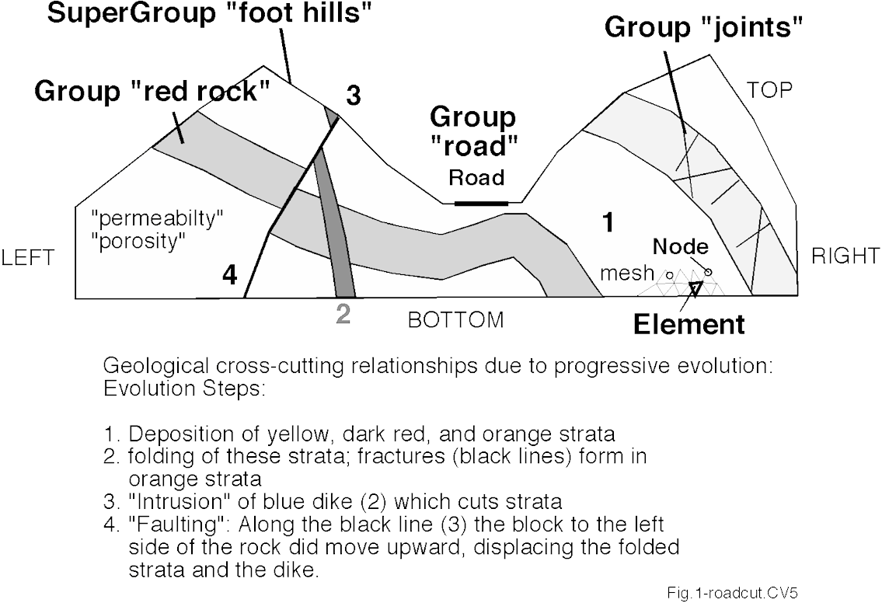
Geologically motivated data model: Model, Regions, Boundaries and SplitBoundaries
The Model represents the computational domain and is composed of contiguous and discontiguous subdomains called Regions
Boundarys can be inserted externally and internally
SplitBoundarys can only be inserted internally
The smallest building block of any model is the Element
Model
Region
Region
Region
Boundary “Model-LEFT”
Non-unique Region “Alteration halo”
Notes:
Note non-unique regions -> consider implications for Region-based properties
Making groups via PropertyConstraints

Slide 32
Region
The RegionInterface of Model provides access to regions:
  ModelSubDomain<>& target = model.Region(name);
Its functionality is restricted to the creation and destruction of Region, Boundary and SplitBoundary,
Any model will contain a region named “Model”, comprising all Elements that shall be part of the computations, but not including Boundaries made up of Face or InterFace elements,
Any other Region/Boundary/SplitBoundary functionality is accessed directly via their interfaces or that of the ModelSubDomain:
  In regions, element and node pointers are sorted: at the end are the elements and nodes on the Region perimeter; specific iterators are available to access these
  An extra vector records the number of element faces and ids, for element faces located at the region boundary, see next slide,
ModelSubDomains (Region, Boundary, and SplitBoundary) can have properties
Boundary properties only exist where these do! – take care in visitations

Slide 33
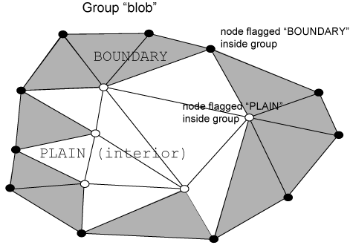
Model subdomains support selective access: interior, perimeter, complete
Region
PERIMETER
PERIMETER
INTERIOR
COMPLETE
The Boolean operations union, difference, intersection involving Regions are supported

Slide 34
ModelSubDomain<> – base class to Region and Boundary
ModelSubDomain<uint32_t,template<uint32_t,class> class FEM>
Region<uint32_t> >
Boundary<uint32_t> >
SplitBoundary<uint32_t> >
Region<3U> box;
Boundary<3U> external_boundary; // external and internal
SplitBoundary<3U> split_node_boundary; // internal only
Implications
PDE_Integrator<uint32_t,template<uint32_t> class ModelSubdomain> integrator;
integrator.IntegrateOver( ModelSubdomain<uint32_t,class> );
model.Accept( Visitor<uint32_t>& );
Notes:
template – template parameter: Demonstration<typename T,template<T> class S, template<S,T> class...>

Slide 35
ModelSubDomain implementation, how?
std::vector<csmp::Element<dim>*> elmt_vec_;
std::vector<csmp::Node<dim>*> node_vec_;
size_t first_bd_node_; std::vector<std::vector<ONE_BYTE_NUMBER> > bd_face_vec_;
LocalVariableStorage<dim> local_storage_;
elmt_vec_[]
Node
Node
Element
Element
Element
Node
Node
Node
Element
Element
node_vec_[]
Node
Node

Slide 36
Boundaries, and SplitBoundaries
Resolution: Keep up the momentum and communications throughout the year
Regular programming exercises are important at each institution
Compile guides for “best ways to do this” code snippets etc. compare and contrast different solutions.
Robert: FAQ for new CSMP
Everybody should use Ali’s configurator
Feedback of what could be improved version 1.0?
Larger user community
Smooth start for new users (Quick-start guide), high-level code out of the box
Freeze of interfaces, focus on crucial functionality
Deadlines for fixing bugs or suggesting alternatives

Slide 37
Boundary – lower dimensional Faces
Build by InsertBoundary(), that invokes the CreateFor(), CreateFrom() and CreateBetween() methods of the ModelSubDomain,
Boundaries and SplitBoundary’s consist of lower-dimensional Face and InterFace elements, respectively. Such elements are not part of the default Region “Model”.
Faces / InterFaces have normals which point to the second (outside) region
All Face normals, on the outer model boundaries point to the outside of the model, there is no neighbor element on that side
Boundary names are generated from the names of the regions which the boundary separates; the first region is on the inside, the second is on the outside Region (example shale-fault), see OpenCSMP User Guide
For convenience, outside boundary names can be retrieved just by querying for the boundary name string; it is unique.
SplitBoundaries (inside of model only) are created from pre-existing Boundaries
Box-related boundary (BOX_BOUNDARY) flags are replaced with Boundary object supported functionality. Corresponding boundary objects are named in the old way (LEFT, RIGHT…). They are created only for box-shaped models
Comment: Unlike for Regions, properties discretised on Boundary objects do not exist on all finite elements of the model, see examples.

Slide 38
Special functionality for box-shaped models
(automatic detection and labeling of edges and corners etc.)
To use this, create CAD entities with box boundary names, indicating a box-shaped model to CSMP (BACK, FRONT, TOP, BOTTOM, LEFT, RIGHT), see Users Guide.
This will generate Boundary objects with the corresponding names, transforming the CAD input regions (of Elements) into boundaries (of Faces).
This transformation is important because, in contrast to the regions, the boundary Face objects do not automatically form part of the domain “Model.” Therefore, they do not make additional contributions to the solution matrix.
Given such a CSMP box shaped model, one can use corresponding interfaces defined in Box, the enumeration BOX_BOUNDARY, and member functions of the model:
template<class T>
void InputBoundaryValue( BOX_BOUNDARY, const char* input_prop, const T& value );
void InputBoundaryFlags( BOX_BOUNDARY, const char* property, const std::vector<VARIABLE_FLAG>& flags );
void InterpolateBoundaryValues( BOX_BOUNDARY, const char* input_prop, const std::vector<ScalarVariable >& bvalues );
void InterpolateBoundaryValues( BOX_BOUNDARY, const char* input_prop, const std::vector<VectorVariable<dim> >& bvalues );

Slide 39
Assignment of boundary conditions using the configuration file
Option 1: const values by region: via “*-configuration.txt” file:
File structure (optional blocks made available by InputDataManager)
Regions from propery value ranges
properties and variable values for entire model (defaults)
regional properties and variable values specific to regions
regional variable flags specific to regions
  For instance, to freeze variable values in a region
essential conditions applied to boundarys; syntax:
  BOTTOM complete Dirichlet fluid pressure 4.0e+8
  LEFT complete Dirichlet saturation water 0.22
  LEFT complete Dirichlet saturation oil 0.78
5. computational settings, see code examples.

Slide 40
SplitBoundary objects
Intended for modelling jump discontinuities in node variables or complete barriers in the mesh domain.
Represent conformal mesh boundaries with matching, but multiplicated nodes. As many multiples of nodes are created as there are materials in contact with one another at that node point.
SplitBoundaries consist of InterFace objects
Like Face objects, InterFace objects know their higher-dimensional neighbor elements on either side.
Are internal model boundaries
SplitBoundary objects can be generated by OpenCSMP; no need for doing this in an external mesh generator
Comments
SplitBoundary objects are conformal (meshes on either side match)
Many features of ModelSubDomain are disabled for them

Slide 41
Contents
Introduction
CSMP variable types and their management
The Model, its Regions and Boundaries
Hybrid finite element – finite volume discretization
Solving PDE’s: the PDE_Integrator framework
Constitutive relationships: Visitors etc.
Advanced topics
Notes:
Jens Reindels modifications?

Slide 42
Finite Element FrameWork
Resolution: Keep up the momentum and communications throughout the year
Regular programming exercises are important at each institution
Compile guides for “best ways to do this” code snippets etc. compare and contrast different solutions.
Robert: FAQ for new CSMP
Everybody should use Ali’s configurator
Feedback of what could be improved version 1.0?
Larger user community
Smooth start for new users (Quick-start guide), high-level code out of the box
Freeze of interfaces, focus on crucial functionality
Deadlines for fixing bugs or suggesting alternatives

Slide 43
Finite Element meshes
see CSMP_FEM_conventions.pdf
Pyramid
Prism
Hexahedron
Tetrahedron
lower-dimensional
elements
Triangle
Quadrilateral
unstructured
structured
Line
Notes:
----- Meeting Notes (12/12/14 15:20) -----
lamda functions try as an extension Standard function
Nagra reports complemented by BGR reports (those contain all the geomechanics stuff)
dissected shear zone

Slide 44
Galerkin Finite Element discretization
Steps:
PDE integral form on element assembly into global algebraic system of equations integration
Requirements:
Element interpolation functions approximate variable(s) of interest in piecewise element-by-element fashion. They should:
capture variation of the field of interest
provide continuity if their derivatives are to be used in further computations
provide smooth, oscillation free interpolation of target field so that PDEs can be integrated in space and time
satisfy the mass-conservation equation when integrated over the domain of interest
! The FEM is globally- but not locally conservative !

Slide 45
Two-dimensional FE discretization of pressure equation
fluid pressure, p
viscosity, μ
-
Variable placement
Element
permeability, k
porosity, ϕ
velocity, v
-
e.g., Matthai et al. (AAPG Bull. 1996)
Gives linear variation of pressure in element
and piecewise constant velocity via Darcy’s law

Slide 46
Integration over element interpolation functions
Differentiation of interpol. functions
Change of pressure in constant permeability domains can be approximated by linear functions N:
Finite-element integrals
N₁ = 1 at x₁ and N₁ = 0 at x₂ while N₂ = 0 at x₁ and N₂ = 1 at x₂. It follows that N₁ + N₂ sum to 1 in the closed interval [x₁, x₂]. Thus, P
is linearly interpolated. Due to this property, the N functions are called interpolation functions.
Algebraic equation for domain
see Zienkiewicz & Taylor, 2000, Istok, J., 1989
Notes:
Zienkiewicz OC. and Taylor RL. The Finite Element Method, Volume 1, The Basis, Fifth Edition. Oxford: Butterworth-Heinemann, (2000).

Slide 47
Element – FiniteElement “Bridge pattern”
FiniteElement types are stored by FiniteElementManager
Notes:
Have a look at the Eigen library (not part of Boost)

Slide 48
The Element interface
Overloaded with methods
Extra functionality has been factored out to policy classes, using static polymorphism:
  FiniteElementTraits<uint32_t,template< uint32_t> class>
  FiniteVolumeTraits<uint32_t,template< uint32_t> class>
  ElementRemeshingTraits<uint32_t,template<uint32_t> class>
  Local VariableStorage<uint32_t,template<uint32_t> class>
To use these, just call their methods like member functions of the Element:
Face and InterFace are separate classes with their own property placements and functionality, but they share these policies.
e.WeightAtIntegrationPoint(i)
etc...
Notes:
Try std::function

Slide 49
Variable placements on finite elements
fluid pressure, p
viscosity, μ
Variable placement
FiniteVolume
=FEM node
FiniteVolumeStencil
(as illustrated for linear triangle)
Element
permeability, k
porosity, ϕ
velocity, v
x
FE integration point
sector integration point
facet integration point
subface of element face
x
FV Sector
x
inside node
FV Facet
outside node

Slide 50
Finite Volume FrameWork
Resolution: Keep up the momentum and communications throughout the year
Regular programming exercises are important at each institution
Compile guides for “best ways to do this” code snippets etc. compare and contrast different solutions.
Robert: FAQ for new CSMP
Everybody should use Ali’s configurator
Feedback of what could be improved version 1.0?
Larger user community
Smooth start for new users (Quick-start guide), high-level code out of the box
Freeze of interfaces, focus on crucial functionality
Deadlines for fixing bugs or suggesting alternatives

Slide 51
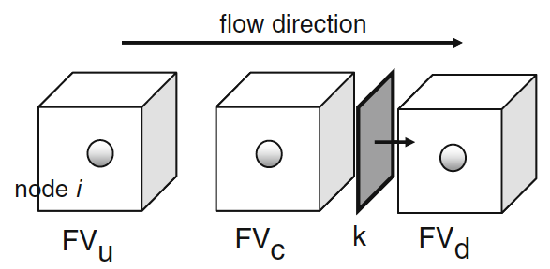
Basic terminology
enum PLACEMENT { ELEMENT_INTEGRATION_POINT,
SECTOR_INTEGRATION_POINT,
FACET_INTEGRATION_POINT,
NODE,
EDGE,
FACE,
INTER_FACE,
ELEMENT,
REGION,
BOUNDARY,
SPLIT_BOUNDARY,
MODEL,
UNDEFINED };
FiniteVolume
=FEM node
FiniteVolumeStencil
(as illustrated for linear triangle)
x
FE integration point
sector integration point
facet integration point
subface of element face
x
FV Sector
x
inside node
FV Facet
outside node
NB: Facet normals always point to node with higher local number

Slide 52
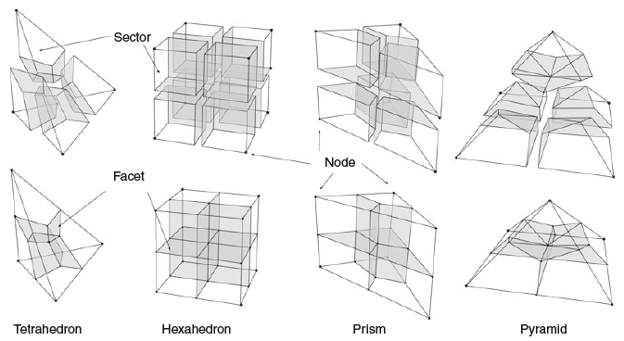
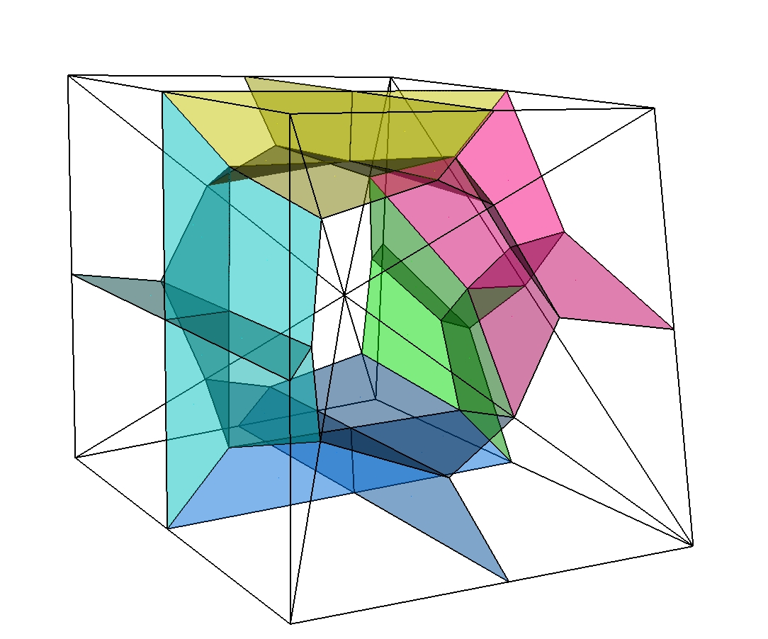
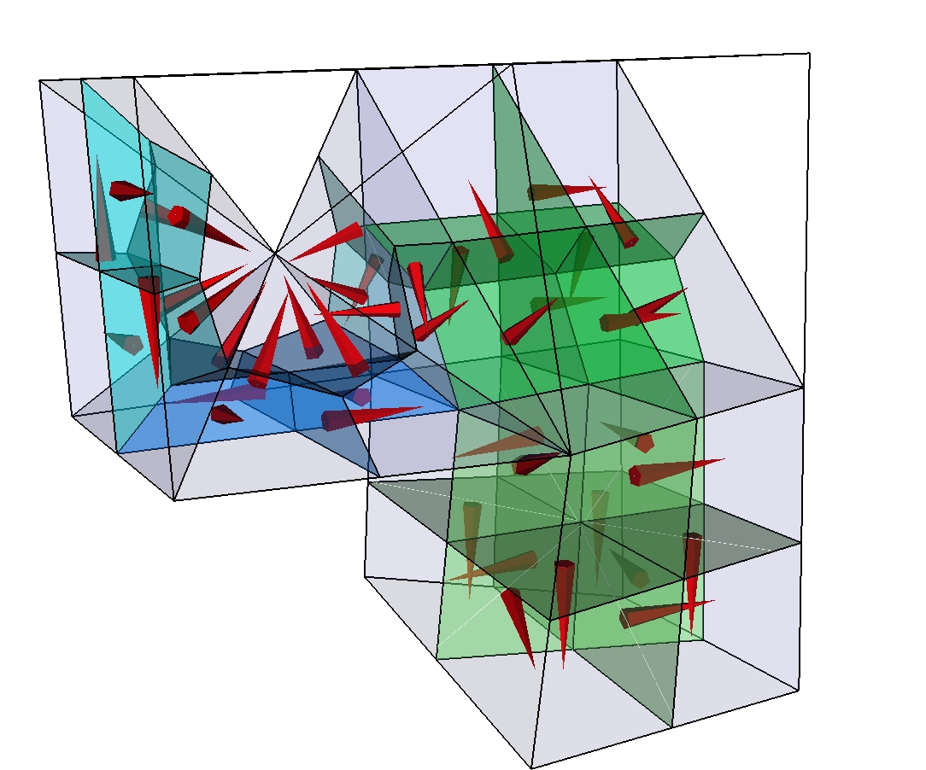
Finite-element finite-volume stencils
For
single element types
Finite volume mesh is not stored
FiniteVolumeStencils for each FE type which has a reference
representation in parametric space
Jacobi transformations applied via FiniteVolumeTraits
to get physical space properties
Paluszny et al. (2007, Geofluids)
FV cells
shared by
different
element
types

Slide 53
Element FiniteVolumePolicy: interface
implemented in FiniteVolumePolicty base class of Element / Face / Interface:
Methods are fast, but parametric space computations are faster
double SectorVolume( uint32_t iSector ) const;
double FacetArea( uit32_t iFacet ) const;
Point<3U> FacetNormal( uint32_t iFacet ) const;
double FacetIntegral( uint32_t iFacet, const Index& ) const;
double SectorIntegral( uint32_t iSector, const Index& ) const;
double PropertyValueAtFacetIntegrationPoint( uint32_t iFacet, uint32_t, const Index& ) const;
double PropertyValueAtSectorIntegrationPoint( uint32_t iSector, uint32_t, const Index& ) const;
double ProjectionOnFacetNormal( uint32_t iFacet, const VectorVariable<3U>& ) const;
void N_AtFacetIntegrationPoint( uint32_t iFacet, uint32_t ip ) const;
void N_AtSectorIntegrationPoint( uint32_t iSector, uint32_t ip ) const;
void N_At( const Point<3U>& rst ) const;
Point<3U> RstToXYZ( const Point<3U>& rst ) const;
etc.
To learn how these computations are done, look at Paluszny et al. (2007, Geofluids)
finiteVolumeAuxiliaryFunctions +
FV interface of element, face or interface
FiniteVolumeTraits
additional FV functionality for the Element
Framework provided through Model
FV in parametric space representation
Element
FiniteVolumeStencil
FiniteVolumeStencilManager
Container of available stencils
FV_IntegrationPointsAndWeights
data container for initialisation

Slide 54
(Legacy) NodeCenteredFiniteVolumeTransport
In collaboration with NodeCenteredFiniteVolumeAlgorithm, StencilProcessor, and finiteVolumeAuxiliaryFunctions (limiters etc.) calculations are done.
Base class NCFVT implements different schemes for single phase transport and CFL calculation.
Subclasses implement implicit and explicit transport schemes for slightly compressible two-phase flow
NodeCenteredFiniteVolumeTransport
NodeCenteredFiniteVolumeAlgorithm
ExplicitNodeCenteredFiniteVolumeTransport
TwoPhaseExplicitNodeCenteredFiniteVolumeTransport
TwoPhaseImplicitNodeCenteredFiniteVolumeTransport

Slide 55
Simplified flow equations, 2-phase slightly compressible
FEM: Global pressure equation including gravity effects but not capillary pressure
Post-processing: Darcy velocity (including buoyancy-driven flow of fluid mixture)
FVM + FEM: Transport equation solved explicitly or implicitly
FEM term (in implicit solution)
for implicit solution
FEM: Nonlinear saturation diffusion
NB: g is pointing upward
Notes:
accompanying derivation is in Maple worksheet Helmig-p107-vs-CSP.mws
NB: It is a problem that advection etc multpliers depend in their form on the way the equations are being solved -> remove?
Notice also that if the permeability is a tensor, only the vertical component will have to be considered in the calculation of the gravitational spreading

Slide 56
Black-oil style 2-phase flow equations
FEM: Pressure equations including gravity effects but not capillary pressure
Post-processing: Darcy velocity (including buoyancy-driven flow of fluid mixture)
Notes:
accompanying derivation is in Maple worksheet Helmig-p107-vs-CSP.mws
NB: It is a problem that advection etc multpliers depend in their form on the way the equations are being solved -> remove?
Notice also that if the permeability is a tensor, only the vertical component will have to be considered in the calculation of the gravitational spreading

Slide 57
Higher-order accurate single-phase tracer transport
This and following slides as described in Matthai et al. 2009 (TIPM)
57

Slide 58
First-Order Implicit FV Solution of Transport Equation
where
As expressed for an incompressible fluid in terms of fluid volume conservation.
Finite Volume / Surface Integrals
Boundary In- & Outflow Conditions
in-flow (+)
out-flow (-)
58

Slide 59
Inclusion of diffusive fluxes in FV framework
NB: we do this with the FEM now
59

Slide 60
Iterative higher-order FV solution with Theta time differencing
LHS stays the same; extra surface integrals are added to RHS:
Matthai et al. TIPM 2009
60
Notes:
Since the lefthandside already contains the first-order solution, it will cancel out upon progressive iteration
And the higher-order solution will be left

Slide 61
Iterative Higher-Order FV Solution with Theta Time Differencing and Diffusion
LHS stays the same; extra surface integrals are added to RHS:
First iteration:
61
Notes:
Since the lefthandside already contains the first-order solution, it will cancel out upon progressive iteration
And the higher-order solution will be left

Slide 62
Iterative Higher-Order FV Solution with Theta Time Differencing and Diffusion
LHS stays the same; extra surface integrals are added to RHS:
All other iterations:
62
Notes:
Since the lefthandside already contains the first-order solution, it will cancel out upon progressive iteration
And the higher-order solution will be left

Slide 63
Spatial Limiting of Advected Quantity
NVD Diagram
1.0
ψ_{min} and ψ_{max} refer to minimum and maximum values of advected property at upstream FV and its immediate neighbor cells.
0.0
0.0
1.0
63

Slide 64
Theta Time Differencing
Idea
θshould be
as close to ½ as
possible
64

Slide 65
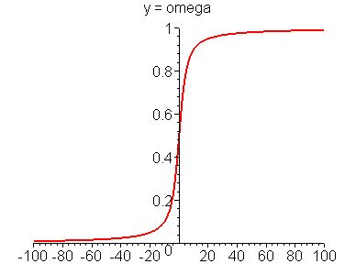
Averting Divergence-Related Negative Contributions to Solution Matrix
Sigma is only used to calculate the omega value !
65
Notes:
This term also needs to be added to the RHS: (1 – omega) psi( surface integral!)
Similar approach for sources and sinks

Slide 66
Bijective-Mapping between FV & FEM Discretisation
Mapped: FV  FEM
FEM
FV (piecewise constant)
66

Slide 67
A typical calculation operator-splitting calculation
Compute pressure
Compute total velocity etc.
Update phase densities and viscosities,
Update multiphase flow terms / constitutive relations,
Determine time increment
Accumulate (higher-order) interior stencils
  Compute viscous, gravitational and capillary fluxes
  Determine upwind direction on basis of composite flux
  Establish flux balances and pressure-change dependent source / sink terms
Accumulate lower order boundary stencils
Solve transport problem
Transfer results to model

Slide 68
Computational procedure
Finite Element Computation
Compute
flow properties
Solve pressure equation
with SAMG solver
Solve transport equation
explicitly or
implicitly with SAMG
Compute facet fluxes
Finite Volume Computation

Slide 69
What currently happens when the NCFV transport is instantiated
Finite volume stencil class instances of FiniteVolumeStencil are constructed and initialized with data from FV_IntegrationPointAndWeights for the different finite element types
Specific stencils are associated with corresponding elements as managed by the FiniteVolumeStencilManager
FV_Parameter instances are initialized doing computations with the FiniteVolumeStencil objects and are stored in the STENCIL_DATA vector inside of the NodeCenteredFiniteVolumeTransport. Initialized are with facet normals, facet areas, and sector volumes for accelerated lookup and projections during run.
FV-pore volumes and flux balance arrays are also computed. For higher order accurate transport schemes, a node connectivity graph and SMINMAX array values are initialized for the limiting, see Matthai et al. (2010, TIPM).

Slide 70
CFL calculation
CFL is currently calculated using the element length in the direction of flow, see NCFVT::AnisotropicCourantIncrement(). This only considers viscous and gravitationally driven flow since capillary spreading is computed with the FE method.
A limiting value is specified by the user for the case when there is no flow.
For explicit calculations, df/ds_{max} is used in the calculation of the 2-phase CFL limit because the resulting step size will be sufficiently small even when df/ds increases from the current to subsequent iterations. For implicit calculations this is not necessary and the virtual CFL method should be overloaded in such schemes to be less restrictive.
To use explit schemes CFL calculation must simultaneously address viscous, gravitational, and capillary terms CFL = max( visc_CFL…) so that even if one of these is zero a meaningful value is established.
For these reasons the CFL methods are virtual so that they can be overriden in the subclasses.

Slide 71
Legacy node-centered FE-FV scheme: participating classes
NodeCenteredFiniteVolumeTransport
ExplicitNodeCenteredFiniteVolumeTransport
TwoPhaseImplicitNodeCenteredFVTransport
TwoPhaseExplicitNodeCenteredFVTransport
FV_Parameter
NodeCenteredFiniteVolumeAlgorithm
assembly and solution of FV matrix equations, SAMG etc.
FiniteVolumeTraits
additional FV functionality for the Element
StencilProcessor
ExplicitStencilProcessor
e.ConnectedFiniteVolumeStencil()->SurfaceEdge( i, inside_node, outside_node );
Element
FiniteVolumeStencil
TwoPhaseModel
FiniteVolumeStencilManager
two-phase flow properties etc., advection, diffusion and gravity multipliers
FV_IntegrationPointsAndWeights

Slide 72
Node-centered CVFE scheme
TwoPhaseExplicitNodeCenteredFVTransport
ExplicitStencilProcessor
NodeCenteredFiniteVolumeTransport
FV_Parameter
FV_Parameter
ExplicitNodeCenteredFiniteVolumeTransport
TwoPhaseImplicitNodeCenteredFVTransport
NodeCenteredFiniteVolumeAlgorithm
Solver
StencilProcessor
InitializeFirstOrder();
InitializeSecondOrder();
InitializeAdvectedVariableValues();
InitializeLimitedDiffusiveFluxes();
IsotropicallyLimitTransportProperties();
LimitExplicitSourceTerm();
EvaluateThetaValues();
AccumulateImplicitTwoPhaseSolution1();
AccumulateExplicitAdvectionSolution2();
AccumulateExplicitAdvectionDiffusionSolution2();
AccumulateExplicitTwoPhaseSolution1();
AccumulateExplicitTwoPhaseSolution2();
FiniteVolumeTraits
Element
FiniteVolumeStencil
Element
FiniteVolumeStencilManager
TwoPhaseModel
FV_IntegrationPointsAndWeights
ThreePhaseModel

Slide 73
Execution sequence
Model
TwoPhaseModel
ExplicitNodeCenteredFiniteVolumeTransport
Mesh
Constructor()
decision whether 1st or higher order
NodeCenteredFiniteVolumeTransport
FiniteVolumeStencilManager
FiniteVolumeStencil
FV_IntegrationPointsAndWeights
FV_Parameter
TransportPhase()
Element
SolveNonConservativeTransportEquation1stOrder()
SolveNonConservativeTransportEquation2ndOrder()
StencilProcessor, ExplicitStencilProcessor
FiniteVolumeTraits
AccumulateExplicitTwoPhaseSolution()
NodeCenteredFiniteVolumeAlgorithm
AccumulateLHS()
AccumulateRHS()
AccumulateHigherOrderRHS()
AddToRHS()
SolveMatrixEquation()
OutputResults()
ResetLHS()
ResetRHS()

Slide 74
Variations of the theme: CSMP transport schemes
Discretization approaches supported by CSMP and transport schemes we have implemented for different purposes:
Spatial discretizations: - CVFE, FEMFVM with embedded discontinuities, FECFVM
- Advection - dispersion – decay (passive transport)
- volume-based slightly compressible 2-phase and species transport
- mass-based compressible 3-phase
Black-oil
multiphase multi-component transport (C# in oil phase etc.)
Time-stepping & flux calculation
- IMPES (substepping)
- IMPIMS
- higher-order methods and multi-dimensional flux limiting
- IMPIMS - theta-limited (2nd order in space and time)
- IMPIMS - large-time step linearized method (streamline alternative)
- line-search Newton-Raphson extension of Jenny method
- DES

Slide 75
Classes supporting your own FVM functionality
Elements have pointers to FiniteVolumeStencil instances
Stencils are initialised from data stored in FV_IntegrationPointsAndsWeights
Stencils are stored / managed by FiniteVolumeStencilManager
FiniteVolumeTraits class provides high-level interface to FVM calculations. For efficiency reasons specialisations for 1-3D were implemented.
FiniteVolumeTraits
additional FV functionality for the Element
Element
FiniteVolumeStencil
FiniteVolumeStencilManager
FV_IntegrationPointsAndWeights

Slide 76
Support FOR EMBEDDED DISCONTINUITIES
Resolution: Keep up the momentum and communications throughout the year
Regular programming exercises are important at each institution
Compile guides for “best ways to do this” code snippets etc. compare and contrast different solutions.
Robert: FAQ for new CSMP
Everybody should use Ali’s configurator
Feedback of what could be improved version 1.0?
Larger user community
Smooth start for new users (Quick-start guide), high-level code out of the box
Freeze of interfaces, focus on crucial functionality
Deadlines for fixing bugs or suggesting alternatives

Slide 77
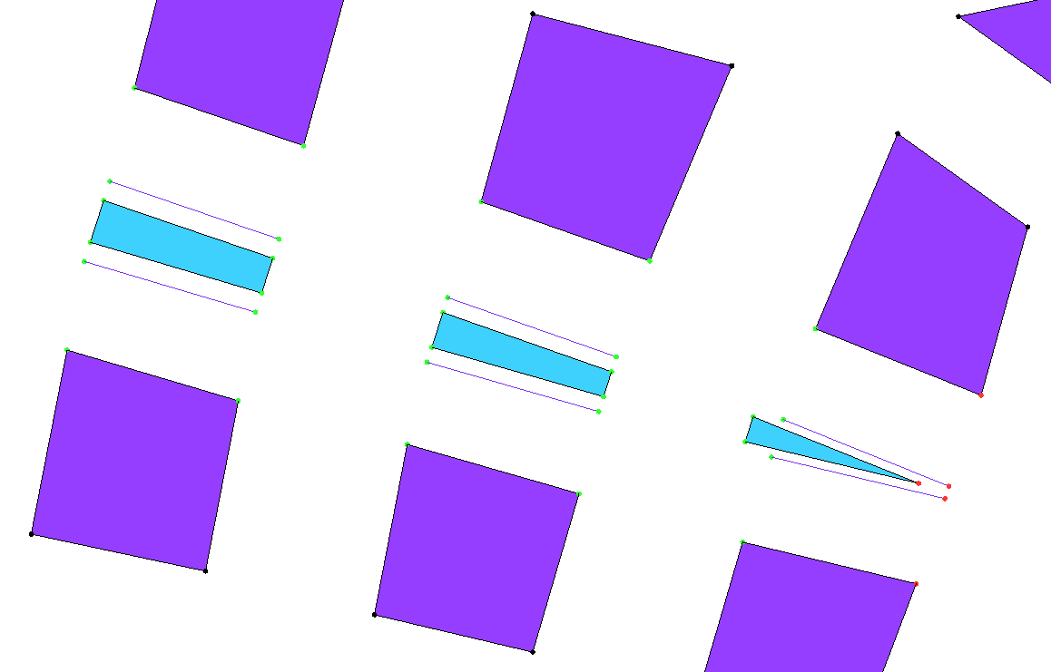
EDS SplitBoundary -based discretisation
Lower dimensional InterFace objects connect multiplicated nodes.
InterFace objects are used to apply transfer terms.
InterFace objects
duplicate Node
matrix
fracture
2D hybrid element model

Slide 78
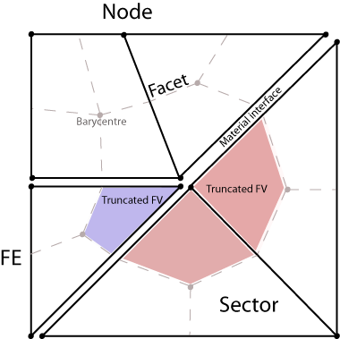

EDF integrals in implicit FEFVM solution
  Pressure equation (FE)
  Advective and diffusive transfer modeled via operator splitting:
  Advection (FV-Implicit)
  Diffusion (FE-Implicit)
see Nick and Matthai (2011, V.Z.J.)

Slide 79
Bridging SplitBoundarys using InterFace elements in implicit fluid pressure computation
To treat multiplicated interface nodes as one, the duplicates receive unity entries in diagonal of solution matrix
Interface nodes are then coupled with minus 1 off-diagonal terms:
p₁
a
b
1D mesh
c
d
interface
e
p₂

Slide 80
Contents
Introduction
CSMP variable types and their management
The Model, its Regions and Boundaries
Hybrid finite element – finite volume discretization
Solving PDE’s: the PDE_Integrator framework
Constitutive relationships: Visitors etc.
Advanced topics
Notes:
Jens Reindels modifications?

Slide 81
PDE_Integrator -> PDE_Integrator
PDE_Integrator<uint32_t, template<uint32_t> class SIMPLICIAL_COMPLEX>
PicardAlgorithm<uint32_t>
IterativeAlgorithm<uint32_t>
UpwindAlgorithm<uint32_t>
NewtonAlgorithm<uint32_t>
DiscontinuityAlgorithm<uint32_t>
higher level classes derived from Integrators
SteadyStateDiffusionSolver
TransientDiffusionSolver
SteadyStateAdvectionDiffusionSolver
TransientAdvectionDiffusionSolver
add checks that these guys are not applied at Peclet numbers > 1
Notes:
New ones are to be derived from the base clase as is demonstrated in the ReservoirSimulator

Slide 82
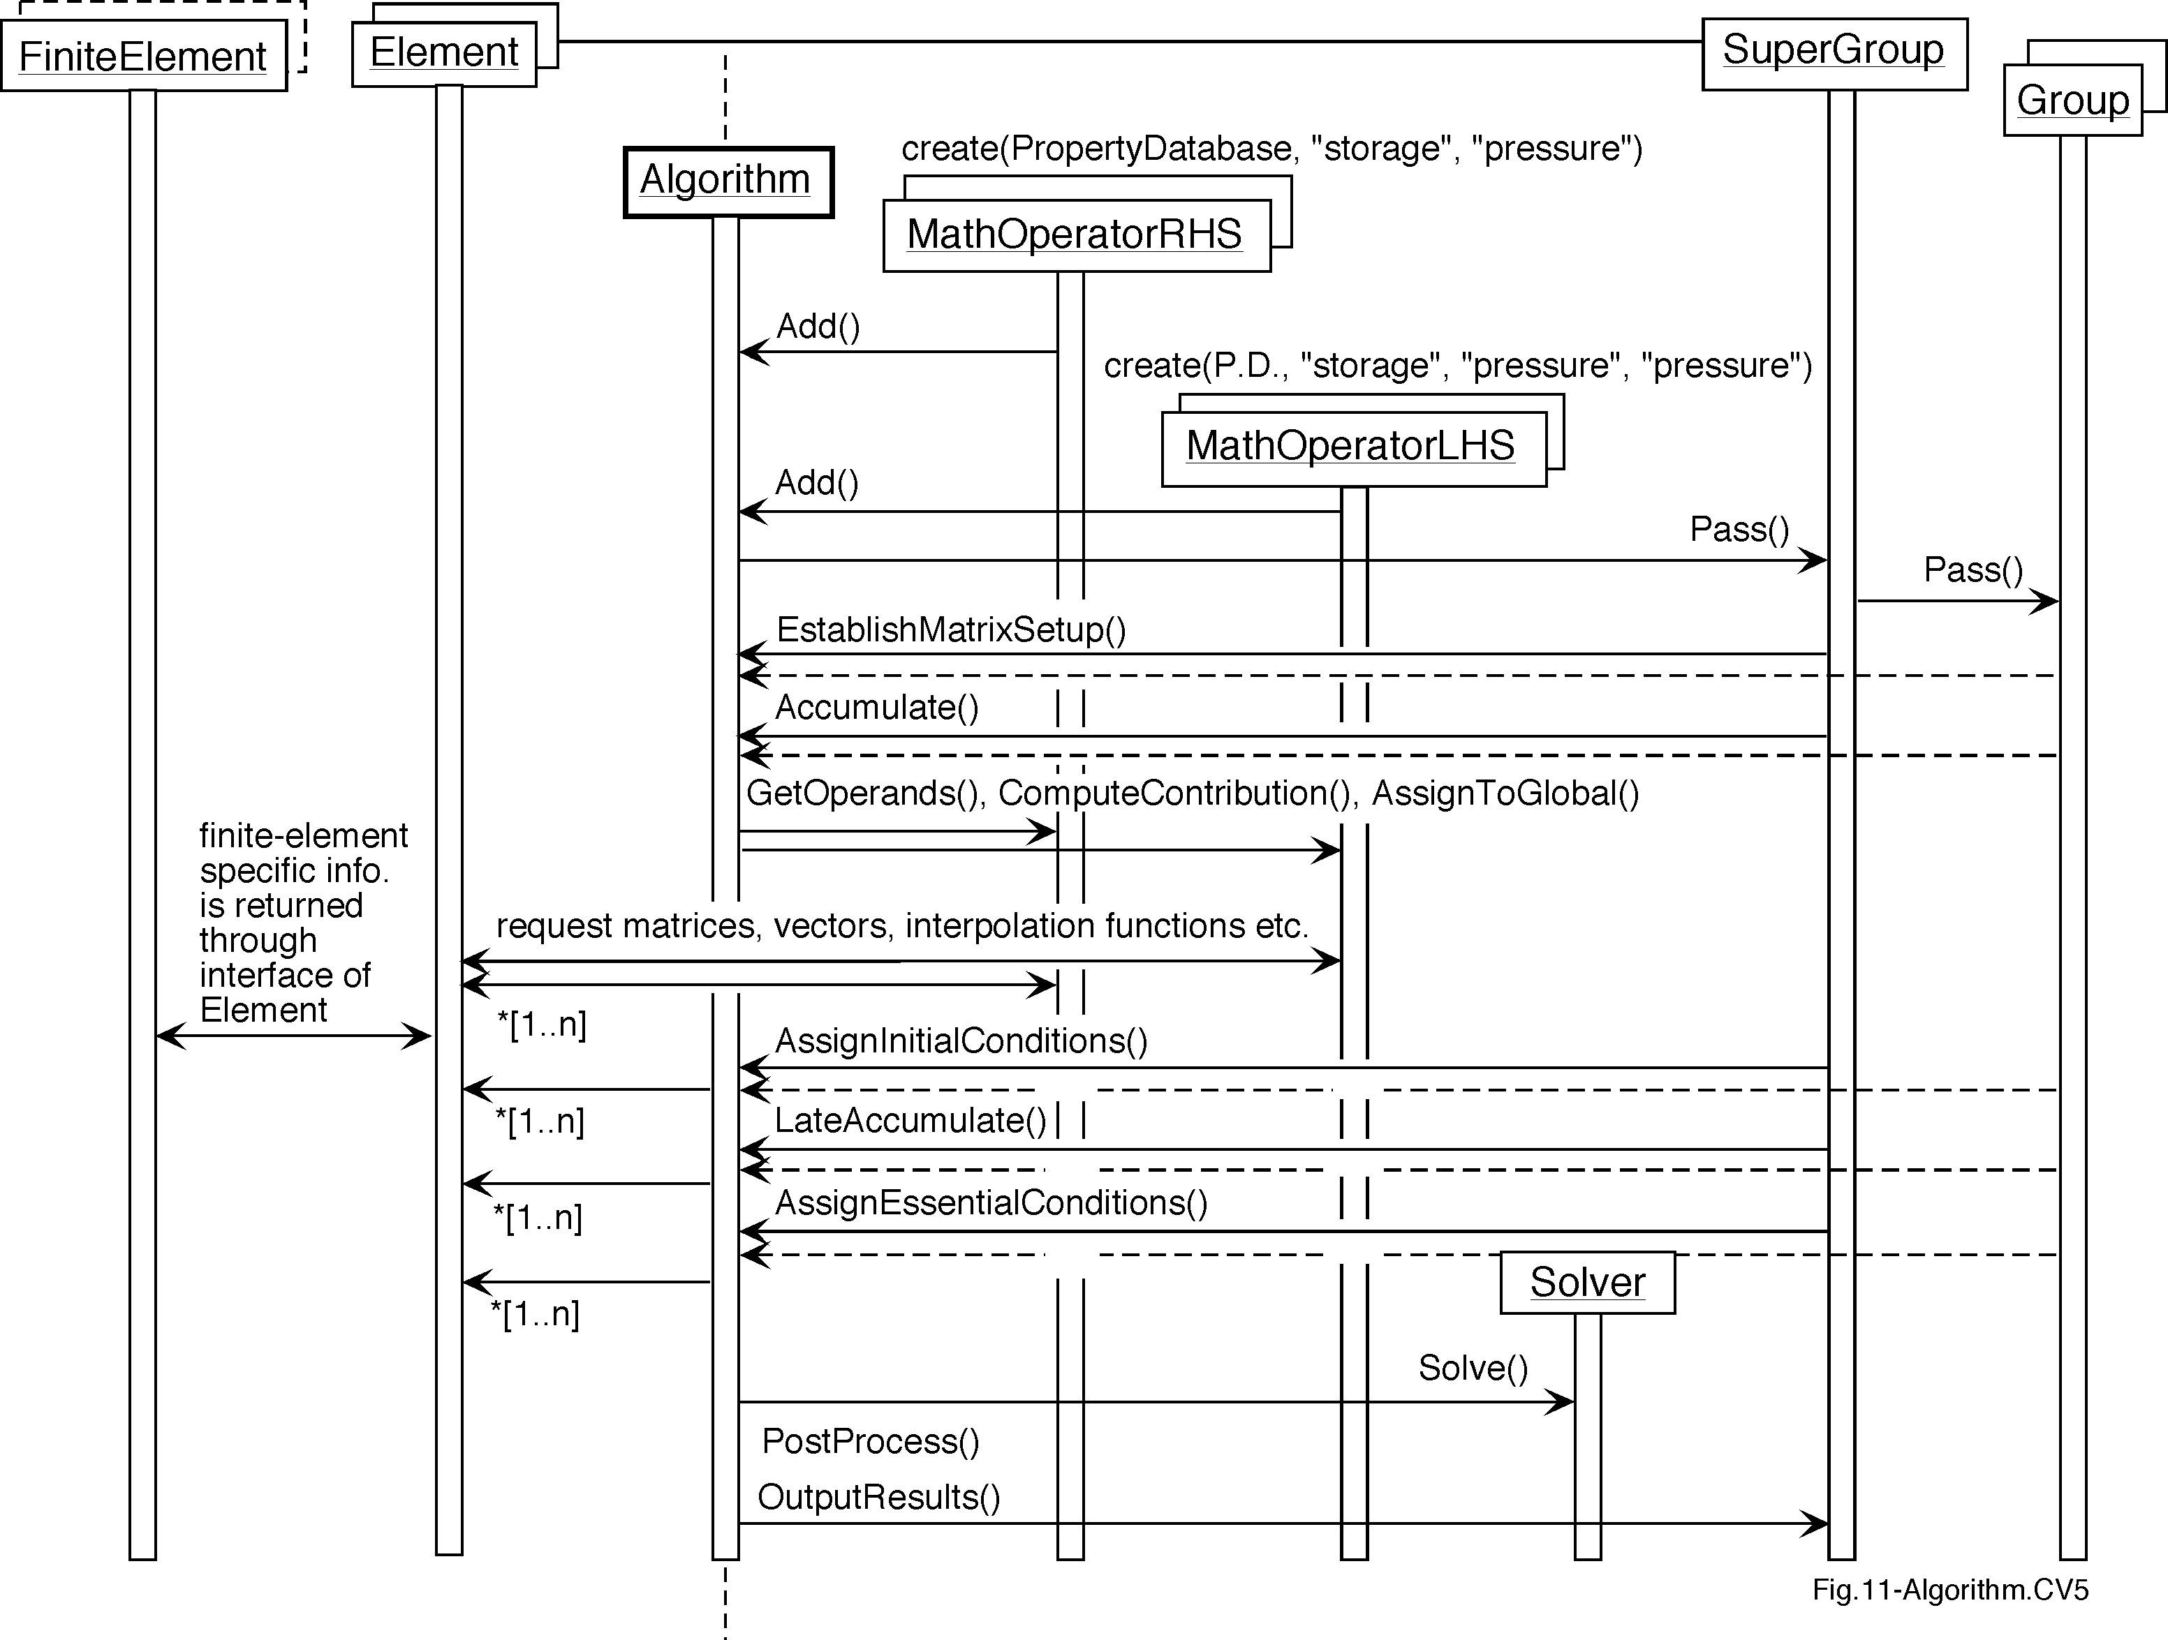
PDE_Integrator framework to solve PDEs
Model
Region
PDE_Integrator

Slide 83
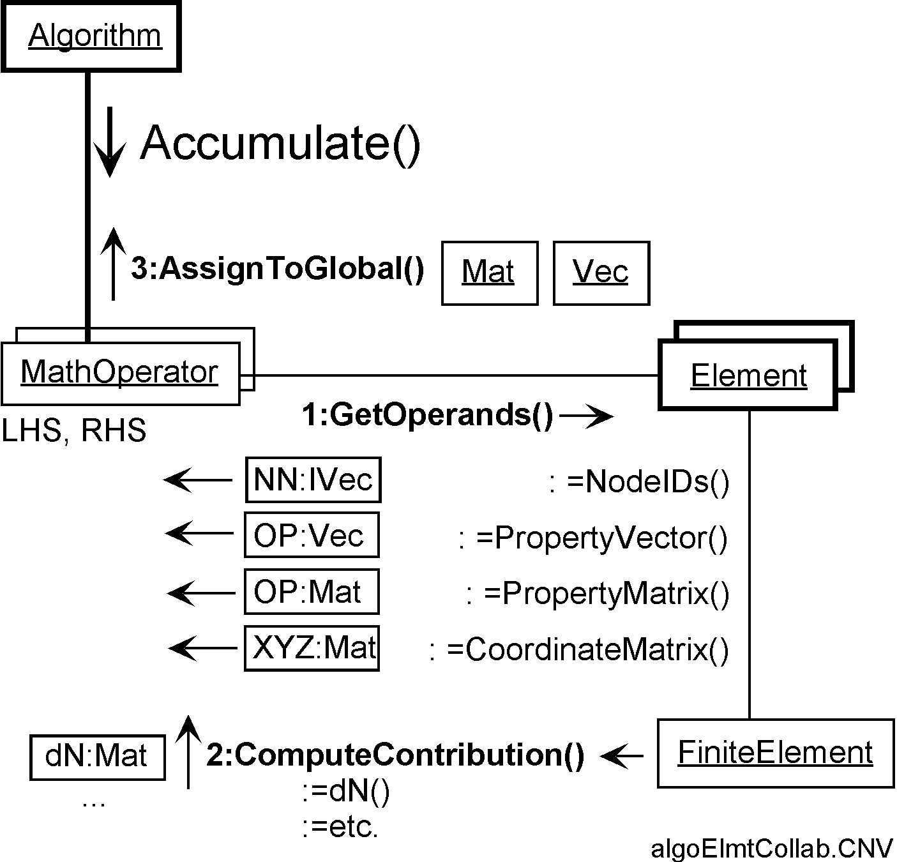
Interaction of PDE_Integrator with FE bridge pattern
PDE_Integrator

Slide 84
PDE_Integrator library
Classes derived from the PDE_Integrator base class template
Should all be called …Integrator
Currently, in we have:
Pending name changes:
  IterativeIntegrator
  NewtonIntegrator
  PicardIntegrator
  SteadyStateDiffusionIntegrator
  TransientDiffusionIntegrator
parallelPlatePermeabilityFromChannelWidth()

Slide 85
PDE_Integrator and Boundaries
To emulate Box shaped model functionality, CSMP automatically creates the boundaries FRONT, BACK... if it is given a CAD model with correspondingly named entities. The old boundary functionality and high-level interfaces are then supported by Boundary and ModelSubDomain interfaces rather than with distributed boundary flags.
Edges = boundaries of Boundaries, consisting of line elements are used to set boundary conditions for computations on boundaries. To do this, these edges must have a unique name in the CAD model.
Face and InterFace objects do not belong to the Region “Model”.
CSMP detects automatically whether Boundary surfaces contact the volume to that the PDE_Integrator applies when the solution or a dependent variable is flagged NEUMANN, CONSTANT_FLUX or ROBIN boundary integrals need to be used in the accumulation occurs.

Slide 86
Accumulation of boundary integrals
PDE_Integrator detects surface (Face / InterFace) integrals
If there are such surface integrals, in the accumulation an extra loop over the Face or InterFaces is executed, collecting their contributions
  To determine which Boundarys are involved, all are looped over while checking their names
  Only those whose name contains that of the region to which the PDE_Integrator applies are accumulated (do not forget special cases BACK, LEFT…, and do not leave naming to user, i.e. BOUNDARY1). Other special cases exist if the PDE integrator is applied to the entire Model
Conventions
Positive source terms / inflows are accumulated “as is”, as the normal to an external Boundary is outward pointing w.r.t. the computational domain; else (somewhere on the model interior) they are treated as negative
Although without special consequence for computations, variable flags should be used to indicate the user’s intent of their assigment (e.g., Neumann for a basal heat flux etc.)
All surface integrals are subclasses of MathOperatorRHS; therefore, only the accumulation of RHS terms is affected by the refactoring.
NB: Surface-associated variables exist only on Boundaries

Slide 87
PDE OPERATORS
Resolution: Keep up the momentum and communications throughout the year
Regular programming exercises are important at each institution
Compile guides for “best ways to do this” code snippets etc. compare and contrast different solutions.
Robert: FAQ for new CSMP
Everybody should use Ali’s configurator
Feedback of what could be improved version 1.0?
Larger user community
Smooth start for new users (Quick-start guide), high-level code out of the box
Freeze of interfaces, focus on crucial functionality
Deadlines for fixing bugs or suggesting alternatives

Slide 88
PDE_Operators
Needed for the computation of element integrals arising from the governing equations.
Subclasses of MathOperatorLHS and MathOperatorRHS
Functionality: Computation of FE integral contributions to the global solution matrix and right-hand side vector, see DOXYGEN documentation.
source.MultiplyWithTimeIncrement(true);
source.AddAccumulateLater();
source.LumpedFormulation(true);

Slide 89
SOLVER
Resolution: Keep up the momentum and communications throughout the year
Regular programming exercises are important at each institution
Compile guides for “best ways to do this” code snippets etc. compare and contrast different solutions.
Robert: FAQ for new CSMP
Everybody should use Ali’s configurator
Feedback of what could be improved version 1.0?
Larger user community
Smooth start for new users (Quick-start guide), high-level code out of the box
Freeze of interfaces, focus on crucial functionality
Deadlines for fixing bugs or suggesting alternatives

Slide 90
Strategy pattern: Linear algebraic solvers
PDE_Integrator
Algorithm
Solver
SolveMatrixEquation(A,x)
Tolerance(tol)
Residual()
SAMG-Solver
GE-Solver
...
SAMG-Settings
SAMG-Solver-Configurator
Collaboration with configuration file reader?
Set...()
Get...()
SAMG-Settings SettingsFromFile(filename)
SAMG-Settings NamedSetting(name)
Set-methods for all subswitches (ca. 50!), Get-methods for compound switches (ca. 20!)
+ Solver profiles,
see solver/ directory
Collection of predefined, named settings. Extendable in subclasses.

Slide 91
CSMP_DEFAULT_LINEAR_SOLVER or SAMG_Solver and SAMG_Settings
Can be permanently associated with PDE_Integrator
User can specify which instance of the optional SAMG DLLs they want to dispatch computations to.
SAMG solver instances distinguish correctly between steady-state / first call type computations and transient runs where the solution of the previous timestep is used as an initial guess (also of the initial residual) and a relative tolerance is used to measure convergence
Various configuration options exist with regard to updating the Solver setup so that computation time can be minimised, see SAMG_Solver profiles.

Slide 92
Contents
Introduction
CSMP variable types and their management
The Model, its Regions and Boundaries
Hybrid finite element – finite volume discretization
Solving PDE’s: the PDE_Integrator framework
Constitutive relationships: Visitors etc.
Advanced topics
Notes:
Jens Reindels modifications?

Slide 93
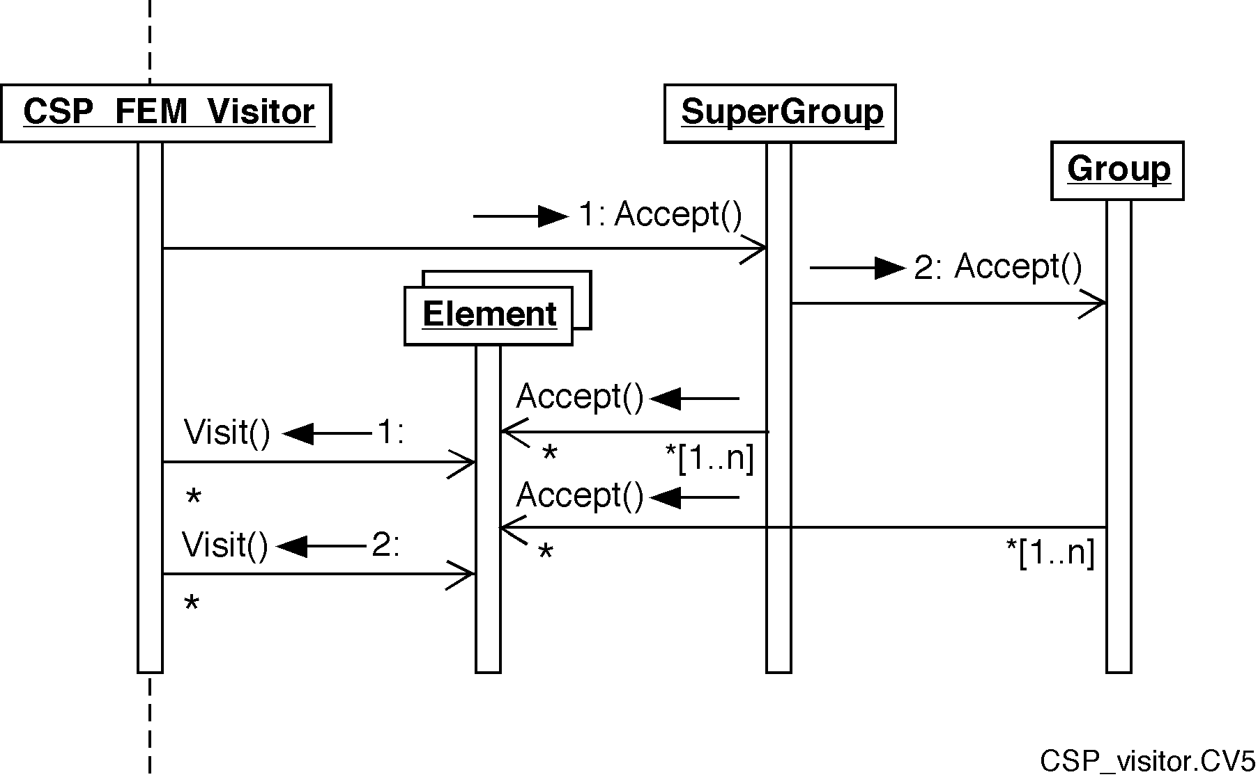
Visitor (design pattern (Gamma et al.))
Visit Region-Boundary-Element-Node hierarchy with full access to FEM / FVM interfaces and their traits
Visitor
Model
Region

Slide 94
How to use visitors correctly
Visitors give access to the full object hierarchy of Model
A distinction is made between application level and target level:
    The application level denotes the entry point of the visitor into the object hierarchy of a model. Thus, if the level is element, the visitor will be applied element by element. Options are Model, Region, Boundary, SplitBoundary, Element, Node
    The application target denotes the lowest level of the object hierarchy for which a Visit() method has been defined. Thus, if one wants to do node-by-node operations, one sets level and target to node. This avoids repetitions of node operations which would have ensued from a level=element, target=node setting.
    Setting the application level to element or node circumvents a region-by-region application of the visitor.
    Visitors can also be sent directly to Region, Boundary, Element etc.
  Thus, if one wants to restrict a visitor to a specific model region or boundary, one simply passes it on to this region: model.Region(“ * “).Accept(vtor);
Visitors using Region variables must visit all regions of a model sequentially (level=region), reading these variable values just once per region.

Slide 95
Contents
Introduction
CSMP variable types and their management
The Model, its Regions and Boundaries
Hybrid finite element – finite volume discretization
Solving PDE’s: the PDE_Integrator framework
Constitutive relationships: Visitors etc.
Advanced topics
Notes:
Jens Reindels modifications?

Slide 96
PropertyHandle
To access and perform calculations with distributed variables
Suitable also for creating/deleting variables at runtime
Overloaded operators to add, subtract, multiply, and divide variables with the same placement.
For variables with a different placement, values will first have to be averaged, interpolated or extrapolated to the placement of the result variable. Only then the operation is performed. To achieve the desired behaviour, MultiPlacement() is set to either of INTERPOLATE, EXTRAPOLATE, ARITHMETIC_MEAN, HARMONIC_MEAN, or GEOMETRIC_MEAN.
Interpolation / extrapolation strategies used in variable interactions must be spelled out and accessible for the user
The application of property handles can be restricted to regions or boundaries. However, if the construction of a property handle provokes the generation of a new node, element, or region variable, itwill be generated for the entire model.
Self-assignment of PropertyHandle is deleted because it would overwrite the left-hand handle / eliminate the variable.
Urgently needs to be updated to perform correctly on ELEMENT_, SECTOR_, and FACET_INTEGRATION POINTS

Slide 97
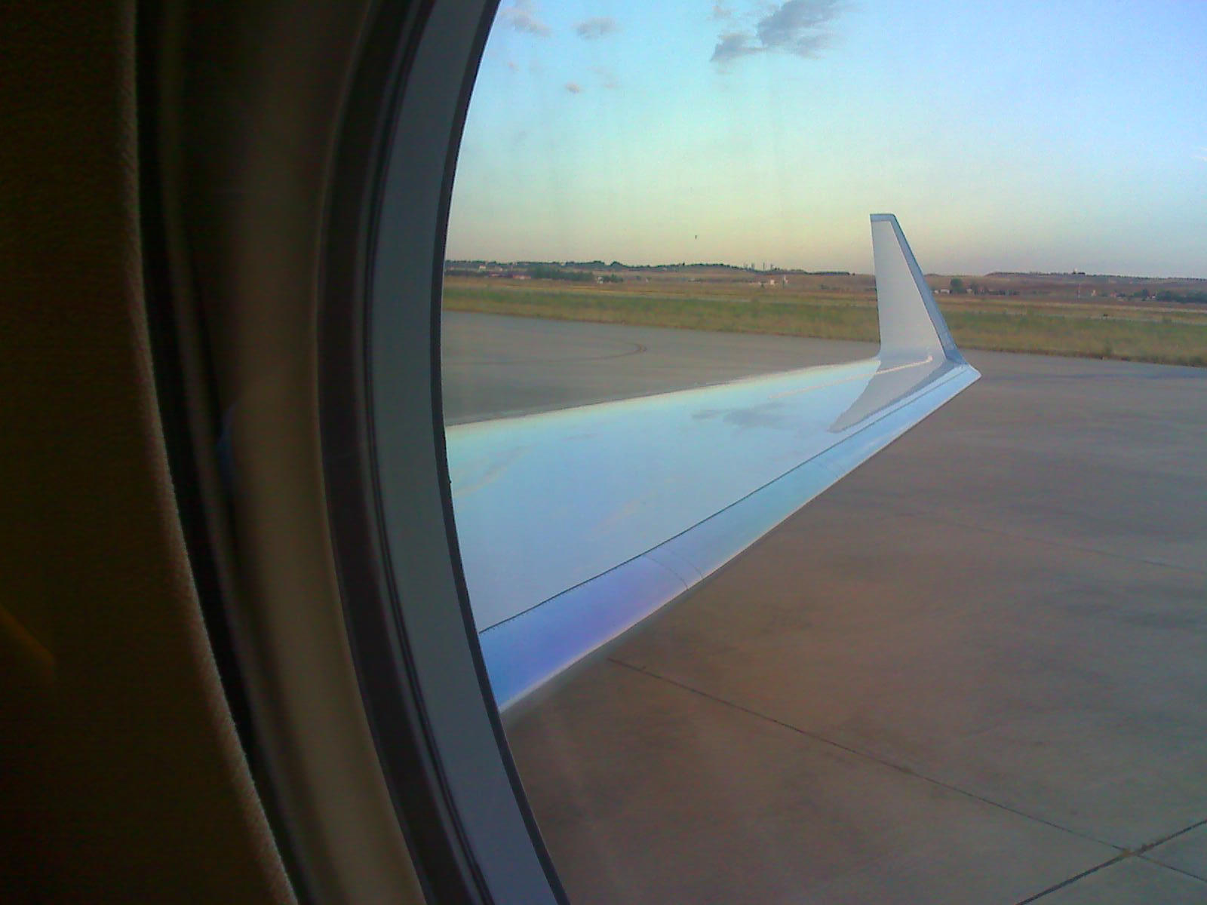
The End
For descriptions of more details and advanced functionality see User Guide and publications

