Slide 1
The Complex Systems Modelling Platform
(CSMP++ )
Transferring a discretised (“meshed”) model to CSMP++
by Stephan K. Matthai

Slide 2
Preface
Presentation introduces text file format and content needed for the construction of a multi-domain (region-based) CSMP++ model with associated properties.
Datatypes and naming conventions in CSMP are described, giving background to understand the datatypes and terminology used in the descriptions.
Much of this follows NCSA’s (HDF5) conventions for polygonal datasets and is similar to Kitware’s VTK file format for unstructured grids:
https://vtk.org/wp-content/uploads/2015/04/file-formats.pdf
The element node-numbering conventions are the same as in ANSYS. The file-based interface is documented as part of CSMP’s ANSYS_Interface.
Example text files are provided with this presentation.

Slide 3
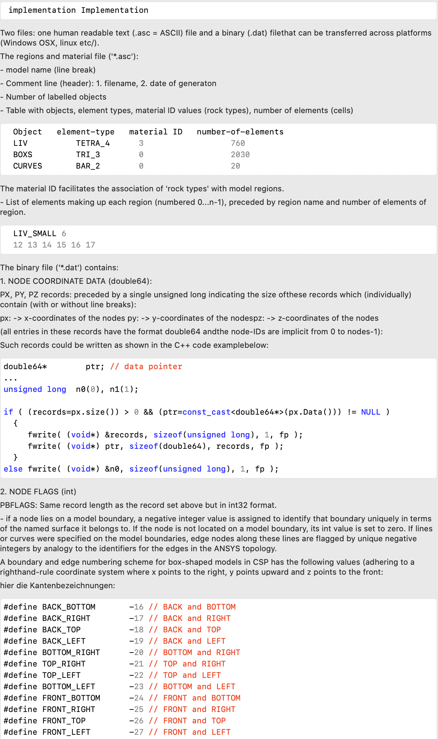
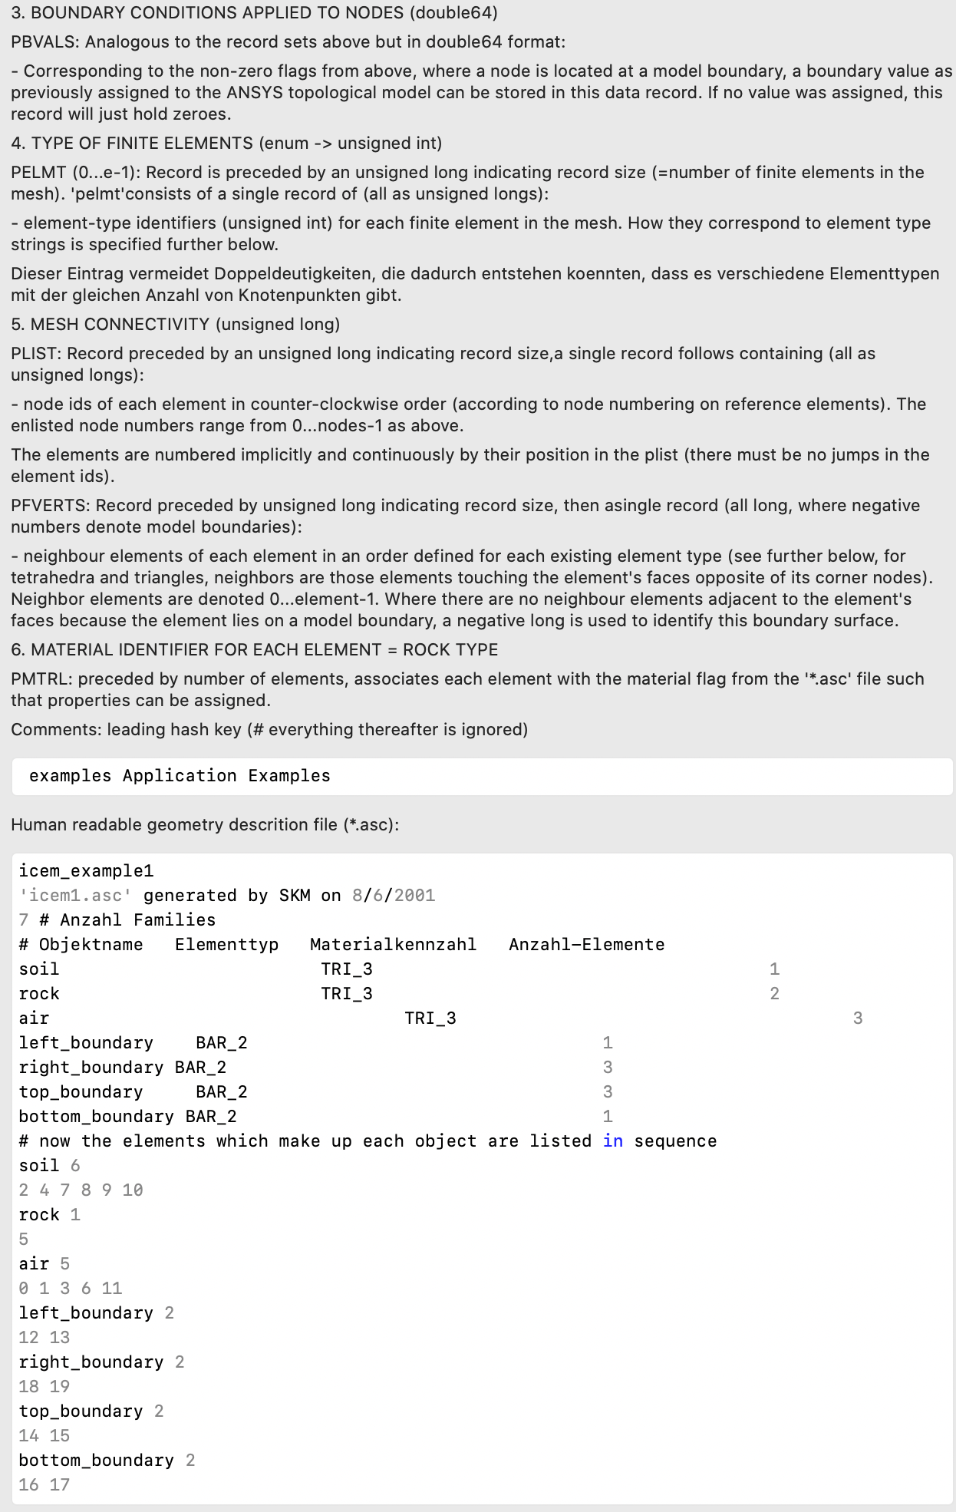
Synopsis: CSMP’s DOxygen documentation
Boundary flags for box-shaped model

Slide 4
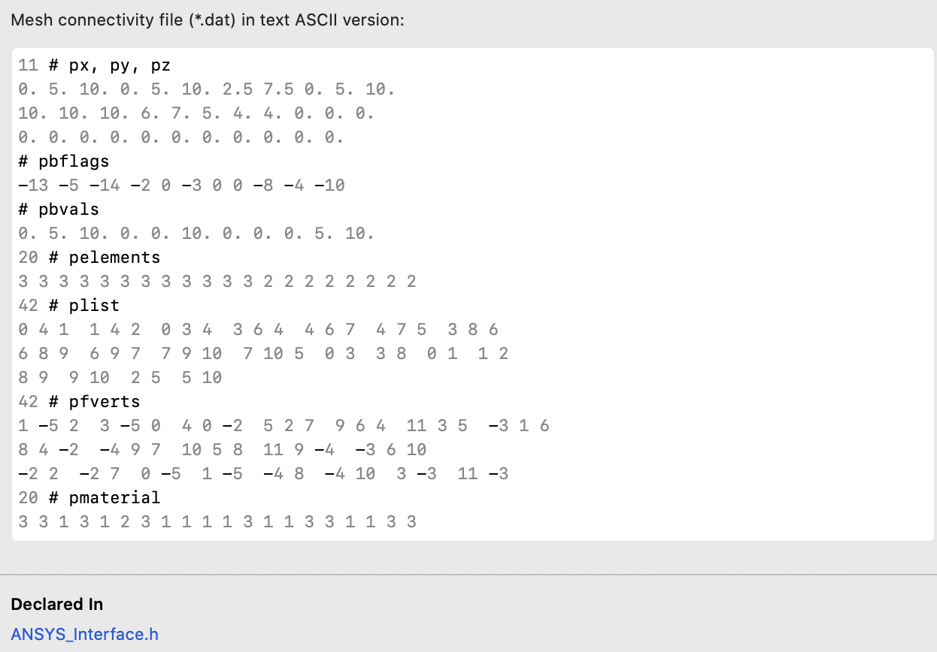
= negative integers that correspond to the boundary flags
= negative integers that correspond to the boundary flags
= rock type

Slide 5
Content of this document
Storage of mesh (VData), variable values & flags (VSet)
CSMP conventions: variable types, flags, placements..
Region - storing sub-domains of model
  Mesh representation of faults
  Boundary & SplitBoundary objects
CSMP - hybrid finite-element finite-volume framework
  Finite-element types supported
  Finite-element finite-volume stencils

Slide 6
1. STORING THE Mesh explanation of polygonal data for interim VSet container…

Slide 7
Storage of unstructured grids / polygonal data
Here the NCSA VSET format (part of their hierarchical data file (HDF)) is described.
To initialise a VSET the file needs to contain the following records:
  FE vertex (px, py, pz): listing element node coordinates (3 1D-arrays for x, y, and z, respectively); vertex numbering is implied by order of entries.
  Boundary vertex array (pbflags): indices of vertices located on model boundary (0 for notes that are not).
  FE types (pelmt): making up each element, face, and interface (CSMP specific)
  Vertex indices for each element (plist): 32-bit unsigned integers again in a 1D array of vertex ids enlisted element by element.
  FE neighbors of each element (pfverts): like plist, but ids (int-32) of elements adjacent to each FE face
  Material identifiers (rock types) (pmtrl): – integer codes for elmts (CSMP only)
  Property values (scalar, vector, tensor…) associated with nodes, elements, faces, and interfaces (CSMP only)
  Note - To read plist and pfverts arrays, the element node- and neighbor numbering must be known (but not contained in VSet file). It is inferred from the element types listed in pelmt. The conventions are described the last section of the presentation (Section 4).
9/11/21
7

Slide 8
Layout of ‘plist’ and ‘pfverts’ arrays
(why ‘pelmt’ is needed to infer from element type how many nodes and faces are connected to each element)
pelmt[]
LINEAR_TRIANGLE, LINEAR_QUADRILATERAL…
plist[]
[node0,n1,n2|n0,n1,n2,n4|…|last element|]
pfverts[]
[neighbor0,n1,n2|…|nbors of last elmt|]
Where an element face has no neighbor a negative-valued boundary flag is assigned (see slide 17).
Elements only know their equidimensional neighbors (volumes->volumes, surfaces-> surfaces, lines->lines).
vset.Out();
method to check a small model whether your initialization performed as expected.

Slide 9
Layout of ‘plist’ and ‘pfverts’ arrays
Differences between Element and dimension-1 Face, and InterFace data types by CSMP to represent Boundary and SplitBoundary objects, respectively.
pelmt[elements,faces,interfaces]
No difference (same types are used). Faces follow elements; InterFace types follow the Face types.
plist[elements,faces,interfaces]
While same element types are used, for interfaces, the number of nodes listed doubles. Inner interface nodes followed by outer.
pfverts[elements,faces,interfaces]
Face neighbors follow element neighbors; InterFace nbors follow Face nbors.
Where an element face has no neighbor a negative-valued boundary flag is assigned (see slide 17).
While elements only know their equidimensional neighbors, Face and InterFace objects also connect to their higher dimensional neighbors.
The higher dimensional neighbors are listed after the nbors. For InterFace objects this is followed by the indices of intervening lower-dimensional elements or zero if there are none.

Slide 10
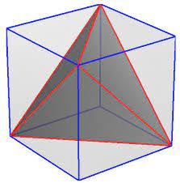
What is stored in pfverts?
7
Tetrahedral element has 4 nodes (0,2,5,7-in this righthand rule order), and 4 tetrahedral neighbor elements (E1-E5) covering its faces (F0-F4).
Element E1 only has one neighbor (E0) all the other neighbors are missing because the faces are at the model boundary. The ‘pfverts’ entry record the CSMP boundary flags accordingly as negative integers.
4
6
5
E1
E3
Element E0
(tetrahedron)
3
E4
0
2
y
E2
z
1
x
pfverts[]
[E3,E1,E4,E2|TOP,LEFT,FRONT,E0|…]

Slide 11
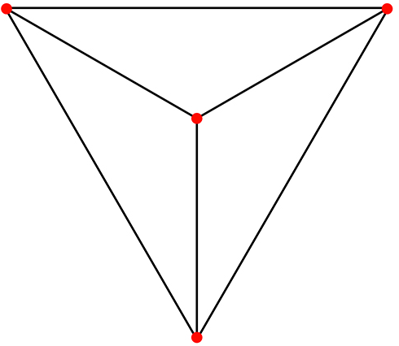
Illustration: Element vs. Face vs. Interface
In CSMP++, Face & InterFace are elements that know their higher dimensional neighbors.
InterFace can contain an extra lower-dimensional Element for the representation of fractures, faults etc.
Element
Face
Element
1
Inside and outside come from application of the right-hand rule,
applied to the triangles making up the original surface.
2
INSIDE
nbor 1
OUTSIDE
nbor 2
0
InterFace
Element
1
Element
2
0
INNER
nbor 3

Slide 12
Face example
Inside and outside come from application of the right-hand rule,
applied to the triangle making up the original boundary surface between the materials associated with the volumetric elements.
Element
Face
Element
1
E1
2
E2
INSIDE
nbor 1
OUTSIDE
nbor 2
0
pelmt[interface1]
LINEAR_TRIANGLE, ...
plist[]
[node0,n1,n2(ordered as nodes of face of inside elenment)|…]
pfverts[]
[nbor0,n1,n2| E1(higher-dim0 neighbor on inside)|E2(nbor outside)|... ]

Slide 13
Interface example
InterFace
Element
1
Element
Inside and outside come from application of the right-hand rule,
applied to the triangles making up the original surface.
2
0
pelmt[interface1]
LINEAR_TRIANGLE, ...
plist[]
[node0,n1,n2(inside)|node0,n1,n2(outside)|…]
pfverts[]
[nbor0,n1,n2(inside)|nbor0,n1,n2(outside)| higher-dim0(inside)|higher-dim nbor1(outside)| intervening element or zero... ]
INNER
nbor 3

Slide 14
Data storage associated with VSet
VSet (container of finite-element mesh and associated properties)
Most important data records (all with a single dimension)
Mesh (VData base class)
(double64) px, py, pz[0..n-1] = coordinates of n nodes (= FE vertices)
(int32) bflags[0..n-1] = negative numbers for nodes at boundary, see later
(enum) pelmt[0..e-1] = CSMP_FEM_TYPE of e finite elements (1 entry only for single element-type mesh)
(size_t) plist[0..e *[sum npe[e]]] = nodes making up each element
int32) pfverts[0..e *[sum fpe[e]]] = neighbor elements adjacent to the faces of each element
Variable values (Vset subclass) (material-, fluid- and computed properties)
map<string,PropertyData”ScalarVariable”> vdata_scalar;
map<string,PropertyData”VectorVariable”> vdata_vector;
map<string,PropertyData”TensorVariable”> vdata_tensor;
map<string,PropertyData”ArrayVariable”> vdata_array;
map<string,PropertyData”FlaggedArrayVariable”> vdata_flagged_array;
Note: all numbering in CSMP is from 0..n-1; 0..e-1

Slide 15
Revised ASC file: example
V6_SOLID2_with_wells
V6_SOLID2_with_wells.asc generated on 11-09-2021
9 # Number of families
# general order (inherited from ANSYS) volumes, surfaces, lines
# REGION objects first, then BOUNDARY, then SPLITBOUNDARY objects
# number after element type corresponds to rock type (unless...)
UNIT_A REGION ISOPARAMETRIC_LINEAR_TETRAHEDRON 0 1775
UNIT_B REGION ISOPARAMETRIC_LINEAR_TETRAHEDRON 1 1743
UNIT_C REGION ISOPARAMETRIC_LINEAR_TETRAHEDRON 2 1761
FAULT1 BOUNDARY ISOPARAMETRIC_LINEAR_TRIANGLE 3 102
FAULT2 SPLIT_BOUNDARY ISOPARAMETRIC_LINEAR_TRIANGLE 8 4
WELL_1 SPLIT_BOUNDARY ISOPARAMETRIC_LINEAR_LINE_ELEMENT 4 4
WELL_2 SPLIT_BOUNDARY ISOPARAMETRIC_LINEAR_LINE_ELEMENT 5 5
WELL_3 SPLIT_BOUNDARY ISOPARAMETRIC_LINEAR_LINE_ELEMENT 6 5
WELL_4 SPLIT_BOUNDARY ISOPARAMETRIC_LINEAR_LINE_ELEMENT 7 6
#
UNIT_A ISOPARAMETRIC_LINEAR_TETRAHEDRON 1775
18
19

Slide 16
2. CSMP Conventions variable types, flags, placements

Slide 17
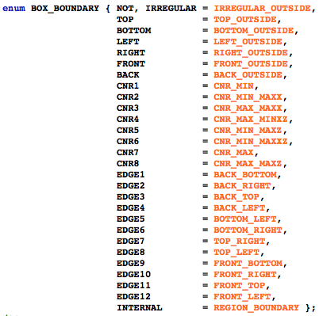
Boundary flags (bflags record in VSet)
Note1: some of these flags have a meaning only for box-shaped models
Note2: free-form boundaries can be conveyed to CSMP by adding the string “BOUNDARY_” to the front of the name of any lower-dimensional region that classifies as CSMP boundary.

Slide 18
CSMP++ interoperable physical variables
In-built types (CSMP_definitions.h)
  typedef double double64;
  STL container<>::size_type = size_t
Abstract data types
  ScalarVariable (1 flag)
  VectorVariable<size_t> (dim flags)
  TensorVariable<size_t> (dim flags)
  ArrayVariable<size_t> (1 flag)
  FlaggedArrayVariable<size_t> (n flags)
  DenseMatrix<size_t> (no flags)
  SparseMatrix<size_t> (no flags)

Slide 19
Variable flags
All CSMP variables are value – flag pairs.
Flags specify how the variable is used in a simulation
ANY is the default flag for an uninitialized variable
DIRICH, NEUMANN, ROBIN and PERIODIC tell solver about solution constraints including values that are to be used as integration constants for governing equations.
// flag indicating treatment in computations
enum VARIABLE_FLAG { PLAIN, // modifyable, dependent or indep. var.
INIT_GUESS, // convergence oriented not phys. meaningful, not checked
INIT_COND, // physically meaningful initial condition, checked
DIRICH, // Dirichlet boundary condition
NEUMANN, // Neumann boundary condition
CONSTANT_FLUX, // Neumann is prescribed gradient, this one is for prescribed flux
ROBIN, // linear combination function and derivative values on domain boundary
PERIODIC, // linked via ID to opposite side of model
FIELD_DATA, // (Geological) field data for comparison
ANY }; // unspecified discriminator

Slide 20
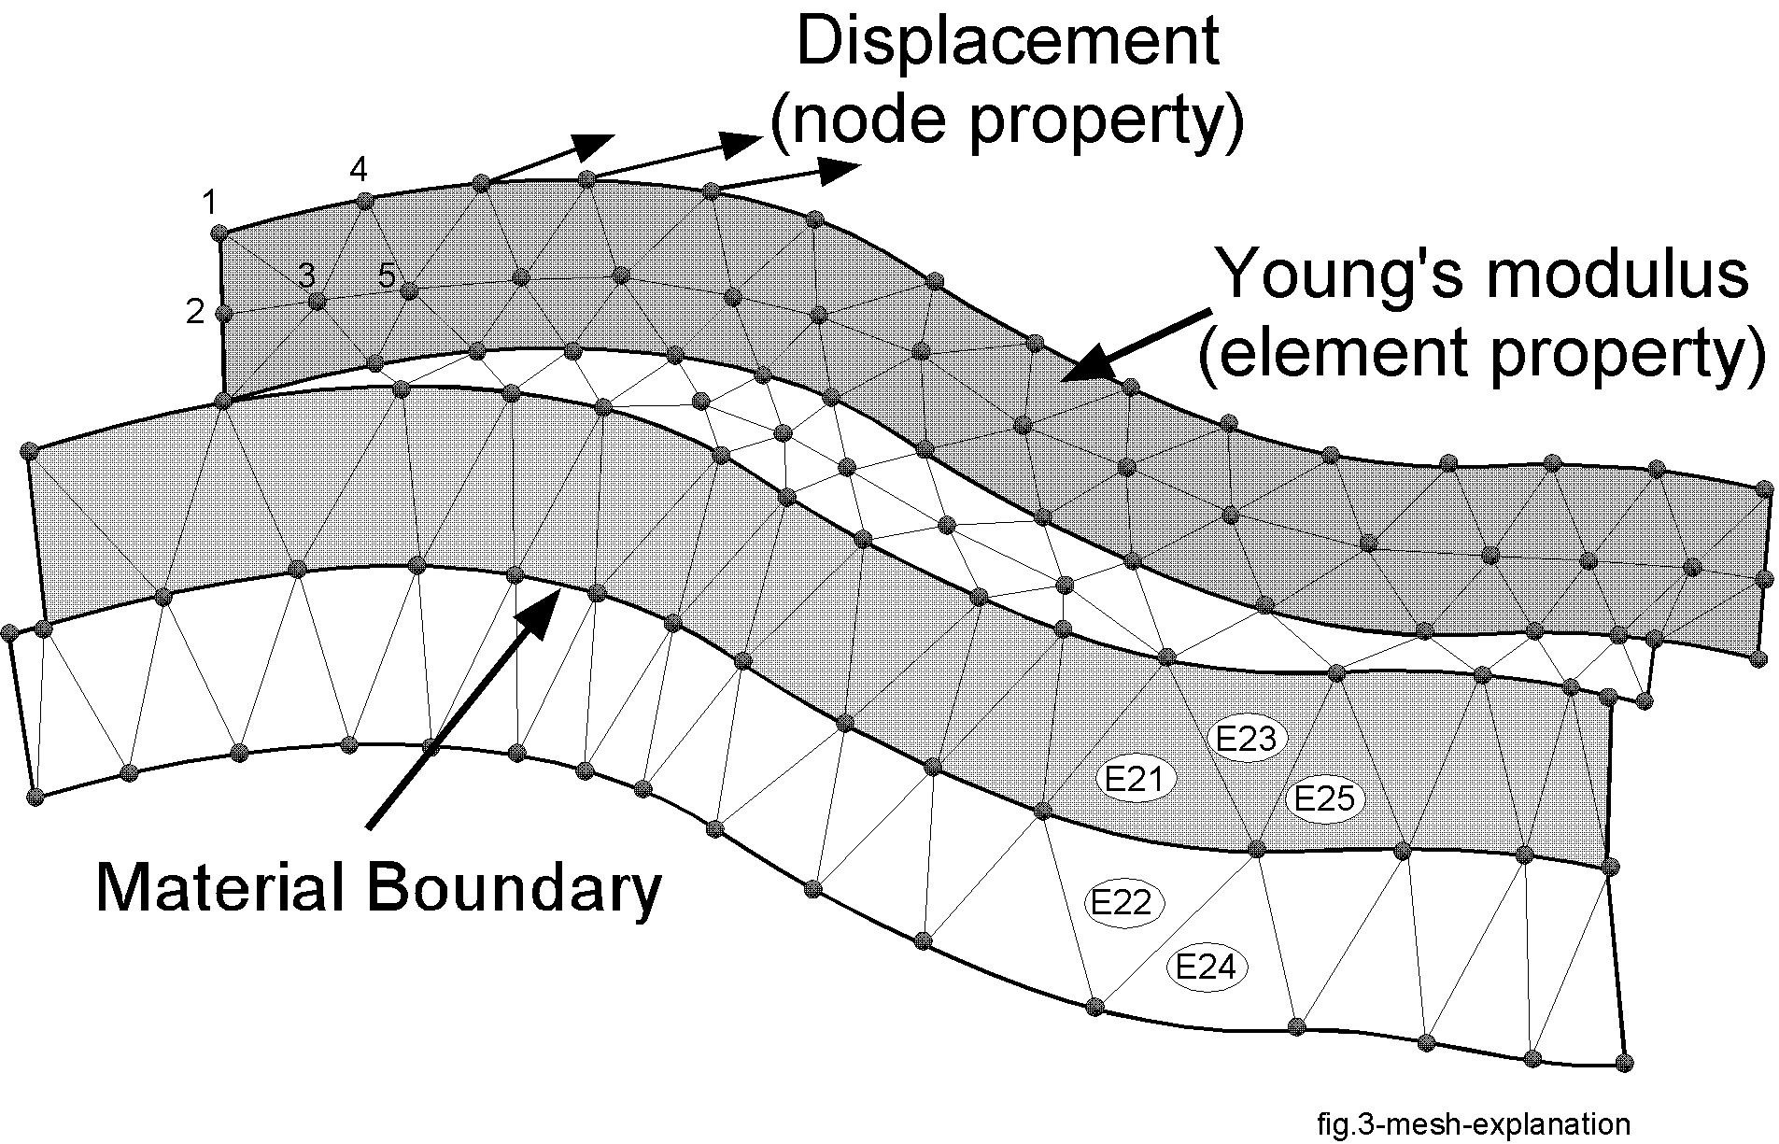
Placement of physical variables on the mesh
FEM inspired options: node, element, face, interface, region, boundary, splitboundary, ELEMENT_INTEGRATION_POINT, FACET_INTEGRATION_POINT, SECTOR_INTEGRATION_POINT.
Node and element are the most important placements.

Slide 21
Variable Placement

Slide 22
Variable management: PropertyDatabase
Runtime creation / deletion of Parameter classes that contain variable specifications: name, notation, SI unit, type, placement, physically meaningful value range
Returns variable Index structs for variable access using Model and Region interfaces; these contain pre-computed offsets for fast lookup
Initialization from text file or within running program
Range checks performed during on all Store() operations
Variables files also contain usage classifier to help GUI configurator
example ‘*-variables.txt’ file for pressure diffusion / single-phase flow
Notes: Names, types and placements of incoming variables must match specs stored in PropertyDatabase.
Neither the PropertyDatabase nor the variables file do store actual variable values.

Slide 23
Creating a CSMP model from VSet & ModelTopology
The full example (paradigm_example_main.cpp) also explains the VSet creation steps.
VSet<3U> mesh_container;
// fill VSet with data…
const bool use_isoparametric_finite_elements(true);
ModelTopology model_topology("paradigm-test-model",
use_isoparametric_finite_elements);
// fill ModelTopology with data
Model<3U> example_model( model_topology,
mesh_container,
"CSMP2-phase-variables.txt" );
// output a variable from the model to an FEM_Data container
FEM_Data<ScalarVariable> saturation0;
example_model.OutputVariableTo( "saturation oil", saturation0 );

Slide 24
Computation Settings
Can be communicated to CSMP via a ComputationalSettings block in config file, which is used to initialise this object:
class ComputationalSettings {
public:
void SetOutputTimes( const std::set<double64>& times );
void AddOutputTime( double64 time );
bool IsOutputTime( double64 time, double64 tolerance ) const;
double64 TimeToNearestOutputTime( double64 current_time ) const;
double64 NearestOutputTime( double64 current_time ) const;
void Duration( double64 duration );
void TimeSteppingApproach( TIME_STRATEGY approach );
TIME_STRATEGY TimeSteppingApproach() const;
void TimeIncrement( double64 );
double64 TimeIncrement() const;
void EstablishMultipliers( double64& pf_multiplier,
double64& adv_multiplier ) const;
// step through output times
double64 PopOutputTime();
virtual void Out() const;
virtual void Out( const char* filename ) const;

Slide 25
3. Region-, BOUNDARY- AND SPLITBOUNDARY objects

Slide 26
Content of this document
Storage of mesh and associated variables
Model sub-domains called Regions
  Mesh representation of faults
  Boundary & SplitBoundary objects
Hybrid finite-element finite-volume framework
  Finite-element types supported
  Finite-element finite-volume stencils
CSMP conventions: variable types, flags, placements..

Slide 27
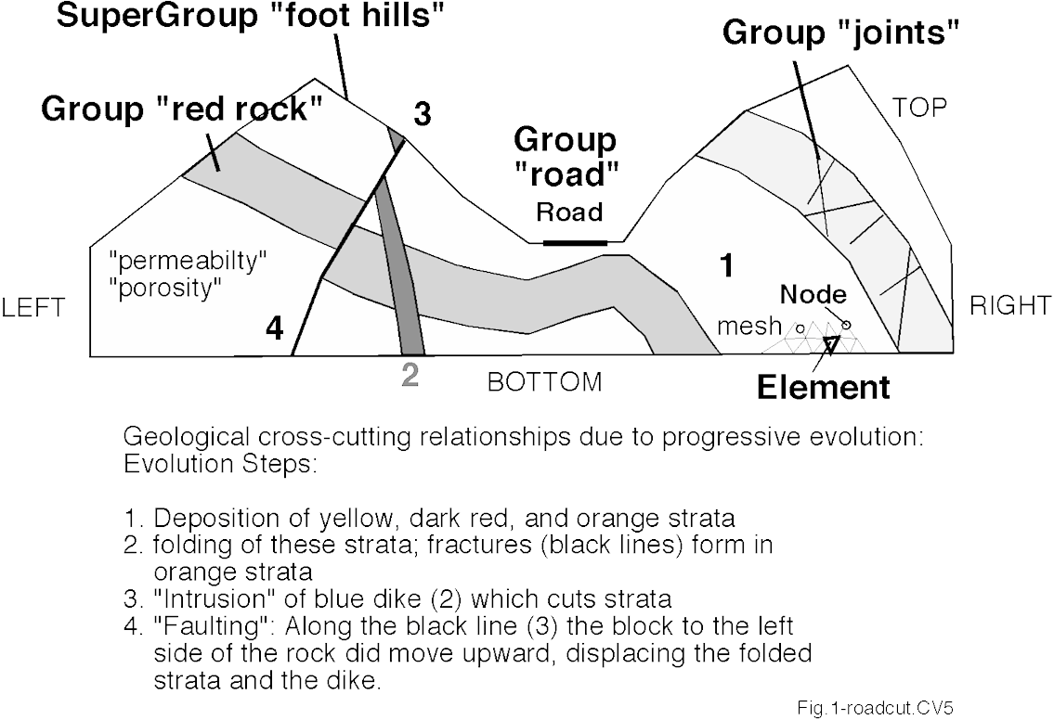
Geologically motivated data model: Model, Regions, Boundaries and SplitBoundaries
In CSMP, the Model represents the computational domain composed of contiguous and discontiguous subdomains called Regions
Boundarys (=dim-1 regions) can be inserted externally and internally
SplitBoundarys can only be inserted internally
Note1: smallest building block of any model is the Element
Note2: regions can be unique (space exclusive) or non-unique (=overlapping)
Model
Region
Region
Region
Boundary “Model-LEFT”
Non-unique Region “Alteration halo”
Notes:
Note non-unique regions -> consider implications for Region-based properties
Making groups via PropertyConstraints

Slide 28
Within model subdomains: distinguishing interior, perimeter, complete
Boolean operations union, difference, intersection involving Regions are supported

Slide 29
Lower-dimensional Regions = Boundaries: Assignment of boundary conditions via configuration file
The addition of Boundary and SplitBoundary objects into CSMP has necessitated a change in the “*-configuration.txt” file structure:
1. properties and variable values for entire model (defaults)
2. regional properties and variable values specific to regions
3. regional variable flags specific to regions
  For instance, to freeze variable values in a region
4. essential conditions applied to boundarys; syntax:
  BOTTOM complete Dirichlet fluid pressure 4.0e+8
  LEFT complete Dirichlet saturation water 0.22
  LEFT complete Dirichlet saturation oil 0.78
5. computational settings

Slide 30
Content of this document
Storage of mesh and associated variables
Model sub-domains called Regions
  Mesh representation of faults
  Boundary & SplitBoundary objects
Hybrid finite-element finite-volume framework
  Finite-element types supported
  Finite-element finite-volume stencils
CSMP conventions: variable types, flags, placements..

Slide 31
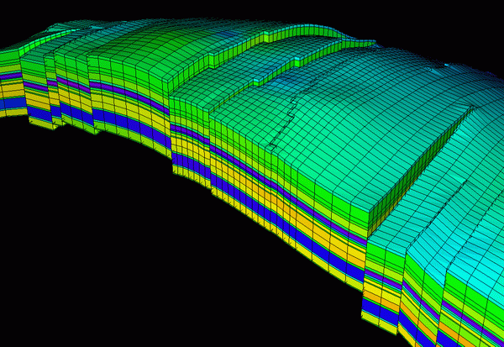
Completely impermeable faults
Disconnected mesh (SplitBoundary): Faults that form flow impediments are represented as internal boundaries: nodes are not matched across these and the extra degrees of freedom gained by this are used to optimise the mesh on on either side.
Note: this approach is similar to the structured grid one currently used in oil industry.

Slide 32
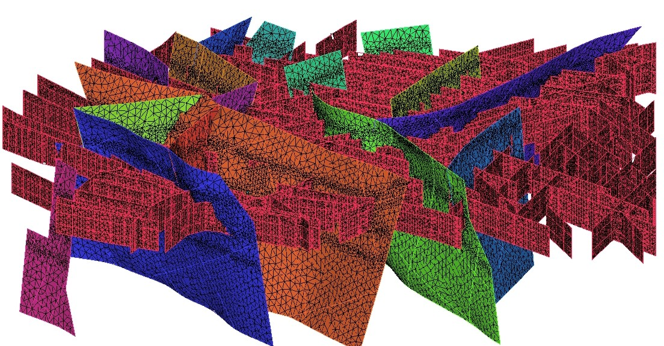
Highly permeable faults and fractures
Surface mesh (Region or SplitBoundary with intervening surface element mesh): Faults and fractures that are more permeable than the surrounding rocks and which lack a layered internal permeability structure can be represented by a conforming surface mesh.
Note: In this example, the volumetric mesh that is node-matched to the faults is not shown.

Slide 33
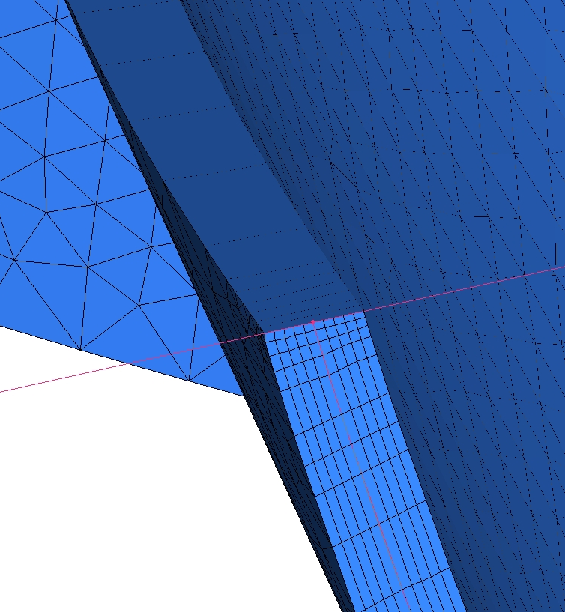
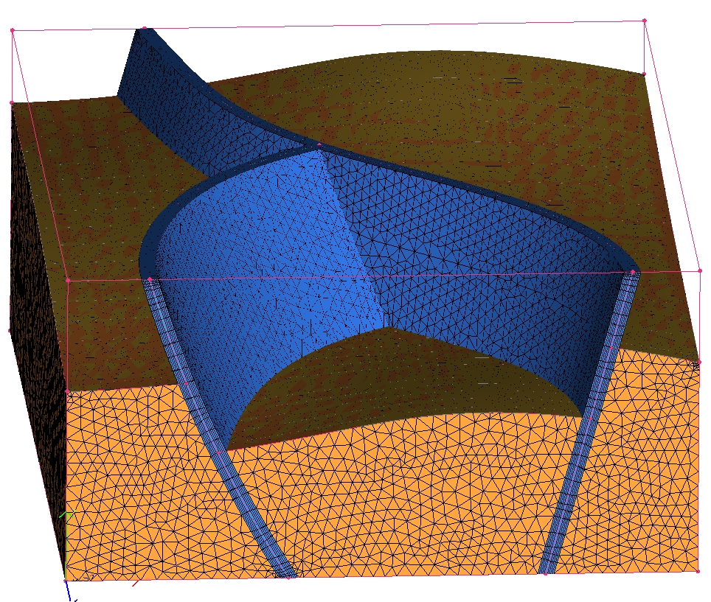
Faults with internal property layers
Volumetric mesh (Region): Faults that have a lower permeability than the surrounding rocks or which have a layered internal structure / permeability – porosity distribution must have a volumetric representation.
In ANSYS this is facilitated using a step-by-step meshing approach starting with a surface mesh from which prisms and hexahedra are grown, see Paluszny et al. (2007, Geofluids).
prism mesh of slip planes, breccia zones, and fractured damage zones
Note: Pressure differences across faults can not be captured using surface fault representation because pressure nodes on either side of the fault are shared.
unstructured grid

Slide 34
4. CSMP++ HYBRID Finite-Element
FINITE-VOLUME FrameWork, ELEMENT types and Conventions

Slide 35
Finite-Element node-centered Finite Volume Scheme
(operator splitting: FEM for elliptic-parabolic equations; FVM for hyberbolic ones)
Exact Solution
Linear FEM Solution
Objective
Mass / volume conservation at the minimum computational cost
f(x)
Element 1
Element 2
Element 3
finite volume
X
Node 1
Node 2
Derivative of Linear FEM Solution, e.g., p_{f} gradient
Notes:
Integration of properties is required

Slide 36
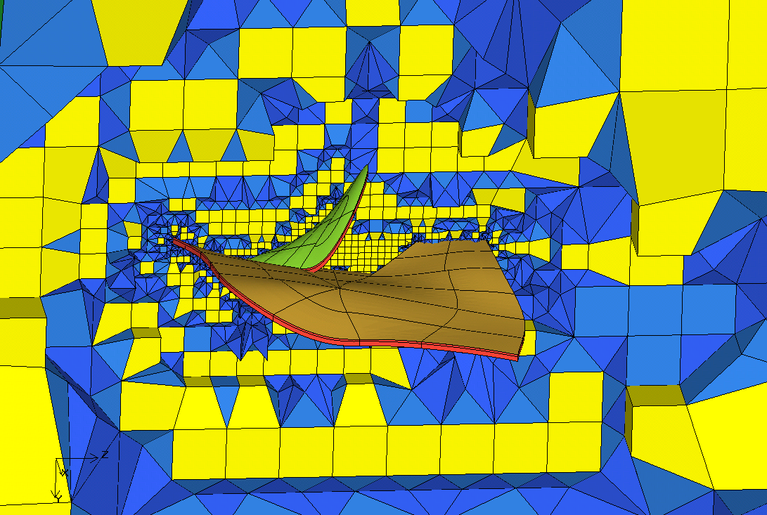
Unstructured finite element Mesh
Pyramid
Prism
Hexahedron
Tetrahedron
Triangle
Quadrilateral
Line

Slide 37
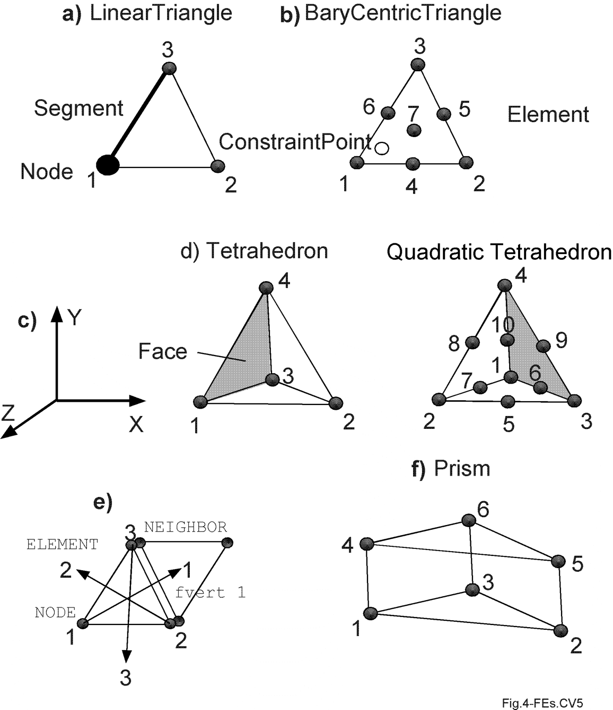
Conventions
Finite-element topology and placement of physical variables on the mesh.
a): Linear triangular element with counter-clockwise node numbering and coordinate system as indicated in ‘c’.
b): Pseudo-cubic triangular element for 2D displacement-stress-strain calculations.
c): 3D coordinate system obeying right-hand rule.
d): Node numbering in 4-noded tetrahedral element and in 10-noded quadratic tetrahedral element.
e): Each element knows its neighbor (fvert) element and can access it through a numbering scheme where neighbor 1 lies opposite of node 1 and so forth.
f): Prism element suitable for reducing number of elements in thin layers.

Slide 38
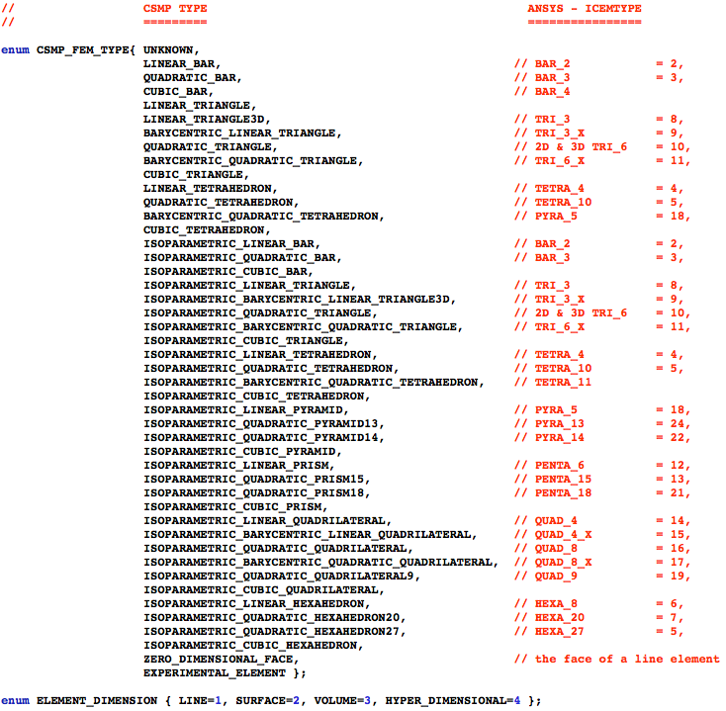
CSMP++ Finite element library

Slide 39
Element integer codes
1 | LINEAR_BAR
2 | QUADRATIC_BAR
3 | CUBIC_BAR
4 | LINEAR_TRIANGLE
5 | LINEAR_TRIANGLE3D
6 | LINEAR_QUADRILATERAL
7 | LINEAR_CUBOID
8 | LINEAR_RECTANGLE
9 | BARYCENTRIC_LINEAR_TRIANGLE
10 | QUADRATIC_TRIANGLE
11 | BARYCENTRIC_QUADRATIC_TRIANGLE
12 | CUBIC_TRIANGLE
13 | LINEAR_TETRAHEDRON
14 | QUADRATIC_TETRAHEDRON
15 | BARYCENTRIC_QUADRATIC_TETRAHEDRON
16 | CUBIC_TETRAHEDRON
17 | ISOPARAMETRIC_LINEAR_BAR
18 | ISOPARAMETRIC_QUADRATIC_BAR
19 | ISOPARAMETRIC_CUBIC_BAR
20 | ISOPARAMETRIC_LINEAR_TRIANGLE
21 | ISOPARAMETRIC_BARYCENTRIC_LINEAR_TRIANGLE
22 | ISOPARAMETRIC_QUADRATIC_TRIANGLE
23 | ISOPARAMETRIC_BARYCENTRIC_QUADRATIC_TRIANGLE
24 | ISOPARAMETRIC_CUBIC_TRIANGLE
25 | ISOPARAMETRIC_LINEAR_TETRAHEDRON
26 | ISOPARAMETRIC_QUADRATIC_TETRAHEDRON
27 | ISOPARAMETRIC_BARYCENTRIC_QUADRATIC_TETRAHEDRON
28 | ISOPARAMETRIC_CUBIC_TETRAHEDRON
29 | ISOPARAMETRIC_LINEAR_PYRAMID
30 | ISOPARAMETRIC_QUADRATIC_PYRAMID13
31 | ISOPARAMETRIC_QUADRATIC_PYRAMID14
32 | ISOPARAMETRIC_CUBIC_PYRAMID
33 | ISOPARAMETRIC_LINEAR_PRISM
34 | ISOPARAMETRIC_QUADRATIC_PRISM15
35 | ISOPARAMETRIC_QUADRATIC_PRISM18
36 | ISOPARAMETRIC_CUBIC_PRISM
37 | ISOPARAMETRIC_LINEAR_QUADRILATERAL
38 | ISOPARAMETRIC_BARYCENTRIC_LINEAR_QUADRILATERAL
39 | ISOPARAMETRIC_QUADRATIC_QUADRILATERAL
40 | ISOPARAMETRIC_BARYCENTRIC_QUADRATIC_QUADRILATERAL
41 | ISOPARAMETRIC_QUADRATIC_QUADRILATERAL9
42 | ISOPARAMETRIC_CUBIC_QUADRILATERAL
43 | ISOPARAMETRIC_LINEAR_HEXAHEDRON
44 | ISOPARAMETRIC_QUADRATIC_HEXAHEDRON20
45 | ISOPARAMETRIC_QUADRATIC_HEXAHEDRON27
46 | ISOPARAMETRIC_CUBIC_HEXAHEDRON
47 | ZERO_DIMENSIONAL_FACE
48 | POINT_ELEMENT
49 | POLYGONAL_ELEMENT
50 | POLYHEDRAL_ELEMENT
51 | EXPERIMENTAL_ELEMENT
Primary focus is on the isoparametric element family.

Slide 40
Numbering Nodes, Segments, Faces and Neighbors
S = Segment, F=Face, C-style numbers, 0...n-1

Slide 41
Numbering Nodes, Segments, Faces and Neighbors

Slide 42
Finite-element finite-volume terminology
enum PLACEMENT { ELEMENT_INTEGRATION_POINT = 1,
SECTOR_INTEGRATION_POINT = 2,
FACET_INTEGRATION_POINT = 3,
NODE,
EDGE,
FACE,
INTER_FACE,
ELEMENT,
REGION,
BOUNDARY,
SPLIT_BOUNDARY,
MODEL,
UNDEFINED };
FiniteVolume
=FEM node
FiniteVolumeStencil
(as illustrated for linear triangle)
x
FE integration point
sector integration point
facet integration point
subface of element face
FV Sector
FV Facet
x
x
inside node
outside node
NB: Facet normals always point to node with higher local number

Slide 43
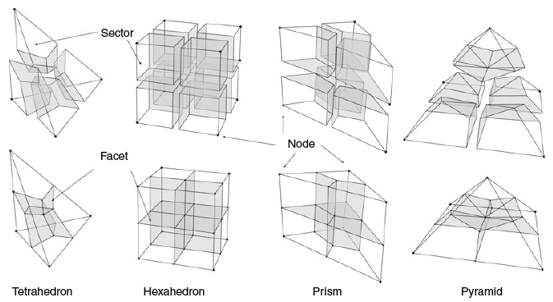
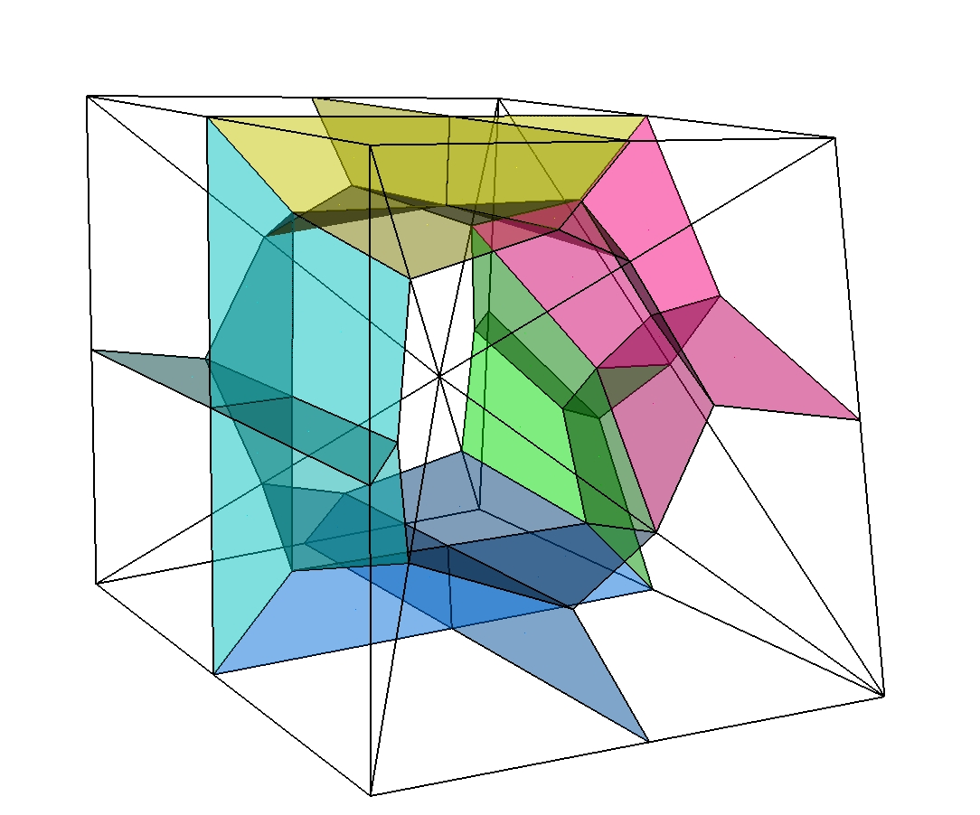
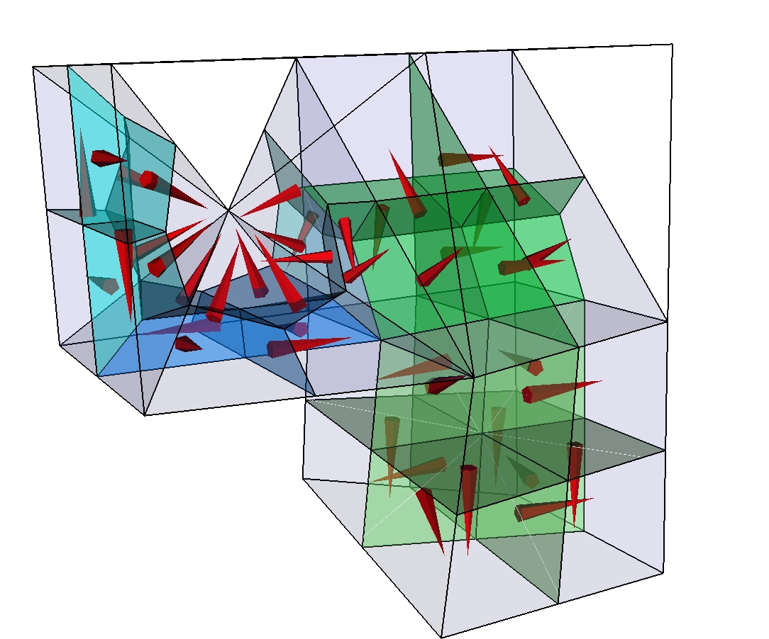
Finite-volume stencils for isoparametric finite elements
Finite volume mesh is not stored
Stencils assemble FVs from different FEs
Efficient
Isoparametric
Numerical integration is applied
For
single element types
Paluszny, Matthai and Hohmeyer (2007, Geofluids)
For
hybrid meshes: FV cells
shared by
different
element
types

Slide 44
Summary
CSMP Models consist of a finite element mesh with associated variables.
Variable types supported by CSMP are Scalar- Vector- Tensor-, Array and FlaggedArray variable.
CSMP variables consist of flag-value pairs.
CSMP Models are constructed with mesh and property data supplied by VSet (*.dat file) and ModelTopology (*.asc file) containers, respectively; their relevant interfaces were described.
CSMP Models consists of Region, Boundary and SplitBoundary objects that divide it into volumetric and surface subdomains,if not disconnected mesh patches, respectively.
CSMP Models are initialised using VSet (mesh + property) and ModelTopology containers.
Initialisation via text files uses a human readable .asc file with the model region info and a text/binary file containing the mesh.

Slide 45
The End
Contact us if you have any questions!

