Slide 1


Notes:
I would like to present a short teaser on what Helma van der Linden is going to present on Thursday in her presentation “Generic screen representations for future proof systems, is it possible?”.
It won’t be technical (won’t explain the proof-of-concept application), but provide the main ideas behind this work.

Slide 2
Assumptions & Problem
Interoperable archetype-based EHR systems exist.
Receiving system: completely unknown data
Fetching underlying archetypes (semantics for machine processing)
HOWEVER, for the best interpretation (by the clinician) the information has to be displayed in a suitable format, which archetypes don’t necessarily provide!
Presentation level interoperability is needed.
Notes:
On the premise that...
So I can happen that a system receives...
...it can understand it and process it further.

Slide 3
Presentation Level Interoperability
Mainly an issue of data display!
Three types of presentation knowledge can be distinguished:
  Information-related presentation knowledge
  Localized presentation knowledge
  Device-related presentation knowledge
Notes:
With data input the type of data is usually known in advance and the input screen can be developed accordingly.
e.g. slash between systolic and diastolic blood pressure
e.g. different data formats in the US
e.g. on PDAs is less space so the screen has to be organised differently.

Slide 4
Idea
Two model approach to generic GUI generation.
Separation between:
  GUI widgets as building blocks (GUI designer)
  Content units made up of widgets (medical expert)
A content unit matches a single archetype or an archetype aggregation.
Content units can be retrieved from a server for optimal display  exchange & reuse.
Notes:
A two model approach to generic GUI generation is suggested, similar to openEHR’s archetype approach.
Such a two model approach separates between:
GUI widgets as building blocks (developed by GUI desinger)
Content units, that are made up of 1 to several widgets (created by medical expert)
...or a combination of archetypes

Slide 5
Cocoon Prototype
Similarities with Ocean Informatics’ EhrView.
Also uses XSLT and outputs XHTML.
Built-in advantages:
  Modularisation (component pipeline)
  Localisation support
End of teasing
Helma’s presentation “Generic screen representations for future proof
systems, is it possible?” – Thursday 4pm, Room GH4
Notes:
The Prototype that Helma will present in her presentation has similarities to OI’s EhrView. It also uses XSLT and outputs XHTML.
The built-in Cocoon advantages:
- ...through typical component pipeline
-

Slide 6
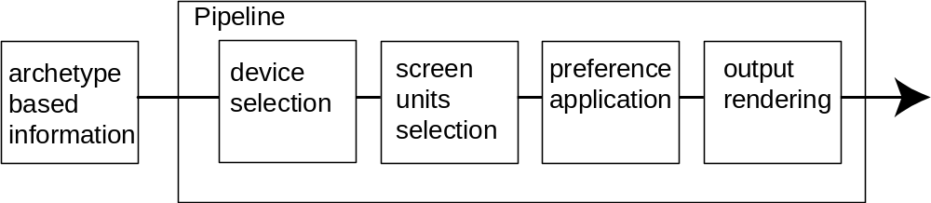
Cocoon Framework
part of the Apache Foundation (http://cocoon.apache.org)
implemented in Java
XML centric
central component pipeline concept
powerful & versatile basis for:
→XML web publishing (initially)
→XML enabled web applications

