Slide 1

Framework for clinical data standardization based on archetypes
José Alberto Maldonado
Biomedical Informatics Group, ITACA Institute, Technical University of Valencia, Spain

Slide 2
Objective
Use dual model methodology to data integration and sharing:
  Archetypes as semantic descriptors of data to be shared.
  Archetypes as a means to normalise legacy data.

Slide 3
Index
Archetype formalization
LinkEHR-Ed
  Management of reference models
  Archetype edition
  Mapping to data sources
  Data transformation scripts

Slide 4
Formalization
Objective. To define a precise semantics for archetypes including instances, relationship with reference models and specialization in order to develop advance archetype tooling.

Slide 5
Formalization
EHR data instances are abstracted as trees with labelled nodes.
Archetype definition section is modeled as a type that defines a set of trees. It is based on label predicates and regular expressions.
For the modeling of archetype specialization we use the notion of subsumption which is compatible with the syntactical rules used for node identification in ADL.
It is also used for modeling the reference models.

Slide 6
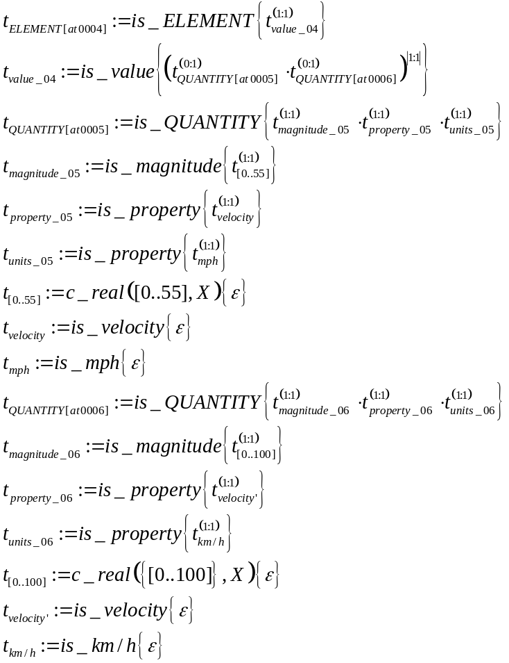
Example
ADL
Type system
ELEMENT[at0004] matches { -- speed limit
value existence matches {1..1} matches {
QUANTITY[at0005] matches {
magnitude matches {0..55}
property matches {"velocity"}
units matches {"mph"} -- miles per hour
}
QUANTITY[at0006] matches {
magnitude matches {0..100}
property matches {"velocity"}
units matches {"km/h"} -- km per hour
}
}
}

Slide 7
LinkEHR
LinkEHR is a multi reference model tool that permits the edition of archetypes, mapping them to data sources and generate XQuery programs that output XML documents compliant with the reference model being used.
LinkEHR is a java based application that has been created as a RCP application of the Eclipse framework. This allows LinkEHR to be completely platform independent.
LinkEHR’s main features are:
  Based on the previous formalisation
  Support multiple reference models

Slide 8
Overall process
Business
archetype
repository
Archetype
repository
Terminology
Data source
Schema Relational, XML)
Saves (ADL, XML)
Reference model
Import
Archetype edition
Mapping edition
Reference model as
XML
Schema
Mapping
repository
2
3
1
3
Instance generation
Data transformation script generation
XML
document
4
Compliant with
Data source
Data source

Slide 9
Reference model importation
Business
archetype
repository
Archetype
repository
Terminology
Data source
Schema Relational, XML)
Saves (ADL, XML)
Reference model
Import
Archetype edition
Mapping edition
Reference model as
XML
Schema
Mapping
repository
2
3
1
3
Instance generation
Data transformation script generation
XML
document
4
Compliant with
Data source
Data source

Slide 10
Reference model importation
LinkEHR is able to handle different reference models. The importation of new reference models is done by analyzing the XML Schema Definition (XSD) at run time:
  the user must specify the business concepts
The import process generates an archetype expressed in ADL for each business concept, we call them business archetypes.
CEN EN13606 and OpenEHR have been tested successfully.

Slide 11
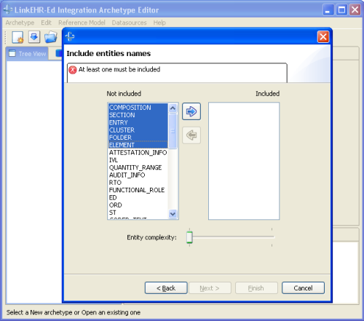
Reference model importation

Slide 12
Archetype edition
Business
archetype
repository
Archetype
repository
Terminology
Data source
Schema Relational, XML)
Saves (ADL, XML)
Reference model
Import
Archetype edition
Mapping edition
Reference model as
XML
Schema
Mapping
repository
2
3
1
3
Instance generation
Data transformation script generation
XML
document
4
Compliant with
Data source
Data source

Slide 13
Archetype edition
Although LinkEHR-Ed is oriented to definition of mappings to data sources, it may operate as a pure archetype editor.
New archetypes can be defined from scratch or by specializing or altering existing ones such as those drawn from public repositories. In either way, there always exists an specialization hierarchy whose root is a business archetype:
Business Archetype
Business Archetype
specialises
Parent archetype
specialises
New archetype
specialises
New archetype

Slide 14
Archetype edition
One interesting consequence of considering business concepts as archetypes is that same logic can be applied both to the specialisation of an existing archetype or to the definition of a new archetype by constraining a business concept.
Therefore, in LinkEHR-Ed for the sake of archetype edition, it is only hard coded the logic that guides archetypes specialization. This allows:
  To work with different reference models easily
  To cope with the evolution of reference models

Slide 15
Comprehensive archetype
For archetype edition and mapping LinkEHR-Ed uses what we call comprehensive archetypes. Given an archetype, its comprehensive archetype contains both the implicit (from reference model) and the explicit constraints that data instances should obey.

Slide 16
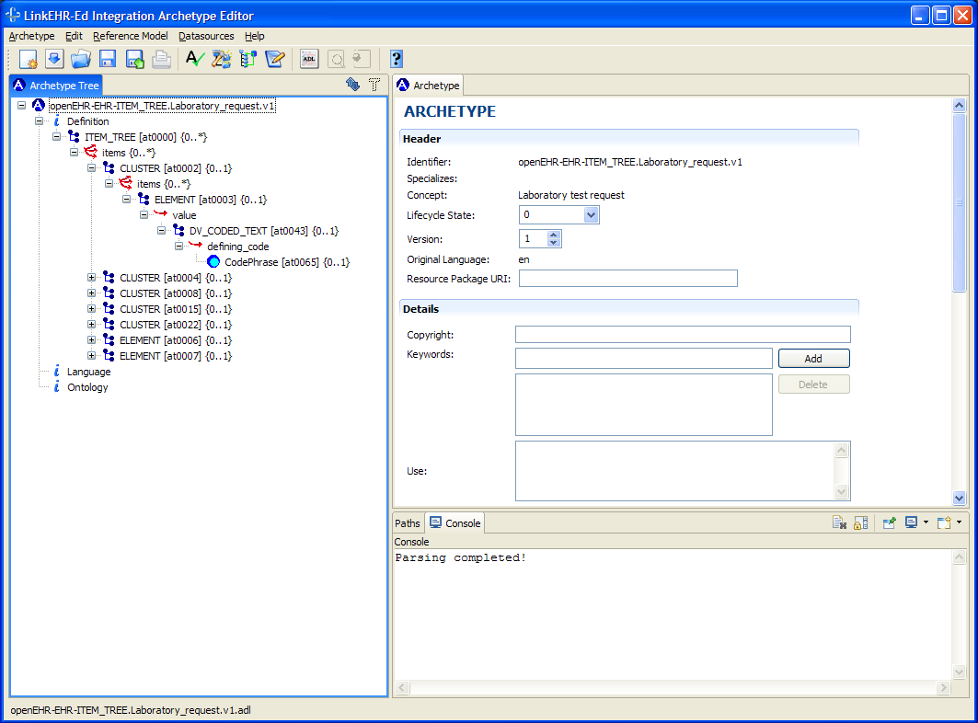
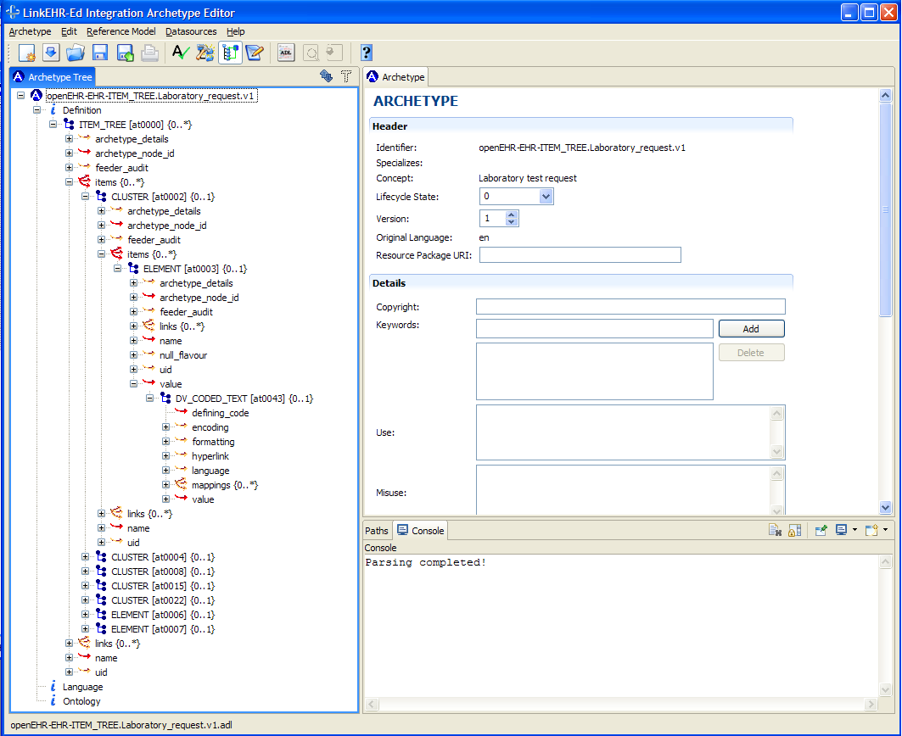
Comprehensive archetype
Original archetype
Comprehensive archetype

Slide 17
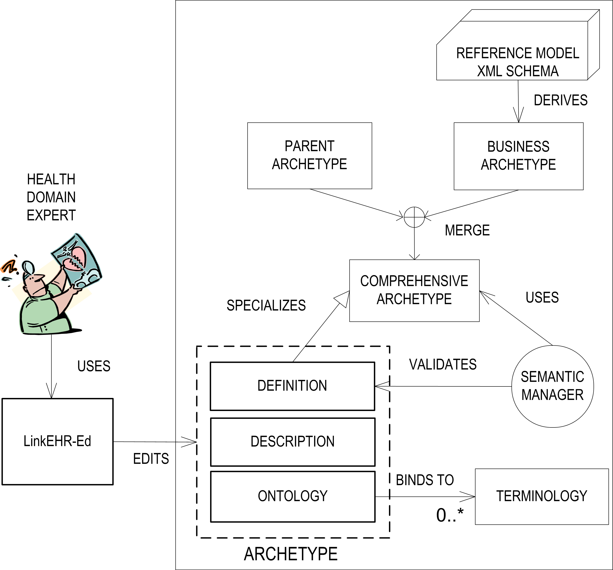
Overall edition process

Slide 18
Validation
LinkEHR assures that the new archetype satisfies both the constraints stated by the reference model entity being archetyped and the archetype being specialized. For this purpose we have developed a semantic validator:
  It checks the validity with respect to the underlying reference model or parent archetype when an archetype is loaded into the editor. For this purpose an algorithm has been developed.
  It check that the mapping information is sound and complete (valid instances can be generated).
  It guides the edition process by determining which entities can be used (examples in the two following slides).

Slide 19
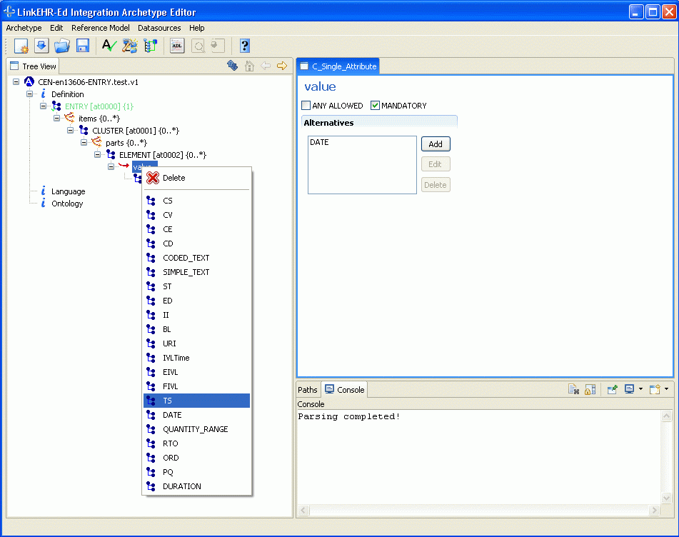
Valid data types (EN13606)

Slide 20
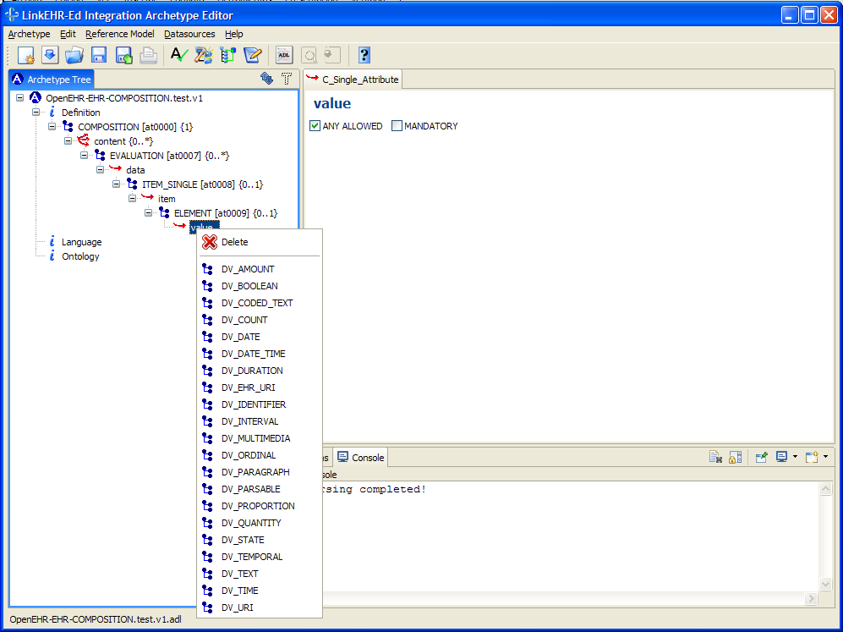
Valid data types (OpenEHR)

Slide 21
Mapping edition
Business
archetype
repository
Archetype
repository
Terminology
Data source
Schema Relational, XML)
Saves (ADL, XML)
Reference model
Import
Archetype edition
Mapping edition
Reference model as
XML
Schema
Mapping
repository
2
3
1
3
Instance generation
Data transformation script generation
XML
document
4
Compliant with
Data source
Data source

Slide 22
Data Source Mapping
LinkEHR helps the user to define mappings between data sources and archetypes.
The canonical data model is XML, therefore data at the sources are viewed as XML documents.
It is based on a specify-generate approach.
Multiple mappings from different data sources can be defined.

Slide 23
Specify-generate
High level mappings
(set of attribute mappings)
Target schema
(archetype)
Source
schema
Compiler
Conforms to
Conforms to
data
EHR instance
Low level mapping
(XQuery transformation program)

Slide 24
Types of mapping
There are two kinds of mappings
  Atomic attribute mappings. They define how to obtain a value for an atomic attribute of an archetype by using a set of values from the data sources.
  Class mappings. They contain both the query to be used to retrieve all the data necessary for generating data instances and the set of attributes that identify univocally the class instances.

Slide 25
Atomic attribute mappings
Are composed of:
  A set of function-condition pairs. The function defines how to compute a value for the archetype atomic attribute by using a set of values extracted from a data source. The condition defines the subset of values of the data source that can be used to compute values for the atomic attribute.
Given a atomic attribute several attribute mappings can be defined.

Slide 26
Examples
Simplest mapping
condition | function
true | Attribute_height
Basic mapping
condition | function
true | Attribute_height * 100
Conversion mapping
condition | function
Attribute=“male” | 0
Attribute=“female” | 1

Slide 27
Class mapping generation
Archetype designers are responsible of defining the atomic attribute mappings and the system tries to generate from them a set of candidate class mappings by taking into acount the archetype constraints and the integrity constraints of data sources.
This approach alleviates the work of defining how to populate archetypes since it is easier for the designer to indicate which data elements of the data sources are relevant to a certain archetype attribute, rather than to specify the possible complex query required to extract and transform all the relevant information.

Slide 28
Data transformation
Business
archetype
repository
Archetype
repository
Terminology
Data source
Schema Relational, XML)
Saves (ADL, XML)
Reference model
Import
Archetype edition
Mapping edition
Reference model as
XML
Schema
Mapping
repository
2
3
1
3
Instance generation
Data transformation script generation
XML
document
4
Compliant with
Data source
Data source

Slide 29
Data transformation
From the set of atomic attribute mappings and class mappings an XQuery expression is generated, which transforms the XML view of the data source into an XML document that satisfies the constraints imposed by the archetype and at the same time is compliant with the RM.
A wrapper that generates an XML representation for the data source in the case of relational sources is also constructed.

Slide 30
Present and future work
To improve the visual interface for mapping specification.
Reference models as plug-ins.
To improve the reference model import module in order to support a wider range of XML Schema constructs.

Slide 31
More information:
  http://www.ibime.upv.es
  José Alberto Maldonado: jamaldo@upv.es
Thank you!

