Slide 1
An Ontology-based Model of Clinical Information
Sam Heard, MD
Thomas Beale
MedInfo 2007
Wednesday 22 Aug

Slide 2
The Authors
Dr Sam Heard
  General practitioner 25 years, academic, clinical training…25 years’ experience in computerising the health record – first patient record system in London
Thomas Beale
  Electrical Engineer, software engineering for 20 years…13 years thinking about EHRs
The value of combining deep clinical and deep technical understanding cannot be over-emphasised…

Slide 3
The Problem
Find a model of recorded clinical information that…
  Delivers the right information at the right time in patient care
  Creates information that computers understand (reliably)
  Enables management of populations of patients – e.g. clinic recalls
  Support medical research use of data

Slide 4
Some Tough Problems
Problems of linguistic interpretation
  ‘Status’ of clinical information & Negation
  Linguistic v clinical meaning of phrases
Problems of inference
  Time → timing of events in the real world?
  Absence (of obs) → absence of condition?
  Multiple recurrences → underlying / chronic
Problems of usability
  Clinical workflow not supported by EHR apps
  Causal & other links between items

Slide 5
(not to mention…)
Context – the basic problem of knowing who the note is about, when, and where
Bitemporality of clinical information
Etc…

Slide 6
Problems we think we can help with

Slide 7
Problem #1
‘Status’ of clinical statements:
  (no) X (observed / assessed?)
  (no) History of X (in patient)
  (no) Family history of X
  Risk of / no risk of / low risk of X
  Fear / Concern of X
  P carried out 2/jun/1974
  P contra-indicated
  P recommended within next 6 months
  P scheduled

Slide 8
Problem #2
Negation
  Does ‘no allergy to bees’ mean ‘no allergy to bees’ or ‘no allergic reaction to bees observed on 13/jun/1999 after beesting’?
  Does ‘not leukaemia’ in a clinical note mean there is really no leukaemia, or just that the signs & symptoms so far don’t indicate it?
Are there better ways than simply narratively saying ‘no allergies’ etc?

Slide 9
Problem #3
Timing and causality
Contextual time needs to be clear
  Time of encounter
  Time(s) of observation (samples)
  Time of committal of information
  Episode (of care)
Clinical sequence of activities:
  Observe → assess → plan …

Slide 10
Problem #4
There is a VAST difference between recording in an uncontrolled narrative mode and structured capture mode
Uncontrolled narrative can still only safely be understood by human beings
Computers need to work with structured and/or coded information – whether it is captured that way or post-processed

Slide 11
Problem #5
We needed a classification basis for an information model of health recording – i.e. what are the classes?

Slide 12
Our basis
Clinical healthcare is a 1) rational scientific 2) problem-solving 3) process used to generate decisions
Decisions require evidence and evaluation of evidence
But real healthcare is messy
  GPs may prescribe without diagnosing
  Patients and nurses administer with no order
  Many exceptions, e.g. reactions to drugs
  Experienced doctors correctly diagnose without ‘following the book’

Slide 13
History of Solutions
Paper records – little internal organisation
Weed’s POMR – SOAP organisation of information – hard to implement
Elstein ‘hypothetico-deductive’ model of clinical reasoning – diagnosis-focussed
Rector et al - PEN&PAD – how to record what we said, what was thought and what should be done about it

Slide 14
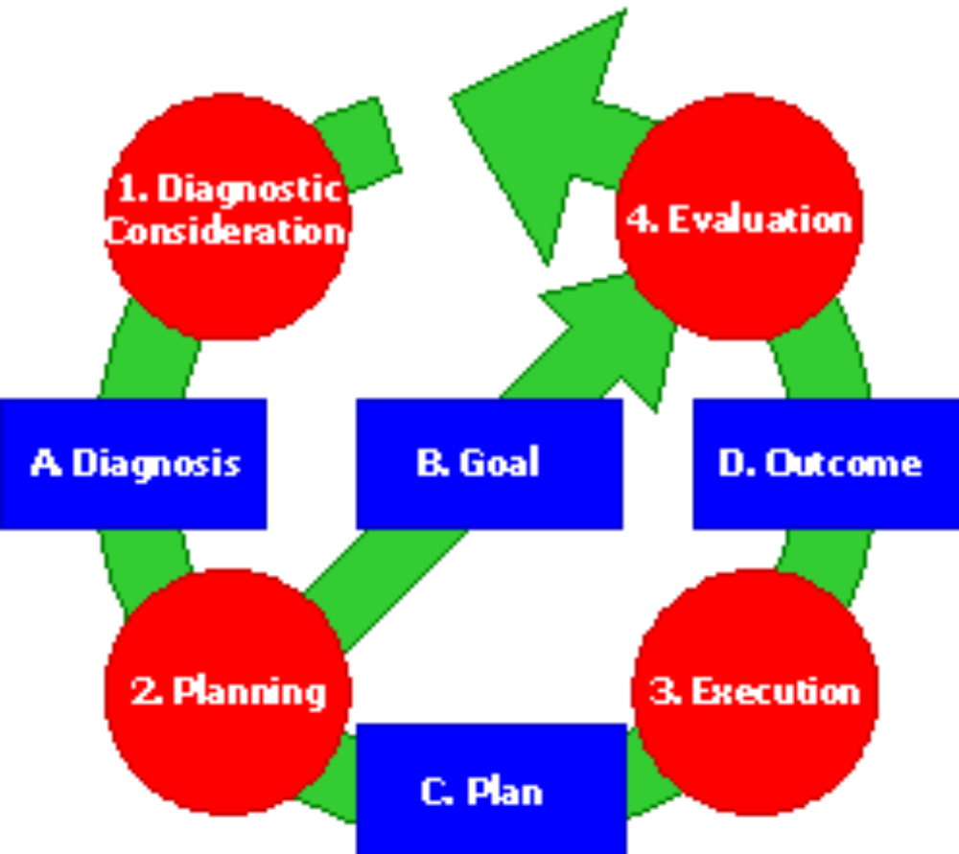
History of Solutions – Danish G-EPJ

Slide 15
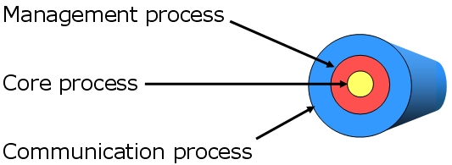
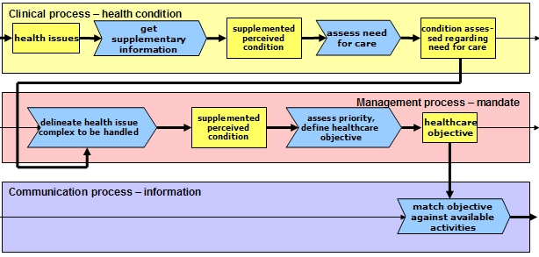
History of Solutions - Samba

Slide 16
History of Solutions – Act-based
Includes
  RICHE
  HL7v3 RIM
  Many others
Problems
  everything is an act – good for tracking business process steps, but not natural to physicians
  Hard to model typical clinical recordings

Slide 17
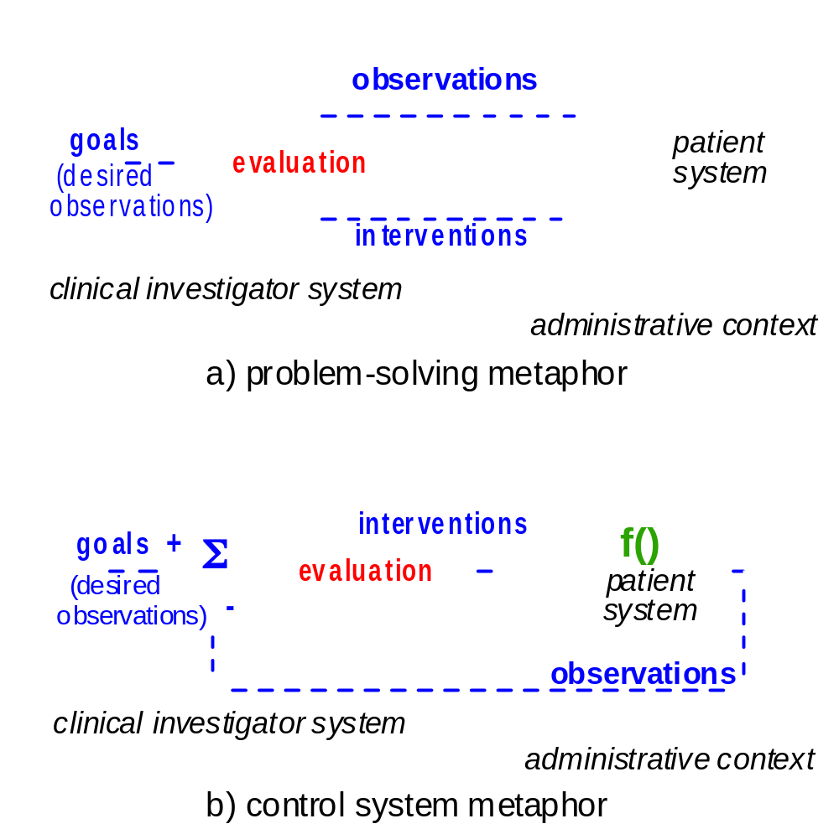
Our approach – ‘Clinical Investigator’
Based on clinical process

Slide 18
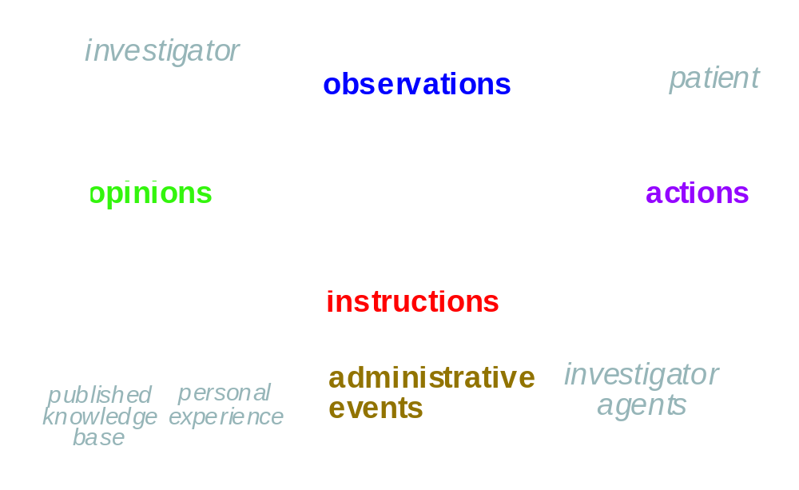
Leading to Types of Information

Slide 19
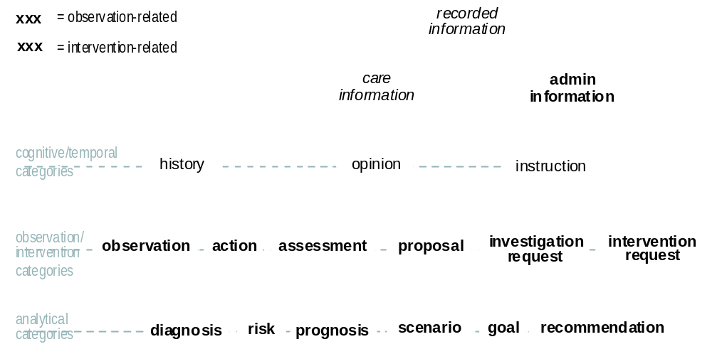
Leading to an Ontology

Slide 20
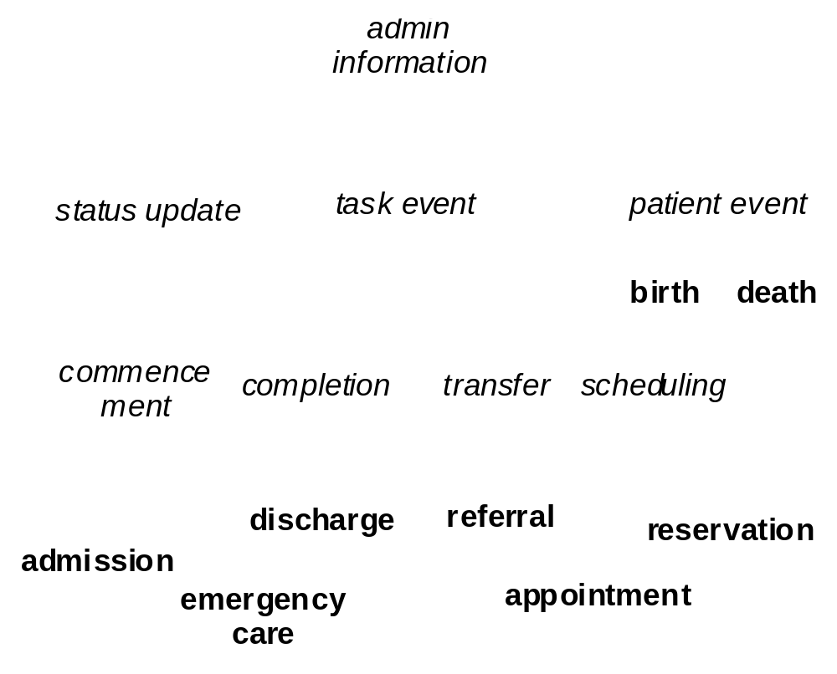
(with a speculative part)

Slide 21
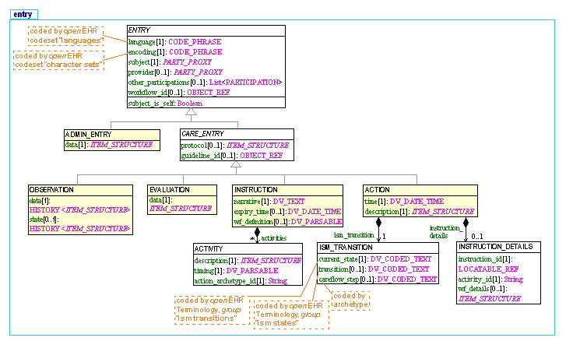
Leading to an Information Model
(Entry part shown here)

Slide 22
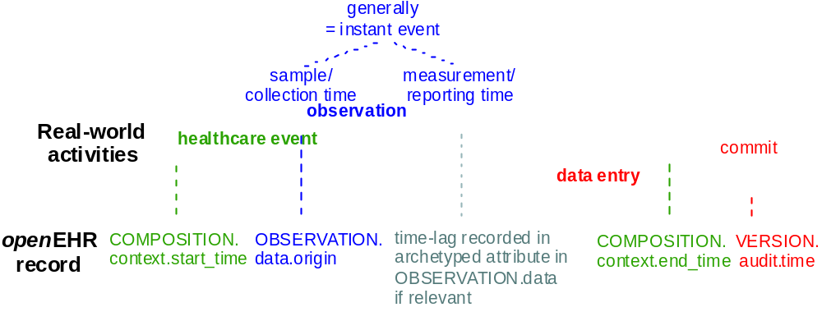
Clear model of timing

Slide 23
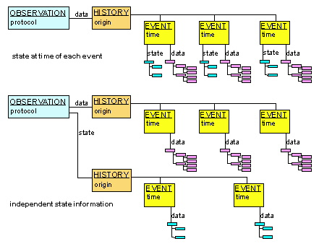
Observation = data/state/protocol

Slide 24
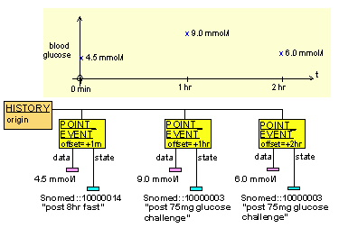
Glucose Tolerance Test

Slide 25
Instructions and Actions

Slide 26
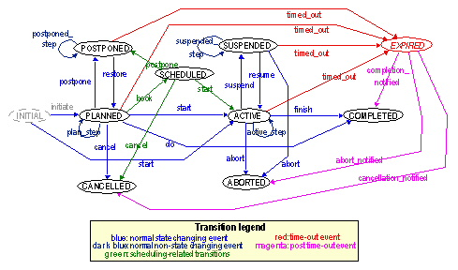
State machine – Instructions and Actions

Slide 27
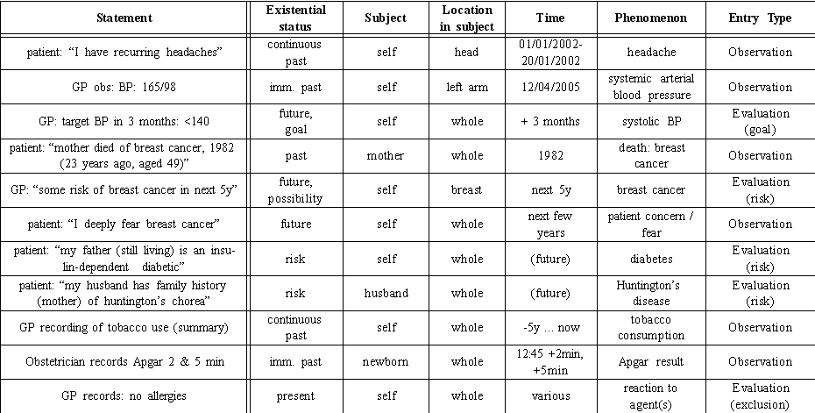
Validation – theoretical

Slide 28
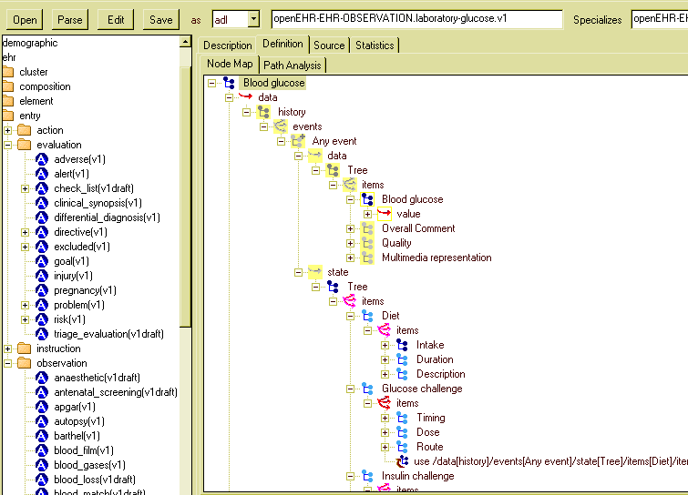
Validation – clinical models

Slide 29
Solving the problems
Clinical process, causality, links now clear
Timing modelled at coarse and fine grain
Clinical statement status –
  Basic categories in information model
  Finer categories in archetype ontology
Negation – falls out in good archetype design
Information model has been very clear (took 4 years to get right)

Slide 30
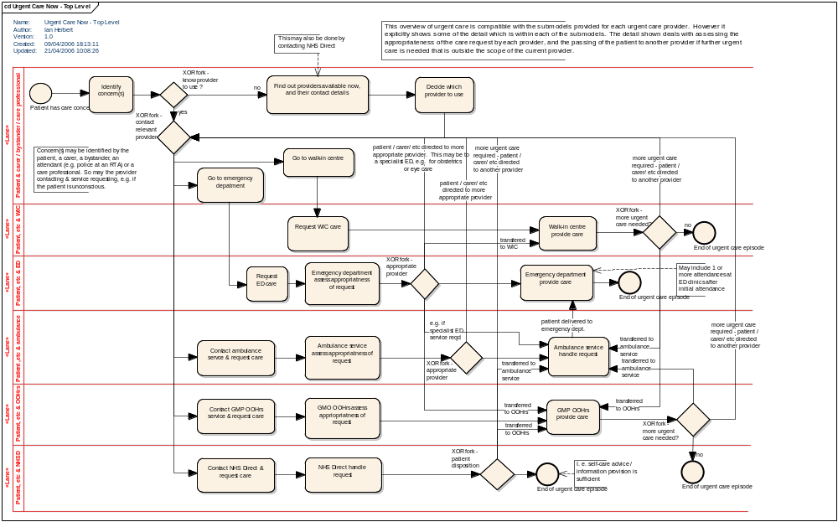
An NHS analysis
(Dr Tony Shannon, cons. ED Leeds General Infirmary)

Slide 31


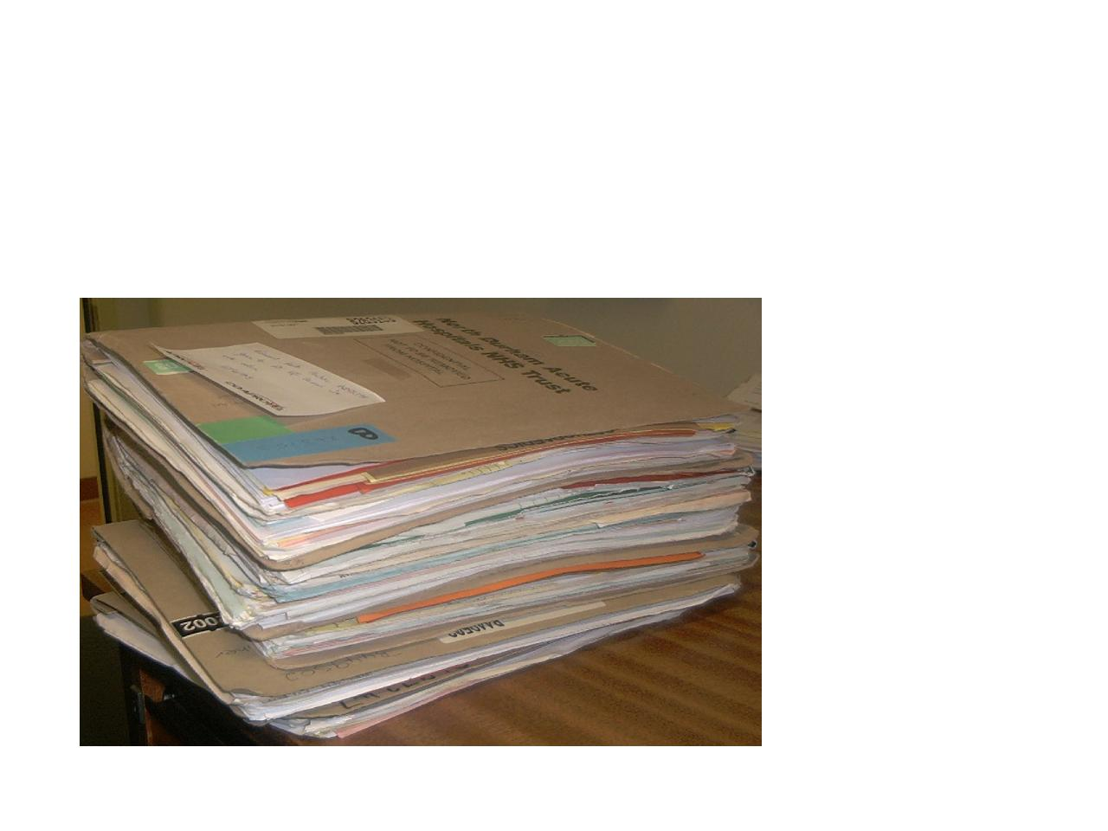
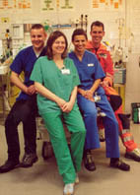
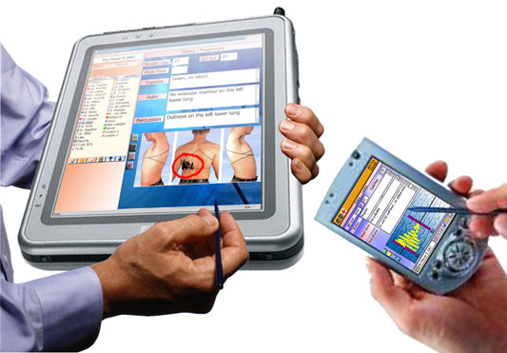
A view of Generic Processes in the NHS
Strategic (++ patients)
Performance management e.g. Audit
Tactical ( > 1 patient)
Resource Management e.g. staff, beds
Operational (1 patient)
Referral in
observation
Assessment
Diagnostics
evaluation
action
Deliver Care
Plan Care
instruction
Sorting
Referral Out

Slide 32
A journey through the NHS …
Self care
Angina diagnosis & 1st care plan
GP
Suspected MI: self-care advice given & ambulance requested
NHS Direct
Ambulance
Taken to A&E: given oxygen in transit
Returns to self / primary care
A & E
Diagnosis confirmed: & patient stabilised
Acute CCU
Transferred to CCU to complete post-MI care
time

Slide 33
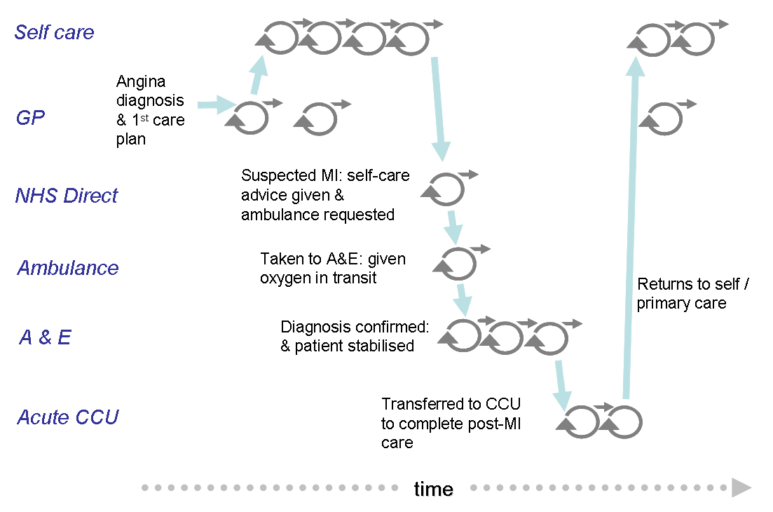
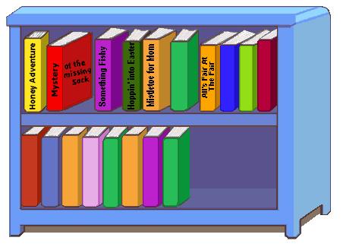

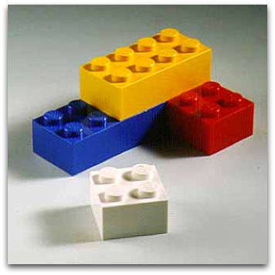

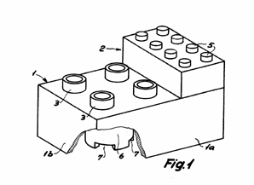
Specific Care Pathways Content Library
Generic Generic Process Record Architecture

Slide 34
Conclusion
Information model has been stable for about 18 months
Core of the openEHR Information Model
Whole clinical process covered
250+ archetypes – Aus & NHS work
Decision support and scientific querying validation still to come

