Slide 1
What if we really had an electronic health record?
W. Ed Hammond, Ph.D.
President, AMIA
Vice-chair, HL7 Technical Steering Committee
Co-chair, HL7 Vocabulary TC
Co-chair, HL7 EHR SIG
Convenor, ISO TC 215 Working Group 2
Chair, Data Standards Working Group, Connecting for Health
Adjunct Professor, Fuqua School of Business, Duke University
Professor-Emeritus, School of Medicine, Duke University
Notes:
W. Ed Hammond
December 13, 2002
e-hammondCopyright 2002

Slide 2
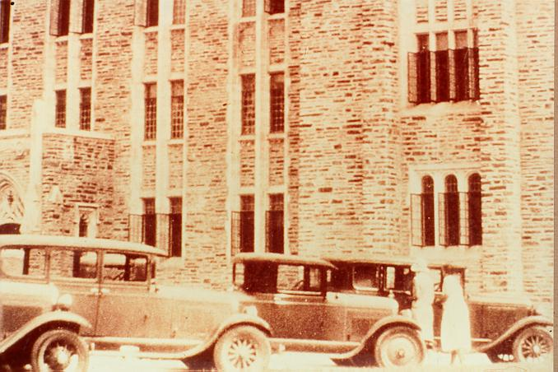
1935

Slide 3
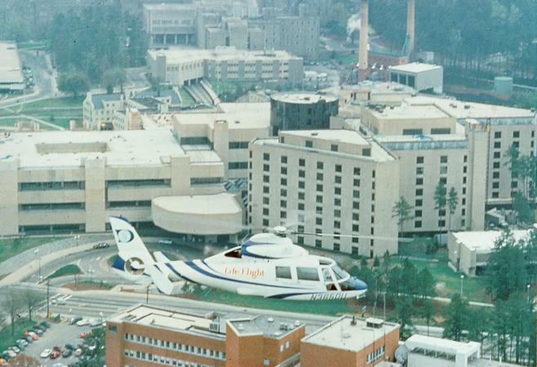
2002

Slide 4
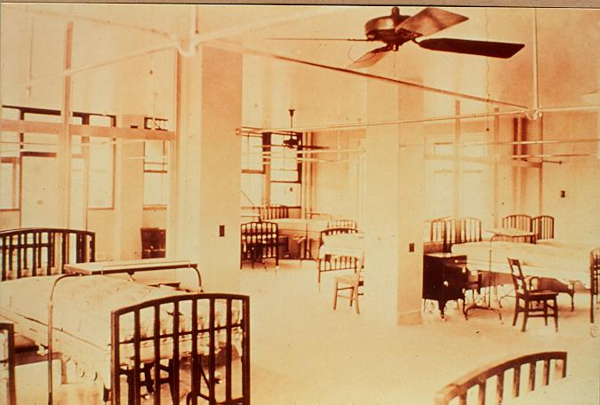
1935

Slide 5
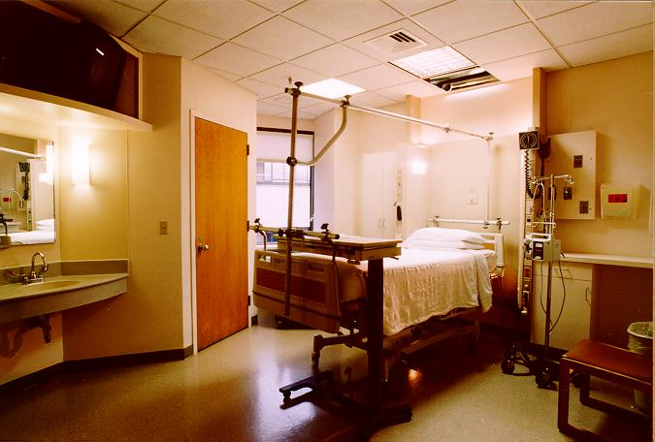
2002

Slide 6
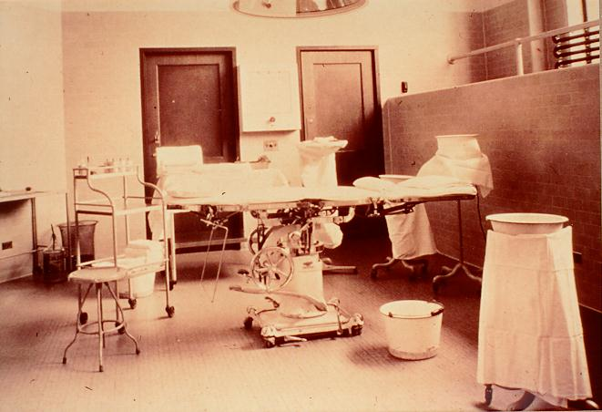
1935

Slide 7
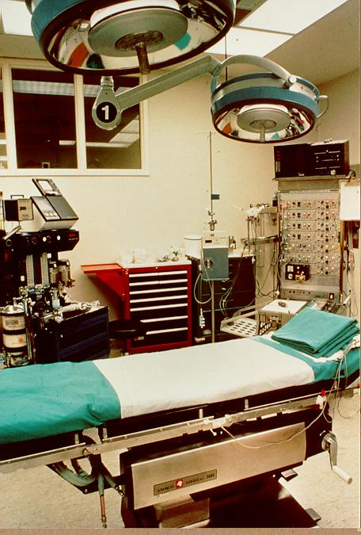
2002

Slide 8
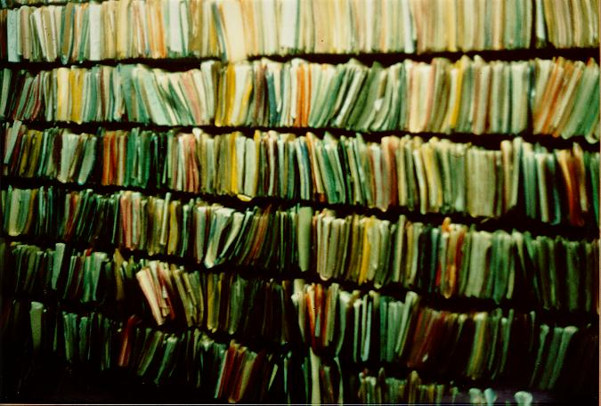
1935

Slide 9

2002

Slide 10
What is it and what do we want from it?
It is called many names – AMR, CPR, EMR, EPR, CBPR, PRMI, EHR, PHR, EHCR, ICRS
ISO defines it by referring to its multiple definitions by others.
For some it is the just the data repository, for others it includes the functionality.
For some, it has a disease orientation; i.e., the diabetes’ record.
For others, it is the place: the inpatient record.
For others, it is the view: the personal health record.
For others, it is the purpose: the billing record.

Slide 11
What does the EHR contain?
Data
  Patient-centered
  Comprehensive
  Aggregated
  Organized
  High data integrity
  Timely
  Structured, semantically understandable
  Sharable
  Accountable
  Secure and private

Slide 12
What does the EHR provide?
Information for …
  Patient care
  Prevention of medical errors
  Improved quality of care
  Consistency in care
  Cost effective care
  Shared understanding of health and health care among patient and provider
  Health surveillance and biodefense
  Workflow management
  Research
  Epidemiology
  Billing

Slide 13
With what does the EHR interact?
Knowledge
  Clinical trials
  Decision support
  Disease demographics
  Outcomes
  Quality indicators
  Evidence based medicine

Slide 14
What does an effective EHR permit?
Wisdom
  New models for health and health care
  More cost effective care
  Better understanding of disease and disease processes
  Better relationship among stakeholders
  A happier, healthier world

Slide 15
What are we talking about?
Hospital Information System
Departmental Systems (laboratory, radiology, pharmacy, materials management)
Computerized Physician Order Entry Systems
ePrescribing Systems
Administrative/Financial/Billing Systems
Ambulatory Systems
Specialty Systems (Cardiology, OBGYN, Pediatrics, Nephrology, …)
Data Warehouse
Research Database

Slide 16
How many EHRs are there?
Inpatient medical record
Outpatient health record
Primary care medical record
Disease-specific record (cardiology, hypertension, diabetes, etc.)
Intensive care record
Emergency department record
Nursing record
Nursing home record
Billing/claims record
Research record

Slide 17
Some thoughts …
There will be more than one type of EHR and the purpose each type will be different.
The site of care is one of the most important features.
The purpose of the EHR is also important.
The required functionality will be somewhat different for each type of record.
The persistence of data will vary with site and purpose.
The core components of all records must be the same in terms of the data elements and how they are represented.
All types of records are interconnected.

Slide 18
More thoughts …
We cannot afford to collect data multiple times. Data must be reusable and must serve all purposes.
Patient care is the primary focus of the EHR. Other purposes, including legal and billing should be derived from that purpose.
Research databases should be derived from clinical data. At times, this effort may require the collection of additional data elements, but process must be absorbed into the care process.
Service processes must be integrated into the EHR and its functionality.

Slide 19
What is an EHR? My definition …
The EHR is not a clinical repository.
Its purpose is to enhance and enable the care of the individual. Its contents are solely justified for that purpose. When data ceases to contribute to the patient care, it is removed from the EHR.
There are other repositories – a data warehouse – that contains everything forever.
The EHR documents process of care, diagnostic and treatment processes, quality, decision making, outcomes and health and functional status.
The EHR provides work-flow and information flow management.

Slide 20
Is there more than one EHR?
Yes and no
The no is because data must be integrated across the continuity of care. In an oncology setting, the patient moves between inpatient, outpatient and home care. In the Duke bone marrow transplant unit, the patient may appear in all three settings in the same day.
The yes is a consequence of the purpose and focus of the site of care. A nursing home will need less detail than an inpatient setting.
However, all the EHRs are interoperable in the sense they can be overlaid. All data is sharable when and as needed.

Slide 21
From an other perspective …
Multiple views of the EHR must also exist
  The institutional/provider view that serves the need of the institution in patient care, service management, workflow management, and billing. This view provides the source of data for other views, since it is in this setting that the patient/provider encounter takes place.
  The composite view that represents a complete summary view (the patient-centric view) of the person’s health. This view also serves needs of health surveillance, bioterrorism surveillance, and global epidemiology.
  The personal health view that is customized to each individual and their current and future health needs.

Slide 22
Multiple views …
Disease registries permit the monitoring and assurance of high quality care.
Research databases are derived for specific purposes and for specific periods of time.
Reimbursement is derived from clinical data, ideally in real time.
Accreditation, credentialing and statistical reporting are derived products.
The data warehouse contains all data for legal and archiving purposes.

Slide 23
The Inpatient View: Hospital and Intensive Care setting
The inpatient EHR (perhaps more appropriately named a Clinical Information System) includes the full functionality of the Hospital Information System. It also includes the functions of the Computerized Physician Order Entry System and the ePrescribing and administration of drugs.
Departmental systems are subsets that feed information into the Inpatient EHR. Separate databases are established to support the functioning of the departmental systems (inventory, quality control, workflow, data flow and reporting).

Slide 24
The Inpatient View:
Much of the data generated in the inpatient setting has short persistence. Its value for patient care is limited to the immediate hospital stay and only a summary is required for the longitudinal, composite summary record. The more intense the setting, the more limited is the persistence of the data.
Much of the data stored relates to process and task management. For example orders and repeat orders, requests, notifications, clinical governance, ward and bed location, patient movements and patient transfers, and operational service management are an important part of these data.

Slide 25
The Inpatient View
Presentation of data for direct patient care
  Ease documentation requirements
  Evidence-based clinical pathways/guidelines/protocols
  Multiple views of data, usually time-oriented
  Automatic creation of discharge summaries
Task and workflow management
  Automatic linkage to task management
  Coupled to scheduling for radiology and diagnostic tests, e.g.
  Patient location, patient status
Asynchronous communication among healthcare providers and workers

Slide 26
The Inpatient View:
Decision support for CPOE and ePrescribing
  Avoidance of medical error and adverse events
  Interactions with knowledge bases
  Assistance in decision making and in therapeutic options
  Longitudinal event control and remainders
  Linkage of tasks
Enhance quality improvement through monitoring and evaluation
Document provider experience
Basis for billing

Slide 27
Outpatient View
Episode and encounter based
Data change more slowly and have value over longer period of time. Patient usually seen in multiple settings asynchronously over the same period of time.
Early trend detection
Orders, prescribing
Scheduling and consults
Task and workflow management
Decision support and clinical guidelines
Primary Care Provider – gatekeeper role
Basis for billing

Slide 28
Content of Provider/Institutional record
Demographic data
  Identification
  Environment
  Occupation
  Functional/Health Status
Administrative detail
Providers, roles, dates
Reimbursement data
Appointment data
Protocols/guidelines/care plans
Activity/management
Clinical Data
  Summary Problem
  Conditions
  Studies
  Treatments
  History/Physical Exam
  Procedures
  Care provided
  Needs assessment
  Functional assessment
Encounter Data
  Place
  Provider
  Orders
  Disposition
  Outcomes
Financial Data

Slide 29
Conceptual architecture of summary longitudinal data
Data is aggregated across all points of care for each person.
Regional database contains summary data for each individual in that region.
High level MPI, contains data to identify person and linkages to regional database.
Data is identified for aggregation but de-identified for presentation unless necessary for patient care.
Detailed data is retained at source site.
Person’s data moves with the person and appropriate linkages are updates.

Slide 30
Summary Longitudinal Record Content
Person confidentiality rules
Summary problem list
Current and past medications
Allergies and adverse reactions
Immunization record
Providers involved in care and roles
Selected clinical data
Sites and dates of care plus linkage data
Reimbursement data
  Insurance eligibility
  Health Plan

Slide 31
Summary Longitudinal Record
Serves as source for new sites of care
Provides
  Utilization data
  Accurate and timely statistics about health and disease in population
  Accurately reporting of events, disease, and outcomes
  Early discovery of outbreaks, new disease, bioterrorist attacks
  General Health Surveillance
  Immunization, infectious disease tracking
  Creation of “on-the-fly” randomized clinical trials

Slide 32
Uses of Summary Longitudinal Record
Automated data search and analyses programs scan data in regions to evaluate occurrence of problems and identified symptoms
Automated analyses programs scan all records in all databases to create epidemiological reports.
Variations in outcomes are analyzed.
Candidates for randomized controlled clinical trials are identified.
Completeness and quality of care is evaluated.
Research funding is influenced by statistics.
Knowledge is extracted from clinical data.

Slide 33
Personal Health Record
Model to meet consumer needs and understanding and permit individual responsibility for planning and execution of their own care.
May ultimately become first line of care with PCP providing backup and linkage.
Focus on individual responsibilities, functioning, behavior and work management not just data repository.
Contains personalized linkage to knowledge, particularly in disease and treatment options.
Information displays driven by query, personal preferences, and behavioral needs.
Some home entry of data coupled with controlled downloads from provider encounters.
Person-controlled release.

Slide 34
Diagnoses:
During your recent visit to Duke University Medical Center, you were cared for on the Cardiology Associates Service by Dr. Donald Duck for the following medical problems:
Atrial Fibrillation
Irregular heart beat that usually requires medication to control the heart rate and in many instances will include a blood thinner (aspirin or Coumadin [Warfarin]) to prevent blood clots from forming in the heart chambers. These blood clots have been known to cause heart attacks and strokes in some people.
Diabetes Mellitus
Many times, it is sugar diabetes. This condition can lead to many complications including kidney damage, damage to vision, damage to the nervous system if not properly treated. Typically, this condition is treated with medicines including insulin or occasionally pills. The most frequent way to monitor the most successful way of controlling this condition is by frequent glucose checks which can be done with a home monitoring device.

Slide 35
Prescription Drug Class Explanation Call you physician if you experience:
Lopressor 50 mg (1 tablet) twice a day by mouth
beta-blocker
Beta blockers are medicines used to slow the heart rate and to decrease the strength of each beat. This class of medicines is also used to treat extra heart beats that would be found in heart rate disturbances like atrial fibrillation.
Extreme fatigue
Difficulties with sexual activities
Enteric Coated Aspirin 325 mg
anticoagulant
Aspirin prevents a blood clotting element call a platelet from clumping. These clumps can lead to heart attacks or strokes
Severe heartburn, indigestion, or gas
Bleeding from mouth or with bowel movement
Nitroglycerin Patch 0.4 mg every 24 hours. Apply patch to skin once a day
anti-angina
Nitroglycerin is used to increase the size of the arteries supplying blood to the heart, preventing angina from occurring.
Severe headaches
Dizziness
Fainting spells

Slide 36
Disease Registries
Driven by diagnoses
Content defined by standards that also define quality indicators for excellence
Templates available from national repository
Contents downloaded from all points of care.
Used to evaluate and rate excellence of care

Slide 37
What is required?
Single, comprehensive, all inclusive object-oriented data model
  no specific application will use all objects
  if an object is used, it will be defined in the data model
Common data types
Common terminologies
Common templates/archetypes
Data element registry that defines and expands the data model
Data interchange standard
Business rules for reimbursement, clinical protocols/EBM, conformance agreements
Tool sets

Slide 38
EHR Interoperability Diagram
Billing/Claims
Enterprise
Data
Warehouse
Profile
Personal
EHR
Personal
EHR
Profile
Patient
Encounter
Provider
EHR
Database
Institution
EHR
Database
Disease
Registry
Profile
Research
Database
Longitudinal
EHR
Profile
Profile
Profiles contain business rules

Slide 39
Download Process
Sensitive
Demographic
Data
Double
Encryption
Silicon
Encoder
ID
ID
HL7
Message
Identifying Data,
name, address, etc.
Encrypted ID
Identifying Data,
Translated (e.g. Zip).
Aggregated
Summary
Longitudinal
EHR
Summary Data

Slide 40
A scenario …
Recently, at my exercise club, my blood glucose measured 112 mg/dl. This elevated value was sent to my composite record then to my PCP and to me. When I logged onto my computer, a flag indicated I had a message in my personal mail at my PCP’s web site. The message ask me to schedule an appointment soon because of the elevated glucose, as well as it was time for my annual physical exam.
I accessed the clinic’s web site and scheduled an appointment with my PCP for the next week. The system identified some additional testing for me, and scheduled me 30 minutes before seeing my PCP for the tests.
I also looked at my on record and noticed that my glucose had been climbing over the past 12 years to its current level.

Slide 41
I arrived at the clinic, entered my health card in to a kiosk registering my arrival. My eligibility was automatically checked and my health plan verified. I was directed to the lab for the blood drawing. I was also assigned a number which provided the linkage for me on this visit. Within 2 minutes of my scheduled time, a white board identifying me by number directed me to Exam Room 10. Here the provider performed the annual physical examination, sharing a terminal between us, and discussing how she proposed to deal with the elevated glucose with exercise and weight reduction. Since my cholesterol was also elevated, she decided to start me on Zocor. My dentist had recently started me on an antibiotic that intensifies the action of the cholesterol-reducing drug. My PCP suggested that I complete the antibiotic before I start the Zocor. She also scheduled me to return in 3 weeks to test my liver function because of the drug.

Slide 42
This information was put into my personal web page for download into my personal health record.
The exercise program was fed directly into my exercise machine, and my daily progress was monitored and recorded into my personal record. I also gave permission for the data to be uploaded to my PCP, since I thought the added pressure of another eye watching me would increase the incentive for my following the program.
I was also given, interactively, a personal diet to help control my weight. I kept an on-line log in my personal health record.
I also accessed information about the medication I had been given to reduce my cholesterol. I read about side effects and some of the controversy. I knew about the side effects; however, I decided to continue the drug at least for the next month.

