Slide 1


Archetype Management and Governance
Sebastian Garde
The openEHR implementation tutorial
and software workshop
19th August 2006
Health Informatics Research Group,
Central Queensland University
and
Ocean Informatics
Notes:
The Open EHR implementation tutorial and software workshop

Slide 2
Aims
Archetype Management & Governance
  What?
  Why?
  How?
  What has been done & what needs to be done?

Slide 3
Why do we need Archetype Management?
Undisciplined creation and application of archetypes threatens the goal of semantic interoperability.
NEHTA: Review of Shared Electronic Health Record Standards
- Version 1.0. 2006

Slide 4
Undisciplined Archetype Design
Overlapping
concepts
Diagnosis
Problem
Histolog.
diagnosis
Systems,
jurisdictions
Notes:
What does that mean?!

Slide 5

Good Archetype Design
Risk
Histological
diagnosis
Diagnosis
Problem
Anaesthetic
risk
Family
history risk
“Painted Easter-Eggs”-Approach

Slide 6
Domain Knowledge Governance
…comprises all tasks related to
establishing or influencing formal and informal organizational mechanisms and structures
in order to
systematically influence the
  building, dissemination, and maintaining of knowledge within and between domains.*
* Garde S, Heard S, Hovenga E. Archetypes in Electronic Health Records: Making the case and showing the path for domain knowledge governance. HIC 2005
Notes:
Firstly, there will be significant concept overlaps between the health care domains, and after all what domains do we need to differentiate for the archetype purpose in the first place? For example, it may be that a nursing archetype for an oral assessment for example is equally applicable to knowledge domains other than nursing? Or that various nursing fields have different needs? Essentially, domain experts need to be coordinated and ‘rank growth’ of archetypes avoided.
Secondly, some archetypes need to be standardised as they are relevant for and need to be semantically interoperable between the various health areas and specialist fields and also between various organisations. It has to be defined what these archetypes are and who is responsible for them.
Thirdly, archetypes need to be easily accessible (e.g. on an internet server) and easily locatable, i.e. organised in a way that a certain archetype can be retrieved with high recall and precision from all archetypes.
Fourthly, archetypes have to be evidence-based. Knowledge in archetypes needs to be based on evidence or best practice although it can include ‘tacit’ knowledge acquired by experts and agreed to by consensus.
Fifthly, archetypes need to be maintained and systematically updated when knowledge changes.
Sixthly, while the Archetype Editor is quite intuitive, domain experts must have a basic understanding of archetypes and openEHR’s logical building blocks of an EHR (folders, compositions, sections, entries, clusters, elements, and data values) to build useful archetypes, adequate training has to be provided.
Finally, and more theoretically, it is argued by [Kumar et al. 2004] and [Pisanelli and Gangemi 2004] that the adoption of an ontological framework facilitates the building of better and more interoperable information systems. It facilitates unambiguous communication of complex and detailed concepts. A domain ontology catalogues various aspects known to exist within the domain of interest from a specific point of view to suit a defined purpose. An ontological domain knowledge model shows how key concepts relate to one another and is usually based on a philosophical or theoretical foundation. The term ‘ontology’ in the field of health concept representation describes the representation of concepts and the reality they attempt to describe. For example terminologies, classifications, knowledge bases, nomenclatures etc are all examples of attempts to represent an ontology [Standards Australia 2004].

Slide 7
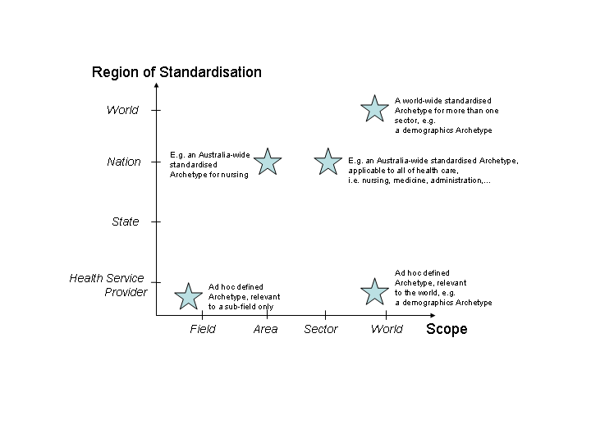
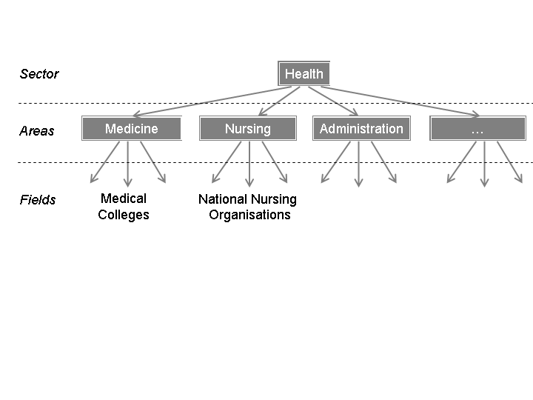
Designing Archetypes: Region and Scope
Notes:
When designing archetypes you have to be aware…

Slide 8
Designing Archetypes: It’s all about processes?
ISO
openEHR foundation
It’s international…
...but needs to be supported by national organisations
SA
NEHTA,
AIHW,
DIMDI,
…
Medical
Colleges,
NNO
Local Provider A
Local Provider B
Local Provider C

Slide 9
Requirements
Defined set(s) of released archetypes
Queries what archetypes in a ‘Release Se’ have been update
modifications locally by specialisation/branching as a rule
Consistency with templates
  Added content to archetype - how does template deal with it...?
  Consistency between template ids/archetype id

Slide 10
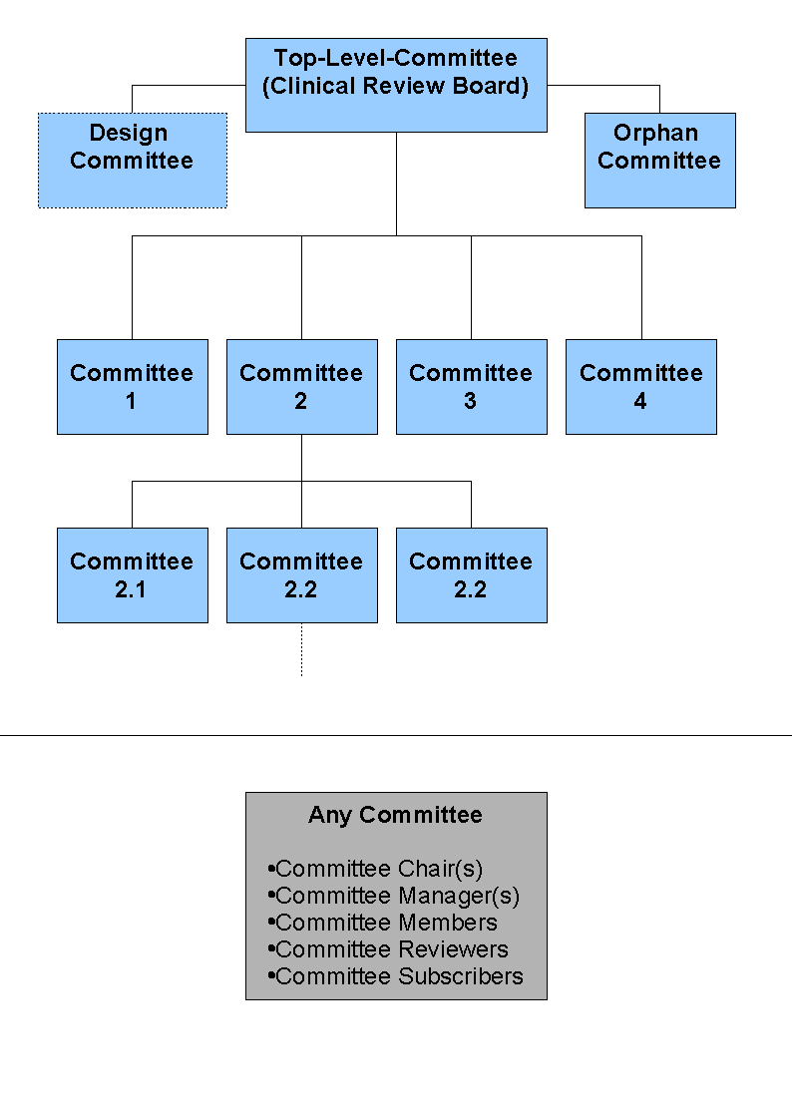
Committee Structure

Slide 11
Roles and Responsibilities
(I)
Committee Chair(s)
  All member role privileges
  Responsible for deliverables of committee
  Merge archetype versions developed by the committee
  Publish archetypes
  Add/modify/delete committee
  Can push lead for certain archetypes to another committee
  Can create sub-committees of 'their' committee
Committee Manager(s)
  Secretarial role to support chair
Committee Members
  Actively involved in development of archetypes, editing, discussion
  Consider and work in reviewer comments
  A committee member can be assigned Chair for the development of a particular archetype

Slide 12
Roles and Responsibilities
(II)
Committee Reviewers
  Reviewers review archetypes upon receiving special review invitation
  Reviewers usually provide comments related to a particular archetype, but also about the general direction of the committee
Design Reviewer
  Does not need specific domain knowledge
  Ensures that archetypes developed by the committee are consistent and adhere to general archetype design principles
  Approves archetype design and is ideally involved early in the development process of an archetype
Committee Subscribers
  Receive announcements for committee and/or archetypes
  Subscribers can comment on archetypes, but these comments will not have to be dealt with formally.

Slide 13
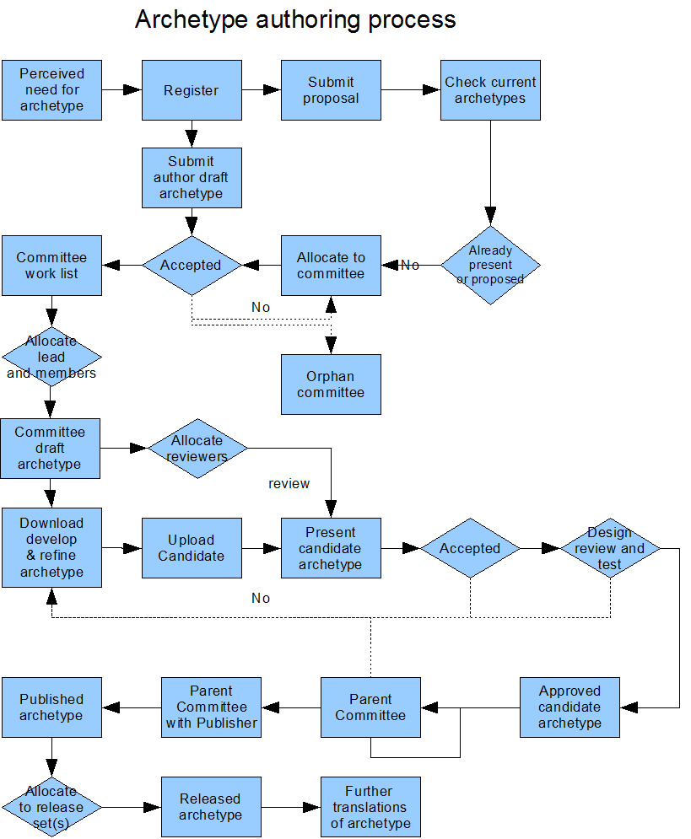
Typical archetype design process

Slide 14
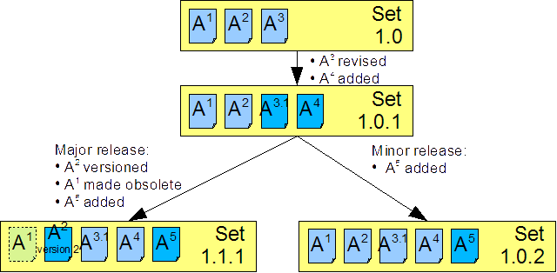
Set Manangement

Slide 15
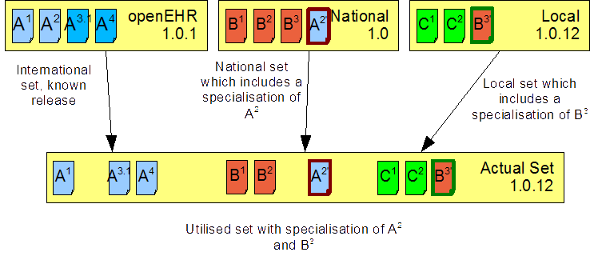
Using Multiple Sets

Slide 16
Other Specific Functionality
ADL-Import / Export
Control changes in archetype revisions/versions
  Compatible changes
  Incompatible changes
Merge archetypes
Validate archetypes
Find archetypes
Synchronise with OWL-ontology
Quality assurance of archetypes/templates
Find potentially overlapping/similar archetypes
…

Slide 17
Validation of Archetypes
Parsable
Compatible with older version
  adding content
    Optional (revision)
    Mandatory (new version)
  adding translation (revision)
  adding metadata (revision)
  Modify constraint
    mandatory to optional (revision)
    Optional to mandatory (new version)
  adding terminology constraints and bindings (revision)
  …
Set of archetypes needs to be a consistent baseline
Be referred by specific template sets

Slide 18
Discussion: For Archetype Management…
…many components already exist
  Some need refinement/extension ($$$)
…more integration is needed
  Web Services
…clear processes are to be defined/enforced
  A common (web-based) platform under development
…we need an international vision for comprehensive semantic interoperability
  Based on national business models?!

Slide 19
Conclusion
Archetype Management and Governance is essential to achieve semantic interoperability
  NEHTA*: ‘Undisciplined creation and application of archetypes threatens the goal of semantic interoperability’
A comprehensive (internationally relevant) Archetype Management System enables Domain Knowledge Governance
  With a clear process for archetype management
High-quality archetypes with high-quality clinical content
  Semantically interchangeable between clinical systems
* NEHTA: Review of Shared Electronic Health Record Standards
- Version 1.0. 2006

Slide 20
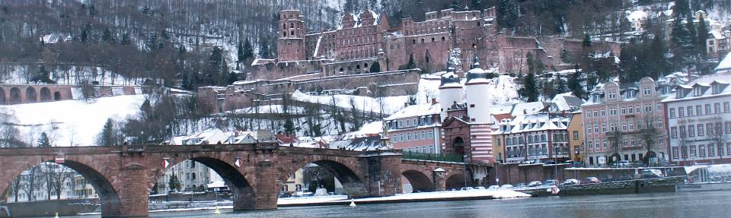
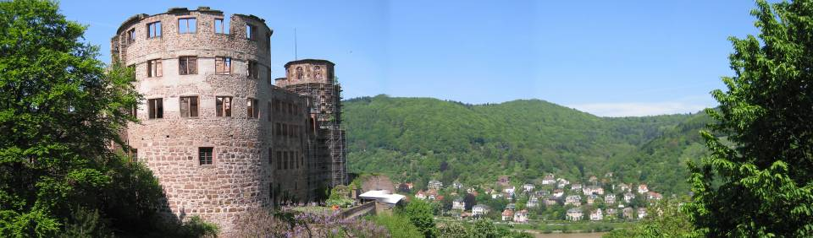
semantic question: what is “winter”
Heidelberg, Germany
s.garde@cqu.edu.au
http://www.archetypes.com.au
http://healthinformatics.cqu.edu.au
http://www.openEHR.org
http://www.oceaninformatics.com

